Slide 1
English for Physicists 2 Week 1
Introduction

Slide 2
Lesson 1 - Introduction
Syllabus
Requirements
Exam
Comparing and contrasting

Slide 3
Study materials
https://is.muni.cz/auth/el/sci/jaro2023/JAF02/ index.qwarp?prejit=4680091

Slide 4
Requirements
attendance, you can miss max. two seminars
homework is compulsory: helping you prepare for the exam
project - presenting a poster, preparing follow-up tasks – listening, speaking
writing formal emails – written part of the exam
writing a summary – written part of the exam
preparing talks for the oral exam topics – oral part of the exam
mock exam test and grammar online – exam test
credit test in Week 14, min. 60% correct

Slide 5
JA001 Examination
Written part
Listening (10 questions/gaps)
Gram-lex: make questions, gap-fill (words given), word formation, sentence transformation
Reading: parts of sentences into the text, multiple choice
Writing: academic email
Summary of a chosen text
Oral part
one topic + your studies & future career (10 minutes)
“EXAM PRACTICE” tasks in the materials

Slide 6
Oral exam topics – 5 mins monologue
1. Define two terms from your field of study and support them with relevant examples.
2. Present a (controversial) problem related to your field of study.
3. Describe and explain a process/notion/experiment within your field of study.
4. Compare and contrast phenomena from your field of study.
5. Classify systems in your field of study.
6. Describe a cause and effect relationship from your field of study.
7. Speculate on an issue from your field of study.

Slide 7
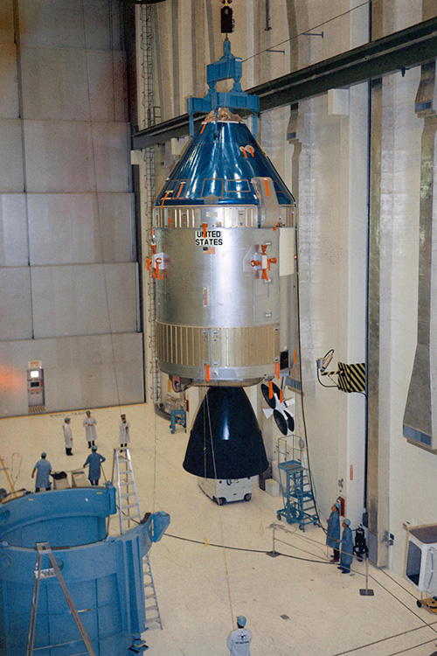
Comparing contrasting – topic 4

Slide 8
 | Apollo | Artemis
Spacecraft
Rocket
Distance
Technology
Goals
Composition of the crew
Crew size
Mission name
Anything else

Slide 9
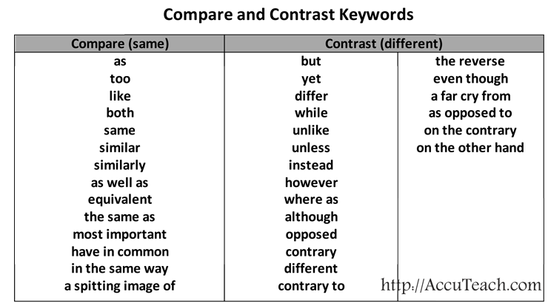
Writing – 5 sentences

Slide 10
Listening
1. The trajectory of the Artemis 1 spacecraft is different from the trajectories of previous spacecrafts.
2. Orion´s journey was shorter than the Apollo 8 journey.
3. It takes more energy to land on Mars than it takes to land on the Moon.
4. The aims of the Apollo and Artemis missions are similar.
5. SLS is more powerful than the Saturn 5.
6. delta-v shows how much the aircraft has to change its speed to complete its journey.
7. delta-v is the same for all rockets and all routes.
8. Any change in the rocket velocity requires energy.
9. The command module in Artemis 1 is bigger than the service module.
10. The Apollo mission had to take the quickest route to the Moon because the crew would not survive a longer journey.

Slide 11
Listening
1. The trajectory of the Artemis 1 spacecraft is different from the trajectories of previous spacecrafts. T
2. Orion´s journey was shorter than the Apollo 8 journey. F
3. It takes more energy to land on Mars than it takes to land on the Moon. F
4. The aims of the Apollo and Artemis missions are similar. F
5. SLS is more powerful than the Saturn 5. T
6. delta-v shows how much the aircraft has to change its speed to complete its journey. T
7. delta-v is the same for all rockets and all routes. F
8. Any change in the rocket velocity requires energy. T
9. The command module in Artemis 1 is bigger than the service module. T
10. The Apollo mission had to take the quickest route to the Moon because the crew would not survive a longer journey. T

Slide 12
Reading – functional language
Comparing Artemis with Apollo is only natural. The spacecraft look similar, they are both lunar exploration programs, and even the names suggest a familial bond. But when it comes to the larger geopolitical context —and the question of whether or not we are in the midst of a new Space Race — the similarities between the programs dissolve. President Kennedy proposed Project Apollo as a political response to the threat of Soviet influence on the world order. He saw spaceflight as an essential form of soft power in the United States’ contest for geopolitical alignment and international influence. The Artemis program is not primarily aimed at international audiences and global

Slide 13
HW week 2
Prepare a monologue for the JA001 (B1) exam for the topic 4 – Compare and contrast phenomena from your field of study (approximate length – 5 mins).
Concentrate mainly on two requirements:
The monologue is clearly structured into an introduction, main body, and a conclusion.
The monologue unfolds logically from one point to another and is effectively connected with appropriate signalling language.

Slide 14
Phrases to structure the talk
INTRODUCTION MAIN BODY CONCLUSION
This talk is about ……
And finally, I will talk about…..
Now let us turn to the next point…….
What I want to do is to show that………………….
I would like to begin by…………
To sum up………..
Moving on, I will look at……………….
That is all I have to say………….
Let me start by………………………….
What I want to point out is ………………

Slide 15
Language and exam practice
1. Critics have complained that school exams are not as difficult as they used to be. (than) ………………………………………………………………………………………………………………………………………………
2. As an institution gets closer to a financial crisis, it feels the pain more. (the more) ………………………………………………………………………………………………………………………………………………..
3. Campaigners hoping for change within the country have become increasingly pessimistic. (and more) …………………………………………………………………………………………………………………………………………..
4. The Swiss wind turbines have not worked as efficiently as the Italian ones. (The Swiss…than) ……………………………………………………………………………………………………………………………………………………..
5. The particles become easier to observe when they gain weight. (The heavier…)
……………………………………………………………………………………………………………………………………………………
6. Introverts do not absorb information as quickly as extroverts, according to research. (Introverts…than)…………………………………………………………………………………………………………………………

Slide 16
Language and exam practice
Critics have complained that school exams are not as difficult as they used to be. (than)
Critics have complained that school exams are less difficult than they used tobe.
2. As an institution gets closer to a financial crisis, it feels the pain more. (the more)
The closer an institution gets to a financial crisis, the more pain it feels.
3. Campaigners hoping for change within the country have become increasingly pessimistic. (and more)
Campaigners hoping for change within the country have become more and more pessimistic.
4. The Swiss wind turbines have not worked as efficiently as the Italian ones. (The Swiss…than)
The Swiss wind turbines have worked less efficiently than the Italian ones.
5. The particles become easier to observe when they gain weight. (The heavier…)
The heavier the particles are, the easier they become to observe.
6. Introverts do not absorb information as quickly as extroverts, according to research. (Introverts…than)
Introverts absorb information less quickly then extroverts, according to research.

Slide 17
True or false?
1 If two things are mutually exclusive, one makes the other impossible.
2 If two methods of doing something are compatible, they cannot both be used.
3 If two things are equated, they are said to be similar or the same.
4 If there are parallels between phenomena, they are very different from each other.
5 If there is an overlap between two things, they share some properties.

Slide 18
True or false?
1 If two things are mutually exclusive, one makes the other impossible. T
2 If two methods of doing something are compatible, they cannot both be used. F
3 If two things are equated, they are said to be similar or the same. T
4 If there are parallels between phenomena, they are very different from each other. F
5 If there is an overlap between two things, they share some properties. T

