Slide 1
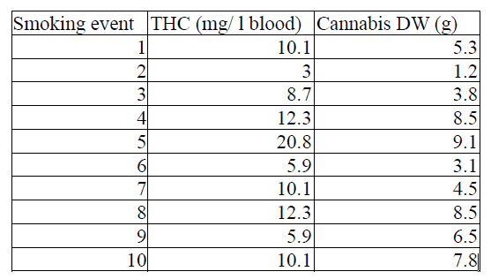
Practicals 9: Regression, correlation, and general linear models
Jessica, Bára
TASK A:
Dependence of THC concentration in blood on the amount of cannabis smoked was analyzed in one person who smoked different amounts of dried cannabis from the same source. The intervals between measurements were long enough to decrease of THC concentration to 0 before each trial.
Does THC concentration in the blood depend on the amount of cannabis smoked?
Perform a statistical analysis and illustrate it with a figure.

Slide 2
H0: The THC concentration in the blood is indepenent on the amount of cannabis smoked.
THC<-read_excel("09_data.xlsx", sheet="A")
summary(THC)
cor.test(THC$THC,THC$DW)
Results:
#Pearson's product-moment correlation
#data: THC$THC and THC$DW
#t = 3.5369, df = 8, p-value = 0.007655
#alternative hypothesis: true correlation is not equal to 0
#95 percent confidence interval:
# 0.2977902 0.9456218
#sample estimates:
# cor
#0.7809846 ’
We reject the H0. There is a significant dependency between THC concentration in the blood and the amount of cannabis smoked. The correlation is quite high.

Slide 3
