Slide 1
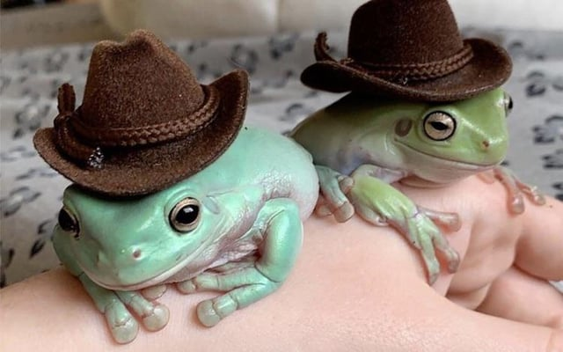
FROGS

Slide 2
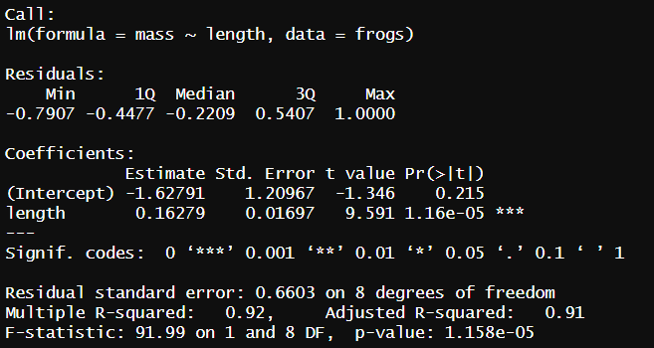
TASK
Is body mass and body lenght correlated?

Slide 3
