Slide 1
Chapter 5
Hypothesis testing
Goodness-of-fit test

Slide 2
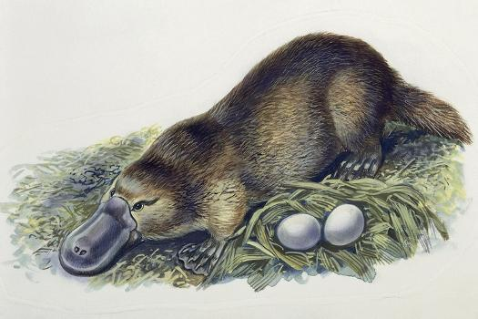


Hypotheses
Basic components of scientific theories
Formulated as universal statements (concerning all objects of a given class)
  E.g. All mammals are viviparous, All plants contain chlorophyll
  Informative about the members of the given class (even without knowledge of a specific case): A lion is a mammal -> it is also viviparous (
Must be falsifiable = sensitive to empirical observations, which may demonstrate it is false
A single contradictory observation can be used to reject a hypothesis no matter how many observations support it
  Empirical singular statement – not informative beyond the
No hypothesis can be demonstrated universally true
Science is a process of rejecting old hypotheses and replacing them with new ones which explain reality better
Platypus is an oviparous mammal.
Rafflesia arnoldii and Lathraea squamaria are parasitic plants containing no chlorophyll.

Slide 3
Statistical hypothesis testing
 |  | Reality
 |  | H₀ is true | H₀ is false
Our Decision | Reject H₀ | Type I Error | Ok
 | Not reject H₀ | Ok | Type II Error
Possible outcomes of hypothesis testing by statistical tests. H₀ = null hypothesis
Empirical evidence mostly comes from measurements of quantitative data
Statistics quantifies the disagreement between a null hypothesis (H0) and empirical observations
  Measured by a test statistic
    E.g. χ², t, F-ratio
  Test statistics have a known probability distribution
    Allows computing the p-value = Type I Error probability (probability of making an error if rejecting the H0)
    Acceptable error typically 0.05 (5%)
    Shape of the distribution depends also on the degrees of freedom
      These depend on the complexity of the system and/or number of observations
Classical biostatistics quantifies precisely only the Type I Error
Hypotheses cannot be confirmed!
A non-significant test means that empirical evidence is not sufficient to reject the H0

Slide 4
Pattern detection
Special cases when H0 = 0 (no effect, independence)
Generic null hypotheses can be converted to pattern detection problems by subtracting hypothesis expectations from observed data
Generally easy to compute
Biology is still largely exploratory science
  many biological problems have the pattern-detection nature

Slide 5
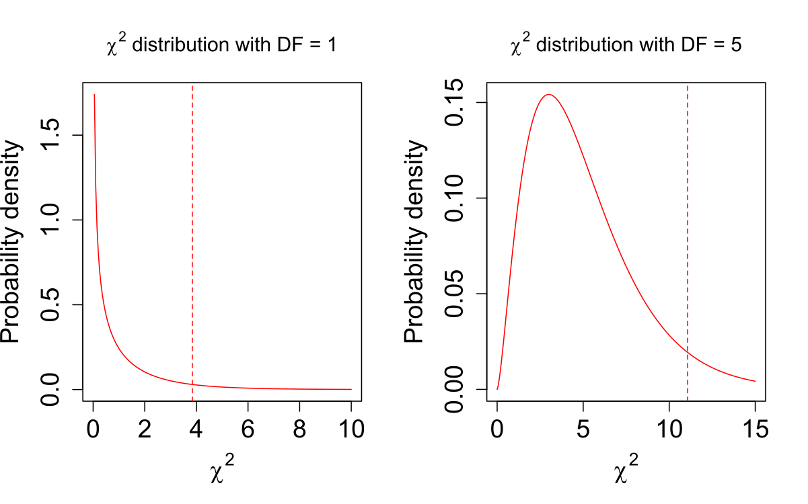
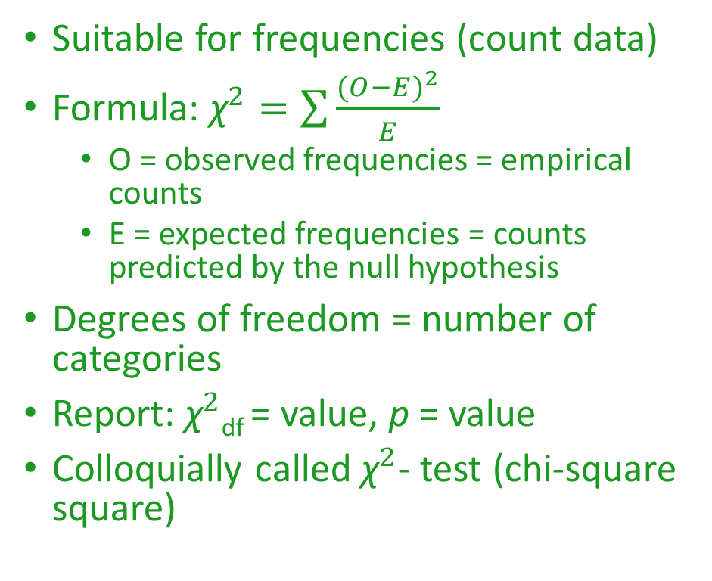
Goodness of fit test
Suitable for frequencies (count data)
Formula: ${\text{χ}}^{2}=\sum{\frac{{(O−E)}^{2}}{E}}$
  O = observed frequencies = empirical counts
  E = expected frequencies = counts predicted by the null hypothesis
Degrees of freedom = number of categories
Report: ${\text{χ}}^{2}$_{df} = value, p = value
Colloquially called ${\text{χ}}^{2}$- test (chi-square square)

