Slide 1
Chapter 6
Contingency tables

Slide 2
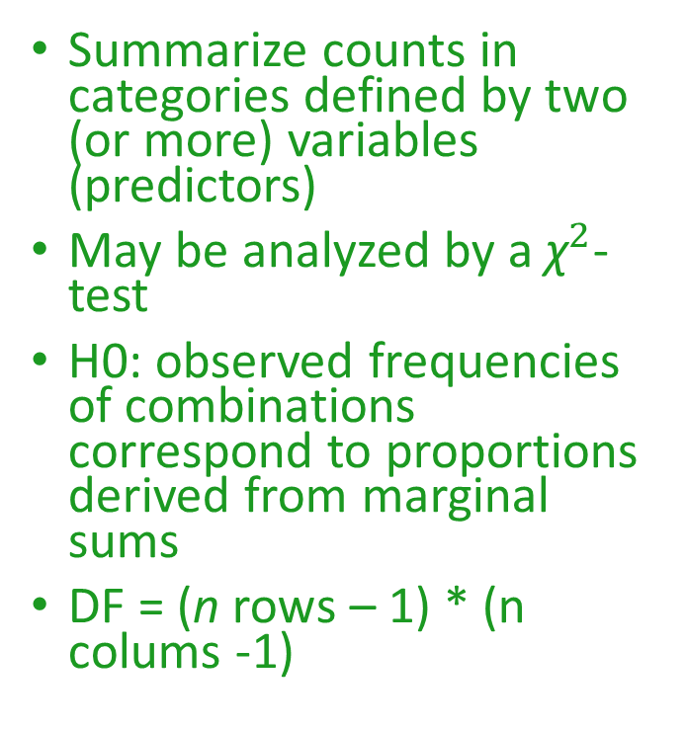
Contingency tables
Summarize counts in categories defined by two (or more) variables (predictors)
May be analyzed by a ${\text{χ}}^{2}$- test
H0: observed frequencies of combinations correspond to proportions derived from marginal sums
DF = (n rows – 1) * (n colums -1)
 |  | Hair color
 |  | black | brown | blonde | marginal sums
Eye color | blue | 12 | 45 | 14 | 71
 | brown | 51 | 256 | 84 | 391
 | marginal sums | 63 | 301 | 98 | grand total: 462

Slide 3
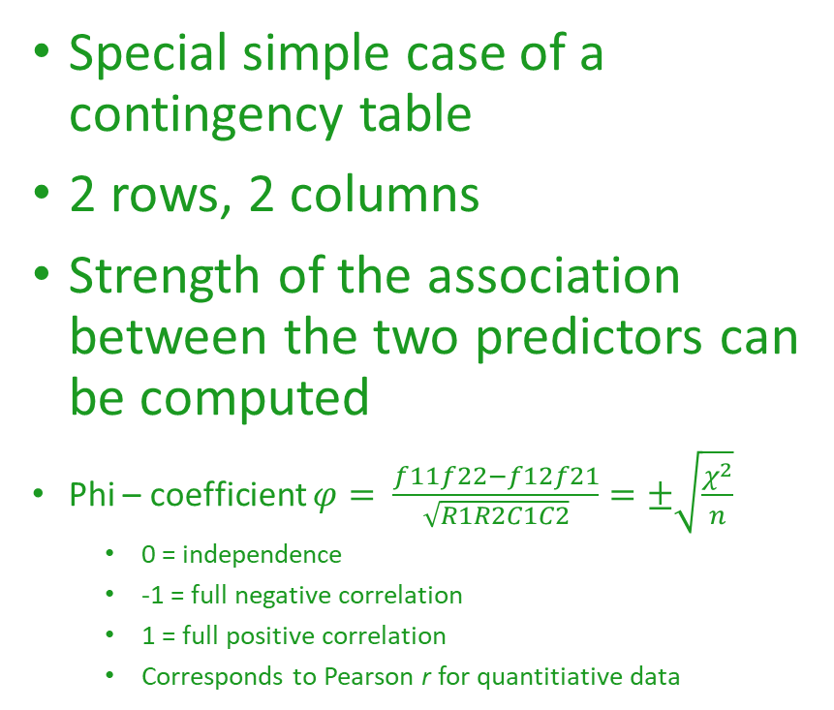
2 x 2 Tables
Special simple case of a contingency table
2 rows, 2 columns
Strength of the association between the two predictors can be computed
Phi – coefficient $φ= \frac{f11f22−f12f21}{\sqrt{R1R2C1C2}}=±\sqrt{\frac{χ^{2}}{n}}$
  0 = independence
  -1 = full negative correlation
  1 = full positive correlation
  Corresponds to Pearson r for quantitiative data
.
 |  | Var2
 |  | level 1 | level 2 | Sums
Var 1 | level 1 | f11 | f12 | R1
 | level 2 | f21 | f22 | R2
 | Sums | C1 | C2 | n

Slide 4
Odds and Odds-ratios
Allow a detailed analysis of contingency tables beyond the rejection of independence of the two variables
Useful for n x 2 tables
Based on a subdivision of the table into several 2 x 2 tables
Odds = probability of one outcome of a variable within one category of the other variable
Odds ratio = ratio of two odds
  Can be tested for significance
 |  | Hair color
 |  | black | brown | blonde | marginal sums
Eye color | blue | 12 | 45 | 14 | 71
 | brown | 51 | 256 | 84 | 391
 | marginal sums | 63 | 301 | 98 | grand total: 462
Odds blue eyes in black-haired people = 12/63 = 0.19
Odds blue eyes in brown-haired people = 45/301 = 0.15
Odds ratio (blue-eyed in black vs. brown-haired people)= 0.19/0.15 = 1.27

