Slide 1
Chapter 6 t-distribution confidence intervals t-tests

Slide 2
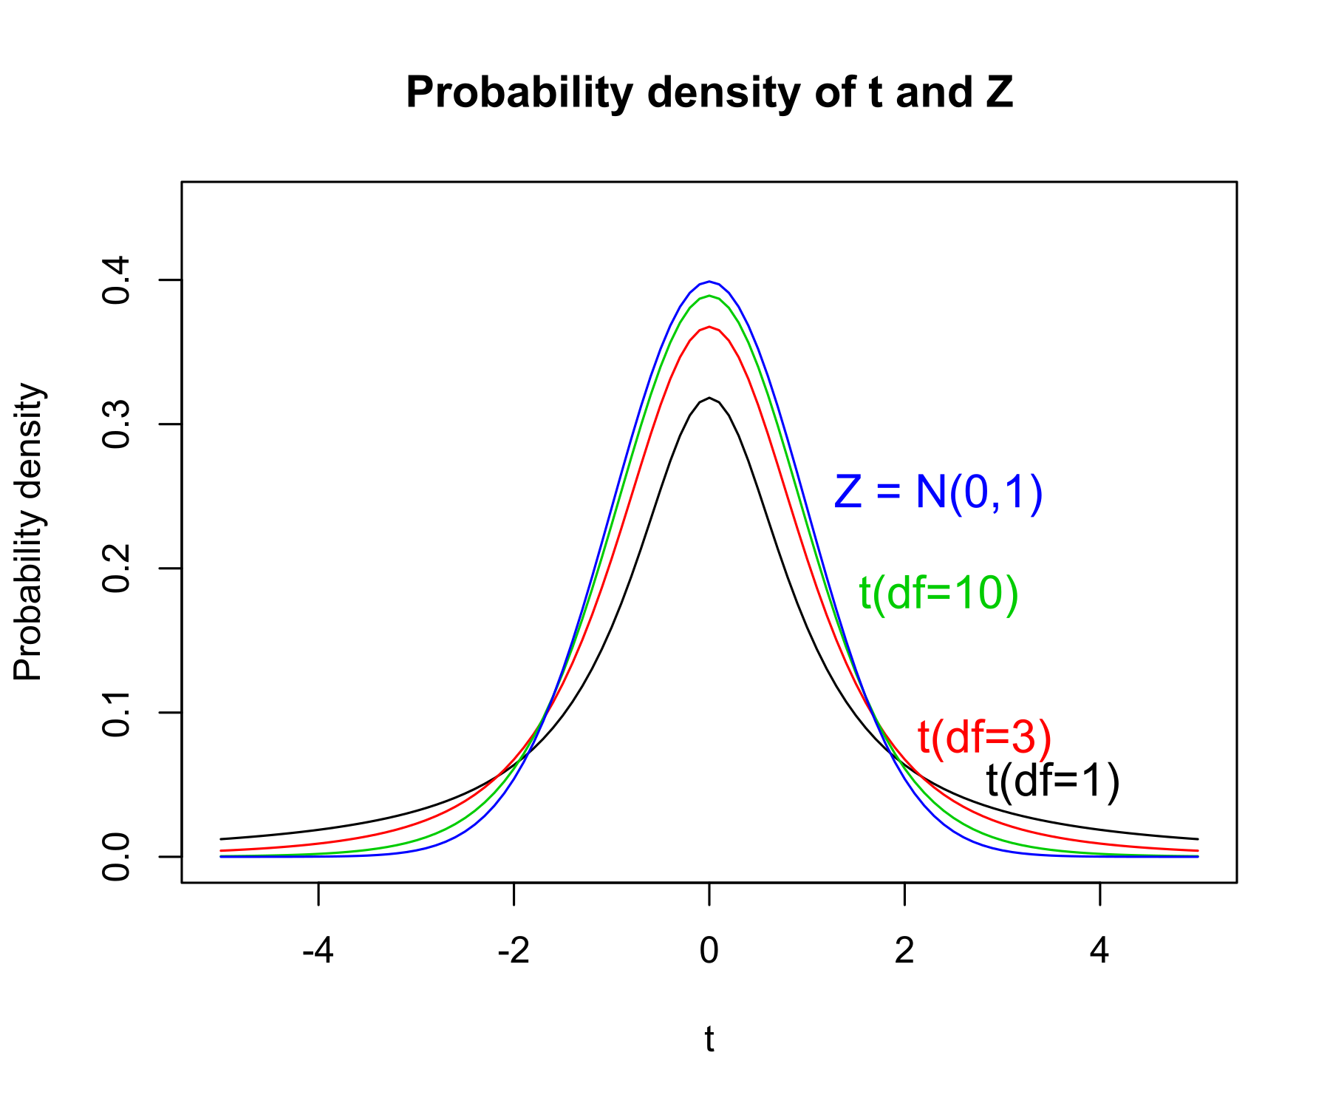
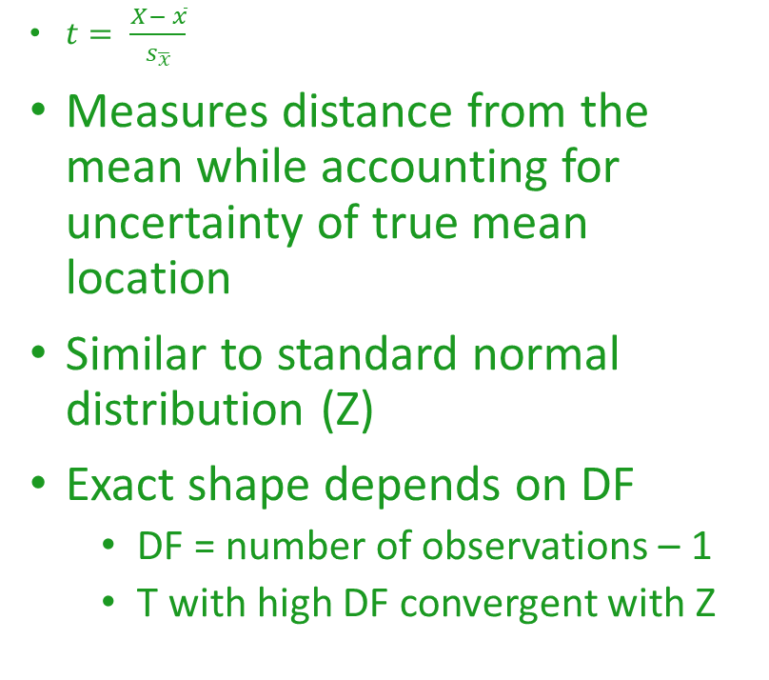
The t-distribution
$t= \frac{X− \overline{x}}{s_{\overline{x}}}$
Measures distance from the mean while accounting for uncertainty of true mean location
Similar to standard normal distribution (Z)
Exact shape depends on DF
  DF = number of observations – 1
  T with high DF convergent with Z

Slide 3
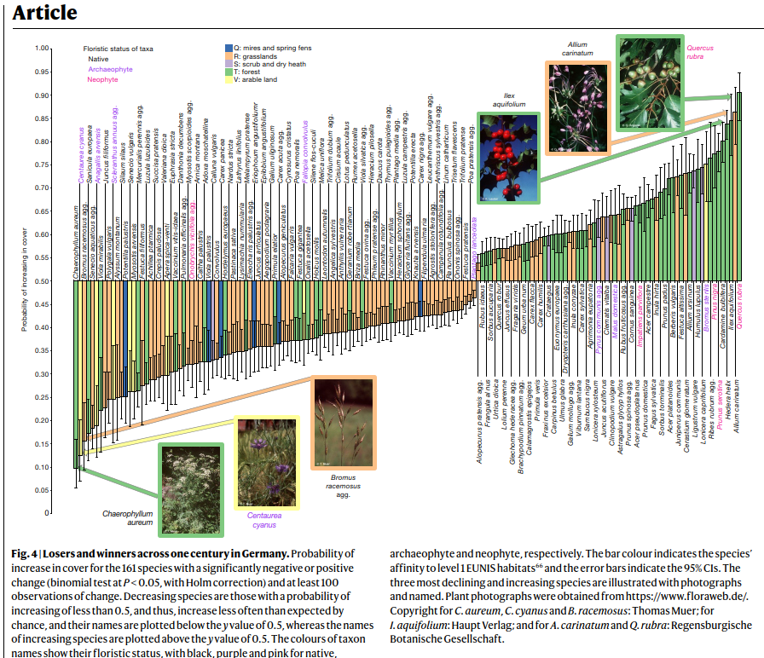
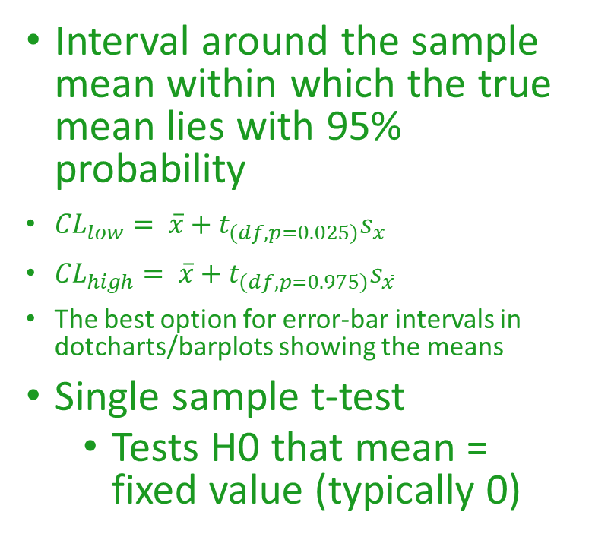
Confidence intervals
Interval around the sample mean within which the true mean lies with 95% probability
${CL}_{low}= \overline{x}+t_{(df, p=0.025)}s_{\overline{x}}$
${CL}_{high}= \overline{x}+t_{(df, p=0.975)}s_{\overline{x}}$
The best option for error-bar intervals in dotcharts/barplots showing the means
Single sample t-test
  Tests H0 that mean = fixed value (typically 0)
Jandt et al. 2022 Nature

Slide 4
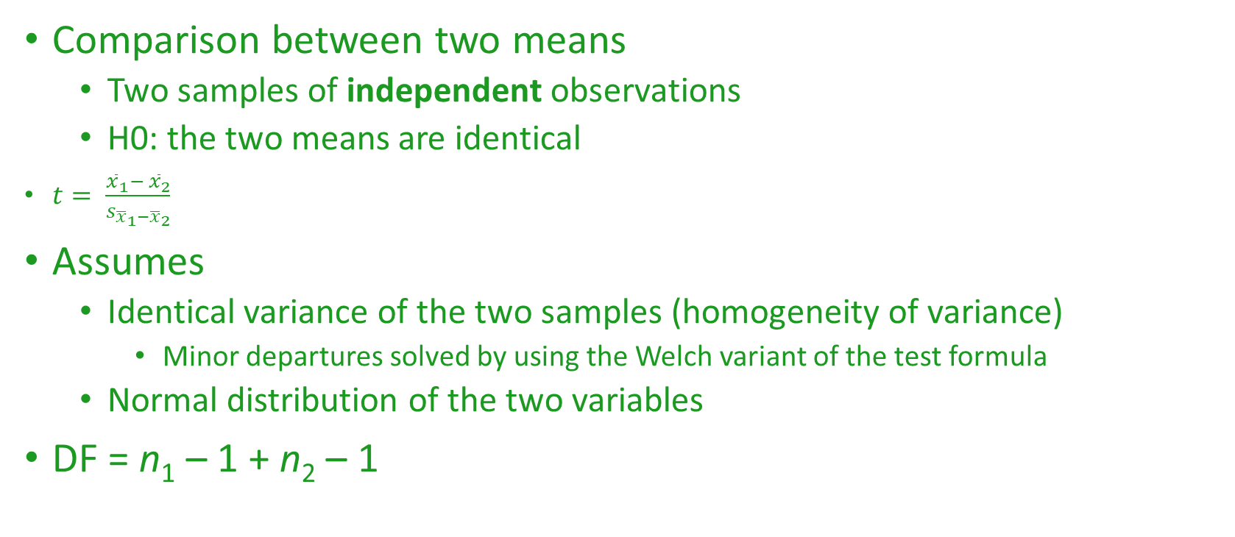
Student t-test
Comparison between two means
  Two samples of independent observations
  H0: the two means are identical
$t= \frac{{\overline{x}}_{1}− {\overline{x}}_{2}}{s_{{\overline{x}}_{1}−{\overline{x}}_{2}}}$
Assumes
  Identical variance of the two samples (homogeneity of variance)
    Minor departures solved by using the Welch variant of the test formula
  Normal distribution of the two variables
DF = n₁ – 1 + n₂ – 1

Slide 5
Paired t-test
Used for paired observations
  Dependence of observations within a pair
  E.g. block design
  Pair is an independent observation
H0: mean difference within pairs = 0
Equivalent to a single sample t-test
DF = n(pairs) - 1

