Slide 1
Chapter 8 F-test ANOVA

Slide 2
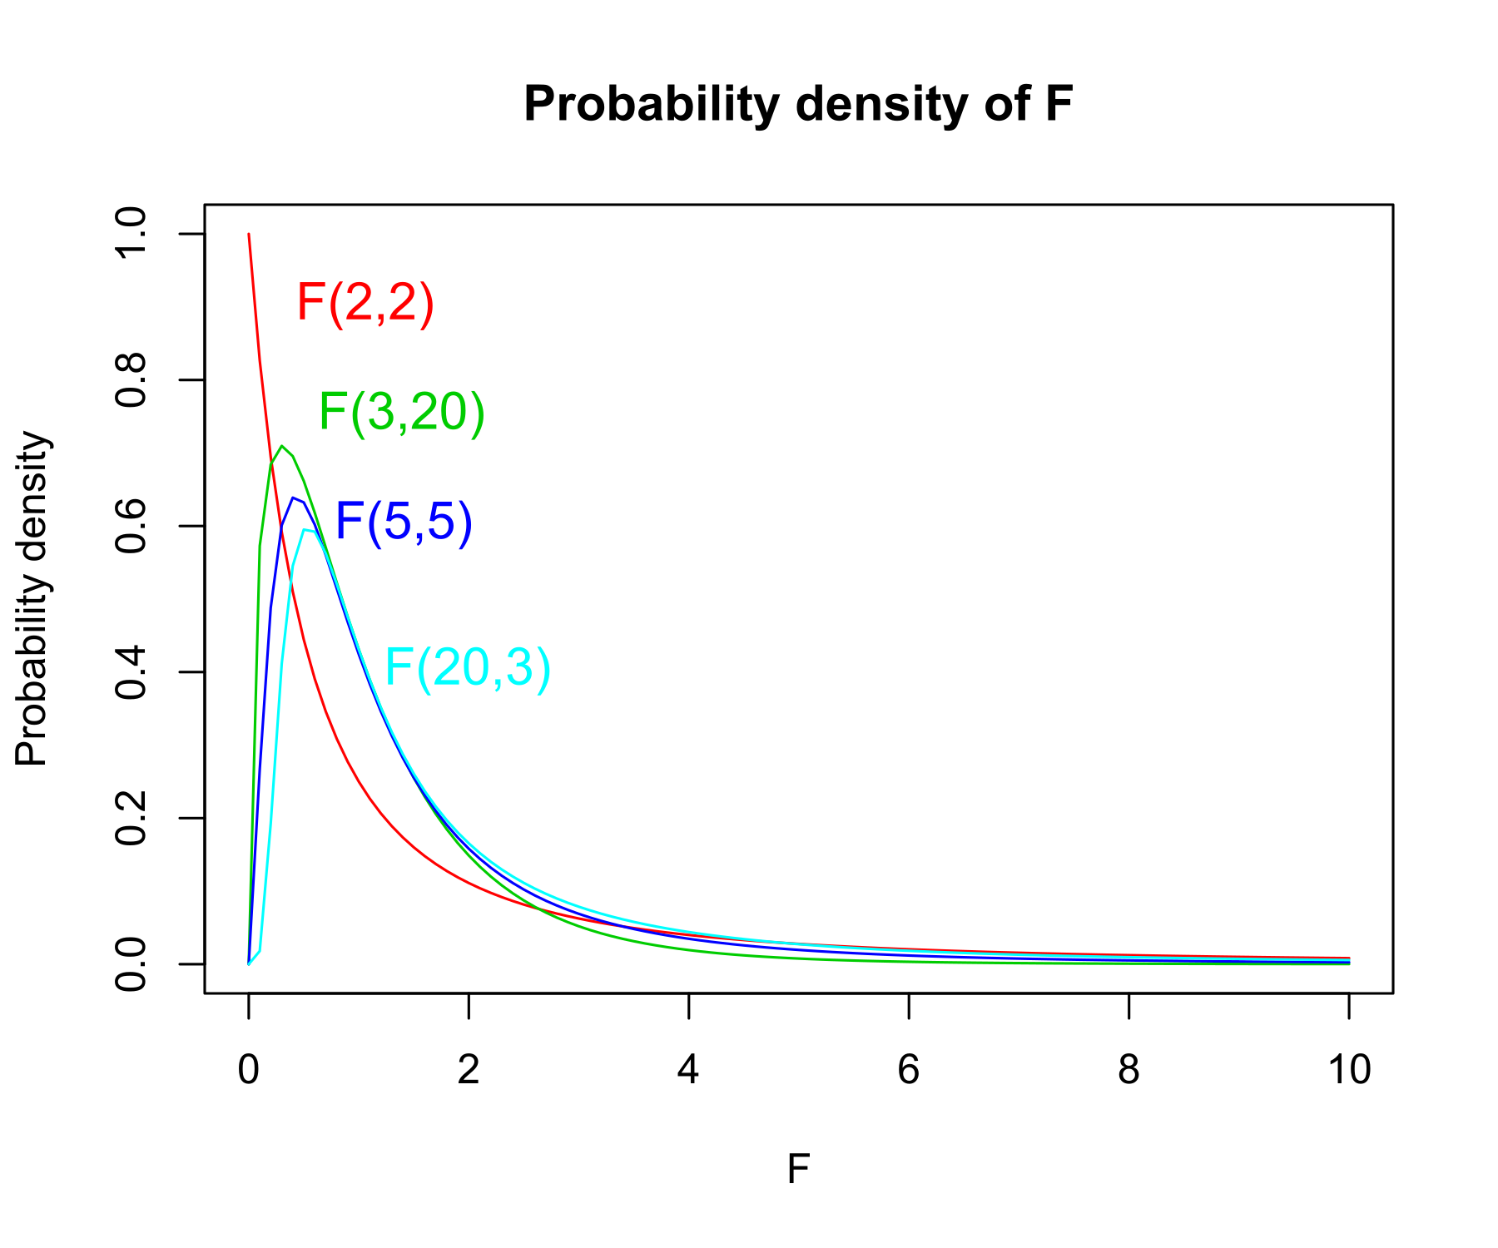
F-ratio
Ratio of two variances
$F= \frac{s_{1}^{2}}{s_{2}^{2}}$
Can be used to test H0 that variances of two variables are equal
Two DFs
DF(numerator) = n (sample 1) – 1
DF(denominator) = n(sample 2) – 1

Slide 3
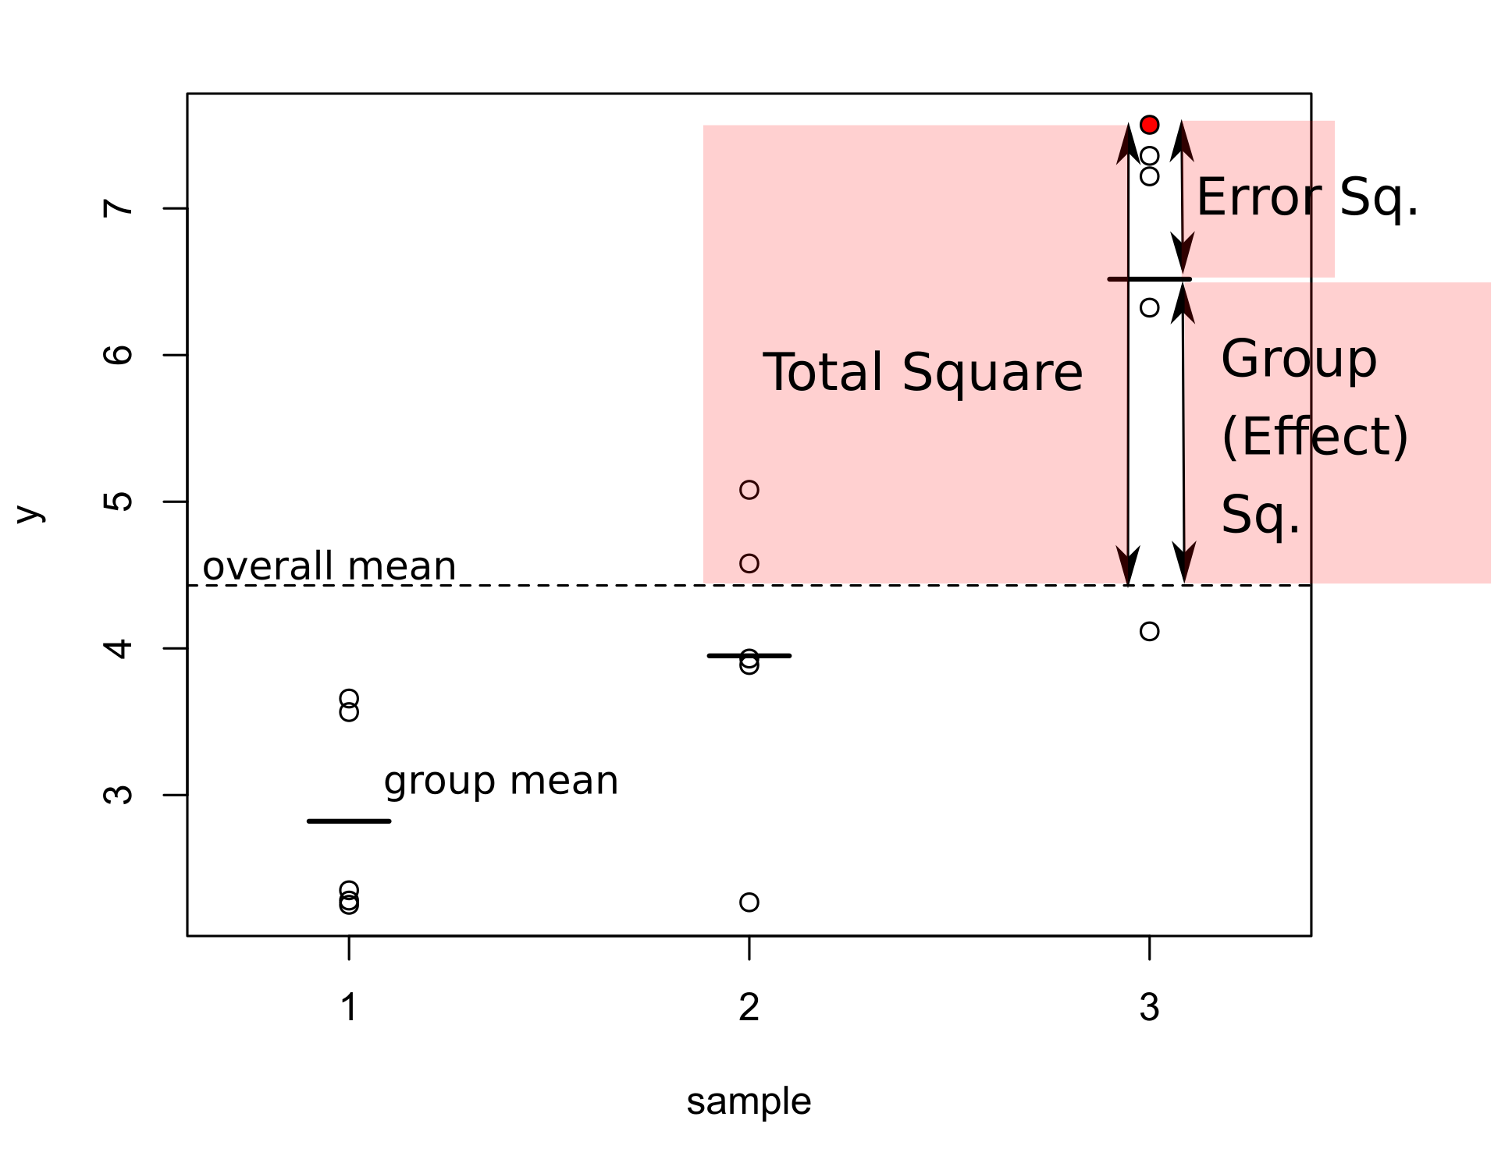
Analysis of variance (ANOVA)
Application of the F-test principle
Allows comparisons of multiple mean values
H0: means of all groups are identical
Decomposes the total Sum of Squares (= numerator in the variance formula) into
Systematic component (Sum of squares effect) – can be scaled by corresponding DF_{effect} (=number of groups – 1) to get Mean Square (MS_{effect})
Residual variability (Error Sum of Sq.) – can be scaled by DF_{error} (= number of obs. – 1 – DF_{effect} ) to obtain the MS_{error}
F = MS_{eff}/MS_{error} to be compared with the F distribution with corresponding DFs
R² (proportion of explained variability) = SS_{effect/} SS_{total}

Slide 4
ANOVA assumptions
Homogeneity of variances (variances in all groups are equal)
Normal distribution of residuals (= of values within individual groups)
ANOVA may be unbalanced (= unequal sample size within groups)
Formal tests exist to check the assumptions
Difficult to interpret
Graphical inspection of residuals using plot(anova.object) is a better option

Slide 5
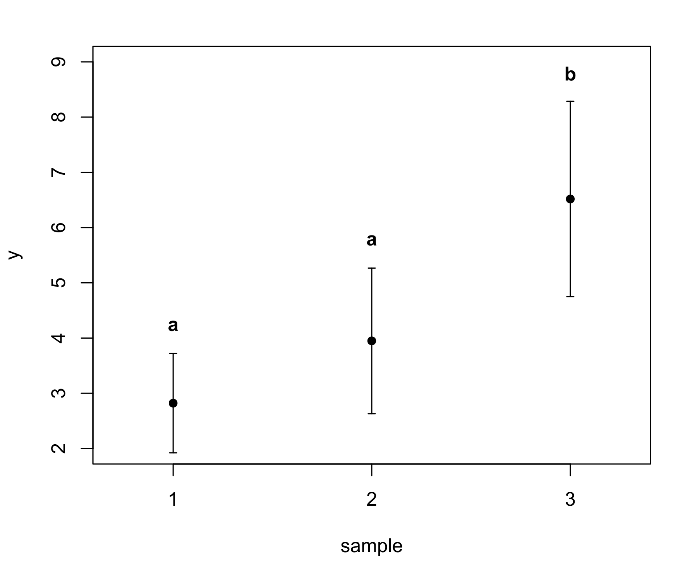
Post-hoc comparisons
Rejecting H0 in ANOVA means that all group means are not identical, i.e. at least one is different
We wonder, which mean is significantly different from which
Post-hoc pairwise comparisons are used for that
Tukey HSD test and others
Various control levels of type-I error in multiple comparisons
Results are best displayed on graphs (groups with different letters are significantly different)

