Slide 1
Chapter 9 Linear regression Correlation

Slide 2
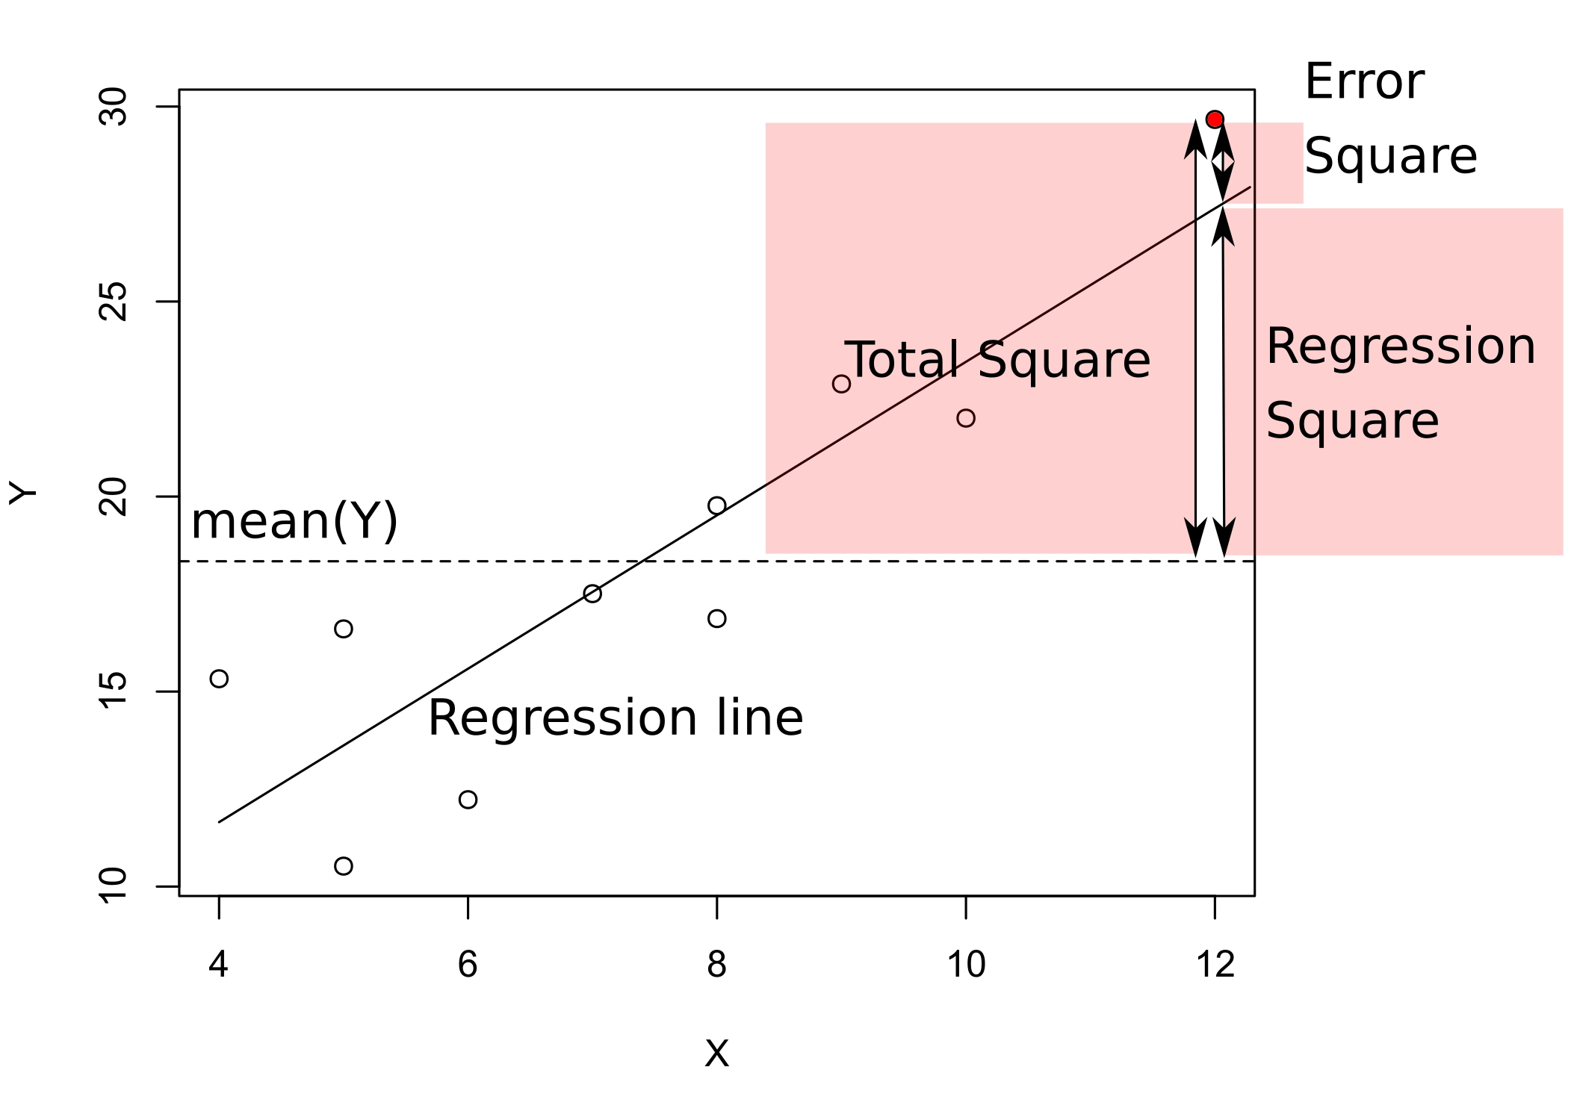
Linear regression
Describes asymetric dependence of two quantitative variables
Response variable depends on predictor(s)
General formula: Y = a + bX + ε
Y = response
X = predictor
a = intercept
b = slope
ε = residuals (error)
Decomposition of total Sum Sq. into Regression Sum Sq. and Error Sum. Sq. as in ANOVA
Significance testing by F-test
F_{DFregr,DFerror} = MS_{regr}/ MS_{error}
DFregr = number of predictors (1 in simple regression)
Dferror = number of observations – DFregr – 1
Coefficient of determination R² = SSregr/SStotal
Adjusted R² = 1 – MS_{error}/MS_{total}
Accounts for the estimate nature of the R²

Slide 3
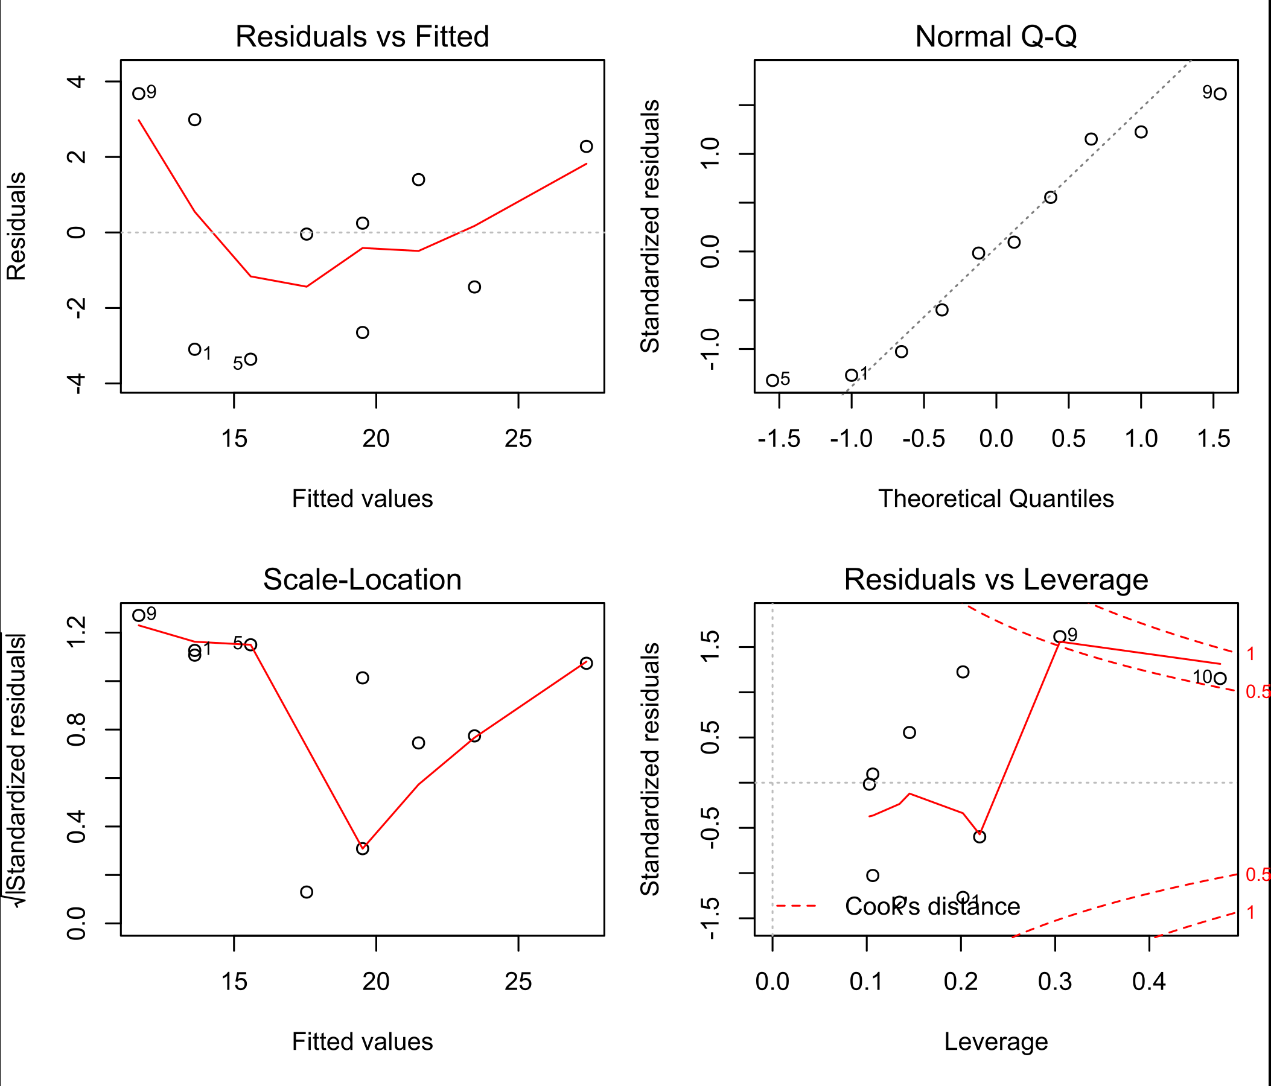
Regression assumptions
Normality of residuals
Indepdendence between residuals and fitted values
Linear relationship between X and Y
Check by Regression diagnostics

Slide 4
Correlation
Symmetric association between two quantitative variables
Pearson correlation coefficient: $r= \frac{\sum_{i=1}^{n}{(X_{i}−\overline{X})(Y_{i}−\overline{Y})}}{\sqrt{\sum_{i=1}^{n}{{(X_{i}−\overline{X})}^{2}\sum_{i=1}^{n}{{(Y_{i}−\overline{Y})}^{2}}}}}$
r > 0 (max. 1): positive correlation
r < 0 (min. -1): negative correlation
r = 0: independence
Can be tested for significance (i.e. difference from 0) by a single sample t-test with DF = n – 2
r² = proportion of shared variability = regression R²

Slide 5
Correlation and causality
Causality = if X changes, Y also changes
Correlation = association between two variables
A change caused by a manipulation in one does not imply a necessary change in the other
Associations are mostly analyzed by regression
Numerical equivalence between correlation and regression
Significant regression does not mean causality
Causality can only be demonstrated by manipulative experiments!

