Slide 1
10: Data transformation and non-parametric tests

Slide 2
What to do if t-test assumptions are substantially violated?
Large difference in variances
Welch approximation usable only when the difference is low to moderate (and with rather high number of observations)
The data might follow the log-normal distribution → use transformation
Use a non-parametric test (but this might be tricky)
Data do not come from a normal distribution
Check the log-normal possibility
Use non-parametric tests

Slide 3
The log-normal distribution
log(X)~N(μ, σ²)
Positively skewed
Defined for numbers > 0
Very common situation in biological research
Masses, dimension of biological objects
Counts can be approximated by log-normal distribution

Slide 4
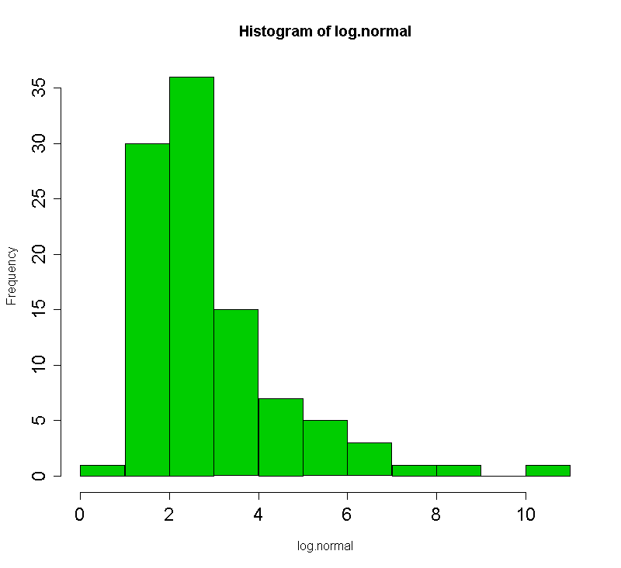
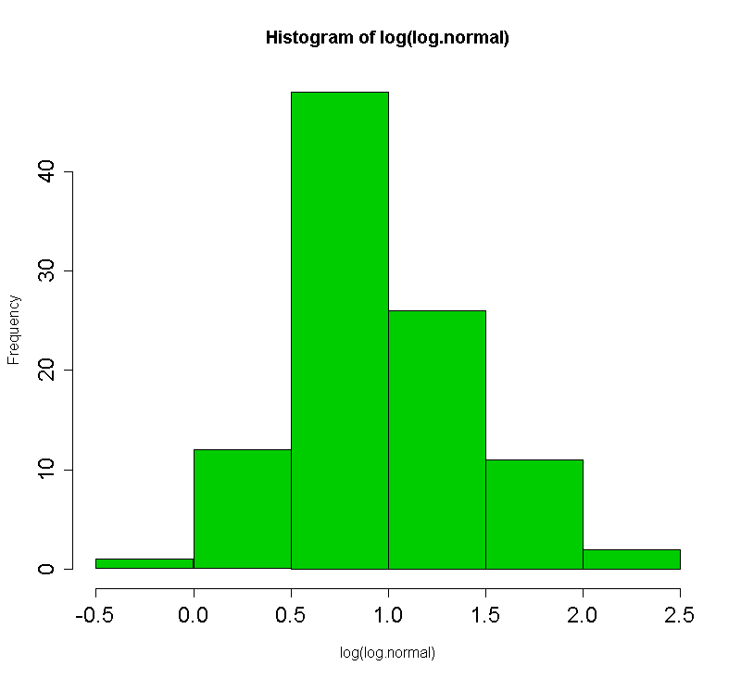
Data transformation using log - function
Changes the scale from additive to multiplicative
geometric instead of arithmetic means; exp(mean(log-data) = geometric mean
H₀: The ratio between geometric means is 1.0
Results say how many times the mean is larger (e.g. 1.2 times = by 20%)
If suitable, improves both normality and homogeneity of variances
Test results do not depend on the type of logarithm used (just consistency is needed)
Log

Slide 5
Some more tricky types of data
Ordinal data
e.g. behavioral experiments
Measures of reaction of an animal on an impulse
Data do not follow the normal distribution
Transformation provides no help
Non-parametric tests
Do not test null hypotheses on parameters of the distributions

Slide 6
Various non-parametric analogues of t-tests
Permutation tests
Based on the principle of repeated random re-assignment of data to groups and calculating the t
P-value corresponds to number of observations for which t is higher than that calculated based on the original data/total number of permutations
Number of permutations where |t_{permut} | > |t_{data} |
$$\frac{x+1}{n+1}$$
Total number of permutations where |t_{permut} | > |t_{data} |

Slide 7
Non-parametric tests based on order
Mann-Whitney test
Analogue of a two-sample t-test
Original values replaced by their order in the whole dataset
These are then used for the calculation of the U statistic
P-value based on direct comparison to theoretical U distribution
Or approximation to normalized normal distribution (Z) – usually applied if ties are present
Wilcoxon test
Analogue of a paired t-test
P-value based also mostly on normal (Z) approximation (if ties are present)
Kruskal-Wallis test
Analogue of ANOVA
Dunn test for multiple comparisons
Spearman correlation coefficient
Order-based non-parametric correlation coefficient

Slide 8
Non-parametric tests have also some assumptions
Identical (though not normal) distributions from which the samples come
If we state the null hypothesis about the shift (i.e. difference of means)
Homogeneity of variances, quite similar to t-test/ANOVA
Same size of intervals for data on the ordinal scale

