Slide 1
Multiple regression and general linear models

Slide 2
ANOVA and regression
Closely related to each other
  same least square principle
ANOVA with a predictor of n levels is analogous to a multiple linear regression with n-1 predictors
  a priori defined contrasts

Slide 3
Models with multiple predictors
Two-way (Multiple-way) ANOVA
  response ~ factor.1 + factor.2 + ...
Multiple regression
  response ~ predictor.1 + predictor.2 + ...
Additive effects vs. interaction
  additivity – response on factor.1 (predictor.1) does not depend on the value of factor.2 (predictor.2)
  additivity can be statistically tested and rejected in favor of interaction

Slide 4
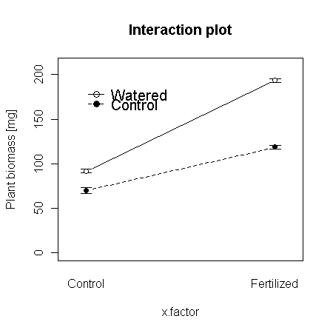
Interaction
Significant interaction indicates a relationship between the effects of the predictors
  y = a + bx₁ + cx₂ + dx₁x₂ + ε
Test of interaction H0: d = 0
  d > 0: positive interaction, higher values of response compared to additivity
  d < 0 : negative interaction, lower values of response compared to additivity
df_{int} = df_{x1}*df_{x2}
Interaction plot
  Plotting of interaction
  Under H₀, the lines connecting factor levels would be parallel
Interaction does not mean interdependence of predictors!

Slide 5
General linear models
Allow an analysis of the dependence of a single response variable on multiple predictors of whatever nature (continuous or categorical)
This is possible because of the equivalence of ANOVA and regression
Include e.g. Analysis of covariance (linear model with a single continuous and multiple categorical predictors)
In R: function lm

Slide 6
Model selection in LMs
Not all candidate predictors are significant but only the significant ones should be included in the model
Statistical theory provides little help for predictor selection but we can compare models differing in their predictor structure
Stepwise selection
  Forward stepwise: most significant predictors are added; suitable for observatory data
  Backward stepwise: non-significant predictors are removed; suitable for experimental data (e.g. with interactions)
  Both directions: the iterative approach used in modern software

Slide 7
Akaike Information Criterion (AIC)
Quantifies the information accounted for by a predictor
  allows comparisons between predictors with different numbers of df model
  lower AIC suggests a better fit, absolute values of AIC are not informative
AIC = 2k – 2log(L) , (log = natural logarithm), k is number of model parameters (i.e. df model in lm)
  in linear models AIC = 2k – 2 log (n/RSS) + C, where RSS is residual sum of squares, C is constant (can be ignored)
Combination with an F-test of significance
  Order importance of predictors based on AIC
  Exclude those that are not significant in F-test
  Pragmatic approach not supported by statistical theory

