Slide 1
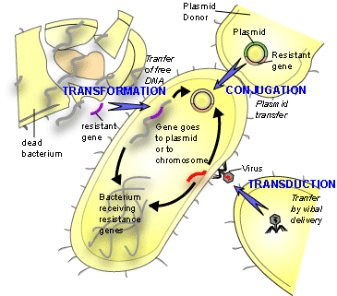
Horizontal Gene Transfer

Slide 2
HGT - Eukaryotes
Endosymbiotic gene
transfer (EGT)
Sibbald et al 2020

Slide 3
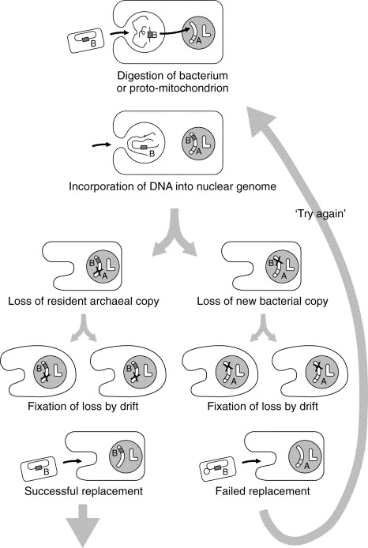
You are what you eat
Doolittle, 1988

Slide 4
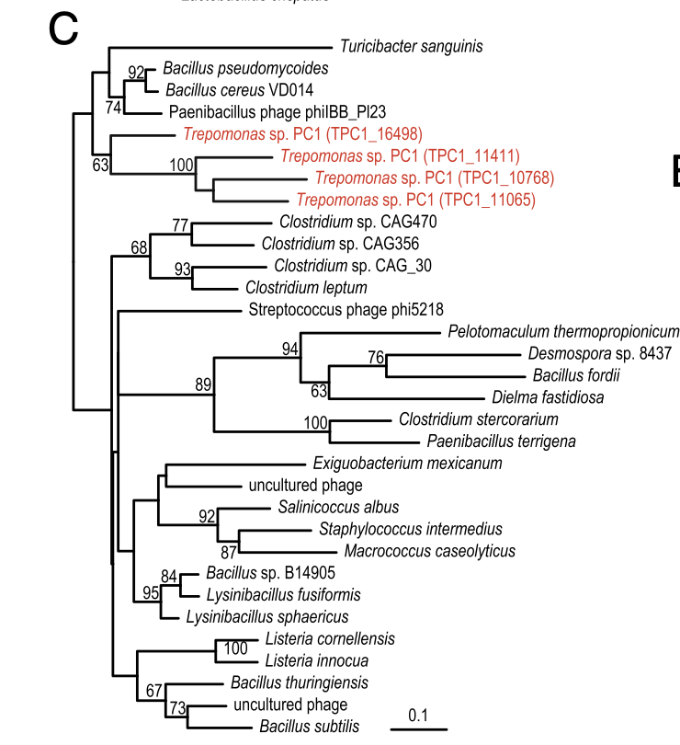
How to infer HGT
But – contamination?
Or
Poor taxon sampling?

Slide 5
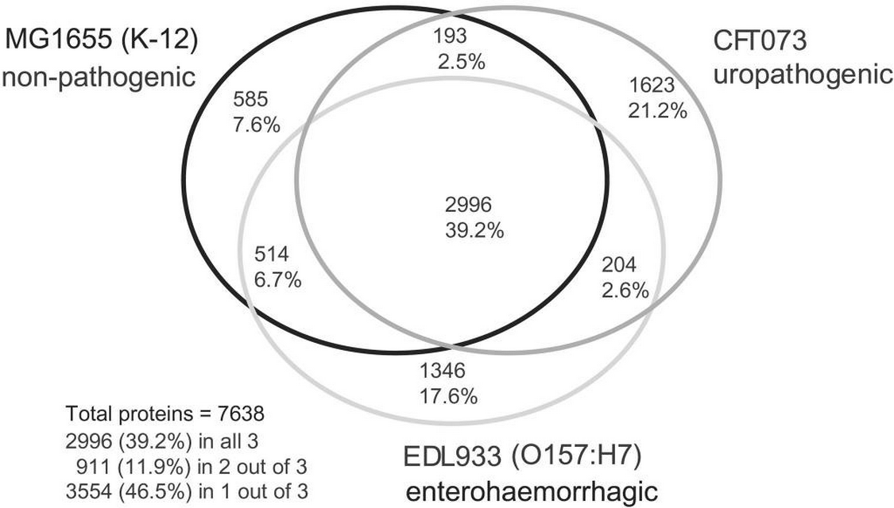
Prokaryote to Prokaryote HGT
Welch a kol. 2009

Slide 6
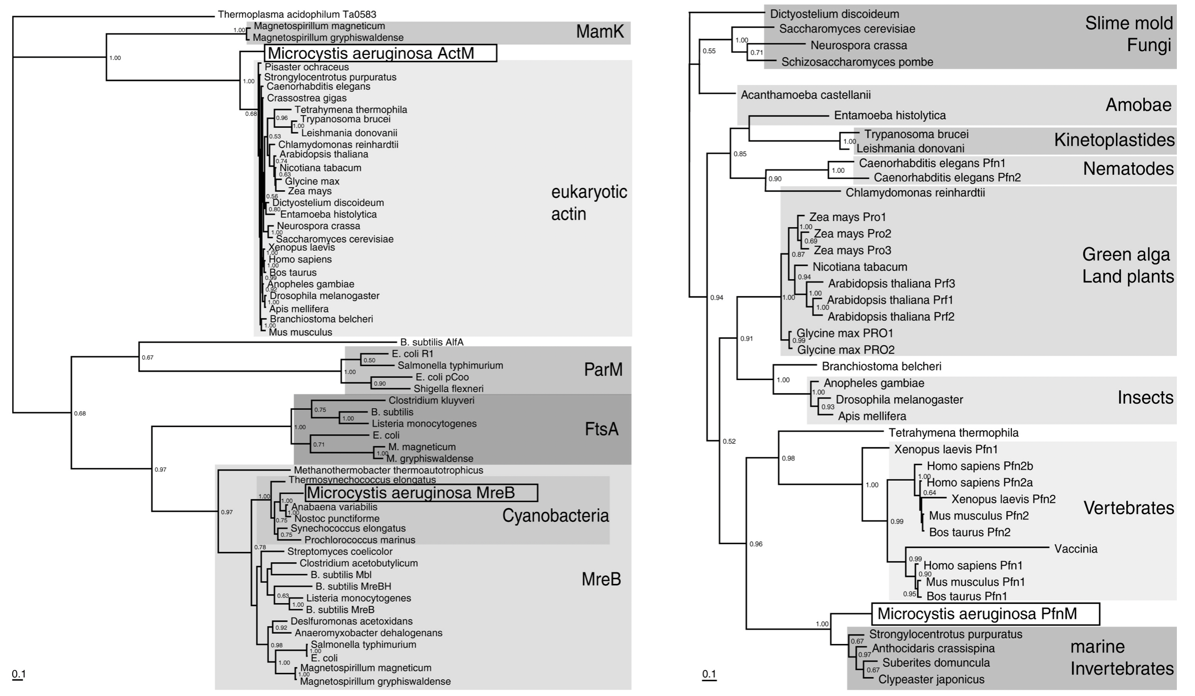
Eukaryote to Prokaryote HGT
Extremely rare
Example: cyanobacterium Microcystis aeruginosa actin ad profilin
Guljamow A et al. Curr Biol. 2007;17(17):R757-9

Slide 7
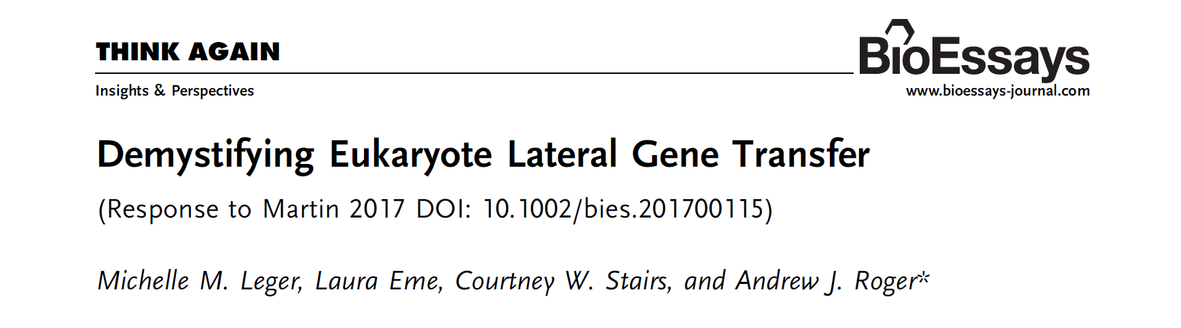
HGT to Eukarytoes – controversial?
Extremely rare
Example: cyanobacterium Microcystis aeruginosa actin ad profilin
Guljamow A et al. Curr Biol. 2007;17(17):R757-9

Slide 8
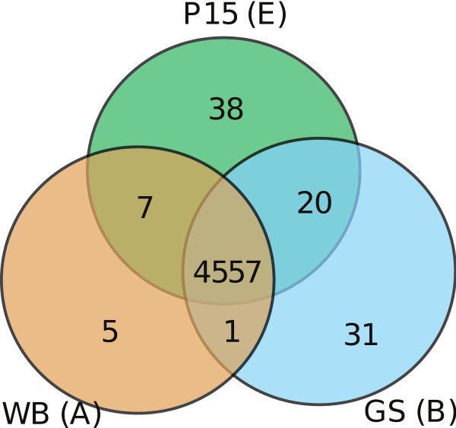
HGT to Eukarytoes – controversial?
Comparison of Giardia strains
Jerlström-Hultqvist a kol. 2010, BMC Genomics

Slide 9
HGT to Eukarytoes – controversial?
McCarthy and Fitzpatrick et al. 2019, Microbial genomics

Slide 10
HGT to Eukarytoes – controversial?
HGT can be amazing source of new adaptations
Help with lifestyle transitions – anaerobiosis, parasitism etc…
But not only, marine diatom Phaedactylum tricornutum contains > 5% HGT genes.

Slide 11
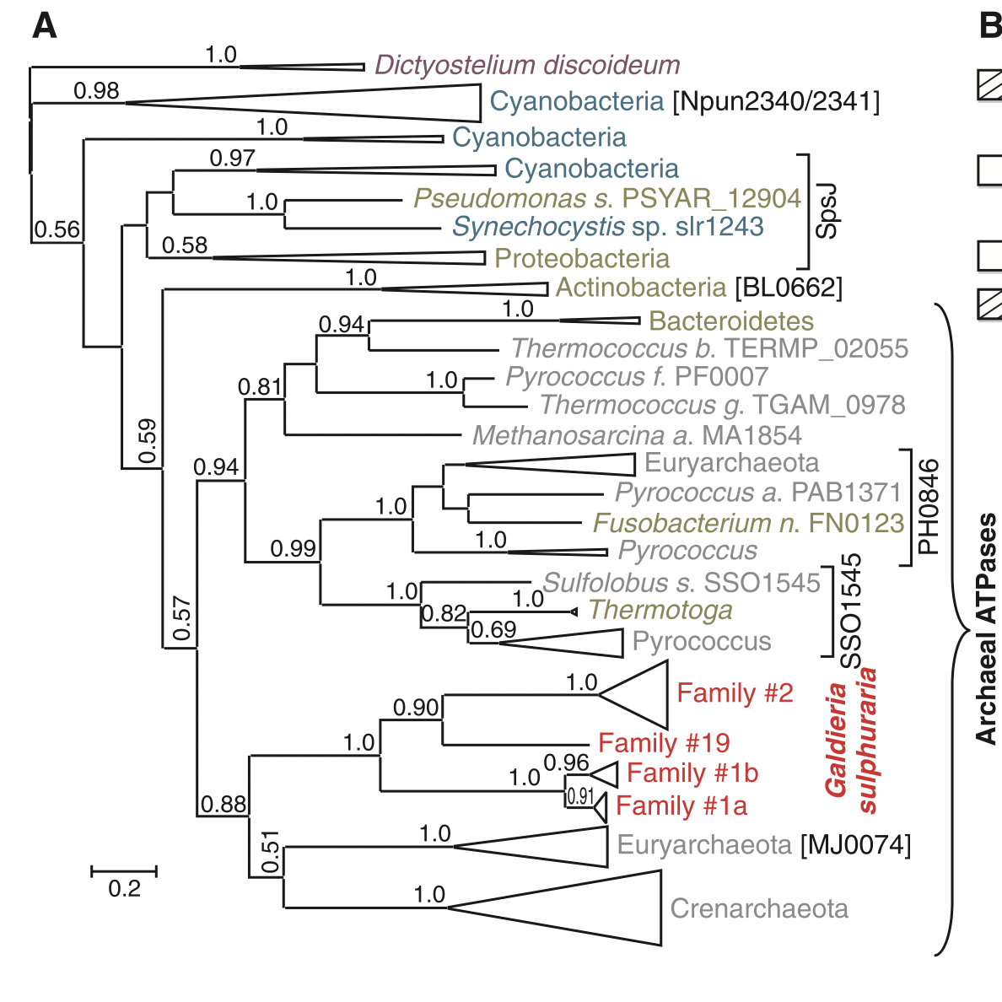
Extremophilic red alga (Cyanidiophyceae)
Adaptation to extreme conditions also thanks to HGT (pH 0-4; temperature 56°C; high tolerance to toxic metals)
Bacterial genes for various ion channels, membrane pumps
Less introns and higher GC content in these genes
Donors: extremophilic prokaryotes

Slide 12
Free-living Diplomonads
Extremophilic red alga (Cyanidiophyceae)
Adaptation to extreme conditions also thanks to HGT (pH 0-4; temperature 56°C; high tolerance to toxic metals)
Bacterial genes for various ion channels, membrane pumps
Less introns and higher GC content in these genes
Donors: extremophilic prokaryotes

Slide 13
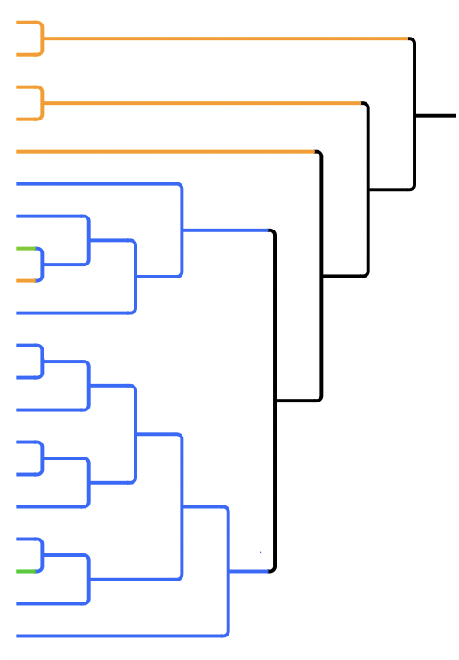


BIG, NO NO!!!
Parasitic Ancestor
Free-Living Ancestor
Giardia muris
Giardia intestinalis
Spironucleus barkhanus
Spironucleus salmonicida
Spironucleus vortnes
Ghost Hexamita
Gyromonas sp.
Trimitus sp. IT1
Trimitus sp.
SM Hexamita
Trepomonas sp. PPS6 BOT
Trepomonas sp. PPS6 MACHU PICCHU
Trepomonas sp. PC1
Trepomonas sp. PPS6 DAR
Trepomonas sp. PPS6 ERAWAN
Trepomonas sp. PPS6 VLADA7
Trepomonas agilis MIS2C
Trepomonas agilis PIG
Trepomonas agilis SOOS
Trepomonas steinii CONGO
Transition between lifestyles
SM Hexamita

Slide 14
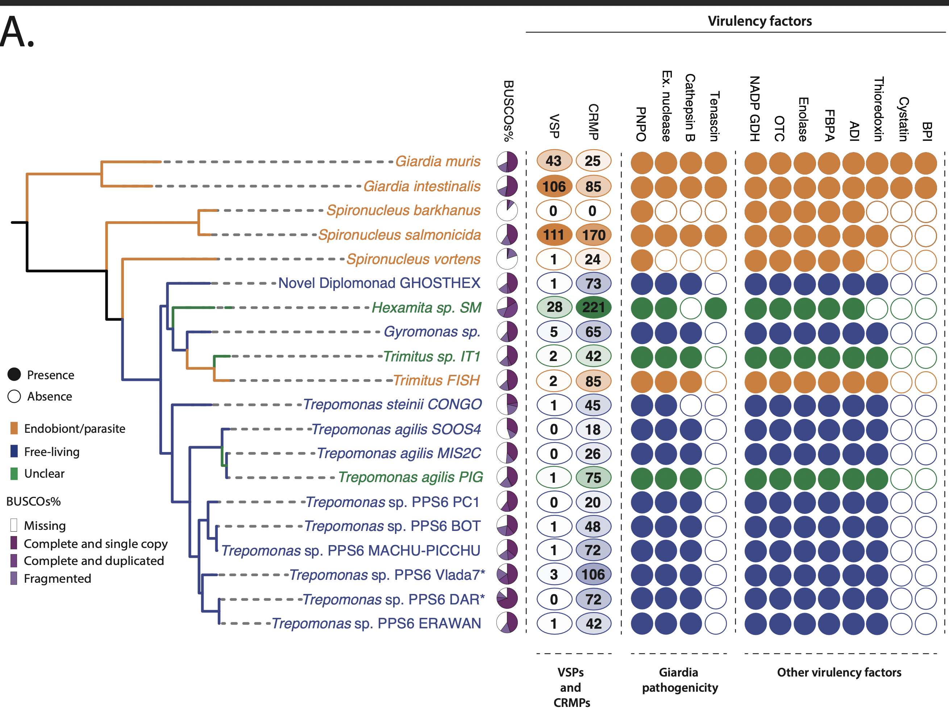
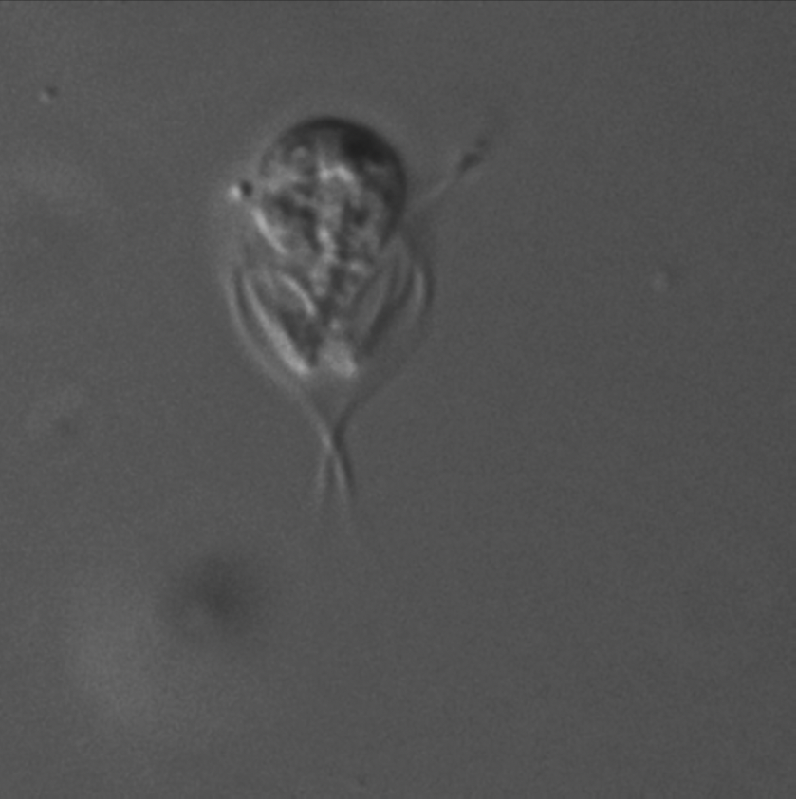
±250 HGT genes
Notes:
Motifs following transmembrane domains in cysteine rich proteins are characteristic of VSPs
5 AA long – use arginine and lysine

Slide 15
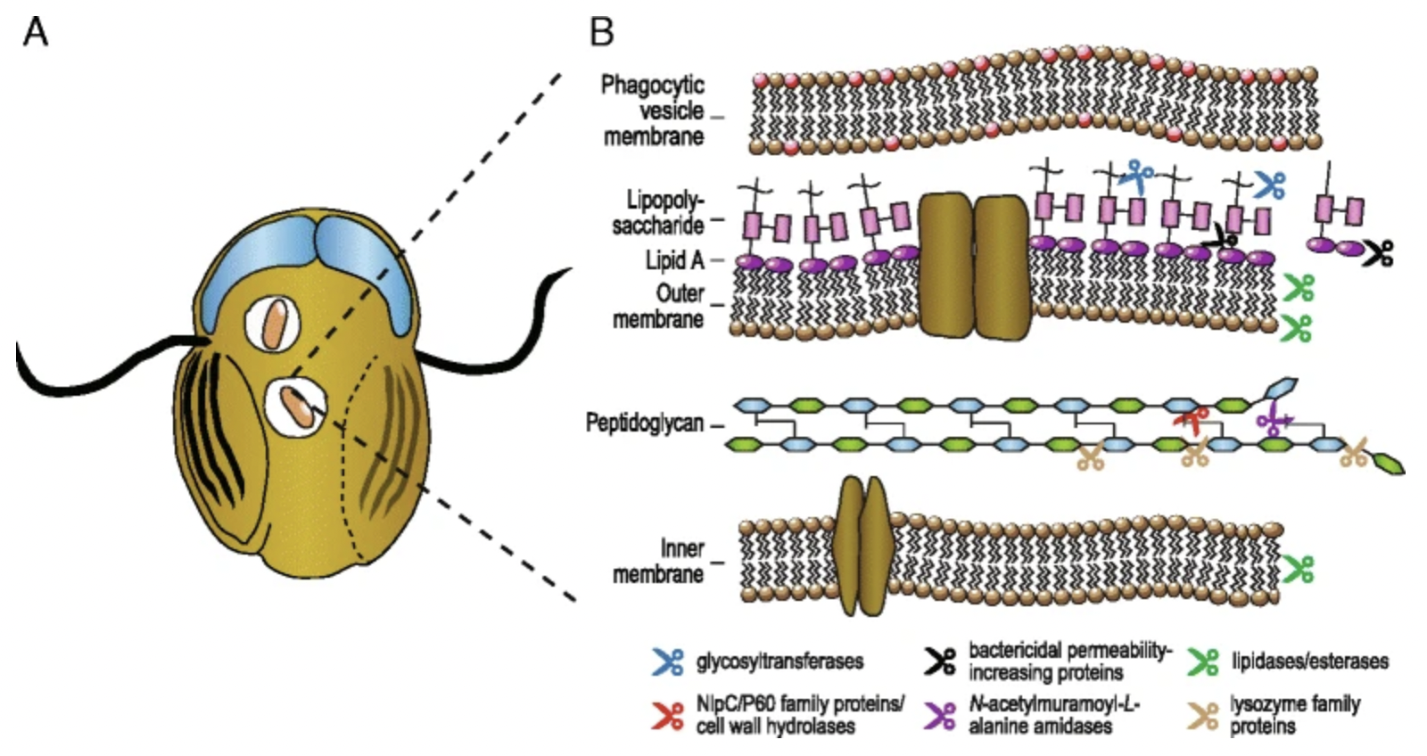
Trepomonas HGTs – adaptive to free-living
Notes:
Motifs following transmembrane domains in cysteine rich proteins are characteristic of VSPs
5 AA long – use arginine and lysine

Slide 16
How much Prokaryote to Eukaryote HGT
Etten 2020

Slide 17
But…
People tend to be conservative when inffering HGTs to Eukarytoes
And unsystematic

