Slide 1
Applications of NMR spectroscopy in supramolecular chemistry
FSC2SB-M3 2023
Jan Novotny
RG of Radek Marek

Slide 2
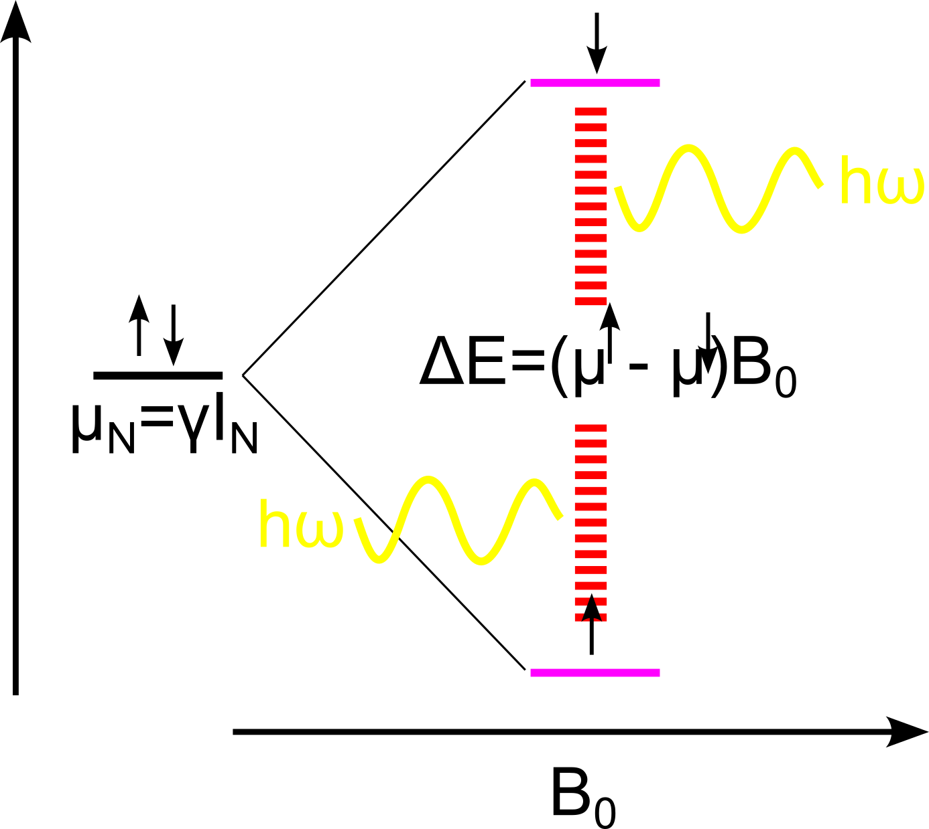
NMR spectroscopy
Transitions of nuclear magnetic moment (α→β) in external magnetic field (~10 T) trough RF irradiations (MHz)
Atomistic resolution, non-invasive, solution environment, structure & dynamics of molecules
Low sensitivity, expensive equipment, spectra complicated by interatomic interactions and external inhomogeneities → relaxation of signal

Slide 3
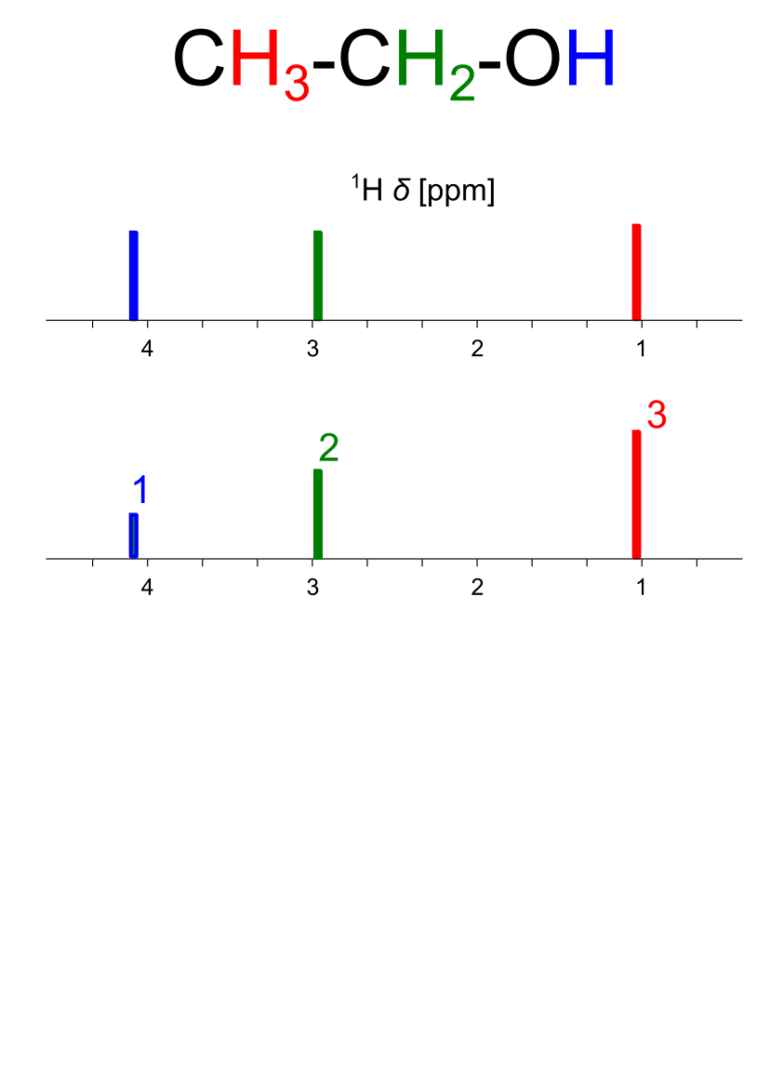
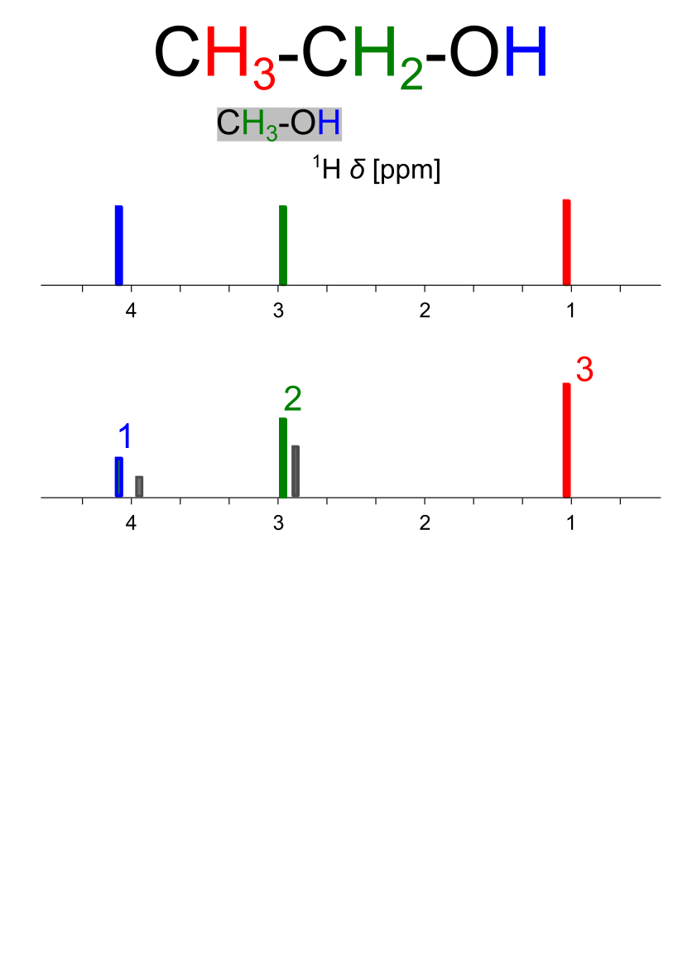
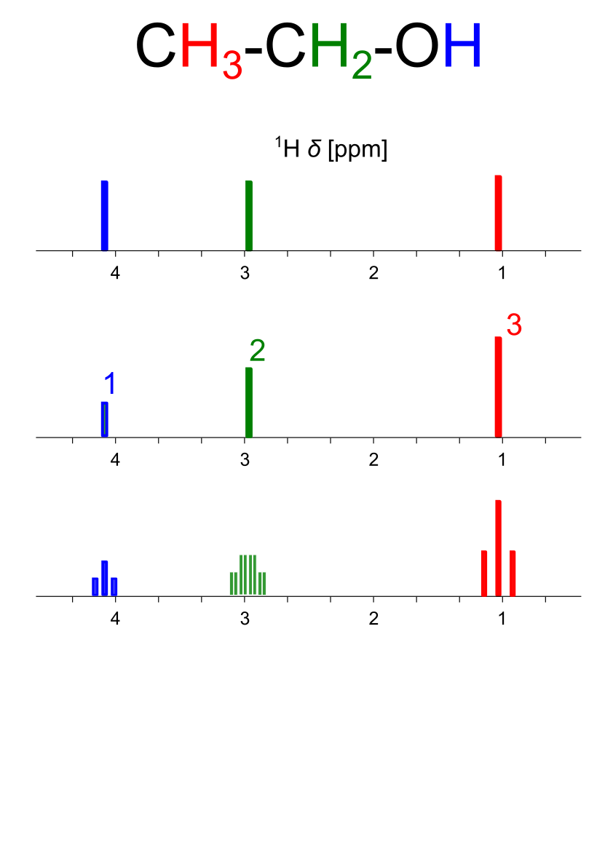
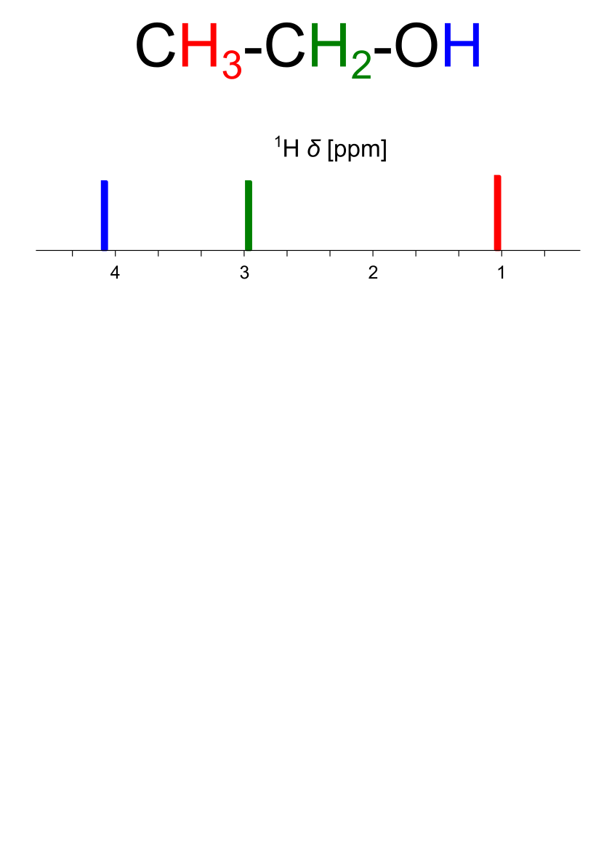
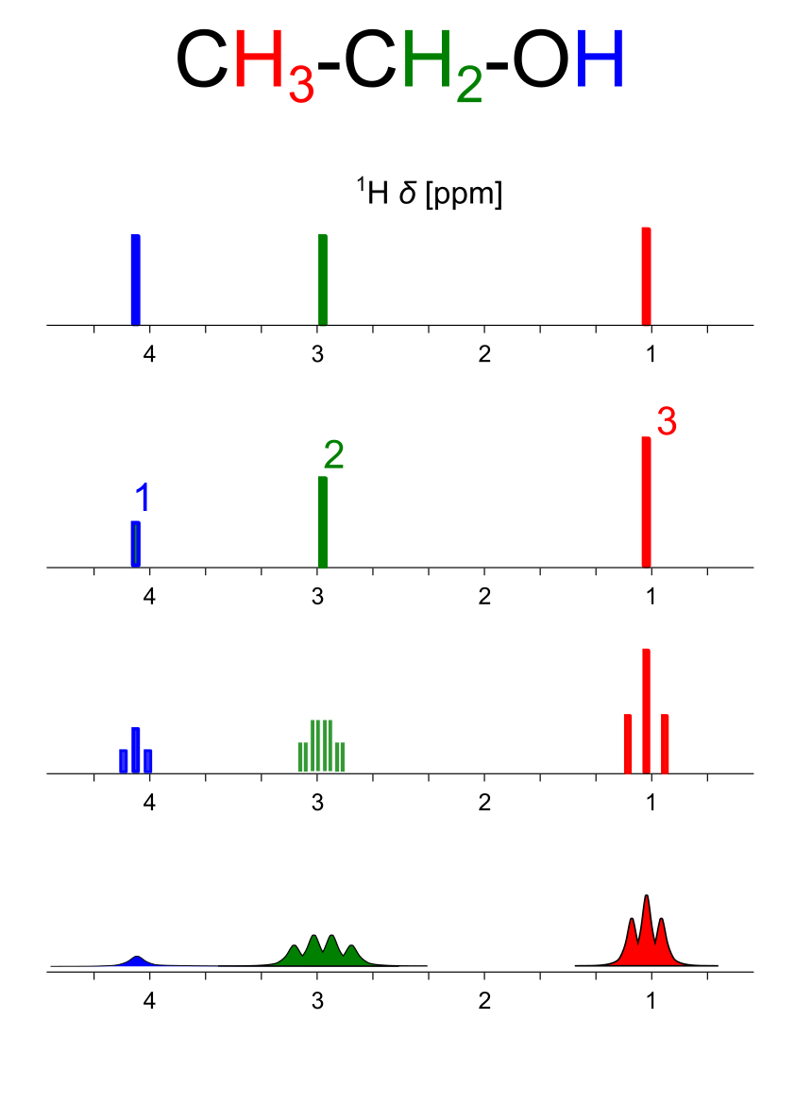
1D NMR spectrum – basic parameters
Shielding by valence electrons – chemical shift (δ)
Chemically non-equivalent atoms – number of signals
Quantity of species – signal integrals
Spin-spin interactions (J-coupling) – peak multiplicity
Relaxation of signal – peak linewidth

Slide 4
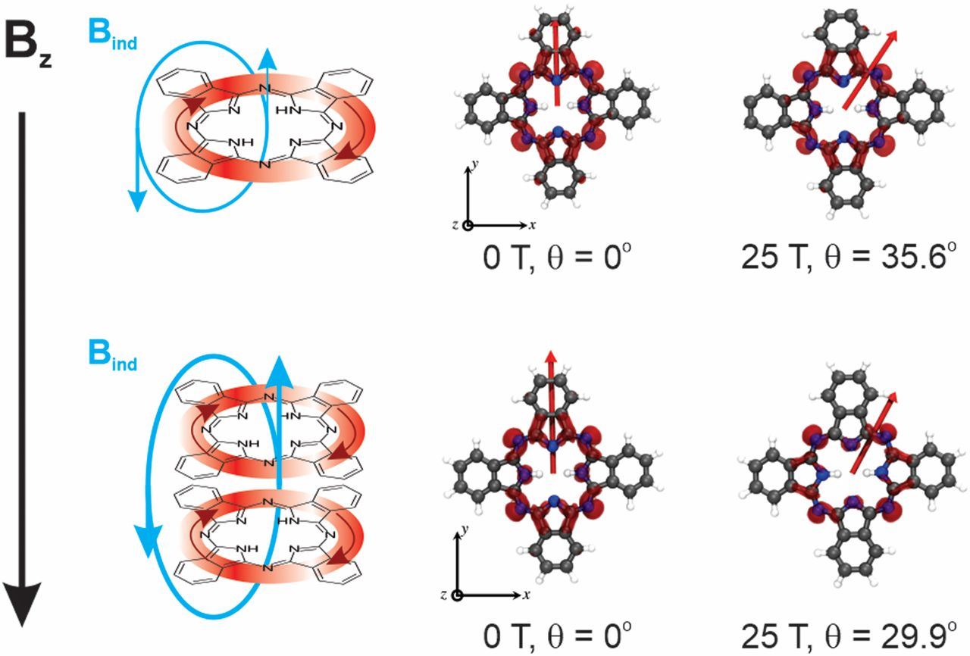
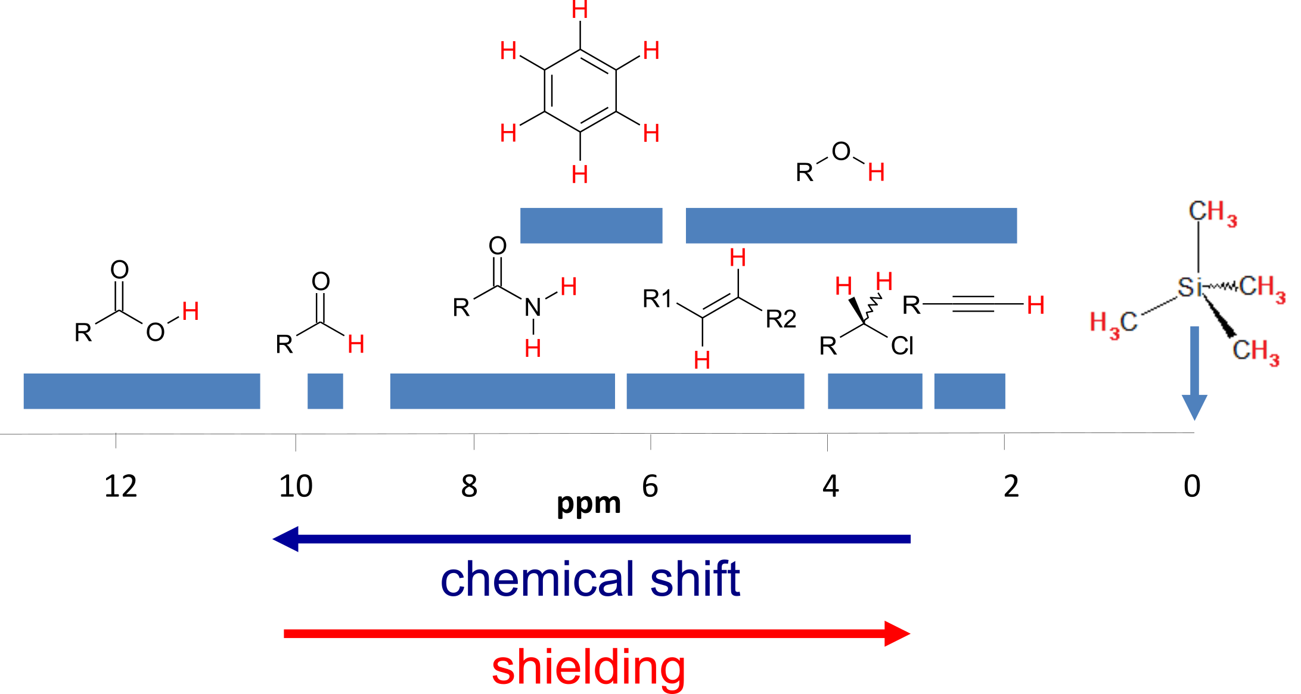
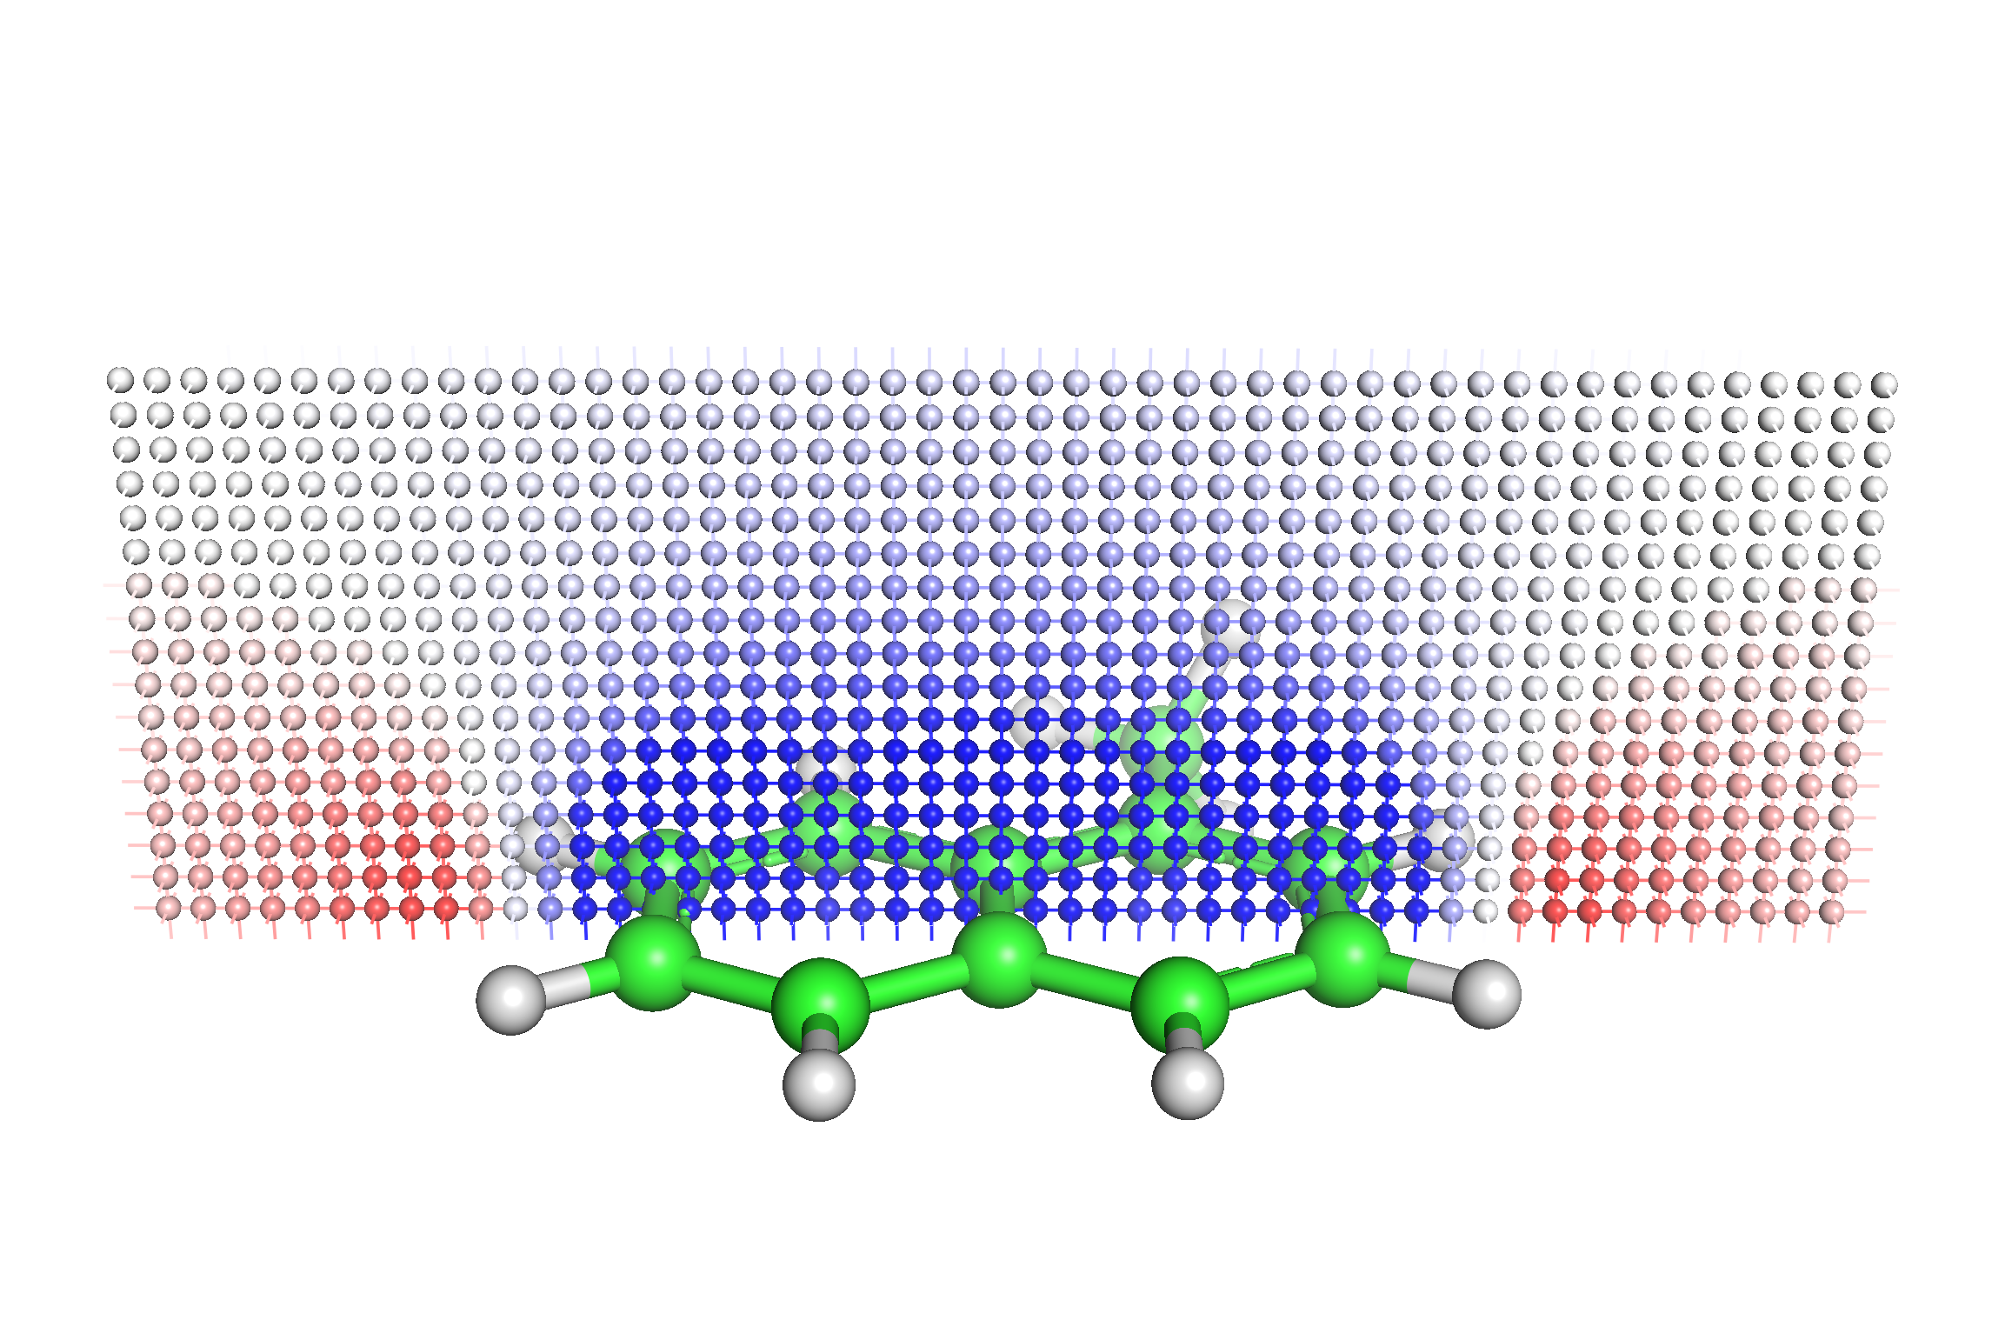
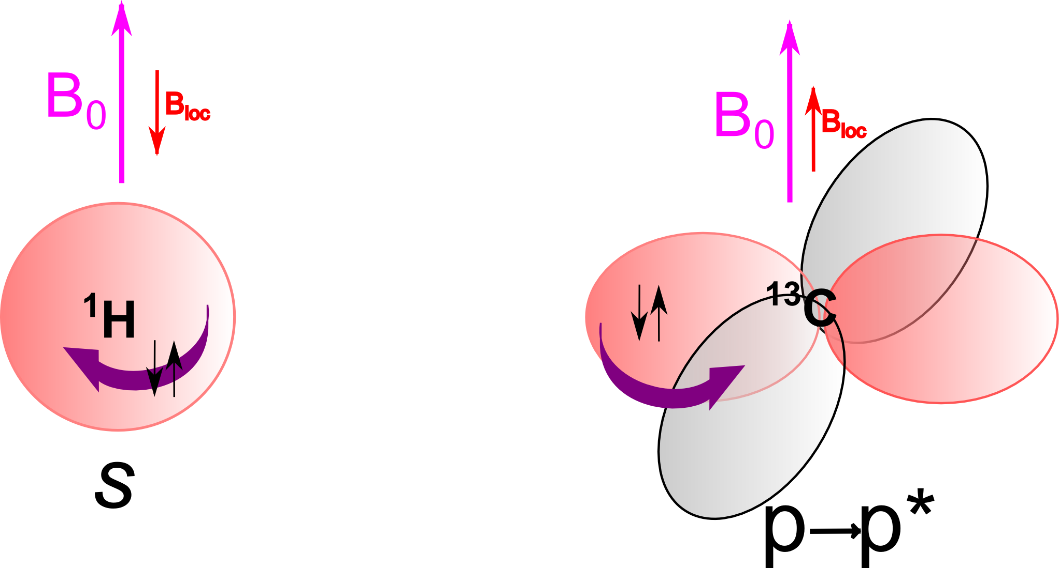
Chemical shift and CSA
https://doi.org/10.1073/pnas.1918148117

Slide 5
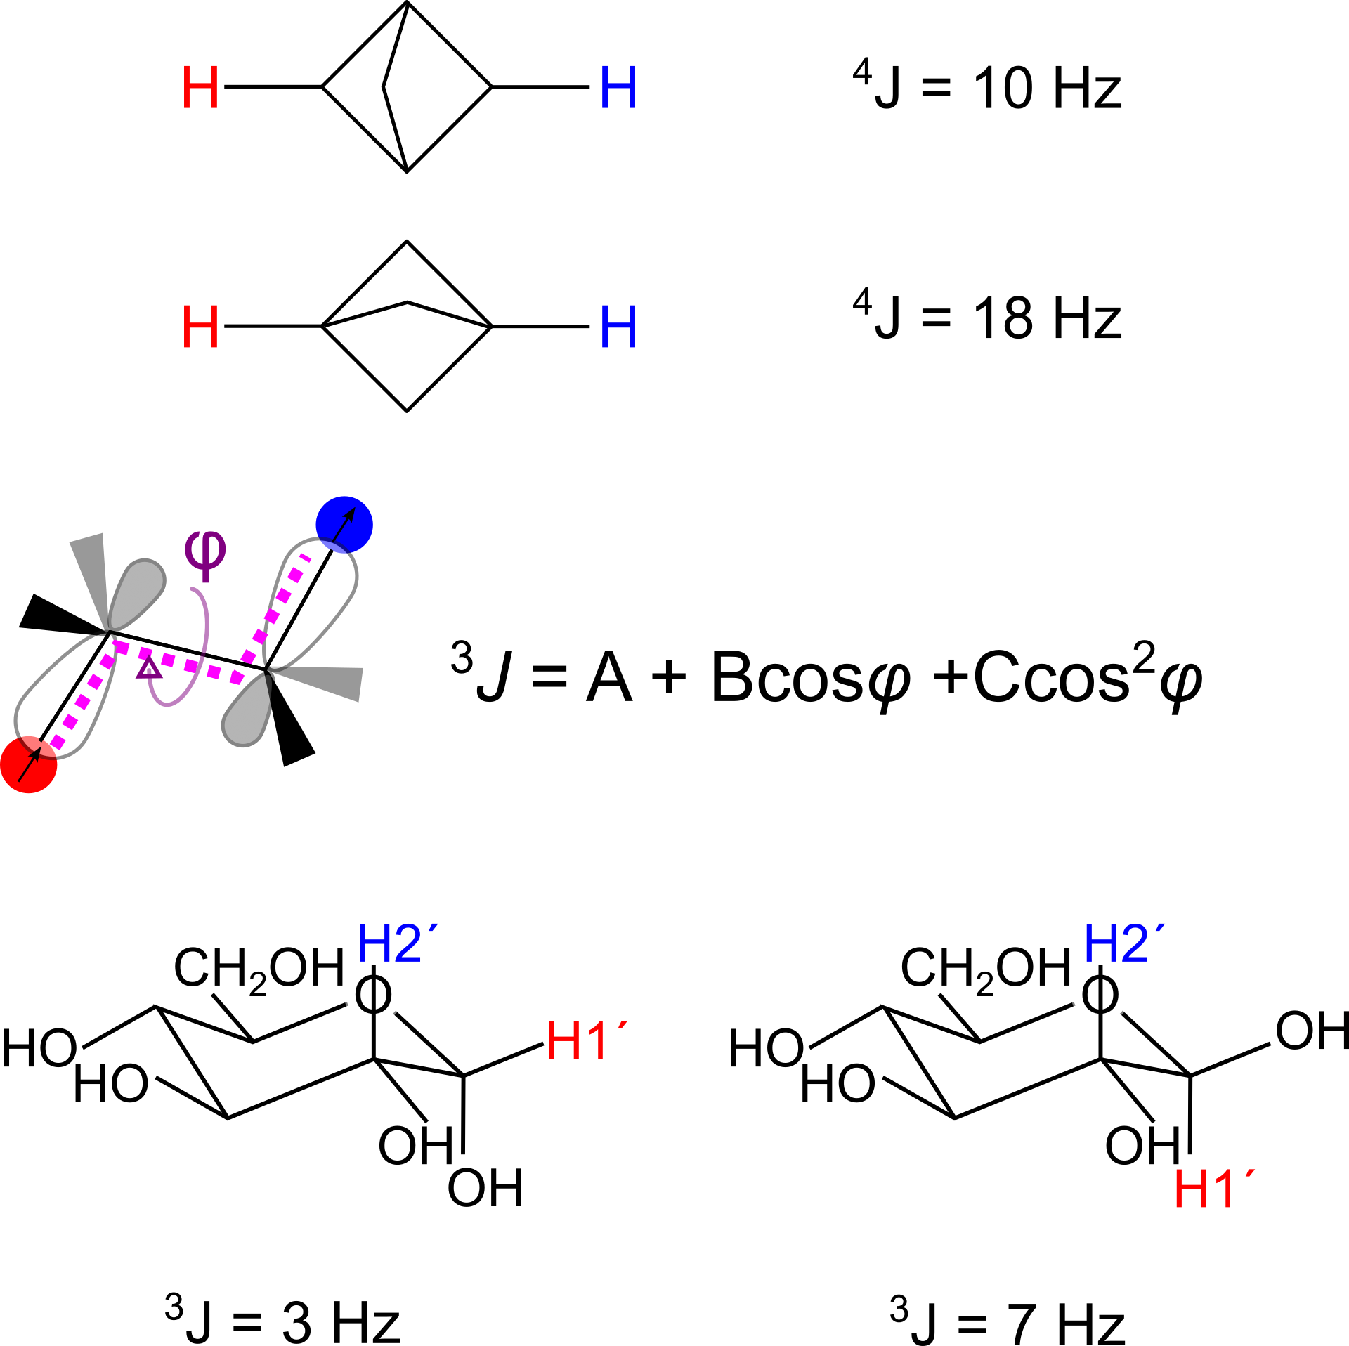
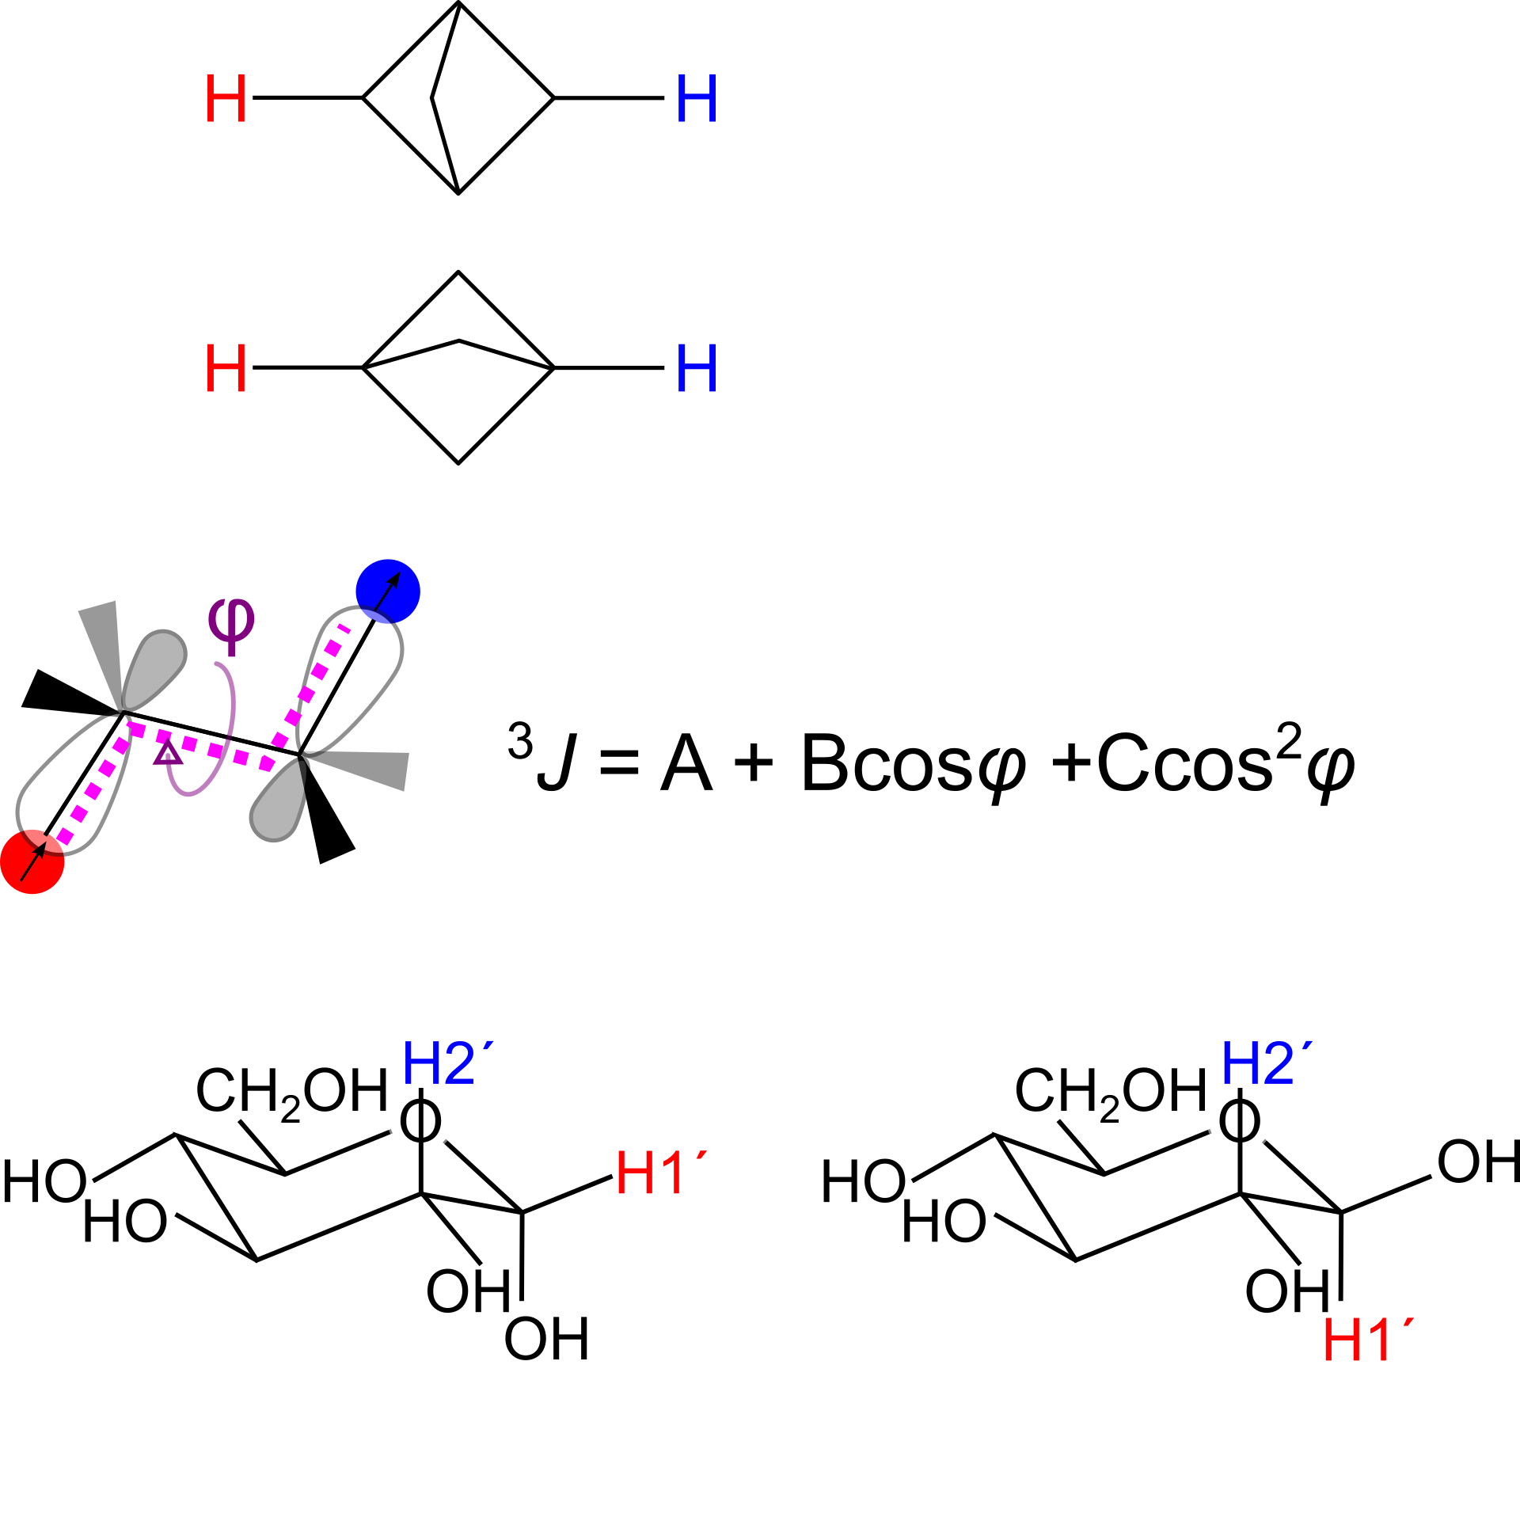
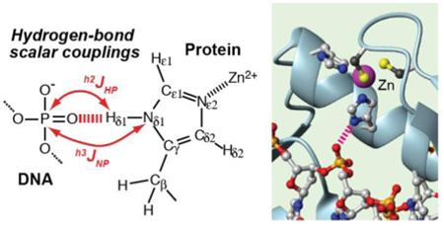
Indirect dipol-dipol interaction (J-coupling) - spin polarisation of valence e
J Phys Chem B. 2016 Oct 20; 120(41): 10679–10685.

Slide 6
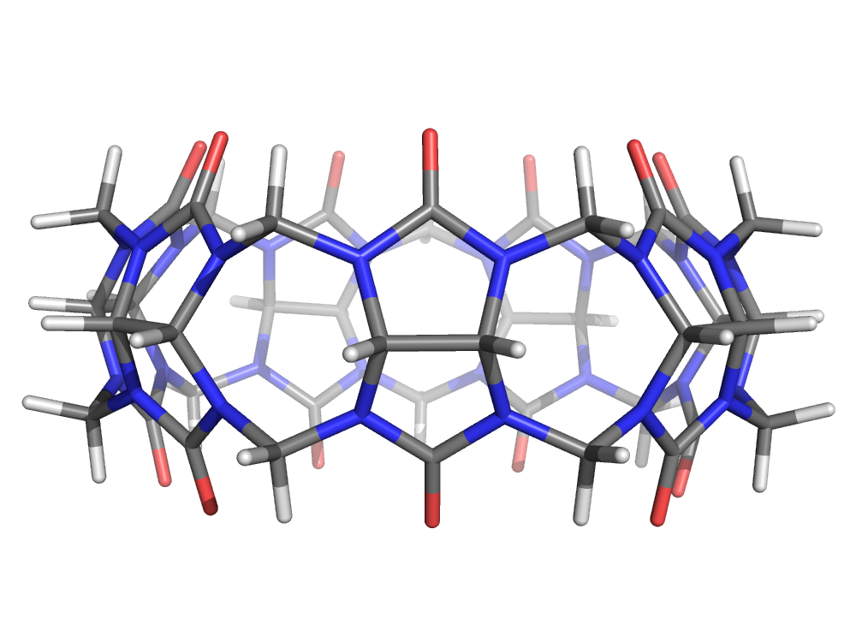
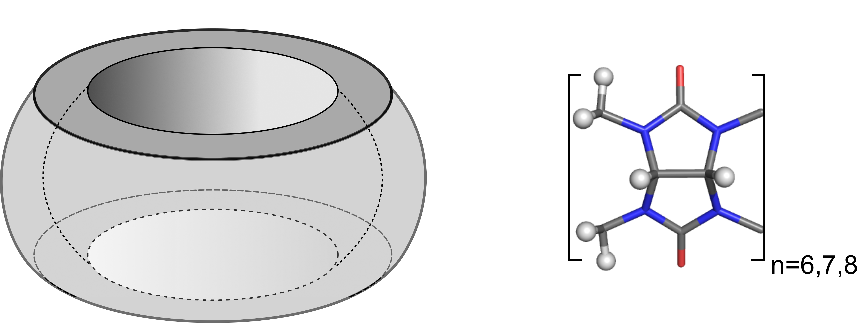
Number of ¹H NMR signals – symmetry of the host system

Slide 7
Number of ¹H NMR signals – symmetry of the HOST system

Slide 8
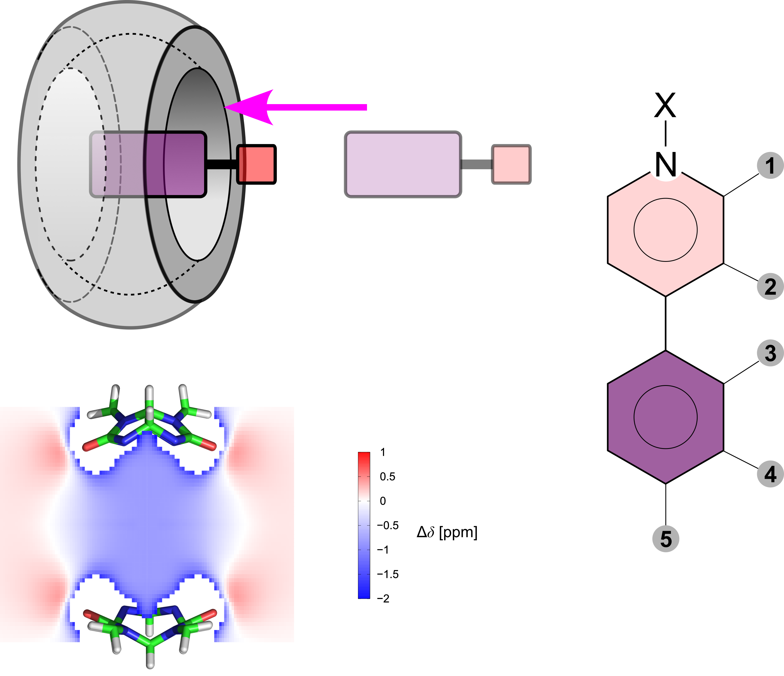
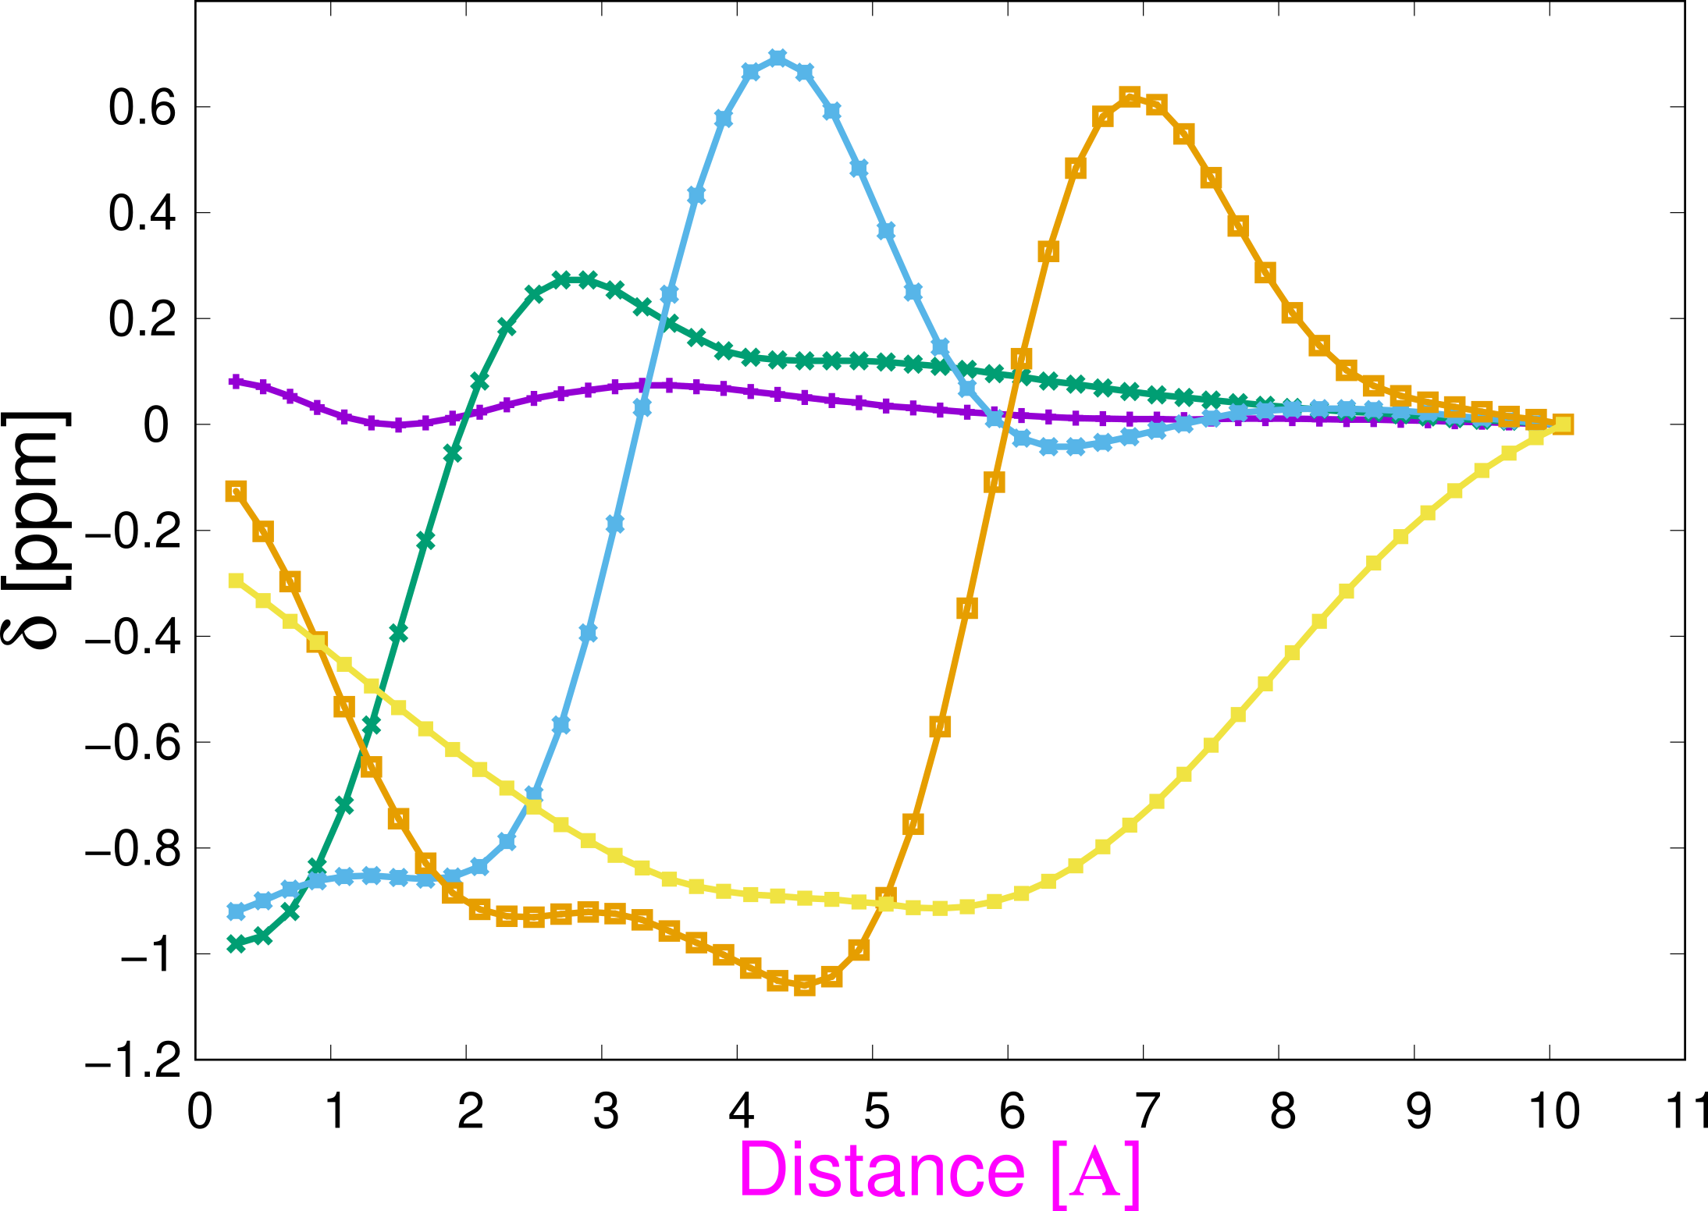
Chemical shift induced by HOST on GUEST atoms
3
4
2
1
5

Slide 9
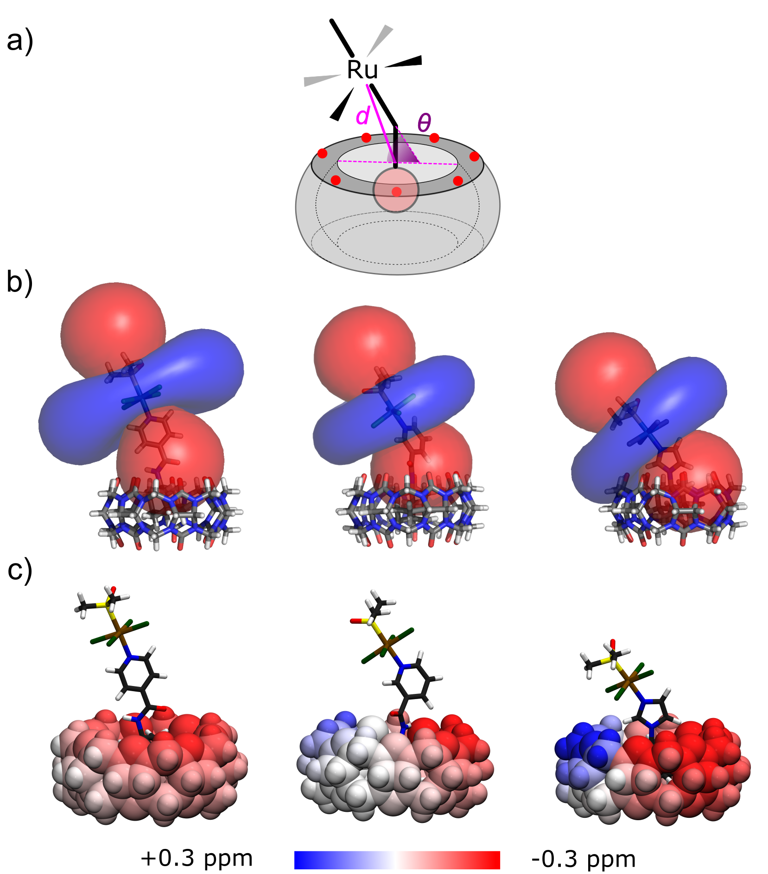
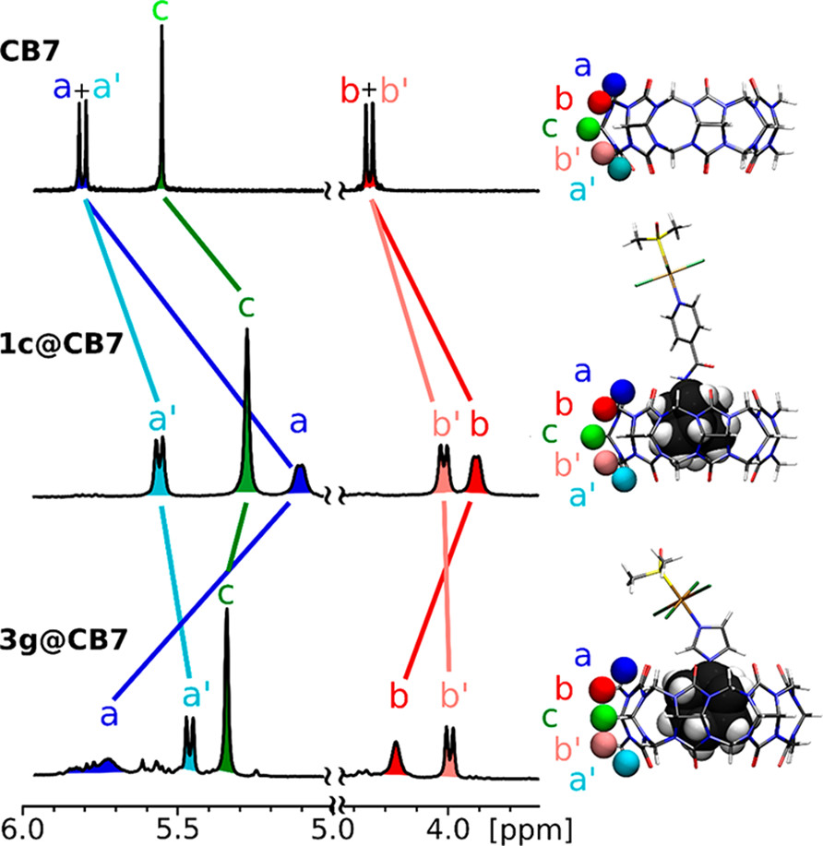
Paramagnetic shift of Ru-guest perturbs ¹H signals of CB7 host
10.1021/acs.inorgchem.7b03233

Slide 10
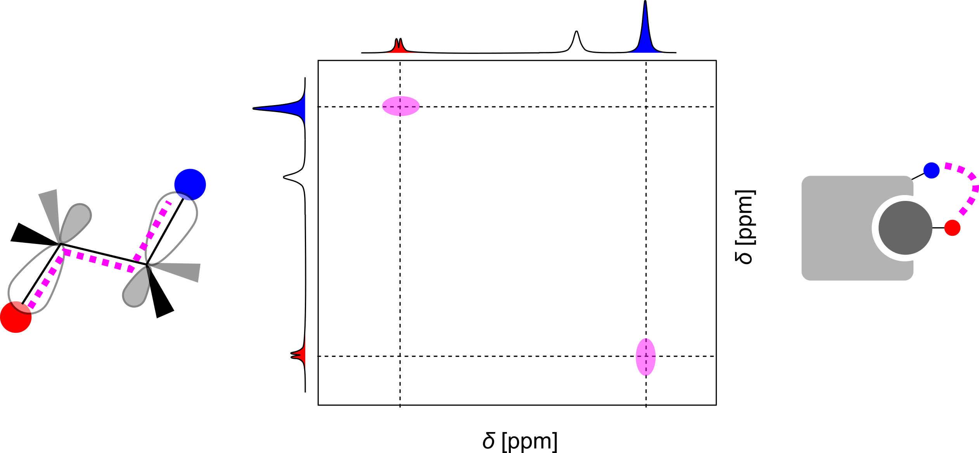
Multidimensional NMR methods - correlations
through bond within a spin system
NOE: through space < 5A

Slide 11
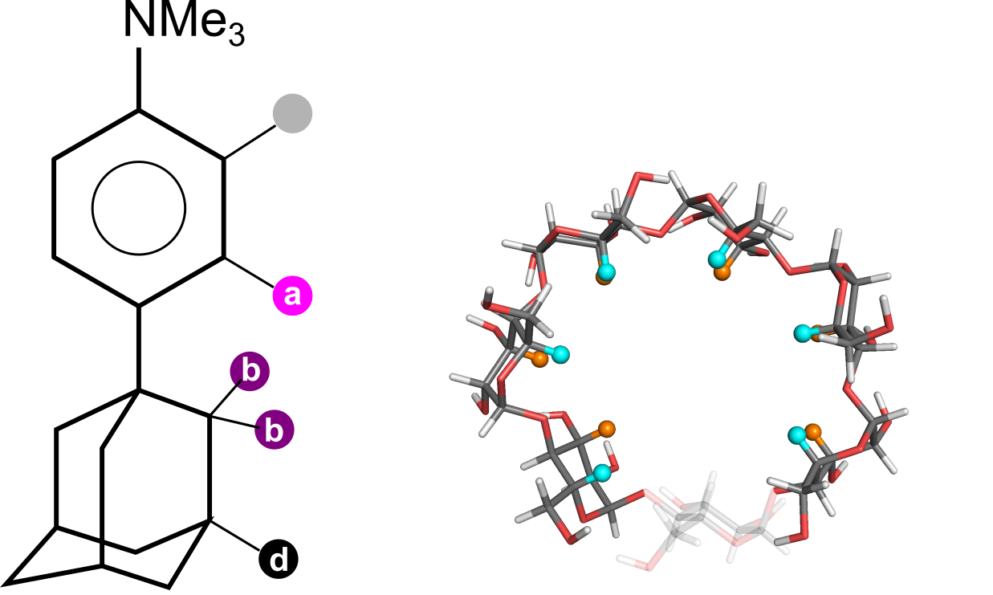
Through space correlation – determination of the mode of encapsulation into asymmetric host

Slide 12
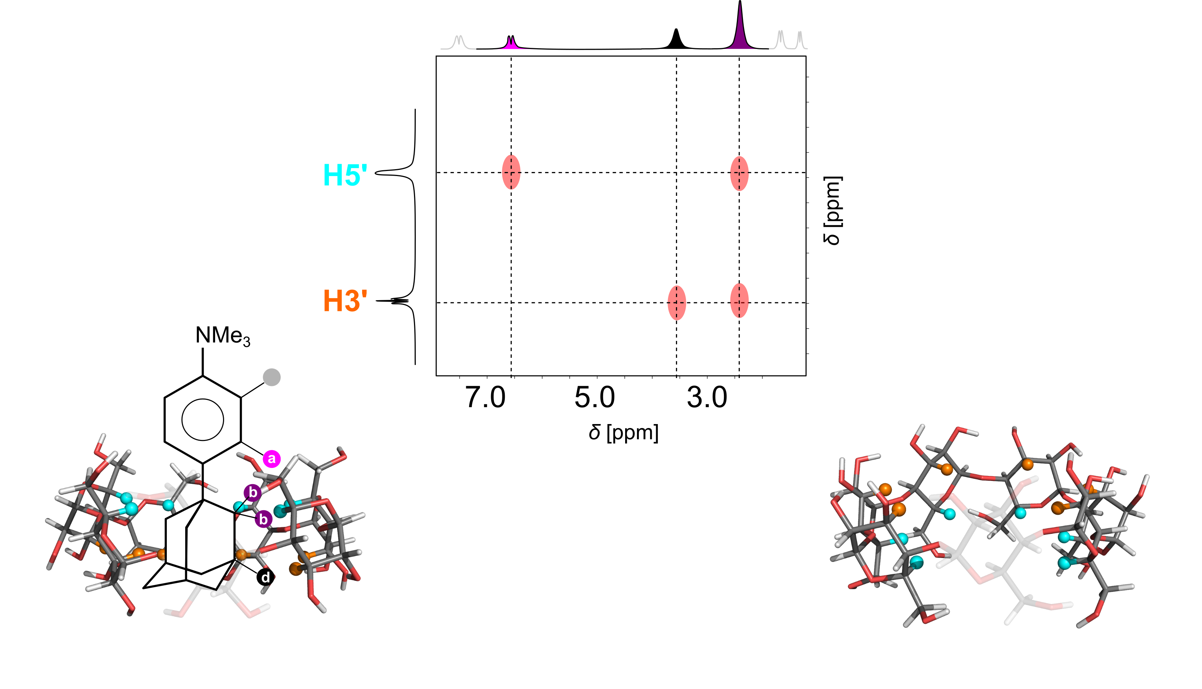
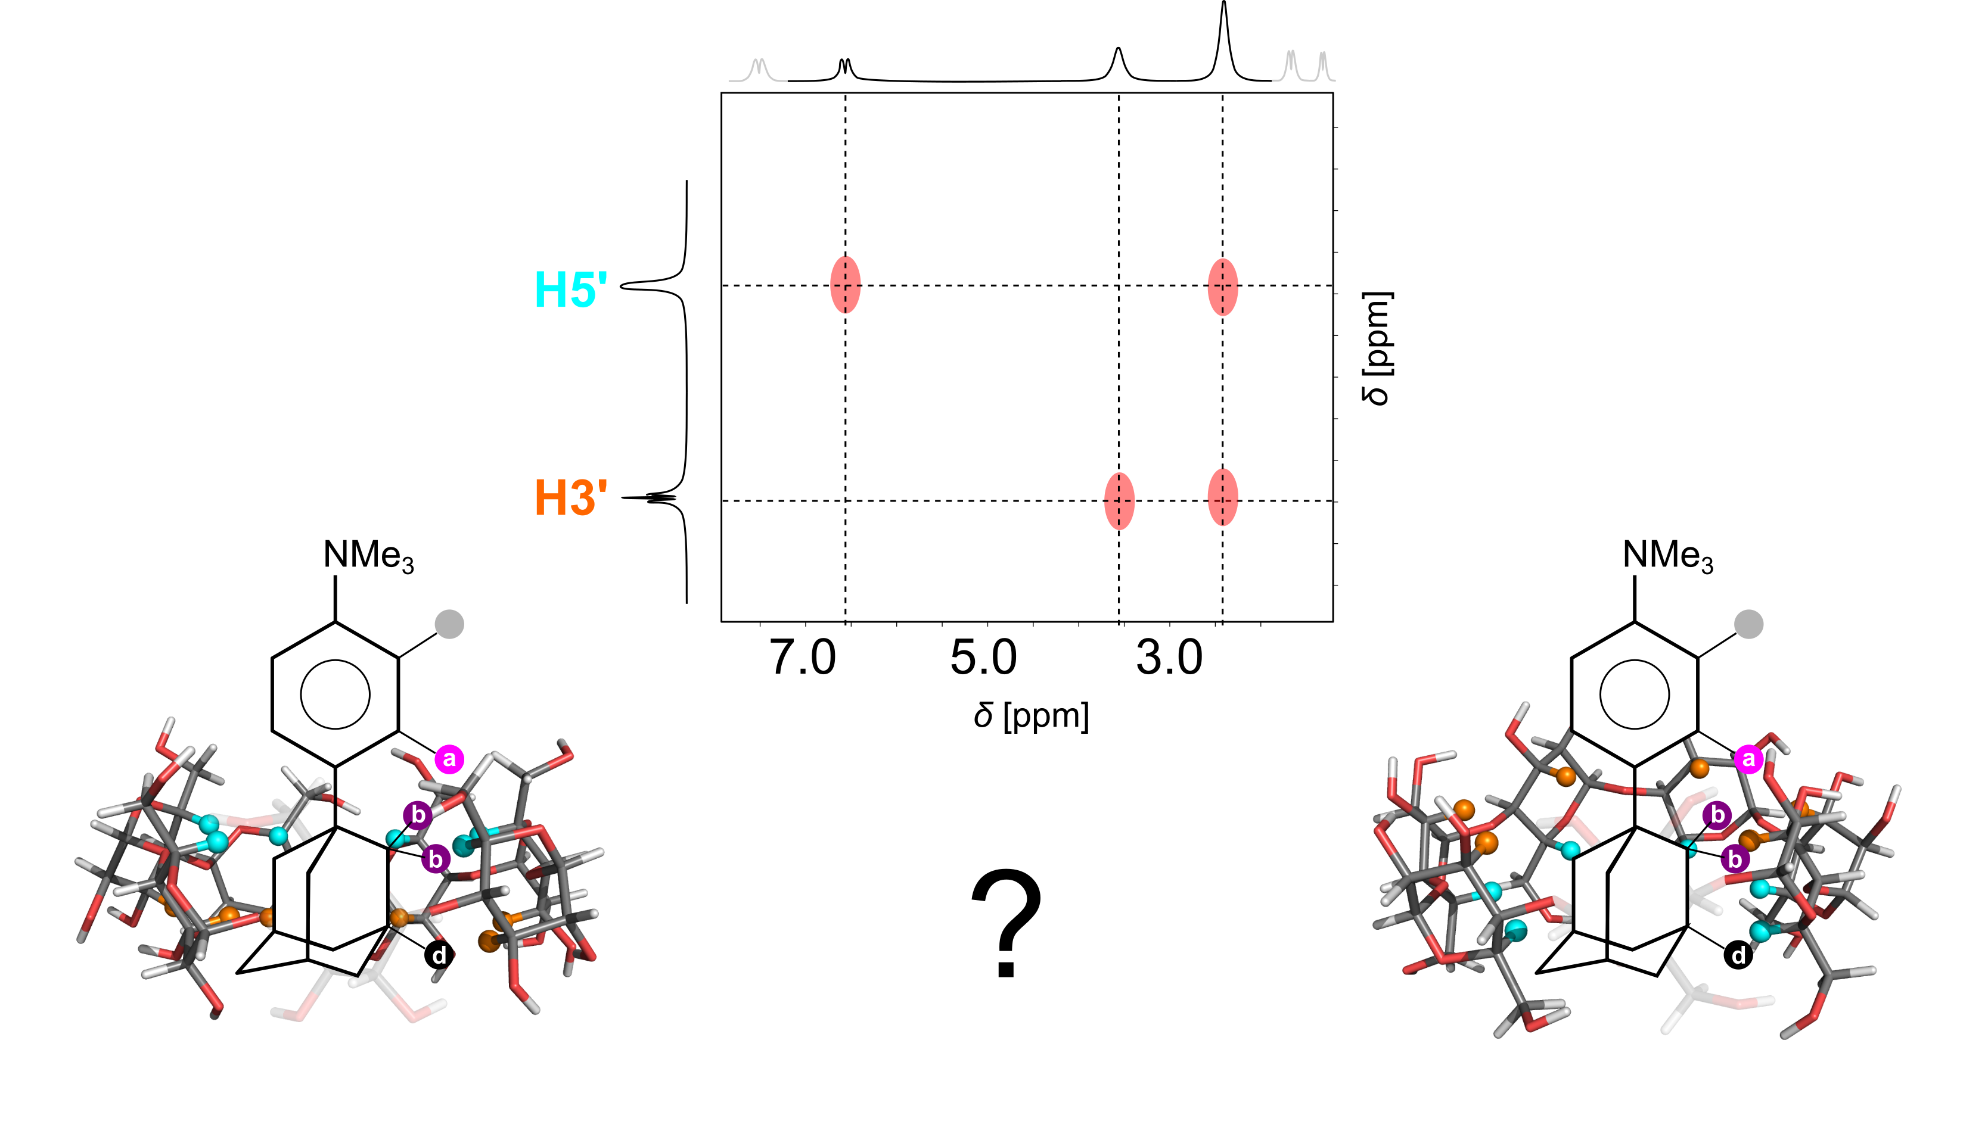
Through space correlation – determination of the mode of encapsulation

Slide 13
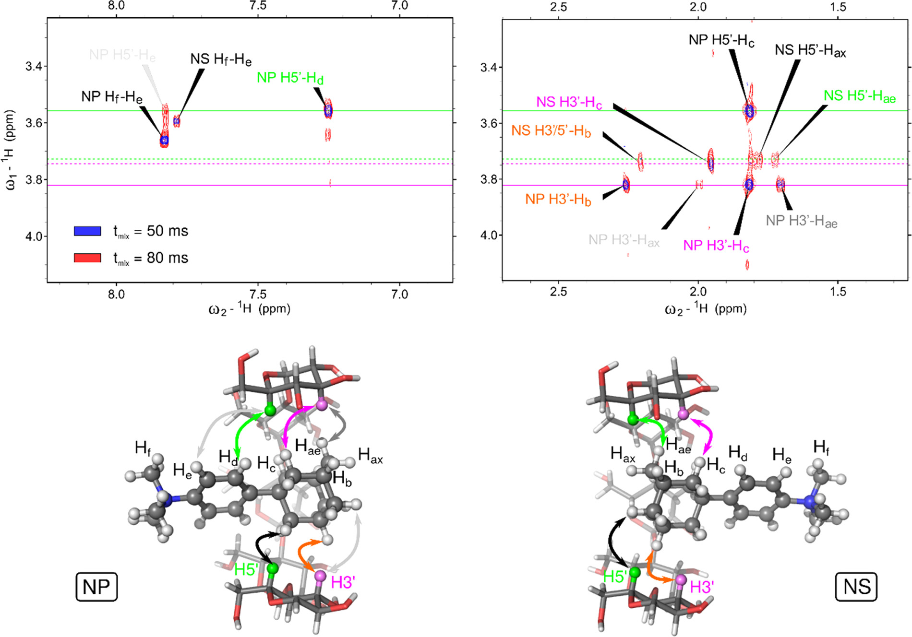
Through space correlation – determination of the mode of encapsulation
doi.org/10.1021/acs.joc.0c02917

Slide 14
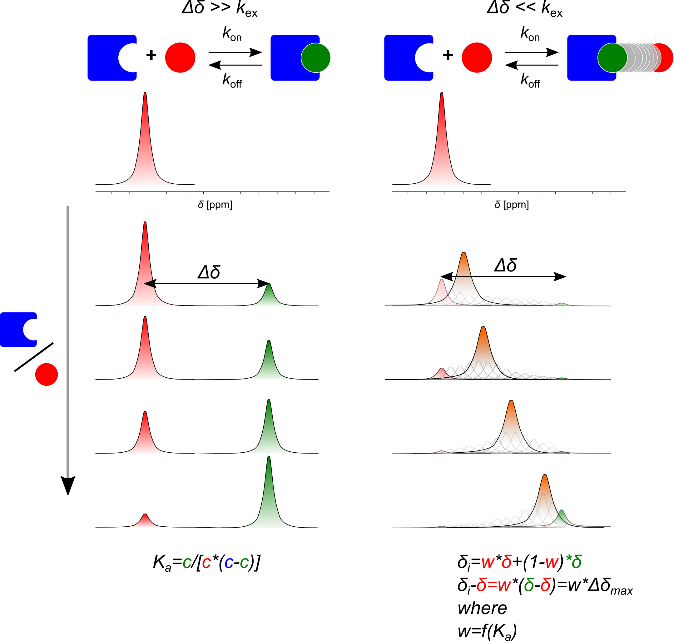
HG binding – regimes of chemical exchange

Slide 15
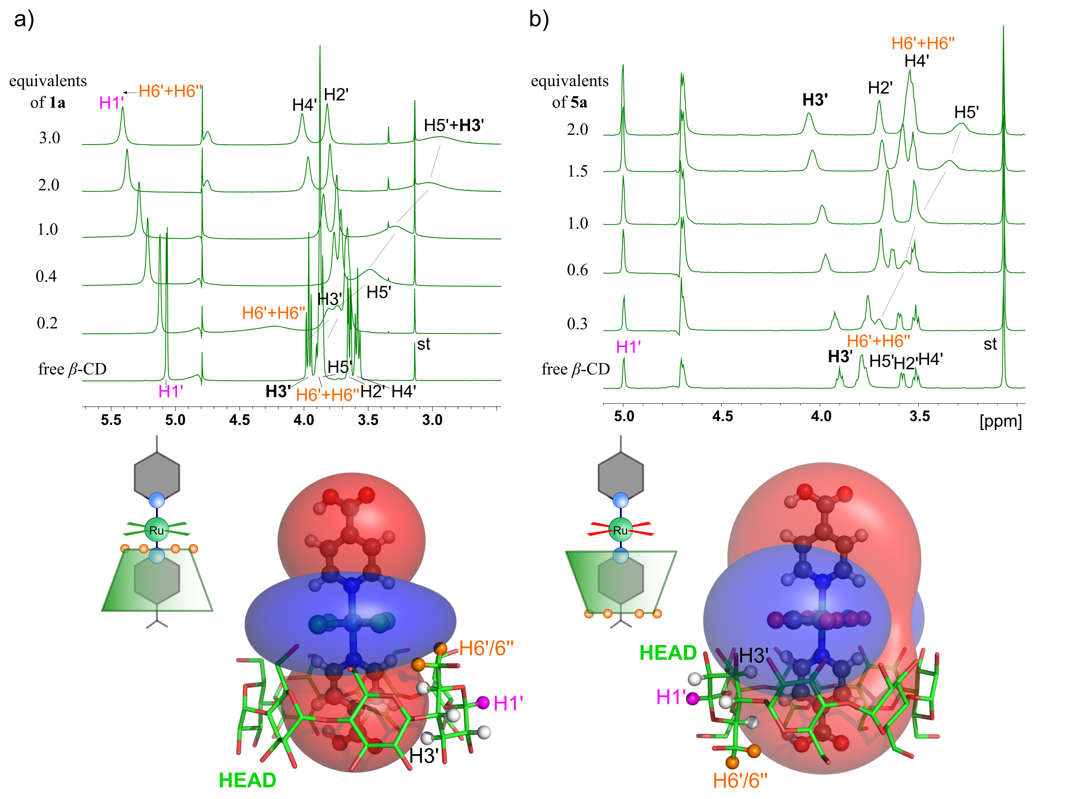
NMR of inclusion complexes with open shell ligands

Slide 16
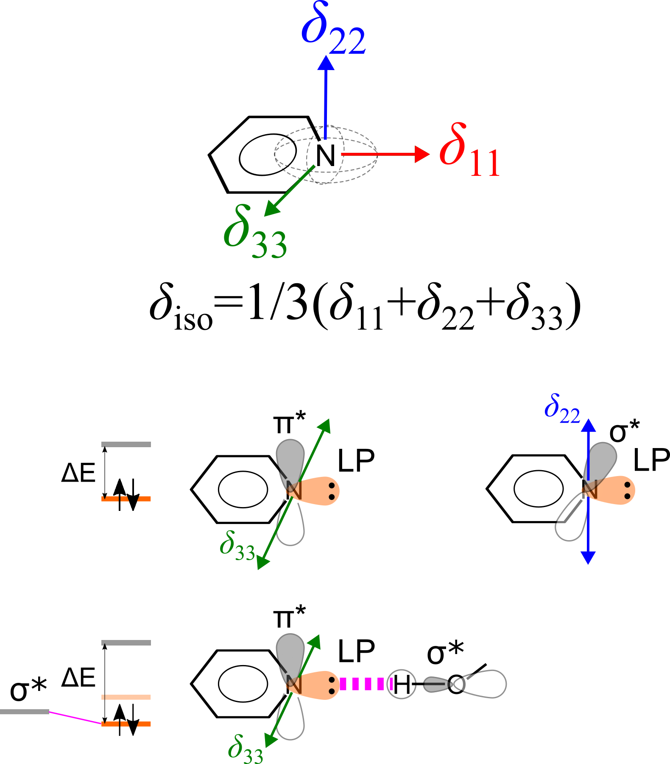
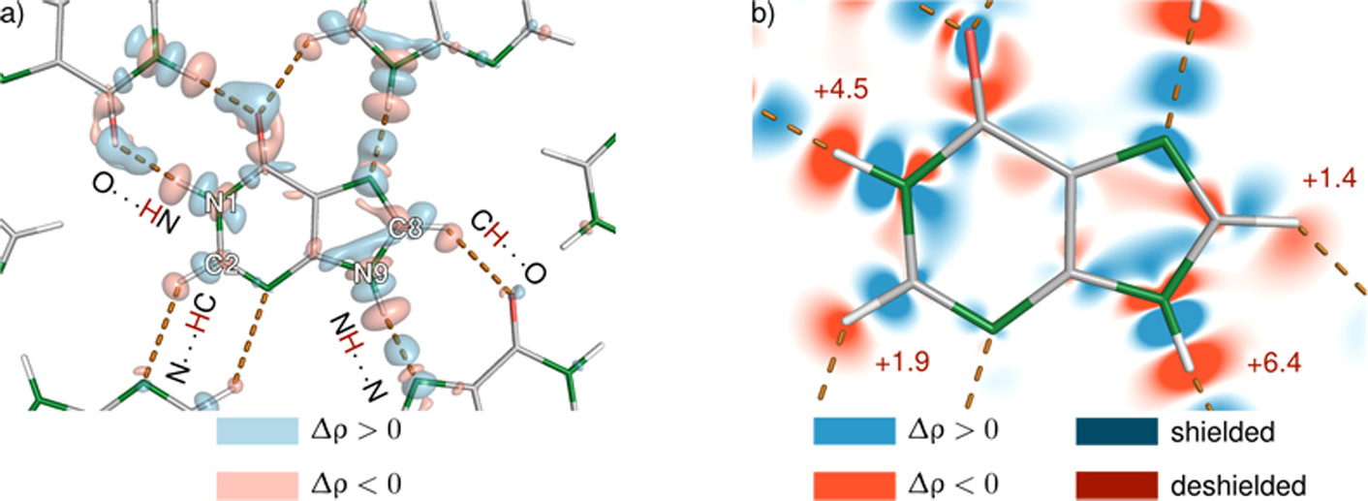
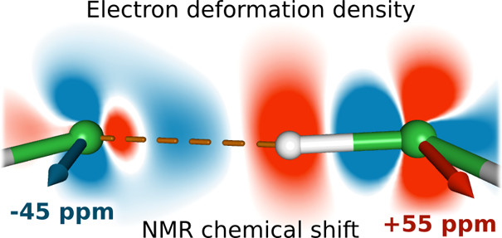
Hydrogen bonding characterized by ssNMR

Slide 17
Thanks for Your attention
https://www.ceitec.eu/structure-of-biosystems-and-molecular-materials/rg108/publication

