Slide 1
E0410 Fundamentals of Statistics for Scientific Data Using R
by Daria Sapunova, PhD student, RECETOX
daria.sapunova@recetox.muni.cz
Bohunice, D29, room 123

Slide 2
Course description
Notes:
Mentimeter.com

Slide 3
Overview
No statistical knowledge or programming skills are required.
Topics to be covered:
Descriptive statistics
Visualization
Data cleaning
The most common R packages in R (dplyr, tidyverse etc.)
Hypothesis testing
Parametric and non-parametric statistics
Parametric tests (t-test, ANOVA)
Non-parametric tests (Kruskal-Wallis, Mann-Whitney)
Pearson and Spearman correlation
Linear regression (OLS)
Multiple regression

Slide 4
Theoretical part
Notes:
Mentimeter.com

Slide 5
Statistics, the science of collecting, analyzing, presenting, and interpreting data.

Slide 6
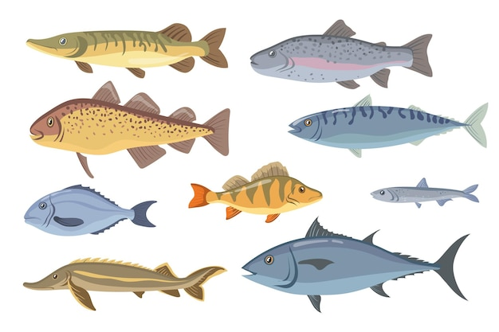
Age
Gender
Height
Weight
Education
Frequency of fish consumption
Source of fish
Chronical disease
Last medical examination
VARIABLES
characteristics of something or someone
CASES
something or someone

Slide 7
CASES
VARIABLES
Age
Gender
Height
Weight
Education
Frequency of fish consumption
Source of fish
Chronical disease
Last medical examination

Slide 8
CASES
VARIABLES
VARIABLES
Population
Number of sailors
Weight of caught fish
…

Slide 9
CASES
VARIABLES
Need to vary!

Slide 10
VARIABLE
Age
6 34 56 12 34 54 47 76 2 21
No variation!
CONSTANT
Village
White Bridge White Bridge White Bridge White Bridge

Slide 11
VARIABLES
Categorical
(qualitative)
Numerical
(quantitative)
Nominal
Categories are unordered
Ordinal
Categories are ordered
Discrete
Integer values
Continuous
No limitation on values
Gender (male/female)
Marital status
Residence
Disease stage (mild/moderate/severe)
Opinion (strongly agree…)
Number of children (1/2/3/4/…)
Not 1.222
Weight in kg (34.456…)
Height in cm
Speed

Slide 12
VARIABLES
Categorical
(qualitative)
Numerical
(quantitative)
Nominal
Categories are unordered
Ordinal
Categories are ordered
Discrete
Integer values
Continuous
No limitation on values
Age
Gender
Education
Frequency of fish consumption
Height
Source of fish
Weight
Chronical disease
Last medical
examination

Slide 13
VALUES
VARIABLES
DATA MATRIX | Age | Gender | Height | Weight | Education | Freq.of fish consumption (times/month) | Source of fish (majority) | Chronical disease | Last med.exam. (years ago)
Person 1 | 45 | Male | 170.4 | 76.4 | PhD | 21 | Market | Diabetes | 10
Person 2 | 26 | Male | 168.3 | 65.3 | BS | 5 | Self-fishing | - | -
Person 3 | 54 | Female | 168.6 | 75.3 | MS | 23 | Grocery store | Bladder infection | 10
Person 4 | 65 | Male | 156.6 | 44.2 | MS | 10 | Market | Diabetes | 5
Person 5 | 21 | Female | 170.1 | 69.9 | HS | 8 | Market | - | -
Person 6 … | 44 | Male | 176.4 | 84.3 | MS | 43 | Self-fishing | - | 2
Person 400 | 6 | Male | 121.2 | 21.9 | - | 15 | Market | - | 1
CASES
OBSERVATION

Slide 14
Frequency Table
shows how the values (observations) are distributed over the cases
Gender | Frequency | Percentage
Male | 245 | 61
Female | 155 | 39
TOTAL | 400 | 100
Weight | Frequency | Percentage
less than 60 | 56 | 14
60-69.9 | 123 | 31
70-79.9 | 169 | 42
80-89.9 | 43 | 11
90 and more | 9 | 2
TOTAL | 400 | 100

Slide 15
Gender | Frequency | Percentage
Male | 245 | 61
Female | 155 | 39
TOTAL | 400 | 100
Pie Chart

Slide 16
Gender | Frequency | Percentage
Male | 245 | 61
Female | 155 | 39
TOTAL | 400 | 100
Bar Graph

Slide 17
Weight | Frequency | Percentage
less than 60 | 56 | 14
60-69.9 | 123 | 31
70-79.9 | 169 | 42
80-89.9 | 43 | 11
90 and more | 9 | 2
TOTAL | 400 | 100

Slide 18
Participants | Weight
Person 1 | 76.4
Person 2 | 65.3
Person 3 | 75.3
Person 4 | 44.2
Person 5 | 69.9
Person 6 … | 84.3
Person 400 | 21.9
Histogram
10 20 30 40 50 60 70 80 90 100

Slide 19
Bell shaped distribution
(normal)
Left skewed distribution
Two peaks distribution
(bimodal)
Right skewed distribution

Slide 20
Summarizing a distribution
Graph
Center
Mode
Median
Mean

Slide 21
Mode
value that occurs most frequently
(the most common outcome)

Slide 22
Participants | Age
Person 1 | 18
Person 2 | 56
Person 3 | 30
Person 4 | 34
Person 5 | 31
Person 6 … | 23
Person 55 | 7
Mode
value that occurs most frequently
(the most common outcome)
34 56 34 76 23 21 18 54 32 34 23 48 47 32 21 17 34 45 66 8 25 31 64 29 38 19 66 52 34 51 23 44 42 47 16 43 34 44 12 58 63 35 34 33 34 60 30 34 35 7 23 32 47 54
31
Mode = 34

Slide 23
Median
the middle value in a set of data when they are ordered from the smallest to the largest
18 7 21 23 19 16 12 17 23 21 8
11 values
7 8 12 16 17 18 19 21 21 23 23
5 values
5 values
11th value in the middle
Median = 18

Slide 24
Median
55 values
55/2 = 27.5
34 56 34 76 23 21 18 54 32 34 23 48 47 32 21 17 34 45 66 8 25 31 64 29 38 19 66 52 34 51 23 44 42 47 16 43 34 44 12 58 63 35 34 33 34 60 30 34 35 7 23 32 47 54 31
55th value in the middle is the median
27 values
7 8 12 16 17 18 19 21 21 23 23 23 23 25 29 30 31 31 32 32 32 33 34 34 34 34 34 34 34 34 34 35 35 38 42 43 44 44 45 47 47 47 48 51 52 54 54 56 58 60 63 64 66 66 76
27 values

Slide 25
Median
12 values
7 8 12 16 17 18 19 21 21 23 23 23
6 values
6 values
7 8 12 16 17 18 19 21 21 23 23 23
5 values
5 values
(18+19)/2=18.5
Median = 18.5

Slide 26
Mean
the sum of all the values divided by the number of values
18 7 21 23 19 16 12 17 23 21 8
Mean = (18+7+21+23+19+16+12+17+23+21+8) / 11 = 16.81

Slide 27
Participant | Mercury (μg/L)
Person 1 | 6.454963
Person 2 | 3.373376
Person 3 | 10.25793
Person 4 | 8.003598
Person 5 | 10.5467
Person 6 | 9.079663
Person 7 | 6.5196
Person 8 | 5.62672
Person 9 | 8.870464
Person 10 | 8.57557
Person 11 | 8.77484
Person 12 | 8.241835
Person 13 | 9.019997
Person 14 | 7.720283
Person 15 | 6.121072
3 5 7 9 11
Left skewed distribution
Median = 8.241835
3.373376 5.62672 6.121072 6.454963 6.5196 7.720283 8.003598 8.241835 8.57557 8.77484 8.870464 9.019997 9.079663 10.257931 10.5467
No Mode
Mean = 7.8124408
(3.373376+5.62672+6.121072+6.454963+6.5196+7.720283+8.003598+8.241835+8.57557+8.77484+8.870464+9.019997+9.079663+10.257931+10.5467)/15

Slide 28
Participant | Mercury (μg/L)
Person 1 | 6.454963
Person 2 | 3.373376
Person 3 | 10.25793
Person 4 | 8.003598
Person 5 | 10.5467
Person 6 | 9.079663
Person 7 | 6.5196
Person 8 | 5.62672
Person 9 | 8.870464
Person 10 | 8.57557
Person 11 | 8.77484
Person 12 | 8.241835
Person 13 | 9.019997
Person 14 | 7.720283
Person 15 | 154.121072
Outlier
Median = 8.57557
3.373376 5.62672 6.454963 6.5196 7.720283 8.003598 8.241835 8.57557 8.77484 8.870464 9.019997 9.079663 10.257931 10.5467 154.121072
No Mode
Mean = 17.6791
(3.373376+5.62672+6.454963+6.5196+7.720283+8.003598+8.241835+8.57557+8.77484+8.870464+9.019997+9.079663+10.257931+10.5467+ 154.121072)/15

Slide 29
Summarizing a distribution
Descriptive statistics
Graph
Center
Spread
Mode
Range
Median
Standard deviation
Mean
Quartiles

Slide 30
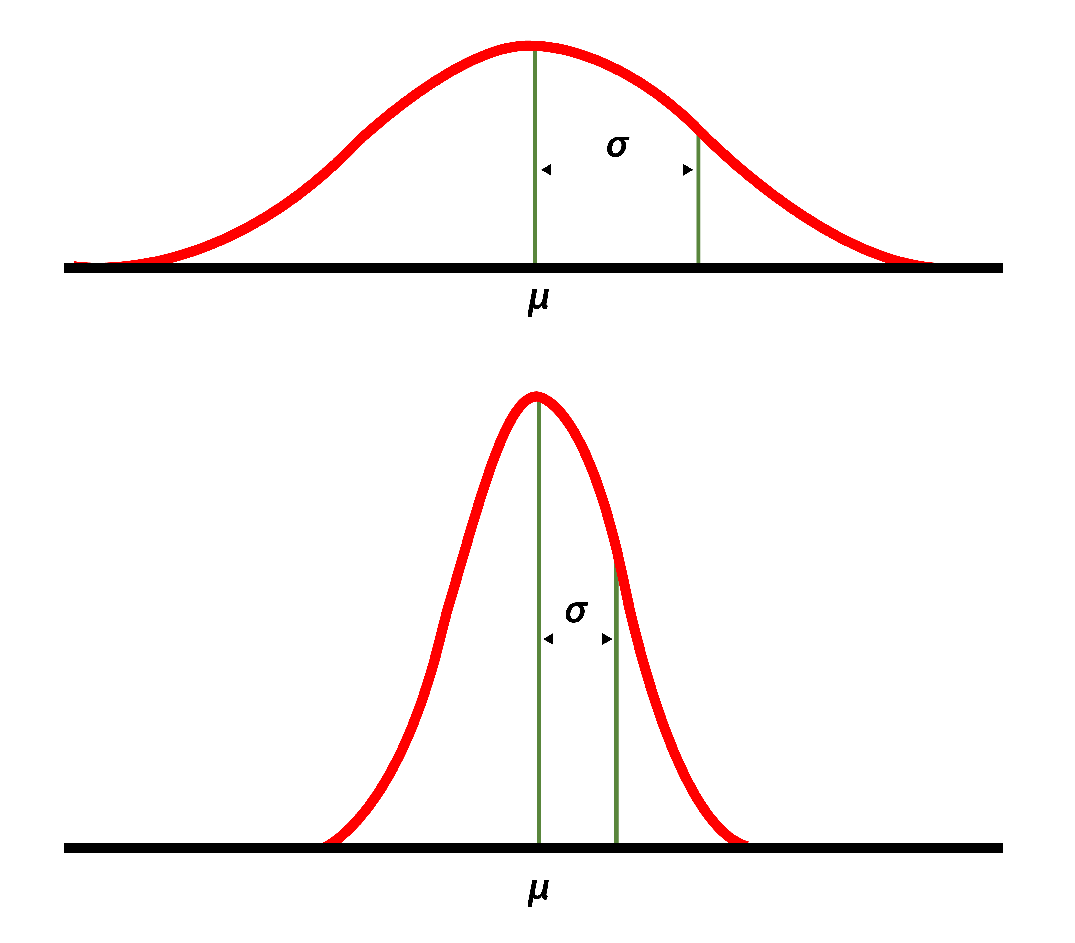
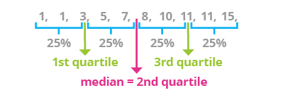
Range
difference between the lowest and highest value
Standard deviation
a summary measure of the differences of each observation from the mean
Quartiles
the first quartile at 25% (Q1),
the second quartile at 50% (Q2 or median),
and the third quartile at 75% (Q3)

Slide 31
Task!

Slide 32
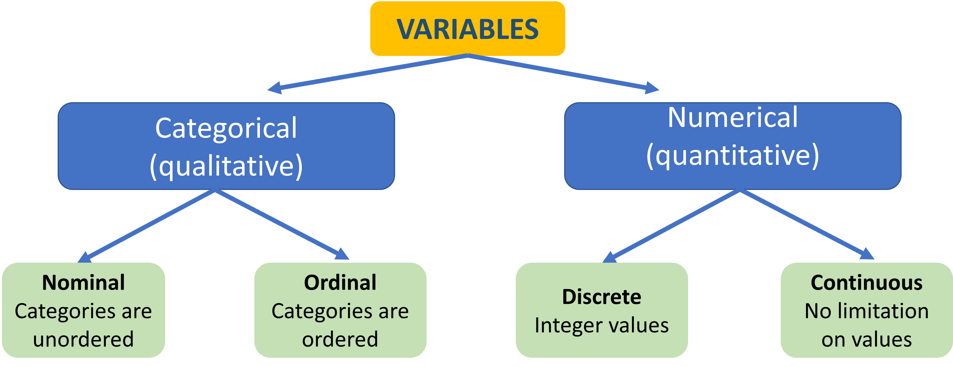
Summary
Statistics isn’t scary.
V
d
VARIABLES
characteristics of something or someone
CASES
something or someone

Slide 33
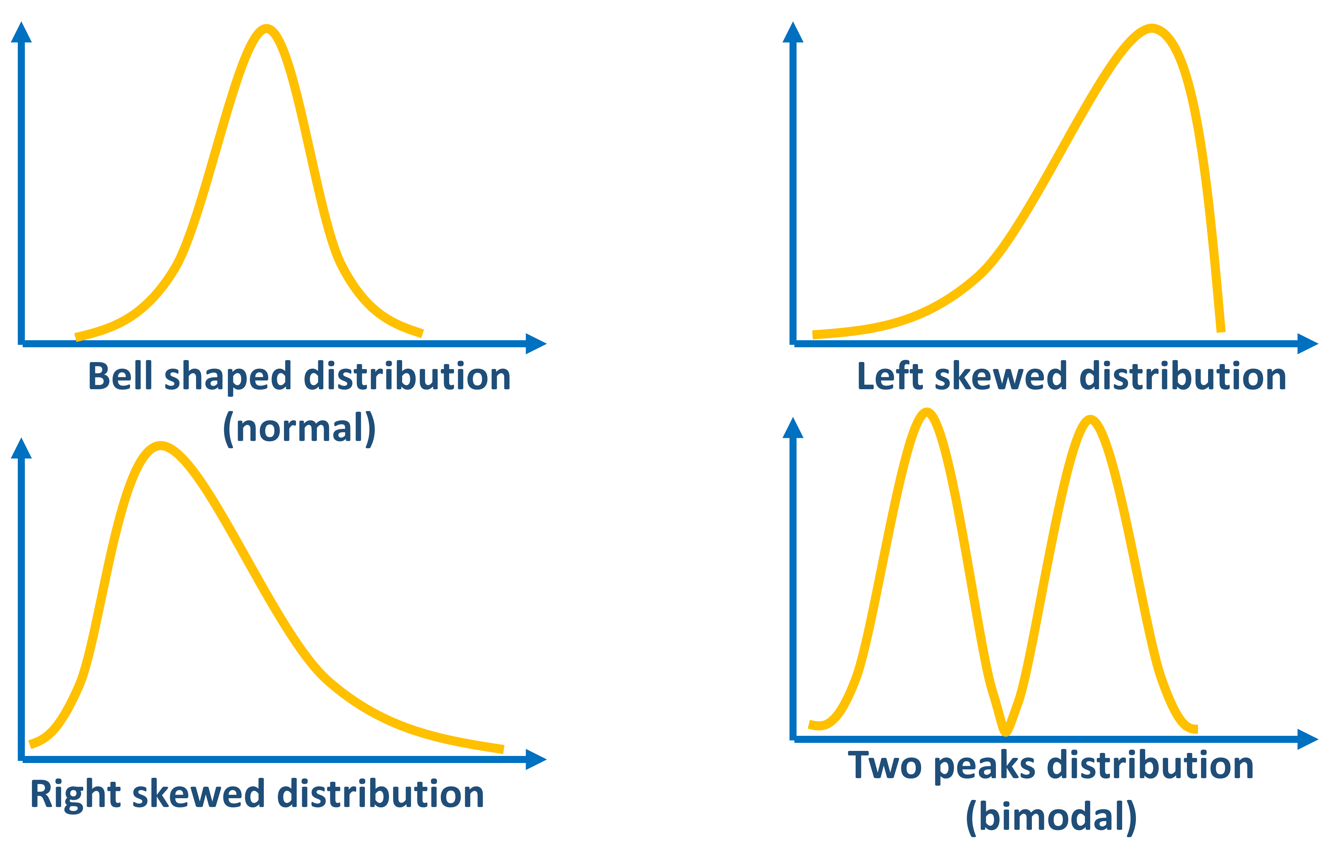
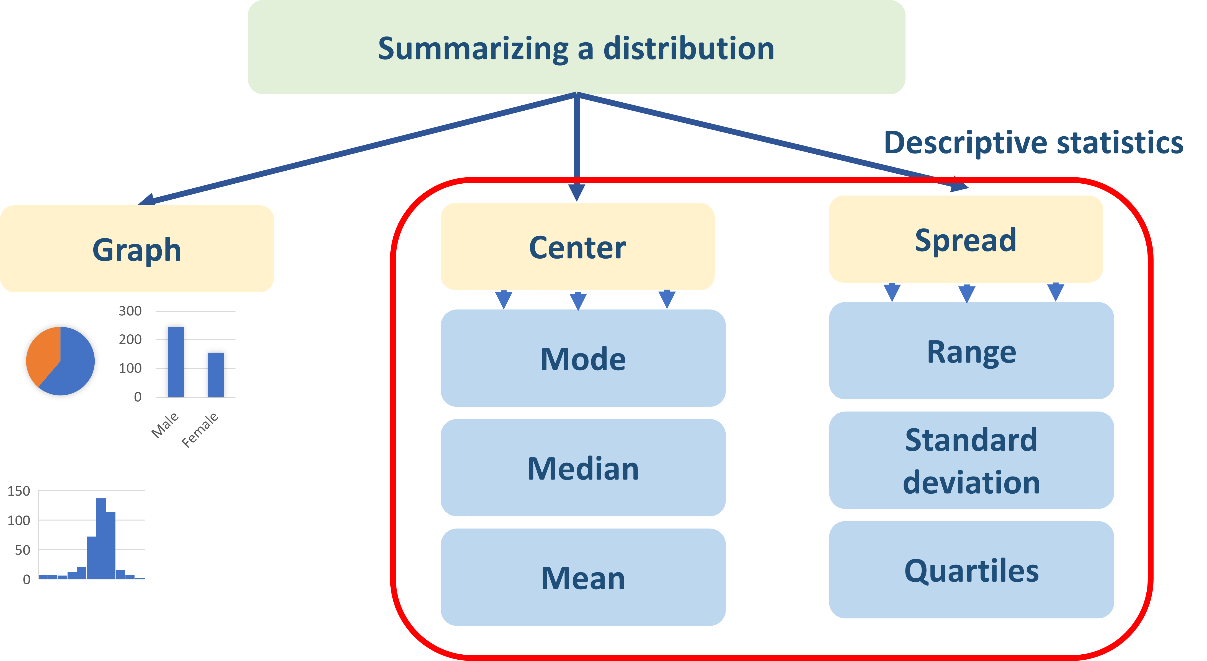
Summary
Pay attention to outliers!
In many cases the median is more appropriate because it isn't influenced by extremely large values.

Slide 34
Practical part

Slide 36
https://www.edx.org/course/data-science-r-basics?index=product_value_experiment_a&queryID=1de26ef0194dcba128f6259ed98186b7&position=1
https://www.coursera.org/learn/basic-statistics

Slide 37
https://www.datacamp.com/

Slide 38
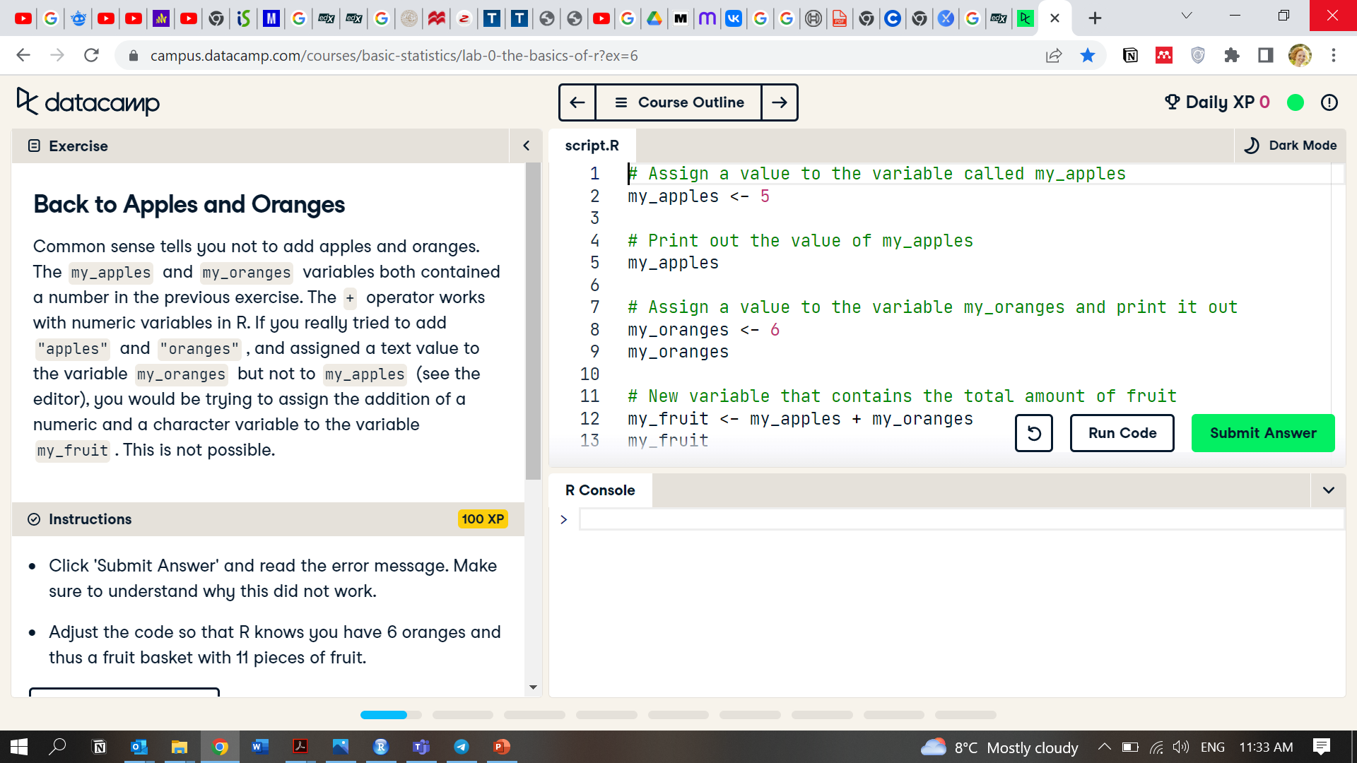

Slide 39
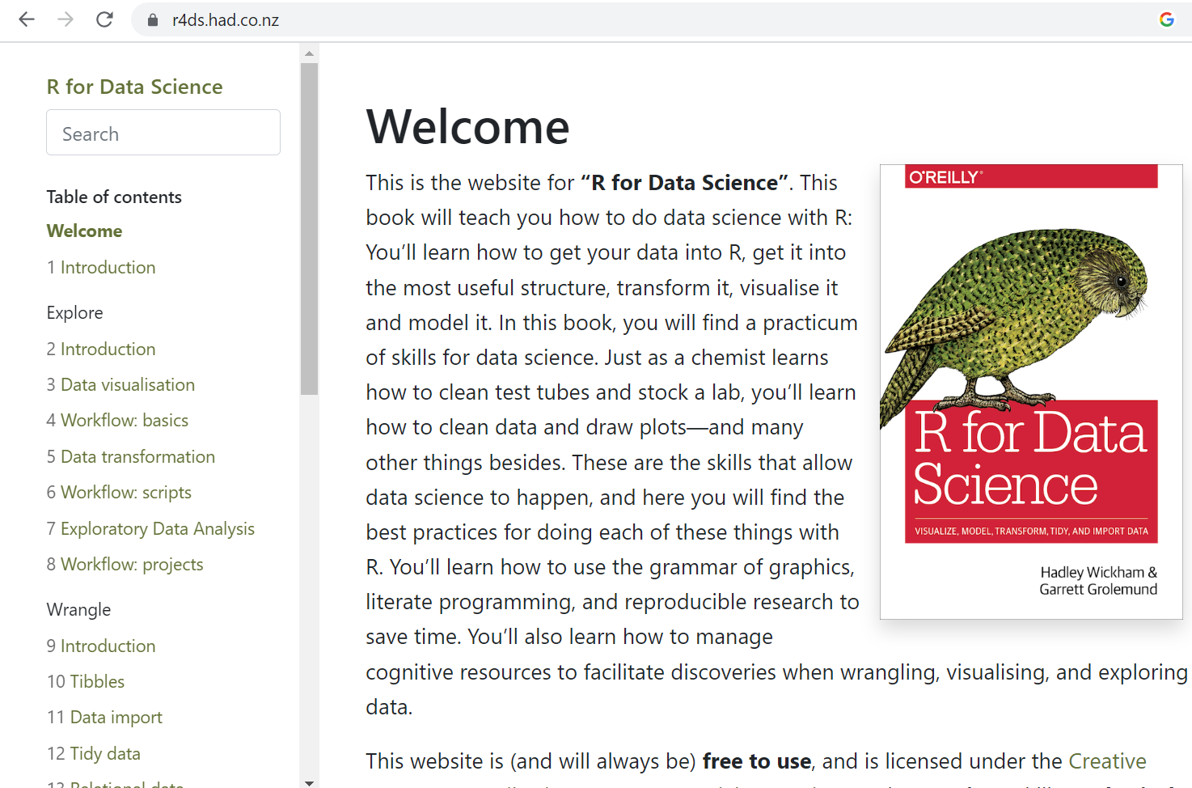
https://r4ds.had.co.nz/

Slide 41
https://docs.posit.co/ide/user/ide/guide/ui/ui-panes.html

