Slide 1
E0410 Fundamentals of Statistics for Scientific Data Using R
by Daria Sapunova, PhD student, RECETOX
daria.sapunova@recetox.muni.cz
Bohunice, D29, room 123

Slide 2
Theoretical part
Notes:
Mentimeter.com

Slide 3
The data is only for visual demonstration!
6 7 8 9 10 11 12 13 14 15 16 17 18 19 20 21 22 23

Slide 4
Weight (kg)
Height (cm)

Slide 5
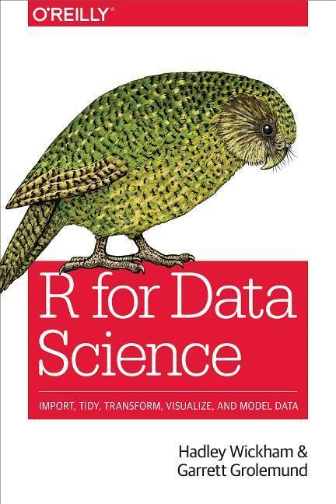
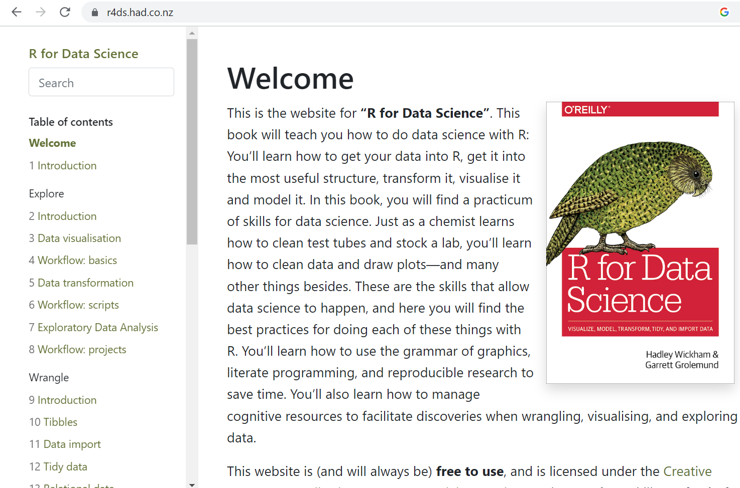
https://r4ds.had.co.nz/

Slide 6
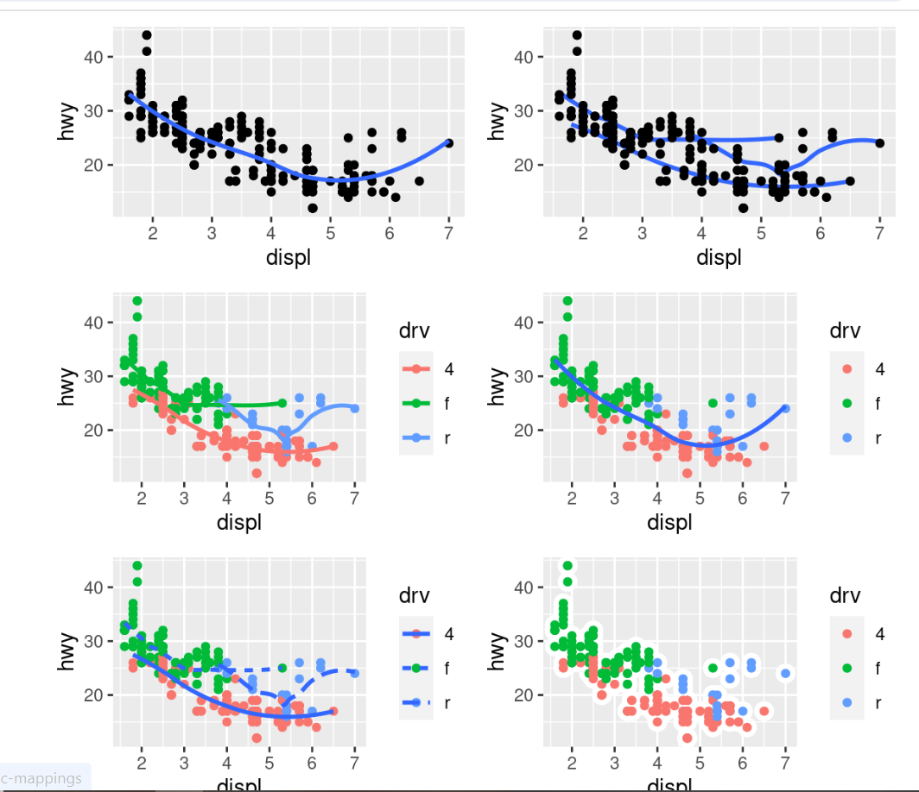
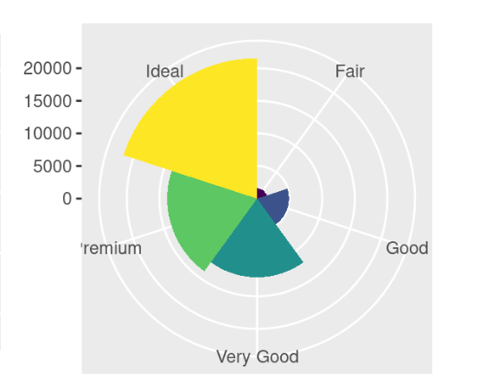
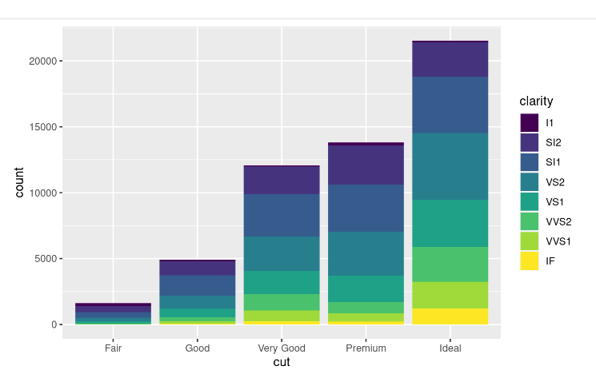

Slide 7
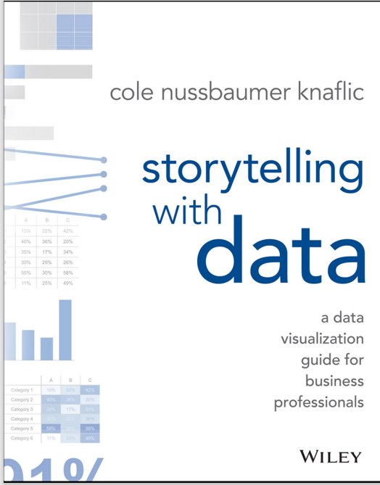
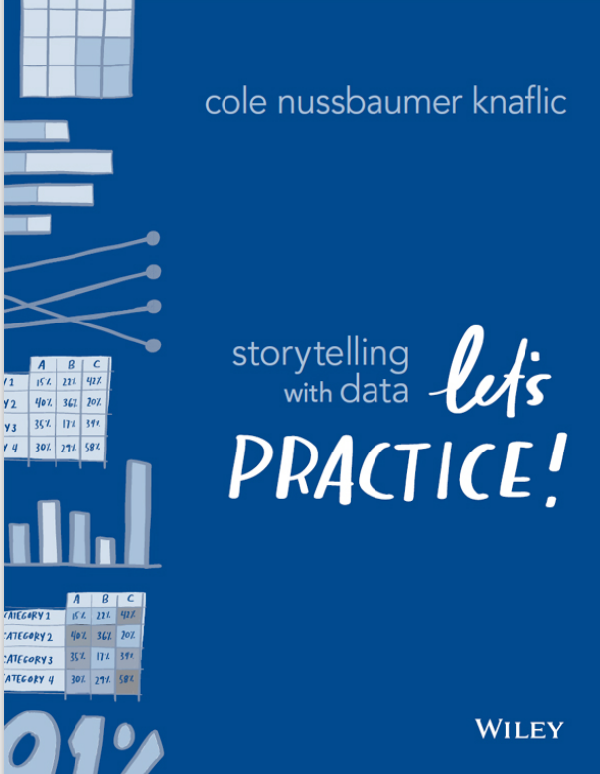

Slide 8
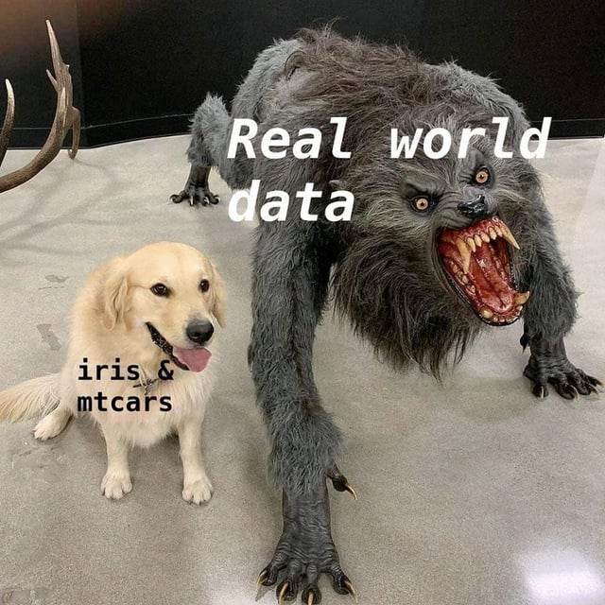

Slide 9
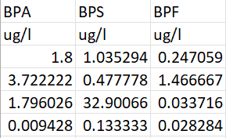
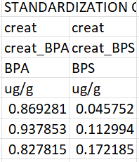
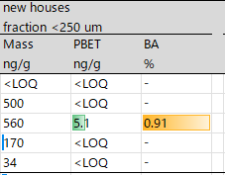
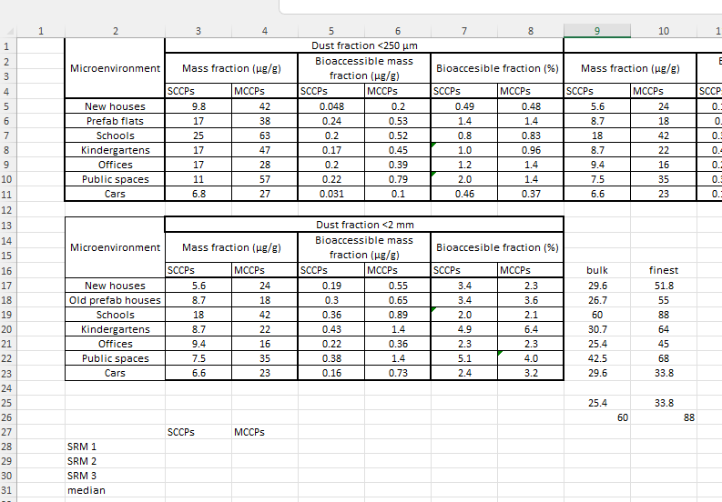
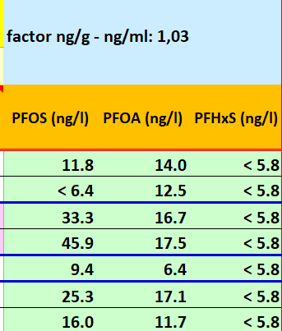
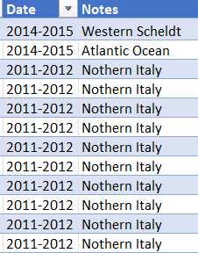
How your data should not look before importing into R
1.
5.
2.
3.
4.

Slide 10
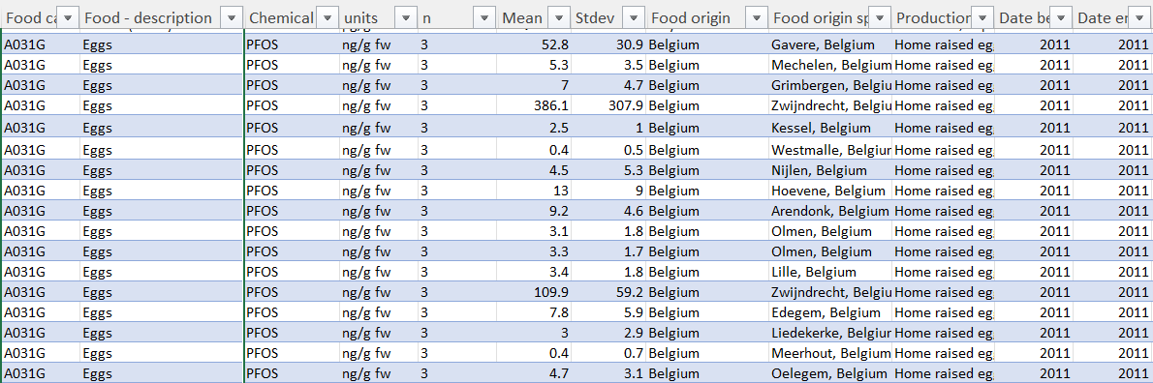
How your data should look before importing into R

Slide 11
How your data should look before importing into R
ID | Age | Gender | Height | Weight | Education | Freq.of fish consumption (times/month) | Source of fish (majority) | Chronical disease | Last med.exam. (years ago)
Person 1 | 45 | Male | 170.4 | 76.4 | PhD | 21 | Market | Diabetes | 10
Person 2 | 26 | Male | 168.3 | 65.3 | BS | 5 | Self-fishing | NA | NA
Person 3 | 54 | Female | 168.6 | 75.3 | MS | 23 | Grocery store | Bladder infection | 10
Person 4 | 65 | Male | 156.6 | 44.2 | MS | 10 | Market | Diabetes | 5
Person 5 | 21 | Female | 170.1 | 69.9 | HS | 8 | Market | No | NA
Person 6 … | 44 | Male | 176.4 | 84.3 | MS | 43 | Self-fishing | No | 2
Person 400 | 6 | Male | 121.2 | 21.9 | NA | 15 | Market | NA | 1

Slide 12
Data preparation –
cleaning, harmonizing and structuring
Upload your data.
Choose variables you are going to work with.
Inspect the variables (do descriptive statistics, check unique values, check data type, check amount of missing data).
Harmonize your variables (esp. categorical variables).
Structure your data.

Slide 13
Preliminary analysis
Build histograms in case of numerical variables.
Build box plots in case of categorical variables.
Build scatterplots to see associations between numerical variables.
Check data distributions in case of numerical variables (normality tests).
Transform the data if necessary.
You may proceed to the analysis

Slide 14

Task!

Slide 15
Data preparation –
cleaning, harmonizing and structuring
Structure your data.
Upload your data.
Choose variables you are going to work with.
Inspect the variables (do descriptive statistics, check unique values, check data type, check amount of missing data).
Harmonize your variables (esp. categorical variables).

Slide 16
Preliminary analysis
Build histograms in case of numerical variables.
Build box plots in case of categorical variables.
Build scatterplots to see associations between numerical variables.
Check data distributions in case of numerical variables (normality tests).
Transform the data if necessary.
You may proceed to the analysis

Slide 17
Practical part

