Slide 1
E0410 Fundamentals of Statistics for Scientific Data Using R
by Daria Sapunova, PhD student, RECETOX
daria.sapunova@recetox.muni.cz
Bohunice, D29, room 123

Slide 2
Theoretical part
Notes:
Mentimeter.com

Slide 3
Data preparation –
cleaning, harmonizing and structuring
Upload your data.
Choose variables you are going to work with.
Inspect the variables (do descriptive statistics, check unique values, check data type, check amount of missing data).
Harmonize your variables (esp. categorical variables).
Structure your data.

Slide 4
Preliminary analysis
Build histograms in case of numerical variables.
Build box plots in case of categorical variables.
Build scatterplots to see associations between numerical variables.
Check data distributions in case of numerical variables (normality tests).
Transform the data if necessary.
You may proceed to the analysis

Slide 5
Hypothesis testing
Question: Is there a difference in female and male heights?
Alternative hypothesis
(H1)
Null hypothesis (H0)
Hypothesis:
There is NO difference
Hypothesis:
There is a difference
What is the probability that there is no difference?
Reject H0, accept H1
The probability is low

Slide 6
Hypothesis testing
The probability is low…
alpha value (the threshold for
statistical significance)
0.01 0.02 0.03 0.04 0.05 0.06 0.07 … …1
Question: Is there a difference in female and male heights?
Null hypothesis (H0)
p-value
(probability value)
test
Alternative hypothesis (H1)

Slide 7
Hypothesis testing
The probability is low…
alpha value (the threshold for
statistical significance)
0.01 0.02 0.03 0.04 0.05 0.06 0.07 … …1
Question: Is there a difference in female and male heights?
Null hypothesis (H0)
test
p-value
(probability value)
Alternative hypothesis (H1)

Slide 8
Question: Is there a difference in female and male heights?
Null hypothesis (H0)
Alternative hypothesis
(H1)
Hypothesis:
There is NO difference
Hypothesis:
There is a difference
Test -> p-value (probability of H0)
p-value < 0.05
p-value >= 0.05
0.01 0.02 0.03 0.04 0.05 0.06 0.07 … …1
H0 (no difference)
H0 (no difference)
H1 (is difference)
H1 (is difference)

Slide 9
Task!

Slide 10
Question:?
Null hypothesis (H0)
Alternative hypothesis (H1)
p-value = 0.003

Slide 11
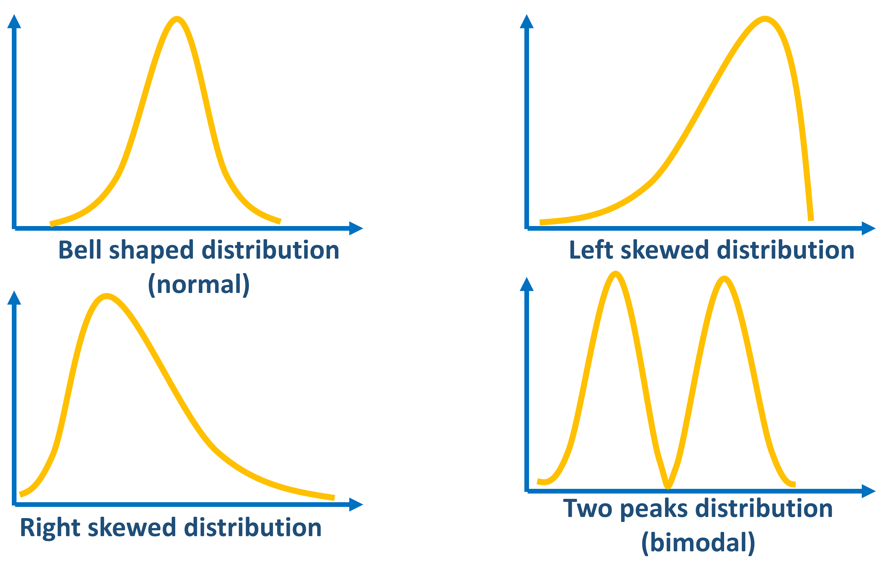
Normality tests
Kolmogorov-Smirnov Test
Shapiro-Wilk Test
Anderson-Darling Test
Null hypothesis (H0): The data is normally distributed
Alternative hypothesis (H1): The data is NOT normally distributed
NO normal distribution
Normal distribution
0.01 0.02 0.03 0.04 0.05 0.06 0.07 … …1

Slide 12
Normality tests
Shapiro-Wilk Test: The Shapiro-Wilk test is widely regarded as one of the most powerful normality tests. Developed in 1965 by Samuel S. Shapiro and Martin B. Wilk, it is specifically designed for small to moderate sample sizes. The test calculates a W statistic, which compares the observed data to the expected data if it follows a normal distribution. A small W value indicates that the data deviates significantly from a normal distribution. It is sensitive to deviations from normality in the tails of the distribution.
Kolmogorov-Smirnov Test: The Kolmogorov-Smirnov (K-S) test is a non-parametric test that compares the empirical distribution function of a dataset to a specified theoretical distribution, typically the normal distribution. The test calculates the maximum difference (D) between the two cumulative distribution functions. A large D value indicates a significant deviation from normality. One limitation of the K-S test is that it is less sensitive to deviations in the distribution’s tails.
Anderson-Darling Test: The Anderson-Darling test, developed by Theodore Anderson and Donald Darling in 1952, is another powerful normality test. Like the K-S test, it compares the empirical distribution function of a dataset to a specified theoretical distribution. Still, it places more weight on the distribution’s tails. This test calculates an A^2 statistic, with larger values indicating a greater deviation from normality.
In summary, while all three tests can be used to assess normality, they have different sensitivities and are suitable for different purposes and sample sizes. The Shapiro-Wilk test is often preferred for testing normality specifically, especially with smaller sample sizes, while the Kolmogorov-Smirnov and Anderson-Darling tests are more general and suitable for comparing any distribution to a theoretical distribution.
https://statisticseasily.com/normality-test/

Slide 13
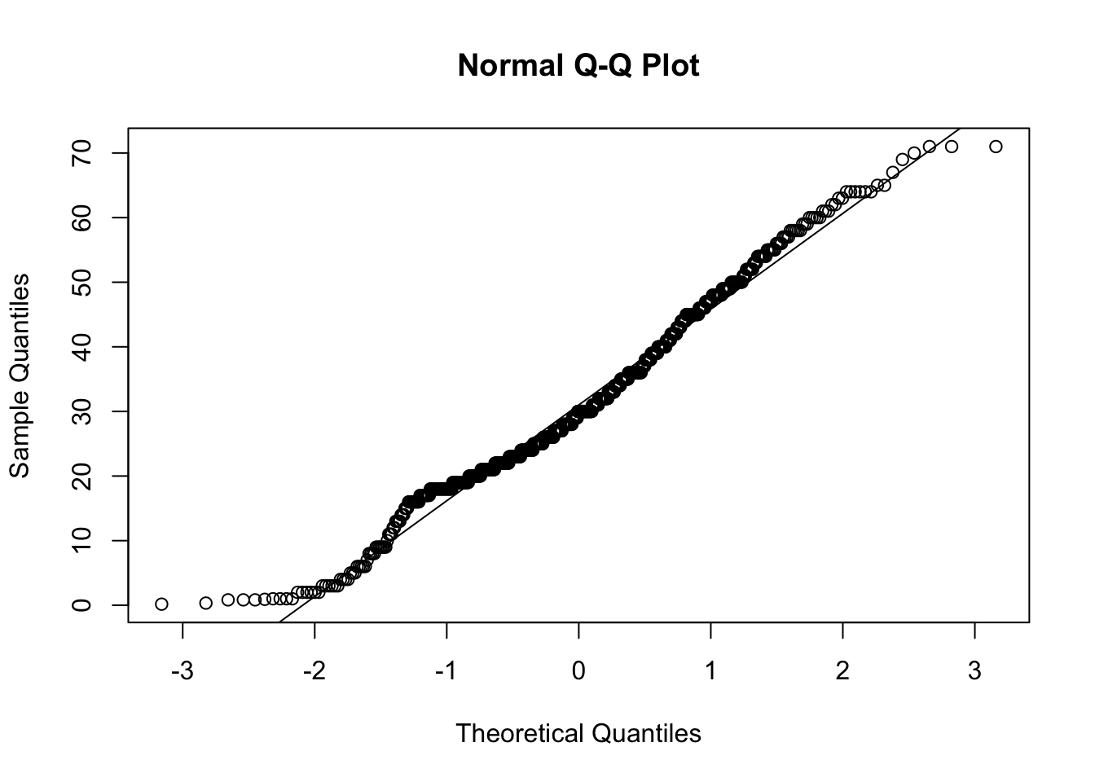
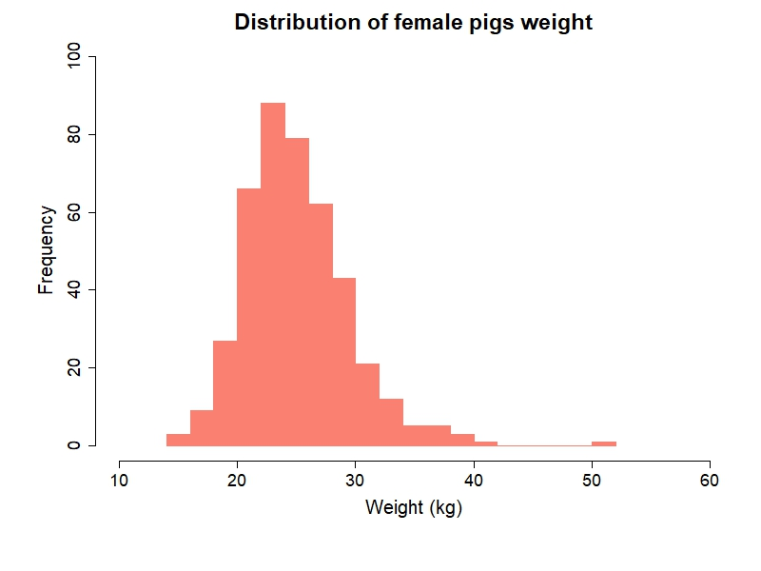
Normality tests
Kolmogorov-Smirnov Test
Shapiro-Wilk Test
Anderson-Darling Test
Analytical
Graphical
https://whitlockschluter3e.zoology.ubc.ca/Tutorials%20using%20R/R_tutorial_Normal_and_sample_means.html#:~:text=The%20QQ%20plot%20should%20follow,a%20QQ%20plot%20for%20you.

Slide 14
Normality tests: disadvantage
Depends on sample size: too large or too small sample size can bias the normality test result
Especially when your distribution is slightly deviates from the normal distribution!

Slide 15
Check data distributions in case of numerical variables (normality tests).
Analytical
Graphical
Kolmogorov-Smirnov Test
Shapiro-Wilk Test
Anderson-Darling Test

Slide 16
Data transformation:
to reach normal distribution
Transform the data if necessary.
Logarithmic Transformation
Square Root Transformation
Reciprocal Transformation
Box-Cox Transformation
Yeo-Johnson Transformation
Rank-Based Transformation
Arcsine Transformation
Johnson Transformation

Slide 17
Data transformation
Logarithmic Transformation
Logarithmic Transformation:
Logarithmic transformation is often applied to right skewed data.
It is particularly useful for data that exhibit exponential growth patterns.
Common transformations include natural logarithm (ln) or base-10 logarithm.
Artificial intelligence tools were used for generating descriptions of the data transformation types.

Slide 18
Data transformation:
Logarithmic Transformation
Our data we want to transform
New values of transformed data
Base,
we will use 10
https://medium.com/@kyawsawhtoon/log-transformation-purpose-and-interpretation-9444b4b049c9

Slide 19
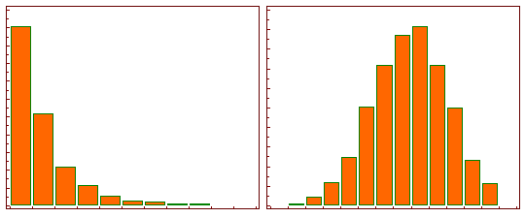
Data transformation:
Logarithmic Transformation
https://medium.com/@kyawsawhtoon/log-transformation-purpose-and-interpretation-9444b4b049c9

Slide 20
Practical part

