Slide 1
Computational Material Science
Karsten Held, Jan Kunes
TU Wien

Slide 2
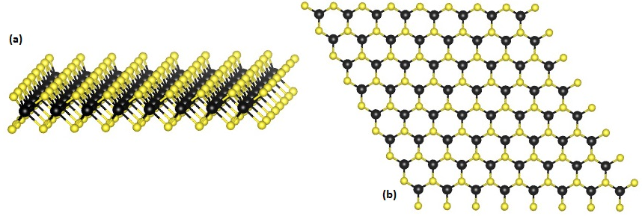
Bloch wave function - what is it?
In most 'real life' cases, the wave functions are hidden somewhere in the memory of our computer. However, looking at their shape sometimes can provide a better intuition about 'how the theory actually works'.
This is such an example.
Transition metal dichalcogenides (e.g. MoS2):
source Wikipedia

Slide 3


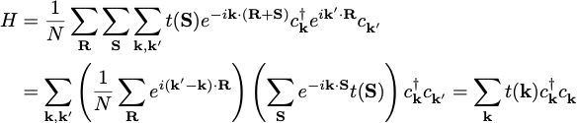
Bloch theorem for lattice models
periodicity
lattice site coincides with the unit cell
(not the most general case)
Unitary transformation (very common trick for periodic systems):

Slide 4

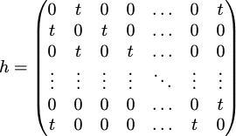
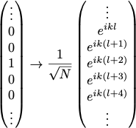

Example: 1D chain with nn hopping
Hopping matrix (Hamiltonian):
Basis transformation:
Dispersion:
Diagonalize h directly for N=3. What eigenstates do you get?
Generalize the problem for square and cubic lattices.

Slide 5
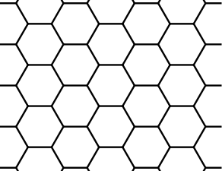

Example: Honeycomb lattice
(-1,0)
b
(0,1)
Type to enter text
(0,0)
(0,-1)
(1,0)
a
After FT:

Slide 6

Example: Honeycomb lattice
After FT:
At each k-point k=(ka,kb) we have a 2x2 matrix to diagonalize:
Finally we get the dispersion relation:

Slide 7
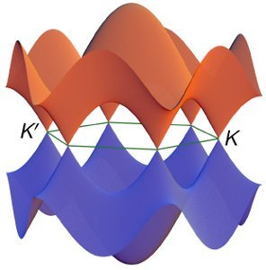
Example: Honeycomb lattice
After FT:
At each k-point k=(ka,kb) we have a 2x2 matrix to diagonalize:
Finally we get the dispersion relation:

Slide 8



Transition metal dichalcogenides (TMDs)
(-1,0)
b
(0,1)
Type to enter text
(0,0)
(0,-1)
(1,0)
a
At K and K' the off-diagonal element vanishes:
How does the wave function at K look?

Slide 9



Wave function at K
b
Type to enter text
a
How does the wave function at K look?

Slide 10
Gb
b
Are different K points equivalent?
a
Ga
Type to enter text

Slide 11
Gb
b
a
Ga
Type to enter text

Slide 12

Gb
b
a
Ga
Type to enter text

Slide 13

Gb
b
a
Ga
Type to enter text

Slide 14

Wave function at K'
Type to enter text
How does the wave function at K look?

Slide 15

Wave function at K'
Type to enter text
How does the wave function at K look?

Slide 16

Is this an eigenstate?
H
=
0
Σ

Slide 17
Are function at K and K' mutually orthogonal?
*
Σ
Type to enter text
.
sites
How does the wave function at K look?

Slide 18
Are function at K and K' mutually orthogonal?
Σ
.
sites
=
Σ
=
0
Type to enter text
sites
How does the wave function at K look?

Slide 19
Linear superposition of |K > and |K'>?
+
Type to enter text
=
Type to enter text
How does the wave function at K look?

Slide 20


Optical transitions (at K)
Type to enter text
Type to enter text
Peierls substitution:
or
light
A is related to the vector potential of the elmag. field

Slide 21
Optical transitions (at K)
Type to enter text
Type to enter text
When driven by external field electron picks a direction dependent phase on any given bond:
Peierls substitution:
A is related to the vector potential of the elmag. field
y
x

Slide 22

Optical transitions (at K)
Type to enter text
Type to enter text
When driven by external field electron picks a direction dependent phase on any given bond:
Peierls substitution:
A is related to the vector potential of the elmag. field
y
x

Slide 23

Optical transitions (at K)
Type to enter text
Type to enter text
Type to enter text
When driven by external field electron picks a direction dependent phase on any given bond:
Peierls substitution:
A is related to the vector potential of the elmag. field
y
x

Slide 24

Optical transitions (at K)
Type to enter text
Type to enter text
When driven by external field electron picks a direction dependent phase on any given bond:
Peierls substitution:
A is related to the vector potential of the elmag. field
y
x

Slide 25
Optical transitions (at K and K')
Type to enter text
Type to enter text
circular polarization:
excites optical transition at K
does not excite optical transition at K
You can show that at K' the role of circular polarizations is exchanged.
=> You can choose the valley K or K' by using a circularly polarized light.

Slide 26
Summary
Continuous and lattice models of solids
Translational symmetry (unit cell, basis vectors)
Bloch theorem
Simple lattice models and their diagonalization
Density of states its calculation
Next time
Basics of the density functional theory

Slide 27
Project no. 1
Calculate the band structure and density of states for 2D Kagome and 3D pyrochlore lattices.
Are there any bands with special properties?
How does the the band structure change when we add a sublattice site potentials?

