Slide 1
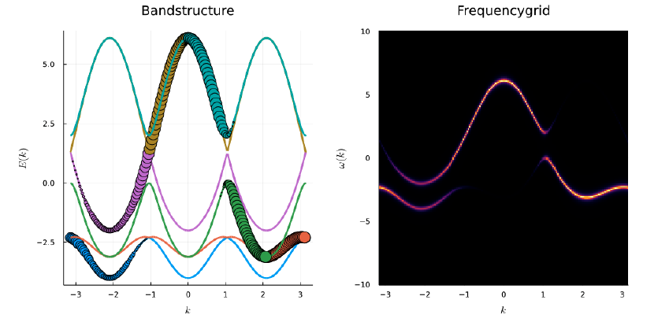
Unfolding of bandstructres

Slide 2
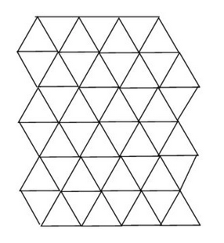
An alloy on triangular lattice
generate random binary potential
in the supercell
How to average over different realizations of the disorder?
How to get a 'bandstructure' in the elementary (1-atom) unit cell?

Slide 3
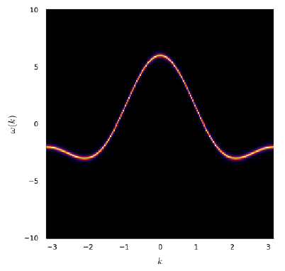
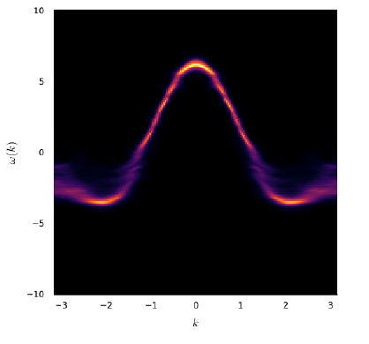
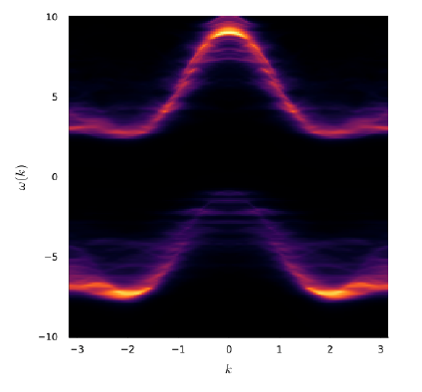
Brute force approach - many realizations of disorder
no disorder
weak disorder
strong disorder

Slide 4

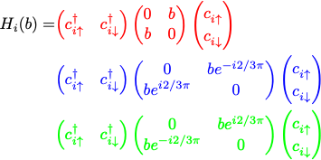
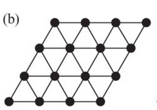
120 deg order on triangular lattice
Calculate the band dispersion and density of states for a triangular lattices with 120 def spin order. Consider non-interacting electrons on triangular lattice (calculate the band dispersion and density of states). Add a local exchange field which has a direction as indicated in the picture.
Hint: Use the enlarged unit cell indicated in the figure. Note that the local term depend on the lattice site (sublattice) and mixes the up and down spin directions (i.e. spin is not a good quantum number). Use t=1 and several different values of b (starting from 0).

Slide 5
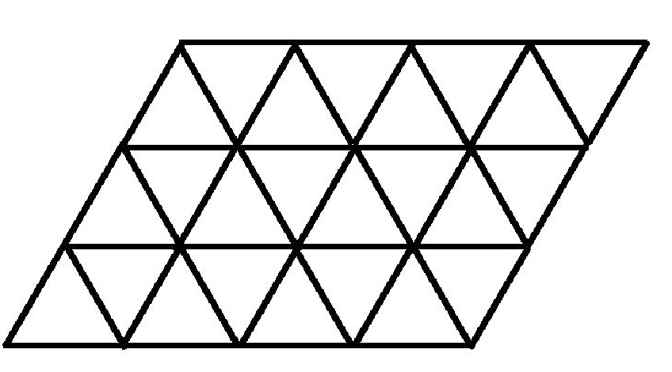
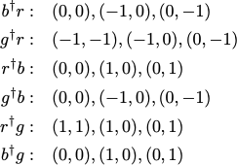



Tight-binding Hamiltonian
(0,1)
b2
(0,1)
(1,1)
(0,0)
(1,1)
(0,0)
(1,0)
b1
a2
Type to enter text
(1,0)
a1
hopping
local fields in xy-plane
total 6x6 structure

Slide 6
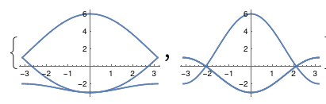
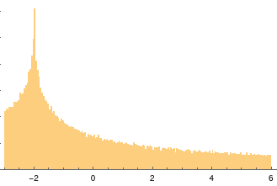
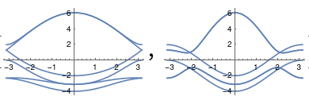
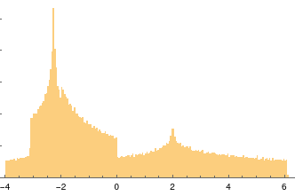
Bandstructure (3-site unit cell)
b2
b1
k=(x,0)
k=(x,-x)
Density of states
b=0
b=1

Slide 7
Bandstructure (3-site unit cell)
b2
b1
k=(x,0)
k=(x,-x)
Density of states
How to go back to 1-band (= 1 atom unit cell)?
b=0
b=1

Slide 8

Bandstructure (3-site unit cell)
b2
b1
k=(x,0)
k=(x,-x)
Density of states
How to go back to 1-band (= 1 atom unit cell)?
b=0
Chose the right quantity!
Dispersion is too 'narrow'.
Spectral function
b=1

Slide 9
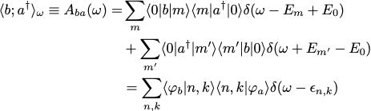


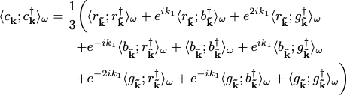
Spectral function
many-body (general) formalism
non-interacting electrons (1p functions)
k-diagonal elements of object, which has also off-diagonal (kk') elements

Slide 10






Going between different cells
(0,1)
(1,1)
b2
a2
(0,0)
(1,0)
Type to enter text
b1
a1

Slide 11


Going between different cells
(0,1)
(1,1)
b2
a2
(0,0)
(1,0)
Type to enter text
b1
a1

Slide 12


Going between different cells
(0,1)
(1,1)
b2
a2
(0,0)
(1,0)
Type to enter text
b1
a1

Slide 13


Going between different cells
(0,1)
(1,1)
b2
a2
(0,0)
(1,0)
Type to enter text
b1
a1

Slide 14
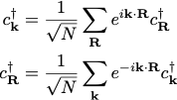
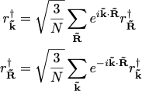
Going between different cells
(0,1)
(1,1)
b2
a2
(0,0)
(1,0)
Type to enter text
b1
a1

Slide 15
Going between different cells
(0,1)
(1,1)
b2
a2
(0,0)
(1,0)
Type to enter text
b1
a1
No reference to Hamiltonian
(lattice dimension) needed in principle

Slide 16




Going between different cells
(0,1)
(1,1)
b2
a2
(0,0)
(1,0)
Type to enter text
a1
b1

Slide 17
Going between different cells
(0,1)
(1,1)
b2
a2
(0,0)
(1,0)
Type to enter text
a1
b1
Strictly speaking we are working with covariant and contravariant tensors:

Slide 18
Spectral function
many-body (general) formalism
non-interacting electrons (1p functions)
k-diagonal elements of object, which has also off-diagonal (kk') elements

Slide 19
Spectral function
many-body (general) formalism
non-interacting electrons (1p functions)
k-diagonal elements of object, which has also off-diagonal (kk') elements

Slide 20
Bandstructure (3-site unit cell)
k=(x,0)
k=(x,-x)
Density of states
b=0
b=1

Slide 21
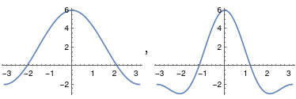
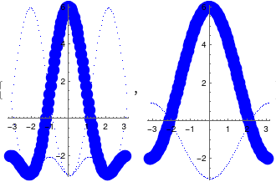
Bandstructure (1-site unit cell)
a2
Type to enter text
a1
b=0
k=(x,x)
k=(x,0)
Density of states
1-site cell
3-site cell
unfolded

Slide 22
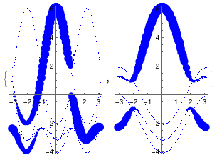
Bandstructure (1-site unit cell)
a2
Type to enter text
a1
Density of states
b=0
b=1

Slide 23
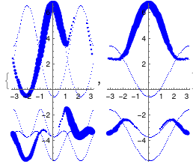
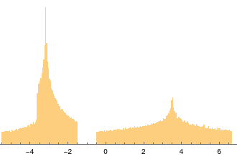
Bandstructure (1-site unit cell)
a2
Type to enter text
a1
Density of states
b=0
b=2.5

Slide 24
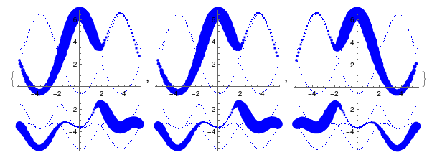
Symmetry and asymmetry (1-site unit cell)
k-space:
Type to enter text
b=2.5

Slide 25
Brillouin zone folding
basis vectors:
k-vectors coordinates:
1-atom unit cell:
a2
Type to enter text
a1
The reciprocal lattice is also triangular

Slide 26
Brillouin zone folding
basis vectors:
k-vectors coordinates:
1-atom unit cell:
(k-space)
a2
Type to enter text
Type to enter text
a1
Brillouin zone

Slide 27
Brillouin zone folding
basis vectors:
k-vectors coordinates:
1-atom unit cell:
(k-space)
3-atom unit cell (k-space):
a2
Type to enter text
Type to enter text
a1
Brillouin zone
The small BZ is 1/3 of the large BZ.
3-atom unit cell (lattice):

Slide 28
Brillouin zone folding
basis vectors:
k-vectors coordinates:
1-atom unit cell:
(k-space)
3-atom unit cell (k-space):
a2
Type to enter text
Type to enter text
a1
Brillouin zone
For each point in the small (blue) BZ there are 3 points in the large BZ.
Band folding: 1 -> 3 bands
Band unfolding: 3 bands (+ off diagonal elements) @ k-point in small BZ
-> 3 k-points in large BZ

Slide 29
An alloy on triangular lattice
generate random binary potential
in the supercell
How to average over different realizations of the disorder?
How to get a 'bandstructure' in the elementary (1-atom) unit cell?

Slide 30
Brute force approach - many realizations of disorder
no disorder
weak disorder
strong disorder

Slide 31
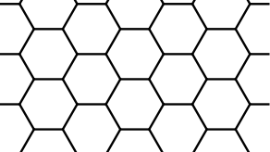
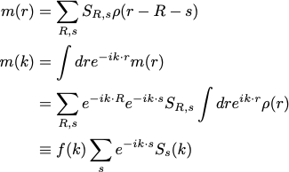
Lattice <-> continuum (theo <-> exp)
Lattice models 'live' on k-space torus <-> materials live in non-compact k-space ?
Bring in the structure of the underlying orbitals.
A: s=(2/3,1/3)
B: s=(1/3,2/3)
(0,-1)
a
b
(-1,0)
(0,0)
(1,0)
A
B
(0,1)

Slide 32
Lattice <-> continuum (theo <-> exp)
Lattice models 'live' on k-space torus <-> materials live in non-compact k-space ?
The model correlation functions capture long wavelength behavior (k inside the 1st BZ).
The matrix elements encode the short wavelength behavior (variation between BZs).
A: s=(2/3,1/3)
B: s=(1/3,2/3)
(0,-1)
a
b
(-1,0)
(0,0)
(1,0)
A
B
(0,1)

