Slide 1
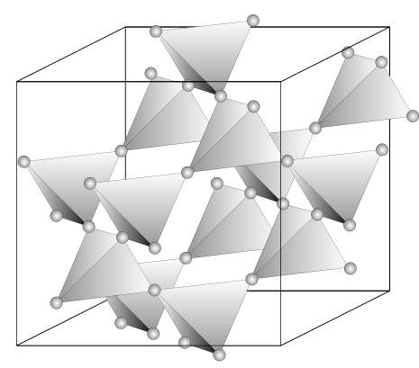
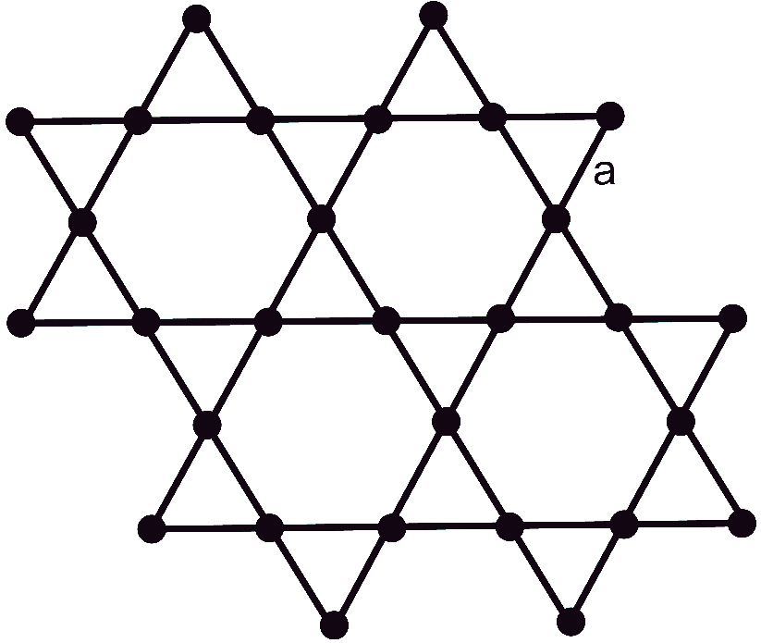
Kagome and pyrochlore lattice
Calculate the band dispersion and the density of states for the Kagome and pyrochlore lattices. We assume that there is one orbital on each lattice site and the site energy is 0. The hopping amplitude between nearest neighbors is t=1 and 0 between any further neighbors, i.e. hopping take place only of the marked bonds in the lattice.
Add a site potential. On the red sublattice ad a site potential E and plot the bandstructures for values E = 0, 0.2, 0.4, 0.6, and 8.
Hint: Identify the periodic lattice and its unit cell, perform the Fourier transformation, solve the eigenvalue problem for each k-vector. To calculate DOS for a uniform k-mesh in the primitive cell of reciprocal lattice and compute a histogram of the eigenenergies arising on this mesh. Use a finer mesh for smoother DOS.
kagome lattice (2D)
pyrochlore lattice (3D)

Slide 2
Intercalated Kagome lattice
Calculate the band dispersion and density of states for the lattices in the picture. There are two distinct lattice sites with energies Ea (black) and Eb (red) and two hopping amplitudes t (full) and t’ (dotted). Perform the calculation
for
Ea = Eb and t=t’
Ea = Eb and t=2t’=1
Ea = 2t+Eb and t=2t’=1
Hint: Identify the periodic lattice and its unit cell, perform the Fourier transformation, solve the eigenvalue problem for each k-vector. To calculate DOS for a uniform k-mesh in the primitive cell of reciprocal lattice and compute a histogram of the eigenenergies arising on this mesh. Use a finer mesh for smoother DOS.

Slide 3

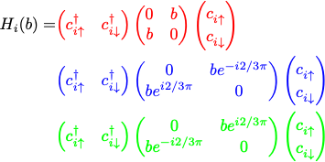
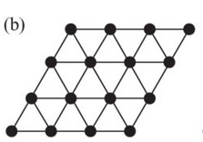
120 deg order on triangular lattice
Calculate the band dispersion and density of states for a triangular lattices with 120 def spin order. Consider non-interacting electrons on triangular lattice (calculate the band dispersion and density of states). Add a local exchange field which has a direction as indicated in the picture.
Hint: Use the enlarged unit cell indicated in the figure. Note that the local term depend on the lattice site (sublattice) and mixes the up and down spin directions (i.e. spin is not a good quantum number). Use t=1 and several different values of b (starting from 0).

Slide 4

Fermions vs hard-core bosons
Calculate and compare the spectra of non-interacting spinless fermions and had-core bosons on a hexagon
and 3x3 square lattice with periodic boundary conditions. For hexagon consider the nearest-neighbor (nn) hopping t=1 and next-neighbor hopping t’=0 and t’=t. For the 3x3 lattice consider only nn hopping. Study all possible charge sectors, i.e., N=0,1,….,6 (or up to 9). Hard-core boson obey bosonic anti-commutation relations:
t
t’
Hint: The Hilbert space of hard-core bosons is isomorphic to the Hilbert space of fermions (site double occupancy is forbidden). The fermionic and ‘bosonic’ Hamiltonian in occupation-number basis has the same zeros, but possibly different signs of the non-zero terms.

Slide 5

Heisenberg ring
Study the S=1/2 and S=1 Heisenberg model on the 5-ring and 6-ring using exact diagonalization. Calculate the spin-spin correlation function as a function of temperature T.
Show that the correlations are isotropic, i.e.,
Hint: There are two and three states per site for S=1/2 and S=1, respectively. The scalar product S.S can be represented using raising and lowering operators S⁺, S⁻ and S^{z}. Make sure to use the correct values of the matrix elements. Note that one can set J=1, since only the ratio T/J matters.

Slide 6
Hubbard ring with nn interaction
Study 6-site Hubbard model with nn interaction. Calculate the spin-spin and charge-charge correlation functions (1st, 2nd and 3rd neighbors) as a function of temperature (assume canonical ensemble). Perform the calculation for 3 and 4 electrons. Use parameters t=1, U=1 and V=0, 1, and 2.
Hint: You can use the notebooks provided with the course.

Slide 7
Heisenberg model on triangular cluster
Study the ground state S=1/2 Heisenberg model on the 9-site cluster below. Calculate the spin-spin correlation function for various pairs of sites. Determine the total spin moment S of the ground state.
Show that the correlations are isotropic, i.e.,
Hint: The exercise is analogy of the Heisenberg ring (the difference is only connectivity of the lattice). Check the solution for FM coupling (J<0), what is the expected ground state energy and its degeneracy (use this as a benchmark for the correctness of your set-up). The actually interesting case is the AFM coupling (J>0).
1
2
3
1
7
8
9
7
4
5
6
4
1
2
3
1

Slide 8


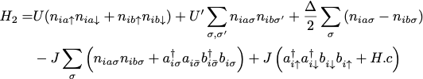
2-orbital Hubbard model
Study the Hubbard 4-ring built from 2-orbital atoms. Calculate the spectrum the eigenstates of the problem in the 5 and 6 electron sector. Calculate the spin-spin correlation function S in the ground state (states in case of degeneracy)
for J from J=0 to J=1. Extend the calculation to a finite temperature and calculate S(J=0.2) for temperatures from T=0.01 to T=1. (t=1, t'=0.1, U=4, U’=U-2J, J’=J, Δ=2)
t
a
Atomic Hamiltonian:
b
t'
Hint: Diagonalize the different Sz sector separately. Note that total numbers of a and b electrons are conserved. You can use the routines H1gen and H2gen of modules.jl Represent the results as graphs Ei vs J, S vs J, S vs T

