Slide 1
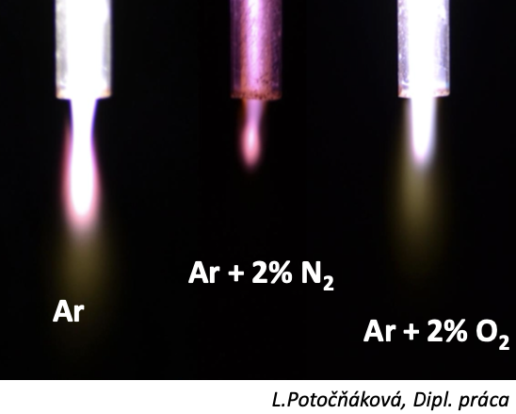
Plasma Physics 2
Lesson 05: High frequency discharges
Notes:
Vylepsit …

Slide 2
Lecture series contents
Townsend breakdown theory, Paschen‘s law
Glow discharge
Electric arc at low and high pressures
Magnetized low-pressure plasmas and their role in material deposition methods.
Brief introduction to high-frequency discharges
Streamer breakdown theory, corona discharge, spark discharge
Barrier discharges
Leader discharge mechanism, ionization and discharges in planetary atmospherres
Discharges in liquids, complex and quantum plasmas
Thermonuclear fusion, Lawson criterion, magnetic confinement systems, plasma heating and intertial confinement fusion.
1
Notes:
Pozor je to pro verejnost … jednoduseji, schemata nazorna, ne moc analyz, jen par rovnic

Slide 3
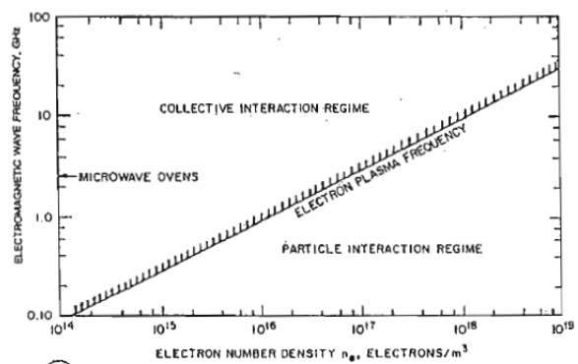
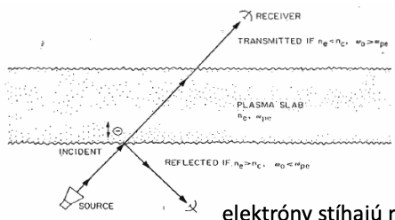
High frequency discharges
enable plasma discharge even for non-conductive electrodes
electron plasma frequency
numerically
varieties: - MHz = RF plasma, ohřev plazmy posuvným proudem - capacitively coupled plasma – collisionall and collisionless heating, can run at very low pressures - inductively coupled plasma – heating on the plasma surface or in plasma volume - GHz = microwave discharges, surface wave heating or volume heating
electrons do have enough time to react to the external electric field!
2
Notes:
Pozor je to pro verejnost … jednoduseji, schemata nazorna, ne moc analyz, jen par rovnic

Slide 4
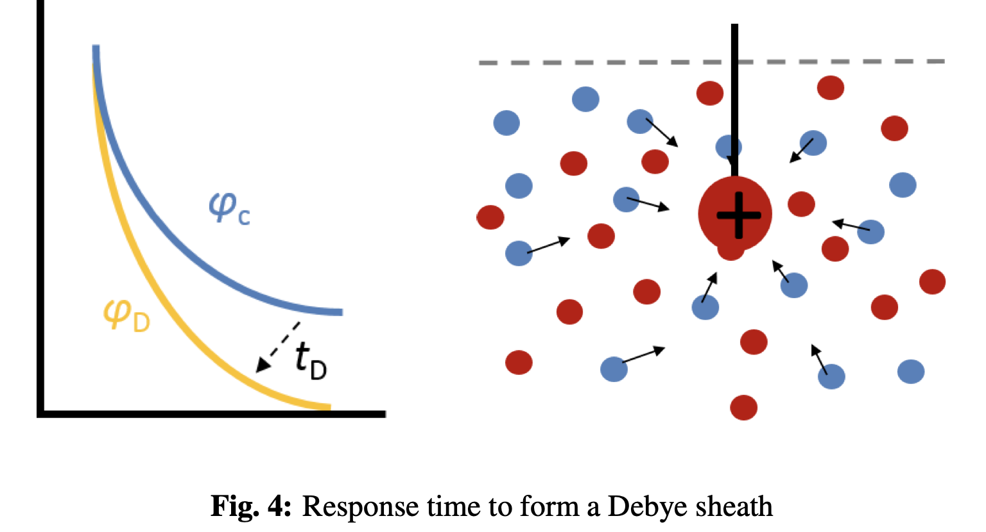
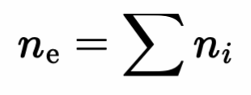
High frequency discharges
enable plasma discharge even for non-conductive electrodes
electron plasma frequency
numerically
2a
Notes:
Pozor je to pro verejnost … jednoduseji, schemata nazorna, ne moc analyz, jen par rovnic

Slide 5
High frequency breakdown

Slide 6
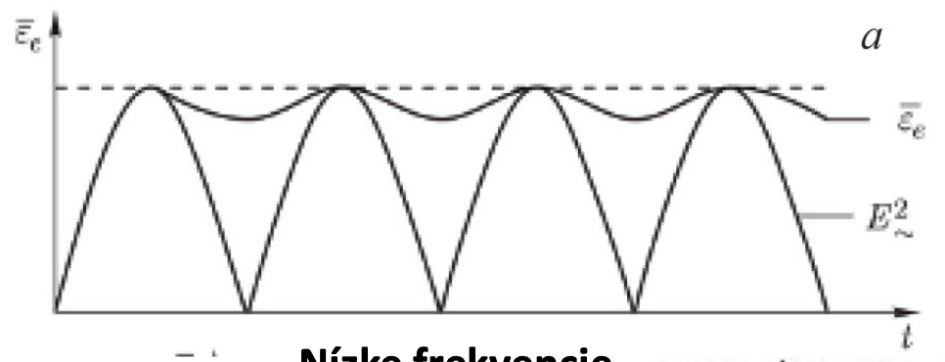
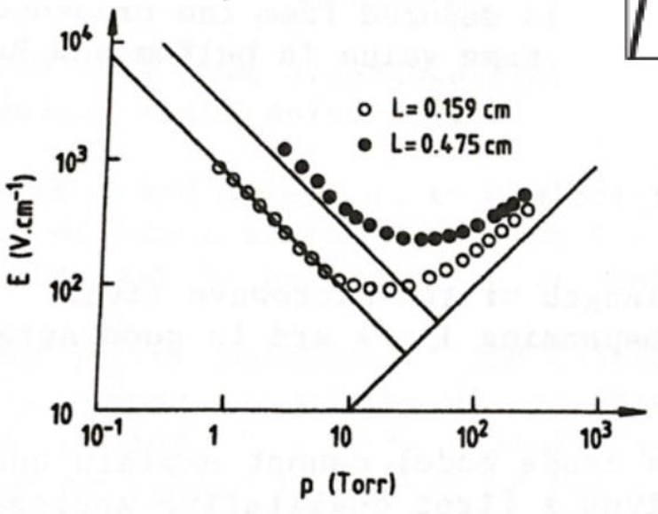
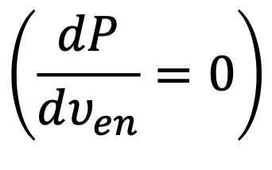
High frequency breakdown
At about 100 kHz, the time that the electron needs to transfer between the electrodes starts to be comparable with the period of the external electric field. The electron avalanche does not reach the electrode and it reverses direction!
electron heating in the external field is given as:
The optimum power is reached when:
Mean electron energy
External electric field
Low frequencies
3
Notes:
Pozor je to pro verejnost … jednoduseji, schemata nazorna, ne moc analyz, jen par rovnic

Slide 7
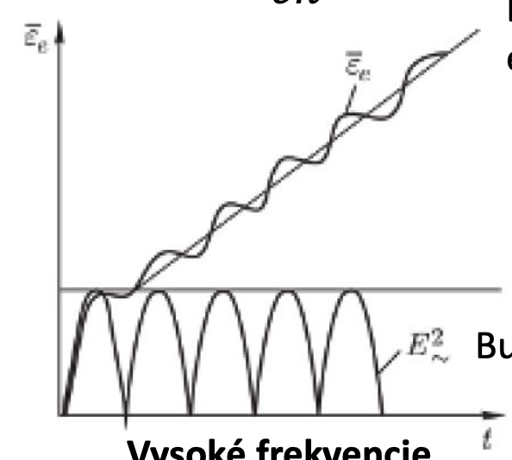
High frequency breakdown
At about 100 kHz, the time that the electron needs to transfer between the electrodes starts to be comparable with the period of the external electric field. The electron avalanche does not reach the electrode and it reverses direction!
electron heating in the external field is given as:
The optimum power
Mean electron energy (prior to multiplication)
Mean electron energy
External electric field
nízké frekvence
External E field
High frequency
3a
Notes:
Pozor je to pro verejnost … jednoduseji, schemata nazorna, ne moc analyz, jen par rovnic

Slide 8
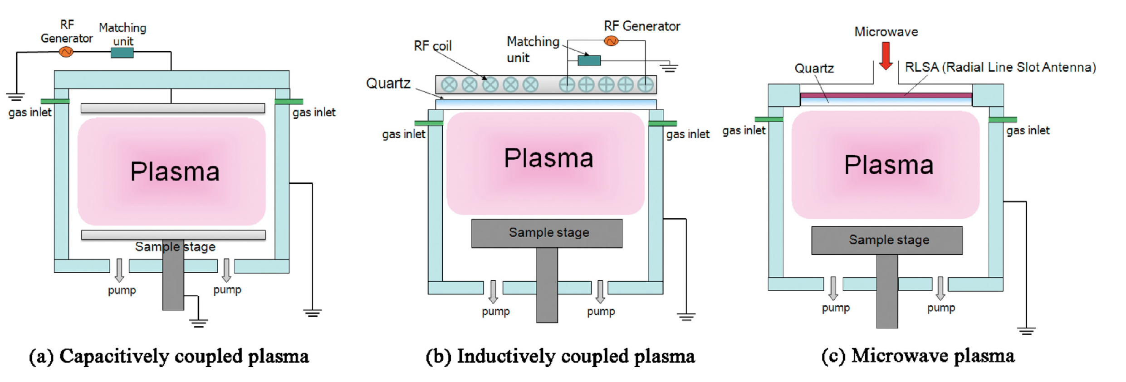
CCP vs ICP vs MW plasma
3a
Notes:
Pozor je to pro verejnost … jednoduseji, schemata nazorna, ne moc analyz, jen par rovnic

Slide 9
Diffusion theory for HF breakdown

Slide 10
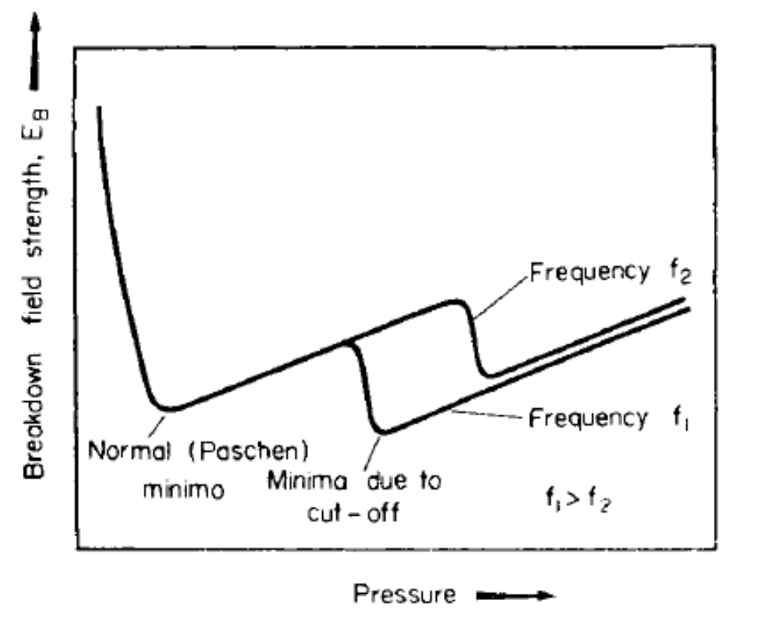
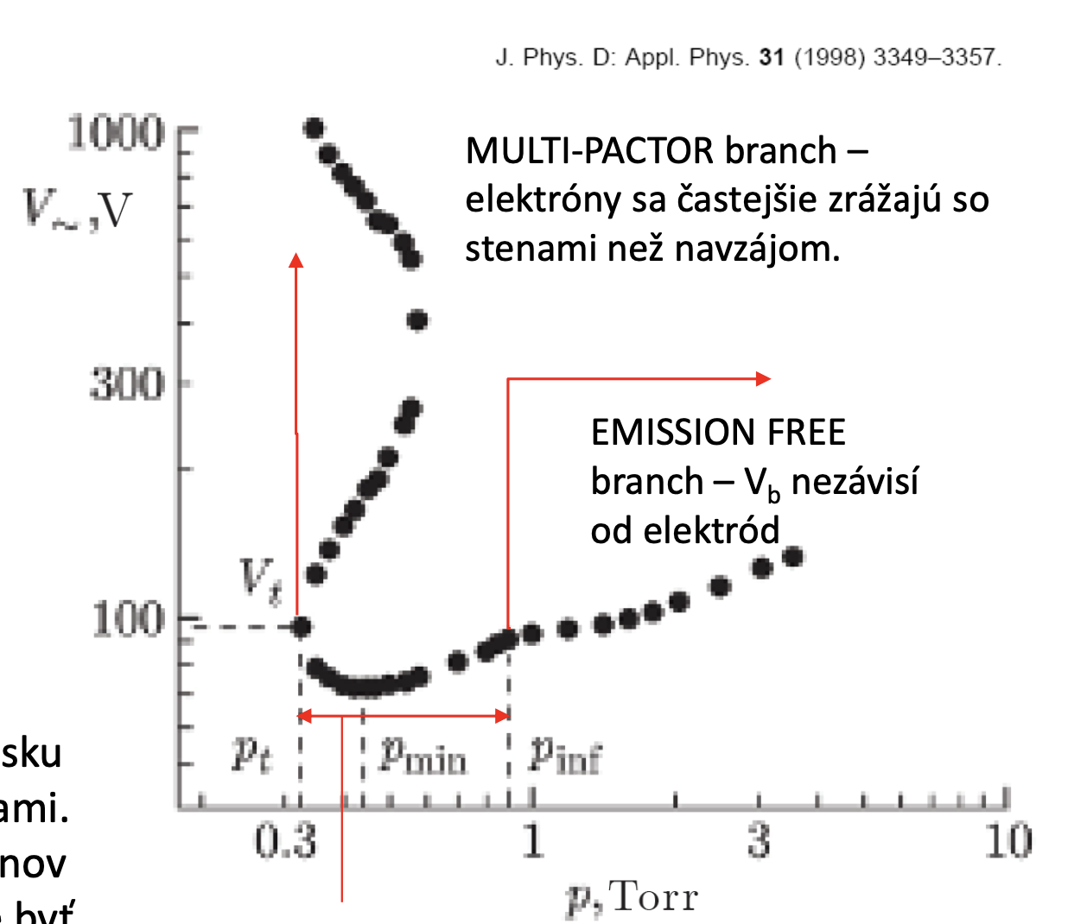
High Frequency breakdown
multi-pactor branch – electrons interact more
with walls than with themselves
Emission-free branch, breakdown voltage does not depend on the electrode distance
The Paschen curve for RF breakdown has two minima: 1) Classical DC-like: Electron attains some „ideal“ energy when traversing between electrodes 2) Resonance capture of electrons: electrons bounce off a plasma sheath that is approaching them.
Drift-diffusion branch – secondary emission affects the breakdown voltage
5
Notes:
Pozor je to pro verejnost … jednoduseji, schemata nazorna, ne moc analyz, jen par rovnic

Slide 11
capacitively coupled plasma anatomy

Slide 12
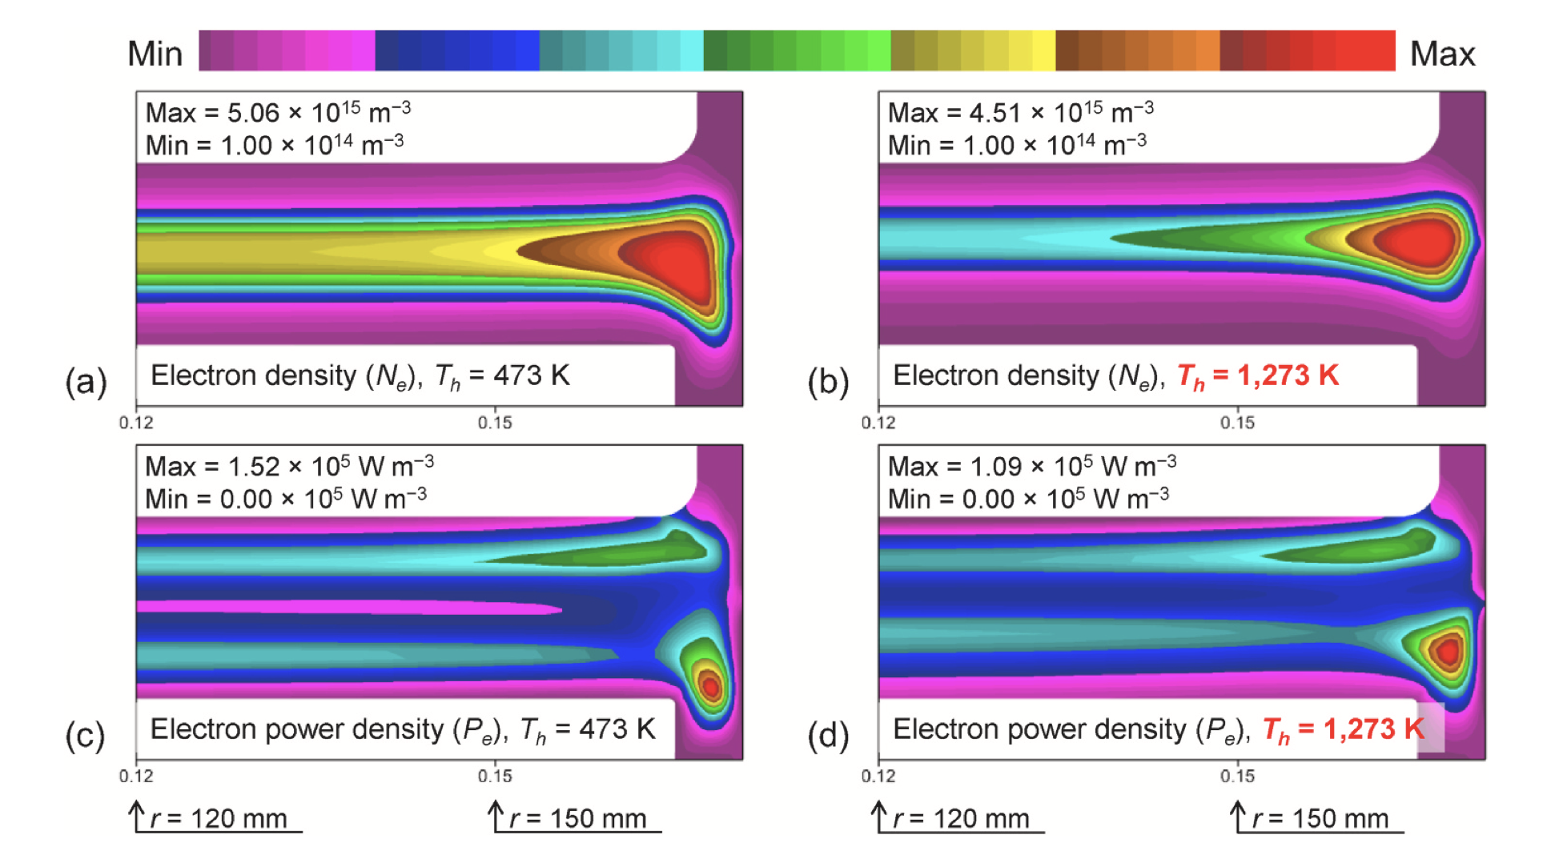
CCP plasma anatomy
Typical frequencies: 10 MHz – 100 MHz (13.56 MHz ”standard”)
Typical pressure: 1 Pa – 1000 Pa
Near-electrode electron heating (stochastic)
Bulk plasma heating (ohmic)
3a
Notes:
Pozor je to pro verejnost … jednoduseji, schemata nazorna, ne moc analyz, jen par rovnic

Slide 13
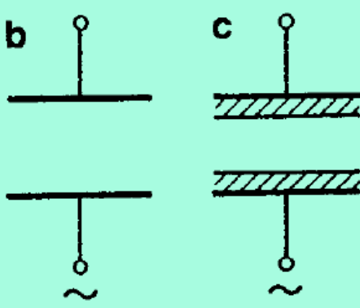
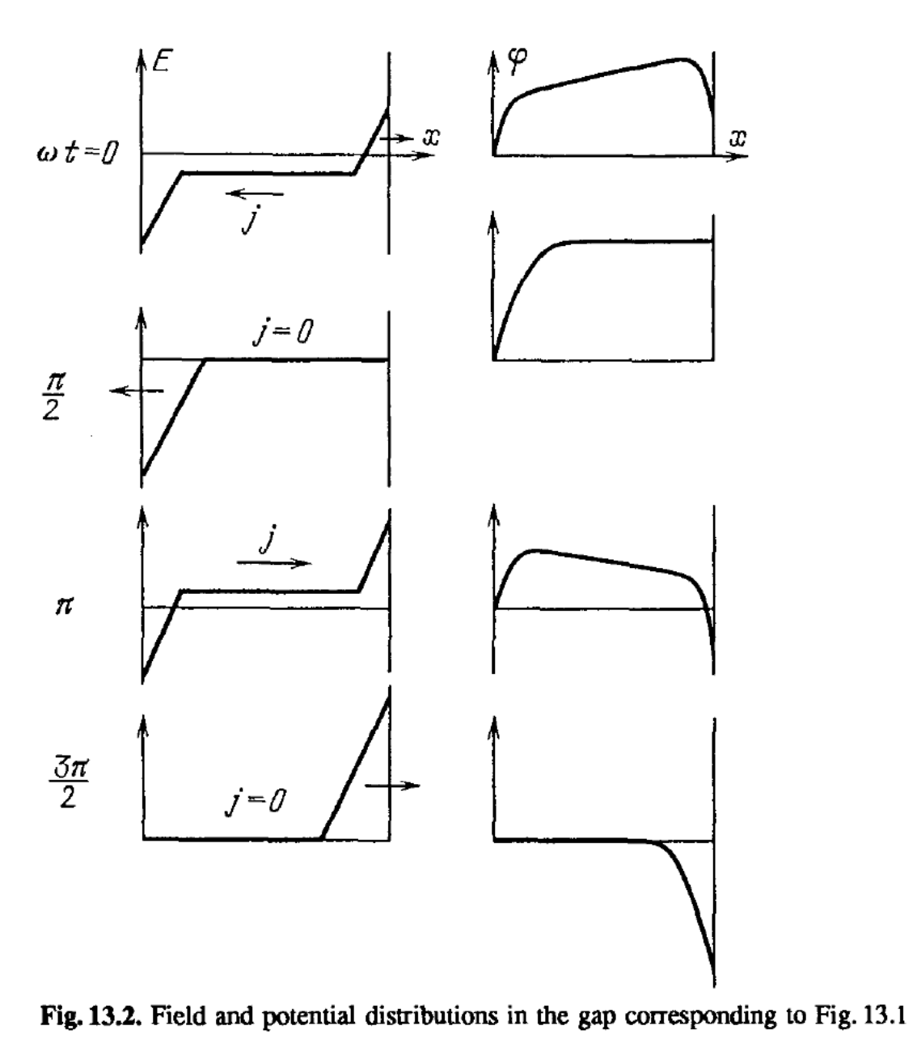
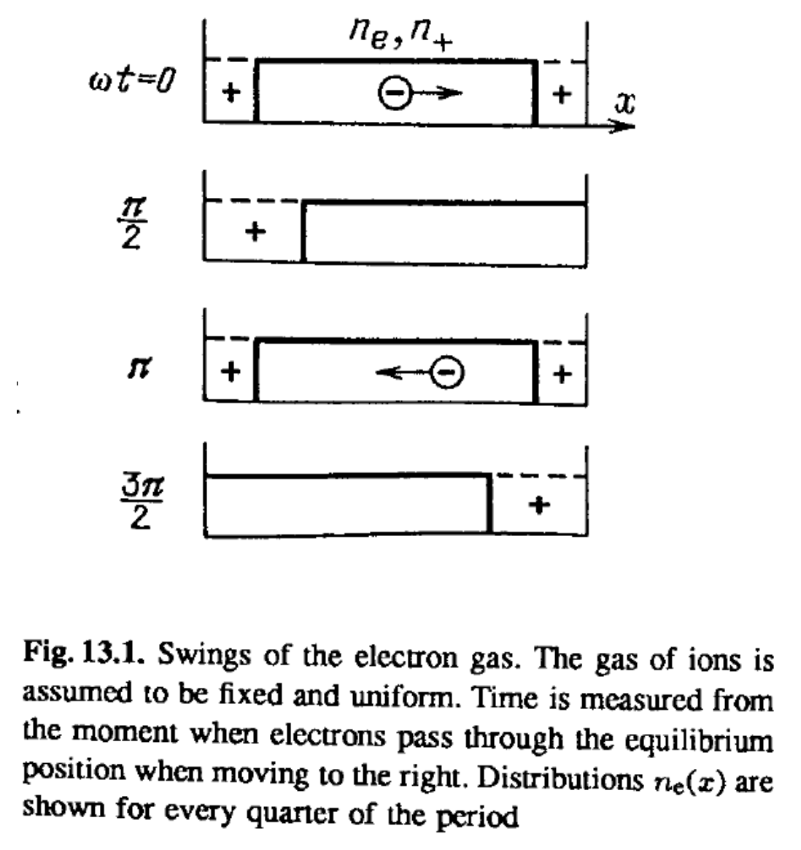
CCP plasma anatomy
Simples case are two planar electrodes, covered with dielectric. Potential and density evolution during phase as follows:
6
Notes:
Pozor je to pro verejnost … jednoduseji, schemata nazorna, ne moc analyz, jen par rovnic

Slide 14
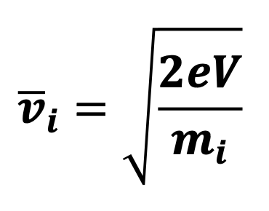
CCP plasma – self bias voltage
In CCP plasmas, we see emergence of the so-called self-bias DC voltage.
empirically, we see: where A₁, A₂ are electrode surface areas
An approximate derivation can be made as follows – we assume that the ion current on both electrodes has to be the same:
And if we further assume that the ion densities in front of both electrodes are the same we obtain
And ultimately
$$\frac{A_{1}}{A_{2}}=\sqrt{\frac{V_{2}}{V_{1}}}$$
The smaller electrode has to have higher negative voltage to draw the same ion current => it acts as a cathode and it can be used e.g. for sputtering of material
This derivation is still extremely simplistic, will be done more properly in Plasma Physics 3
8
Notes:
Pozor je to pro verejnost … jednoduseji, schemata nazorna, ne moc analyz, jen par rovnic

Slide 15
Inductively coupled plasma anatomy

Slide 16
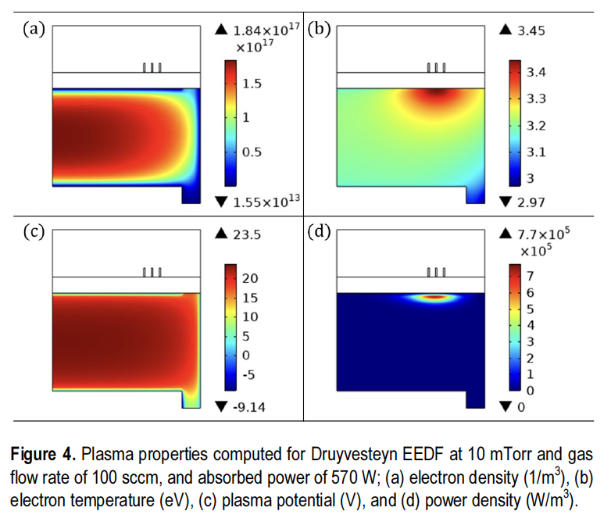
ICP plasma anatomy
Typical frequencies: 10 MHz – 100 MHz (13.56 MHz ”standard”)
Typical pressure: 1 Pa – 1000 Pa
Localized power deposition
3a
Notes:
Pozor je to pro verejnost … jednoduseji, schemata nazorna, ne moc analyz, jen par rovnic

Slide 17
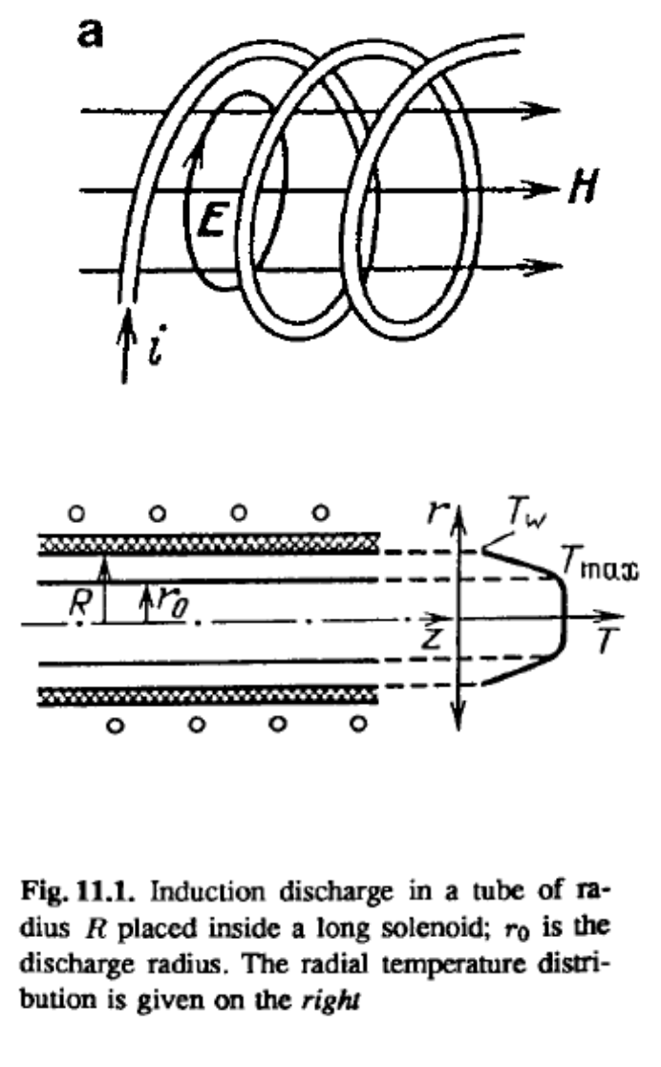
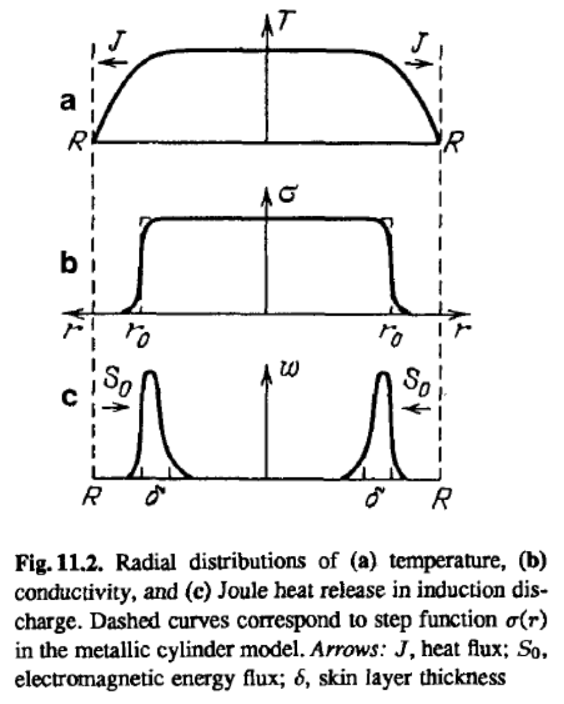
ICP plasma anatomy
Plasma is generated by electromagnetic induction – The RF coil creates H field, which creates poloidal E field in the volume
This wireless transfer of energy makes it possible to run the system at very high temperatures, because the walls can be made of ceramics with high thermal resistivity.
9
Notes:
Pozor je to pro verejnost … jednoduseji, schemata nazorna, ne moc analyz, jen par rovnic

Slide 18
Microwave plasma anatomy

Slide 19
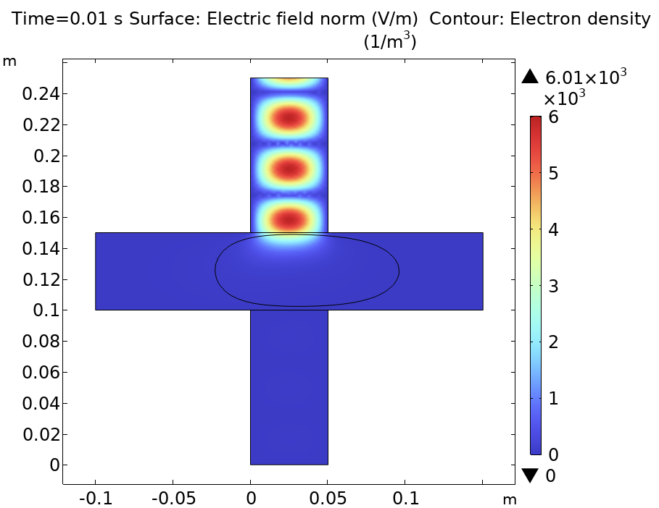
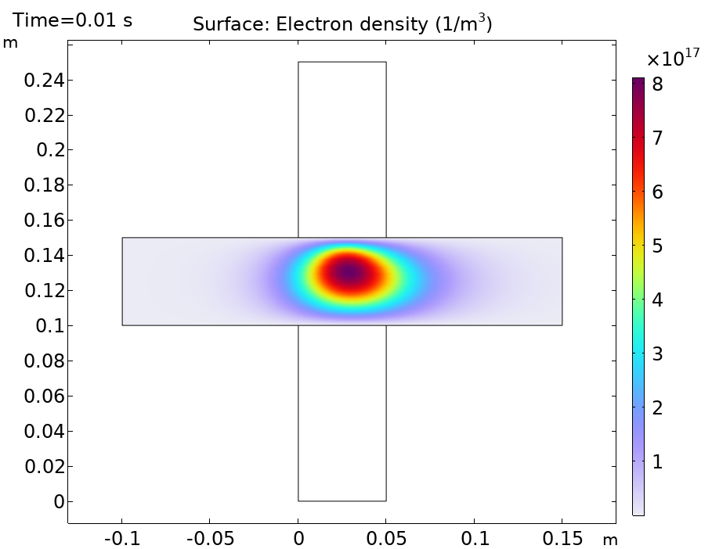
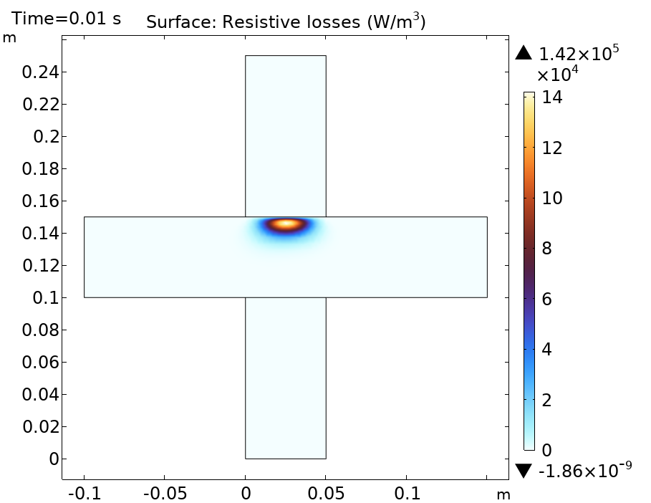
MW plasma anatomy
Typical frequencies:
100 MHz – 10 GHz MHz (2.45 GHz ”standard”)
Gas pressure:
100 Pa – 1 atm
3a
Notes:
Pozor je to pro verejnost … jednoduseji, schemata nazorna, ne moc analyz, jen par rovnic

Slide 20
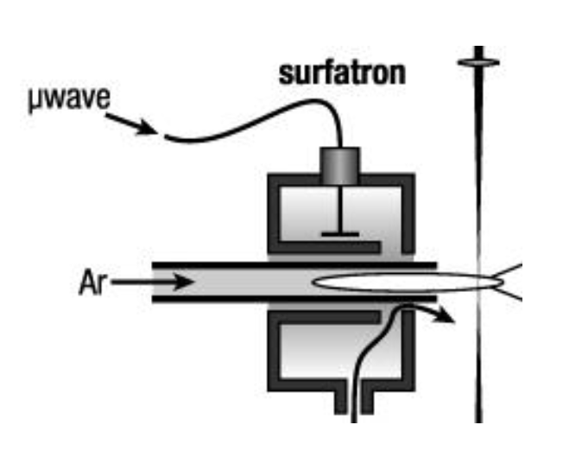
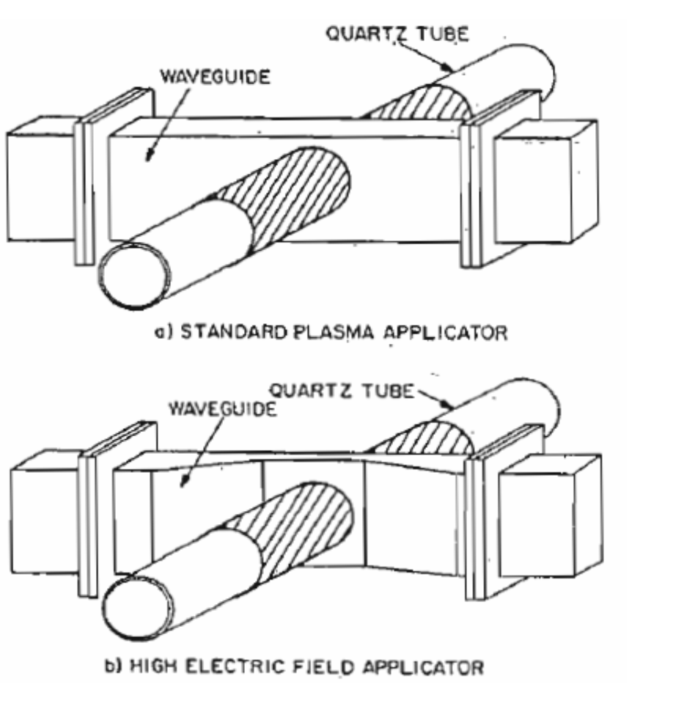
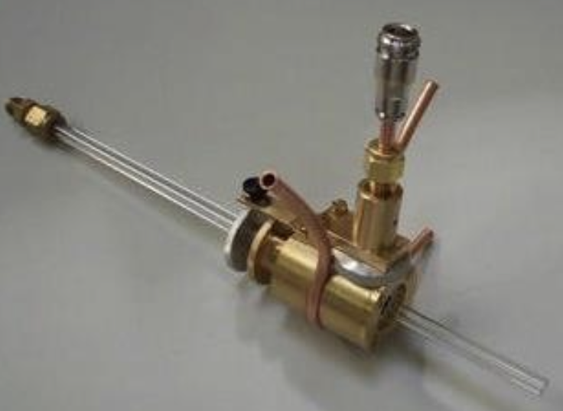
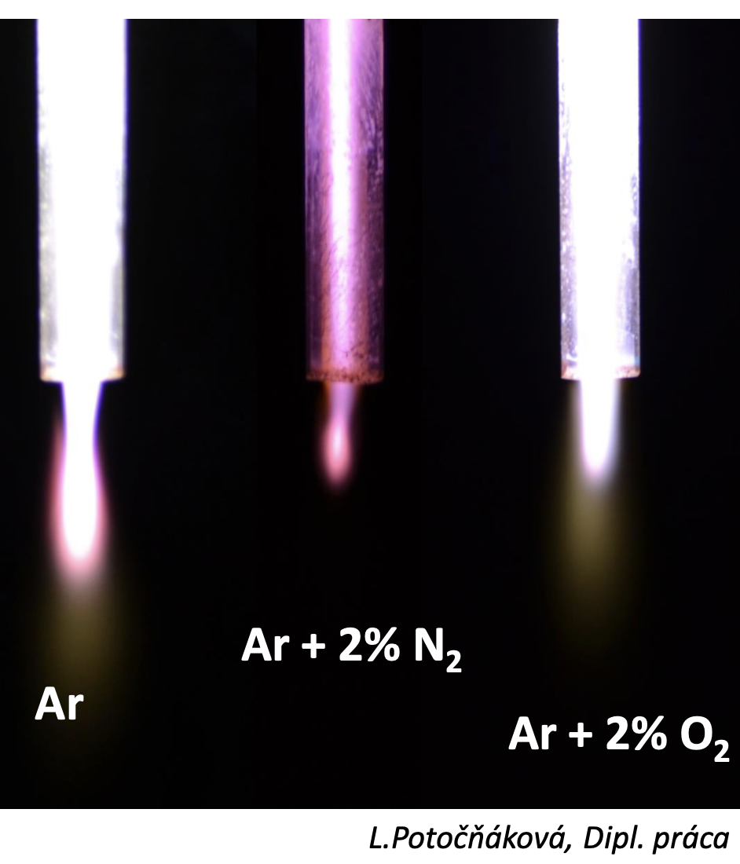
MW plasma anatomy
There are various setups for MW plasma generation – surfatron, surfaguide, coaxial line, ….
10
Notes:
Pozor je to pro verejnost … jednoduseji, schemata nazorna, ne moc analyz, jen par rovnic

Slide 21
Applications of CCP, ICP, MW

Slide 22
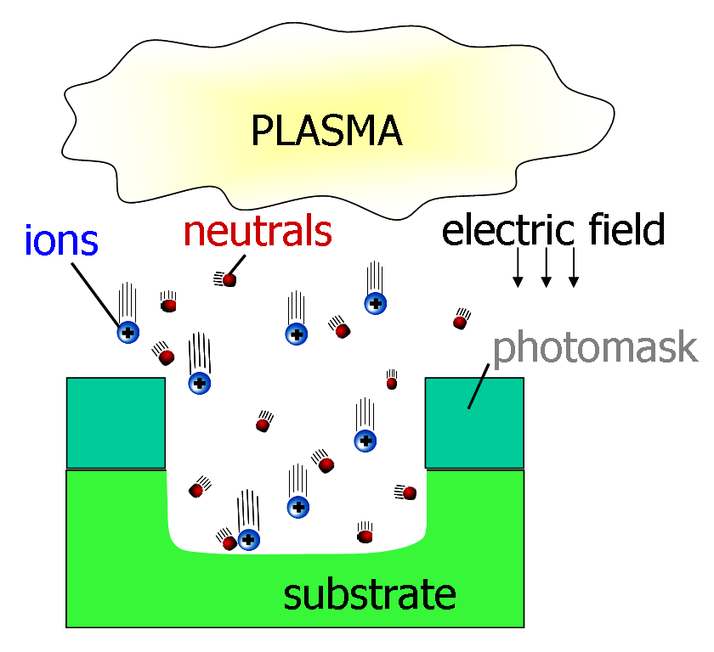
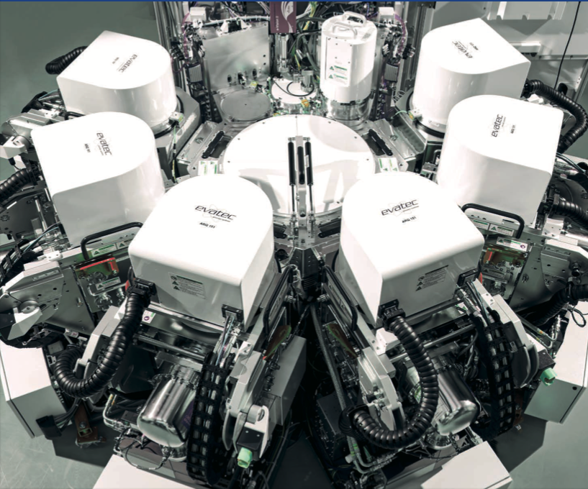
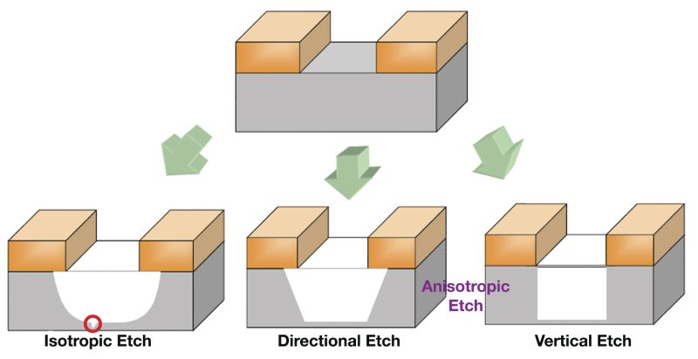
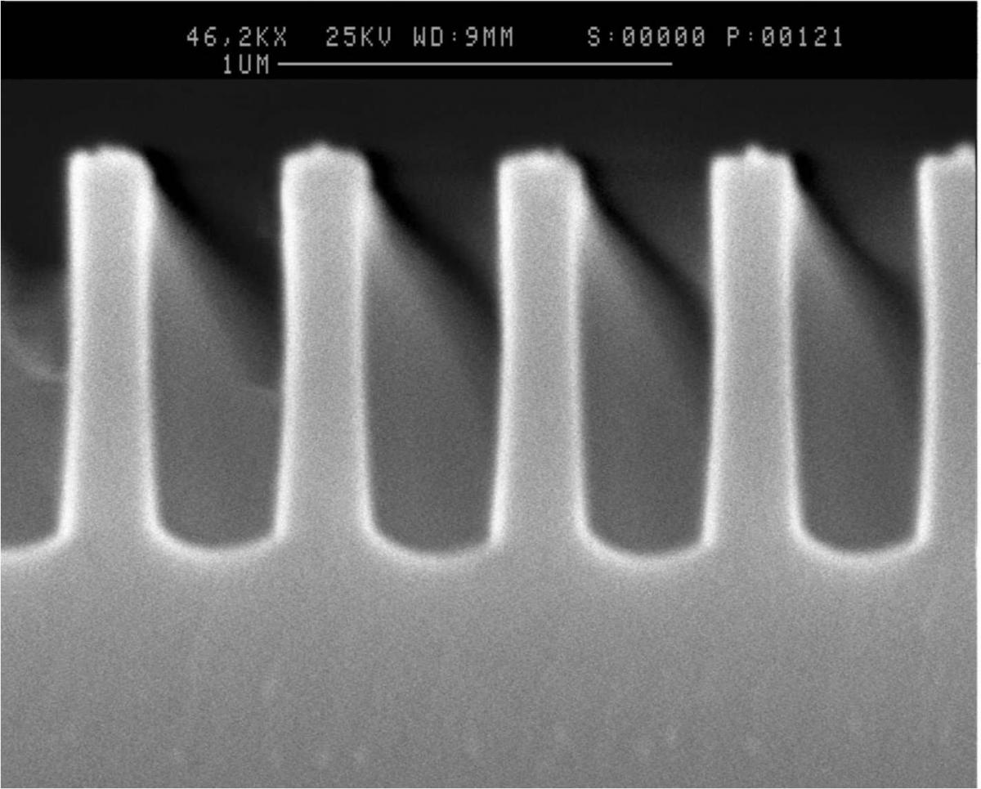
CCP and ICP applications – semiconductor etching
10
Notes:
Pozor je to pro verejnost … jednoduseji, schemata nazorna, ne moc analyz, jen par rovnic

Slide 23
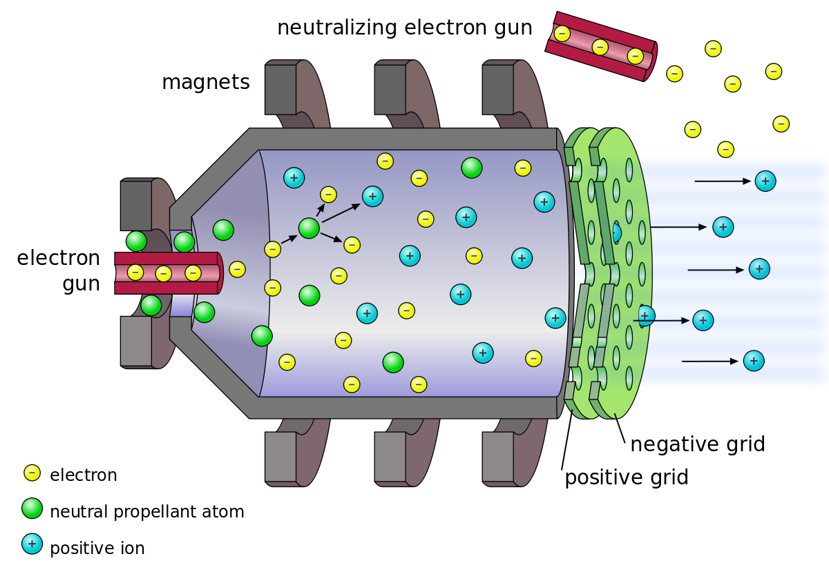
CCP application – gridded ion thruster
10
Notes:
Pozor je to pro verejnost … jednoduseji, schemata nazorna, ne moc analyz, jen par rovnic

Slide 24
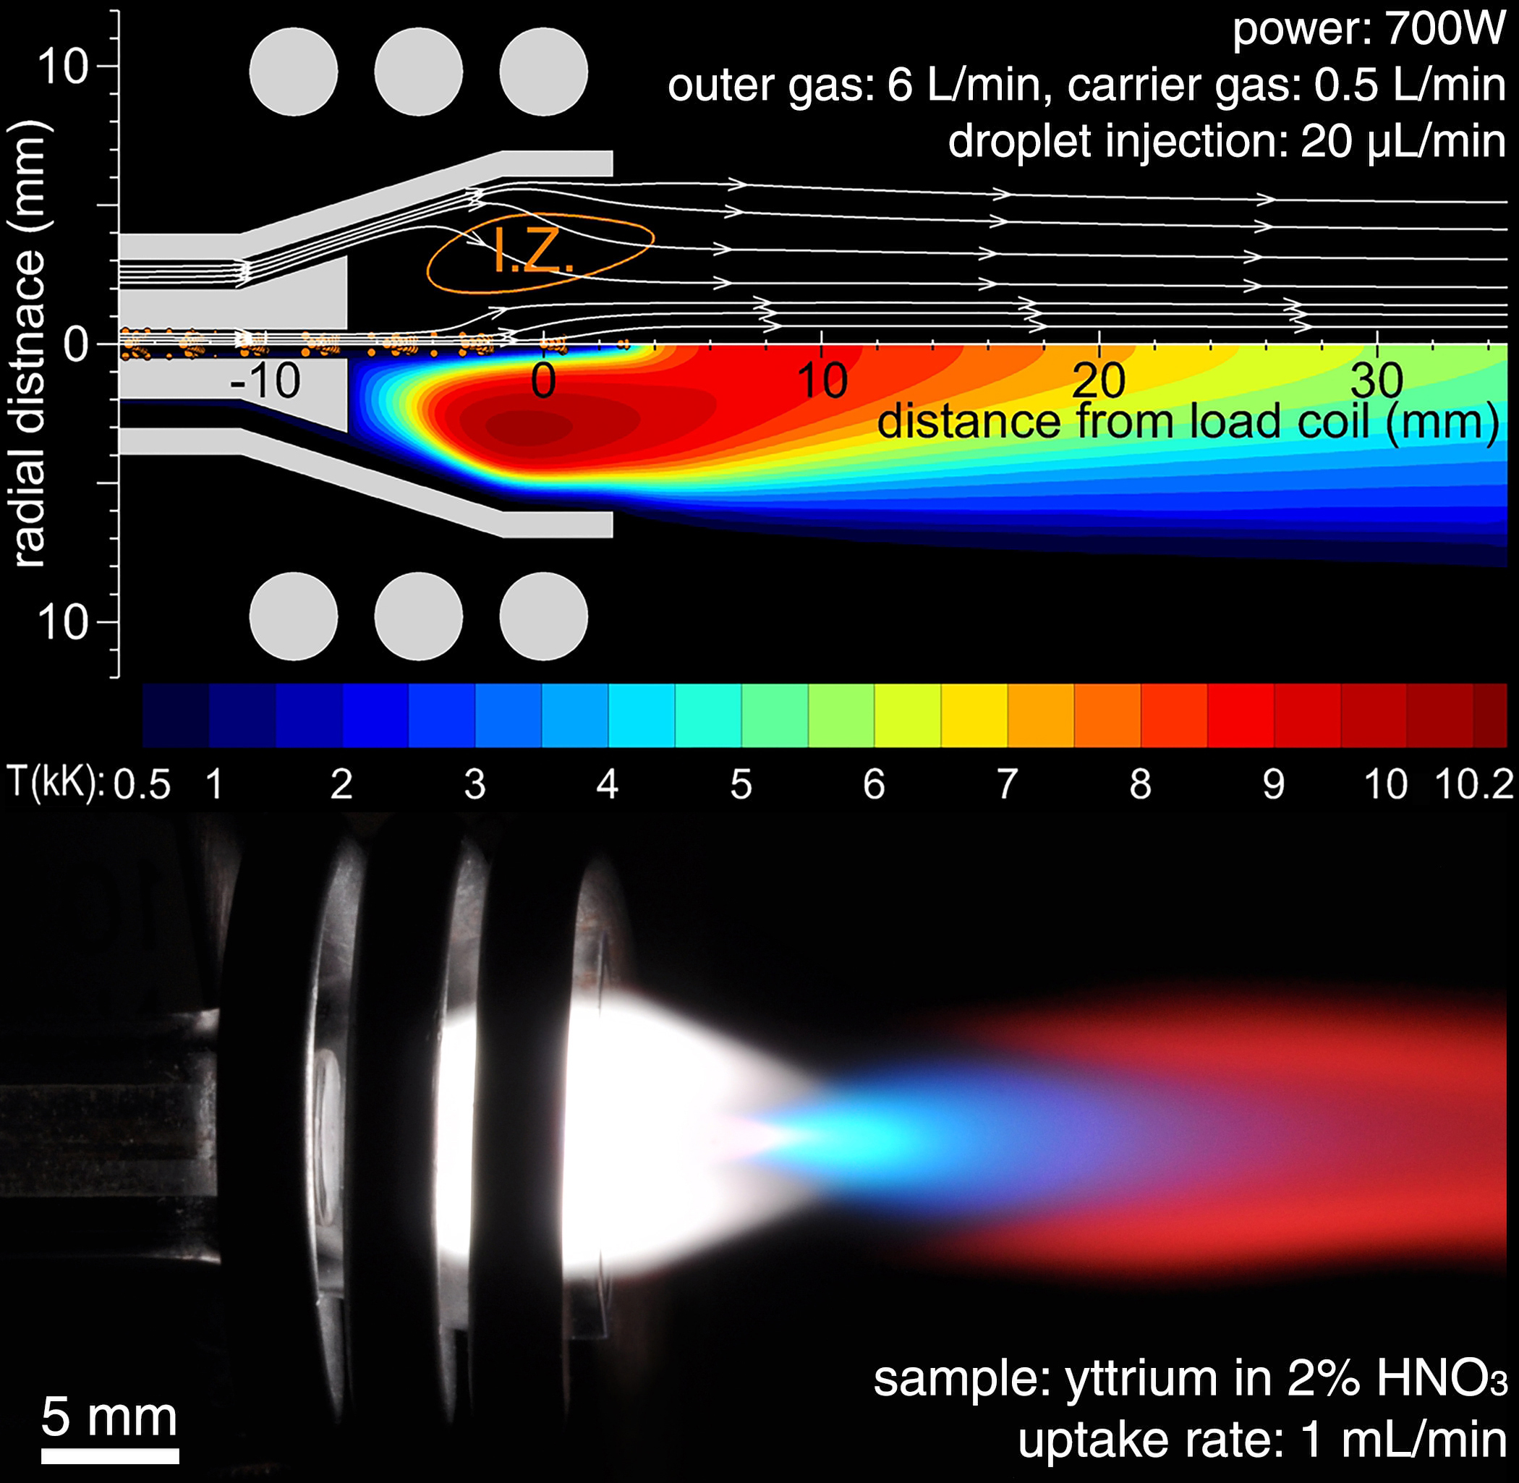
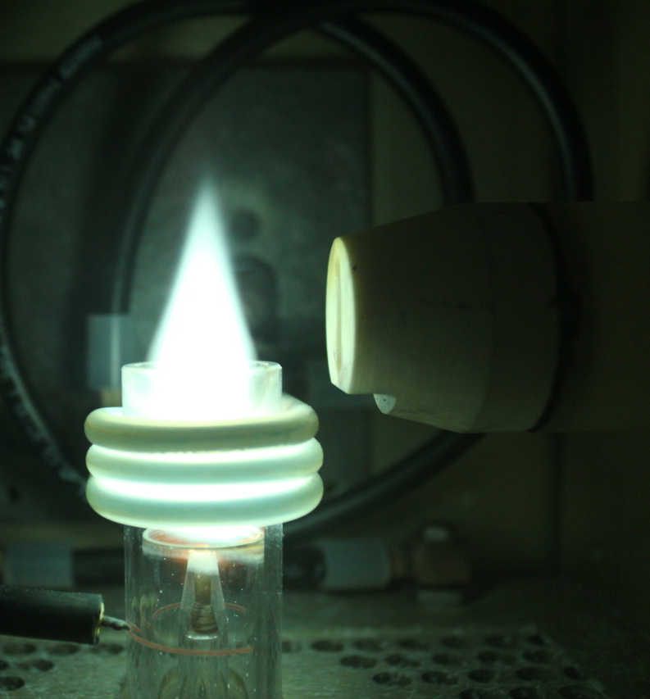
ICP application – DC torch analogue
At atm. pressure and high power levels, so-called ICP torches can generate fully ionized plasmas. Support similar power ranges (5 kW – 1 MW)
Advantage over DC torches: no contact with metal
10
Notes:
Pozor je to pro verejnost … jednoduseji, schemata nazorna, ne moc analyz, jen par rovnic

Slide 25
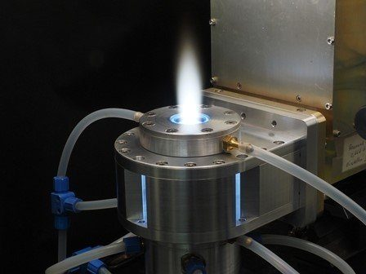
MW application – DC torch analogue
MW plasma is also being used as an analogue to DC torches
As opposed to DC or ICP torches, MW plasma typically operates at lower powers (tens of kW)
Microwave plasma can also be non-LTE (plasma does not have to be so conductive to enable MW absorption) => lower plasma densities achievable
10
Notes:
Pozor je to pro verejnost … jednoduseji, schemata nazorna, ne moc analyz, jen par rovnic

Slide 26
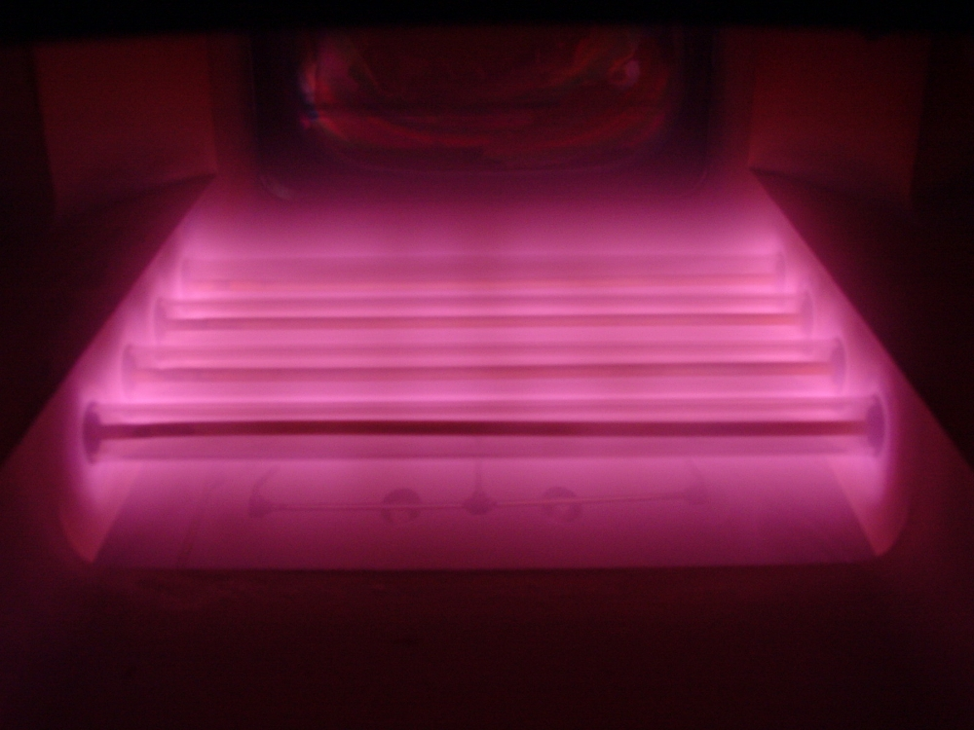
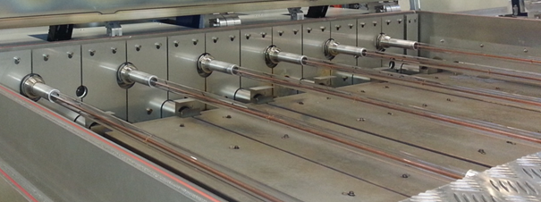
MW application – Plasmaline for solar cells
At atm. pressure and high power levels, so-called ICP torches can generate fully ionized plasmas.
Advantage over DC torches: no contact with metal
10
Notes:
Pozor je to pro verejnost … jednoduseji, schemata nazorna, ne moc analyz, jen par rovnic

Slide 27
Takeaways
High frequency breakdown
Different layouts for wave-driven discharges
CCP, ICP, MW – different power absorption mechanisms
Applications

