Slide 1
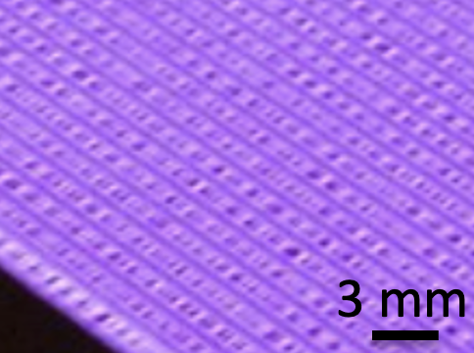
Plasma Physics 2
6. Dielectric barrier discharge
Notes:
Vylepsit …

Slide 2
Lecture series contents
Townsend breakdown theory, Paschen‘s law
Glow discharge
Electric arc at low and high pressures
Magnetized low-pressure plasmas and their role in material deposition methods.
Brief introduction to high-frequency discharges
Streamer breakdown theory, corona discharge, spark discharge
Barrier discharges
Leader discharge mechanism, ionization and discharges in planetary atmospherres
Discharges in liquids, complex and quantum plasmas
Thermonuclear fusion, Lawson criterion, magnetic confinement systems, plasma heating and intertial confinement fusion.
1
Notes:
Pozor je to pro verejnost … jednoduseji, schemata nazorna, ne moc analyz, jen par rovnic

Slide 3
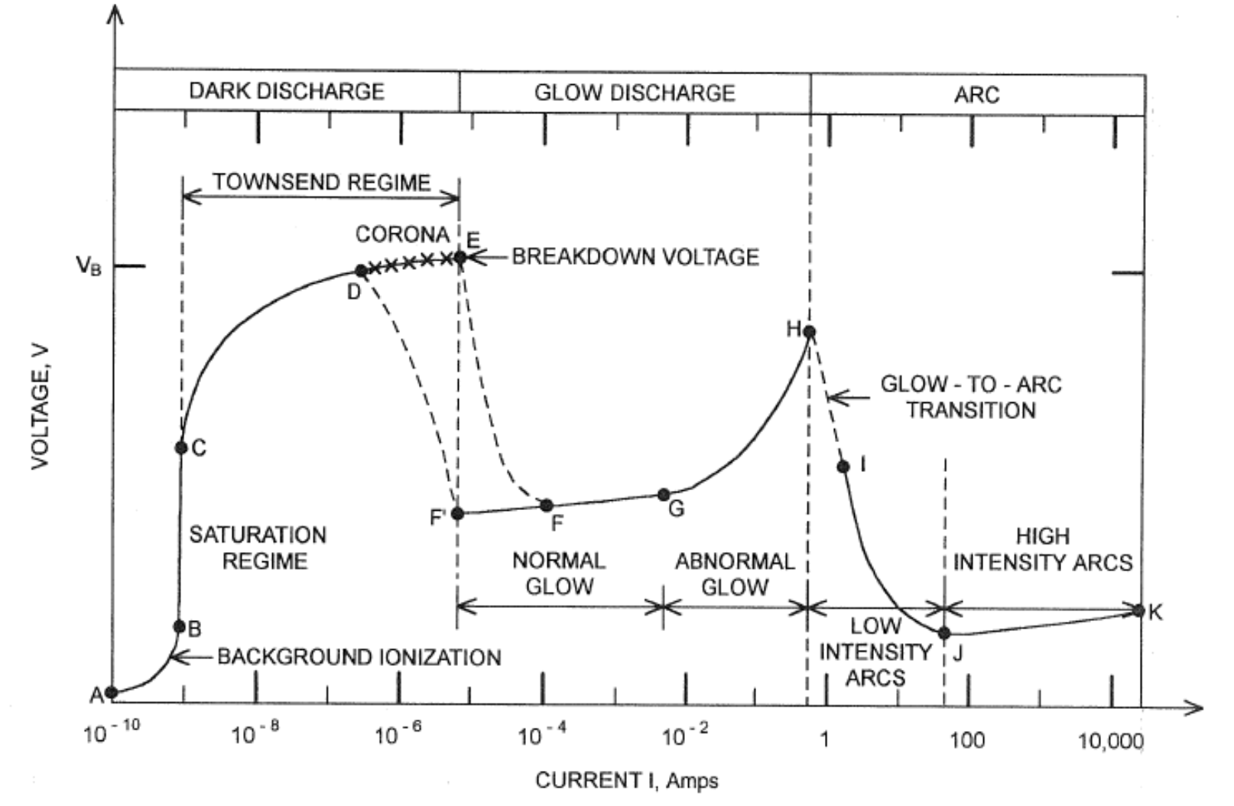
Where are we in the IV chart?
We have seen last time that the deformation of the E field in various real-life scenarios leads to a formation of non-uniform discharge structures (streamers, arcs, coronas).
Today, we are expanding further on those by analyzing DBDs which operate in Townsend/Glow part of the IV characteristic
volt-ampérová charakteristika elektrických DC výbojů
(vznik jednoho mikro-výboje bariérového výboje můžeme
pro daný čas uvažovat jako DC)
2
Notes:
Pozor je to pro verejnost … jednoduseji, schemata nazorna, ne moc analyz, jen par rovnic

Slide 4
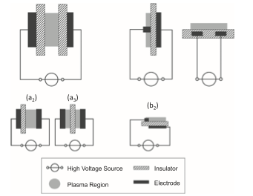
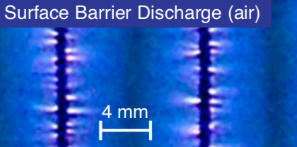
Barrier discharge fundamentals
A barrier discharge is characterized by the fact that there is a dielectric between the electrodes, preventing the formation of a conductive channel – an electrical short cannot occur
Some fundamental configs (Brandenburg 2017):
Often filamentary, here is a glow discharge at the atm. pressure:
4 mm
3
Notes:
Pozor je to pro verejnost … jednoduseji, schemata nazorna, ne moc analyz, jen par rovnic

Slide 5
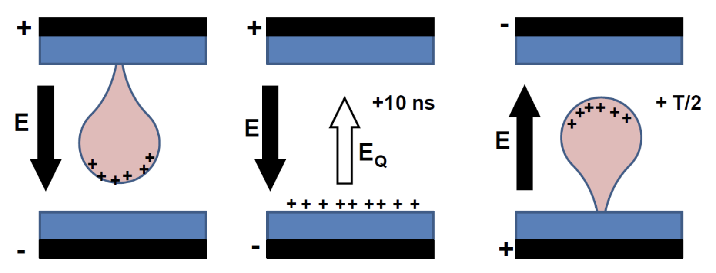
General barrier discharge mechanism
(Dielectric) barrier discharge occurs between electrodes, at least one of which is covered by a dielectric.
An important driver for DBD formation is charge accumulation on the dielectric.
When described by an equivalent circuit, it behaves like a capacitor.
Due to the dielectric, it always has to be driven by an AC field
4
Notes:
Pozor je to pro verejnost … jednoduseji, schemata nazorna, ne moc analyz, jen par rovnic

Slide 6
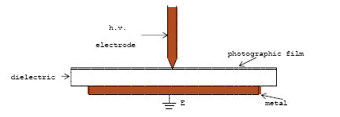
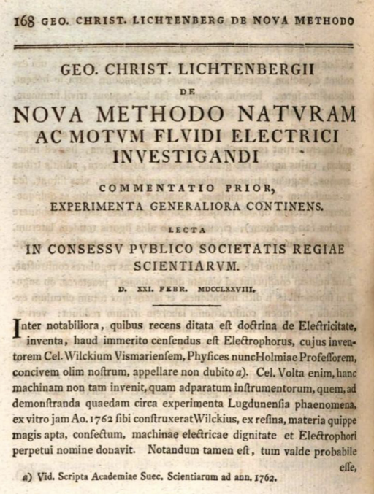
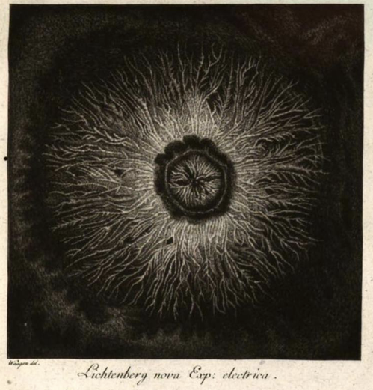
Dielectric barrier discharge – ancient history
dust
Ancient history - G.C.Lichtenberg (1777):
5
Notes:
Pozor je to pro verejnost … jednoduseji, schemata nazorna, ne moc analyz, jen par rovnic

Slide 7
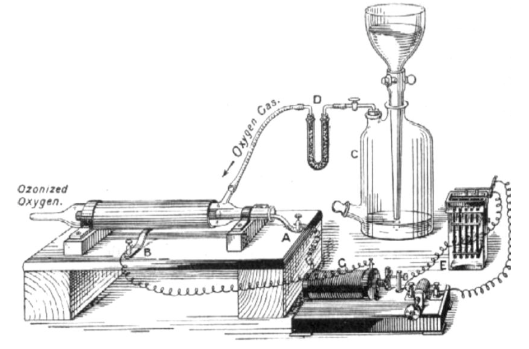
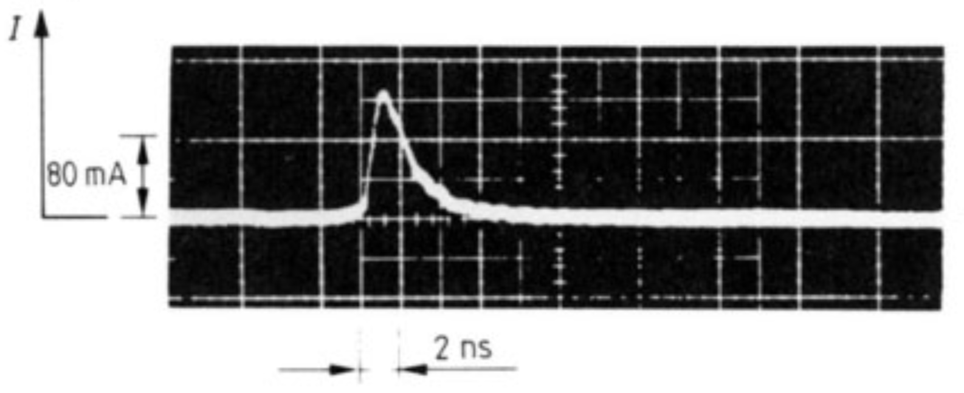
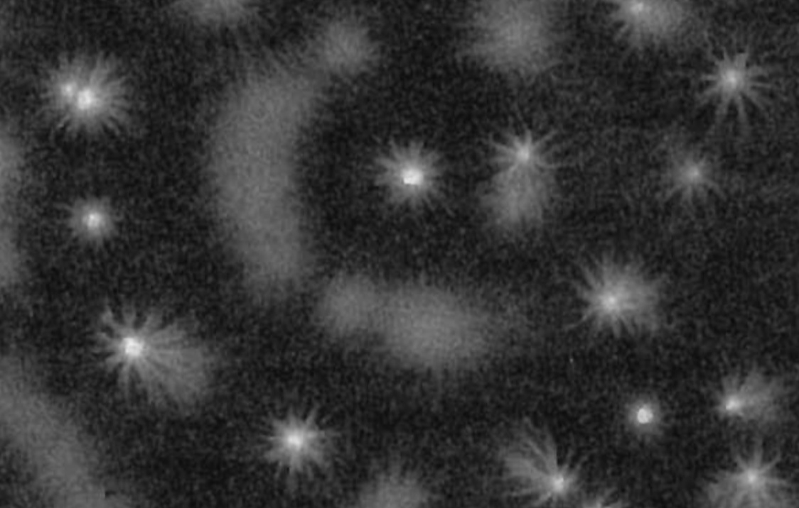
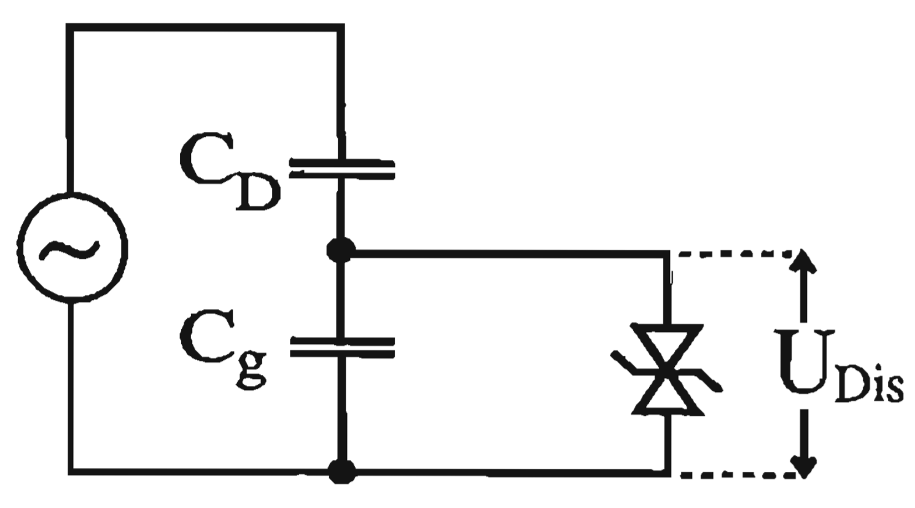
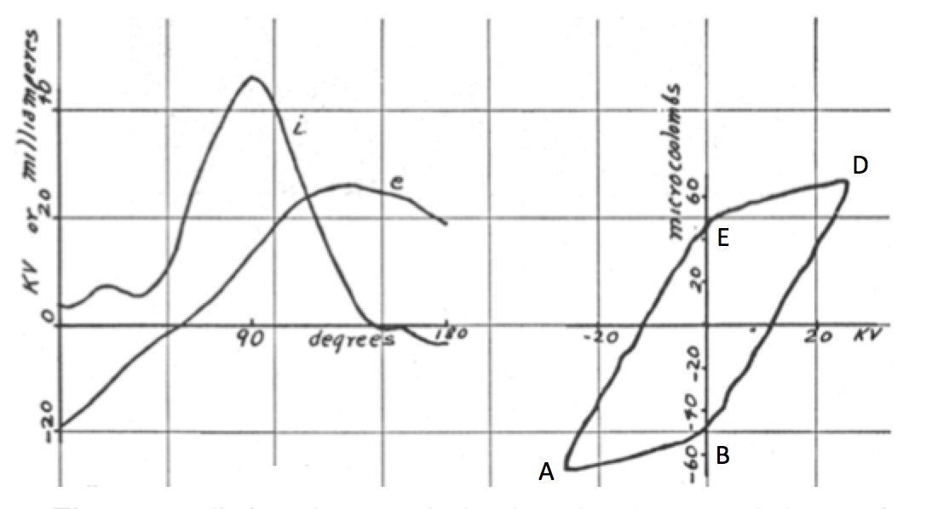
Brief history of the dielectric barrier discharge
Ozone generation, Lichtenberg figures, streak measurements.
W. Siemens 1857 and Buss 1932, Klemenc 1937, Manley 1943, Samoilovich 1966,
Gibalov 1981, Eliasson, Kogelschatz 1983, Heuser 1985, Okazaki 1993, Zhu, Hidaka 1996, Guikema 2000, Kozlov 2001, Wagner 2010
6
Notes:
Pozor je to pro verejnost … jednoduseji, schemata nazorna, ne moc analyz, jen par rovnic

Slide 8
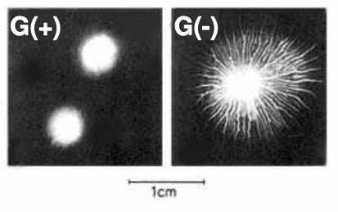
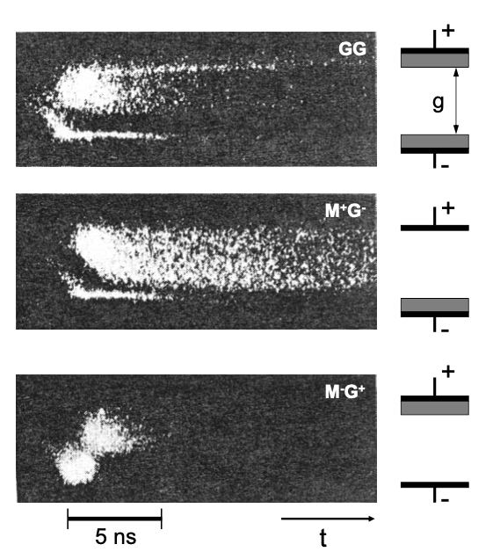
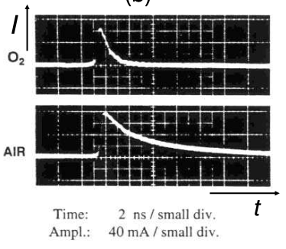
Initial observations of DBD discharges
Optical and electrical studies historically performed in Aachen (Pietsch, Heuser, Gibalov) and in ABB (Hirth, Kogelschatz, Eliasson):
Lichtenberg figures
Streak camera – pulsed barrier discharge
prouduvá měření
16
Notes:
Pozor je to pro verejnost … jednoduseji, schemata nazorna, ne moc analyz, jen par rovnic

Slide 9
General forms of the DBD discharge
Basic modes of the DBD are filamentary and (Brandenburg 2004):
In the filamentary mode, the fialment diameter is sub-millimeter. Individual filaments také nanoseconds and the electric field is hundreds of Td owing to the streamer mechanism.
In the diffuse mode, the discharge size is given by electrode width but the mode is not universaly stable.
Penning ionization – one of phenomena contributing to the stability of the discharge
Diffuseness is important for various applications of the discharge. Note that even the filaments can be distributed uniformly and the discharge is pseudo-diffuse.
filamentary
diffuse
14
Notes:
Pozor je to pro verejnost … jednoduseji, schemata nazorna, ne moc analyz, jen par rovnic

Slide 10
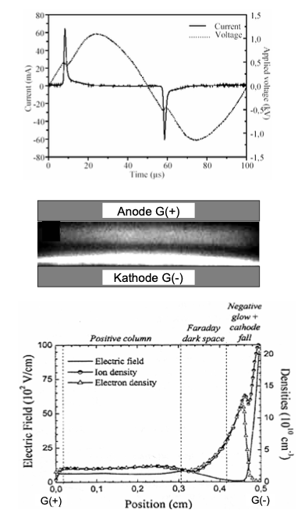
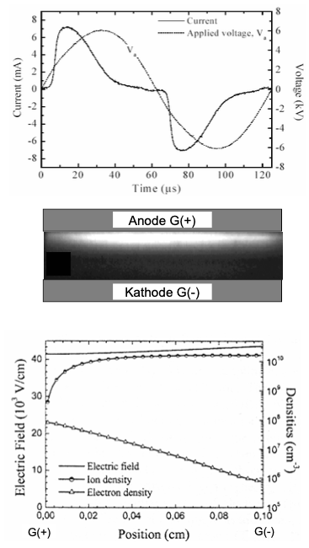
Diffusion barrier discharges (Massines)
Diffusion barrier discharge in He
Diffusion barrier discharge in N2
15
Notes:
Pozor je to pro verejnost … jednoduseji, schemata nazorna, ne moc analyz, jen par rovnic

Slide 11
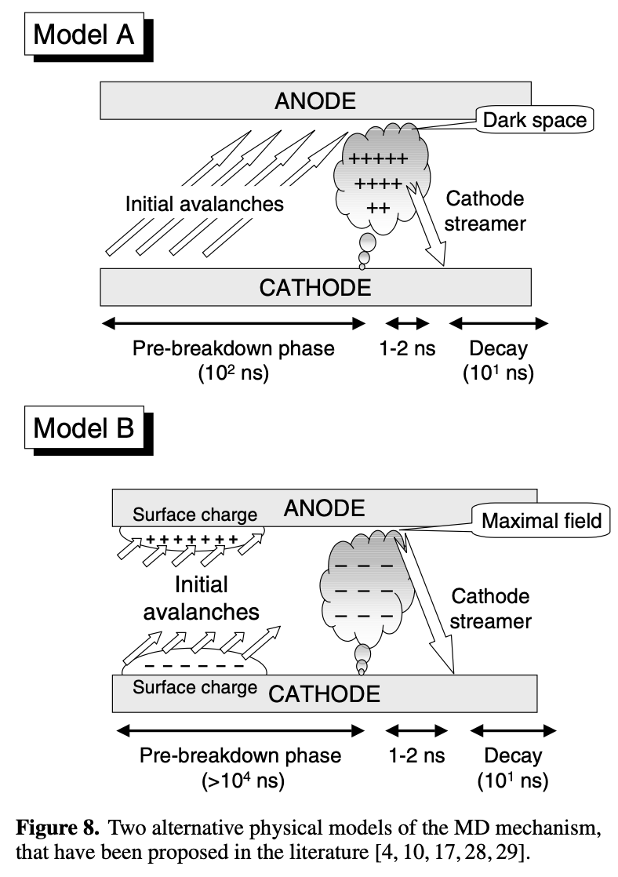
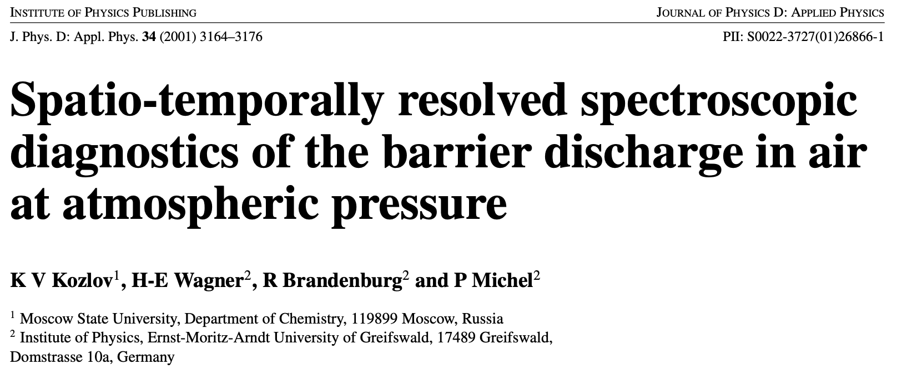
General DBD mechanism – repetitive mode
Even in early 2000s, the mechanism of DBD discharges was still being speculated on.
17
Notes:
Pozor je to pro verejnost … jednoduseji, schemata nazorna, ne moc analyz, jen par rovnic

Slide 12
Current in DBD discharges

Slide 13
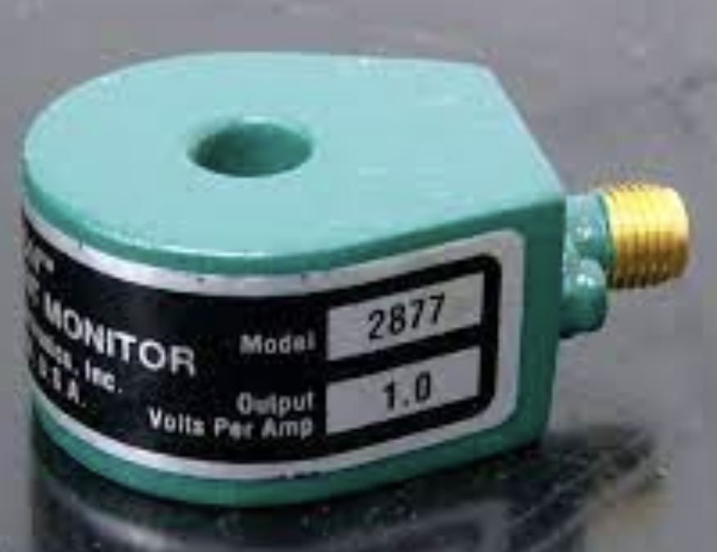
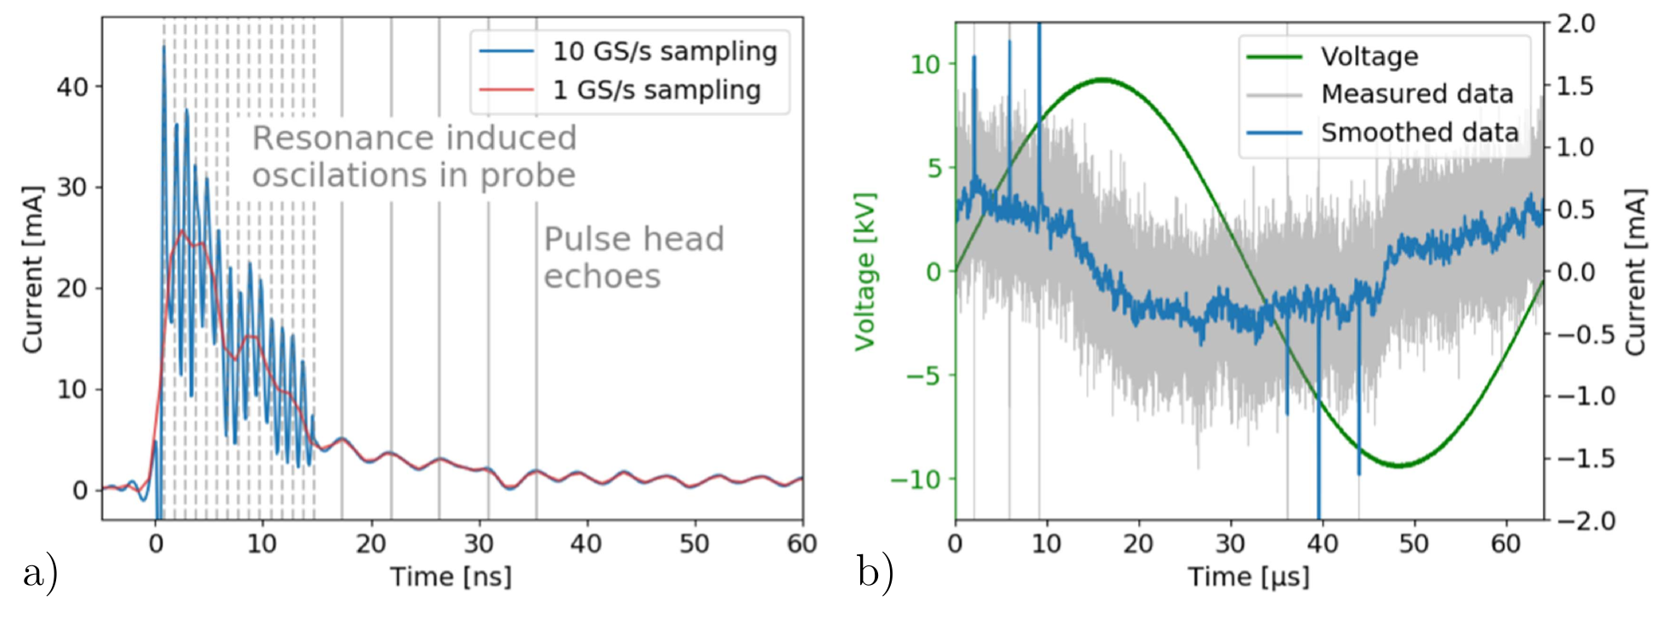
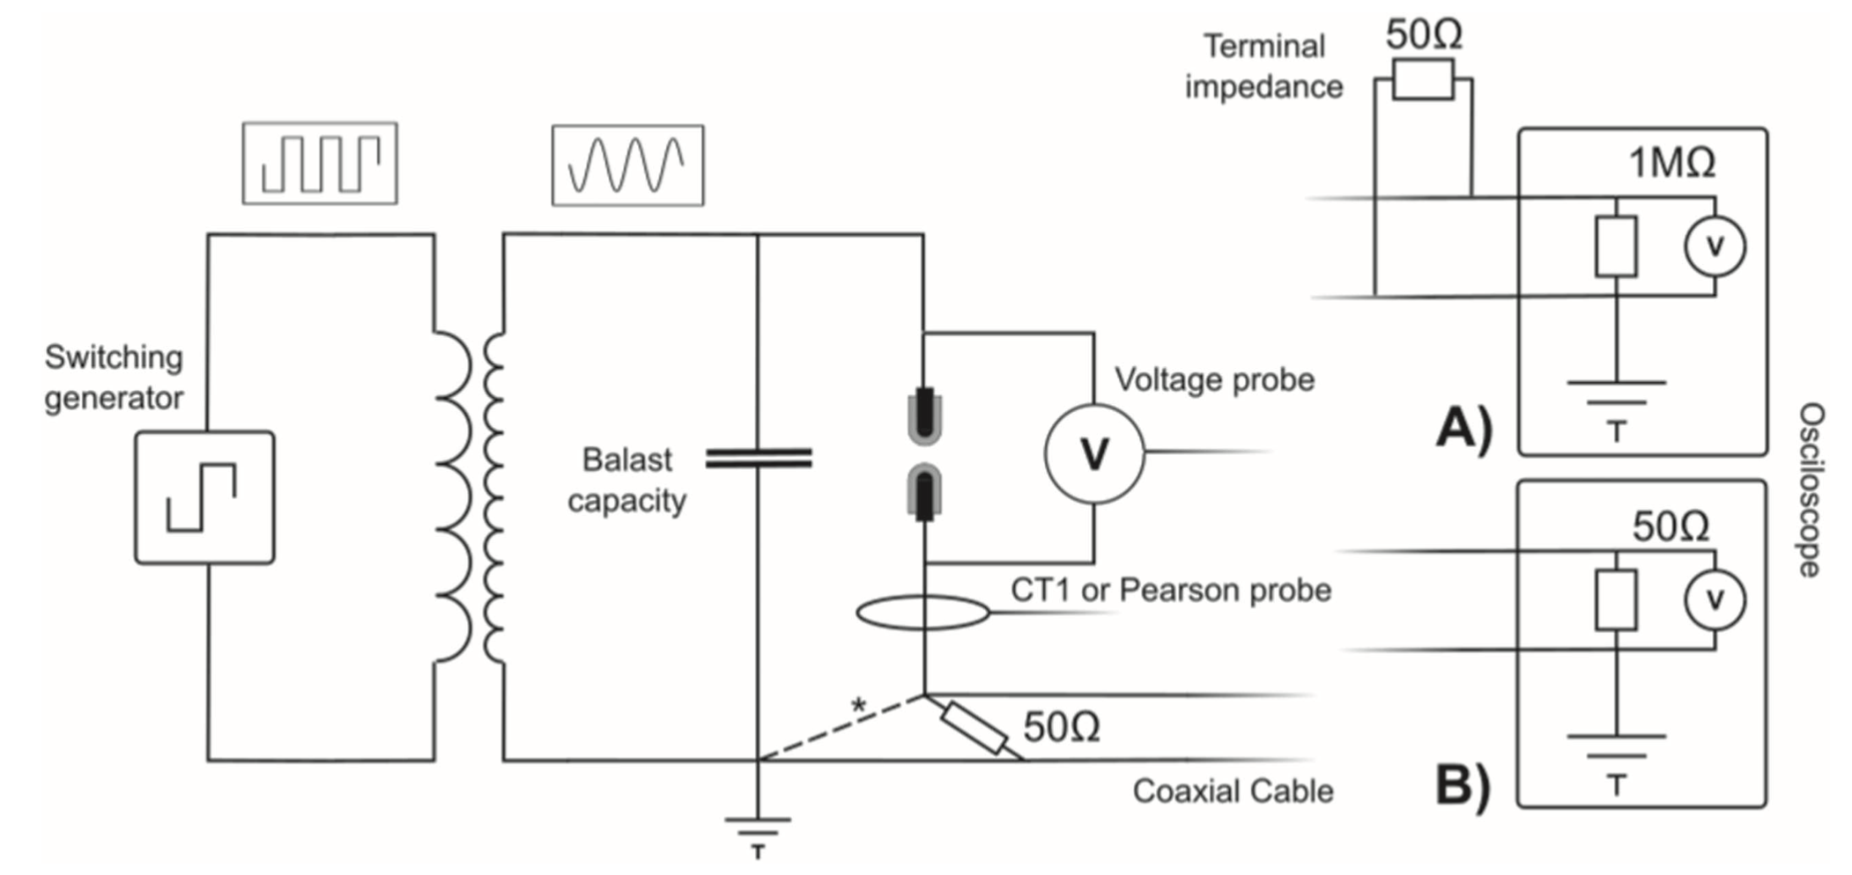
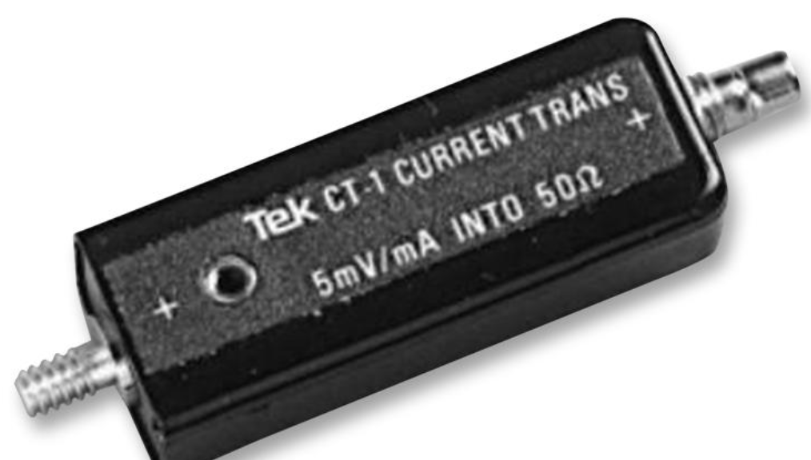
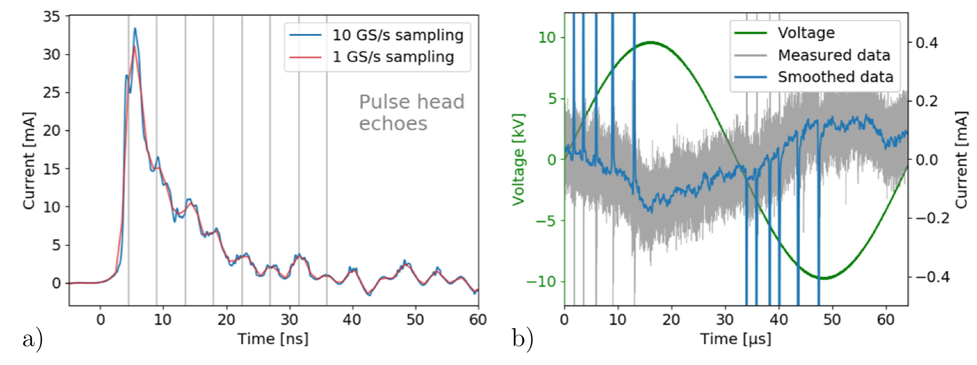
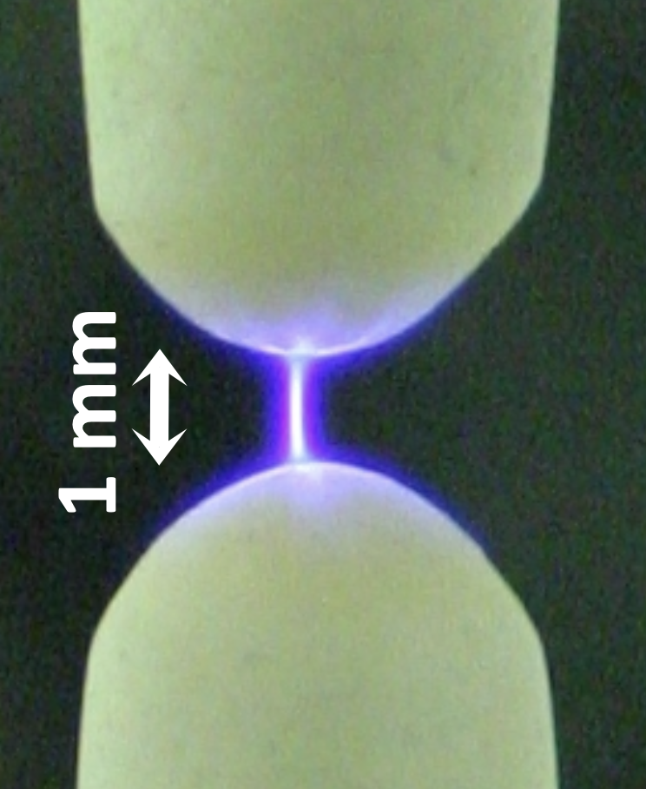
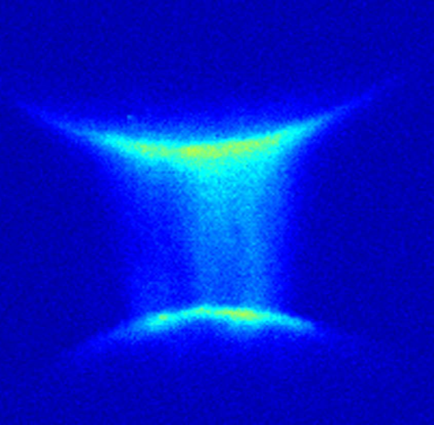
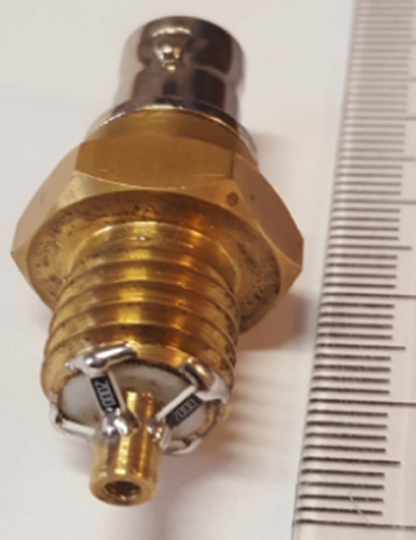
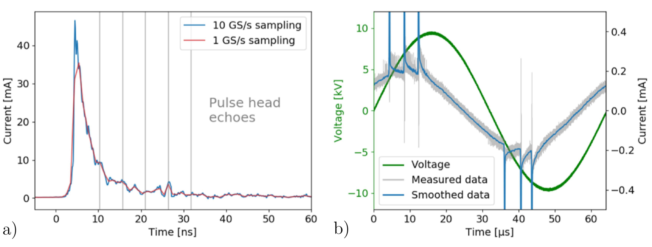
Measuring electrical current in a DBD discharge
You can either measure current using induction-based probes or by measuring voltage on a parallel resistor.
Equivalent circuit for a single-filamentary discharge in air.
Pearson 2877, 300 Hz – 200 MHz
Tektronix CT-1, 25 kHz – 1 GHz
ICCD imaging:
BNC sonda, 0 kHz – 2 GHz
7
Synek et al. 2018 PSST
Notes:
Pozor je to pro verejnost … jednoduseji, schemata nazorna, ne moc analyz, jen par rovnic

Slide 14
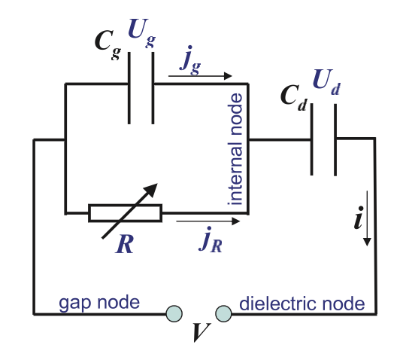
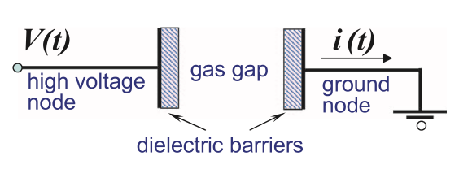
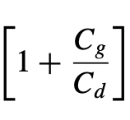
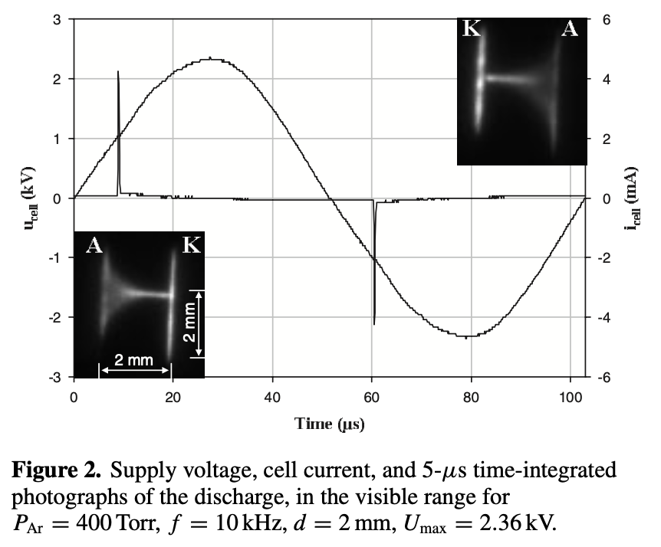
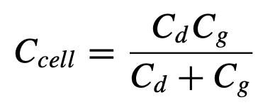
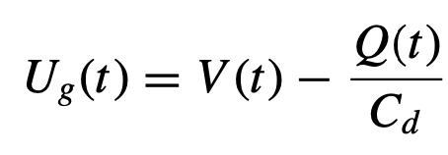
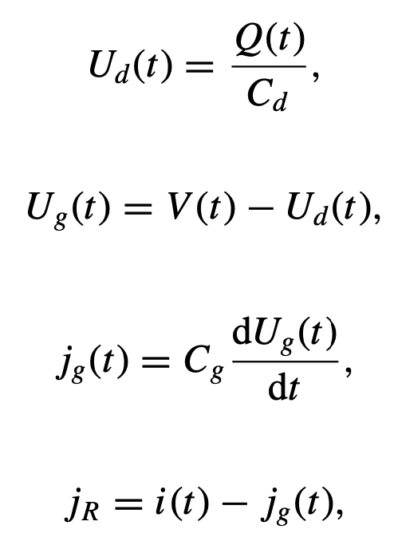
Electrical characterization of a DBD discharge
To measure the actual current is challenging, because the Maxwell translation current makes a major contribution.
the gap voltage determines the effective electric field between the dielectrics E_{eff} = U_{gap}/g
j_{R} is the pure discharge current
q is the charge transferred by a discharge
The following factor is not negligible:
8
Merbahi 2004, Pipa 2012
Notes:
Pozor je to pro verejnost … jednoduseji, schemata nazorna, ne moc analyz, jen par rovnic

Slide 15
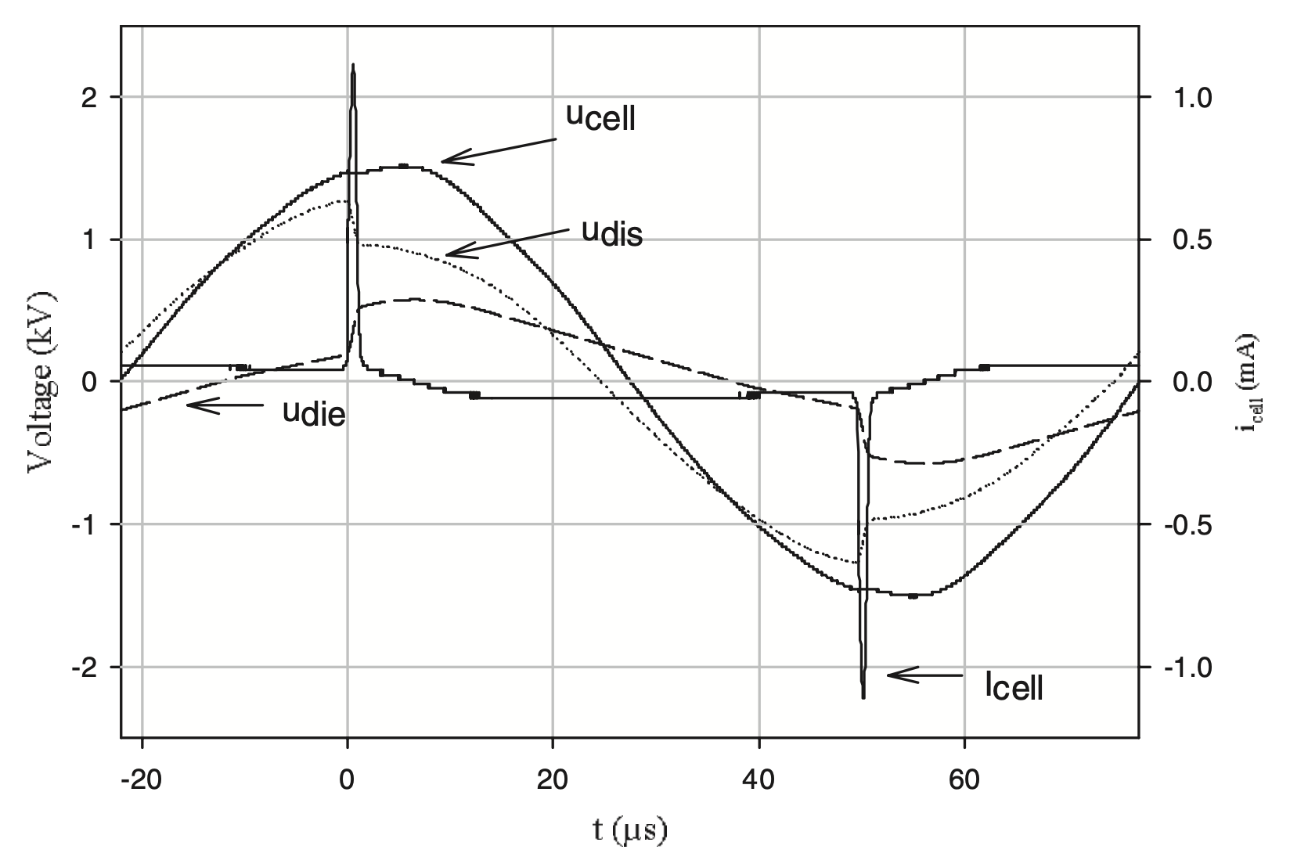
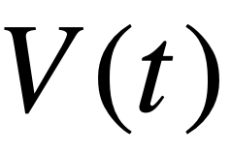
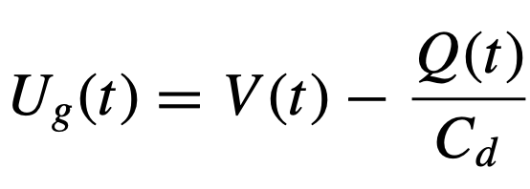
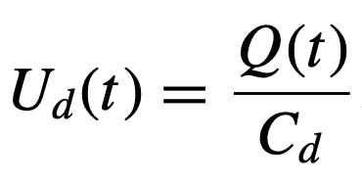
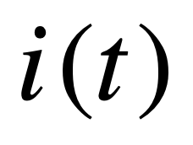
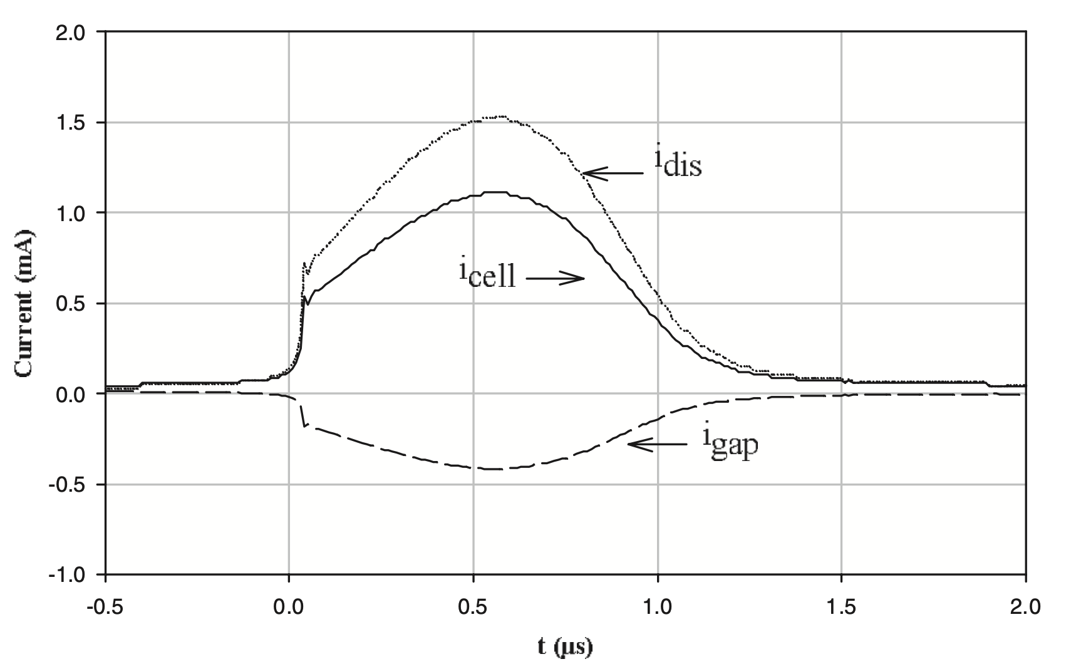
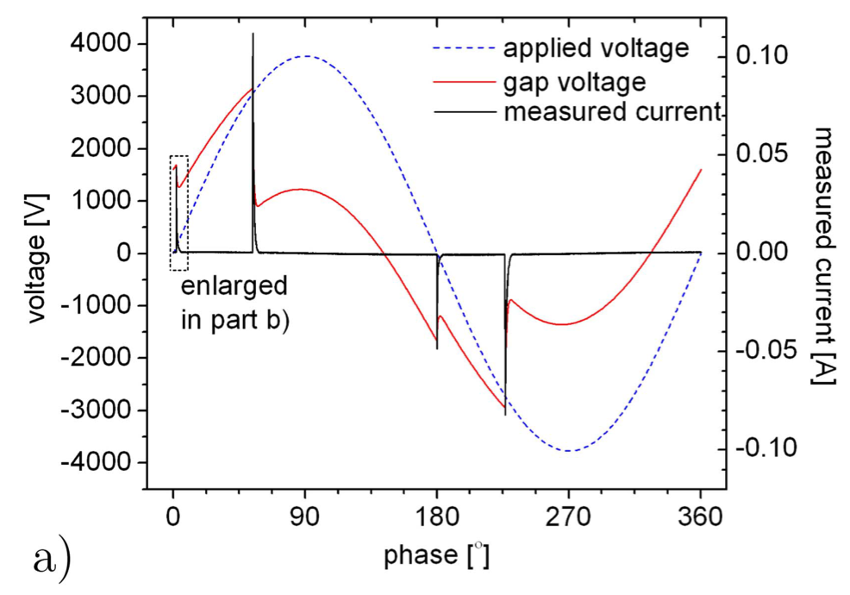
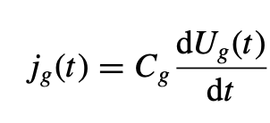
Analyzing electrical measurements
Single-filamentary volume barrier discharge in atmospheric pressure argon.
9
Notes:
Pozor je to pro verejnost … jednoduseji, schemata nazorna, ne moc analyz, jen par rovnic

Slide 16
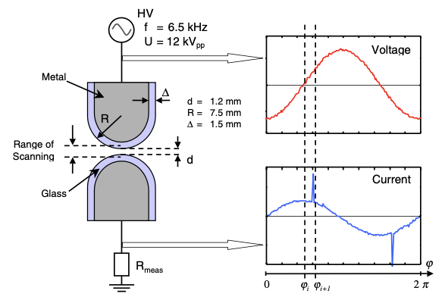
Analyzing electrical measurements
You cannot simply subtract the sine component to get the correct current
Single-filamentary volume barrier discharge in atmospheric pressure argon.
9b
Notes:
Pozor je to pro verejnost … jednoduseji, schemata nazorna, ne moc analyz, jen par rovnic

Slide 17
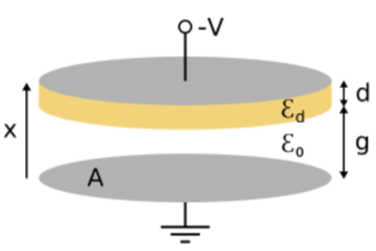
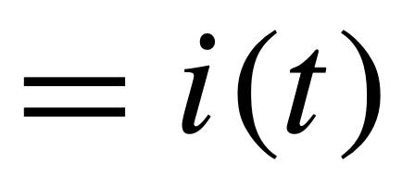
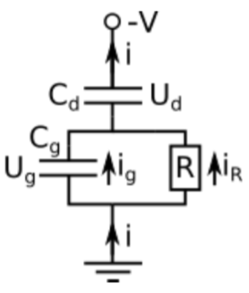
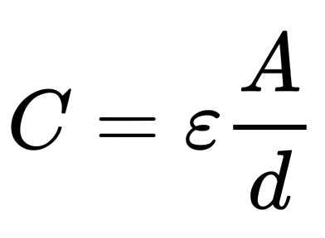
An alternative method for obtaining j_{R}
Conduction current
Translational current
Let‘s start with the equation for the total current
Measured current density
plate capacitor capacitance
From Kirchhoff’s laws
10
Notes:
Pozor je to pro verejnost … jednoduseji, schemata nazorna, ne moc analyz, jen par rovnic

Slide 18
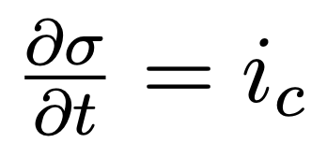
An alternative method for obtaining j_{R}
If we take into account the deposited surface charge, then (Bonaventura 2020):
surface charge deposition
step condition on the boundary of a dielectric (Tirpák)
after a few modifications:
the calculated current j_{R} obtained from Kirchhoff laws is identical to conduction current j_{C}
11
Notes:
Pozor je to pro verejnost … jednoduseji, schemata nazorna, ne moc analyz, jen par rovnic

Slide 19
QV diagrams of the DBD discharge
Manley 1943 showed that the energy dissipated in a DBD can be obtained from Lissajouse figures, graphically.
Today, these plots are called more accurately – QV plots/diagrams
12
Merbahi et al. 2004 JPDAP
Notes:
Pozor je to pro verejnost … jednoduseji, schemata nazorna, ne moc analyz, jen par rovnic

Slide 20
QV diagrams of the DBD discharge
So how do the equivalent circuit and QV plots play together?
Power dissipated in the discharge can be obtained from current and voltage:
And for total dissipated energy, it has to hold that:
Effective capacitances obtained directly from experiment
13
Notes:
Pozor je to pro verejnost … jednoduseji, schemata nazorna, ne moc analyz, jen par rovnic

Slide 21
Volume diagnostics of DBD plasmas

Slide 22
Applying cross-correlation spectroscopy to understand DBDs (Kozlov 2001)
Symmetrical atm. pressure discharge
Light emission during the discharge
Time-correlated photon counting technique
Light emission in the Townsend phase
18
Notes:
Pozor je to pro verejnost … jednoduseji, schemata nazorna, ne moc analyz, jen par rovnic

Slide 23
Measuring the electric field in DBDs
Spectroscopic method based on nitrogen emission bends, developed by Kozlov in 2001
19
Notes:
Pozor je to pro verejnost … jednoduseji, schemata nazorna, ne moc analyz, jen par rovnic

Slide 24
Spatio-temporal evolution of DBDs
Applicable to different types of DBDs
objemový bariérový
výboj
koplanární bariérový
výboj
povrchový bariérový
výboj
20
Notes:
Pozor je to pro verejnost … jednoduseji, schemata nazorna, ne moc analyz, jen par rovnic

Slide 25
Spatially resolved simulations of DBD discharges
Simulating a co-planar DBD discharge, Jánský 2022
21
Notes:
Pozor je to pro verejnost … jednoduseji, schemata nazorna, ne moc analyz, jen par rovnic

Slide 26
Surface charge in dbd discharges

Slide 27
Surface charge in DBDs
Pockels effect has been used to measure surface charge (Zhu 1996), for a point-to-plane config
Positive tip transitioning to negative polarity
Negative tip transitioning to positive polarity
22
Notes:
Pozor je to pro verejnost … jednoduseji, schemata nazorna, ne moc analyz, jen par rovnic

Slide 28
Surface charge in DBDs
There is a „surface streamer“ forming in point-to-plane DBDs (Kumada 2009)
The electric field exceeded an equivalent of 30kV/cm at higher pressure (experiments done at low pressure)
24
Notes:
Pozor je to pro verejnost … jednoduseji, schemata nazorna, ne moc analyz, jen par rovnic

Slide 29
Povrchový náboj bariérového výboje
srovnání množství deponovaného náboje určeného skrze elektrická měření a ekvivalentní obvod a skrze Pockelsův efekt (Bogaczyk 2012):
objemový bariérový výboj za atmosférického tlaku v heliu:
25
Notes:
Pozor je to pro verejnost … jednoduseji, schemata nazorna, ne moc analyz, jen par rovnic

Slide 30
Self organization of filamentary DBD discharges

Slide 31
Self organization of filamentary DBDs (Guikema 2000)
Localized filaments – they „prefer“ to ignite in discrete places, rather than randomly.
The decisive mechanism is the surface charge accumulation and the „dose“ of charge deposited by individual discharges.
přenos náboje skrze jednotlivé výboje
střední vzdálenost filamentů
26
Notes:
Pozor je to pro verejnost … jednoduseji, schemata nazorna, ne moc analyz, jen par rovnic

Slide 32
Samo-organizace filamentů bariérových výbojů (Stollenwerk 2004)
Localized filaments – they „prefer“ to ignite in discrete places, rather than randomly.
The decisive mechanism is the surface charge accumulation and the „dose“ of charge deposited by individual discharges.
pozitivní
náboj
negativní
náboj
26b
Notes:
Pozor je to pro verejnost … jednoduseji, schemata nazorna, ne moc analyz, jen par rovnic

Slide 33
Self organization of filamentary DBDs
Microscopic view of the charge accuulation effect
neúplné pokrytí nábojem
reprodukce polohy skrze lokální elektrické pole
27
Notes:
Pozor je to pro verejnost … jednoduseji, schemata nazorna, ne moc analyz, jen par rovnic

Slide 34
DBD applications

Slide 35
Ozone generation (Eliasson 1987)
Possibly oldest application of DBD discharges
Motivated formulation of the first physical and chemical models.
1D model described the formation of a transient glow discharge at high pressure.
Actuall EEDF was calculated and from it, rate coefficients and transport properties were deduced.
The mechanism for ozone formation and potential ozone loss was identified as follows:
28
Notes:
Pozor je to pro verejnost … jednoduseji, schemata nazorna, ne moc analyz, jen par rovnic

Slide 36
Ozone production – oxygen dissociation
29
Notes:
Pozor je to pro verejnost … jednoduseji, schemata nazorna, ne moc analyz, jen par rovnic

Slide 37
Ozone production – effect of admixtures
In industrial production, gases that form metastable excited species are often added, further enhancing the dissociation rate of oxygen by plasma.
Microdischarge in pure oxygen
30
Notes:
Pozor je to pro verejnost … jednoduseji, schemata nazorna, ne moc analyz, jen par rovnic

Slide 38
Ozone production – an industrial setup
31
Notes:
Pozor je to pro verejnost … jednoduseji, schemata nazorna, ne moc analyz, jen par rovnic

Slide 39
Surface processing
pro reaktivní plyny a depozice (Massines 2012)
změna kontaktního úhlu, PET povrch, DCSBD (Homola 2017)
DCSBD – in-line opracování, no-pinholing, i tepelně citlivé povrchy/vzorky
32
Notes:
Pozor je to pro verejnost … jednoduseji, schemata nazorna, ne moc analyz, jen par rovnic

Slide 40
Excimer light sources
Very intense UV light sources
surface and water cleaning by UV
UV curing and photopolymerization
excimer lasers for semiconductor applications
33
Notes:
Pozor je to pro verejnost … jednoduseji, schemata nazorna, ne moc analyz, jen par rovnic

Slide 41
Excimer light sources
Very intense UV light sources
surface and water cleaning by UV
UV curing and photopolymerization
excimer lasers for semiconductor applications
34
Notes:
Pozor je to pro verejnost … jednoduseji, schemata nazorna, ne moc analyz, jen par rovnic

Slide 42
Takeaways
What is a DBD and what are its various arrangements
Where is the voltage drop in DBDs, what are the methods for accurately measuring plasma power and voltage?
What are some methods of DBD diagnostics.
DBD applications

