Slide 1
English for Physicists 2 Week 9
Light and describing a process

Slide 2
Light quiz
Different types of lamps
Describing a process

Slide 3
Discussion
White light can be separated into different colours. What
are they?
b) What is the difference between a transparent and
translucent material?
c) What is the difference between light and sound waves?
d) What colour clothes do you like to wear?
e) What do different colours mean in our culture?

Slide 4
Light quiz
1 B
2 D
3 C
4 A
5 D
6 C
7 B
8 C
9 C
10 D

Slide 5
What is light?
called photons
contained in each photon
detected by the human eye
as demonstrated in the dual slit experiment
which is the colour of the light
changing electric and magnetic fields
which is the brightness of the light
speeding those particles

Slide 6
What is light?
Light is simply a name for a range of electromagnetic radiation that can be 1. ____. What is electromagnetic radiation, then?
Electromagnetic radiation has a dual nature as both particles and waves. One way to look at it is as 2. ____which propagate through space, forming an electromagnetic wave. This wave has amplitude, 3. ____, wavelength, 4. ____, and an angle at which it is vibrating, called polarization. This was the classical interpretation, crystallized in Maxwell's equations, which held sway until Planck, Einstein and others came along with quantum theory. In terms of the modern quantum theory, electromagnetic radiation consists of particles 5.____, which are packets ("quanta") of energy which move at the speed of light. In this particle view of light, the brightness of the light is the number of photons, and the colour of the light is the energy 6.____.
Which interpretation is correct? Both of them, actually. It turns out electromagnetic radiation can have both wave-like and particle-like properties 7. ____.

Slide 7
What is light?
Light is simply a name for a range of electromagnetic radiation that can be 1. C. What is electromagnetic radiation, then?
Electromagnetic radiation has a dual nature as both particles and waves. One way to look at it is as 2. F which propagate through space, forming an electromagnetic wave. This wave has amplitude, 3. G , wavelength, 4. E, and an angle at which it is vibrating, called polarization. This was the classical interpretation, crystallized in Maxwell's equations, which held sway until Planck, Einstein and others came along with quantum theory. In terms of the modern quantum theory, electromagnetic radiation consists of particles 5. A, which are packets ("quanta") of energy which move at the speed of light. In this particle view of light, the brightness of the light is the number of photons, and the colour of the light is the energy 6. B.
Which interpretation is correct? Both of them, actually. It turns out electromagnetic radiation can have both wave-like and particle-like properties 7. D.

Slide 8
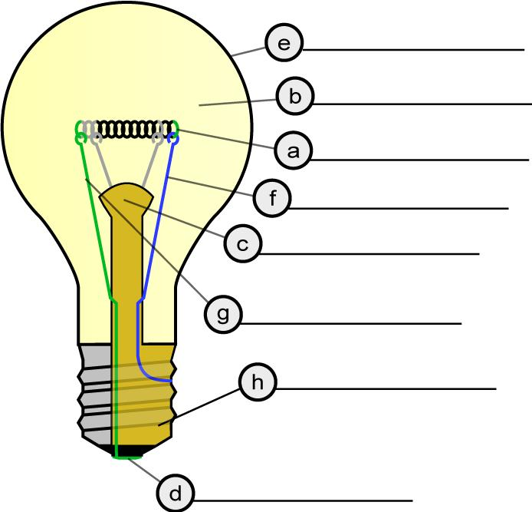
Filament lamps
a tungsten filament coil
b inert gas
c glass mount
d electrical foot contacts
e glass case or bulb
f support wire
g support wire
h screw thread

Slide 9
Describing a process While … concludes with prior to this … commences with subsequently
Firstly, | The first step is | Secondly, Thirdly, | After this,
First of all, | The first stage is | Next, | Further,
To begin with, | …begins with | Then, | In the next stage,
Initially, |  |  | In the following stage,
Beforehand, | Before this, | Later, | Following this,
Previously, |  | Eventually, | …until…
Once | When this happens | Lastly | …finishes with…
At the same time, | During | Finally,
Simultaneously, |  | In the last stage, | The last step is…

Slide 10
Describing a process While … concludes with prior to this … commences with subsequently
Firstly, | The first step is | Secondly, Thirdly, | After this,
First of all, | The first stage is | Next, | Further,
To begin with, | …begins with | Then, | In the next stage,
Initially, | commences | subsequently | In the following stage,
Beforehand, | Before this, | Later, | Following this,
Previously, | prior to this | Eventually, | …until…
Once | When this happens | Lastly | …finishes with…
At the same time, | During | Finally, | concludes with
Simultaneously, | while | In the last stage, | The last step is…

Slide 11
Filament lamps
a tungsten filament coil
b inert gas
c glass mount
d electrical foot contacts
e glass case or bulb
f support wire
g support wire
h screw thread

Slide 12
LED light – how does it work?
1.What any LED is made up of | 3 main _____
2. What is between an anode and a cathode | _____
3. The basis of a LED operation | ______
4. What determines the colour of the LED light | ____
5. Most common use of LEDs | ______
6. The problem with using LEDs as a light source | amount of ______________
7. The example of a less efficient light source mentioned | ______
8. It absorbs heat to reduce an LED’s degradation | ________________

Slide 13
LED light – how does it work?
1.What any LED is made up of | 3 main components
2. What is between an anode and a cathode | a semiconductor crystal
3. The basis of a LED operation | electroluminiscence
4. What determines the colour of the LED light | semiconducting material
5. Most common use of LEDs | indicators
6. The problem with using LEDs as a light source | amount of light emission
7. The example of a less efficient light source mentioned | incandescent light bulbs
8. It absorbs heat to reduce an LED’s degradation | heat sink

Slide 14
a) What do these terms refer to: valence band, conduction band, and band gap.
b) Which colours can LEDs have?
c) Which colour is most difficult to produce?
d) Why?

Slide 15
Describing a process
These points are commonly covered in a process description:
Sequence
Method
Position
Purpose
Describe a process of light generation using – incandescent lamp
fluorescent lamp
LEDs

Slide 16
How lightning stikes
Use these connectors to coherently describe this process.
While doing so Thus Eventually As As a result Subsequently
the hail strips electrons from the ice.
static electricity builds.
a thundercloud billows, rising ice crystals collide with falling hailstones.
a negative spark is launched from the lower cloud by a yet unknown trigger.
the top of the cloud becomes mostly positive and the bottom negative.
negative charges in the lower cloud induce a positive region, or “a shadow” on the earth below.

Slide 17
How lightning strikes
As a thundercloud billows, rising ice crystals collide with falling hailstones.
While doing so, the hail strips electrons from the ice.
As a result, the top of the cloud becomes mostly positive and the bottom negative.
Thus, negative charges in the lower cloud induce a positive region, or “a shadow” on the earth below.
Subsequently, static electricity builds.
Eventually, a negative spark is launched from the lower cloud by a yet unknown trigger.

Slide 18
HW for week 10: Prepare a monologue - Describe and explain a process / notion / experiment within your field of study (approximate length – 3-5 mins).

Slide 19
Jumbles texts – predict the content
Nulled Starlight A Perfect Dielectric Mirror Solar Surgery

Slide 20
Jumbles texts – predict the content
Nulled Starlight A Perfect Dielectric Mirror Solar Surgery
5, 3, 9 1, 4, 7 6, 2, 8

Slide 21
Vocabulary task
1. Solar surgery may be on the horizon.
a) coming b) reaching high point
2. Concentrated sunlight can match the laser power density.
a) equal b) combine
3. Cutting tissue with sunlight wouldn´t be feasible.
a) comfortable b) possible to do
4. High power absorption matters.
a) is material b) is important
5. That is also the case for most laser procedures.
a) Situation is the same b) There is an exception

Slide 22
Vocabulary task
1. Solar surgery may be on the horizon.
a) coming b) reaching high point
2. Concentrated sunlight can match the laser power density.
a) equal b) combine
3. Cutting tissue with sunlight wouldn´t be feasible.
a) comfortable b) possible to do
4. High power absorption matters.
a) is material b) is important
5. That is also the case for most laser procedures.
a) Situation is the same b) There is an exception

Slide 23
HW – underline the correct word
The fluorescent lamp is a sealed 1 (cylindrical / circular) glass tube that 2 (contains / consists) mercury at high pressure and electrodes at either ends of the tube. Sometimes a small amount of inert gas, such as argon, is placed in the tube. A phosphor powder 3 (skirts / coats) the inside of the glass. When the lamp is turned on, the current 4 (swims/flows) through the electrical circuit to the electrodes, which shoot electrons into the mercury vapour causing it to 5 (emit / emerge) a bluish light and ultraviolet radiation. We are unable to see the radiation but, when it hits the phosphor powder in the glass tube, it causes the emission of 6 (visible / seeable) light. These lamps do not produce much heat. 7 (Incandescent / Non-candescent) light bulbs glow because the filament is 8 (heated / heating) to a very high temperature. So a lot of energy is wasted as heat. Therefore, fluorescent lamps are more 9 (economical / economic) than conventional light bulbs, even though the initial installation 10 (price / cost) of the fluorescent lamp is higher.

Slide 24
HW – underline the correct word
The fluorescent lamp is a sealed 1 (cylindrical / circular) glass tube that 2 (contains / consists) mercury at high pressure and electrodes at either ends of the tube. Sometimes a small amount of inert gas, such as argon, is placed in the tube. A phosphor powder 3 (skirts / coats) the inside of the glass. When the lamp is turned on, the current 4 (swims/flows) through the electrical circuit to the electrodes, which shoot electrons into the mercury vapour causing it to 5 (emit / emerge) a bluish light and ultraviolet radiation. We are unable to see the radiation but, when it hits the phosphor powder in the glass tube, it causes the emission of 6 (visible / seeable) light. These lamps do not produce much heat. 7 (Incandescent / Non-candescent) light bulbs glow because the filament is 8 (heated / heating) to a very high temperature. So a lot of energy is wasted as heat. Therefore, fluorescent lamps are more 9 (economical / economic) than conventional light bulbs, even though the initial installation 10 (price / cost) of the fluorescent lamp is higher.

