Slide 1
English for Mathematicians IV
Week 5

Slide 2
HW for week 5: Think about the mathematical concept of your choice. The purpose is to convey a difficult idea to your audience in a comprehensible way. How would you explain it to
a) your fellow student of mathematics
b) a layperson

Slide 3
Outline
Delivering a presentation
Visuals – how, why, what

Slide 4
Why are these items important for a successful presentation?
eye-contact postures and gestures right pace (not fast or slow)
correct pronunciation of key terms
knowing your slides intonation and pauses

Slide 5
Read the article bellow and find out what it says about
Memorizing Filler words Body posture
Eyes Non-native audience Reciting
Tone & volume of voice Gestures Knowing your slides
Mispronouncing key terms

Slide 6
Watch two versions of the video. As you watch, make notes on Dr Linden’s presentation. Use this checklist to help you.
 | Version 1 | Version 2
eye- contact
gestures and postures
intonation
use of pauses
pace

Slide 7
What are the differences between written and spoken language? Divide the statements into two groups.
long sentences simpler arguments personal style
complex vocabulary shorter sentences
impersonal style complex arguments
simpler vocabulary

Slide 8
Using visuals
a) Why are visuals used in scientific papers and presentations?
b) What visuals do people in your field commonly use to show
data? Why?

Slide 9
Visuals
What can be used as a visual? | Why to use visuals? | How to use visuals effectively?

Slide 10
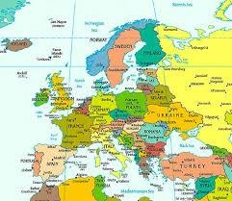
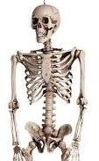
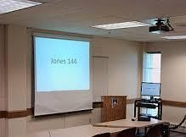
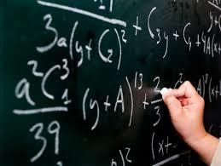
Presentations: VISUALS
WHAT?

Slide 11
Presentations: VISUALS
WHY? – visuals can:
focus the attention (reinforce your main ideas)
help to explain (illustrate points)
help the presenter’s memory
motivate the audience
involve the audience, …

Slide 12
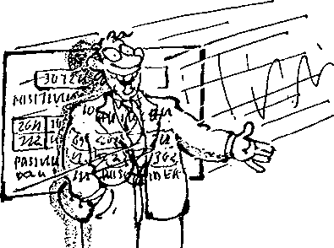
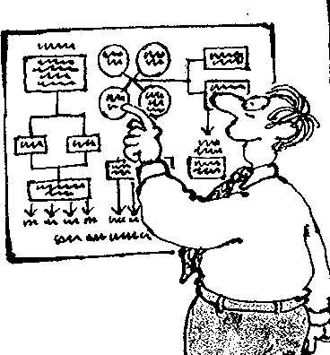
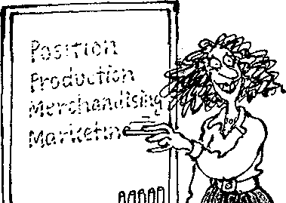
Presentations: VISUALS
HOW?
visuals should be:
visible
simple
interesting
practical
to the point

Slide 13
Rules for using visuals
1 Tables, graphs, etc. are necessary | a be consistent with them.
2 Visual summaries allow | b reduced in size in a paper.
3 Deciding how to present data visually makes you | c show trends; tables to show exact numbers.
4 Visuals need to be clear even when | d the reader to check the data for themselves.
5 Graphs should be used to | e think carefully about what your results mean.
6 Too much information in a visual | f to avoid filling up the text with lists of numbers.
7 Use standard symbols and | g will confuse the reader.

Slide 14
Rules for using visuals
1 Tables, graphs, etc. are necessary F | a be consistent with them.
2 Visual summaries allow D | b reduced in size in a paper.
3 Deciding how to present data visually makes you E | c show trends; tables to show exact numbers.
4 Visuals need to be clear even when B | d the reader to check the data for themselves.
5 Graphs should be used to C | e think carefully about what your results mean.
6 Too much information in a visual G | f to avoid filling up the text with lists of numbers.
7 Use standard symbols and A | g will confuse the reader.

Slide 15
Introducing visuals
attention aspects Illustrate glance see take appreciate refers
OK. Let’s 1)…………. a look at …..
The first / second / next / final slide is …..
This shows / illustrates / demonstrates / 2)……… to …..
As you can 3)………… from these figures...
Let's have a look at this model...
To 4)………….. my point let’s look at some diagrams...
If you look at this bar chart you'll notice...
If you look at this histogram you'll 5)………………...
If you look at this flow chart you'll understand ...
I’d like to draw your 6)……………… to …..
One of the most important 7)………………. of this is …..
At first 8)………….. it seems ….. but …..

Slide 16
Introducing visuals
attention aspects Illustrate glance see take appreciate refers
OK. Let’s 1) take a look at …..
The first / second / next / final slide is …..
This shows / illustrates / demonstrates / 2) refers to …..
As you can 3) see from these figures...
Let's have a look at this model...
To 4) illustrate my point let’s look at some diagrams...
If you look at this bar chart you'll notice...
If you look at this histogram you'll 5) appreciate
If you look at this flow chart you'll understand ...
I’d like to draw your 6) attention to …..
One of the most important 7) aspects of this is …..
At first 8) glance it seems ….. but …..

Slide 17
Effective use of captions
1. Should the caption appear above or below the visual it describes?
Why?
2. What kind of information should the caption include?

Slide 18
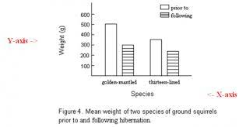

Slide 19
Rewriting captions – noun phrases
a) The table compares the physical and chemical characteristics of the hydrothermal fluids.
The comparison of the physical and chemical…
b) The chart depicts how many students in class speak both English and Spanish.
The number of students…
c) This table lists the names of people who have seen the Loch Ness monster.
Loch Ness monster witnesses
d) The picture illustrates the way in which functions can be categorized.
The categorization of functions
e) The pie chart shows how the percentage of the expenditure incurred is distributed.
The distribution of the incurred expenditure percentage

Slide 20
TED talk
Watch the extract from a TED talk and comment on the way in which the presenter uses visuals.

Slide 21
Listening. Fill in the missing words.
a) Differential equations arise whenever it is easier to describe ……………….. than ………………………….
b) In Newtonian mechanics, motion is described in terms of …………., and it determines ……………….
c) ODEs involve functions with a ……………………….. and PDEs deal with functions with …………………….
d) You think of PDEs as involving a …………………………… of values changing with time.
e) ODEs involve only a ……………………………………………………………….of values changing with time.
f) The …………………………………………………………………., however, does not have to be time.

Slide 22
Listening. Fill in the missing words.
Differential equations arise whenever it is easier to describe change than
absolute amounts.
b) In Newtonian mechanics, motion is described in terms of force, and it determines acceleration.
c) ODEs involve functions with a single input and PDEs deal with functions with multiple inputs.
d) You think of PDEs as involving a whole continuum of values changing with time.
e) ODEs involve only a finite collection of values changing with time.
f) The one independent variable, however, does not have to be time.

Slide 23
The spread of a rumor
Suppose two students at your school start a rumor. How could we describe the spread of the rumor throughout the school population? Could we determine a function S such that S(t) approximates the number of people that know the rumor at a time arbitrary time t, where t is measured in, say, hours?
We'll begin by trying to decide what the graph of S might look like. Assume that M is the population of your school, and that M is sufficiently large that it makes sense to model discrete numbers of students with a continuous function. Thus, if S(3) = 127.8, we'll predict that the number of students who know the rumor after 3 hours is approximately 128.

Slide 24
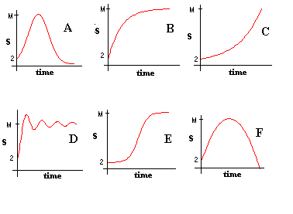
The spread of a rumor

Slide 25
Which conditions determine the rate of spread of the rumor?
1.
2.
3.

Slide 26
Matching task
1 – Oscillation – amplitude of a pendulum
2 – S-curve (logistic function) – spreading of an infectious disease
3 – Damped oscillation – amplitude of a mass on a spring
4 – Exponential growth – money on account with fixed interest rate, population with
unlimited resources
5 – Exponential decay – radioactive decay, heat transfer
6 – Exponential collapse – collapse of ice cover
7 – Growth and collapse – population growth in limited environment

Slide 27
HW Sentence transformations
a) A surface chart is useful when you want to find optimum _________ (combine) between two sets of data. As in a topographic map, colours and patterns indicate areas that are in the same range of ________(evaluate).
b) Pie charts show the size of items in one data series, proportional to the sum of the items. The data points in this type of chart are displayed as a ______ (per cent) of the whole chart.
c) Area charts ______ (emphasis) the magnitude of change over time, and can be used to draw attention to the total value across a trend.
d) Column charts are useful for showing data changes over a period of time or for illustrating ________ (compare) among items.
e) You could use a stock chart to indicate the ________ (fluctuate) of daily or annual temperatures.
f) Like a pie chart, a doughnut chart shows the _______ (relate) of parts to a whole, but it can contain more than one data series.
g) A bar chart is a _______ (graph) method of displaying several data series in the form of a two-dimensional chart of three or more quantitative ______ (vary) represented on axes starting from the same point.

Slide 28
HW Sentence transformations
a) A surface chart is useful when you want to find optimum combinations between two sets of data. As in a topographic map, colours and patterns indicate areas that are in the same range of values.
b) Pie charts show the size of items in one data series, proportional to the sum of the items. The data points in this type of chart are displayed as a percentage of the whole chart.
c) Area charts emphasize the magnitude of change over time, and can be used to draw attention to the total value across a trend.
d) Column charts are useful for showing data changes over a period of time or for illustrating comparisons among items.
e) You could use a stock chart to indicate the fluctuation of daily or annual temperatures.
f) Like a pie chart, a doughnut chart shows the relationship of parts to a whole, but it can contain more than one data series.
g) A bar chart is a graphical method of displaying several data series in the form of a two-dimensional chart of three or more quantitative variables represented on axes starting from the same point.

