Slide 1
English for Physicists IV
Week 6 – Ending, questions and astrophysics

Slide 2
Presentation Skills
Efficient ending?

Slide 3
ENDING = final impression ☺
traditional structure
I-N-A-G-L-S O-T D-E-N
M-M-R-A-U-S-Y
C-C-O-O-N-N-S-L-U-I
E-S-O-C-L
I-N-T-I-V-A-T-O-I-N F-R-O S-Q-U-E-T-S-N-I-O

Slide 4
ENDING = final impression ☺
traditional structure
SIGNAL TO END
SUMMARY
CONCLUSION
CLOSE
INVITATION FOR QUESTIONS

Slide 5
SUMMARY X CONCLUSION
summary – repeating the main points (no details, no new things)
conclusion – a commentary, the lessons learned, recommendations, suggestions or the next steps

Slide 6
How to conclude a scientific presentation
Summarize the key points.
Echo the core message.
Present a call to action.
Use a powerful quote.
Ask a rhetorical question.
Tell a story.
Give a visual image.
Acknowledge others.
Use a short but powerful sentence.
Make the audience laugh.

Slide 7
2. Listening. The ending of a scientific presentation should contain three parts. List them.
(5:08)
a)……………………………………….
b)………………………………………
c)………………………………………
What does the speaker say in the last part of her talk?

Slide 8
2. Listening. The ending of a scientific presentation should contain three parts. List them.
(5:08)
a) Restate the main take-away
b) Summarize the main points
c) Provide a sense of closure
What does the speaker say in the last part of her talk?

Slide 9
Dealing with questions

Slide 10
Dealing with questions – TRACT technique
T
R
A
C
T

Slide 11
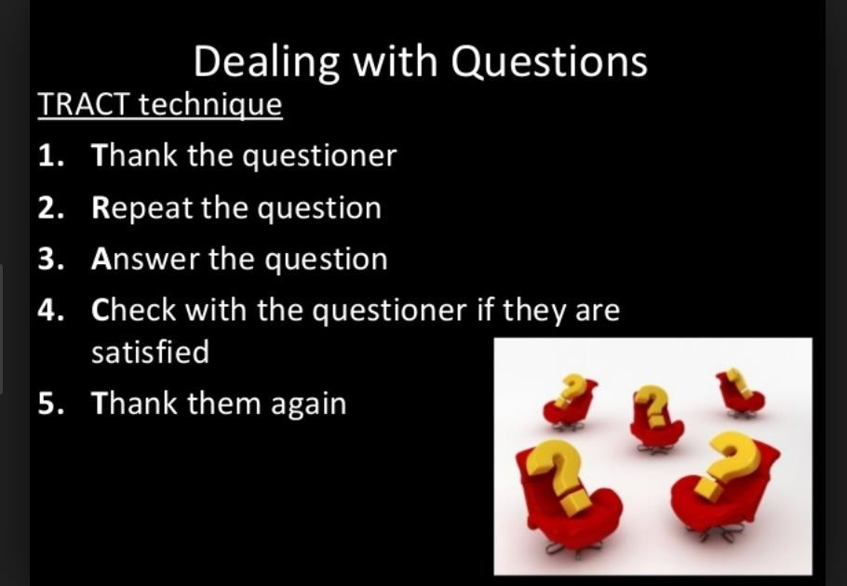

Slide 12
2. Watch and decide whether the speaker does (✓) or does not (x) carry out each stage
version 1
1x 2x 3x
1 2 3
1 2 3
1 2 3
1 2 3
version 2
welcomes the question
1 ✓ 2 ✓
3x phrases………………………..
takes time to think before answering
1
clarifies the question
1
replies positively
1
2 3 …………………………………
2 3 ………………………………….
2 3 ……………………………………
checks the questioner is satisfied
1 2 3 …………………………………..

Slide 13
2. Watch and decide whether the speaker does (✓) or does not (x) carry out each stage
version 1
1x 2x 3x
1 2 ✓ 3
1 2
1 2 ✓ 3
1 2
version 2
welcomes the question
1 ✓ 2 ✓
3x phrases………………………..
takes time to think before answering
1
clarifies the question
1 ✓
replies positively
1 ✓
2 ✓ 3 ✓ …………………………………
2 3 ………………………………….
2 ✓ 3 ……………………………………
3
checks the questioner is satisfied
1 2 3 ✓…………………………………..
3

Slide 14
Q&A sessions at conferences
After your presentation, the audience will ask you questions. What will you do in the following situations?
The person asks a question that will require a very long, complicated answer.
Instead of asking a question, the person states his viewpoint that agrees with yours.
Instead of asking a question, the person strongly, rather angrily, disagrees with you.
The person says that some of your information is inaccurate, but you are absolutely sure that you are correct.
The person says that some of your information is inaccurate, and you are not sure whether your information was correct or not.

Slide 15
1. Instead of asking a question, the person strongly, rather angrily, disagrees with you.
Instead of asking a question, the person states his/her viewpoint that agrees with yours.
The person says that some of your information is inaccurate, but you are absolutely sure that you are correct.
The person says that some of your information is inaccurate, and you are not sure whether your information was correct or not.
The person asks a question that will require a very long, complicated answer.
  Do not regard this as an attack. You can say: I appreciate your bringing this to my attention. I will have to recheck my sources to see what is correct.
  If possible, give your source of information. If you cannot do so, you can say: I believe that my information is correct, but I will certainly recheck my facts.
  You can say: That is an interesting question, but it would take much too long to answer it. Perhaps we can discuss it later.
  Listen politely, then restate your point of view, with additional evidence, if possible. Do not argue with the person. If he/she repeat their position, you can say: Well, we will have to agree to disagree on this point. or Unfortunately, there is no time to go into this more deeply right now.
  Show how this person’s ideas support your own point of view. You can say: Yes, that fits exactly with
what I was saying.

Slide 16
1. Instead of asking a question, the person strongly, rather angrily, disagrees with you. d
Instead of asking a question, the person states his/her viewpoint that agrees with yours. e
The person says that some of your information is inaccurate, but you are absolutely sure that you are correct. b
The person says that some of your information is inaccurate, and you are not sure whether your information was correct or not. a
The person asks a question that will require a very long, complicated answer. c
  Do not regard this as an attack. You can say: I appreciate your bringing this to my attention. I will have to recheck my sources to see what is correct.
  If possible, give your source of information. If you cannot do so, you can say: I believe that my information is correct, but I will certainly recheck my facts.
  You can say: That is an interesting question, but it would take much too long to answer it. Perhaps we can discuss it later.
  Listen politely, then restate your point of view, with additional evidence, if possible. Do not argue with the person. If he/she repeat their position, you can say: Well, we will have to agree to disagree on this point. or Unfortunately, there is no time to go into this more deeply right now.
  Show how this person’s ideas support your own point of view. You can say: Yes, that fits exactly with
what I was saying.

Slide 17
Match the type of question 1-4 and a recommended strategy a-d:
1. GOOD QUESTIONS a- try not to sound rude
2. DIFFICULT QUESTIONS b- you’ve already given the information, answer briefly
3. UNNECESSARY QUESTIONS c- ask the audience what they think, say you don’t know
4. IRRELEVANT QUESTIONS d- thank people for them

Slide 18
Match the type of question 1-4 and a recommended strategy a-d:
1. GOOD QUESTIONS D a- try not to sound rude
2. DIFFICULT QUESTIONS C c b- you’ve already given the information, answer briefly
3. UNNECESSARY QUESTIONS B c- ask the audience what they think, say you don’t know
4. IRRELEVANT QUESTIONS A d- thank people for them

Slide 19
4. Handling questions
I’m afraid I don’t see the connection.
Sorry, I don’t follow you.
Good questions
Difficult questions Unnecessary questions Irrelevant questions
I think I answered that earlier.
Good point.
Interesting. What do you think?
Well, as I said/mentioned earlier…
I’m afraid I don’t have that information.
That’s a very good question.
I don’t know that off the top of my head.

Slide 20
4. Handling questions
I’m afraid I don’t see the connection.
Good point.
Good questions 2, 8 Difficult questions 7,9 Unnecessary questions 3, 6 Irrelevant questions 4, 1, 5
I think I answered that earlier.
Sorry, I don’t follow you.
Interesting. What do you think?
Well, as I said/mentioned earlier…
I’m afraid I don’t have that information
That’s a very good question.
I don’t know that off the top of my head.

Slide 21
Indirect question
An indirect question is a question embedded inside another sentence. The word order of an indirect question is the same as for a statement, not a question. Indirect questions are a more polite way to ask for information or make requests.
Which calculation will you do tomorrow? direct question
indirect question?
Could you tell me which calculation you will do tomorrow?

Slide 22
7. Grammar focus – indirect questions.
Do you know…?
Can you tell me….?
I have no idea…
I would like to know…..
I wonder / was wondering … Do you happen to know…?
I am not sure……………. Have you any idea………. ?
Where does the author come from?
Is this the only solution?
Do you know where the author comes from?
Can you tell me if/whether this is the only solution?
Who proved that?
I have no idea who proved that.
Did you have a control group?
Why have you chosen this topic?
I would like to know if/whether you had a control group.
I wonder why you have chosen this topic.

Slide 23
More examples:
What variables were investigated? ………………………………………
How did the authors interpret the results? ………………………………..
What were the main findings? ………………………………………….
Why is this research relevant? …………………………………………..
What procedure was used? ……………………………………………..
Why have you decided to use this method? ………………………………………..

Slide 24
Which questions to expect?

Slide 25
Discussion
a) Is there only one scientific method or is there a specific scientific method for each field of science?
b) Why do scientists sometimes use a model rather than trying to analyse the behaviour of the real system?
c) Science nowadays is becoming more interdisciplinary. In your future careers, do you expect some cooperation with the experts from other fields?
d) Think about the title of the TED Talk. How do you think astrophysics can be applied in studying earthbound problems?

Slide 26
How do we use astrophysics to study earthbound problems?
1) What does Federica Bianco study?
2) What does she mention as her personal limitation?
3) How is the work of an astrophysicist different from the work in other fields of science? How do they obtain knowledge?
4) What are astrophysicists usually good at?
5) Who established the Urban Observatory and why?
6) What can the study of city lights tell us?
7) What does a mathematical model developed by the NYU students detect and classify?
8) Where else were the data analysis methods used in astrophysics applied?
9) What is the similarity between the stellar explosions and court cases?
10) How did her work in urban science enriched her perspective in astrophysics?

Slide 27
How do we use astrophysics to study earthbound problems?
1) What does Federica Bianco study? stellar explosions
2) What does she mention as her personal limitation? restlessness
3) How is the work of an astrophysicist different from the work in other fields of science? How do they obtain knowledge? through pictures and movies
4) What are astrophysicists usually good at? creating simple models and solutions from large data
5) Who established the Urban Observatory and why? her husband, to study earthbound problems
6) What can the study of city lights tell us? how much energy the city needs
7) What does a mathematical model developed by the NYU students detect and classify? plumes of smoke
8) Where else were the data analysis methods used in astrophysics applied? analysis of court cases
9) What is the similarity between the stellar explosions and court cases? vast amount of data
10) How did her work in urban science enriched her perspective in astrophysics?
she adapts models for detecting plumes to reflections of stellar explosions

Slide 28
3. Controversial statements to discuss – exam practice.
In your group, choose one topic you would like to discuss. Prepare arguments for and against the statement and present them. Other students will take turns to react using cards.
a) Astrophysics is not as practical as other branches of physics – it is mostly a blue-skies research.
b) Life on other planets is probably impossible, and projects like Mars Mission are mostly a waste of resources.
c) A black hole can possibly destroy the Earth.
d) Fusion is a viable energy source for the future.
e) Renewable energy sources can replace fossil fuels.
f) People are afraid of nuclear energy because they are largely ignorant of the physical processes behind it.
g) University education is necessary for a person´s success in life.
h) University students should at least partly pay for their education.

Slide 29
CARDS
Extra questions
My opinion concerning the topic
Agreeing
Disagreeing

Slide 30
HW for week 7: Abstract peer-review – you will get instructions.

