Slide 1
Introduction, general terms,reproduction, gametogenesis, HELENA NEJEZCHLEBOVÁ, helanej@sci.muni.cz
This material is intended only for students of Bi6140en Embryology (spring 2025). Free distribution prohibited. THANK YOU.

Slide 2
Embryology
study of the individual development (ontogenesis) of the embryo from an fertilized egg;
study of the formation and development of an embryo and fetus to the hatching/birth of a new individual;
study of the development of a fertilized egg into the complex of interdependent system of organs that contribute to adult animal
„embryon“ (gr.); embryo = formation developing from a fertilized egg cell, a formation formed by the first mitosis of the zygote;
„foetus“ (lat.); fetus = unborn vertebrate (mammal), the fetal period follows the embryonic
embryology: descriptive, comparative, experimental (microsurgical experiments), …
Importance of embryology:
a) broadening and deepening our knowledge
b) knowledge of factors, mechanisms and critical periods in ontogenesis is of great importance for the healthy development of individuals (prevention of congenital malformations, infertility treatment,…)
c) clarifies how normal and abnormal structures develop
d) knowledge of prenatal development is necessary for a number of professions: vets, scientists, embryologists, obstetricians, pediatricians, surgeons,…

Slide 3
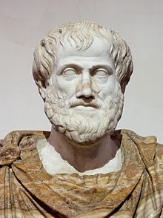
Hall of Fame
Aristotle (384-22 B. C.):
founder of biology as a science
1st textbook of reproductive biology De generatione animalium (On animal reproduction)
1st written records of the developing organisms: incubated and observed chicken eggs at various stages of development, he described the gradual formation of a shape from an unstructured mass
his theory of the origin and development of animals is very complex, it includes plants and animals, but also spontaneous births - generatio spontanea (lat.): life arising from non-living matter, mice born of mud or butterflies of dewdrops etc.
Claudius Galenus(130-200 A. D.):
theory of male and female semen
https://cs.wikipedia.org/wiki/Aristotel%C3%A9s

Slide 4
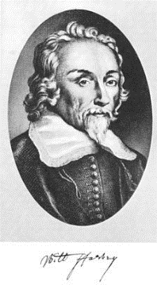
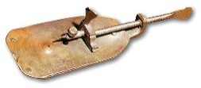
Hall of Fame
William Harvey (1578-1657):
1st person who recognized the full circulation of the blood in humans, rejected the theory of spontaneous birth formulated by Aristotle
"Omne vivum ex ovo" (all animals develop from an egg, but was unable to prove its existence)
De Generatione Animalium (1651): the beginning of the "embryological revolution", WH believed that sperm after entering the uterus metamorphose to form an embryo
Antony van Leeuwenhoek (1632-1723):
amateur researcher, founder of microscopic anatomy, „father of mikrobiology“, discovered sperm, follower of preformism (= ontogenesis is the unpacking of preformed forms): supposed to observe all parts of man in the embryo and sperm (homunculi), similarly leaves / flowers are present in seeds
Marcello Malpighi (1628-1694):
observed homunculi in eggs ☺, thought that unfertilized chicken eggs contained miniature chickens
Lazarro Spallanzani (1729-1799):
1st artificial fertilization (frog) and insemination (dog), proven importance of egg and sperm, refused theory of preformisn and spontaneour birth
Carl Linné (1707-1778):
plant pollination experiments (1740)
http://freethoughtblogs.com/pharyngula/files/2015/02/leeuwenhoek.jpg, https://cs.wikipedia.org/wiki/William_Harvey

Slide 5
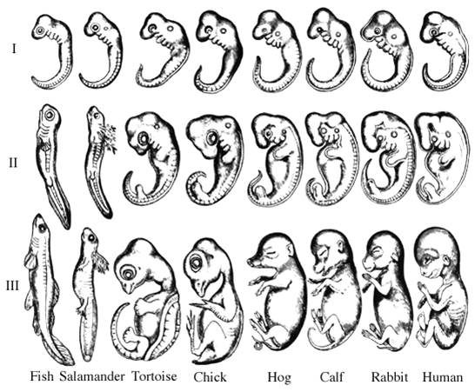
Hall of Fame
Carl Ernst von Baer (1791 – 1876):
microscopic description of a mammalian egg (1827)
comparison of embryonic development in mammals → Baer's ontogenetic law: general features common to large groups occur earlier in embryos than specialized features; embryos of different species differ more and more during development ; early embryo of „a higher animal“ (phylotypic stage) is similar to the early embryo of „a lower animal“, not an adult
J. E. Purkyně (1787–1869):
egg nucleus description („vescicola germinale“)
http://www.rustreg.upol.cz/_materials/vbi/10_Vyskot_Evodevo.pdf

Slide 6
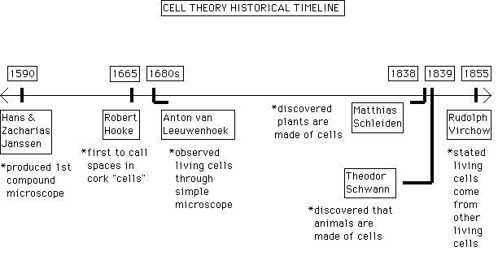
Hall of Fame
Rudolf Virchow (1821-1902): cell theory: „Omnis cellula ex cellula“
Ernst Haeckel (1834-1919): biogenetic law (recapitulation theory): ontogeny recapitulates phylogeny
August Weismann (1834-1914): germ plasma continuity theory, ie. germ cell lines = immortal "germen", transmitted through the mortal body
Oscar and Richard Hertwig (19./20. stol.): study of fertilization (model organism: sea urchin, zygote comes from the union of two different germ cells), mesoblast: middle germ leaf
O. Hertwig (1875): fertilization ← a single sperm, 1890 description of the stages of meiosis
http://ezlinking.blogspot.cz/2013/04/cell-theory_22.html
Notes:
v roce 1876: oplodnění zahrnuje pronikání spermie do vaječné buňky.

Slide 7
Hall of Fame
Theodor Boveri (1862-1915): chromosome theory: defined nuclear complexes with different effects on different cells
Thomas Hunt Morgan (1866 - 1945): model Drosophila, 1933: Nobel Prize as the first biologist!
Hans Spemann (1869-1941): amphibian research, embryonic induction (1924) = the ability of a embryonic tissue to induce differentiation of another tissue, 1935: Nobel Prize
Sydney Brenner (1927): model organism Caenorhabditis elegans, 2002: Nobel Prize; interesting videos about the importance of Caenorhabditis elegans in biology: http://www.jove.com/science-education/5110/c-elegans-development-and-reproduction and http://www.jove.com/video/2852/time-lapse-microscopy-of-early-embryogenesis-in-caenorhabditis-elegans
Robert Edwards and Patrick Steptoe (1978): Louise Brown (UK) is the first "test tube baby" in the world; R. Edwards (2010): Nobel Prize in Physiology and Medicine, (Steptoe died 1988); Luisa's birth raises a number of questions → 1984 Warnock Report (model document for assisted reproduction legislation in the UK and other countries)
Notes:
http://www.jove.com/science-education/5110/c-elegans-development-and-reproduction
http://www.jove.com/video/2852/time-lapse-microscopy-of-early-embryogenesis-in-caenorhabditis-elegans

Slide 8
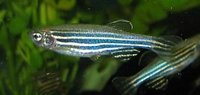
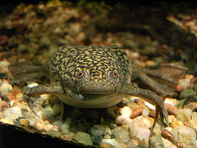
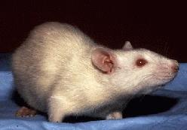
Model organisms in embryology
Model organisms: their research serves to acquire information about these species, but also to study general phenomena and derive laws applicable to other organisms. The study of these species has enabled significant discoveries in many disciplines, including embryology and developmental biology, with far-reaching implications for practice
Important model species include:
worm (Caenorhabditis elegans, Phylum: Nematode)
fruit fly (Drosophila (“dew lover”) melanogaster (“dark gut”), Phylum: Arthropod)
sea urchin (genus Echinus, Phylum: Echinoderm)
zebrafish (Brachydanio rerio, Phylum: Chordate)
African clawed frog (Xenopus laevis, Phylum: Chordate)
chicken (Gallus gallus domesticus, Phylum: Chordate)
mouse (Mus musculus, Phylum: Chordate)
Rattus norvegicus (Phylum: Chordate)
dog (Canis lupus familiaris, Phylum: Chordate)
https://cs.wikipedia.org/wiki/Dr%C3%A1patka_vodn%C3%AD, https://cs.wikipedia.org/wiki/D%C3%A1nio_pruhovan%C3%A9, https://en.wikipedia.org/wiki/Laboratory_rat

Slide 9
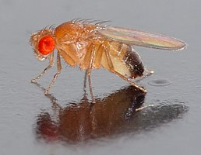
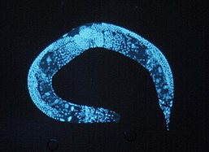
Model organisms in embryology
Why we generally do not study prenatal development in humans?: observation of embryos/fetuses is difficult inside body; morally and ethically problematic; experimental procedures very limited in humans
→ model organisms: similarities in the development of very different organisms; the eggs of different model organisms vary in size and design, but the overall design and body plan is very similar among embryos; model organisms allow understand a broad spectrum of biological principles or answer particular questions;
advantages: easy and cheep breeding under laboratory conditions, easy manipulation with gametes, embryos, adults; embryos develop outside the mother’s body, short life cycle, simple genom, …
https://cs.wikipedia.org/wiki/Octomilka, https://cs.wikipedia.org/wiki/H%C3%A1%C4%8F%C3%A1tko_obecn%C3%A9

Slide 11
Basic terms
development = qualitative change
ontogenesis = development of the individual
phylogenesis = evolution of species
gamete = a mature germ cell
zygote = a fertilized egg
proliferation = cell division
cell growth = quantitative change, anabolism / catabolism> 1
differentiation = cells change their functional or phenotypical type
migration = cell movement
morphogenesis = shape and structural development
association = moving cells into larger units
apoptosis = programmed cell death

Slide 12
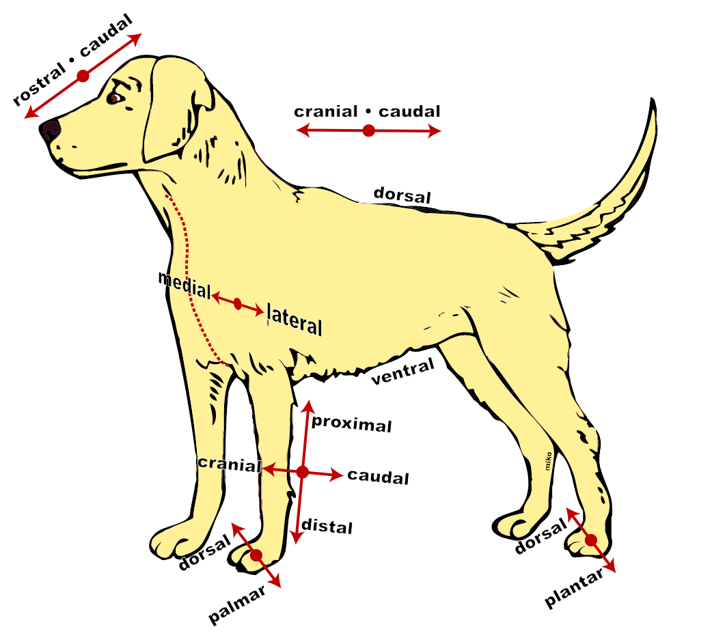
Anatomical terms of location
Anterior | In front of or front
Posterior | In behind of or behind
Ventral | Towards the front of the body
Dorsal | Towards the back of the body
Distal | Away or farthest away from the trunk or the point of origin of the body part
Proximal | Closer or towards the trunk or the point of origin of the body part
Median | Midline of the body
Medial | Towards the median
Lateral | Away from median
Superior | Towards the top of the head
Inferior | Towards the feet
Cranial | Towards the head
Caudal | Towards the tail
External | Towards the surface, superficial
Internal | Away from the surface, deep
Superficial | Nearer to the surface
Deep | Farther from the surface
Palmar | Anterior hand or palm of hand (palmar)
Dorsal (of hand) | Posterior surface of hand (dorsum)
Plantar | Inferior surface of foot (sole)
Dorsal (of foot) | Superior surface of foot (dorsum
https://static.wikia.nocookie.net/psychology/images/c/c2/Anatomical-directions.svg/revision/latest?cb=20070410223948, https://www.kenhub.com/en/library/anatomy/anatomical-terminology

Slide 13
Reproduction
basic property of living organisms
ability to form the basis of a system, which is the same as the founding system
allows to preserve the species and time continuity of life, to develop, increase the number of individuals, ensure the survival of the genetic lineages
sexual and asexual, or their alternation (metagenesis)
the level of reproduction is an indicator of the well-being of an organism in a given environment
an indicator of the balance of conditions in the external and internal environment of the organism
alternative definition by my colleague Aleš Bourek, Ph.D. ☺: male/man + female/woman + God/nature/fortune = offspring

Slide 14
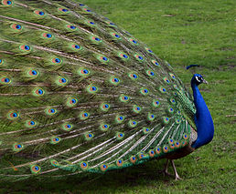
Reproductive system
system of reproductive organs (so-called generative organs)
glands + ducts (urogenital system) + accessory glands (yolk, endocrine, seminal vesicles in ♀, seminal vesicles in ♂) + copulatory organs + organs used for sexual selection (feathers, sounds, odor signals,…)
primitive reproductive organs can already be found in the phyllum Cnidaria
Fertility:
basic biological property
a prerequisite for the time existence of the species
complex feature based on the ability to have healthy offsprings in the optimal number (in a given time period)
determined by a number of genes (polygenic inheritance)
heritability, (h²) of fertility indicators is low, fertility of animals is decided mainly by environmental conditions (eg. breeding conditions)
https://upload.wikimedia.org/wikipedia/commons/thumb/a/af/PeackockSide.jpg/258px-PeackockSide.jpg

Slide 15
Asexual reproduction
x million species of animals exist on the Earth, but only about 1,000 of them reproduce asexually, in some species: (regular) alternation of sexual and asexual reproduction = metagenesis
offsprings are „genetic copies“ of a single parent
based on regeneration, mitosis (and its modifications)
in addition to mitosis, promitosis, multipolar mitosis, and multiple division of multinucleated cells can be observed
in unicellular and primitive multicellular organisms, leads to clones
somatic cells of the parent individual → somatic cells of offsprings
disadvantages: does not lead to genetic diversity among offsprings, but to genetic uniformity; → limited ability of offsprings to adapt
advantages: just one individual is needed for this type of reproduction, fast multiplication

Slide 16
Mitosis and its modifications
endomitosis: shortened karyokinesis, the cell enters a modified prophase: chromosomes form and divide longitudinally in the nucleus, BUT the nucleus does not divide, the multiplied chromosomes despiralize, the nucleus enters the resting phase, → increased cell function, leads to polyploidy (increased number of chromosomes in the cell); back: somatic reduction
polytenia: chromatin synthesized in S phases is stored in so-called polytene chromosomes, in each S phase the number of chromosomes doubles, but there is no division into chromatids; →increases cell function - but does not lead to polyploidization, back: somatic reduction
somatic reduction: the cell enters a typical mitosis without previous S phase of the cell cycle
restitution division of the nucleus: after metaphase, telophase reconstruction of a single nucleus follows, the result: a cell with twice the number of chromosomes, in the parthenogenetic development of eggs, it adjusts the haploid state of the egg to diploid
promitosis (pseudomitosis): all karyokinetic phases inside the nucleus → a constriction; phylogenetic precursor of mitosis, especially in protozoa (formation of plasmodia - multinucleated cells): plasmodia are formed by repeated karyokinesis within a single cell (eg. spores), which may be followed by the breakdown of a multinucleated cell into mononuclear cells
multipolar mitosis: in eggs in polyspermia; however, chromosomes are not evenly distributed in daughter cells and development does not continue
Notes:
endomitosis = division of chromosomes without following nuclear division → increased number of chromosomes in the nucleus

Slide 17
Sexual reproduction
combination of genetic material 2 organisms → genetically variable offsprings
chromosomes of two parents are segregated and recombined → no two offsprings are identical to each other or to either parent
relatively slow type of reproduction
external and internal fertilization
hologamy (the gametes are like ordinary cells, one cell org.)
oogamy (in multicellular, germ cells different from somatic cells)
gametic reduction (1n gametes, otherwise 2n phases)
zygotic reduction (2n only briefly for zygotes until the end of reduction division)
gonochorism: individuals have one sex of two distinct ones, males + females
hermaphrodism : an individual has both male and female reproductive organs
parthenogenesis: development of an individual from an unfertilized egg without male gamete (Insecta), sperm-based parthenogenesis is not known
heterogony: alteration of sexual and parthenogenetic reproduction (according to external conditions; Insecta)
Notes:
hermafrodismus: simultánní, geografický, sukcesní – proterogynie, proterandrie; division of chromosomes not followed by nuclear division that results in an increased number of chromosomes in the cell
Oocyt má oocyt má zásobu všech typů RNA a může v průběhu dlouhé profáze syntetizovat proteiny z prekurzorů v cytolazmě

Slide 18
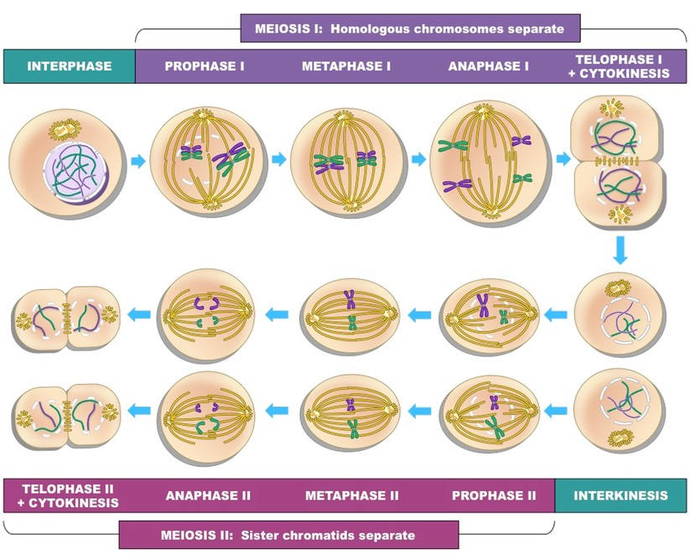
Meiosis
the formation of gametes and accurate transfer of genetic material to them in sexually reproducing organisms
key event in eukaryotes;
ensures the same number of chromosomes in the offspring as in the parent organism
the first meiotic division separates pairs of homologous chromosomes to halve the chromosome number (2n → 1n), immediately followed by:
the second meiotic division - separates sister chromatids
disorders → serious consequences (see further)
https://www.youtube.com/watch?v=LUFYcqtMKf0
Notes:
video meióza, nejčastější příčiny abortů: Turnerův s., trisomie 16, triploidie

Slide 19
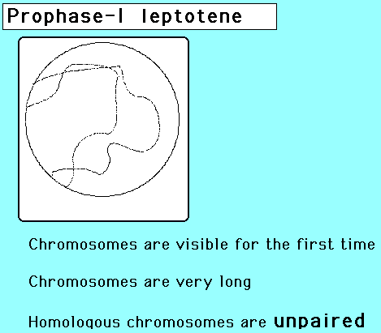
Meiosis
MEIOSIS I
PROPHASE I
anonymus (2)

Slide 20
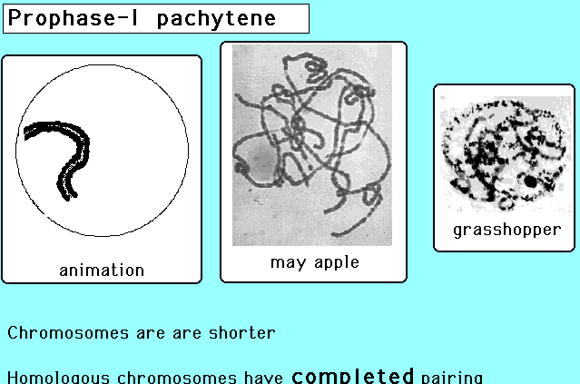
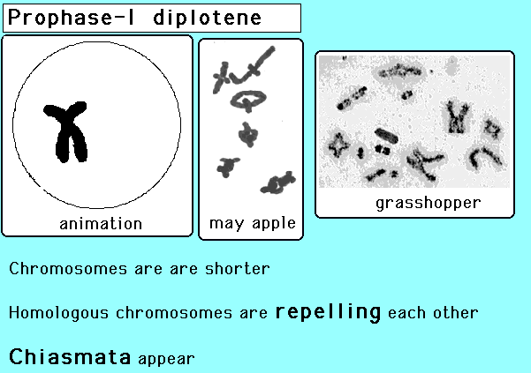
Meiosis
MEIOSIS I
PROPHASE I
anonymus (3)

Slide 21
Meiosis
METAPHASE I: homologous chromosomes → equatorial plane, microtubules of the dividing spindle connected to the centromere kinetochores so that from each pole they always reach one of the homologous chromosomes
ANAPHASE I: separation of whole homologous chromosomes to opposite poles of the nucleus (reduction of the number of chromosomes), a set of chromosomes is collected at each pole (combination of maternal and paternal chromosomes, with recombinant chromatids due to crossing-over)
TELOPHASE I: terminated by cell division → two haploid cells
MEIOTIC DIVISION II: except for the haploid number of chromosomes, it do not differ from mitosis
https://ib.bioninja.com.au/standard-level/topic-3-genetics/33-meiosis/crossing-over.html

Slide 22
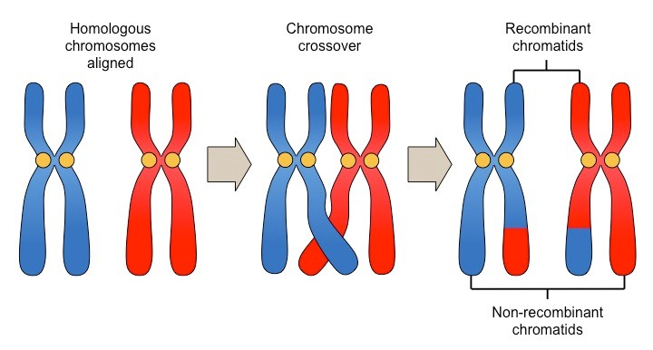
Meiosis
No crossing-over (left): 4 gametes, due to the random segregation 2 gamets are always are identical to each other
Crossing-over occurs (right): 4 different recombinant gametes
→ separation of sister chromatids → 4different recombinant gametes
https://ib.bioninja.com.au/standard-level/topic-3-genetics/33-meiosis/meiotic-division.html
https://ib.bioninja.com.au/standard-level/topic-3-genetics/33-meiosis/crossing-over.html

Slide 23
Gametogenesis
development of primordial germ cells (extraembryonic origin) and their migration into the gonads, further development → mature gametes
most animals contain primordial germ cells → gametes
primitive animals: gametes arise from undifferentiated cells in tissues and transformation into gametes is due to external influences (eg. adverse conditions); special reproductive organs (e.g. in Porifera) are not differentiated;
in most cases, reproductive organs develop and produce germ cells (gametes, sperm, and eggs) and allow them to fuse in the zygote. Reproductive organs usually arise from the special germinal epithelium of the coelom wall. Primitive special reproductive organs can already be found in phyllum Cnidaria.
Notes:
Savčí typ (typ Drosophila)
savci včetně člověka, někteří obojživelníci, plazi, většina řádů hmyzu a většina dvoudomých rostlin
pohlaví: XX (homogametní) tvoří vajíčka pouze s chromozomem X (samice)
pohlaví: XY (heterogametní) tvoří spermie buď s chromozomem X nebo s Y v poměru 1 : 1 (samci)
Ptačí typ (typ Abraxas)
ptáci, některé ryby, někteří obojživelníci a motýli
pohlaví: ZW (samice)
pohlaví: ZZ (samci)

Slide 24
Gametogenesis
multiplicative phase: mitotic division of primordial oogonia and spermatogonia
growth phase: increasing the volume of the cytoplasm, formation of primary spermatocytes and oocytes
maturation phase: formation of haploid secondary spermatocytes and oocytes (1st meiotic division)
the second meiotic division produces haploid spermatids and an ovulated secondary oocyte, while spermatids must undergo another process of differentiation, so-called spermateliosis (the course depends on what type of sperm are produced, the most common type are with flagellum = tail), the oocyte is a mature egg cell after the second meiotic division
spermatogenesis → 4 mature spermatozoa
oogenesis → 1 mature oocyte and 3 polar bodies or 2 if the first polar body does not undergo cell division (as in humans)
Notes:
Savčí typ (typ Drosophila)
savci včetně člověka, někteří obojživelníci, plazi, většina řádů hmyzu a většina dvoudomých rostlin
pohlaví: XX (homogametní) tvoří vajíčka pouze s chromozomem X (samice)
pohlaví: XY (heterogametní) tvoří spermie buď s chromozomem X nebo s Y v poměru 1 : 1 (samci)
Ptačí typ (typ Abraxas)
ptáci, některé ryby, někteří obojživelníci a motýli
pohlaví: ZW (samice)
pohlaví: ZZ (samci)

Slide 25
Gametogenesis
includes development of germ cells (extraembryonic origin) and their migration into the gonads
further development according to different schemes for ♂ and ♀:
mitotic germ cells proliferation in the germinal epithelium
in humans, oogonia multiplie in ♀ by the end of the 5th month of pregnancy, up to 7 million germ cells are formed, then their loss (atresia) until menopause
spermatogonia retain the ability to reproduce throughout life
Notes:
Savčí typ (typ Drosophila)
savci včetně člověka, někteří obojživelníci, plazi, většina řádů hmyzu a většina dvoudomých rostlin
pohlaví: XX (homogametní) tvoří vajíčka pouze s chromozomem X (samice)
pohlaví: XY (heterogametní) tvoří spermie buď s chromozomem X nebo s Y v poměru 1 : 1 (samci)
Ptačí typ (typ Abraxas)
ptáci, některé ryby, někteří obojživelníci a motýli
pohlaví: ZW (samice)
pohlaví: ZZ (samci)

Slide 26
Primordial germ cells (PGC)
→ germ cells (gametes)
their isolation and cultivation → embryonic germ cells ("embryonic germ cells", EGCs, therapeutic potential)
= gonocytes, mitotic division → spermiogonia (spermatogonia) and oogonia
in the human embryo, they are detectable 24 days after fertilization in the area of the yolk sac, in week 4-6 they migrate (active movement ?, growth forces and directed proliferation?) to the genital region and become part of the germinal epithelium of the ovaries / testicles, → oogonia / spermatogonia
PGC in extragonadal areas → teratomas
the basics of human gonads acquire an M / F character at week 12: development determined by gonosomes, TDF ("testis-determining factor" on the short arm of the Y chromosome) and MIF (Müllerian inhibiting factor; produced by Sertoli cells)

Slide 27
Spermatogenesis
spermatozoa: develop in the seminiferous tubules (type of tubular glands) from male primordial germ cells called spermatogonia
maturation begins under the influence of sex hormones in puberty
spermatogonia and further developmental stages of cells are connected by cytoplasmic bridges - synchronous development of a group of cells, initially dependent on Sertoli cells
Sertoli cells: → environment for development, a barrier regulating the exchange of molecules and protect against immunological destruction (blood-testis barrier, one of the tightest tissue barriers in the mammalian body, similar to blood-brain barrier )
sperm production in men: development takes 64 days, attention!: eg. antibiotics, antimitotic treatment !!!
sperm belong to the smallest cells of the body

Slide 28
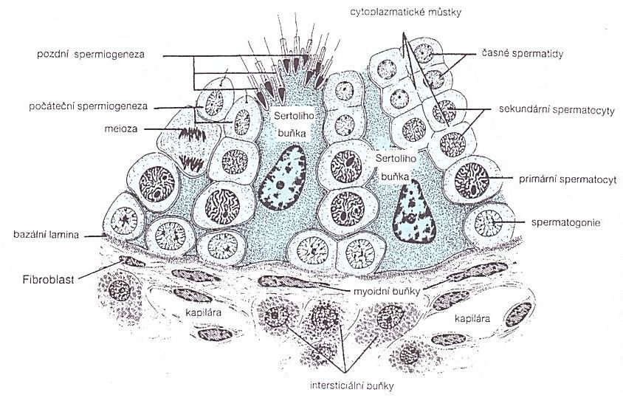
Spermatogenesis
spermatogonia: on the basement membrane of the seminiferous tubules
→ developmental stages of type A, IM and B. Type B leaves the basal compartment and enters the adluminal compartment between Sertoli cells → mitosis → 2 spermatocytes I. Thus, spermatogonia repeatedly divide (reproductive zone), enriched with nutrients and mitotically divided into spermatocytes I. We call this stage the growth stage.
when the cell enters the maturation stage, the first meiotic division occurs. Spermatocytes II are formed (prespermatids, relatively shortest period of existence within spermatogenesis). The second meiotic division produces spherical spermatids with haploid sets of chromosomes. Spermatocytogenesis is finished and spermiohistogenesis (spermateliosis) begins
Junqueira a kol., 1997

Slide 29
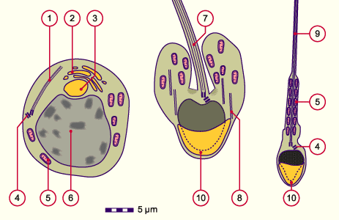
Spermiohistogenesis
reduction of the nucleus: chromatin condensation
cytoplasm reduction: → residual bodies (phagocytosis by Sertoli cells)
condensation of the Golgi apparatus → acrosome: hyaluronidase, acrosin, proacrosin, collagenase
flagellum development: mitochondria spirally arranged in the proximal part in the tale
the cells are still connected by cytoplasmic bridges
 | 1 Axonemal structure,first flagellar primordium 2 Golgi complex 3 Acrosomal vesicle 4 Pair of centrioles (distal and proximal) 5 Mitochondrion 6 Nucleus 7 Flagellar primordium 8 Microtubules 9 Sperm cells tail 10 Acrosomal cap
anonymus (2)

Slide 30
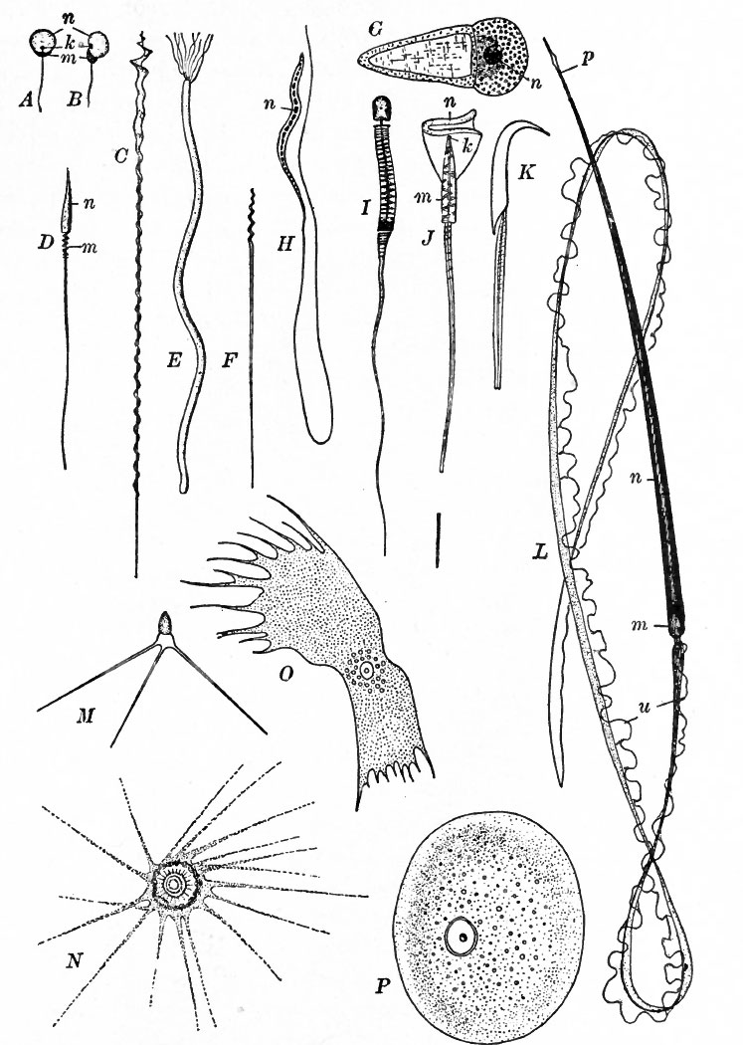
Spermatozoa
mammalian sperm in the seminiferous tubules: only morphological maturity, immobile, incapable fertilization
by the fluid produced by tubules, spermatozoa enter the epididymis
biological maturation during transport in ♂ reproductive tract
in ♀ reproductive tract: capacitacion - changes in cytoplasmatic membrane, acquisition of fertilization ability
human sperm: movement 1 to 4 mm / min., few reserve substances, diffusion nutrition, limited life, calcium fundamentally affects functionality
Sperm of different animals: A, B fish; C, D birds; E, F snakes; G Nematoda - Ascaris; H bats; K rodents; L newt; M, N, O, P crustaceans; u: undulating membrane
Knoz J., 1979

Slide 31
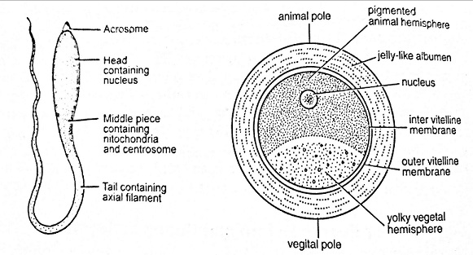
Oocytes
ova (plural, lat.), ovum (singular, lat.)
unicellular formations that contain genetic information and nutrition material in the early stages of embryo development
spherical, with an asymmetric internal structure
during oogenesis, animal-vegetal polarity arises, the animal pole contains germinal vesicle; vegetal pole is rich in yolk
the amount of yolk (proteins, lipids and glycogen to nourish the embryo) correlates with the duration of development reguired before the individual can feed itself after hatching or before placental attachement with mother is established
the envelopes: membrana vitellina (vitelline envelope), albumen („egg white“), shell membranes, calcium shell; zona pellucida in mammals;
the plasma membrane of an egg is covered by a glycoprotein layer in mammals (=zona pellucida) and generally referred to as vitelline envelope which plays an important role in fertilization. Eggs deposited on land (reptiles, birds) have hard shells. Eg. the yolky chicken egg is surrounded initially by a vitelline envelope. Above this envelope, “egg white” (contains ovalbumin) is deposited + shell membranes are added.
quantity of yolk and its distribution in the eggs → different types of cleavage after fertilization
fertilization → holoblastic (total) cleavage (sea urchins, amphibians,…)
→ meroblastic (partial) cleavage (superficial; insects, disc-shaped in fish, reptiles and birds)
when an egg develops in the presence of follicular cells, the oocyte is surrounded by one or more layers of epithelially arranged cells that are not its sister cells. These are somatic cells form a follicle around the oocyte. We encounter this development, for example, in insects, reptiles, birds and mammals, incl. humans.

Slide 32
Eggs based on yolk quantity and its distribution
Holoblastic (oligolecithal) eggs
alecithal: without yolk
isolecithal: even distribution of yolk, total cleavage → equally large blastomeres, equal cleavage (mammals, echinoderms)
heterolecithal: moderate yolk at vegetative pole (amphibians)
Meroblastic (polylecithal) eggs
telolecithal: most vertebrates (fishes, reptiles, birds), yolk accumulated at the vegetative pole (heavier), the opposite animal pole contains the nucleus of the oocyte → inequal cleavage: animal pole → micromers, vegetative pole → macromers; special type: discoidal cleavage
centrolecithal: arthropods, superficial cleavage
Note: humans - oligolecithal, isolecithal oocytes, total and equal cleavage
accordint to Knoz J., 1979

Slide 33
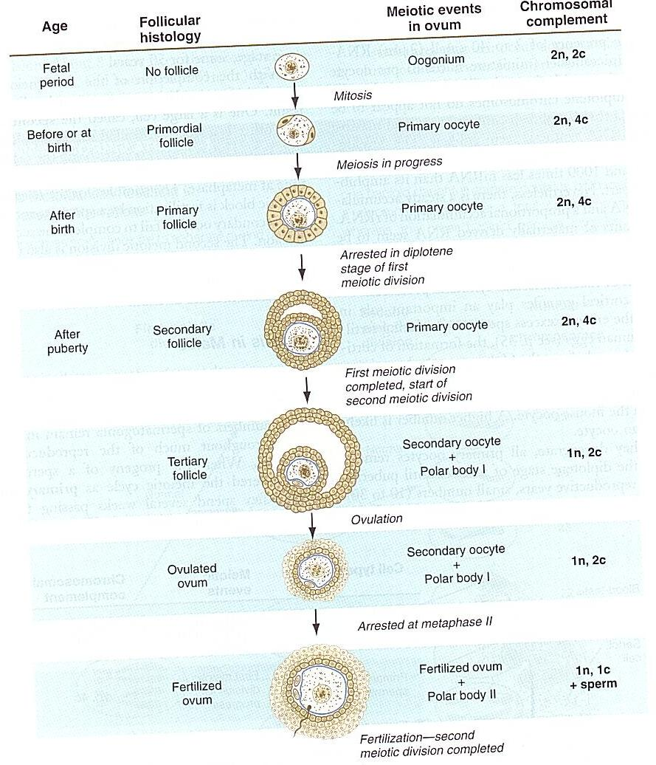
Oogenesis, folliculogenesis
oogenesis: the process by which female germ cells develop into mature eggs (ova)
folliculogenesis: is the process by which ovarian follicles develop from primordial to Graafian (mature) follicles, culminating in ovulation or atresia
primordial follicle
primary follicle
secondary follicle
tertiary (antral) follicle: contains an antrum (fluid-filled cavity), but it is not fully mature
Graafian follicle: mature/preovulatory follicle, the antrum is fully expanded, and the oocyte is surrounded by the cumulus oophorus (a cluster of granulosa cells), hormonal changes trigger the oocyte to complete meiosis I and prepare for release during ovulation
anonymus

Slide 34
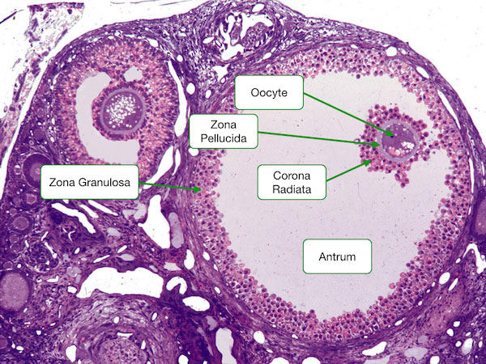
Oogenesis
maturation of the follicles continues only in and after puberty due to hormones
meiosis I → two haploid cells: one oocyte II and one polar body
meiosis II is initiated at the time of ovulation (in most mammals) and is completed only after the sperm penetrates the egg: oocyte II. → one egg and the second pole body are formed
all polar bodies are resorbed (this is generally the case, in humans the first polar body does not undergo division
Note: the picture shows (the largest) tertiary (antral) follicle
ovulation in uniparous animals: ovulation of a single egg (human, apes, elephants,…)
ovulation in multiparous animals: ovulation of more eggs (rodents, carnivores,…)
http://medcell.med.yale.edu/histology/ovary_follicle.php

Slide 35
Oogenesis
ovulation is caused by LH peak → ovulated oocyte (human): limited lifespan (!), no reserve substances, diffuse nutrition, energy source: pyruvate, nucleic acid synthesis does not take place, but the oocyte contains them
in humans: at the beginning of the cycle a cohort of about 20 early antral follicles begins to evolve, but only about 3 reach Ø 8 mm → one of the growing follicles (most sensitive to gonadotropins) reaches ovulation as the so-called dominant follicle, the others undergo atresia (apoptosis) )
AMH ("anti-Müllerian hormone"): important role in oocyte development - produced by granulosa cells of preantral and early antral follicles, its concentration correlates with ovarian reserve (diagnostic significance)
after ovulation: luteinization of granulosa cells → corpus luteum → progesterone (affects the differentiation of tissues of the reproductive system)
absence of fertilization: luteolysis (apoptosis) and collagenous degeneration of corpus luteum → corpus albicans
fertilization: hCG (human chorionic gonadotropin, produced by the syncytiotrophoblast blastocyst), hCG supports the activity of the corpus luteum graviditatis (produces progesterone especially in the first 2 months of pregnancy)

Slide 36
Gametogenesis (meiosis) disorders
teratomas: tumors of partly unclear origin, possible explanation: they arise from primordial germ cells that have deviated from their migratory pathway
disorders of gametogenesis (meiosis) → chromosomal abnormalities (structural and numerical):
a) aneuploidies (abnormalities in the number of chromosomes, usually trisomy or monosomy = there is an extra chromosome in the chromosome pair, or it is missing):
• non-disjunction (= incorrect segregation) of the chromosome(s) during the 1st (2nd) meiotic division
• incorrect (premature) sister chromatid separation during 1 meiotic division (dominant way?)
• other causes: Spindle Assembly Checkpoint (SAC) permeability, spindle instability
• Down s. (trisomy 21), Edwards s. (trisomy 18), Patau s. (trisomy 13), Klinefelter's s. (47, XXY, or 48, XXXY), Turner s. (45, X), triple syndrome X,…,often of maternal origin, age depend
b) structural chromosomal abnormalities: translocation of a part of a chromosome to another (common for chromosomes 13, 14, 15, 21, 22); loss of a chromosomal part (cri-du-chat syndrome = cat scream syndrome = partial deletion of short arm of chromosome 5), inversion,…
gene mutations
more than 75% of miscarriages during the first 2 weeks and more than 60 % in the first trimester of pregnancy are caused by chromosomal abnormalities (the most common are 45, X (Turner syndrome), triploidy, trisomy 16).
chromosomal abnormalities cause 7% of congenital malformations and gene mutations another 8 % of congenital malformations

Slide 37
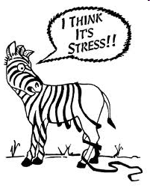
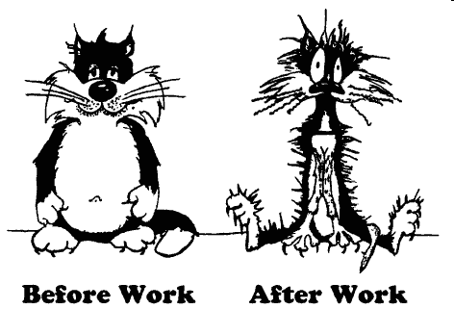
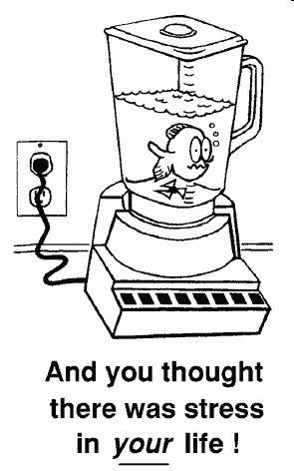
Role of hormones in reproduction
Stress → increase in stress hormone levels (cortisol) → decrease in GnRH and increase in GnIH → decrease in sperm count / impaired ovulation,…
anonymus (3)

Slide 38
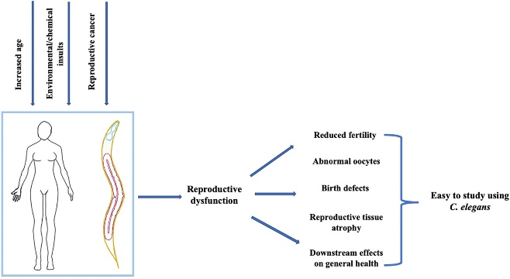
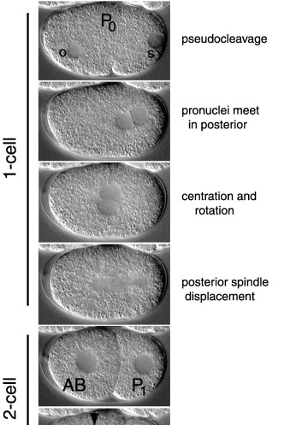
Coenorhabditis elegans
hermaphrodites + males
a pioneer in facilitating the study in the field of cell biology and genetics
model animal in infertility/fertility research
ameboid sperm
posterior pole is defined by the site of sperm entry into the unfertilized egg
1st mitosis of the zygote is unequal → larger A daughter cell (AB), and a smaller P daughter cell (P₁)

Slide 39
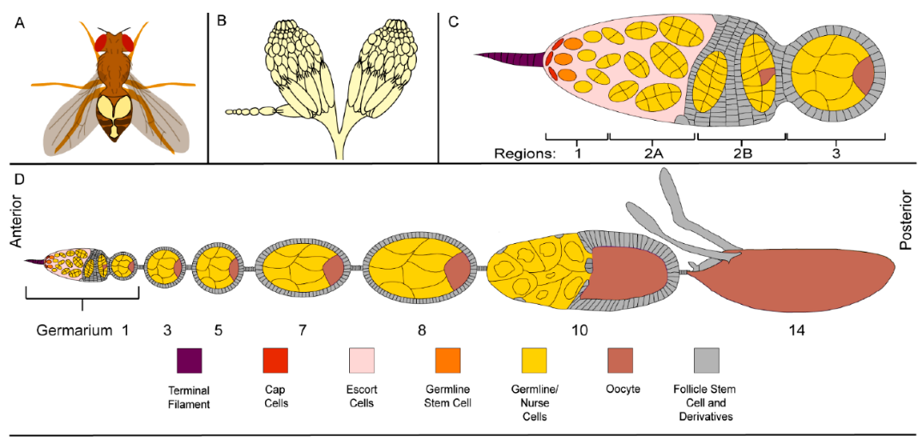
Drosophila melanogaster
centrolecithal eggs in ovarioles
fertilization occurs only in the region of the oocyte which will become the anterior of the embryo
sperm are stored within the female’s body in a seminal receptacle and the paired spermathecae
egg chambre = multicellular structure in flies’ ovaries; in each a single egg is produced
egg chambre = internal cluster of germ cells comprised of 15 nurse cells and one oocyte, surrounded by an epithelial monolayer of somatic follicle cells
fertilization: internal; occurs after ovulation in the uterus
formation of A-P axis: maternal effect genes expressed in the ovaries → messenger RNAs that are placed in different regions of the egg → translation of these mRNAs after fertilisation: bicoid protein controls the production of anterior embryonic parts, nanos protein controls the formation of the posterior parts
D-V polarity: during oogenesis, the oocyte nucleus moves from a central posterior to an asymmetrical anterior position; nuclear movement = a symmetry-breaking step → A-P and D-V axes. The asymmetrically placed nucleus defines a region in the oocyte which accumulates high levels of gurken mRNA and protein; gurken = ovarian-specific member of TGF-α family of secreted ligands → concentration gradient → D-V gradient of EGF receptor activation in the follicle cells surrounding the oocyte.
HEAD
HEAD

Slide 40
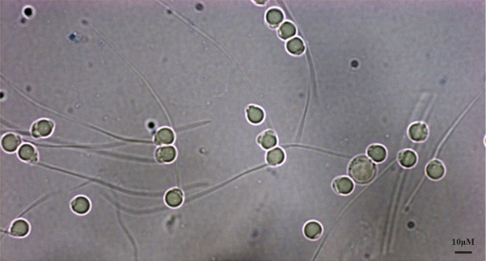
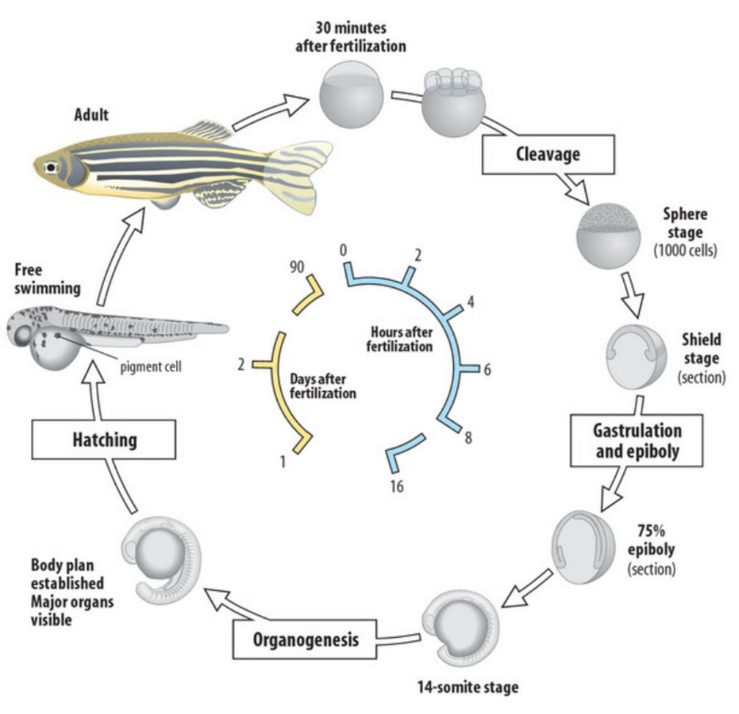
Danio rerio
excellent model for human development
transparent embryos
telolecithal eggs: blastoderm + large amount of yolk
incomplete (meroblastic) cleavage
quick development
sperm with a tail piece
external fertilization
https://www.jove.com/v/5151/zebrafish-reproduction-and-development

Slide 41
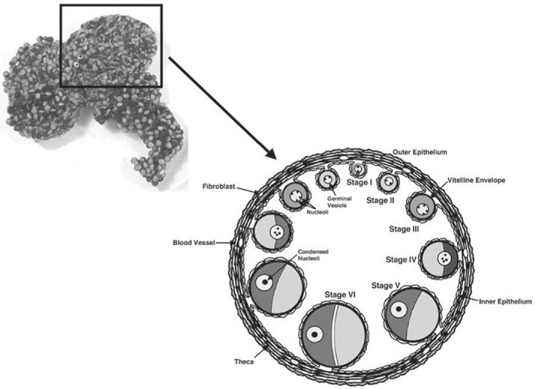
Xenopus laevis
large heterolecithal/mesolecithal oocytes ( >1 mm in diameter: a large nucleus/germinal vesicle (100,000 times larger than a nukleus in somatic cells, 1/3 of oocyte’s volume)
oocytes with synchronous cell cycle → large amounts of fertilized eggs can be obtained easily
a fully grown oocyte: 200,000 times as many ribosomes as an average somatic cell
arrested in MI until activation by progesterone → meiotic maturation of the oocytes
eggs surrounded by the vitelline membrane + jelly coating
sperm with a tail piece, 30 μm long
external fertilization

Slide 42
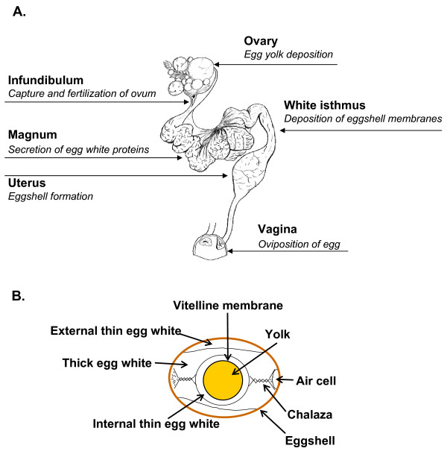
Gallus gallus
one of the model amniote species for experimental embryology and development of the extraembryonic membranes
telolecithal eggs
recently ovulated egg: a preprimitive streak blastodisc + a large yolk mass; vitelline membrane; a large amount of albumen („egg white“) surrounds the vitelline membrane and is surrounded by the shell membrane and eggshell
internal fertilization

Slide 43
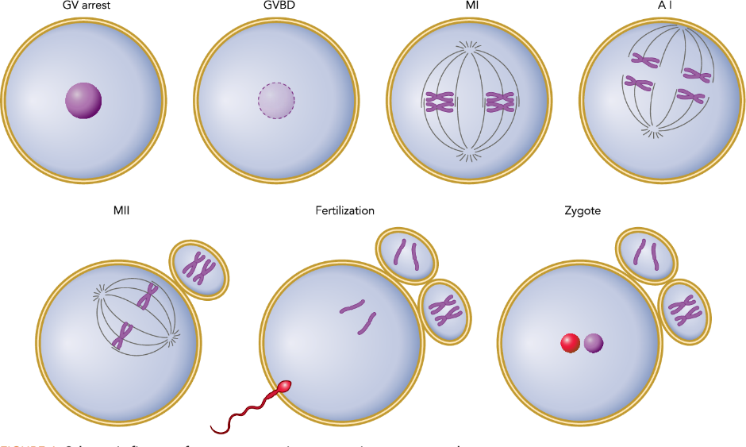
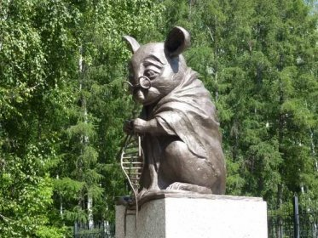
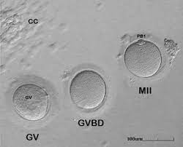
Mus musculus
oligolecithal eggs (in eutherian mammals in general)
sperm with a tail piece
https://www.jove.com/v/5159/development-and-reproduction-of-the-laboratory-mouse
Monument to the laboratory mouse (bronze mouse knitting DNA, Памятник лабораторной мыши, Russia)
www.wikipedie.cz

Slide 44
Summary
Sperm (← spermatogenesis):
extremely small cells which lack most of their cytoplasm
ability to travel through an (internal or external) aquatic medium to reach the egg cell
flagellum to move toward the egg
all sperm consist of three basic pieces: the head (contains the genetic material and is capped by the acrosome (cap) (with enzymes needed for the sperm to penetrate the egg); the middle piece (with mitochondria that fuel the movements of the tail piece); the flagellum (tail piece) Eggs ( ← oogenesis):
designed for providing nutrients to the developing embryo
contains yolk (lipids, proteins, glycogen for embryo nutrition)
classified by the amount and the distribution of yolk in the egg
quantity of yolk and its distribution in the eggs → different types of cleavage after fertilization
the amounts of yolk are minimal in mammalian eggs, placenthal development is necessary for further embryo development
large eggs (birds, reptiles) have large amount of yolk to support embryonic development to advanced stages

Slide 45
Used and recommended literature
F. Athar, N.M. Templeman. C. elegans as a model organism to study female reproductive health. Comparative Biochemistry and Physiology Part A: Molecular & Integrative Physiology. 2022; 266, 111152.
L. W. Browder, C.A. Ericson, W.R. Jeffery. Developmental Biology. 3rd edition, 1991. ISBN 0-03013514-1.
B. M. Carlson: Human embryology and developmental biology. 4th edition, 2009. ISBN 978-323-05385-3.
G. German, T. Child. In vitro maturation of oocytes. In K. Coward & D. Wells (Eds.), Textbook of Clinical Embryology (pp. 300-312). 2013. Cambridge: Cambridge University Press. doi:10.1017/CBO9781139192736.031
R. Hodge: Developmental Biology : from a Cell to an Organism. 1st edition, 2010. ISBN 978-0-8160-6683-4.
S. Horne-Badovinac . The Drosophila egg chamber-a new spin on how tissues elongate. Integr Comp Biol. 2014;54(4):667-676. doi:10.1093/icb/icu067
J. Knoz. Obecná zoologie. I Taxonomie, látkové složení, cytologie a histologie. II Organologie, rozmnožování, vývoj živočichů a základy biologie. PřF UJEP, Brno. 1979.
L. C. Junqueira, J. Carneiro J, R. Kelly R. Základy histologie. 1997. ISBN 80-85787-37-7.
R. Lüllmann-Rauch . Histologie. Překlad 3. vydání. Grada, Praha. 2012, 556 s.
K. L. Moore, T. V.N Persaud: The developing human. Clinically oriented embryology. 8th edition, 2008. ISBN 978-0-8089-2387-9.
S. Roth, J. Lynch. Symmetry Breaking During Drosophila Oogenesis. Cold Spring Harbor perspectives in biology. 2009. 1. a001891. 10.1101/cshperspect.a001891.
J. M. W Slack: Essential developmental biology. 2nd edition, 2006. ISBN 978-4051-2216-0.
Z. Vacek: Embryologie. 2006. ISBN 978 -80-247-1267-3.
Z. Věžník: Repetitorium spermatologie a andrologie, metodiky spermatoanalýzy. Brno : Výzkumný ústav veterinárního lékařství, 2004. 1 sv. (různé stránkování).
http://www.are.cz/data/file/gametogeneze_mitoza_a_meioza.pdf
https://ib.bioninja.com.au/standard-level/topic-3-genetics/33-meiosis/stages-of-meiosis.html
https://owlcation.com/stem/The-why-and-how-of-breeding-zebrafish-for-research
https://sunlab.pnb.uconn.edu/research/
www.sci.muni.cz/ptacek
https://link.springer.com/protocol/10.1007/978-1-59745-000-3_2
https://onlinesciencenotes.com/sequential-events-and-stages-in-the-development-of-frog-pre-embryonic-embryonic-and-post-embryonic-development/
http://web.as.uky.edu/Biology/faculty/cooper/Population%20dynamics%20examples%20with%20fruit%20flies/08Drosophila.pdf
https://www.mdpi.com/2073-4409/10/6/1454/htm
https://www.pacc.in/e-learning-portal/ec/admin/contents/60_BZO%2052_2020111502214594.pdf
https://www.prirodovedci.cz/zeptejte-se-prirodovedcu/1696
https://www.researchgate.net/figure/General-structure-of-the-zebrafish-egg-The-zebrafish-egg-is-approximately-07mm-in_fig3_328858072
https://www.researchgate.net/figure/A-representative-image-showing-sperm-suspensions-prepared-in-the-present-study-are-mainly_fig1_282244810
https://www.researchgate.net/figure/Non-passerine-a-and-Passerine-b-Spermatozoa-a-Non-passerines-Filiform-head_fig5_326827104
https://www.researchgate.net/figure/Chicken-oviduct-segments-A-and-egg-components-B_fig1_41110738
https://www.researchgate.net/figure/Germinal-vesicle-GV-transfer-a-GV-stage-mouse-oocyte-with-opened-zona-b-GV_fig1_12355102
https://www.sciencedirect.com/topics/agricultural-and-biological-sciences/gallus-gallus
https://www.shsu.edu/~bio_mlt/Chap5.html
https://www.xenbase.org/anatomy/intro.do

