Slide 1
Structural Virology
Lecture 3
Pavel Plevka

Slide 2
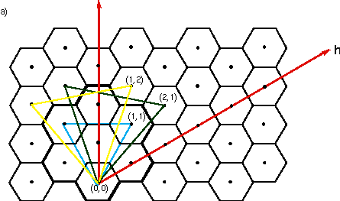
Quasi equivalence
T = h² + hk + k²

Slide 3
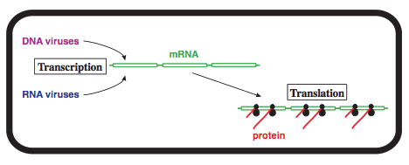
Transcription, Translation, and Transport

Slide 4
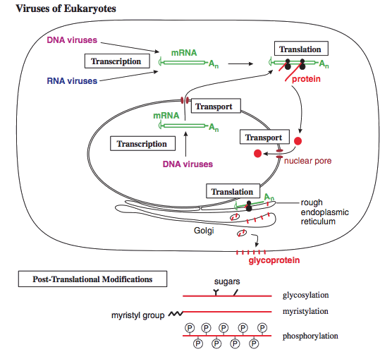
Transcription, Translation, and Transport

Slide 5
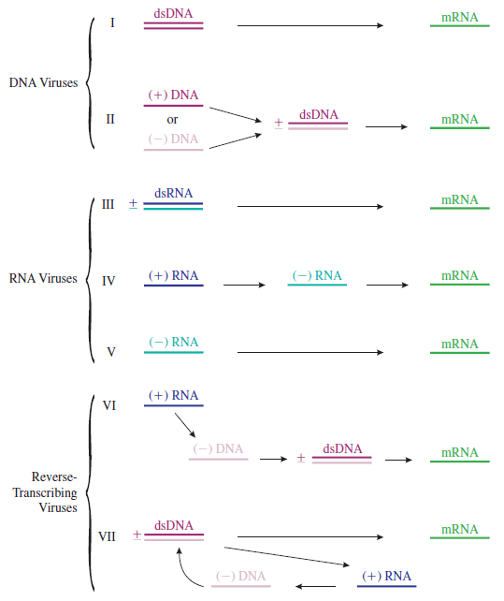
(David) Baltimore virus classification
- genome type
- mode of transcription
(-) and (+) relative to mRNA
- ambisense viruses (ssDNA - geminiviruses, arenaviruses)

Slide 6
Central Dogma of Molecular Biology

Slide 7
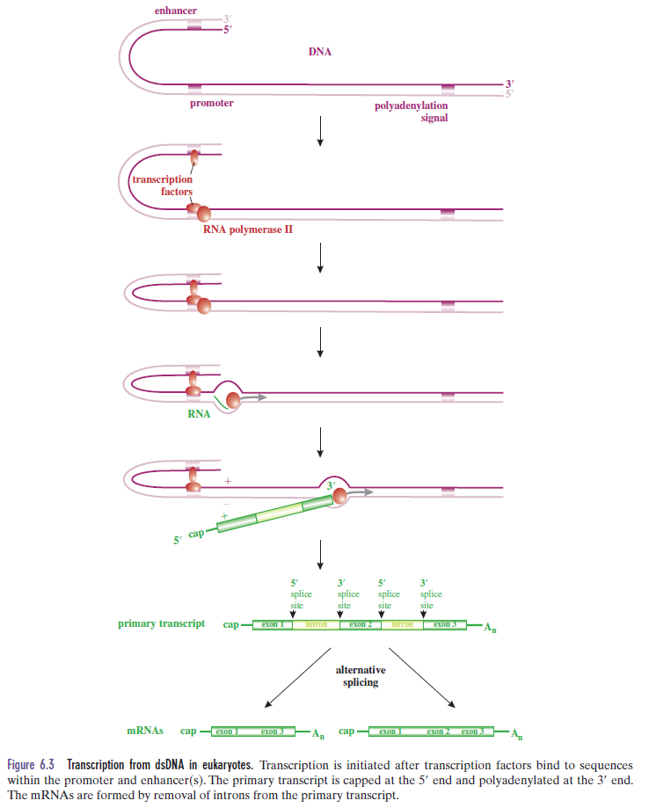
Transcription in Eukaryotes

Slide 8
Promoters, Enhancers, and TATA box
T A T A A/T A A/T A/G
General cellular transcription factors: TFIID
Specific cellular transcription factors.
Virus transcription factors: VP16 of herpes simplex virus
- different transcription factors used during different stages of infection

Slide 9
Transcriptases
Notes:
Which viruses carry transcriptase in virions?

Slide 10
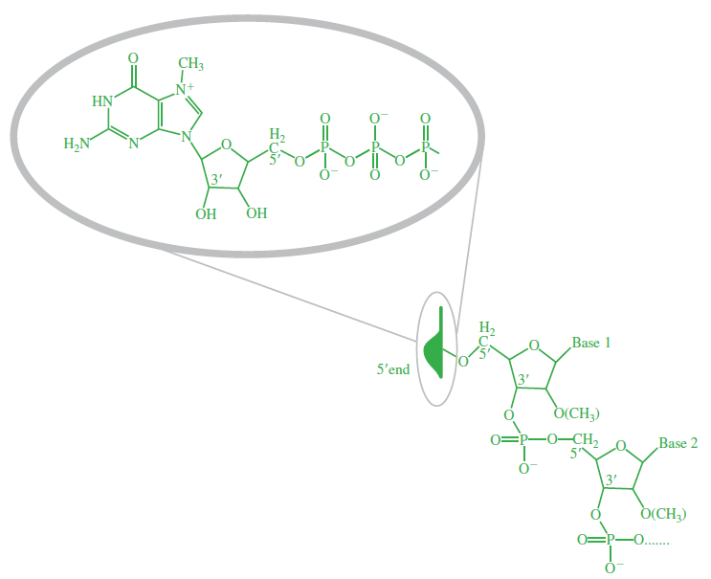
mRNA cap
aid mRNA transport from the nucleus to the cytoplasm
protect the mRNA from degradation by exonucleases
required for the initiation of translation
Guanosine triphosphate joined by 5’-5’ linkage (methylated in ribose)

Slide 11
Obtaining mRNA cap
Cell enzymes:
RNA triphosphatase
Guanylyl transferase
Methyl transferase(s)
Influenza virus – cap snatching
Poxviruses, coronaviruses, reoviruses replicate in cytoplasm and encode own capping enzymes.
Cap snatching in cytoplasm – bunyaviruses
Non-capped mRNAs – picornaviruses
De-capping of host mRNAs – totiviruses

Slide 12
mRNA polyadenylation
A A T A A A
Poly(a) polymerase
First identified in SV40 transcripts in 1981.

Slide 13
Pre-mRNA splicing

Slide 14
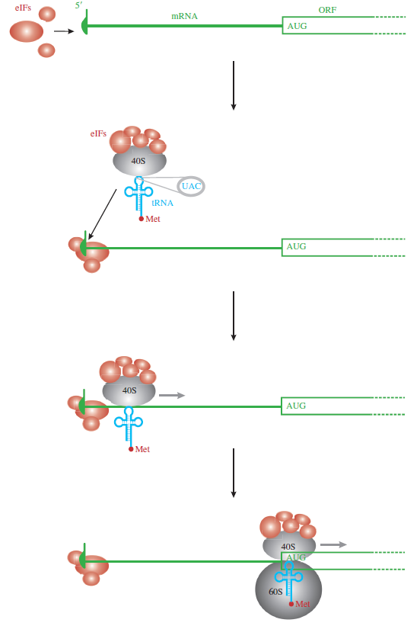
Translation
Most viruses use host translation machinery.
Mimiviruses encode their own tRNAs.
eukaryotic Initiation Factors (eIF) (CAP)
polyA binding proteins
mRNA circularization
5’->3’ scanning by 40S subunit (AUG) x Sendai virus (ACG)
IRES

Slide 15
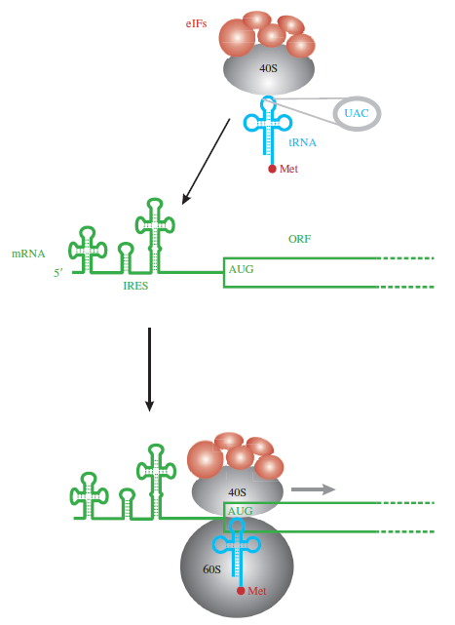
IRES dependent Translation
Hepatitis C virus
Picornaviruses
Kaposi’s sarcoma associated herpesvirus
Some cellular mRNAs

Slide 16
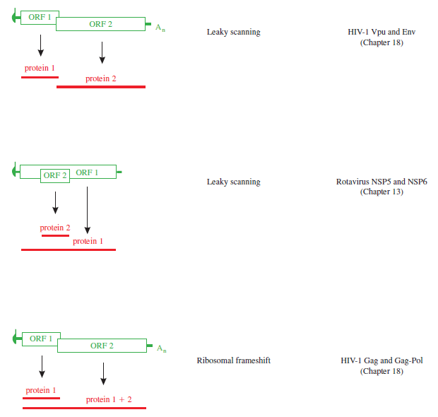
Bicistronic mRNAs

Slide 17
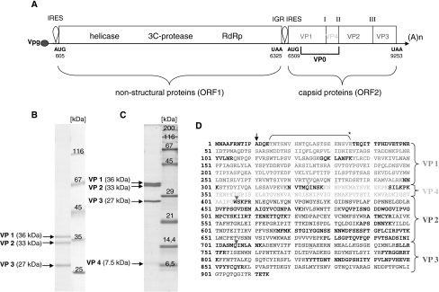
Bicistronic mRNAs of dicistroviruses

Slide 18
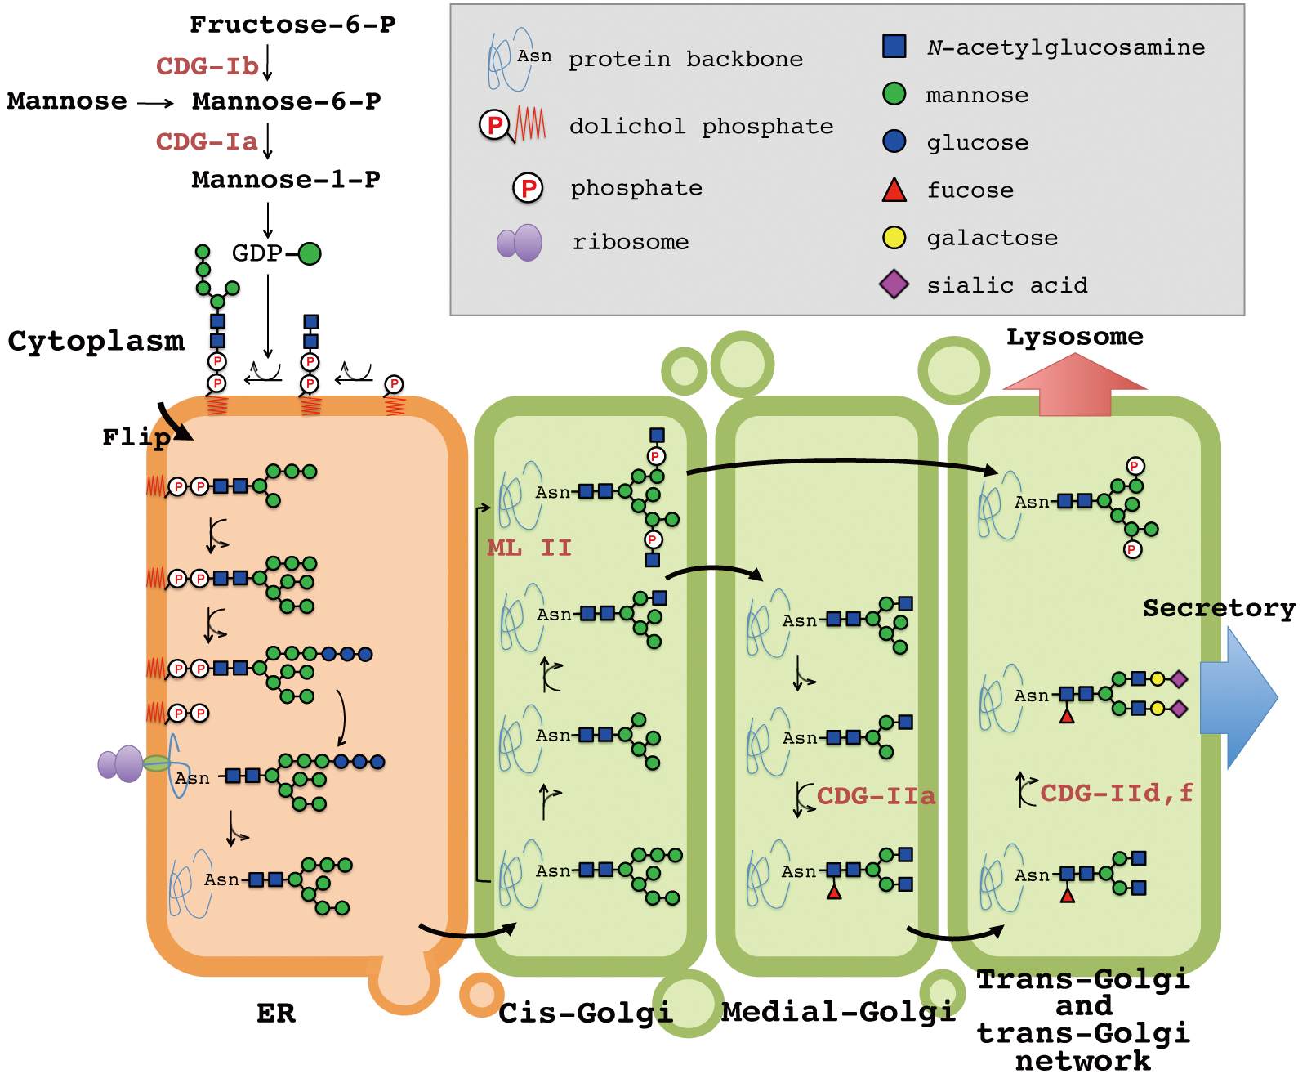
Co- and post translational protein modification
N-glycosylation (Asn)
O-glycosylation (Tyr, Ser)

Slide 19
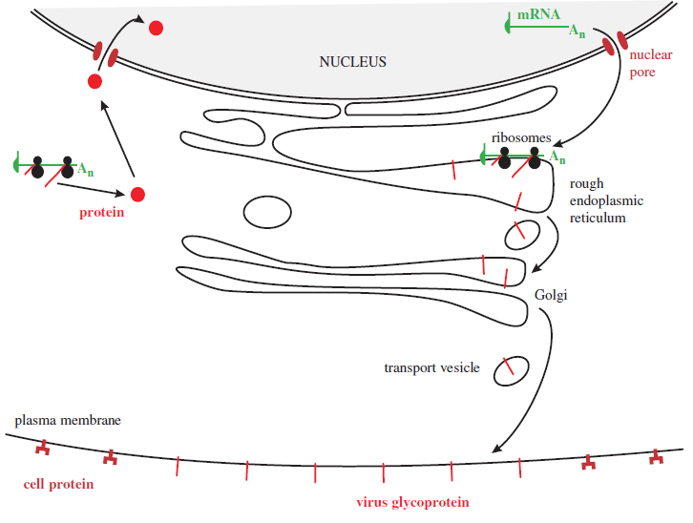

Slide 20
Co- and post translational protein modification
Acylation (addition of Myristic acid)
- Gag of HIV
- VP4 of picornaviruses
Phosphorylation
- serine, threonine, tyrosine
Cleavage

Slide 21
Targeting of virus proteins
Nuclear localization signal:
PKKKRKV

Slide 22
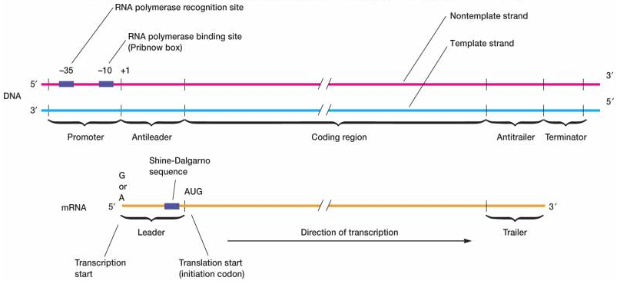
Transcription in bacteria

Slide 23
Learning outcomes
explain how virus genes are transcribed and translated
describe the post-translational modifications that some virus proteins undergo
highlight differences in transcription and translation between prokaryotic and eukaryotic cells
discuss the transport of virus proteins and RNA within cells

Slide 24
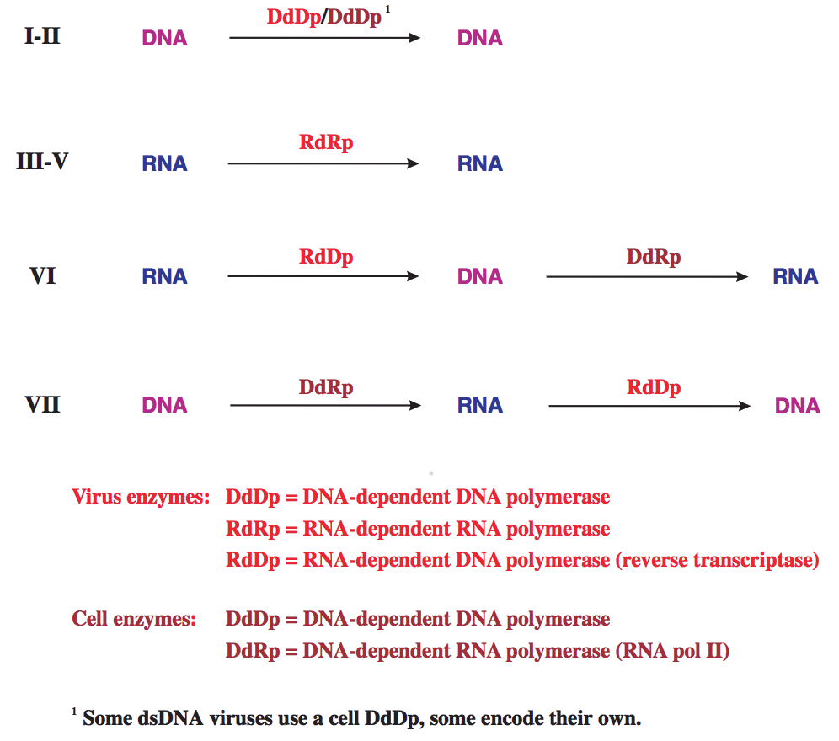
Virus Genome Replication

Slide 25
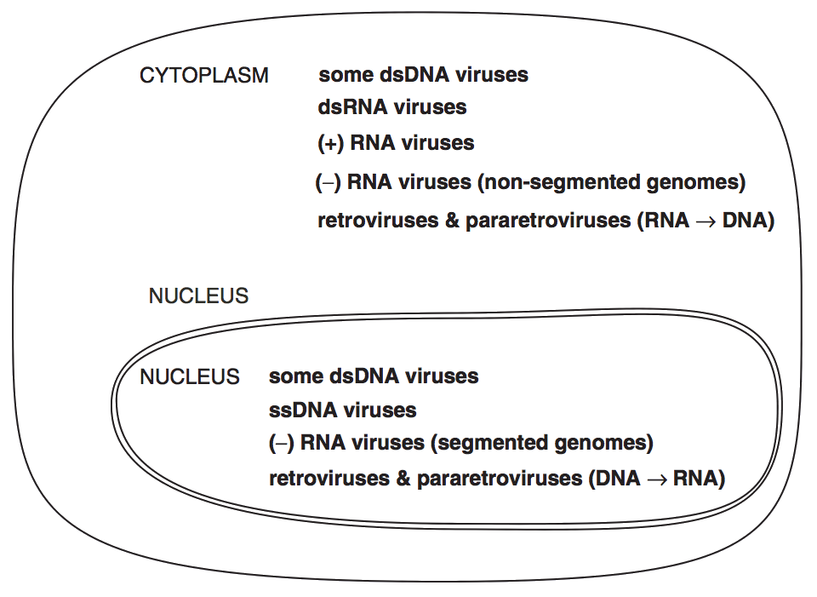

Slide 26
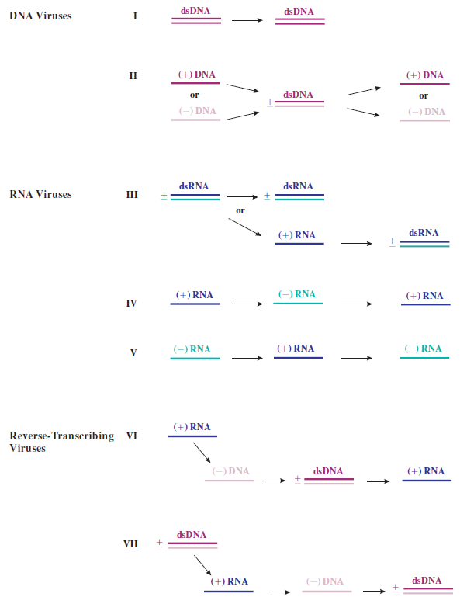

Slide 27
Priming of NA synthesis

Slide 28
Leading and Lagging strands in dsDNA replication

Slide 29
Rolling circle x “normal” replication

Slide 30
Conservative x semiconservative replication

Slide 31
Replication of retroviruses

Slide 32
Learning outcomes
state the locations within eukaryotic cells where different categories of virus genome are replicated
explain the role of primers in virus nucleic acid synthesis
discuss the roles of virus and host proteins in virus genome replication
outline the replication mechanisms of virus DNAs and RNAs
explain the term ‘reverse transcription’

