Slide 1
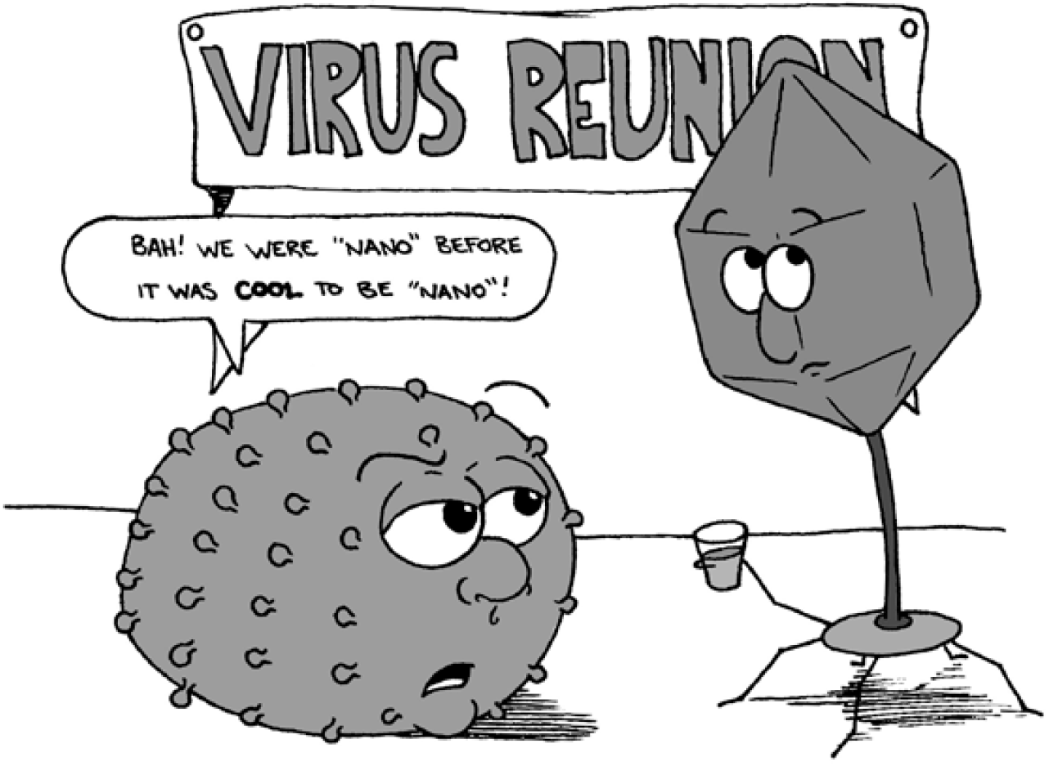

Slide 2

Structural Virology
Spting 2025
Pavel Plevka

Slide 3
Class rules
Turn off anything that beeps or rings.
Reading any material that is not related to the class, texting, or checking the internet during the class is discouraged.
It is ok to eat or drink.
Ask questions - it will help to clarify the issue not only for you but for your peers as well!
In class discussions, be respectful of other students' opinions.

Slide 4
Aims of the course
learn elementary molecular virology
appreciate role of structural information in understanding of biological processes
learn to read and evaluate scientific papers
learn history of some fundamental discoveries in biology
be able to evaluate what is an important research question

Slide 5
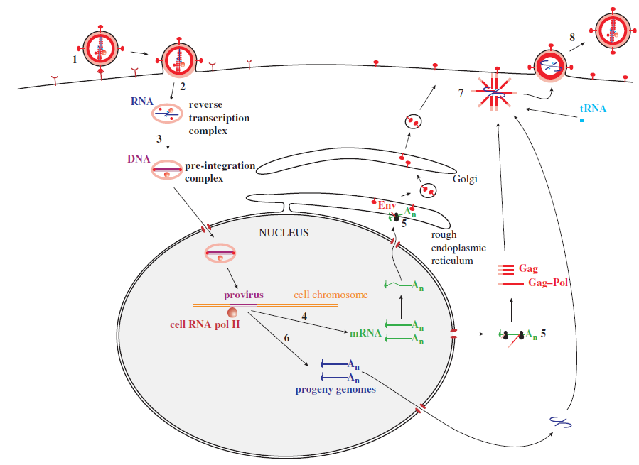
Elementary molecular virology
HIV replication cycle
1. Attachment
2. Entry
3. Transcription
4. Translation
5. Genome replication
6. Assembly
7. Exit

Slide 6
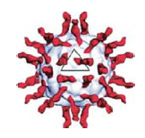
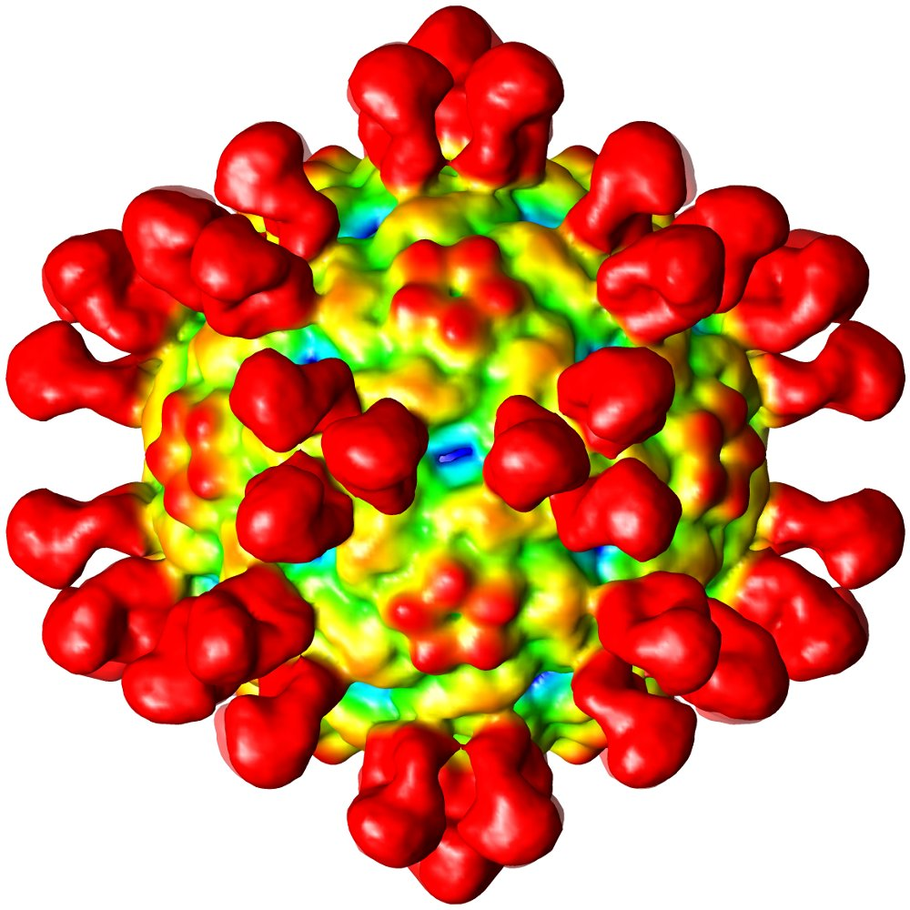
Structural biology in understanding virus infection
Virus binding to receptor
Binding of antibodies to virus particle

Slide 7
Read and evaluate scientific papers
CHALLENGES IN IRREPRODUCIBLE RESEARCH:
- more than 50% of drug-related research articles in high profile journals contain irreproducible data
Reasons for irreproducibility:
- Under supervised students and post-docs
- “Publish or Perish” threat
- wrong design of experiments – “know your statistics”

Slide 8
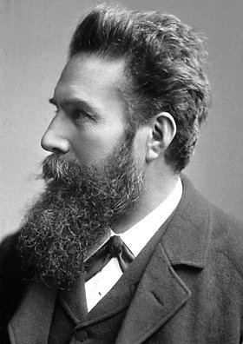
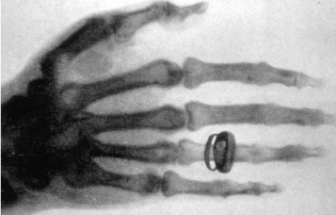
History of fundamental discoveries
WILHELM CONRAD RÖNTGEN (1845-1923)
1901 Nobel Laureate in Physics
discovery of the remarkable rays subsequently named after him

Slide 9
What is important research question?
Interesting x Important
1. It asks about something other people care about
2. It builds on what you and others already know
3. It allows you to learn something you don't already know
Summary – It helps you to predict future in a meaningful way.
What are evolutionary relationships of anaerobic protists?
What is the probability of Ebola epidemics spreading outside of Africa?

Slide 10
What is asked of you:
Read assigned readings before the day for which they are assigned
Bring five-sentence essay describing the importance of a scientific paper to each lecture
Participate in discussions
Submit two mini-assignments
I am here to help, learning is up to you!

Slide 11
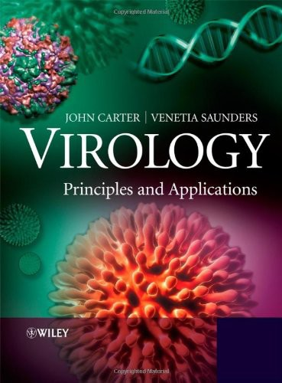
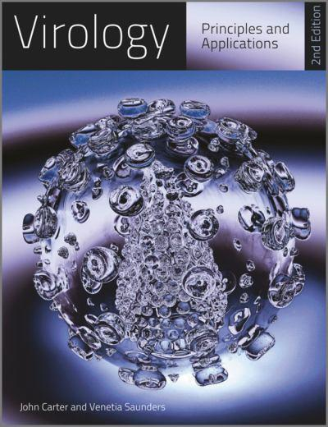
Course textbook:
14 copies are available in campus library

Slide 12
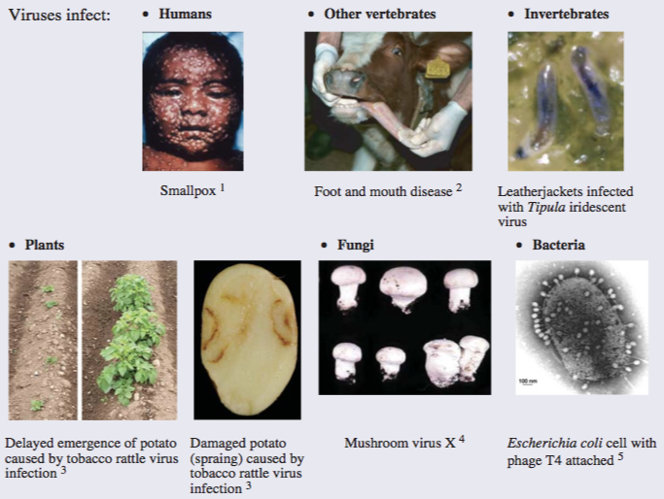
Viruses and their importance

Slide 13
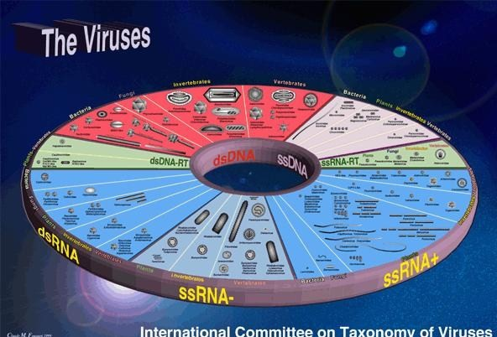
Virosphere!

Slide 14
Useful viruses
• Phage typing of bacteria
• Sources of enzymes (polymerases, T4 ligase, reverse transcriptase)
• Pesticides (baculoviruses – lepidoptera, hymenoptera, myxoma virus - rabits) SPECIFICITY!
• Anti-bacterial agents (S. aureus phage phi812)
• Anti-cancer agents (adeno-associated viruses)
• Gene vectors (capsids used as vehicles for gene delivery)
• Mass protein production

Slide 15
Fundamental discoveries in biology
Phage T2 and E. coli were used to provide evidence that genes are composed of DNA.
The first enhancers to be characterized were in genes of simian virus 40 (SV40).
The first transcription factor to be characterized was the T antigen of SV40.
The first nuclear localization signal of a protein was identified in the T antigen of SV40.
Introns were discovered during studies of adenovirus transcription.
The role of the cap structure at the 5’ end of eukaryotic messenger RNA was discovered during studies with vaccinia virus and a reovirus.
The first internal ribosomal entry site was found in poliovirus.
The first RNA pseudoknot in the genome of turnip yellow mosaic virus.

Slide 16
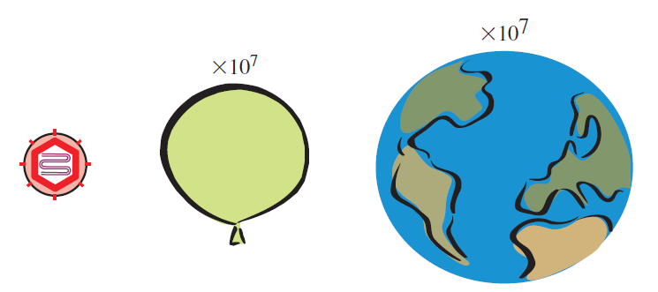
Most viruses are 25-400 nm in size

Slide 17
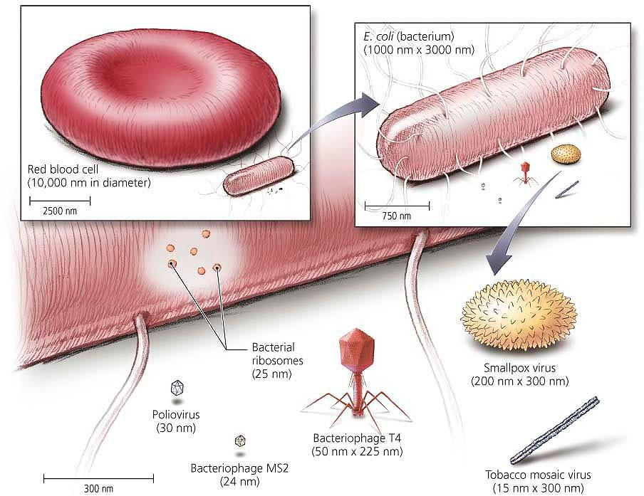

Slide 18
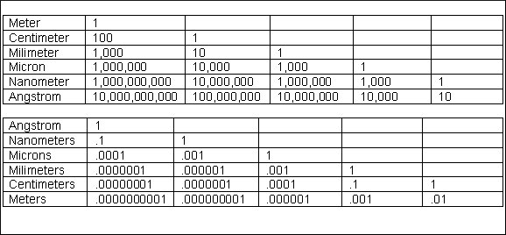
Units of length

Slide 20
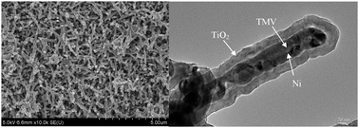
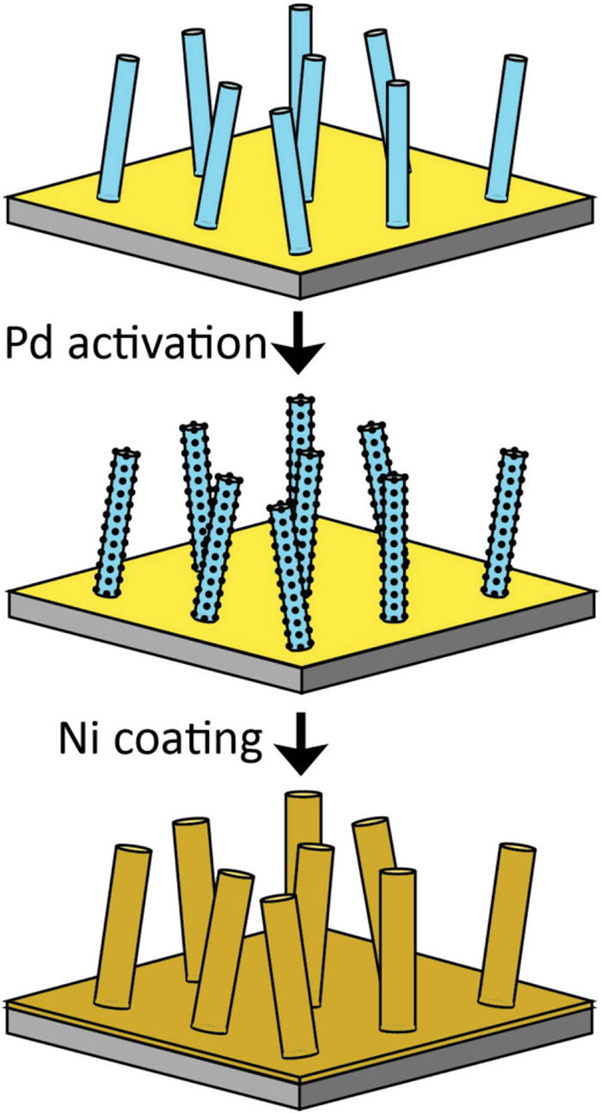
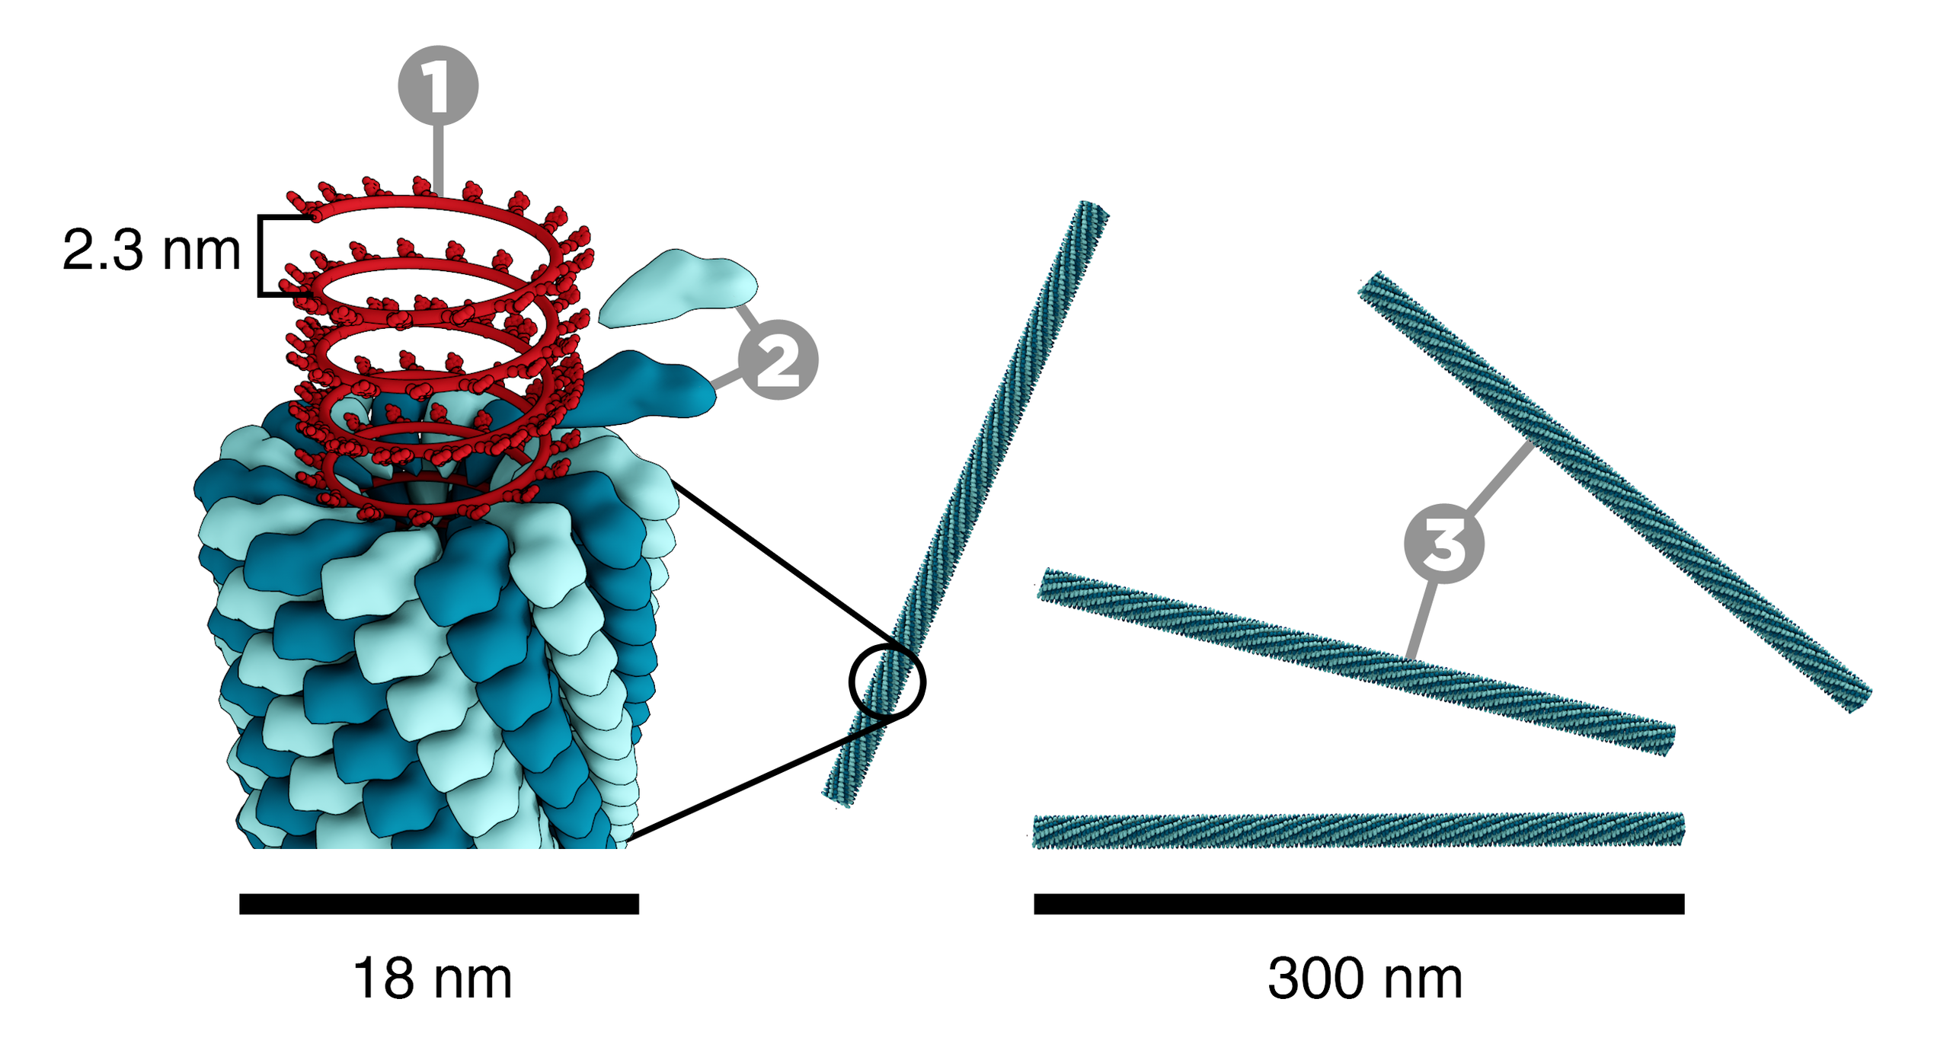
Using TMV to increase surface of electrodes

Slide 21
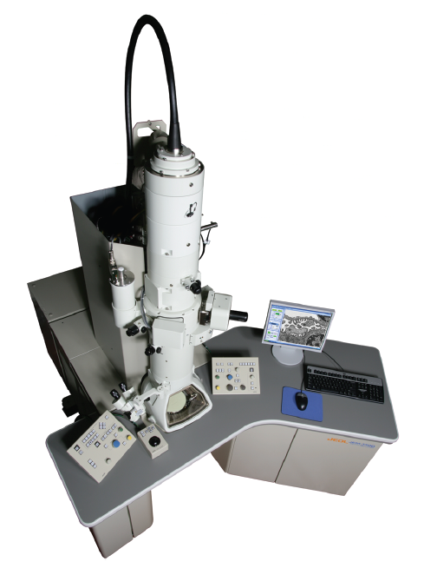
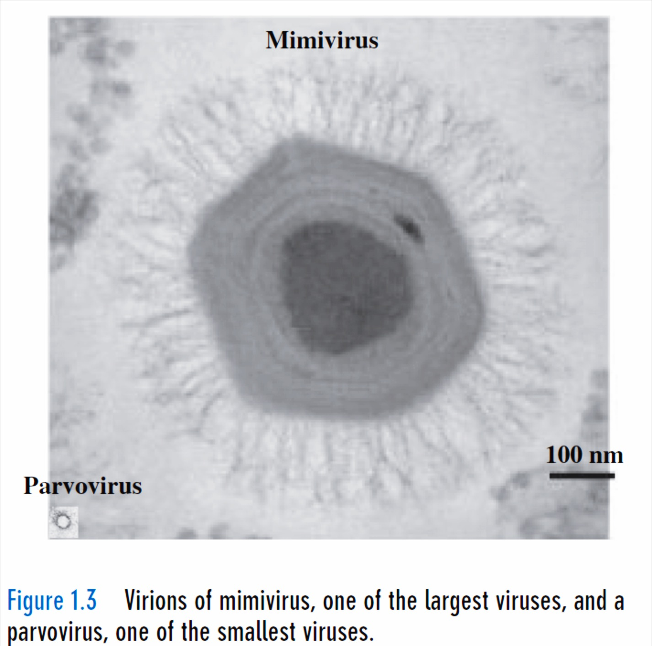
Methods to study virus structures

Slide 22
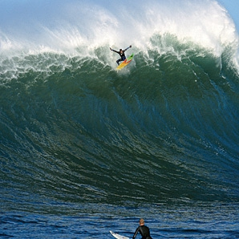
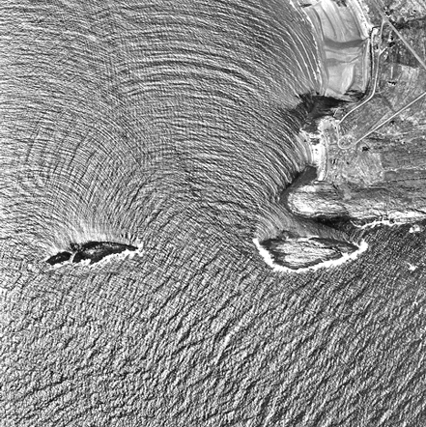
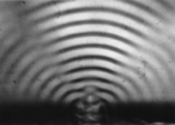
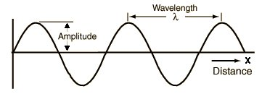
Wavelength and diffraction

Slide 23
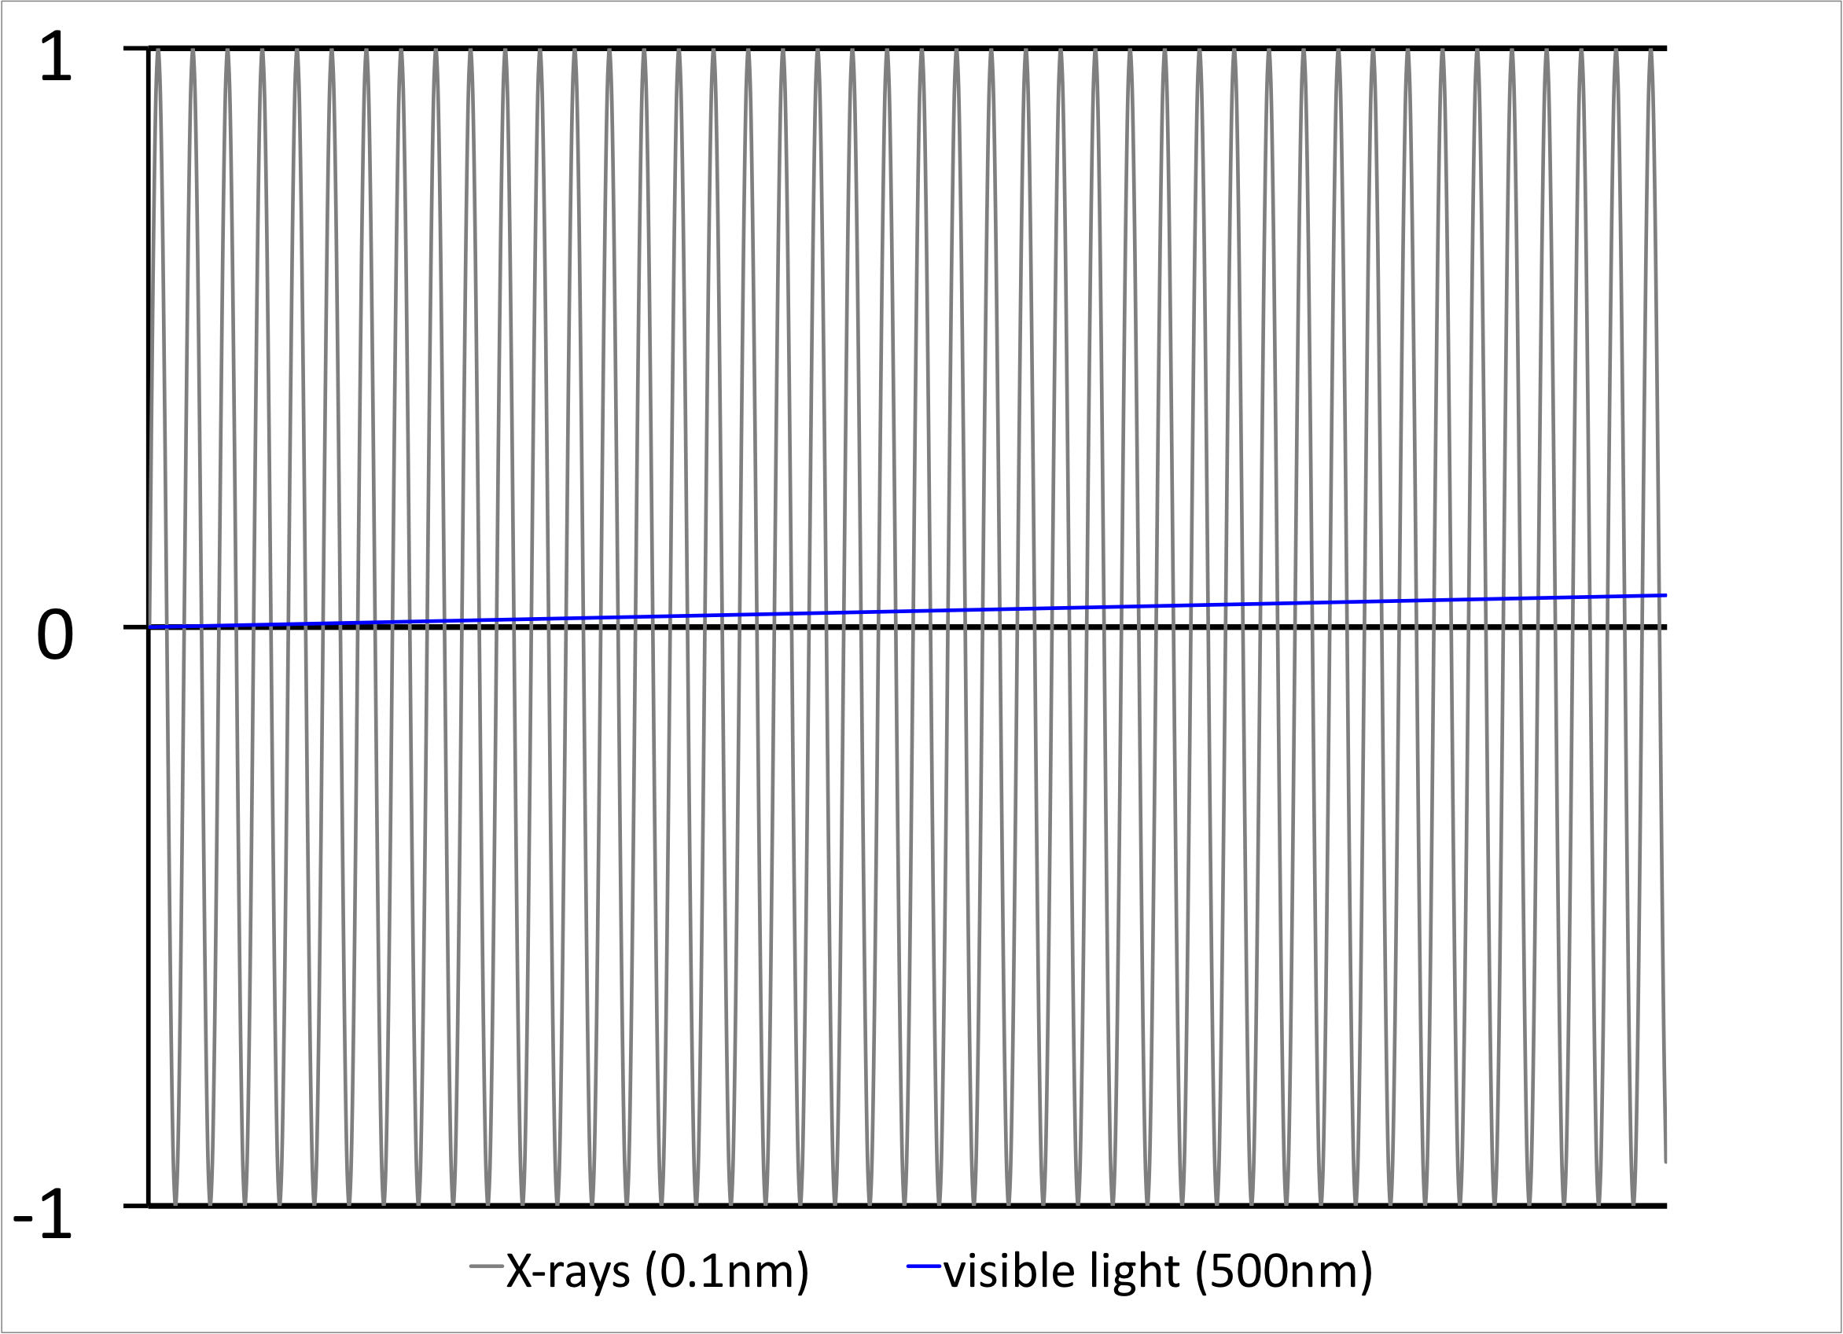
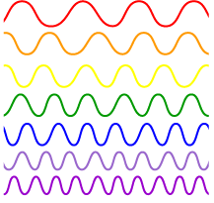
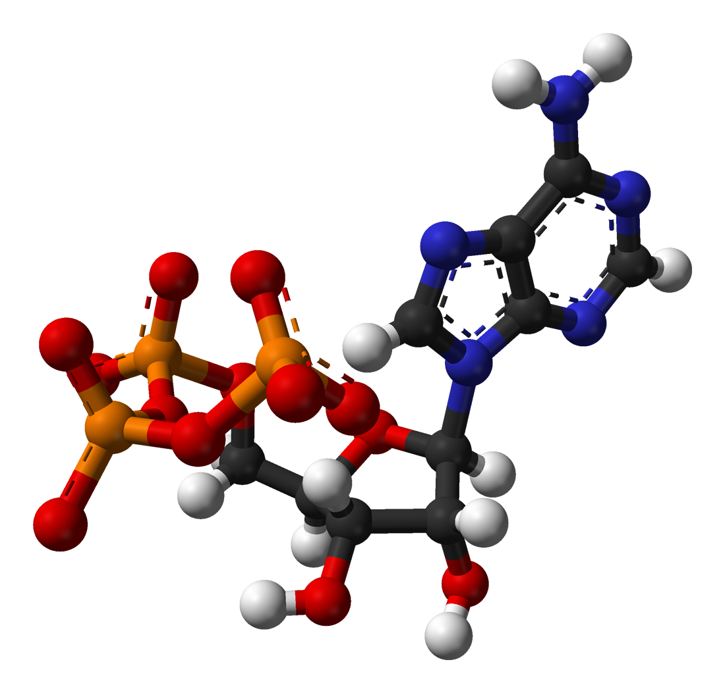
Wavelength comparison of X-rays and visible light
38λ

Slide 24
Cellular organisms
Viruses
Replication
dsDNA
DNA
Transcription
ssRNA
RNA
Protein
Translation
Protein

Slide 25
Viruses are intracellular parasites
HIV replication cycle

Slide 26
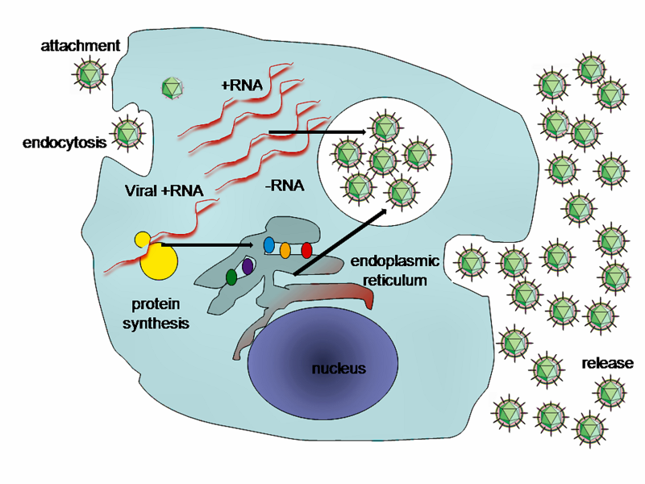
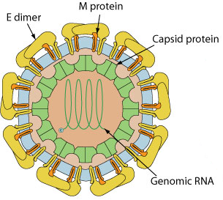
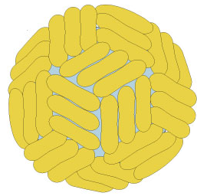
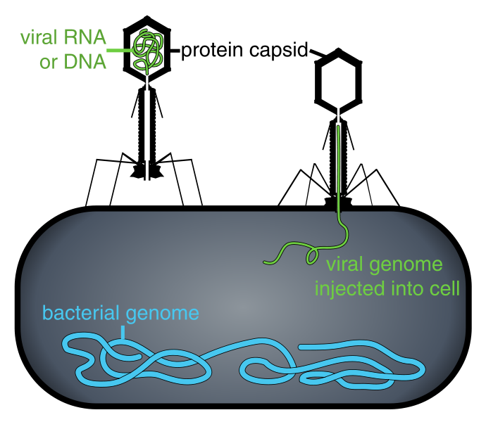
“Virion” – virus particle
Two forms of virus existence
Cell infection – Viro-cell
Notes:
Carrier of genetic information from cell to cell:
- "extracellular organelle”
- packages viral genome
- escapes from infected cell
- survives transfer from one cell to another
- attaches, penetrates, initiates replication in new host cell

Slide 27
Are viruses alive?
Pro-life | Anti-life
Have genes | Do not have cellular structure
They evolve | No metabolism
Subject to natural selection | Require host cell for pro-creation
Procreate | New viruses assemble from parts
Notes:
These features show that viruses are simple macromolecular machines and thus we can aspire to understand them at the atomistic level.

Slide 28
Virus definition
A virus is a very small, non-cellular parasite of cells. Its genome, which is composed of either DNA or RNA, is enclosed in a protein coat.

Slide 29
Learning outcomes
• discuss reasons for studying viruses
• explain how viruses differ from other organisms
• define the term ‘virus’

Slide 30
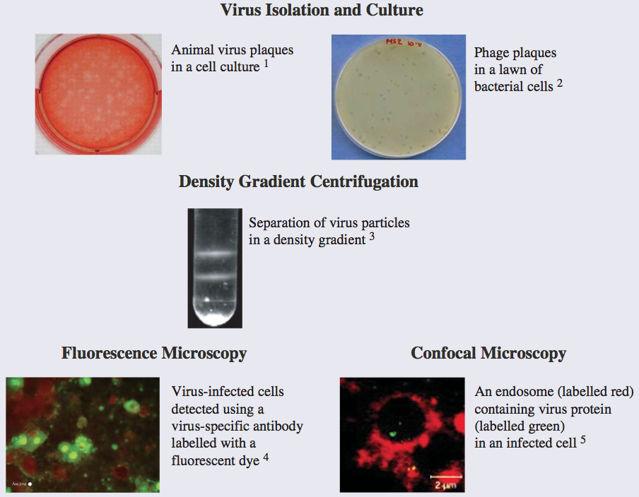
Methods used in virology

Slide 31
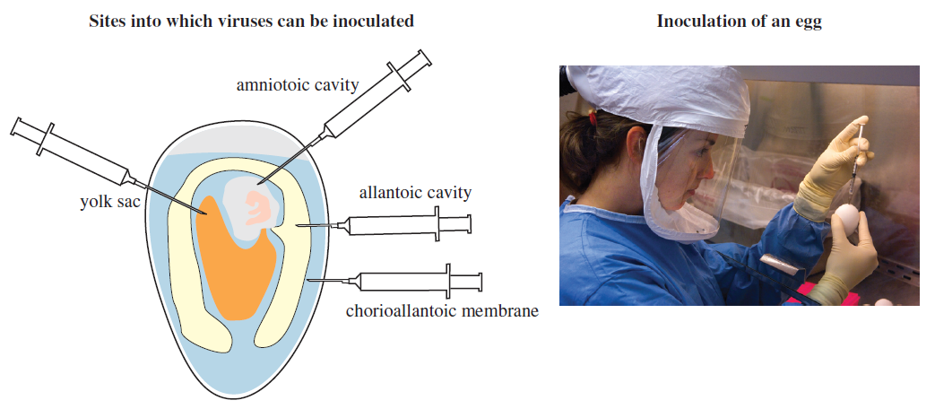
Virus production in eggs

Slide 32
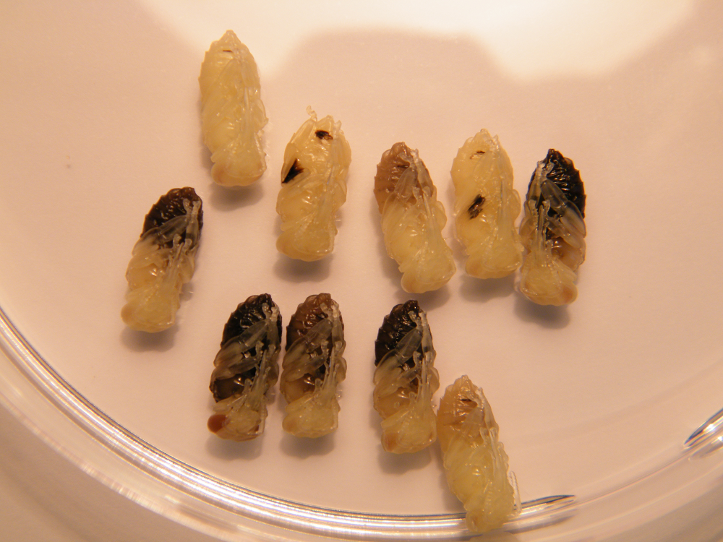
Virus production honeybee pupae

Slide 33
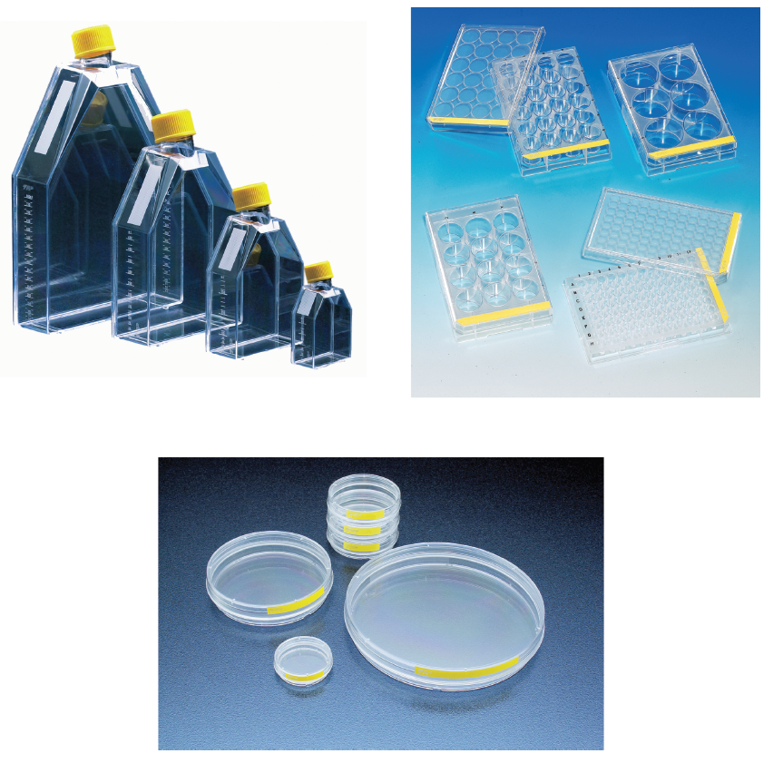
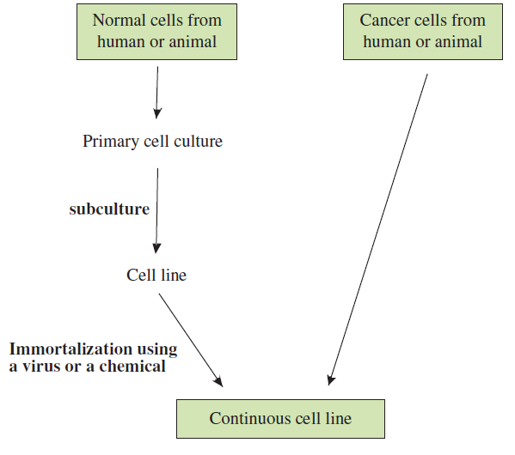
Virus production in vitro in tissue culture

Slide 34
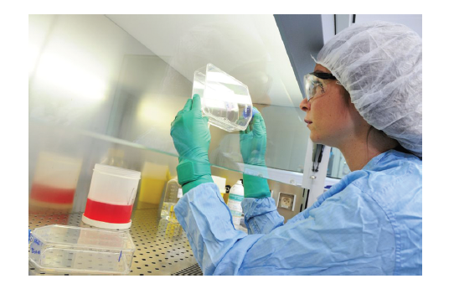
Sterile work with tissue cultures

Slide 35
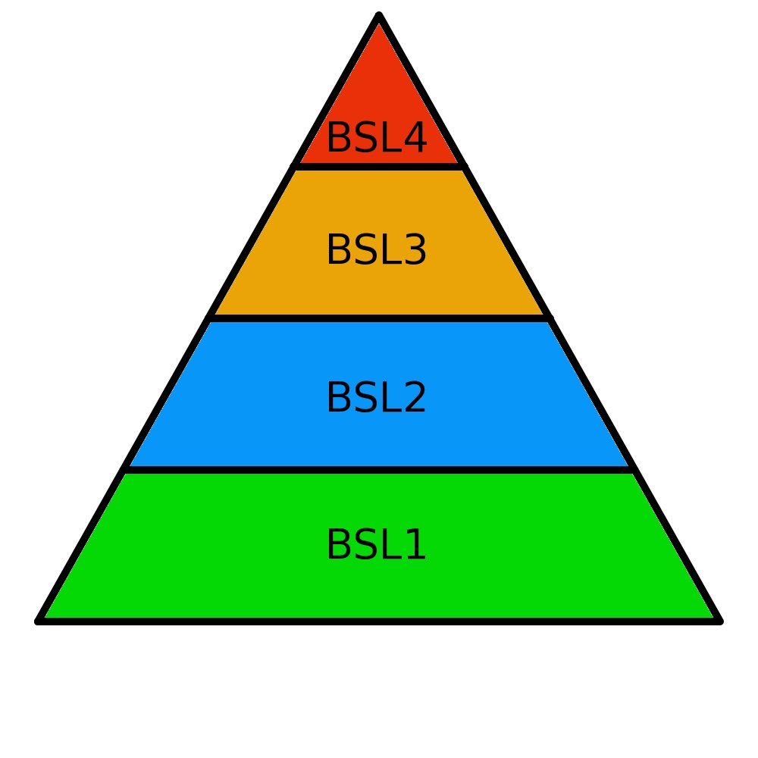
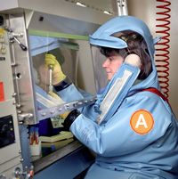
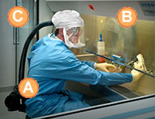
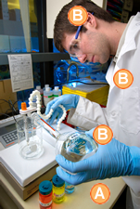
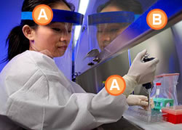
BSL levels
Notes:
Viruses as pathogens
- viruses bear the genetic information needed to harness cellular biosynthetic machinery and replicate itself
- hence, selective advantage for virus may be selective disadvantage for host
- some of the most deadly pathogens: polio, HIV, Ebola, SARS, influenza, smallpox
- evolution of host defense (immunity)

Slide 36
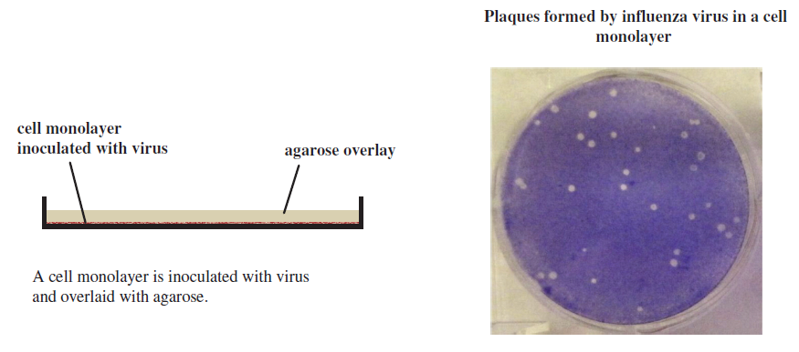
Plaque assay for animal viruses

Slide 37
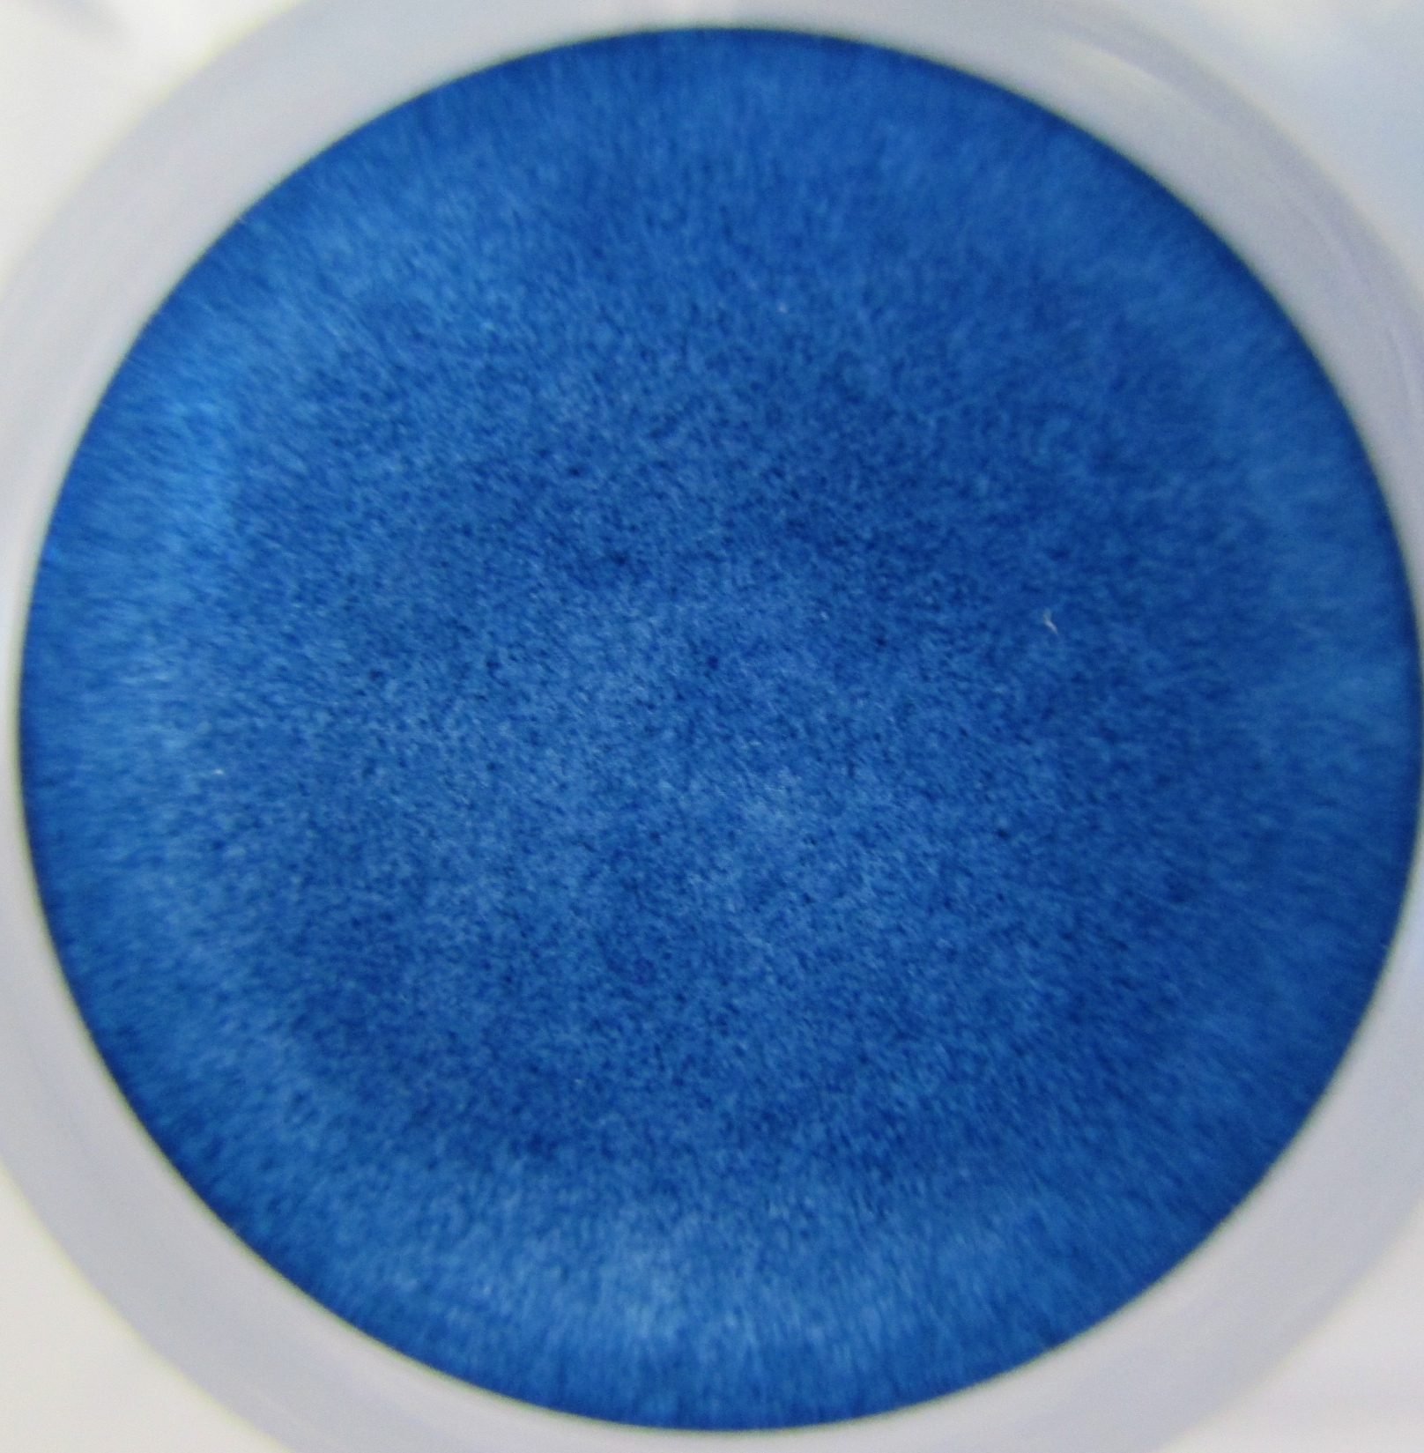
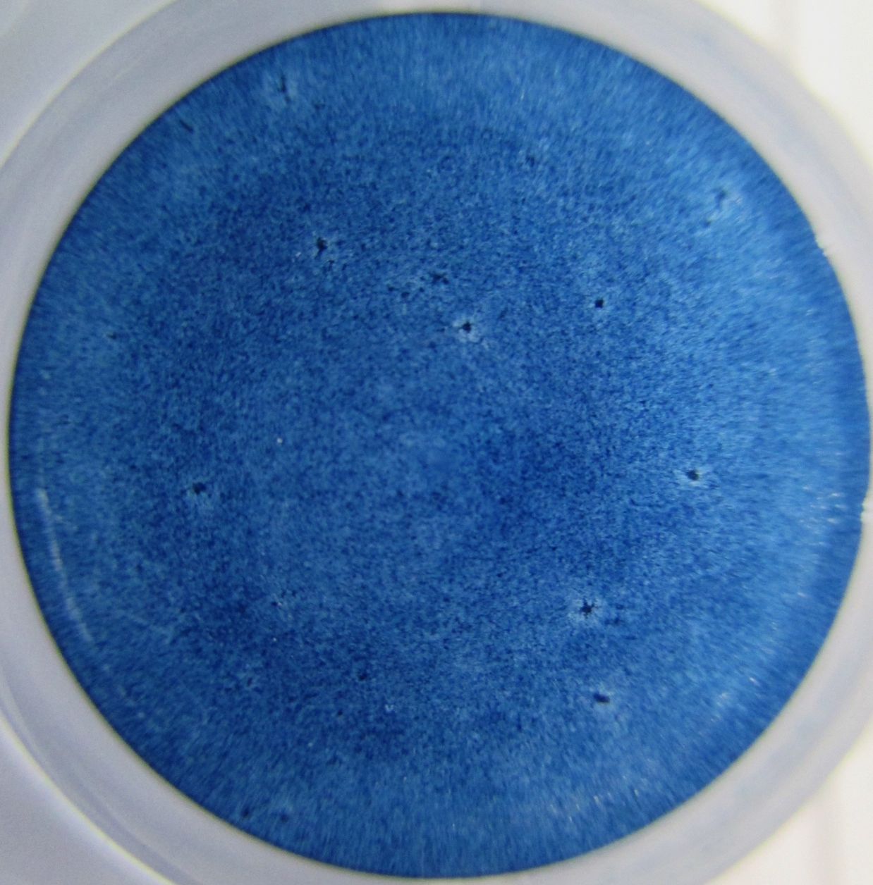
HeLa 300 tis bb./ml, 10.2.14
Fixed after 72h
BEST OF CMC
HRV16 from stock 28.11.13, PFU 5.10³

Slide 38
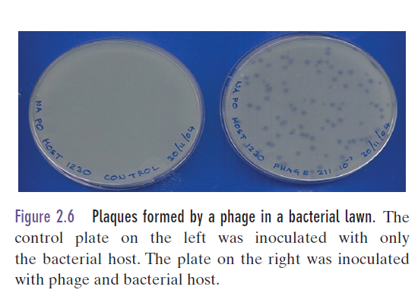
Phage plaque assay

Slide 39
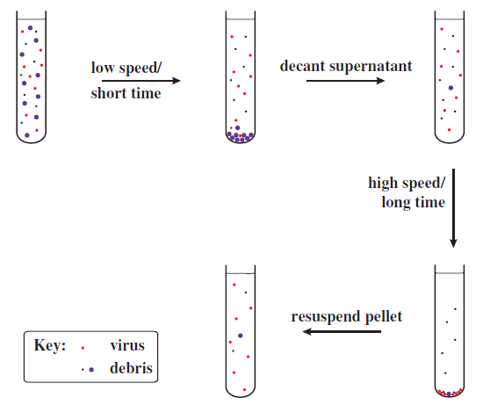
Differential centrifugation

Slide 40
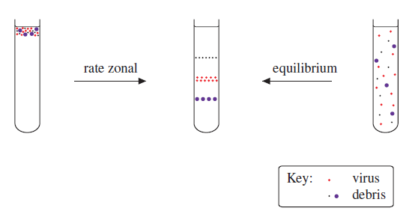
Density gradient centrifugation

Slide 41
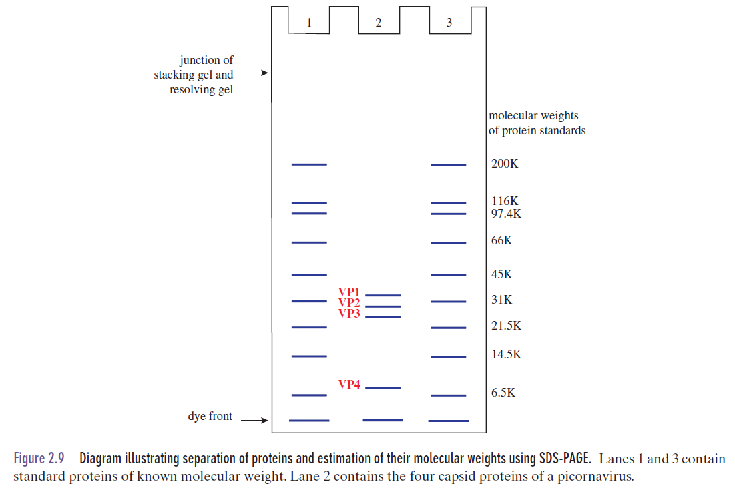
SDS-PAGE

Slide 42
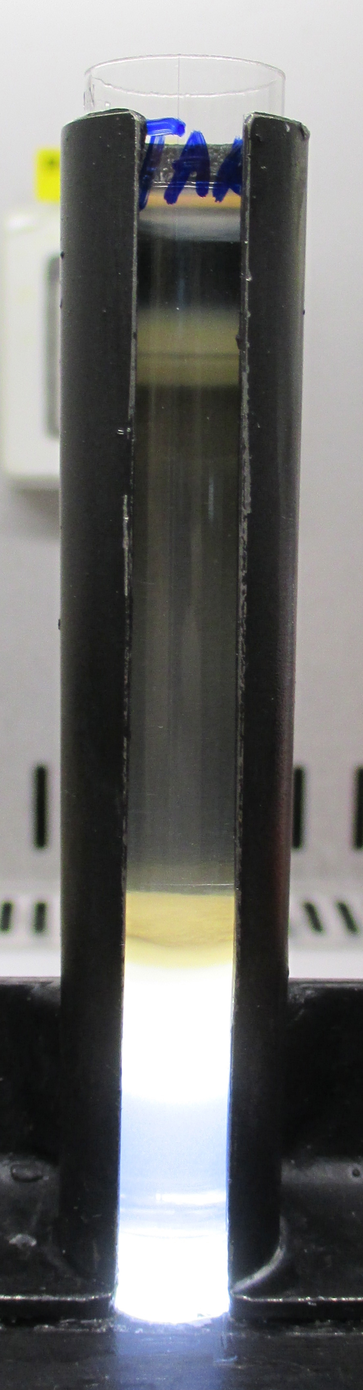
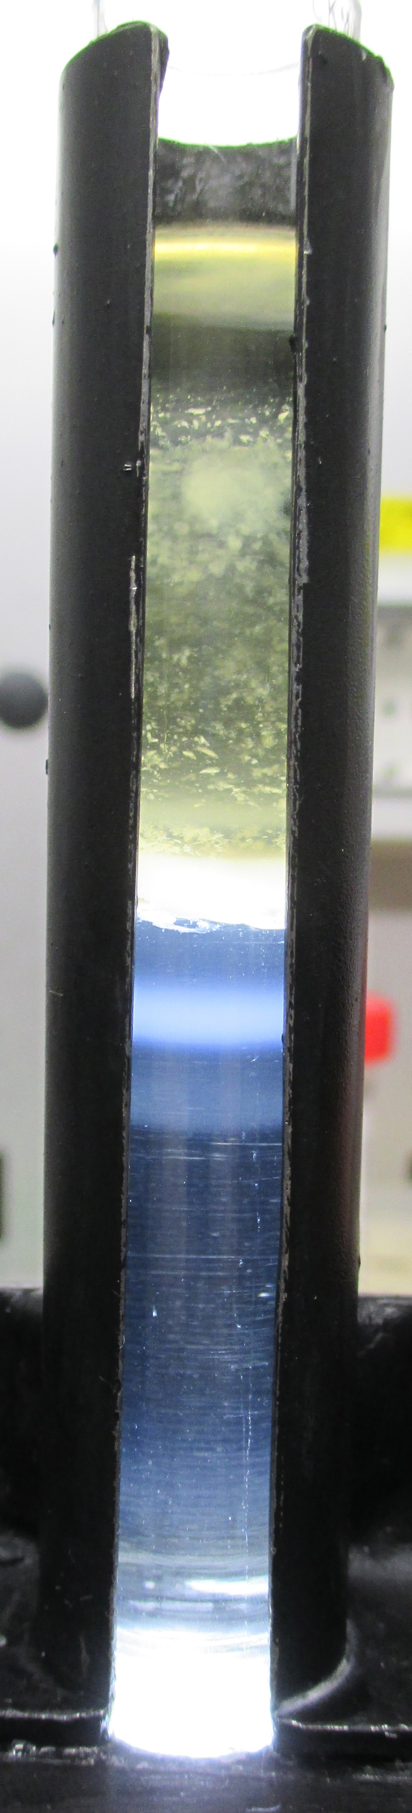
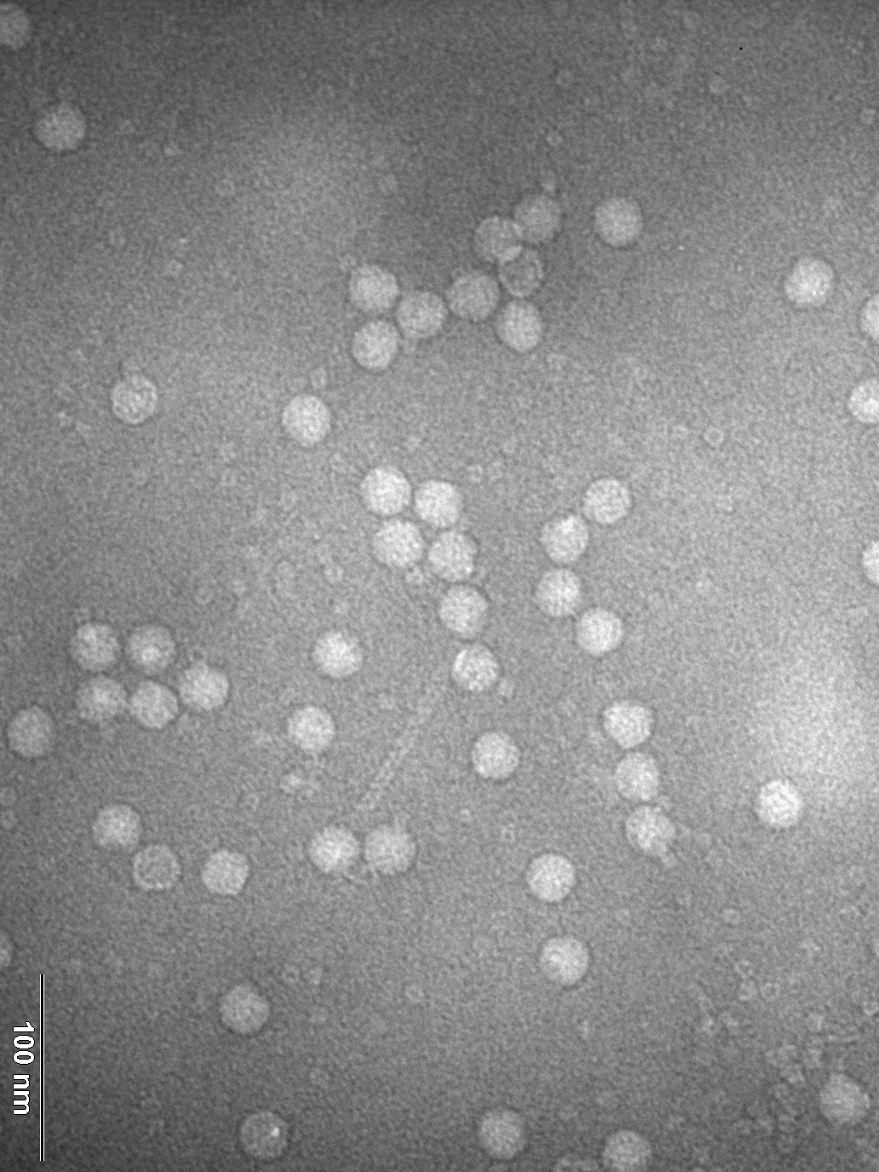
Israeli acute bee paralysis virus
tartrate gradient
CsCl gradient
CsCl gradient – middle fraction

Slide 43

SDS-PAGE of IAPV
LADDER
1.F tartrate
2.F tartrate
4.F tartrate
3.F tartrate
2.F CsCl
1.F CsCl
3.F CsCl
1.F tartrate A₂₆₀=133.083, A₂₈₀ = 160.379
2.F tartrate A₂₆₀=36.575, A₂₈₀ = 28.762
3.F tartrate A₂₆₀=86.795, A₂₈₀ = 70.081
4.F tartrate A₂₆₀=10.029, A₂₈₀ = 6.267
1.F CsCl A₂₆₀=111.613, A₂₈₀ = 63.564
1.F CsCl A₂₆₀=2.555, A₂₈₀ = 1.556
1.F CsCl A₂₆₀=6.836, A₂₈₀ = 3.918

Slide 44








1. Virus purification
2. Grid preparation
3. cryo-EM
4. Reconstruction

Slide 45

Cryo-EM of phage phi812

Slide 46





1. Virus purification
2. Crystallization
3. Diffraction data
4. Solve structure

Slide 47


Crystals of IAPV
0.1 M Cadmium Chloride
0.1 M Na acetate pH 4.5
15 % PEG 400
0.2 M Na/K Phosphate
0.1 M BisTris Propane pH 7.5
20 % PEG (w/v)3350

Slide 48

Hybridization detection of nucleic acids

Slide 49

Microarrays

Slide 50

rtPCR assay

Slide 51

TCID₅₀ assay

Slide 52

Sequencing of virus genomes

Slide 53
Learning outcomes
• outline methods for
◦ cultivation of viruses;
◦ purification of viruses;
◦ detection of viruses and their components;
◦ assay of virus infectivity;
◦ investigation of virus gene function;
• assess the value of virus genome sequencing.

Slide 54


Virus structures
Helical
Icosahedral
Complex
Irregular

Slide 55

Virus structures

Slide 56


Slide 57


Slide 59


Slide 60


Slide 61

Picornavirus virion

Slide 62

Icosahedron

Slide 63


Slide 64


Slide 65


Slide 66


Slide 67


Slide 68


E18 Fab
E19 Fab

Slide 69


Slide 70



Slide 71


Slide 72


Slide 73


Slide 74


Slide 75


Slide 76


Slide 77


Slide 78


Slide 79


Slide 80


Slide 81


Slide 82



Slide 83


Slide 84


Slide 85


Slide 86


Slide 87


EhV-201 virions are pleiomorphic

Slide 88




EhV-201 virions contain inner and outer membranes
confidence interval
background level

Slide 89


Sub-tomogram reconstruction of EhV-201 vertex

Slide 90

T-number and ideal EhV-201 virion
10 nm

Slide 91

T-number and ideal EhV-201 virion
10 nm

Slide 92


T-number and ideal EhV-201 virion
5 nm
10 nm
5 nm

