Slide 1

2 Nanomaterials
nanomaterials and nanostructures – overview
carbon – nanotubes, graphene
metal-based nanostructures - nanowires, gold nanoparticles (nanorods, nanocages, nanoshells)
magnetic nanoparticles
polymer nanostructures (dendrimers)
protein-based nanostructures - nanomotors from microbes and mammalian cells (myosin).
nanomachines based on nucleic acids

Slide 2
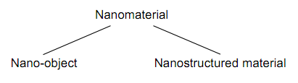
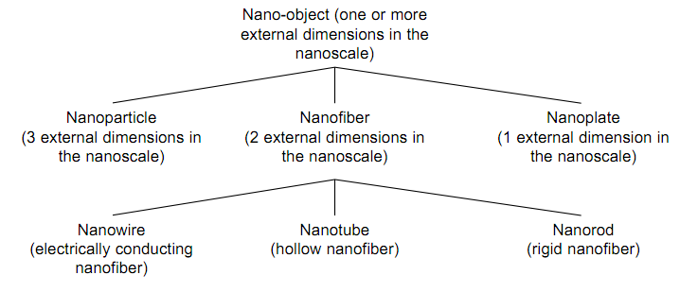
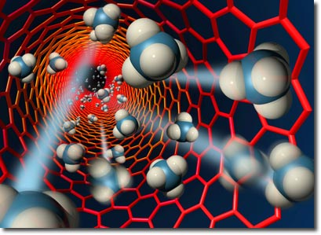
Definition
a nanomaterial is a material made up of nanostructures between
1 and 100 nanometres in size
nanostructures can include nanoparticles, nanotubes or nanocrystals, etc.
properties of nanomaterials are different to those of ordinary materials because of the small size of the structures that make them up
principal parameters of nanoparticles are
  shape
  size
  morphological sub-structure
  of the substance

Slide 3
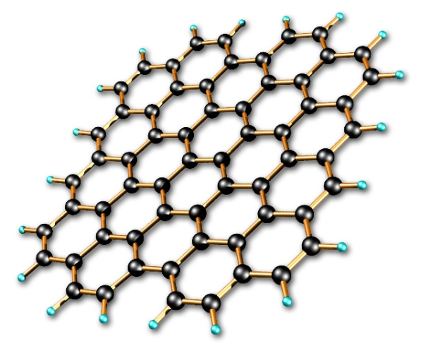
Overview
nanomaterials are manufactured for a wide variety of applications
a typical example might be carbon nanotube-based nanomaterials, with applications anticipated in
  nanoelectronics (components)
  medicine (transport of drugs in the body)
  information technology (computer memory) ....
composite nanomaterial (combinations of materials that are normally immiscible) are also being produced
the idea is to introduce nanostructures - nanoparticles, for instance into a matrix (metal, organic material, etc.) to obtain specific properties of hardness, mechanical strength, conductivity or electrical insulation

Slide 4
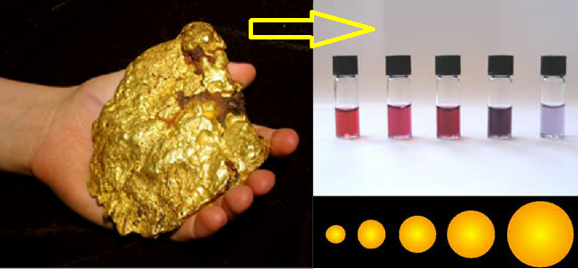
Properties vary with size of the material
(bulk) gold is a shiny yellow metal
nanoscopic gold, i.e. clusters of gold atoms measuring 1 nm across, appears red
bulk gold does not exhibit catalytic properties
Au nanocrystal is an excellent low temperature catalyst.
therefore, if we can control the processes that make a nanoscopic material, then we can control the material’s properties

Slide 5
Physical properties of nanomaterials
significantly lower melting point or phase transition temperature
  due to a huge fraction of surface atoms in the total amount of atoms
mechanical properties may reach the theoretical strength
  1 or 2 orders of magnitude higher than that of single crystals in the bulk form
  enhancement in mechanical strength - reduced probability of defects
optical properties can be significantly different from bulk crystals
  e.g. the optical absorption peak of a semiconductor nanoparticle shifts to short wavelength, due to an increased band gap
  color of metallic nanoparticles may change with their sizes due to surface plasmon resonance
electrical conductivity decreases with a reduced dimension
  due to increased surface scattering;
  however, electrical conductivity of nanomaterials could also be enhanced appreciably due to the better ordering in microstructure, e.g. fibrils
magnetic properties are distinctively different from that of bulk materials
  ferromagnetism of bulk materials disappears and transfers to superparamagnetism in the nanometer scale due to the huge surface energy
self-purification is an intrinsic thermodynamic property of nanostructures and nanomaterials
  any heat treatment increases the diffusion of impurities, intrinsic structural defects and dislocations, pushing them to the nearby surface
  increased perfection would have appreciable impact on the chemical and physical properties – enhanced chemical stability

Slide 6
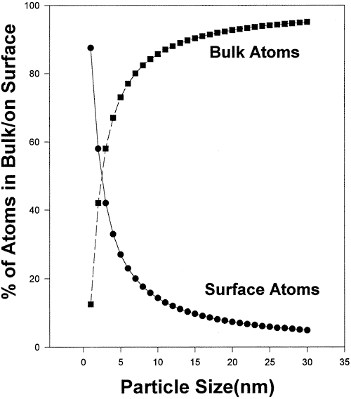
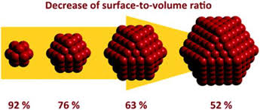
Special properties of nanomaterials
high surface / bulk ratio
  catalysis
  nanoparticle reagents
  heat dissipation
  laminar flow
finite size effects
  quantum confinement
  interparticle tunneling
  proximity effects
  high probability of defect- free crystals

Slide 7
Nanostructures
aerogels
biomolecules
nanocarbon
composites
dendrimers
glasses / ceramics
hydrogels
metals and alloys
nanomagnets
nanoparticles/ catalysts
nanostrings
nanowires
quantum dots
self assembled monolayers (SAMs)
silicon structures and mems devices
thin films

Slide 8
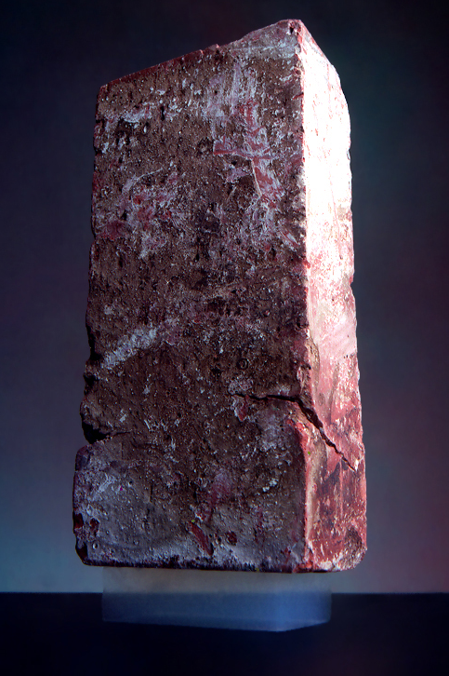
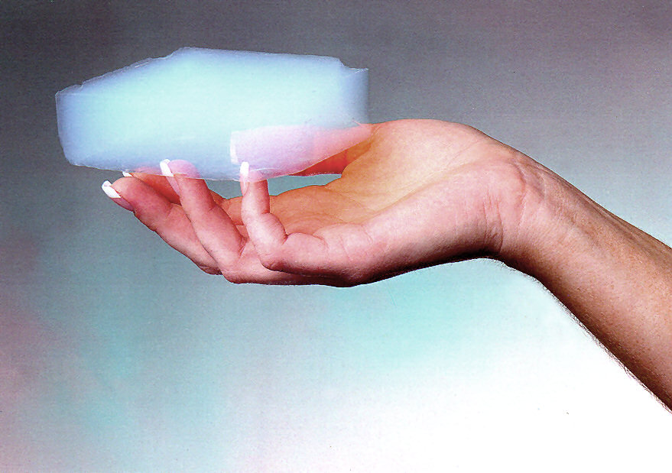
Aerogels
manufactured material with the lowest bulk density of any known porous solid
derived from a gel in which the liquid component of the gel has been replaced with a gas
produced by extracting the liquid component of a gel through supercritical drying
this allows the liquid to be slowly drawn off without causing the solid matrix in the gel to collapse from
capillary action, as would happen with
conventional evaporation

Slide 9
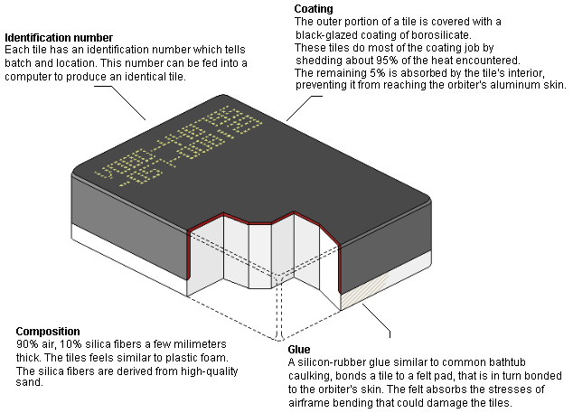
Space Shuttle tile - alumina-silicate aerogel
black coating on the tiles is Reaction Cured Glass (RCG, tetrasilicide and borosilicate)
RCG is applied to all but one side of the tile to protect the porous silica and to increase the heat sink properties
to waterproof the tile, dimethylethoxysilane is injected into the tiles by syringe.
densifying the tile with tetraethyl orthosilicate (TEOS) also helps to protect the silica and waterproof

Slide 10
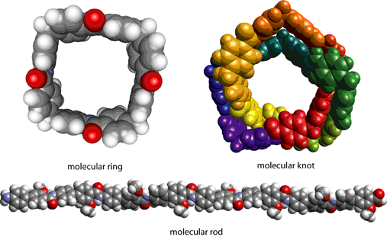
Biomolecular nanotechnology
molecular structures and functional complexes
DNA templating
synthetic biology – synthetic biomacromolecules
liposomes and novel cellular structures
… not exactly our field

Slide 11
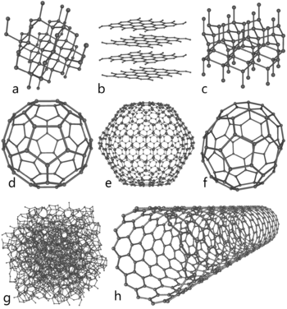
Nanocarbon
carbon nanotubes - single (SWNT) and multiwalled (MWNT)
graphene
carbon nanospheres
nanodiamonds

Slide 12
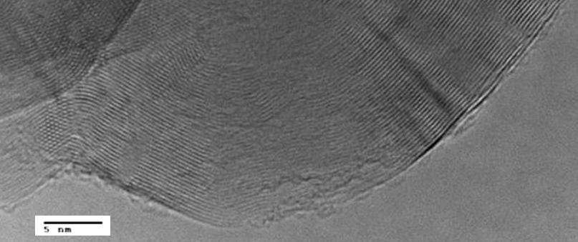
Composite materials
carbon nanofibers (CNFs) - vapor grown carbon fibers (VGCFs) or nanofibers (VGCNFs) are cylindrical nanostructures with graphene layers arranged as stacked cones, cups or plates
nano-onion structure observed in nanospheres, and annealed carbon black (soot)
it is thought that the extended nanostructure forms by wrapping of graphene over a fullerene seed-like nanostructure

Slide 13
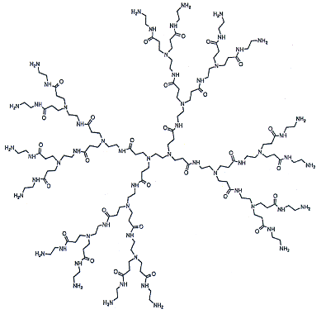
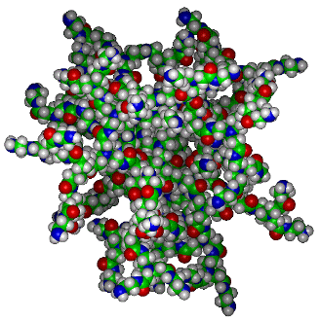
Dendrimers
repetitively branched molecules
  also known as arborols and cascade molecules
typically symmetric around the core
  often adopts a spherical three-dimensional morphology

Slide 14
Glasses and ceramics
glasses are similar to polymers - long chains and almost a liquid
ceramics are metal - nonmetal compounds with typically ionic bonding
  high melting points, can be brittle, and typically are non-conductive
  electroceramics can be conductive
  have high temperature properties

Slide 15
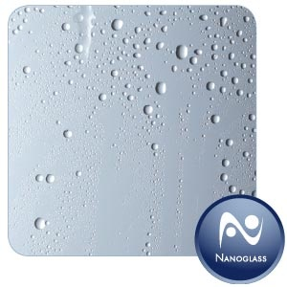
Nanoglass coatings
hydrophobic coatings on glass help water to bead up - increased visibility, easier cleaning
added mechanical / abrasion resistance, by promoting surfaces that are also scratch resistant
made from fluoropolymers, or methylated siloxane materials, both deposited as plasma polymerized coatings
Notes:
15

Slide 16
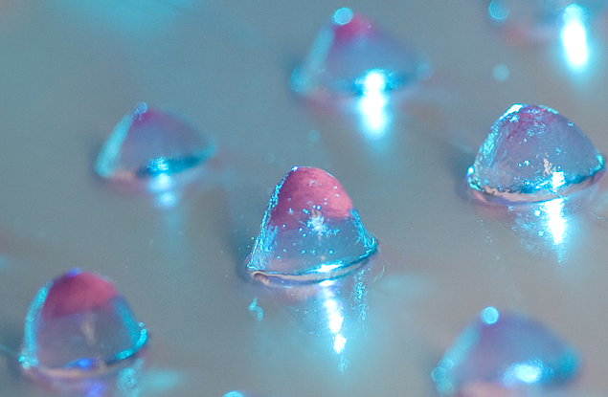
Hydrogels
hydrogel (also aquagel) is a network of polymer chains that are hydrophilic, sometimes found as a colloidal gel in which water is the dispersion medium
highly absorbent (can contain up to 99.9% water) natural or synthetic polymers
possess a degree of flexibility very similar to natural tissue, due to their significant water content
highly cross-linked polymers, water insoluble but soak up water, can be ‘mechanically
interactive’
novel biomaterial with surprising
antibacterial properties that can
be injected as a low-viscosity gel
into a wound where it rigidifies
nearly on contact
delivering a targeted payload
of cells and antibiotics to repair
the damaged tissue
(Univ. Delaware)

Slide 17
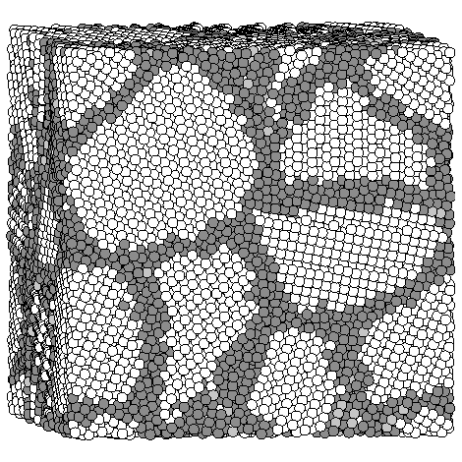
Metals and alloys
grain boundary engineering - high performance alloys
careful control chemistry / processing
increase strength / stiffness, fatigue
grain boundary is the interface between two grains, or crystallites, in a polycrystalline material; defects in the crystal structure, tend to decrease the electrical and thermal conductivity of the material
high interfacial energy and relatively weak
bonding in most grain boundaries often makes
them preferred sites for the onset of corrosion
and for the precipitation of new phases
important to many of the mechanisms of creep
disrupt the motion of dislocations through
a material, so reducing crystallite size is
a common way to improve strength

Slide 18

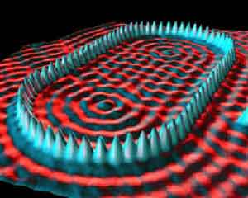
Nanomagnetic materials
nanotechnology used to ‘freeze’ the positions of atoms in an orientation that aligns the weak magnetic polarization
nanomagnetic structures are formed by careful control of material composition and processing parameters
applications in magnetic / data storage
magnetic force microscopy (MFM)
imaging of novel nanomaterials
magnetic structure of a quantum “corral”, which
consists of magnetic iron atoms deposited on
a copper surface that "corral" copper electrons

Slide 19
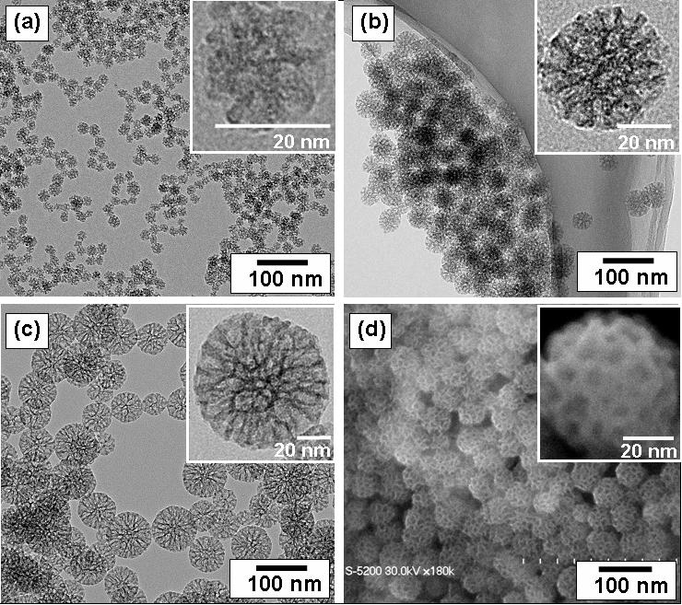
Nanoparticles
in nanotech, particle is defined as a small object that behaves as a whole unit in terms of its transport and properties
particles are further classified according to size
coarse - between 10,000 and 2,500 nm
fine - 2,500 to 100 nm
ultrafine particles, or
nanoparticles 100 to 1 nn
TEM (a, b, c) and SEM (d) images
of mesoporous silica nanoparticles,
mean diameter: (a) 20 nm, (b) 45 nm,
(c) 80 nm.
SEM (d) image corresponding to (b)

Slide 20
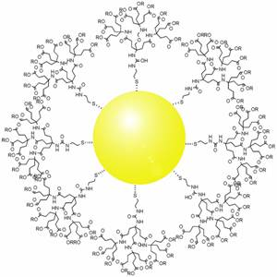
Nanoparticles and catalysts
high surface area
tailored surface chemistry
added to bulk / composite materials
metal, ceramic, or polymer
can also be ‘powder-like’
dendron conjugated gold
nanoparticle

Slide 21
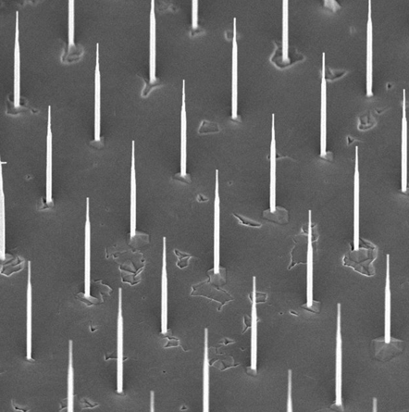
Nanowires
nanowire is a nanostructure, with the diameter of the order of a nanometer
alternatively, nanowires can be defined as structures that have a thickness or diameter constrained to tens of nanometers or less and an unconstrained length
at these scales, quantum mechanical effects are important - "quantum wires“
image width, 5 um

Slide 22
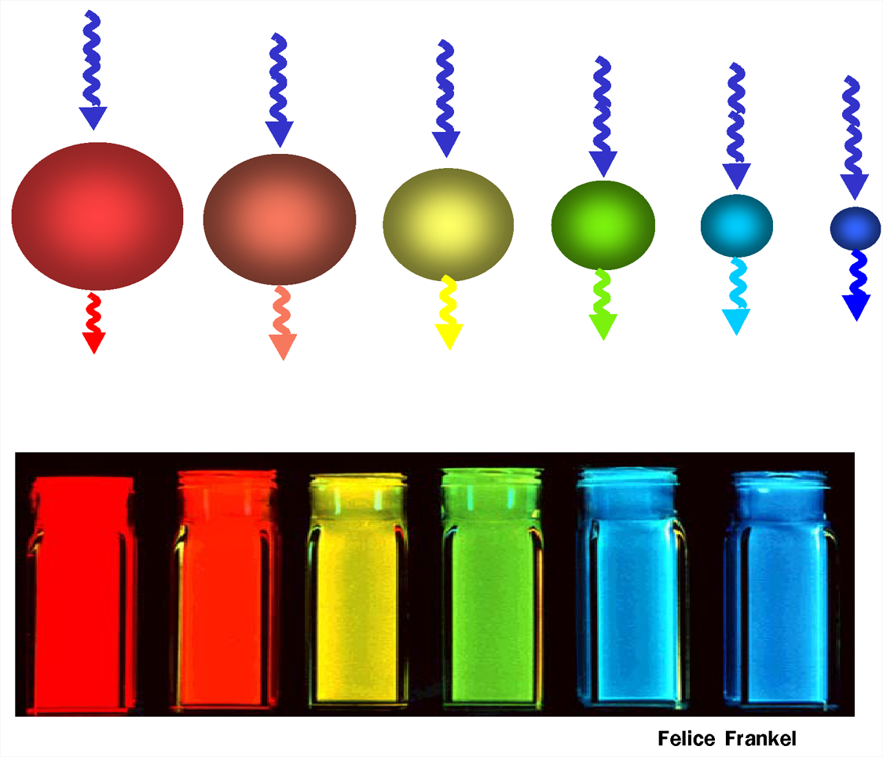
Quantum dots (QD)
QD is a portion of matter (e.g. semiconductor) whose excitons are confined in all three spatial dimensions
electronic properties intermediate between bulk semiconductors and discrete molecules
QD are semiconductors whose electronic properties are closely related to the size and shape of the individual crystal
the smaller the size of the crystal, the
larger the band gap, the greater the
difference in energy between the
highest valence band and the lowest
conduction band
more energy is needed to excite the
dot, and more energy is released when
the crystal returns to its resting state

Slide 23
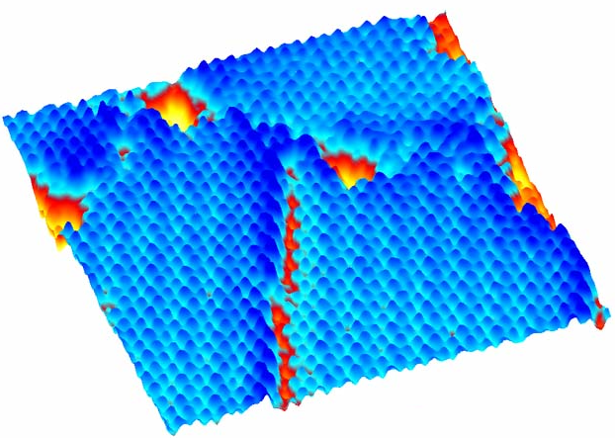
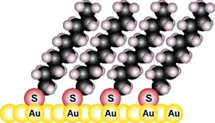
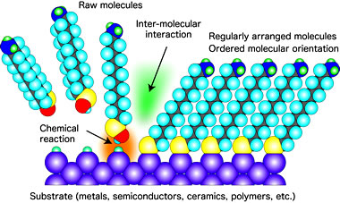
Self assembled monolayers (SAMs)
most typical – spontaneous adsorption of thiols on gold

Slide 24
Self-assembly
making nanostructures by letting the molecules sort themselves out
molecules will always seek the lowest energy available to them
molecules will align themselves into particular positions
use for large nanoscale arrays, different length scales, low cost, generality
electronic applications, coatings
molecular model (top) of a self-assembled
"mushroom"
photograph (bottom) shows control of surface wetting by a layer of these mushrooms

Slide 25
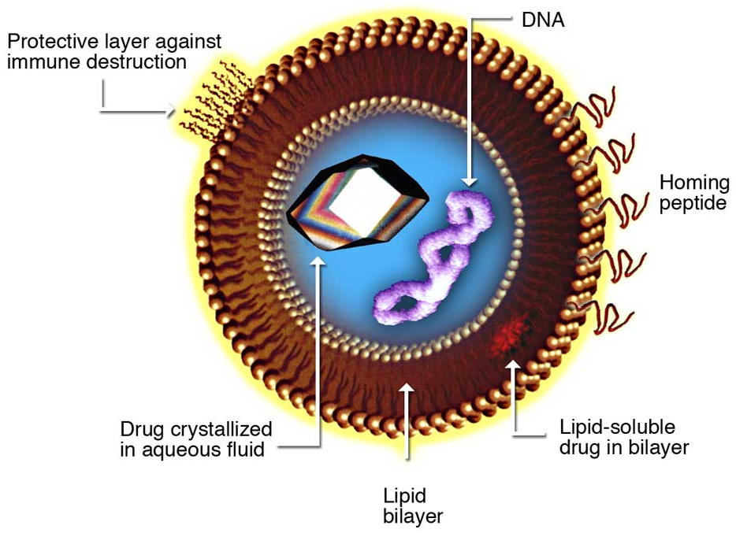
Liposomes
artificial composite structures made of phospholipid bilayer and may contain small amounts of other molecules
vary in size from low micrometer range to tens of micrometers
unilamellar liposomes (shown) are typically in the lower size range with various targeting ligands attached to their surface allowing for their surface-attachment and accumulation in pathological areas for treatment of disease
can be filled with drugs and used to deliver drugs
disrupting biological membranes
– sonication
from natural phospholipids with
mixed lipid chains (e.g. egg
phosphatidylethanolamine) or
other synthetic surfactants
should not be confused with
micelles and reverse micelles
composed of monolayers

Slide 26
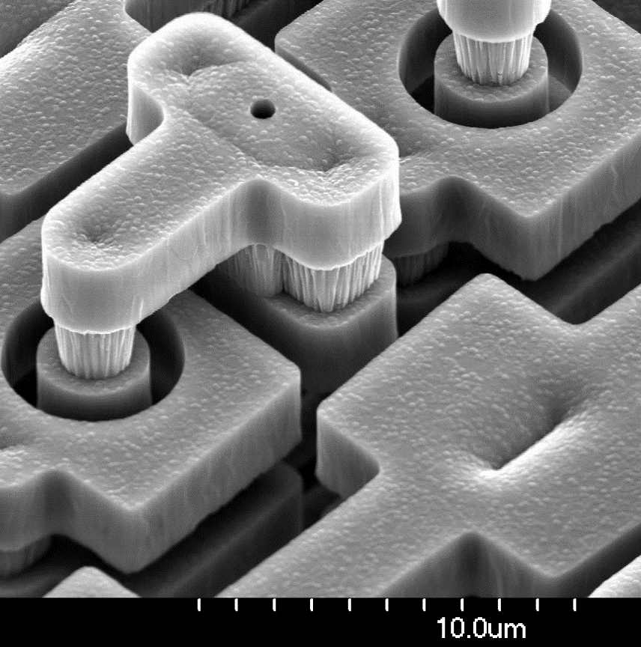
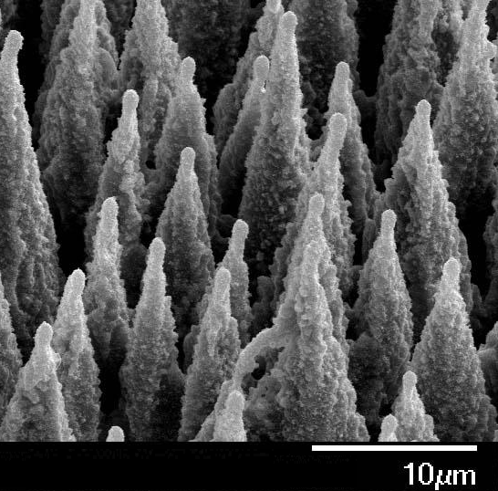
Silicon structures / materials
wafers
MEMS
LOC
biomimetic
structures

Slide 27
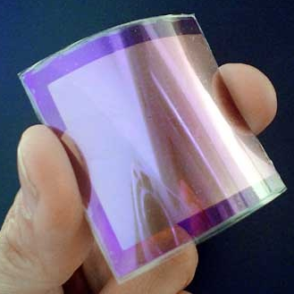
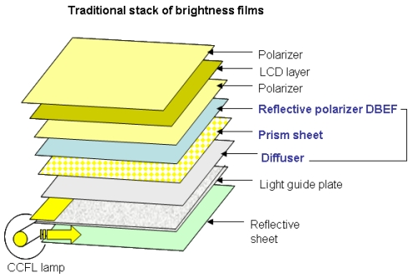
Thin films
physical coatings
layered stacks
deposited films
functionalized (SAMs)
magnetic and optical applications
metallization in silicon semiconductors

Slide 28
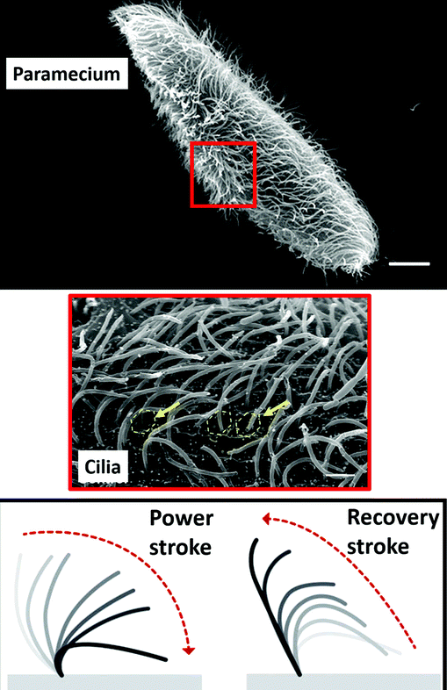
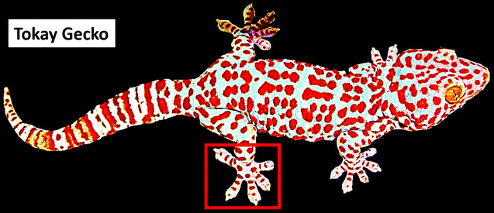
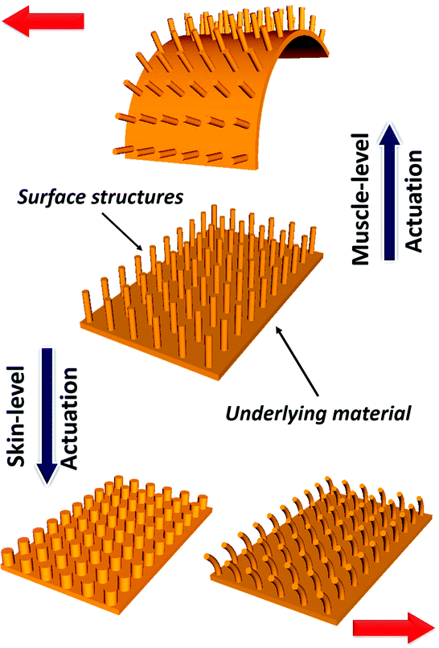
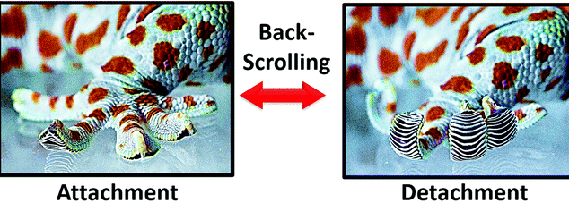
Biomimetic structures
learning from nature
using shape as well as chemistry
some similar function (light gathering, sensing/detection, etc.
from nanostructures to nanosystems

Slide 29
Nanofabrication techniques
nanoparticles
    colloidal processing
    flame combustion
    phase segregation
nanorods or nanowires
    template-based electroplating
    solution-liquid-solid growth (SLS)
thin films
    chemical vapour deposition (CBD and MOCVD)
    molecular beam epitaxy
    atomic layer deposition
nanostructured bulk material
    photonic bandgap crystals by self-assembly of nanosized particles
    grouped according to the form of products

Slide 30
Making of nanostructures
the bottom-up approach: whereby structures are made atom-by-atom and molecule-by-molecule, harnessing covalent, ionic, metallic or non-covalent bonds. This approach represents how nature self-assembles functioning nanostructures, such as enzymes and viruses, or
the top-down approach: whereby structures are etched into bulk materials such as silicon. This approach represents how silicon chips are fabricated
nanoscale science is more than creating structures on the length scale of 1-100 nm; it is about making nanostructures which also function in some way

Slide 31
How to make things small?
Lithographic Techniques
Molecular Beam Epitaxy
SPM Probes
Nanotechnology
Supramolecular Chemistry – Aggregates
Nanoparticle Synthesis
Covalent Chemistry – Dendrimers

