Slide 1
PROCESS CHEMISTRY
INTRODUCTION
Petr Beňovský

Slide 2




Slide 3
My experience has been that process chemistry is a roller-coaster ride, with tremendous highs and lows, where you learn theory and concepts, as needed, on the fly, from your colleagues and from those reference books (while meeting seemingly unattainable milestones and timelines)
Peter J.Harrington
Pharmaceutical Process Chemistry for Synthesis Rethinking the Routes to Scale-up, Wiley, 2011

Slide 4
DIFFERENCES BETWEEN ACADEMIC AND PROCESS CHEMISTRIES
Academic – Discovers, reveals, disputes, confirms, brings new knowledge.
Small amount of material.
Process – Selects, optimizes, seeks for efficiency, defines control points, considers efficiency and environment (also safety).
Role of chemical engineers.
Relatively large amount of material.

Slide 5
Outline of the class
History of fine process chemistry, recent trends, future;
Differences between laboratory and larger scale experiments;
Scale-up/downscale considerations;
Safety;
Crystallization (solubility, metastable zone, nucleation, crystal growth, optical resolution, Viedma ripening, attrition enhanced deracemization, seeding, Ostwald ripening, new trends in crystallization);
Polymorphism;
Typical process operations (mixing, heat transfer, agglomeration, product isolation, distillation, drying, purification, work up, reactors);

Slide 6
Outline of the class (cont.)
Continuous manufacturing, flow chemistry;
Synthetic route selection;
Analytical methods, Process Analytical Technology (PAT), Design of Experiments (DoE), Quality by Design (QbD), Purge Analyses;
Environmental Aspects;
Economy, Cost of Goods (CoG);
Regulatory issues, patents.
Examples from recent literature about various topics within the whole lecture.

Slide 7
Recommended reading:
Anderson, N.G. Practical Process Research & Development, A Guide for Organic Chemists, 2nd Edition, Elsevier Inc. 2012; ISBN 978-0-12-386537-3
Hulshof, L.A. Right First Time in Fine-Chemical Process Scale-up, Scientific Update LLP 2013; ISBN 978-0-9533994-1-3
Blacker, A.J.; Williams, M.T. Pharmaceutical Process Development, Current Chemical and Engineering Challenges, RSC Publishing 2011; ISBN 978-1-84973-146-1

Slide 8
Examination:
Written test (total 50 points)
45 – 50 points ….. A
39 – 44 points ….. B
33 – 38 points ….. C
27 – 32 points ….. D
21 – 26 points ….. E

Slide 9
HISTORY, RECENT DEVELOPMENT AND FUTURE OF PROCESS (PHARMACEUTICAL) CHEMISTRY
Petr Beňovský

Slide 10
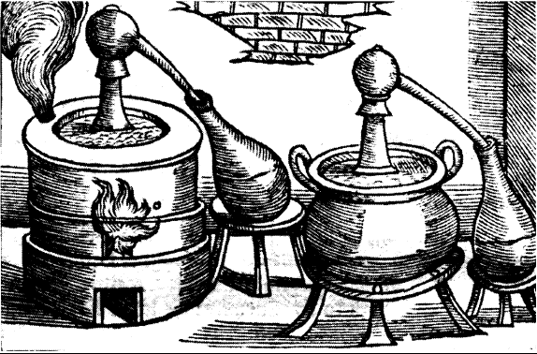
HISTORY OF PROCESS (PHARMACEUTICAL)
CHEMISTRY
From Alchemy to Chemistry
Gesner’s treatise – 1599 – bath of Marie

Slide 11
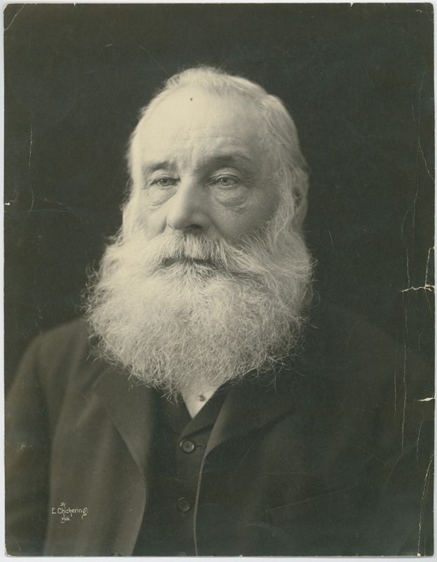
HISTORY OF PROCESS (PHARMACEUTICAL)
CHEMISTRY
1668 – Merck founded in Germany, nowadays one of the largest chemical and pharmaceutical companies all over the world;
1891 – Merck US subsidiary founded (Merck & Co.), in 1917 (after WW I) expropriated and became independent American company;
1856 – William Henry Perkin assigned by his teacher (August Wilhelm von Hofmann) to attempt the synthesis of quinine from aniline. Instead, he prepared mauveine;
1876 – Eli Lilly company founded by colonel Eli Lilly in US (1923 first
commercially available insulin; 1940 first mass production
penicillin); first written instructions to process workers; quality
controls;
1899 – Bayer – blockbuster Aspirin® (still manufactured – about
40 000 tons per year);
1903 – Merck – diethylbarbituric acid

Slide 12
HISTORY OF PROCESS (PHARMACEUTICAL)
CHEMISTRY
1899 – Bayer –Aspirin®;
Arthur Eichengrün (the head of pharmaceutical division);
Felix Hoffmann (a chemist);
Heinrich Dreser (the head of pharmacological section responsible for the clinical studies).
Desborough, M.J.R. et al British J.Haematol. 177, 674 (2017)

Slide 13
CORTISONE ACETATE
Early 1950s – Merck the synthesis of cortisone acetate from desoxycholic acid
(Org.Process Res.Dev. 8, 708 (2004))

Slide 14
CORTISONE ACETATE

Slide 15
CORTISONE ACETATE

Slide 16
CORTISONE ACETATE

Slide 17
CORTISONE ACETATE
DNBS = 3,5-dinitrobenzene- sulfonic acid
MPPA = monoperoxophthalic acid
DDH = dibromodimethyl hydantoin

Slide 18
CORTISONE ACETATE

Slide 19
HISTORY OF PROCESS (PHARMACEUTICAL) CHEMISTRY
1960s – Upjohn and ICI companies developed synthetic routes to prostaglandins
1960s to 1980s – the advent of asymmetric synthesis (Sharpless, Jacobsen, the Monsanto process – asymmetric hydrogenation, Takasago – asymmetric isomerisation)

Slide 20
HISTORY OF PROCESS (PHARMACEUTICAL) CHEMISTRY
1990s - Merck - Indinavir
Treatment of HIV – AIDS related diseases;
Very large dose – 2.4 g per day, i.e. cca 1 kg per year per person;
Challenge to design a synthesis that could be executed on a scale approaching that of commodity chemicals.

Slide 21
INDINAVIR (cont.)
Hudlický, T.; Reed J.W. The Way of Synthesis; Wiley 2007

Slide 22
INDINAVIR (cont.)
Senanayake, C.H. et al Tetrahedron Lett. 36, 3993 (1995)
Hudlický, T.; Reed J.W. The Way of Synthesis; Wiley 2007

Slide 23
INDINAVIR (cont.)
Rossen, K. et al Tetrahedron Lett. 36, 6419 (1995)
Hudlický, T.; Reed J.W. The Way of Synthesis; Wiley 2007

Slide 24
INDINAVIR (cont.)

Slide 25
HISTORY OF PROCESS (PHARMACEUTICAL) CHEMISTRY
2004 – Novartis – Discodermolide – large scale production (60 g) – 39 steps – 17 chromatographic purifications – 43 chemists participation – over 20 months (!!)
A polyketide natural product;
One of the most potent promoters of tubulin assembly;
A potent inhibitor of tumor cell growth in several MDR (multidrug resistence) cancer cell lines;
Attempts to do semi-synthesis by a fermentation process failed;

Slide 26
HISTORY OF PROCESS (PHARMACEUTICAL) CHEMISTRY
MATERIAL – limitation in materials, equipment and commercial suppliers;
METHODOLOGY – relatively good portfolio of various reactions, but often harsh reaction conditions;
CHEMICALS – difficult to get broad range of commercially available starting material;
ANALYTICAL SUPPORT – degradation methods, tedious
INSTRUMENTS – very limited, later spectroscopy (UV/VIS, IR, optical rotation)
FINANCIAL SUPPORT – money from science enthusiasts, maybe some societies or companies (focused on particular field of interest)
SAFETY – significant improvement and systematic evaluation of possible risks over last 40 years

Slide 27
RECENT DEVELOPMENT
Increased regulatory expectations – even more focused on the patient’s safety – more controls and deeper process understanding;
Automated platforms and robotics – high throughput methods;
Cooperation of process chemists with academics;
Green chemistry, sustainability;
Continuous production (finally !!), flow chemistry;
Powerful software enables better modeling;
Biotechnologies

Slide 28
THE FUTURE
Intensification of the research and development work;
Automation; continuous manufacturing;
Real-time measurement – Process Analytical Technology (PAT);
Shift from the Quality by Certificate (QbC) to Quality by Design (QbD)
Outsourcing;
University spin-offs – contract synthesis and cooperation;
More environmental oriented

Slide 29
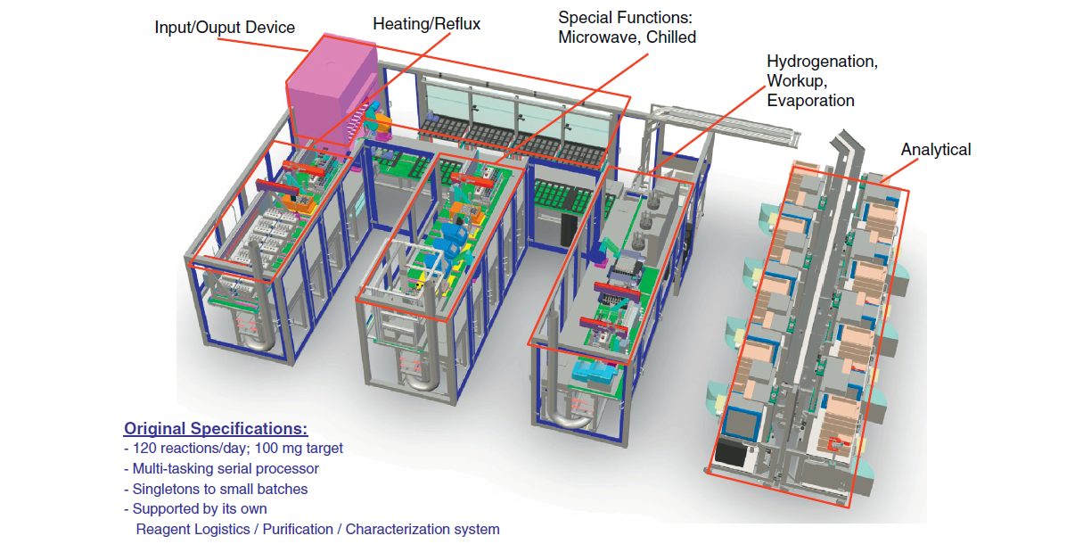
THE FUTURE
Drug Discovery Today 18, 795 (2013)

Slide 30
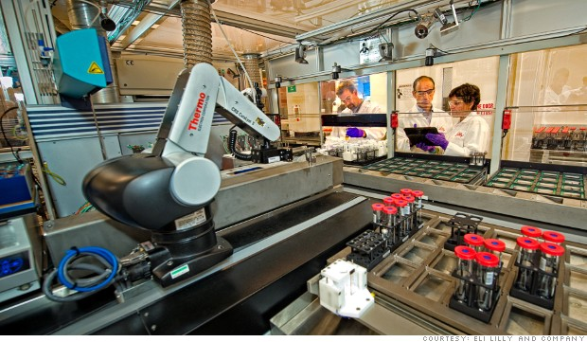
THE FUTURE
Drug Discovery Today 18, 795 (2013)

