Slide 1
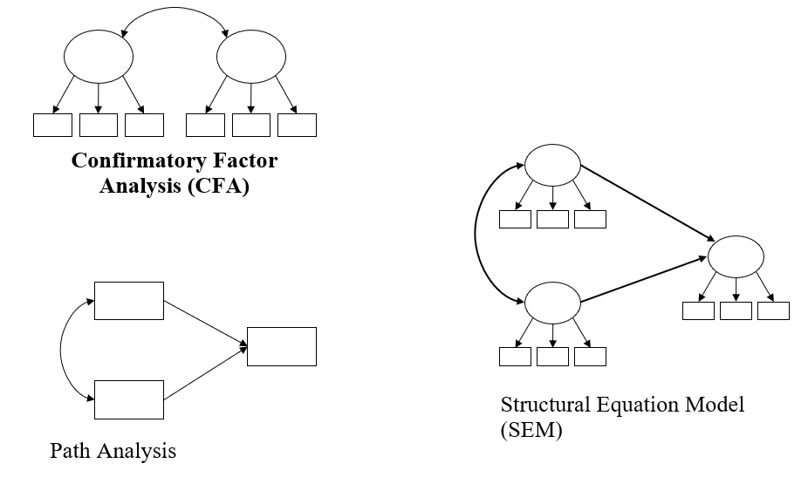
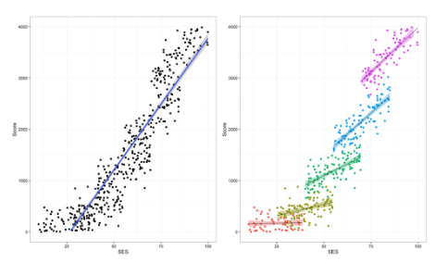
Introduction and Recap
E0430
Week 1

Slide 2
HLM approach
Hierarchical Linear Modeling (HLM)
Synonyms: MLM, mixed-effect or random effects model
Linear regression that takes into account clustering/nesting of data, i.e., their hierarchical structure
Clusters = countries, institutions, households, etc.

Slide 3
HLM Example
Positive association between SES and academic achievement overall
However, the strength and (potentially) significance of the association vary across schools
https://www.r-bloggers.com/2016/10/multilevel-modeling-of-educational-data-using-r-part-1/

Slide 4
SEM approach
Structural Equation Modeling (SEM)
Diverse set of methods (path analysis, CFA, SEM, LGM)
Estimation of complex associations between variables
Fit between hypothesized model and data
Modeling latent variables

Slide 5
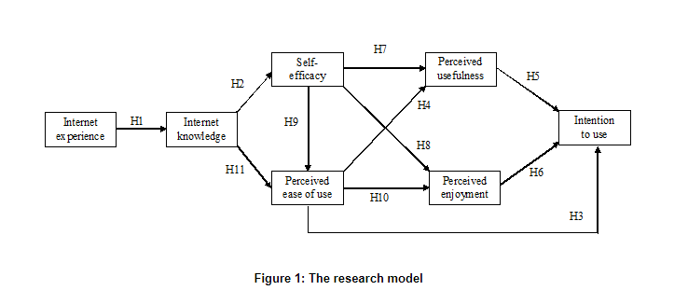
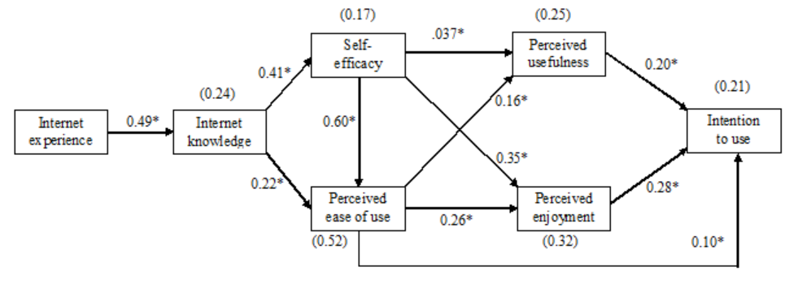
SEM Examples

Slide 6
SEM Examples

Slide 7
Modeling approach
Theoretical model: hypothesis (or set of hypotheses) about associations between variables
Theoretical model → Statistical model
Models are necessarily simplifications and only approximate reality

Slide 8
Common Features of HLM and SEM
Useful techniques for analysis of large, complex, and/or longitudinal data
Require large sample sizes
Can be combined (hierarchical SEM)
Based on covariance/correlation and regression

Slide 9
Covariance and Correlation
Covariance/correlation is a measure of the joint variability of two variables
Linear association between variables
Covariance = unstandardized
Correlation = standardized
Positive correlation
Negative correlation
y
y
0
x
0
x

Slide 10
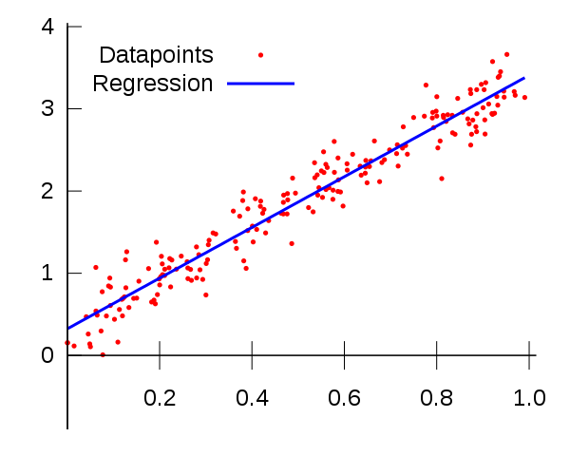
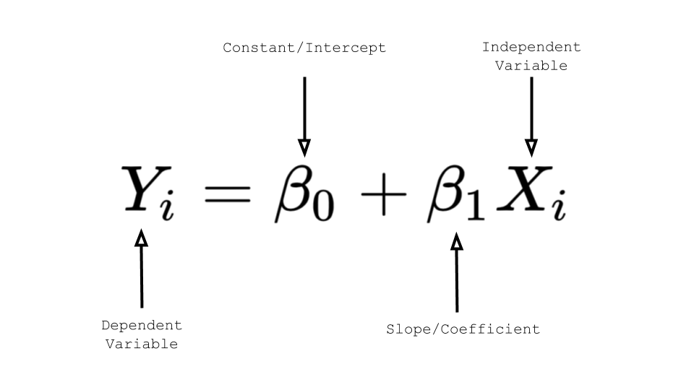
Regression
Linear association between variables
Simple regression (one IV and one DV) is statistically equivalent to correlation between the variables (r = β)
Prediction – exposure (IV) and outcome (DV)
OLS regression - minimizing the sum of the squared vertical distances to the data points
Notes:
Multiple regression
- The estimates now reflect the relationship accounting for the effect of other variables (conditional effect – partial regression coefficient)
- Multiple regression also accounts for the correlation between the IVs

Slide 11
Variance explained – R²
x
y
The total proportion (or %) of the DV variability that is explained by knowing X is called R²
1 - r²
r²
1 - r²

Slide 12
Practical
Open dataset students.sav
Test whether there is a statistically significant correlation between hours spent online and hours slept per night
What is the magnitude and significance of the r coefficient?
Interpret the r coefficient
Run simple linear regression to test whether hours spent online predict hours slept per night
What is the magnitude and significance of the regression coefficients (B, β)?
What proportion of variance in hours slept per night do hours spent online explain?
Summarize the results of the regression analysis in your own words

