Slide 1
El-mag 2
Elektrické pole od nabité přímky.
Elektrické pole na ose nabitého kroužku.
Elektrické pole nabité sféry (výpočtem, fyz. úvahou).
Gaussova věta elektrostatiky.

Slide 2



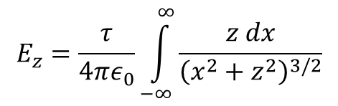


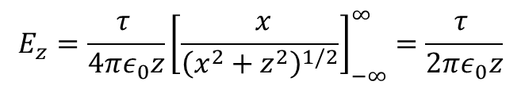

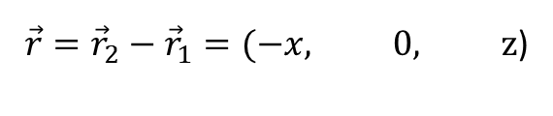
intenzita elektrického pole v okolí nabité přímky
$$\vec{r}={\vec{r}}_{2}−{\vec{r}}_{1}$$
$$\vec{E}=\frac{τ}{4πε_{0}}\int_{S}{ }$$
z
$${\vec{r}}_{2}=(0, 0, z)$$
$$E_{z}=\frac{τ}{4πε_{0}}\int_{−∞}^{∞}{\frac{z dx}{{\left(x^{2}+z^{2}\right)}^{3/2}}}$$
$${dE}_{z}$$
${\vec{r}}_{1}=(x, 0, 0$)
z
$$\vec{r}={\vec{r}}_{2}−{\vec{r}}_{1}=(−x, 0, \text{z}\text{)}$$
$$x$$
$$E_{z}=\frac{τ }{4πε_{0}z}{\left[\frac{ x}{{\left(x^{2}+z^{2}\right)}^{1/2}}\right]}_{−∞}^{∞}=\frac{τ }{2πε_{0}z}$$

Slide 3
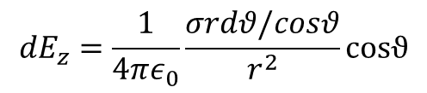






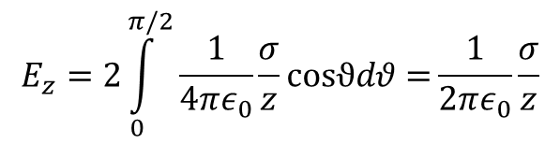

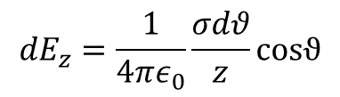

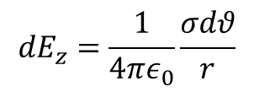
intenzita elektrického pole v okolí nabité přímky
z
$${dE}_{z}=\frac{1}{4πε_{0}}\frac{σrdθ/cosθ}{r^{2}}cosϑ$$
$${dE}_{z}$$
$$d\vec{E}$$
$${dE}_{z}=\frac{1}{4πε_{0}}\frac{σdθ}{r}$$
$$θ$$
$${dE}_{z}=\frac{1}{4πε_{0}}\frac{σdθ}{z}cosϑ$$
$$r=\frac{z}{cosθ}$$
$$dθ$$
z
$$\frac{1}{r}=\frac{cosθ}{z}$$
$$rdθ$$
$$r$$
$$E_{z}=2\int_{0}^{π/2}{\frac{1}{4πε_{0}}\frac{σ}{z}cosϑdθ=}\frac{1}{2πε_{0}}\frac{σ}{z}$$
$$rdθ/cosϑ$$

Slide 4
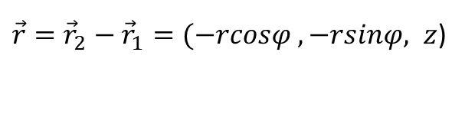



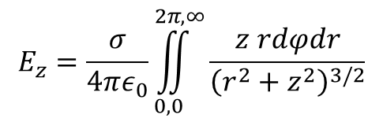


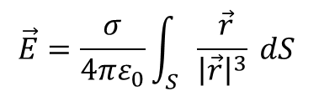
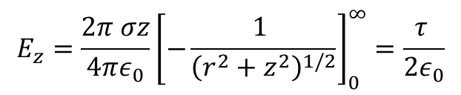
intenzita elektrického pole v okolí nabité roviny
$$\vec{E}=\frac{σ}{4πε_{0}}\int_{S}{ \frac{ \vec{r}}{{\left|\vec{r}\right|}^{3}} dS }$$
$$\vec{r}={\vec{r}}_{2}−{\vec{r}}_{1}$$
z
$${\vec{r}}_{2}=(0, 0, z)$$
$$E_{z}=\frac{σ}{4πε_{0}}\iint_{0,0}^{2π,∞}{\frac{z rdφdr}{{\left(r^{2}+z^{2}\right)}^{3/2}}}$$
$${dE}_{z}$$
${\vec{r}}_{1}$
$=(rcosφ, rsinφ, 0$)
z
$\vec{r}={\vec{r}}_{2}−{\vec{r}}_{1}=(−rcosφ , −rsinφ, z$)
$$E_{z}=\frac{2π σz}{4πε_{0}}{\left[−\frac{1 }{{\left(r^{2}+z^{2}\right)}^{1/2}}\right]}_{0}^{∞}=\frac{τ }{2ε_{0}}$$
$$y$$
$${\vec{r}}_{1}$$
$$x$$

Slide 5






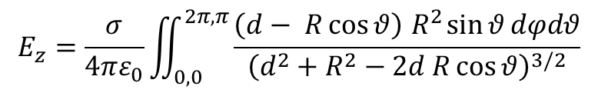


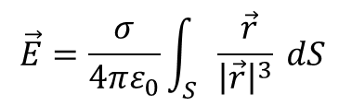




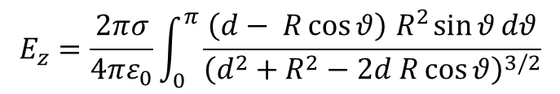

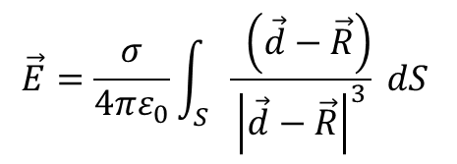




Intenzita elektrického pole v okolí homogenně nabité kulové sféry
$$\vec{E}=\frac{σ}{4πε_{0}}\int_{S}{ \frac{ \vec{r}}{{\left|\vec{r}\right|}^{3}} dS }$$
$$\vec{d}=(0, 0, d)$$
$\vec{R}=(R sin{θ}\cos{φ},R sin{θ}\sin{φ},\operatorname{Rcos}{θ}$)
$$\vec{r}=\vec{d}−\vec{R}$$
$$r^{2}=d^{2}+R^{2}−2d R\cos{θ}$$
$${r^{3}=\left|\vec{d}−\vec{R}\right|}^{3}={\left(d^{2}+R^{2}−2d R\cos{θ} \right)}^{3/2}$$
$$\vec{E}=\frac{σ}{4πε_{0}}\int_{S}{ \frac{ \left(\vec{d}−\vec{R}\right)}{{\left|\vec{d}−\vec{R}\right|}^{3}} dS }$$
$$r^{2}=\left(\vec{d}−\vec{R}\right)\left(\vec{d}−\vec{R}\right)$$
$\vec{r}=(−R sin{θ}\cos{φ},−R sin{θ}\sin{φ},d−\operatorname{Rcos}{θ}$)
$$dS=R^{2}\sin{θ}dθ dφ$$
$$E_{z}=\frac{σ}{4πε_{0}}\iint_{0,0}^{2π,π}{\frac{\left(d− R\cos{θ}\right){ R}^{2}\sin{θ}dφdθ}{{\left(d^{2}+R^{2}−2d R\cos{θ}\right)}^{3/2}}}$$
$$x$$
$$z$$
$$\vec{d}$$
$${\vec{E}}_{z}$$
$$φ$$
$$θ$$
$$\vec{R}$$
$$\vec{r}$$
$$E_{z}=\frac{2πσ}{4πε_{0}}\int_{0}^{π}{\frac{\left(d− R\cos{θ}\right){ R}^{2}\sin{θ}dθ}{{\left(d^{2}+R^{2}−2d R\cos{θ}\right)}^{3/2}}}$$
$$y$$

Slide 6

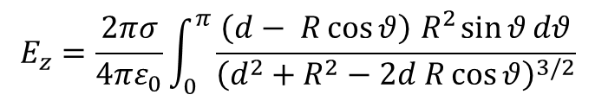



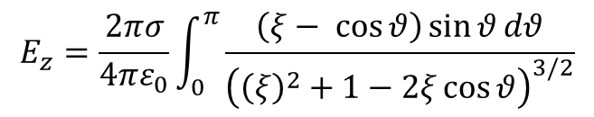



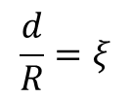



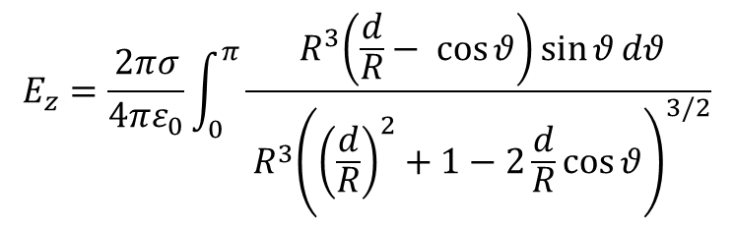
Intenzita elektrického pole v okolí homogenně nabité koulové sféry
$$E_{z}=\frac{2πσ}{4πε_{0}}\int_{0}^{π}{\frac{{ R}^{3}\left(\frac{d}{R}− \cos{θ}\right)\sin{θ}dθ}{{{ R}^{3}\left({\left(\frac{d}{R}\right)}^{2}+1−2\frac{d}{R}\cos{θ}\right)}^{3/2}}}$$
$$\frac{d}{R}=ξ$$
$$x$$
$$z$$
$$\vec{d}$$
$${\vec{E}}_{z}$$
$$φ$$
$$E_{z}=\frac{2πσ}{4πε_{0}}\int_{0}^{π}{\frac{\left(d− R\cos{θ}\right){ R}^{2}\sin{θ}dθ}{{\left(d^{2}+R^{2}−2d R\cos{θ}\right)}^{3/2}}}$$
$$θ$$
$$\vec{R}$$
$$\vec{r}$$
$$dS=R^{2}\sin{θ}dθ dφ$$
$$y$$
$$E_{z}=\frac{2πσ}{4πε_{0}}\int_{0}^{π}{\frac{\left(ξ− \cos{θ}\right)\sin{θ}dθ}{{\left({\left(ξ\right)}^{2}+1−2ξ\cos{θ}\right)}^{3/2}}}$$

Slide 7

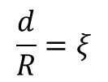



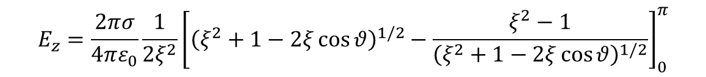



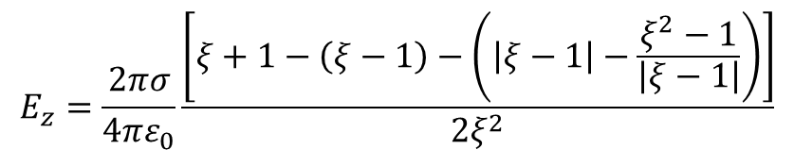



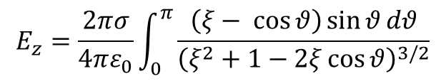
Intenzita elektrického pole v okolí homogenně nabité kulové sféry
$$E_{z}=\frac{2πσ}{4πε_{0}}\int_{0}^{π}{\frac{\left(ξ− \cos{θ}\right)\sin{θ}dθ}{{\left(ξ^{2}+1−2ξ\cos{θ}\right)}^{3/2}}}$$
$$\frac{d}{R}=ξ$$
$$E_{z}=\frac{2πσ}{4πε_{0}}\frac{1}{2ξ^{2}}{\left[{\left(ξ^{2}+1−2ξ\cos{θ}\right)}^{1/2}−\frac{ξ^{2}−1}{{\left(ξ^{2}+1−2ξ\cos{θ}\right)}^{1/2}}\right]}_{0}^{π}$$
$$E_{z}=\frac{2πσ}{4πε_{0}}\frac{\left[ξ+1−\left(ξ−1\right)−\left(\left|ξ−1\right|−\frac{ξ^{2}−1}{\left|ξ−1\right|}\right)\right]}{2ξ^{2}}$$
$$x$$
$$z$$
$$\vec{d}$$
$${\vec{E}}_{z}$$
$$φ$$
$$θ$$
$$\vec{r}$$
$$\vec{R}$$
$$dS=R^{2}\sin{θ}dθ dφ$$
$$y$$

Slide 8

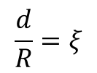










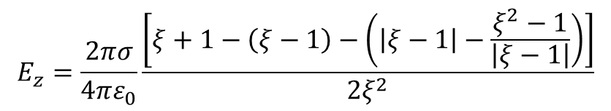
Intenzita elektrického pole v okolí homogenně nabité kulové sféry
$$E_{z}=\frac{2πσ}{4πε_{0}}\frac{\left[ξ+1−\left(ξ−1\right)−\left(\left|ξ−1\right|−\frac{ξ^{2}−1}{\left|ξ−1\right|}\right)\right]}{2ξ^{2}}$$
$$ξ>1$$
$$E_{z}=\frac{2πσ}{4πε_{0}}\frac{\left[ξ+1−ξ+1−ξ+1+ξ+1\right]}{2ξ^{2}}=\frac{4πσ}{4πε_{0}ξ^{2}}=\frac{4πσR^{2}}{4πε_{0}d^{2}}=\frac{q}{4πε_{0}d^{2}}$$
$$\frac{d}{R}=ξ$$
$$x$$
$$\vec{d}$$
$${\vec{E}}_{z}$$
$$φ$$
$$z$$
$$θ$$
$$\vec{r}$$
$$\vec{R}$$
$$dS=R^{2}\sin{θ}dθ dφ$$
$$y$$

Slide 9


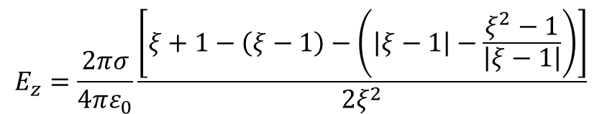


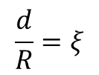


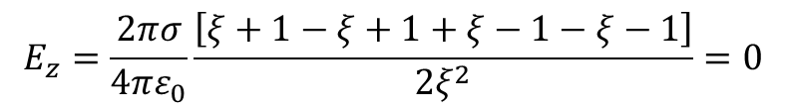





Intenzita elektrického pole v okolí homogenně nabité kulové sféry
$$E_{z}=\frac{2πσ}{4πε_{0}}\frac{\left[ξ+1−\left(ξ−1\right)−\left(\left|ξ−1\right|−\frac{ξ^{2}−1}{\left|ξ−1\right|}\right)\right]}{2ξ^{2}}$$
$$ξ<1$$
$$E_{z}=\frac{2πσ}{4πε_{0}}\frac{\left[ξ+1−ξ+1+ξ−1−ξ−1\right]}{2ξ^{2}}=0$$
$$\frac{d}{R}=ξ$$
$$x$$
$$\vec{d}$$
$${\vec{E}}_{z}$$
$$φ$$
$$z$$
$$θ$$
$$\vec{r}$$
$$\vec{R}$$
$$dS=R^{2}\sin{θ}dθ dφ$$
$$y$$

Slide 10

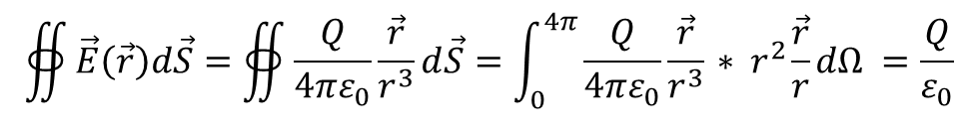




Tok vektoru $\vec{E}$ od bodového náboje kulovou sférou se středem v náboji
$$\vec{E}=\frac{Q}{4πε_{0}}\frac{\vec{r}}{r^{3}}$$
$$\vec{n}$$
$$\vec{n}=\frac{\vec{r}}{r}$$
$$d\vec{S}=r^{2}\frac{\vec{r}}{r}dΩ$$
$$dΩ$$
+
$$∯{\vec{E}\left(\vec{r}\right)d\vec{S}=∯{\frac{Q}{4πε_{0}}\frac{\vec{r}}{r^{3}}d\vec{S}=\int_{0}^{4π}{\frac{Q}{4πε_{0}}\frac{\vec{r}}{r^{3}}}{ ∗ r}^{2}\frac{\vec{r}}{r}dΩ }}=\frac{Q}{ε_{0}}$$

Slide 11


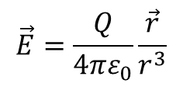










Tok vektoru $\vec{E}$ od bodového náboje obecnou uzavřenou plochou.
$$\vec{n}$$
$$\vec{n}$$
$$\vec{E}=\frac{Q}{4πε_{0}}\frac{\vec{r}}{r^{3}}$$
$$θ$$
$$d\vec{S}=\frac{r^{2}dΩ }{\cos{θ}}\vec{n}$$
$$dΩ$$
$$\vec{ r }\vec{n}=\cos{θ}$$
$$\vec{r}$$
+
$$θ$$
$$\vec{r}$$
$$θ$$
$$r^{2}dΩ$$
$$∯{\vec{E}\left(\vec{r}\right)d\vec{S}=∯{\frac{Q}{4πε_{0}}\frac{\vec{r}}{r^{3}}\frac{r^{2}dΩ }{\cos{θ}}\vec{n}=\int_{0}^{4π}{\frac{Q}{4πε_{0}r}} \frac{1}{\cos{θ}}\vec{ r }\vec{n} dΩ }}=\int_{0}^{4π}{\frac{Q}{4πε_{0}}} \frac{1}{\cos{θ}}\cos{θ} dΩ=\frac{Q}{ε_{0}}$$

Slide 12
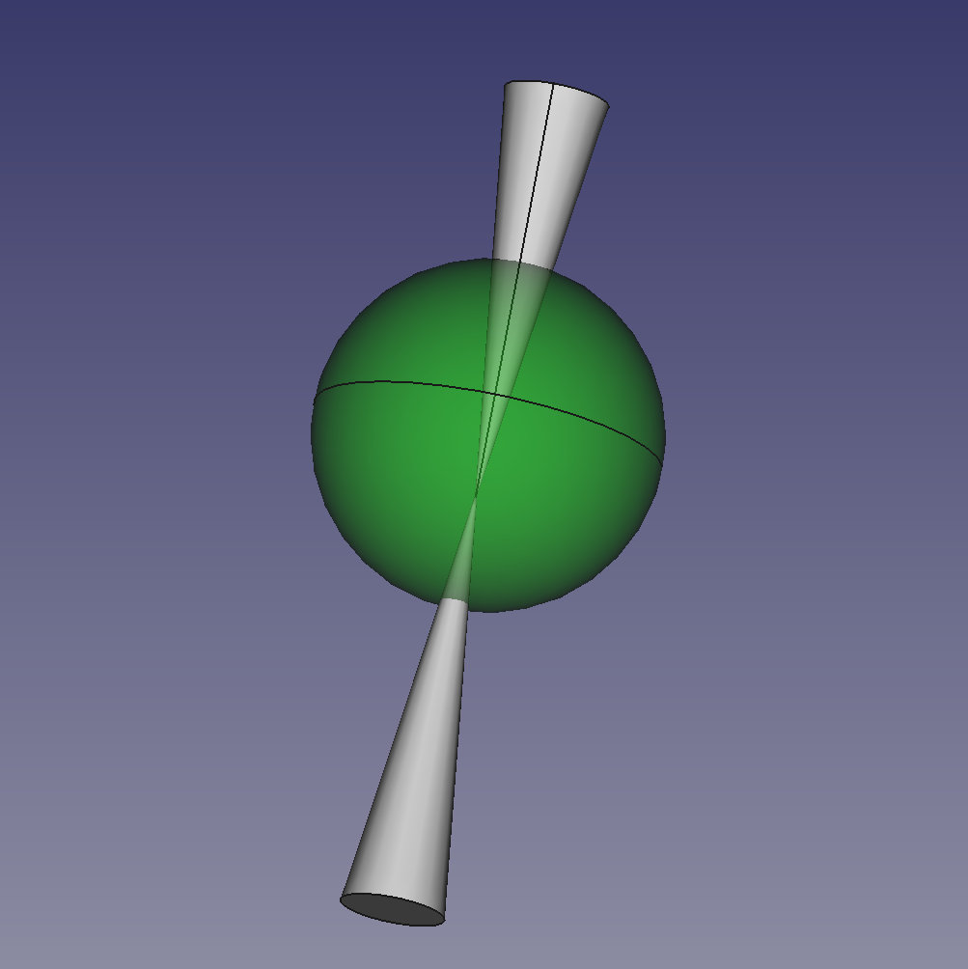

Slide 13


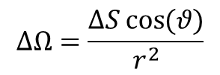



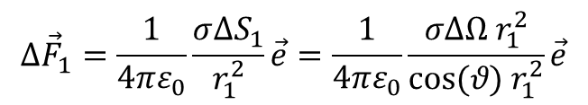


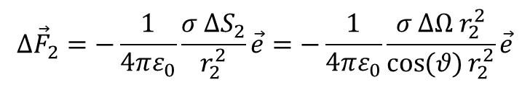


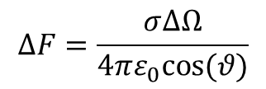


Síla působící na náboj uvnitř rovnoměrně nabité kulové sféry.
$∆Ω$ je prostorový úhel, pod kterým je vidět ploška $∆S_{1}$, $∆S_{2}$
$$Δ{\vec{F}}_{1}=\frac{1}{4πε_{0}}\frac{σ∆S_{1}}{r_{1}^{2}}\vec{e}=\frac{1}{4πε_{0}}\frac{σ∆Ω{ r}_{1}^{2}}{cos⁡(θ){ r}_{1}^{2}}\vec{e}$$
$$θ$$
$${\vec{n}}_{1}$$
$$Δ{\vec{F}}_{2}=−\frac{1}{4πε_{0}}\frac{σ ∆S_{2}}{r_{2}^{2}}\vec{e}=−\frac{1}{4πε_{0}}\frac{σ ∆Ω r_{2}^{2}}{\cos{(θ)}r_{2}^{2}}\vec{e}$$
$$∆S_{1}$$
$${\vec{r}}_{1}$$
$$q$$
$$ΔF=\frac{σ∆Ω}{4πε_{0}cos⁡(θ)}$$
Prostorový úhel
$∆Ω$
$$∆Ω=\frac{∆S\cos{(θ)}}{r^{2}}$$
$${\vec{r}}_{2}$$
$${\vec{n}}_{2}$$
$Δ{\vec{F}}_{1}$+$Δ{\vec{F}}_{2}$=0
$$∆S_{2}$$
$$θ$$

Slide 14



Tok vektoru plochou
$∆$S
$\vec{n}$normála k ploše
$∆$S

Slide 15









Tok $Φ$ vektoru plochou
vektor $\vec{E}\left(\vec{r}\right)$
$$θ$$
$∆$S
$\vec{n}$normála k ploše
$∆$S
$$∆Φ=\vec{E}\vec{n}∆S=\vec{E} ∆\vec{S }=E∆S\cos{θ}$$
$$\vec{r}$$
$$x$$
$$y$$

Slide 16


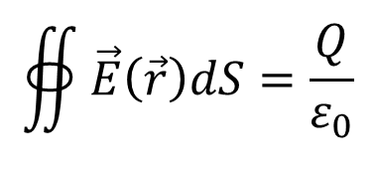
Gaussova věta elektrostatiky
$$\vec{E}\left(\vec{r}\right)$$
$$∯{\vec{E}\left(\vec{r}\right)dS=\frac{Q}{ε_{0}}}$$
$$dS$$

Slide 17





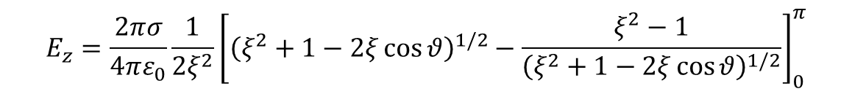





Příklad 1: určete pro jaký úhel $θ_{0}$ bude el. pole v bodě P od každé z obou částí homogenně nabité sféry vymezené kružnicí, která je určena úhlem $θ_{0}$ poloviční, než je od celé sféry.
$$dθ$$
$$\vec{r}$$
$$\vec{R}$$
$$θ$$
$$\vec{d}$$
$$φ$$
$$P$$
$${\vec{E}}_{z}$$
$$z$$
$$E_{z}=\frac{2πσ}{4πε_{0}}\frac{1}{2ξ^{2}}{\left[{\left(ξ^{2}+1−2ξ\cos{θ}\right)}^{1/2}−\frac{ξ^{2}−1}{{\left(ξ^{2}+1−2ξ\cos{θ}\right)}^{1/2}}\right]}_{0}^{π}$$
$$\frac{E_{z}}{2}=\frac{σ}{4ε_{0}}\frac{1}{2ξ^{2}}{\left[{\left(ξ^{2}+1−2ξ\cos{θ}\right)}^{1/2}−\frac{ξ^{2}−1}{{\left(ξ^{2}+1−2ξ\cos{θ}\right)}^{1/2}}\right]}_{0}^{π}=\frac{σ}{2ε_{0}}\frac{1}{2ξ^{2}}{\left[{\left(ξ^{2}+1−2ξ\cos{θ}\right)}^{1/2}−\frac{ξ^{2}−1}{{\left(ξ^{2}+1−2ξ\cos{θ}\right)}^{1/2}}\right]}_{0}^{θ_{0}}$$
$$\frac{1}{2}{\left[{\left(ξ^{2}+1−2ξ\cos{θ}\right)}^{1/2}−\frac{ξ^{2}−1}{{\left(ξ^{2}+1−2ξ\cos{θ}\right)}^{1/2}}\right]}_{0}^{π}={\left[{\left(ξ^{2}+1−2ξ\cos{θ}\right)}^{1/2}−\frac{ξ^{2}−1}{{\left(ξ^{2}+1−2ξ\cos{θ}\right)}^{1/2}}\right]}_{0}^{θ_{0}}$$

Slide 18


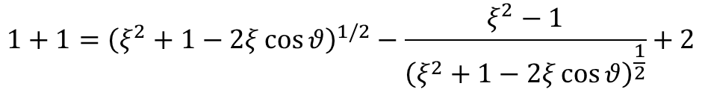
Příklad 1, řešení
$$dθ$$
$$\vec{r}$$
$$\vec{R}$$
$$θ$$
$$\vec{d}$$
$$φ$$
$$P$$
$${\vec{E}}_{z}$$
$$z$$
$$\frac{1}{2}{\left[{\left(ξ^{2}+1−2ξ\cos{θ}\right)}^{1/2}−\frac{ξ^{2}−1}{{\left(ξ^{2}+1−2ξ\cos{θ}\right)}^{1/2}}\right]}_{0}^{π}={\left[{\left(ξ^{2}+1−2ξ\cos{θ}\right)}^{1/2}−\frac{ξ^{2}−1}{{\left(ξ^{2}+1−2ξ\cos{θ}\right)}^{1/2}}\right]}_{0}^{θ_{0}}$$
$$1+1={\left(ξ^{2}+1−2ξ\cos{θ}\right)}^{1/2}−\frac{ξ^{2}−1}{{\left(ξ^{2}+1−2ξ\cos{θ}\right)}^{\frac{1}{2}}}+2$$
$$\cos{θ}=\frac{1}{ξ}$$

Slide 19
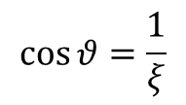




Příklad 1, řešení
$$\frac{π}{2}$$
$$\vec{R}=\vec{1}$$
$$θ$$
$$φ$$
$$P$$
$${\vec{E}}_{z}$$
$$ξ$$
$$z$$
$$\cos{θ}=\frac{1}{ξ}$$

