Slide 1

FYZIKA VE FIRMĚ
Martin Zadražil, 9.11.2011

Slide 2

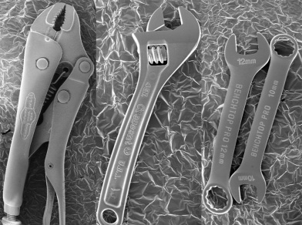
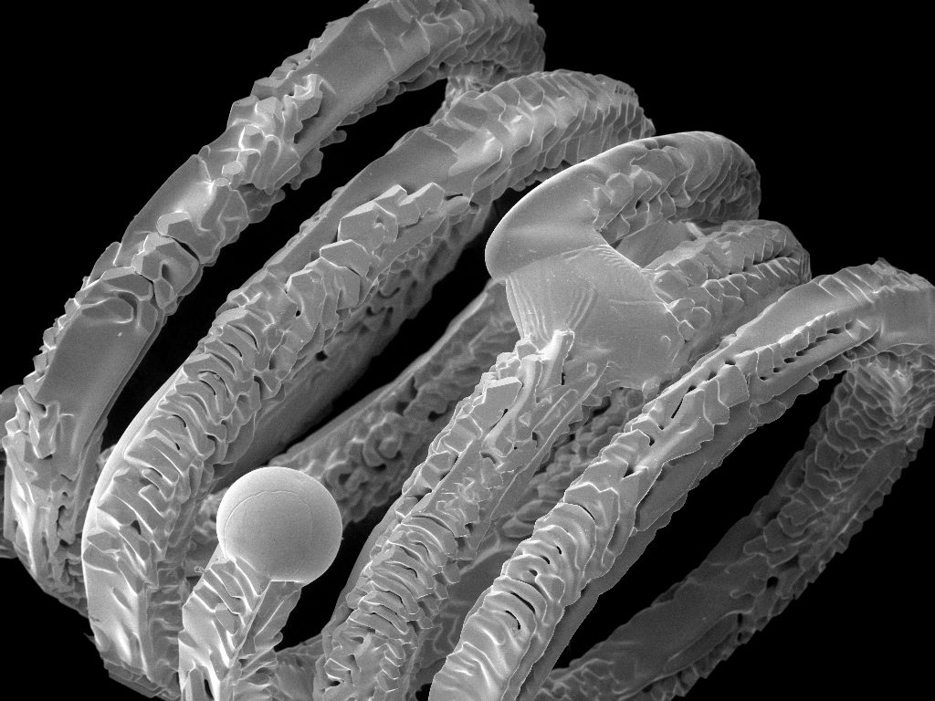
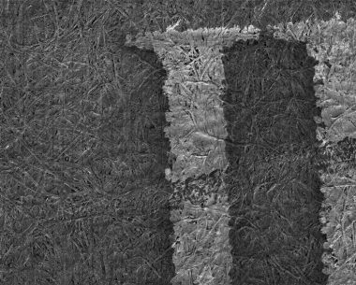
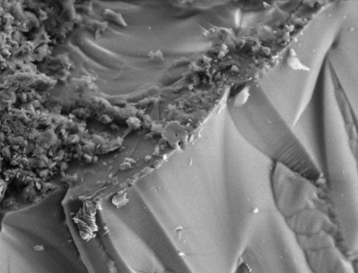
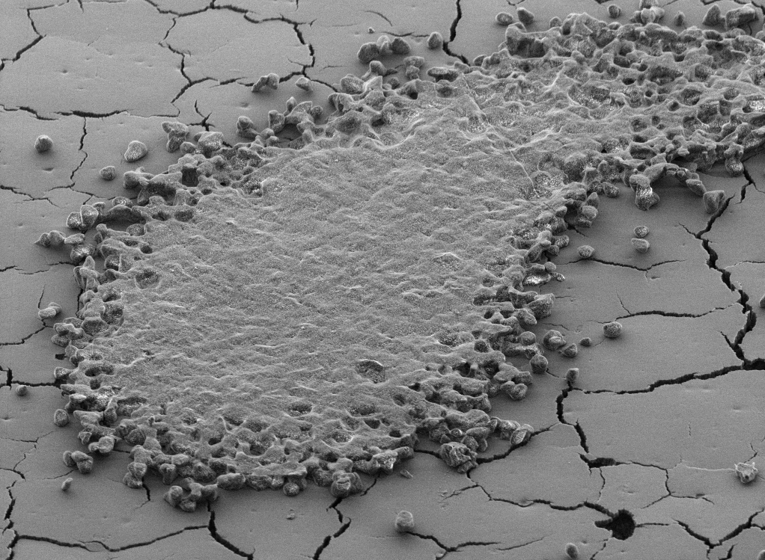
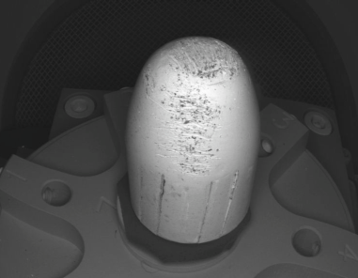
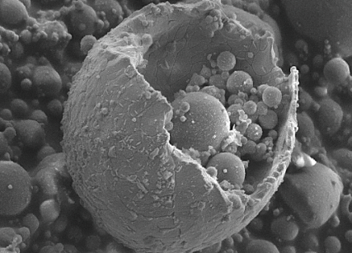
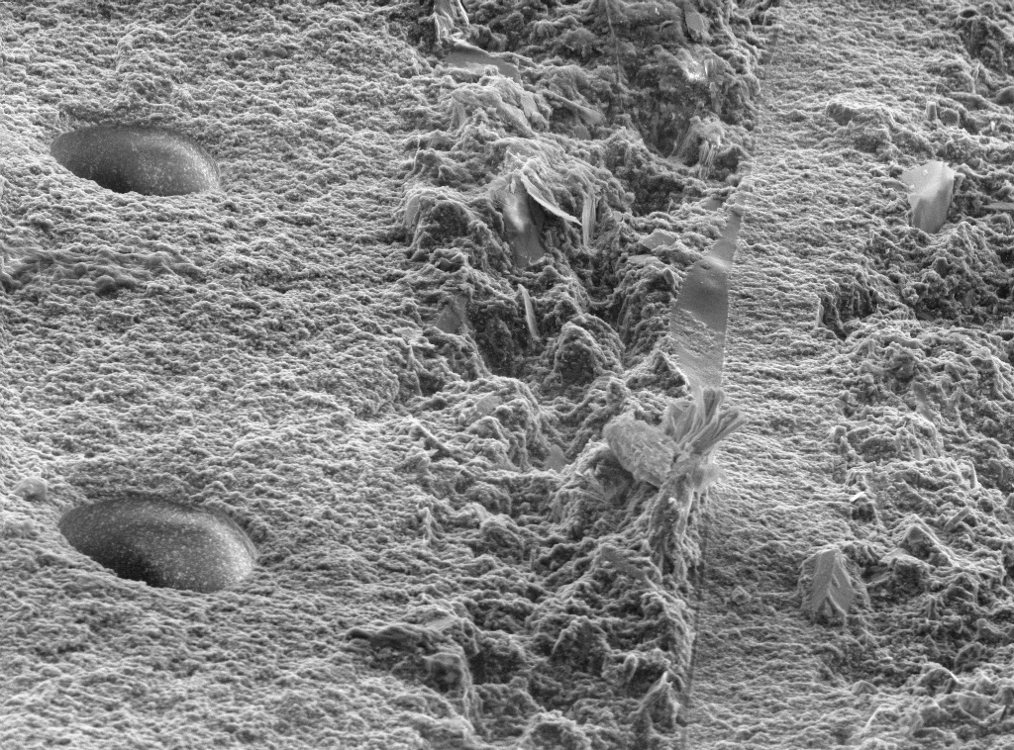
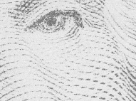
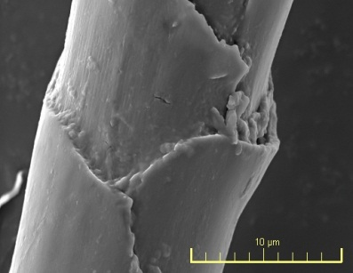
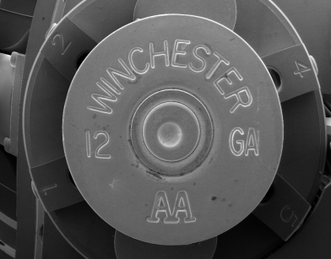
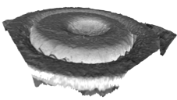
SEM in Forensic Lab
Forensic Applications in SEM :
Gun shot residue analysis (GSR)
Bullets and cartridge investigation
After car crash filament and bulb investigation
Tool marks investigation
Analysis of hairs, textiles and papers
Paints, prints and ink analysis
Counterfeit signatures, bank notes
Minerals, soils and metals analysis
and many others...

Slide 3
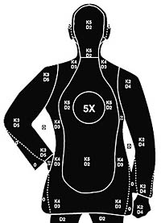
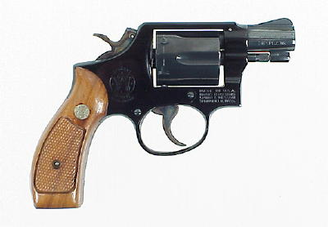
GSR Analysis
Gunshot Residuum analysis.
Identification of the shooter
According GSR particles on hands/clothes
  Typical size, shape
  Typical composition: Pb, Sb, Ba.
Fig. GSR Particles composition in ternary chart
Notes:
3

Slide 4
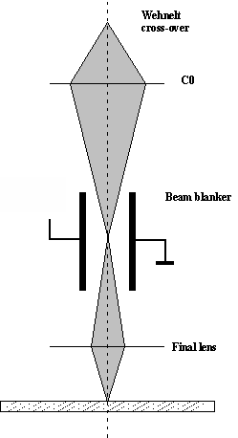
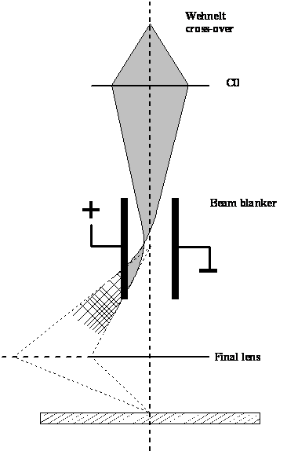
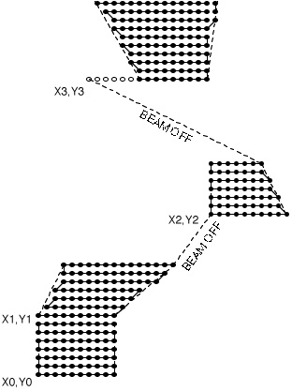
Electron Beam Lithography
Beam interruption – Beam blanker
Beam ON
Blanked beam
0
Beam blanker electro-statically deflects the electron beam
Value & Excellence in SEMs

Slide 5
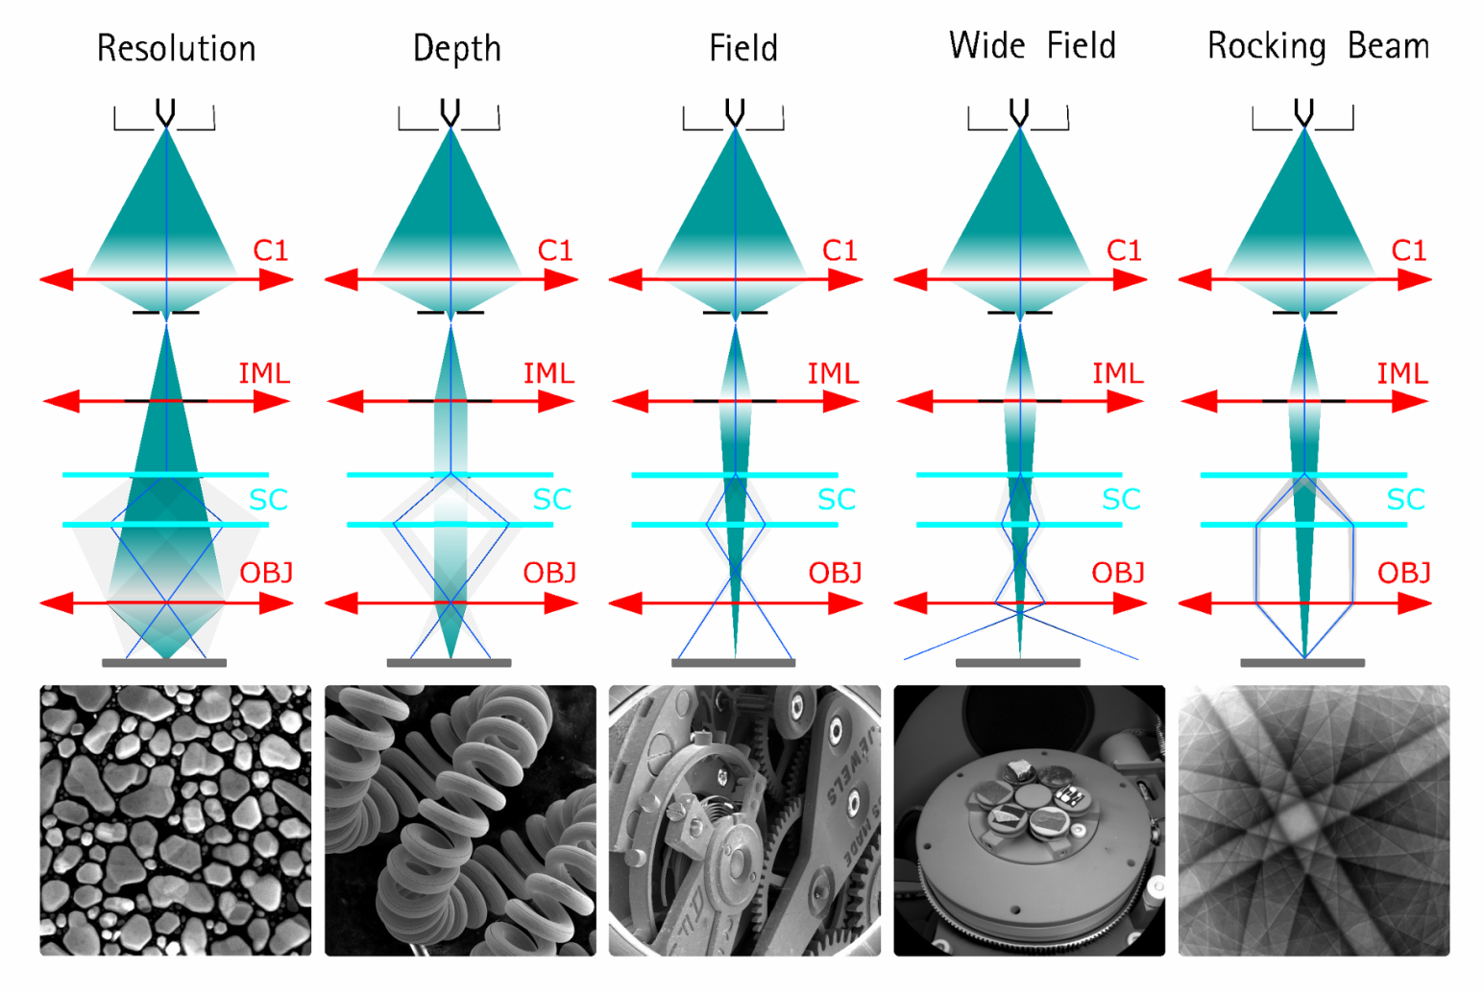
Technical details - Wide Field OpticsTM
Value & Excellence in SEMs

Slide 6
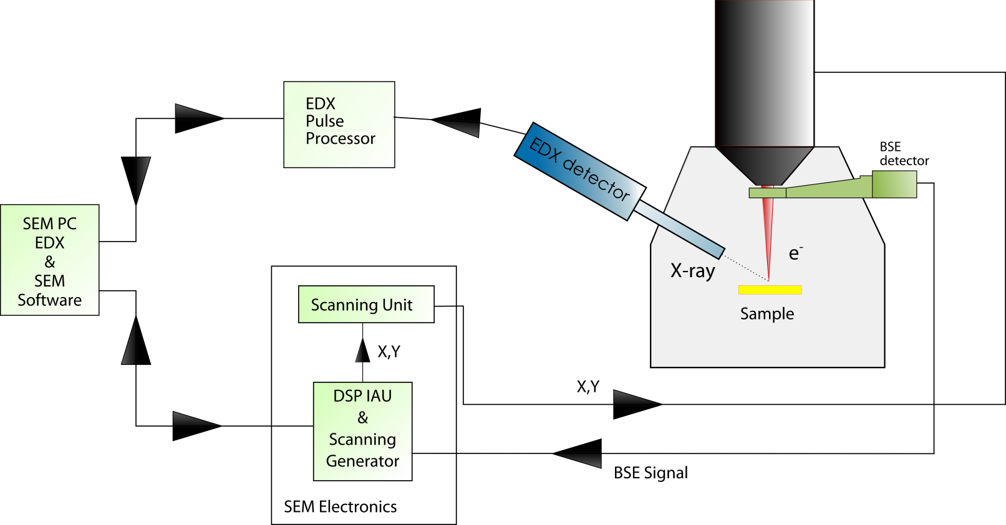
TESCAN TRACE GSR Hardware
TESCAN TRACE GSR Hardware Integration
TESCAN TRACE GSR

Slide 7
TESCAN TRACE GSR Hardware
Scanning Generator
Powerful 50 MHz internal Pattern Generator
2 x DAC for each stage of deflection coils (X, Y)
16-bit scanning ramp DACs
(65,536 x 65,536 virtual write field)
Variable dwell time
Static and dynamic distortion correction
Digital compensation of field errors
Automatic control of electrostatic beam blanker (10 MHz)
TESCAN TRACE GSR

Slide 8

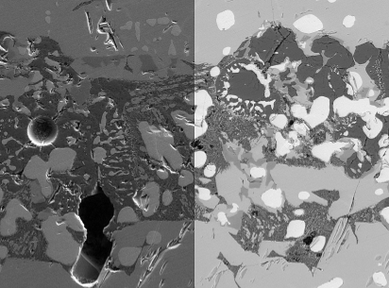
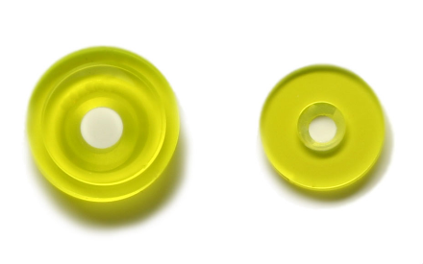
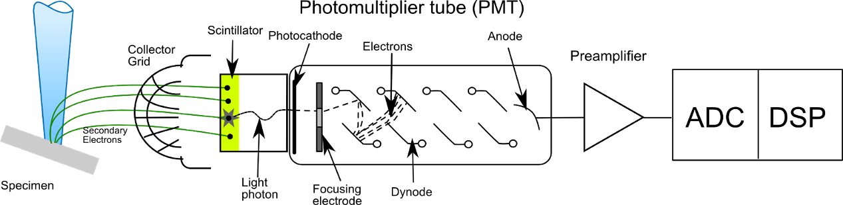
First Class Detectors
Synthetic YAG crystal
High efficiency – low noise
Fast response
Unlimited lifetime
Suitable for high vacuum
SE – Everhardt-Thornley type with YAG
Fast imaging rate (20ns/pix)
Fig. On-line SE/BSE signal mixing
Dwell/pix | 1Mpix | 100 fields analysis
50 us | 50 s | > 1 hour
100 ns | 0.2 s | < 3 min
Fast detectors save time!!
Fig. Everhart-Thornley SE Detector

Slide 9
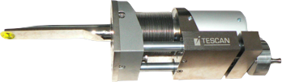
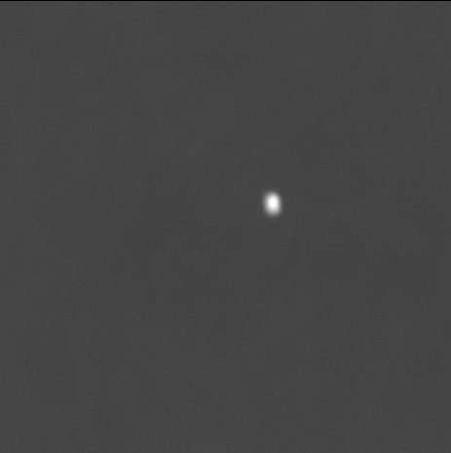
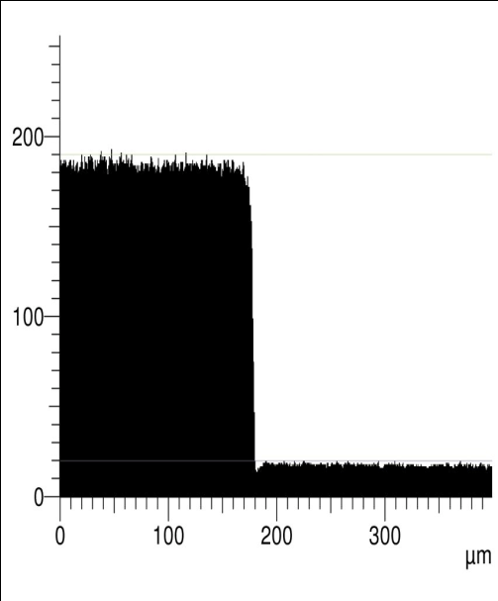
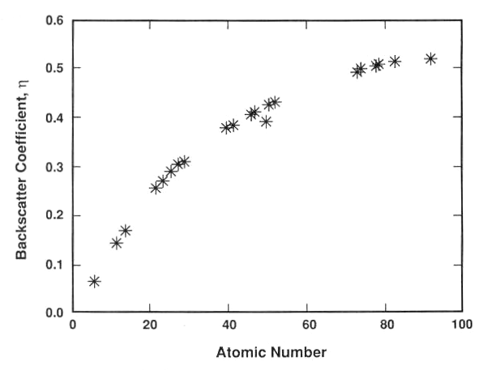
BSE Detector
Backscattered Electron Detector
Crucial for GSR applications
Detection of particles containing heavy elements
Tescan R-BSE detector
Fig. Phase identification by material contrast
Used for GSR particles location
Fig. Thresholding on a callibration sample
Fig. Dependecy of BSE intensity on Atomic number

Slide 10
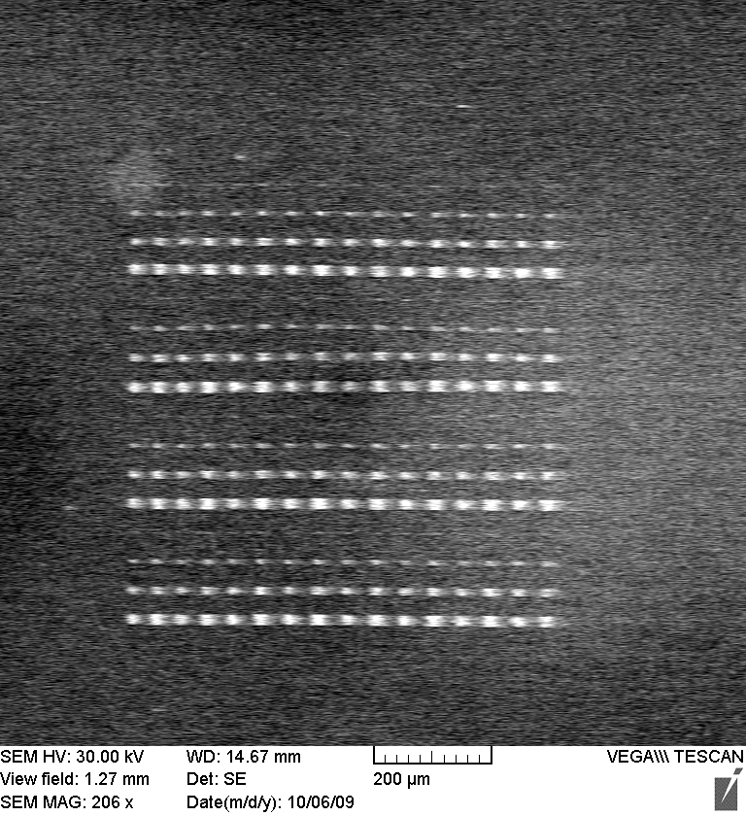
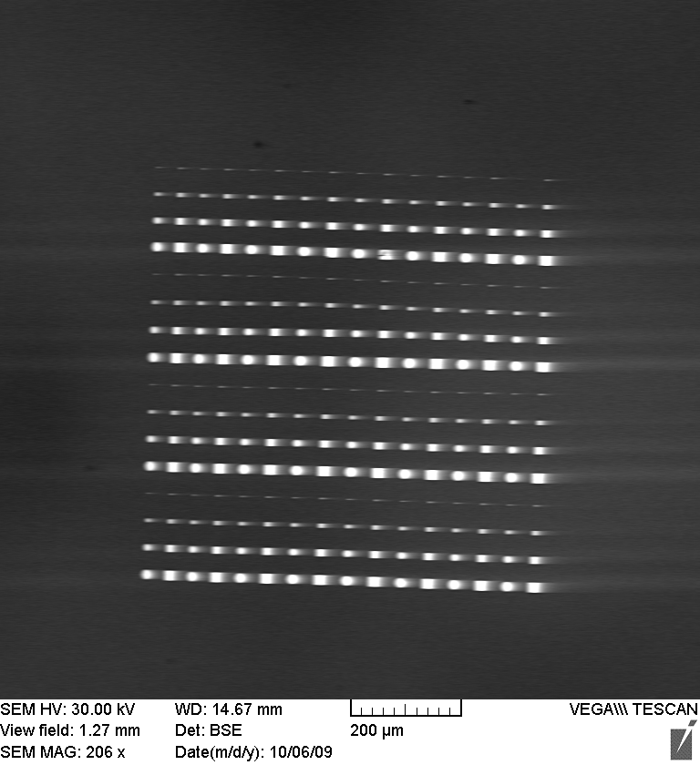
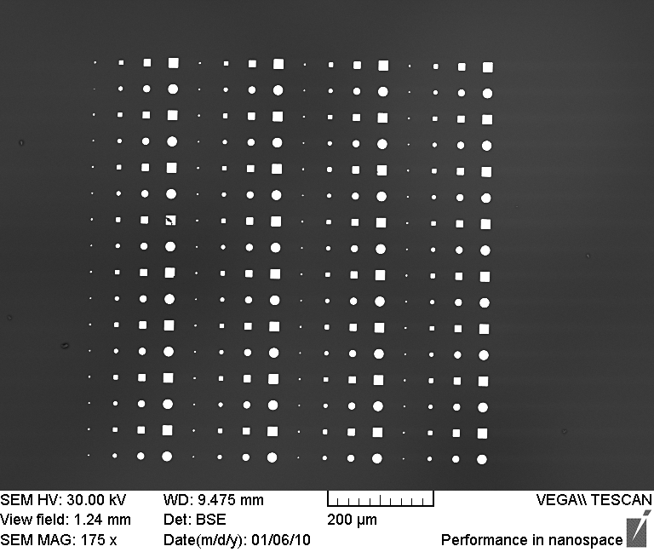
Fast imaging rates,
but no compromises on Image Quality
Testing sample: Gold on Si imaging standard
Low-end solid-state BSE detector
1us/ pixel
Middle-class scintillation BSE detector
500ns /pxl
Latest generation
Tescan YAG scintillation BSE
100ns /pxl

Slide 11
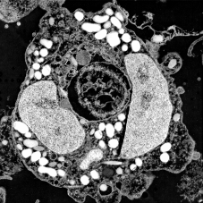
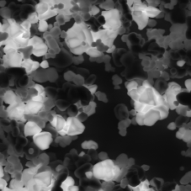
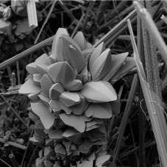

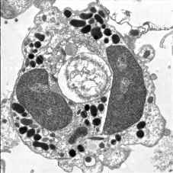
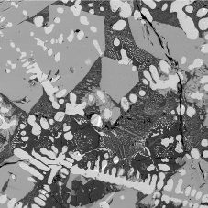
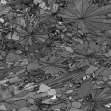
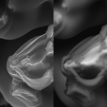
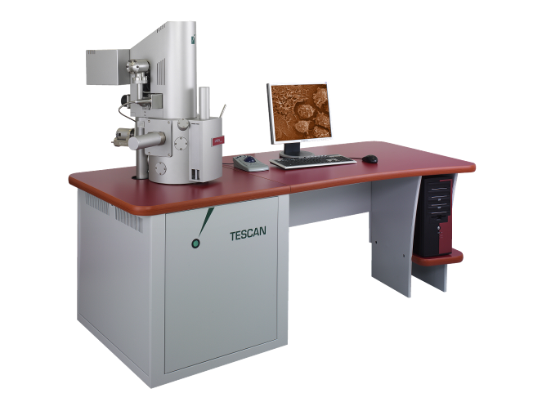
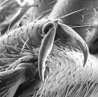
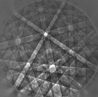
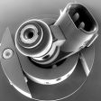
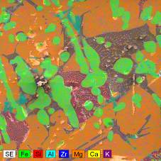

Great Analytical Potential
Great Analytical Potential
CL
TEI
SEI/BEI
EBSD
LVSTD
EDX/WDX
Other accessories
EBIC, Absorbed current measurement, IR chamber view camera and many other

Slide 12
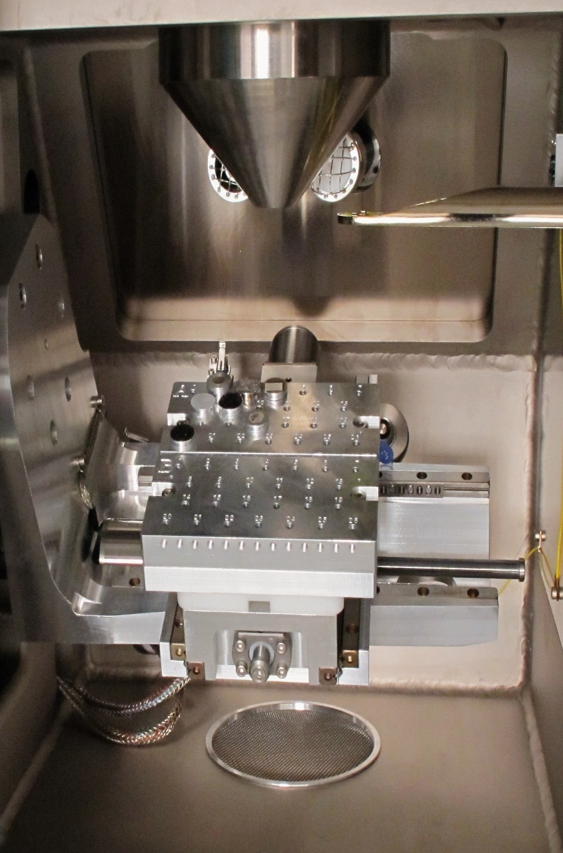
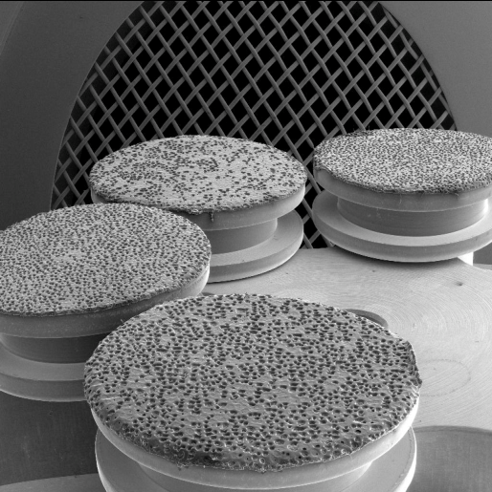
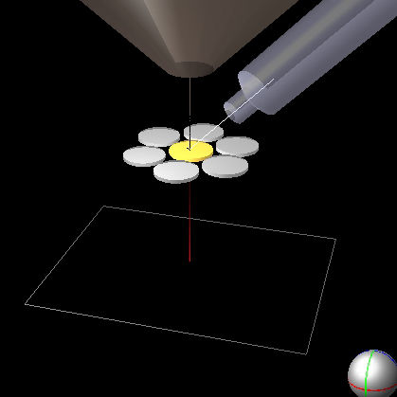
Positioning Accuracy
Stage movements
During GSR analysis the sample is divided into individual fields. Location and analysis of the particles is done filed-by-field using stage movements.
Positioning accuracy is critical parameter for GSR analysis.
Tescan XM Stage:
XY Range : 130 x 130 mm
Min. Step : 300 nm
Relocation accuracy: < 2um guaranteed
Speed: 5 mm/s

Slide 13
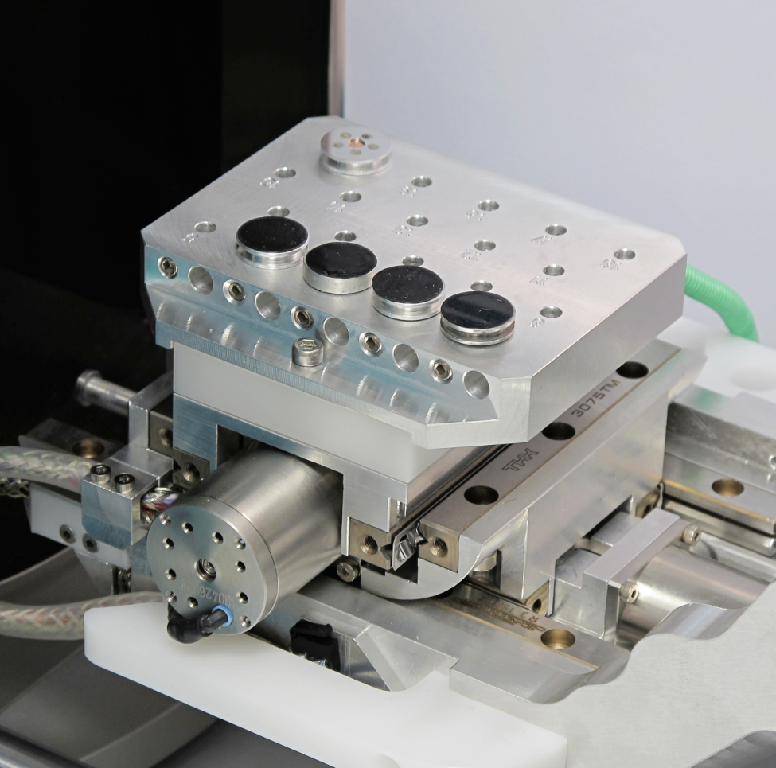

Slide 14
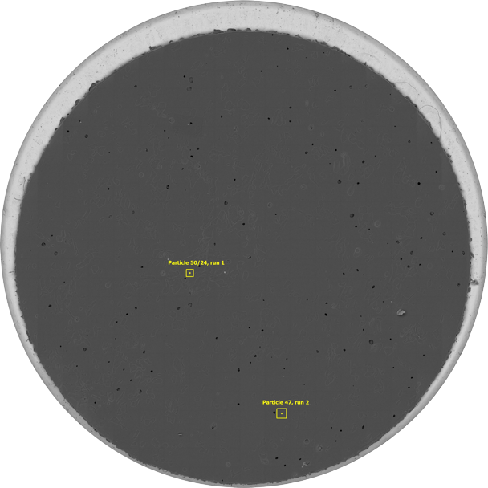

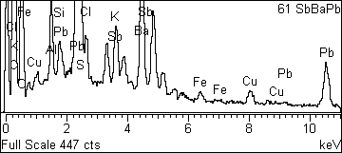
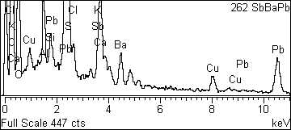

Stage Positioning Accuracy
Image montage from 1048 BSE image fields with two submicron GSR particles found from totaly 48 detected particles.

Slide 15
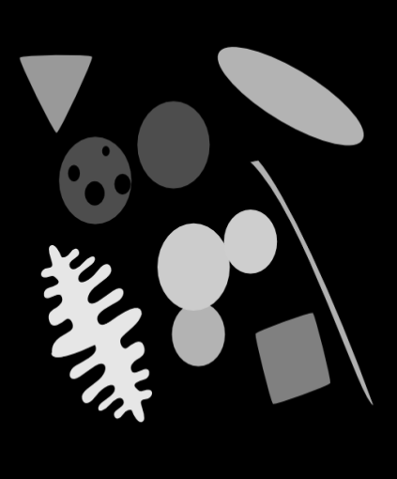
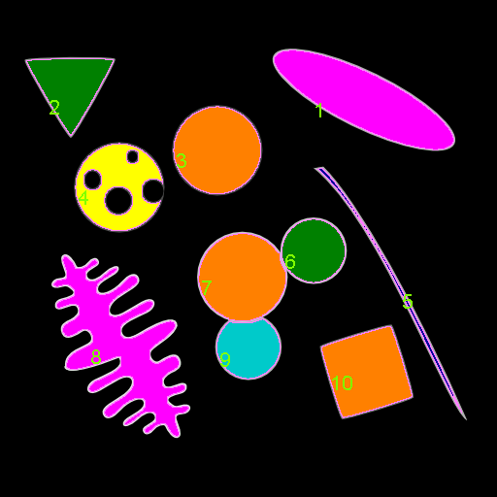



Morphological Analysis
Classification by Area
Classification by Roundness
Classification by Extension
(Compactness)
Object size and
shape classification
Over 40 parameters
Object filtering
Statistical output
Roundness: R²/(4*đ*Area)
Circle = 1
Square = 1.3
Triangle = 1.5
Ellipse = 2
Dendrite ~ 15
Thread ~ 25
Extension:
Circle = 0
Square = 0.3
Triangle = 0.5
Ellipse = 2.5
Dendrite ~ 4
Thread ~ 14
TESCAN KOREA Users Meeting 2009, Hanyang University
Notes:
15

Slide 16

TESCAN ENFSI Results
TRACE GSR Results
 | Plano GmbH | TESCAN, a.s.
10/15/20 µm | 3 | 3
0,5 µm | 38 | 36
0,7 µm | 30 | 29
1 µm | 33 | 32
1,5 µm | 32 | 30
2 µm | 27 | 27
2,5 µm | 27 | 27
total no. | 190 | 185
TESCAN TRACE GSR

Slide 17


TESCAN ENFSI Results
TESCAN TRACE GSR

Slide 18


Nanotechnology Workbench
FEG SEM
E-Beam Blanker
FIB
EDS
SE
GIS
BSE
Nanomanipulators
EBSD
Fig. Tescan LYRA Demo as installed on EMC Aachen 2009

Slide 19



What’s Inside?
SEM objective lens
One Coincidence Point for All Parts
FIB column nose
GIS stage with nozzles

Slide 20


Why SEM + FIB on One System?
Ion Beam Imaging
Pillar in silicon
diameter 1μm
SE generated by ions
Ion imaging resolution < 5 nm
High surface sensitivity with ions
High channeling effect contrast
Ion imaging is destructive!
SE generated by electrons
High Electron Imaging Resolution
Lower surface sensitivity especially for light elements
Nondestructive - reason for “dual beam” systems
SE imaging FIB , SEM
Electron Beam Imaging

Slide 21

Gas Injection System Option
FIB + GIS Capabilities
Enhanced Milling (Etching) – examples: XeF₂ enhances Si, SiO₂ and W etching by factor of 5-100 times; H₂O of PMMA and diamond 10-20 times
Selective Milling (Etching) – combination of enhanced and reduced milling. Examples: H₂O greatly reduces etching of Al, Si and SiO₂; XeF₂ of Al.
Material deposition – Adsorption of the precursor molecules on the surface, ion beam (or e-beam) induced dissociation of the gas molecules, deposition of the material atoms (e.g. Pt, W, C, SiO_{x}) .

Slide 22



Applications
Common SEM+FIB Applications
Nano-structuring
IC process inspection and failure analysis
Nano-tomography
Local cross-sectioning, thin film thickness measurement
TEM sample preparation
Biology
Materials science
Mineralogy
Fossils analysis
Forensic applications

Slide 23


Simulteneous Imaging
Forensic Application
Gun Shot Residue Volume Analysis
Simultaneous imaging of the milling process.

Slide 24


Questions ?

Slide 25


Applications
Value & Excellence in SEMs
Notes:
The aim of the NASA’s Genesis sample-return mission was to collect solar wind, material ejected from the outer portion of the sun, and return it to Earth.

Slide 26

Applications
The collectors after assembly on Earth before flight
Value & Excellence in SEMs
Notes:
This was done by allowing the species to implant in the surfaces of ultra-pure collectors. These collectors included single crystal, sapphire, silicon carbide; those materials coated with aluminum, silicon, diamond like carbon, and gold; and isotopically enriched polycrystalline diamond and amorphous carbon. The majority of these materials were distributed on five collector arrays. Three of the materials were housed in an electrostatic concentrator designed to increase the flux of low-mass ions. There was also a two-inch diameter bulk metallic glass collector and a gold foil, polished aluminum, and molybdenum coated platinum foil collector

Slide 27

Applications
Genesis Timeline
Value & Excellence in SEMs

Slide 28


Applications
Value & Excellence in SEMs
Notes:
The Genesis mission was launched in August 2001. The spacecraft was sent to a special orbit 1 million km from Earth where it was well away from any contamination and exposed ultra-pure collectors to the solar wind. The Genesis mission returned to Earth on September 8, 2004 after a three-year mission.

Slide 29



Applications
Value & Excellence in SEMs
Notes:
The intent was to deploy a drogue chute high over the Utah desert and to catch the capsule in mid-air by helicopter. The capsule would then be opened in a cleanroom constructed for that purpose.

Slide 30

Applications
Although the mission was a success with solar wind atoms implanted into the collectors, the return to Earth was ‘non-optimal’ with the parachutes failing to open.
Value & Excellence in SEMs
Notes:
Unfortunately, both chutes failed to deploy, causing the capsule to fall to the desert floor at a speed of 311 km/h.

Slide 31

Applications
Gravity switch
Value & Excellence in SEMs
Notes:
After studying the problem for a month, the board announced the capsule had crashed because four tiny gravity switches that were supposed to release the parachutes were installed backward.

Slide 32

Applications
Monument purchased and designed by Genesis team members to commemorate the return to Earth
Value & Excellence in SEMs
Notes:
A minute’s of silence shall be observed…..

Slide 33



Applications
Hundreds of collector fragments were retrieved
Value & Excellence in SEMs

Slide 34






Applications
Backside of Collector Array
Gold Foil Collector – post landing
Value & Excellence in SEMs

Slide 35

Applications
Genesis Timeline
Value & Excellence in SEMs

Slide 36


Applications
< Gold Foil Collector – post landing
REQUIREMENT> SEM-EDS instrument with the ability to perform fast, automated detection, location and quantification of 10-μm clay-based dirt particles, molybdenum coating and platinum substrate over the entire area of minimum 16 cm x 16 cm square) crumpled Pt-Mo foils. Approximately 8000 cm2 Pt-Mo foils will be imaged in total. Gold Foil Post-landing
Value & Excellence in SEMs
Notes:
The large samples to be examined are foils (sheets) of Pt with a Mo coating. These foils were used in the Genesis spacecraft to collect solar wind particles; the particles are embedded in the Mo and Au layer. The foils were of course damaged during the crash of the Genesis capsule.
(i) radioactive nuclides in the solar wind collected by the NASA Genesis mission;
(ii) the study of cometary dust collected by the NASA Stardust mission, and
(iii) the study of interstellar dust impacts in foils, also collected by the NASA Stardust mission.

Slide 37


Applications
VEGA 3 XMU – X8M5
Value & Excellence in SEMs
Notes:
Design of the VEGA 3 XMU – X8M5 for the Genesis project

Slide 38

Applications
TESCAN's automated particle analysis
Value & Excellence in SEMs
Notes:
The large samples to be examined are foils of Pt with a Mo coating. Particles are embedded in the Mo layer. The foils were of course damaged during the crash of the Genesis capsule

