Slide 1
COMPARING OF MINERALS
Šárka Lankašová

Slide 2
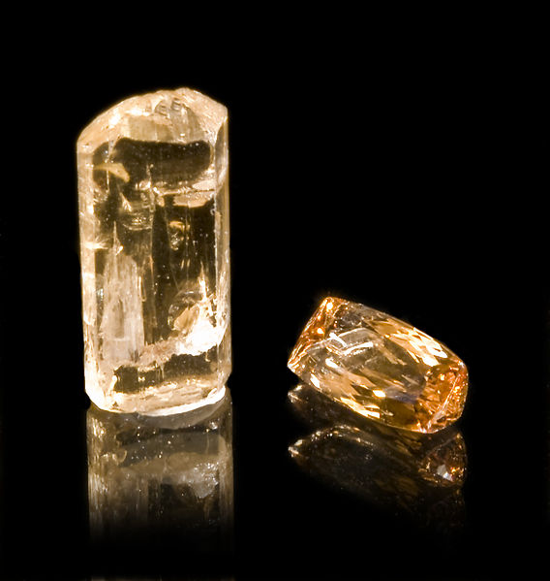
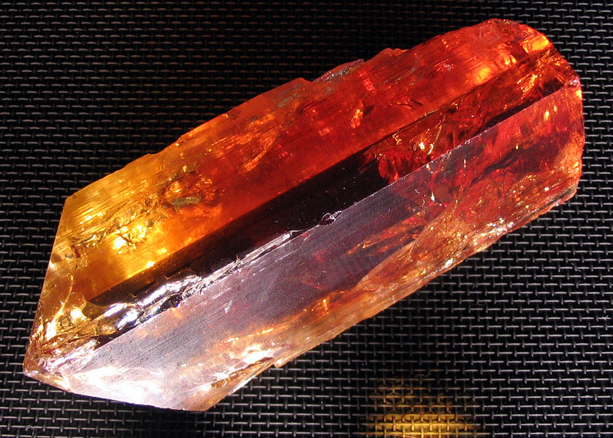
TOPAZ
Silicate mineral
Yellow, wine,pale gray
Perfect cleavage
Conchoidal fracture
8 on the Mohs scale
Glassy luster
White streak
transparent

Slide 3
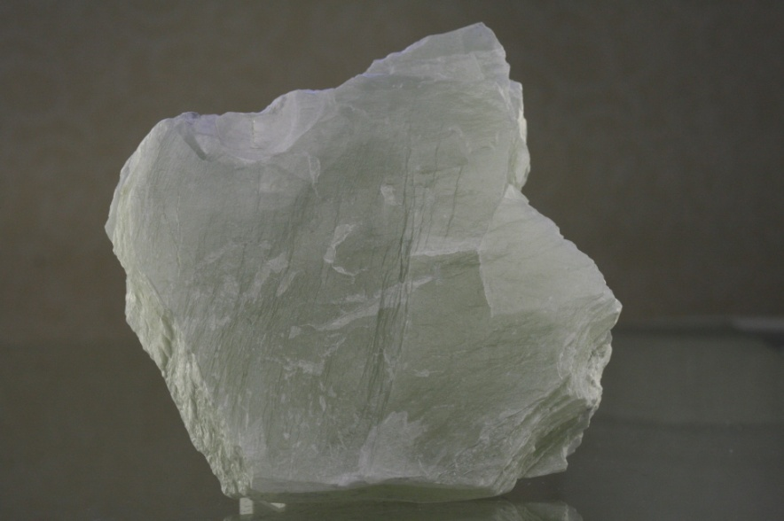
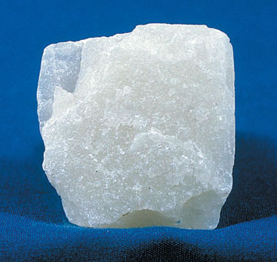
TALC
Silicate mineral
Perfect cleavage
White,brown ,green
1 on the Mohs scale
Dull or pearly
Translucent
White ,pearly green streak

Slide 4
COMPARING
Same properties
Silicate minerals
cleavage
Different properties
Hardness
Color
Luster
Diaphaneity

