Slide 1
Project of colonization, modernity and Modernization school
Historical embededdness of inequalities

Slide 2
Structure of presentation
1) colonialism and its repercussions (impact) on contemporary development
2) modernity as European period and culture
3) main aspects of European project
4) post war development
5) economic theories of development - ´old´ theories of development vs. New theories of growth
6) modernization school

Slide 3
Colonialism – definition
- subjugation by physical and psychological force of one culture by another –
by a colonizing power – through military conquest of territory .

Slide 4
Colonialism – WHAT IT MEANT
Direct political control and administration of an overseas territory by a foreign state
Colonial mission to develop colonial peoples - concept of trusteeshep
Cowen, Shenton (1996)- Doctrines of Development

Slide 5
Expansion of the European colonial sytem - impact
Colonialism – institutions and structures of colonialism had profound effect on the colonized societies (Preston)
Key factor – relations between local elites and the center power, nationalism – Benedict Anderson

Slide 6
Reorganization of colonial labour
Non-European societies were fundamentally transformed by the loss of their resources and craft tradition as their people became colonial subject
(labouring in mines, fields, plantations under regime of explorative production

Slide 7
Africa and colonialism - nation states, nationalism
Africa - table-drawn boundaries,
Scramble for Africa at the Berlin conference (1884–1885),
cut across many indigenous communities and created superficial divisions that further aggravated the already complicated situation.

Slide 8
Two types of colonies
A) colonies of settlement – which other eliminated indigenous people (Spanish destruction of the Aztec and Inca civilizations
B) colonies of rule – colonial administrators reorganize existing cultures to facilitate their exploitation (British use of local zamindars to rule the Indian subcontintent)

Slide 9
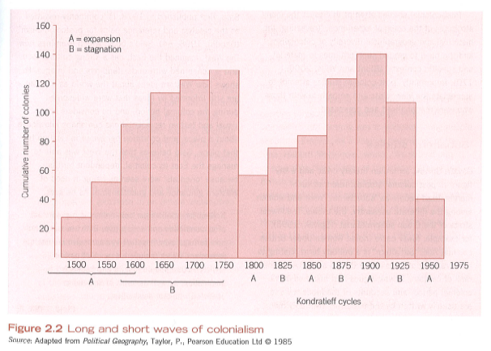

Slide 10
Types of colonial rule
Spanish, portugese patterns of colonization – did not bring about economic growth for the colonizing powers;
Netherlands and United Kingdom profited

Slide 11
Types of colonial rule
British empire – administrators from England – to colonies
Incorporation of indigenous people into administrative machinery
French – tried to win over the domestic elite, assimilation via education system.

Slide 12
Enlightenment and indigenous communities
Enlightenment interpretation of primitive societies – ideal of innocence
Who inspired the approach?
MEHMET, O. (1999): Westernizing the Third World, The Eurocentricity of economic development theories, Routledge, London.

Slide 13
Bodley: Victims of Progress – cultural dimension of colonialism

Slide 14
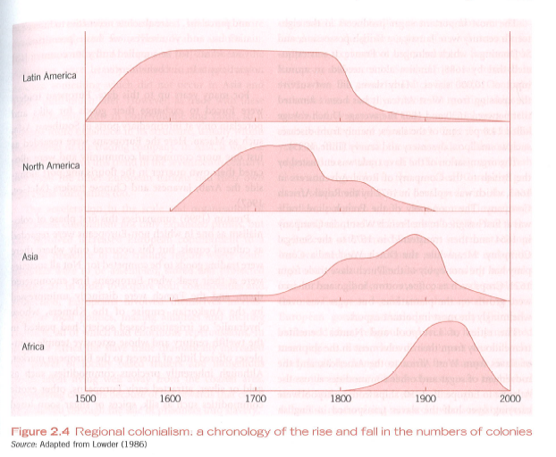

Slide 15
Reorganization of colonial labour
A great deal of colonial labor was channeled away from reproducing local, non Europen culture and into sustaintin distant European urban and industrial needs.

Slide 16
Political changes in colonies
19th century colonialism became more bureaucratic and centrally organized
Late 19th century – colonial administrations in Asia and Africa were self-financing system,

Slide 17
Political changes in colonies
Putting to use the loaylty of local princes and chiefs, bought with titles, land and tax-farming privileges.
Colonal subjects were forces into cash cropping to pay the taxes that finances the whole colonial enterprise

Slide 18
Changed role division
Incorporation of male colonial subjects into cash cropping
Disruption of formely comlementary gender roles of men and women in traditional cultures

Slide 19
Changed role division
Women´s traditional land-user rights were often displaced by new system of private property
Increasing pressure on good prodution, normally the responsibiltiy of women

Slide 20
Changed role division
Kenya – the former interdependence between men and women in Kikuyu culture was fragmented – peasants´s land confiscated –
men migrated to work on European farms,
reduction of women´s control over the resources and lowering their status, wealth and authority.

Slide 21
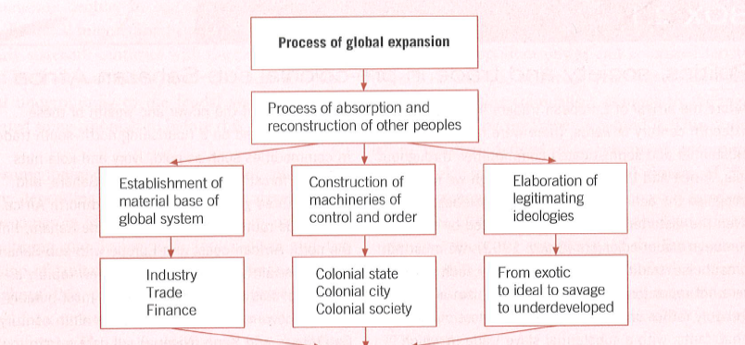

Slide 22
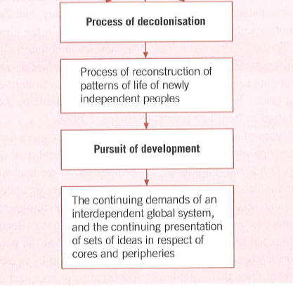
Processes of decolonisation

Slide 23
Nation states, nationalism
Africa - table-drawn boundaries,
Scramble for Africa at the Berlin conference (1884–1885),
cut across many indigenous communities and created superficial divisions that further aggravated the already complicated situation.

Slide 24
What is the relevence of colonialism? - conclusions
Is colonialism relevant?
How ?
Consider – political, economic, cultural dimension
Political – nation states, impact on stratification of society
Economic – patterns of trade
Cultural – Rahmena
Other dimensions?

Slide 25
Modernity and uneven development
Development as spread of Modernity

Slide 26
European project of modernity
Hall and Gieben
(1) The Reason and its derivative notion of rationality:
“the primacy of reason and rationality as ways of organizing knowledge, tempered by experience and experiment” (Hall, Gieben, 2000: 21).
.

Slide 27
Development as spread of Modernity
(2) Empiricism represents a fundamental shift from believing into sensing :
“the idea that all thought and knowledge about natural and social world is based upon empirical facts, things that all human beings can apprehend through their sense organs” (ibid.).

Slide 28
Development as spread of Modernity
(3) Science as the driving force fuelling the modernization
“Scientific knowledge, based upon the experimental method as developed in the scientific revolution of the seventeenth century, was the key to expanding all human knowledge (ibid)

Slide 29
Development as spread of Modernity
Relevence of science –
science at the onset of the modernization project
was believed to provide us with unequivocal and indisputable knowledge

Slide 30
Feminist perspective on science
Braidotti et al. (1994) write of Western science as of the motor of the crisis.
Braidotti (1994:10)
role of science that assumes ´totalizing control over reality´.

Slide 31
Feminist perspective on science
“Science with its claims to objective truth plays an important role in the way we think and act, in the way the modern societies function” (Braidotti et al, 1994: 9, emphasis added).
Vandana Shiva (Post-development Reader, Rahmena,

Slide 32
Development as spread of Modernity
(4) Universalism, “The concept that reason and science could be applied to any and every situation and that their principles were the same in every situation.
Science, in particular, produces general laws which govern the entire universe, without exception” (Hall, 2001: 21; emphasis added

Slide 33
Development as spread of Modernity
(5) Progress - idea that the natural and social conditions of human beings could be improved, and would result in an ever-increasing level of happiness and well-being” (Hall, 2000: 21).
The founding concepts of social science - intimately bound up with the Enlightenment’s concept of science that offers the possibilities of control.

Slide 34
The concept of progress
During much of the development era t- he concept of progress was narrowly viewed as economic growth, which in turn was summarized by the growth of the GDP.
Cf measurements of uneven development
progress understood as economic growth is either ancient or universal
Deboraj Ray in her Development economics (2007)
economic growth is the modern invention and there is nothing universal or necessary about it.

Slide 35
Economic progress – universal phenomenon?
“Economic growth (cf Kuznets 1996) is a relatively modern phenomenon. Throughout most of human history, appreciable growth in per capita gross domestic product (GDP) was the exception rather than rule.
In fact it is not far from the truth to say that modern economic growth was born after the Industrial
Revolution in Britain” (Ray, 2007: 48; emphasis added).

Slide 36
Rostow identifies: “The value system of these societies was generally geared to what might be called a long-run fatalism” (Rostow, 1962: 5). Which entailed also undesirable ascriptive allocation of status within the traditional societies:
“Generally speaking, these societies (…) had to devote a very high proportion of their resources to agriculture; and flowing from the agricultural system there was a hierarchical social structure, with relatively narrow scope – but some scope of vertical mobility” (Rostow, 1962: 5).

Slide 37
Progress
as Hall explains further: “The founding
concepts of social science were intimately bound up with the Enlightenment’s concept of progress, the idea that through the application of reasoned and
empirically based knowledge, social institutions could be created that would make men happier and free from cruelty, injustice and despotism” (Hall, 2000: 37). The concept of progress is intrinsically connected with science as science offers the possibilities of control.

Slide 38
individualism
(6) Individualism is the concept that the
“individual is the starting point for all knowledge and action, and that individual
reason cannot be subjected to a higher authority” (Hall, 2000: 22; emphasis added).
Out of this characteristic stems the methodological individualism that prevailed
in economics throughout the 20th century

Slide 39
toleration
(7) Toleration is the notion
that all human beings are essentially the same, despite their religious or moral convictions,
and that the beliefs of other races or civilizations are not inherently
inferior to those of European Christianity” (Hall, 2001: 21).

Slide 40
freedom
(8) Freedom
can be defined “an opposition to feudal and traditional constraints on beliefs, trade, communication, social interaction, sexuality, and ownership of property” (ibid.).

Slide 41
Uniformity of human nature
Uniformity of human nature means “the belief that the principal characteristics of human nature were always and everywhere the same” (Hall, 2000: 22).
liberation from tradition and other constraints and the pursuit of individualistic aspiration
it is in sharp contrast with the existence of colonialism.
Cf . large part of the project of modernity occurred during the colonial times.

Slide 42
secularism
10) Secularism
Existence of religion-free PUBLIC SPHERE
virulent anti-clericalism.
The philosopher’s opposition to traditional religious authority stressed the need for secular knowledge free of religious orthodoxies” (Hall, 2000: 22).

Slide 43
Nation states, nationalism
multiplied the already existing cleavages in the torn
societies, but beside the existing tribal, regional and religious cleavages another one was created and imposed upon the former colonial subjects – the national one.
the case in Africa, where the table-drawn boundaries,
conceived during the Scramble for Africa at the Berlin conference (1884–1885), cut across many indigenous communities and created superficial divisions that
further aggravated the already complicated situation.

Slide 44
POST WAR DEVELOPMENT PERIOD
CONDITIONS OF POST-WAR DEVELOPMENT

Slide 45
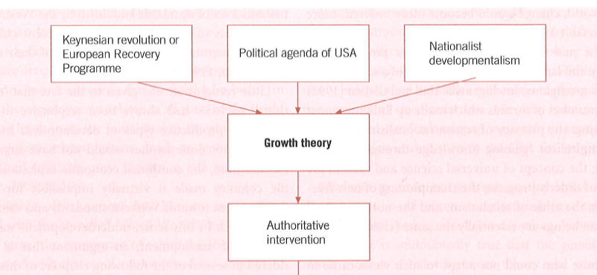

Slide 46
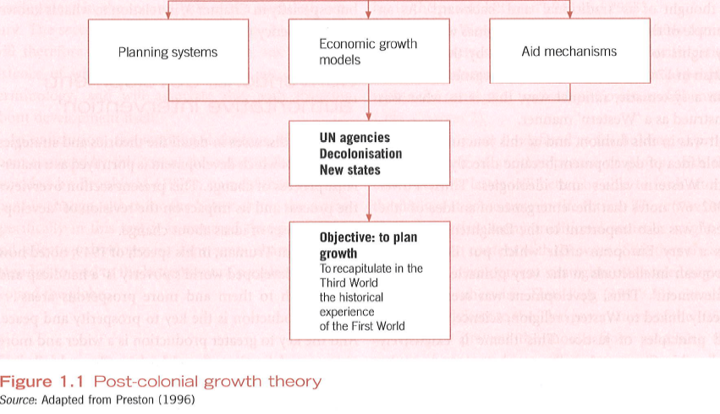

Slide 47
Project of development

Slide 48
Project of development

Slide 49
´Old´ Theories of Growth
development process = process of capital formation;
Capital formation is largely determined by levels of savings and investment
Growth = function of savings and investments (S,I)

Slide 50
´Old´ Theories of Growth
Focus on high-growth sectors such as manufacturing ( to the detriment of agriculture)
In instances where market imperfections prevent this process from reaching a successful conclusion,
intervention may be required form the state and/ or external sources

Slide 51
Neo-classical approach
Marshall – Principles of economics (1890)
General equilibrium
Self-clearing markets
Laisser faire- laisser passer
PRINCIPLE OF NON-INTERVENTION (BY STATES)

Slide 52
Neo-classical approach
Neoclassical models neglect structural rigidities common to developing countries
Prevent market form responding to price changes in ´NORMAL´ E.G. THEORIZED MANNER

Slide 53
´Old´ Theories of Growth
As income levels increase with development
MARGINAL PROPENSITY TO SAVE (MPS)
Growth – self-sustained character
Growth – market driven; however breaking free form the inertia of long term stagnation might require extensive state intervention.

Slide 54
Growth theory
Growth theory – development process of capital formation;
Capital formation is largely determined by levels of savings and investment
Focus on high-growth sectors such as manufacturing
In instances where market imperfactions prevent this process from reaching a successful conslution, intervention may be required form the state and/ or externam sources

Slide 55
Growth theory II
As income levels increase with development
MARGINAL PROPENSITY TO SAVE (MPS)
Growth – self-sustained character
Growth – market driven; however breaking free form the inertia of long term stagnation might require extensive state intervention.

Slide 57
Criticism of neoclassical approach
Neoclassical models neglect structural rigidities common to developing countries
Prevent market form responding to price changes in ´NORMAL´ E.G. THEORIZED MANNER

Slide 58
Growth theory
Growth theory – development process of capital formation;
Capital formation is largely determined by levels of savings and investment
Focus on high-growth sectors such as manufacturing
In instances where market imperfactions prevent this process from reaching a successful conslution, intervention may be required form the state and/ or externam sources

Slide 59
Growth theory II
As income levels increase with development
MARGINAL PROPENSITY TO SAVE (MPS)
Growth – self-sustained character
Growth – market driven; however breaking free form the inertia of long term stagnation might require extensive state intervention.

Slide 60
Preston: teorie růstu

Slide 62
The development matrix
In search on a mono-causal explanations
the divine recipe to induce development
The dangerous idea of self-sustained growth – automatic process
Cypher, J.M.; Dietz, J.L.: The Process of Economic Development, Routledge, 1997.

Slide 63
Characteristics of modernization theory
Growth is regarded as unilinear process
Self-sustained once the big-push is introduced
Possibilities of decline or underdevelopment are not taken into account

Slide 64
Lewis – self sustained growth 1950:39
Once the snowball starts to move downhill, it will move of its own momentum
You have, as it were, to begin by trolling your snowball up the mountain.
Once it get there, the rest is easy, but you cannot get it there without the first making and initial effort.

Slide 65
Paradigm shift
The rise of growth theory - rift in mainstream development studies
Older orthodox neoclassical theory replaced by Keynesian interventionist school
However continued stress on the importance of a ´pure´ market and export-led growth
Principle of comparative advantage

Slide 66
Criticism of neoclassical approach
Neoclassical theory is static and focused on allocation of given resources
Development problems – dynamic; focus on increasing investable resources through stimulation of savings and investment
Big push needed to initiate the process
Neoclassical theory offers only marginal adjustment and piecemeal improvements

Slide 67
Criticism of neoclassical approach
Neoclassical models neglect structural rigidities common to developing countries
Prevent market form responding to price changes in ´NORMAL´ E.G. THEORIZED MANNER

Slide 68
Criticism of neoclassical III
The neoclassical emphasis on development – comparative advantage + free trade = inappropriate to the late industrializes of the South
Direct static losses from state intervention to support industrialization – more that offset by dynamic gains
Dynamic gains = technological change, improved skills, long-term benefits from infant industries

Slide 69
Eurocentric vision
Growth theory – structured by Eurocentric vision of development based in Keynesian interpretation of the unique albeit historically important experience of core industrial capitalism
´New nations´ - were to follow the Western model
´Modernization imperative´ Nayar 1972
Based on a stylized version of Western economic history
Sequence of states on a unilinear path toward higher Western-style development

Slide 70
Rosenstein-Rodan – hidden potential for economic development
Taking advantage of increasing returns from large scale planned industrialization
Several sector simultaneously

Slide 71
Brohman
Modernization –mixture of development factors – technological change capital accumulation changing values and attitudes
Inducing social change (values, norms, beliefs, customs)
Theorization of such social change – principally via conceptual apparatus of classical sociology

Slide 72
Path dependence
“The term path dependence has been used to describe the important role which historical events and historically formed institutions have in determining the future range of possibilities for a nation. Once institutions have been formed, they tend to lock-in certain evolutionary path for the nation [Fieldhouse, quoted by Cypher, Dietz, 1997:72]

