Slide 1
Bi9393 Analytická cytometrie
Lekce 5
Karel Souček, Ph.D.
Oddělení cytokinetiky
Biofyzikální ústav AVČR, v.v.i.
Královopolská 135
612 65 Brno
e-mail: ksoucek@ibp.cz
tel.: 541 517 166
K. Souček Bi9393 Analytická cytometrie

Slide 2
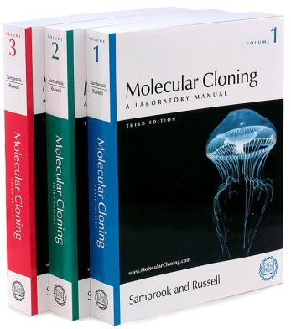
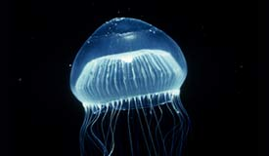
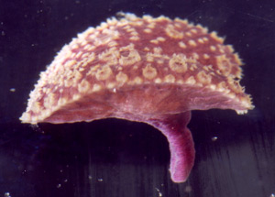
Fluorescenční proteiny
bioluminescence resonance energy transfer (BRET)
  Aequorea victoria - medúza žijící ve vodách na pobřeží Severní Ameriky.
  je schopna modře světélkovat (bioluminescence). Ca²⁺ interaguje s fotoproteinem aequorinem.
  modré světlo excituje green fluorescent protein.
  Renilla reniformis – korál žijící ve vodách na severním pobřeží Floridy.
  luminescence vzniká degradací coelenterazinu za katalytického působení luciferázy.
  modré světlo excituje green fluorescent protein.
Aequorea victoria “Crystal jelly “
Renilla reniformis "Sea Pansy"
http://www.mbayaq.org/efc/living_species/default.asp?hOri=1&inhab=440
http://www.whitney.ufl.edu/species/seapansy.htm

Slide 3
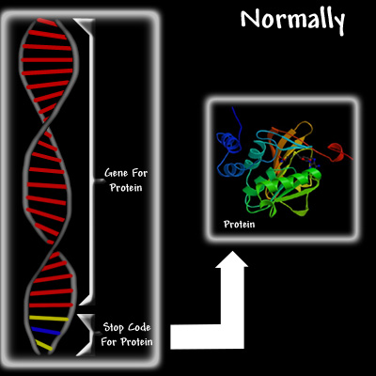
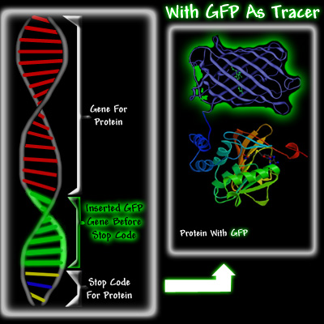
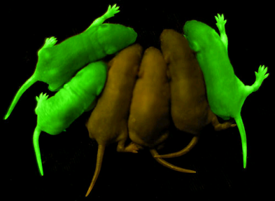
Fluorescenční proteiny
http://www.conncoll.edu/ccacad/zimmer/GFP-ww/GFP2.htm

Slide 4
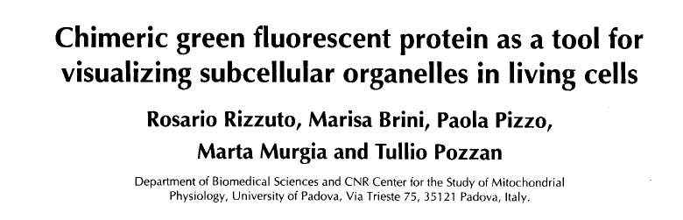
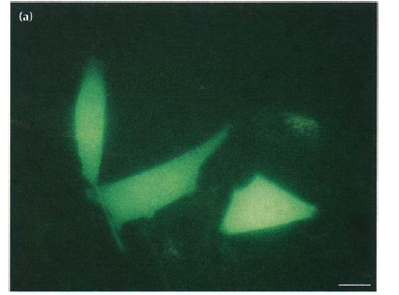
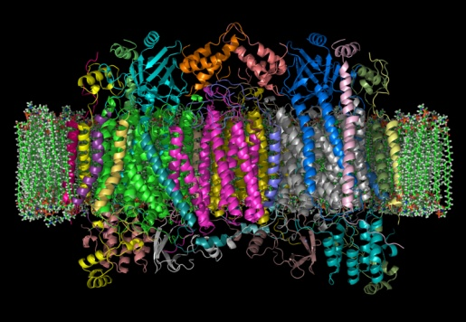
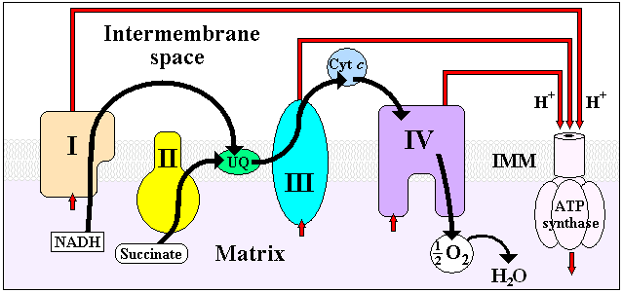
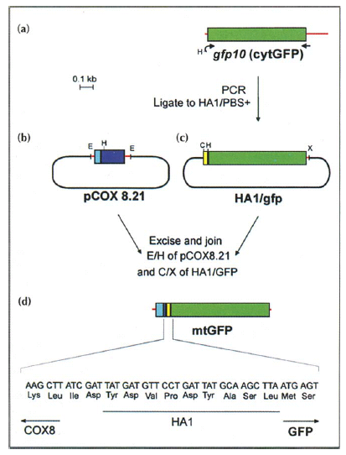
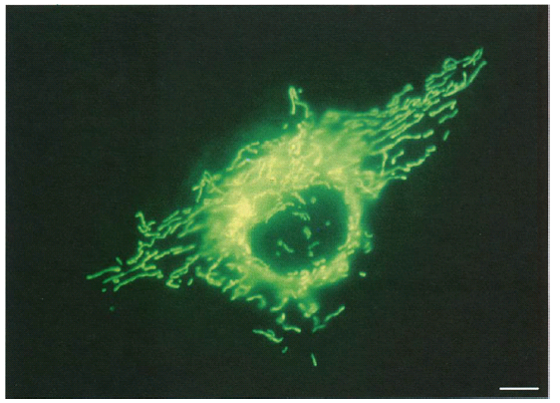

Slide 5
4 e– reduction to water
O₂
e–
O₂• –
e–
H₂O₂
e–
• OH
e–
H₂O
Unreactive at STP, but a great electron acceptor
Biological activation via radicals, transition metals
Generally, radical intermediates are enzyme-bound
Reacts with virtually any molecule at diffusion-limited rates
The molecule that makes ionizing radiation toxic
Actually a chemical reductant
Not so terribly reactive with most biomolecules
Mitochondrial superoxide the major source of active oxygen
Maintained at very low concentration
Superoxide dismutases
Not so terribly reactive with most biomolecules
Maintained at very low concentration
Catalases, peroxidases, GSH, etc…
© Simon Melov

Slide 6
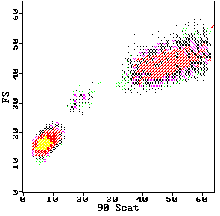
DCFH-DA DCFH DCF
2’,7’-dichlorofluorescin diacetate
O
O
CH3-C-O
O
O-C-CH3
Cl
Cl
2’,7’-dichlorofluorescin
H
COOH
HO
O
OH
Fluorescent
Cellular Esterases
Cl
Cl
H
COOH
2’,7’-dichlorofluorescein
Hydrolysis
HO
O
O
H₂O₂
Cl
Cl
Oxidation
H
COOH
DCFH-DA
Neutrophils
DCFH-DA
Monocytes
80
Control
PMA-stimulated PMN
DCFH
H O
60
2 2
Lymphocytes
counts
40
DCF
20
0
.1
1
10
100
1000
log FITC Fluorescence
© J. P. Robinson, Purdue University

Slide 7
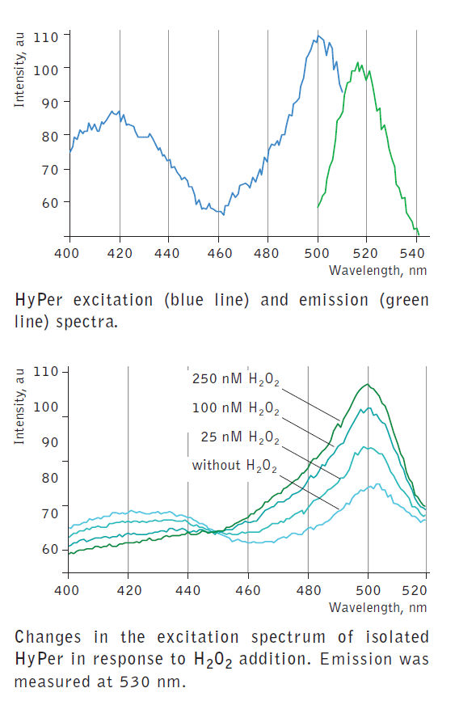
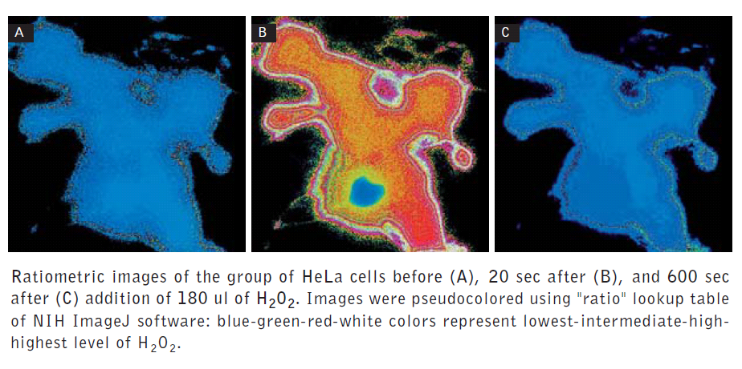

Fluorescent sensors for detection of H₂O₂

Slide 8
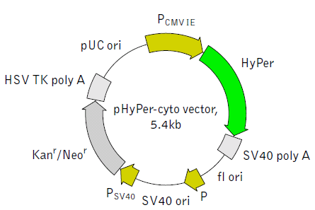
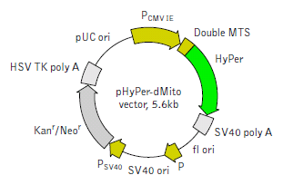
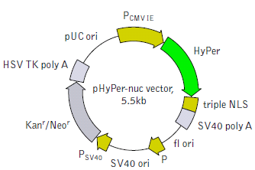
Variants & fusions
pHyPer-cyto vector
pHyPer-dMito vector
  Duplicated mitochondrial targeting sequence (MTS) is fused to the HyPer N-terminus. MTS was derived from the subunit VIII of human cytochrome C oxidase [Rizzuto et al., 1989; Rizzuto et al., 1995].
pHyPer-nuc vector
  Three copies of the nuclear localization signal (NLS) fused to the HyPer C-terminus provide for efficient translocation of HyPer to the nuclei of mammalian cells [Fischer-Fantuzzi and Vesco, 1988]

Slide 9
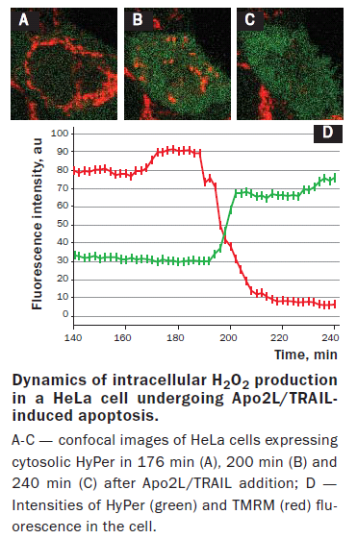
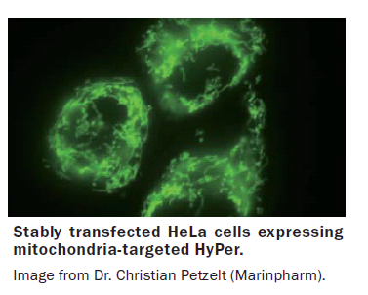


Slide 10
„High Throughput Flow Cytometry“
automatizace + robotizace = urychlení a efektivita sběru dat (měření desítky vzorků za hodinu s minimálním zásahem operátora )
využití principu vícebarevné analýzy
K. Souček Bi9393 Analytická cytometrie

Slide 11
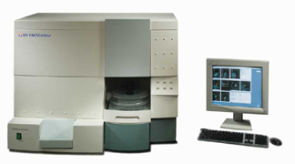

Automatizované systémy měření vzorků
Automatický karusel (autosampler)
Adaptér pro nasávání vzorků z
mikrotitrační desky

Slide 12
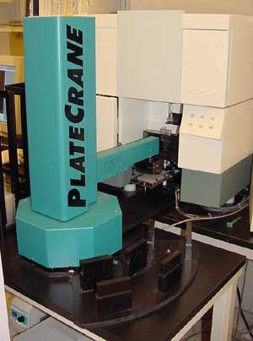
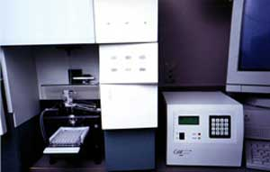
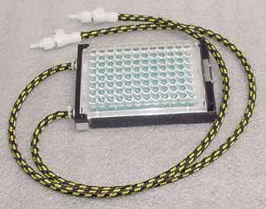

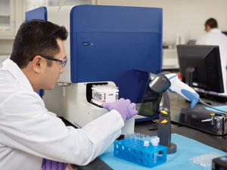

Automatizovaný „microsampler“ systém
K. Souček Bi9393 Analytická cytometrie

Slide 13
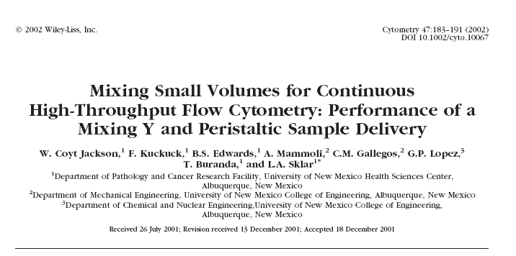

Slide 15
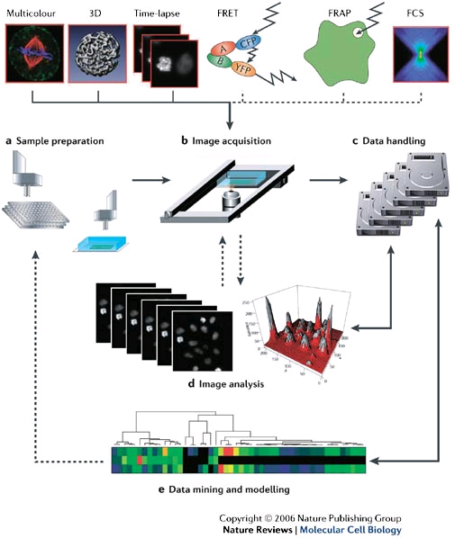
The steps in a high-throughput fluorescence-microscopy experiment.

Slide 16
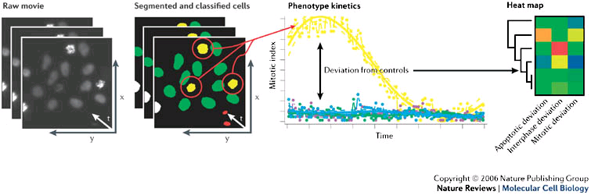
Analysis

Slide 17
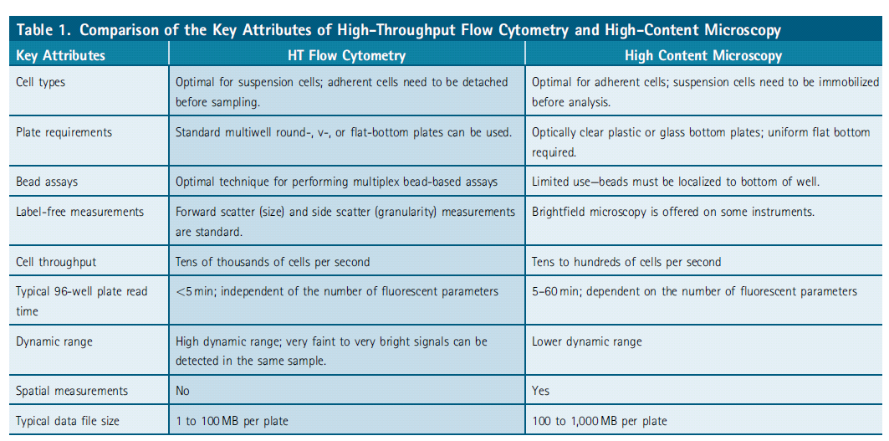

Slide 18
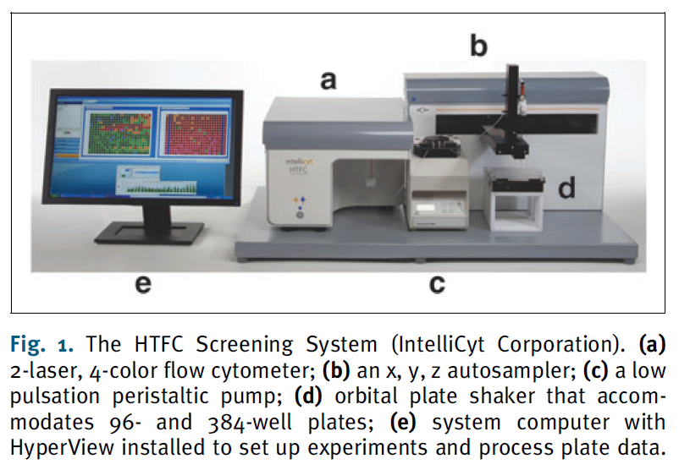

Slide 19
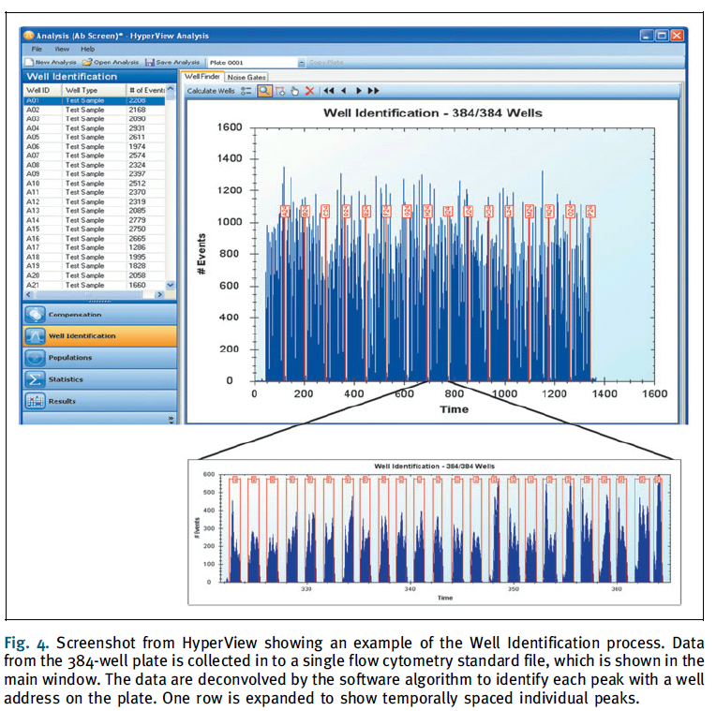

Slide 20
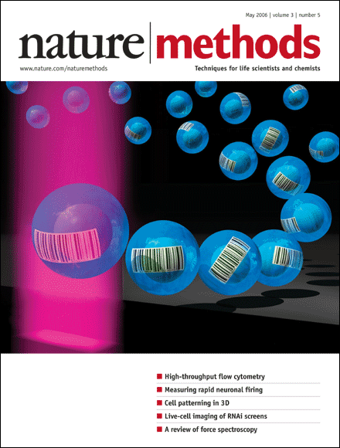

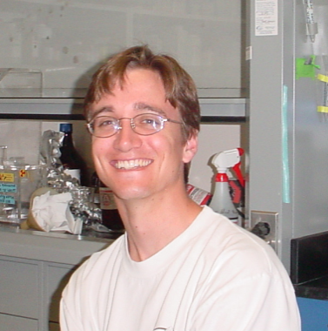
Garry Nolan
Peter Krutzik
„Fluorescent cell barcoding“
http://www.stanford.edu/group/nolan/

Slide 21
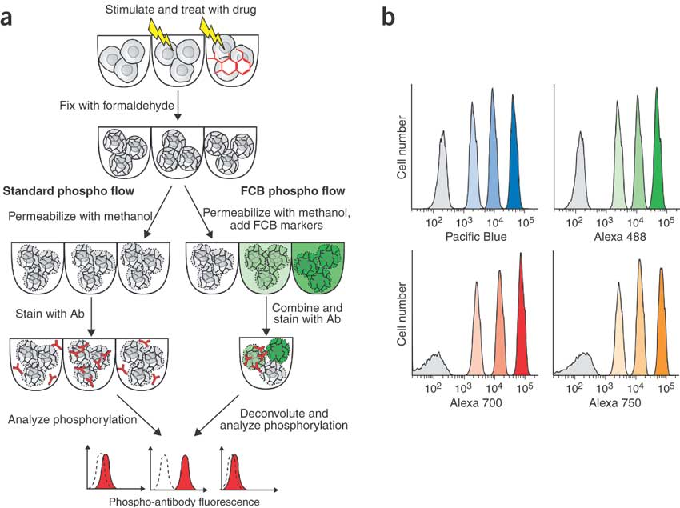
Krutzik PO, Nolan Fluorescent cell barcoding in flow cytometry allows high-throughput drug screening and signaling profiling.
Nat Methods. 2006 May;3(5):361-8.
K. Souček Bi9393 Analytická cytometrie

Slide 22
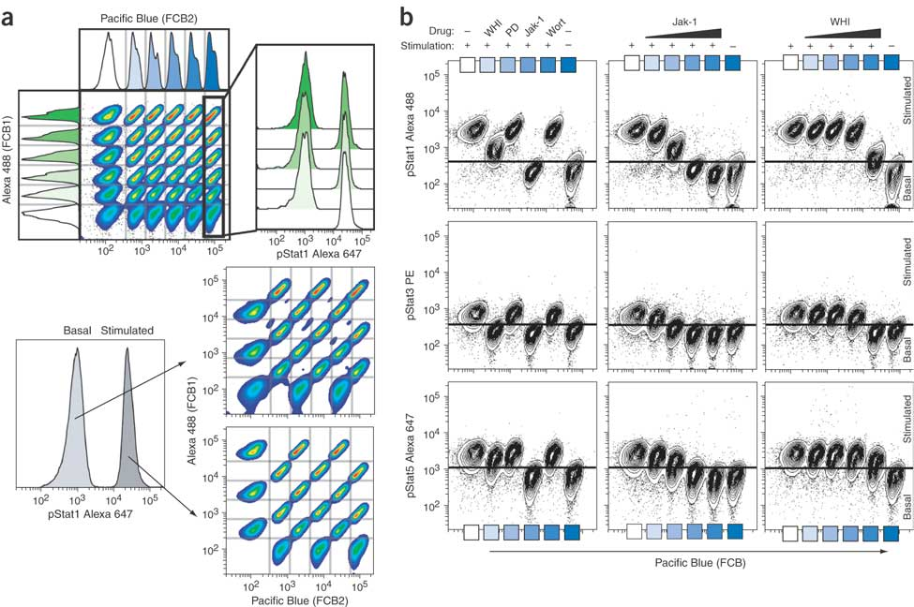
Krutzik PO, Nolan Fluorescent cell barcoding in flow cytometry allows high-throughput drug screening and signaling profiling.
Nat Methods. 2006 May;3(5):361-8.
K. Souček Bi9393 Analytická cytometrie

Slide 23
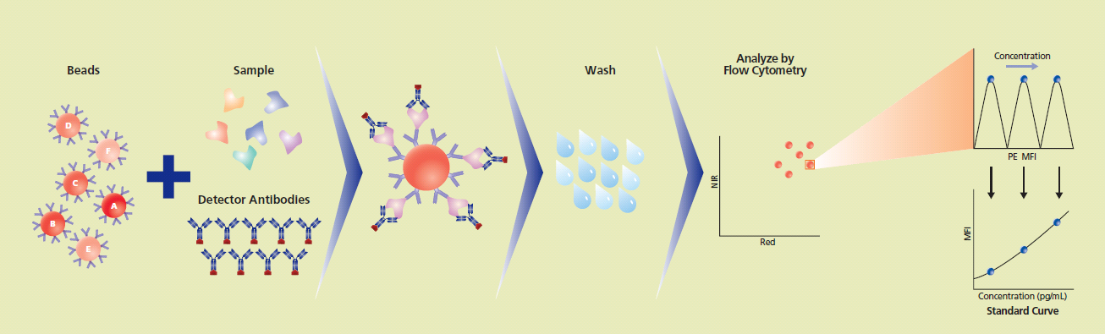
Cytometric bead array (CBA)
Multiplexed Bead-Based Immunoassays
flow cytometry application that allows users to quantify multiple proteins simultaneously

Slide 24
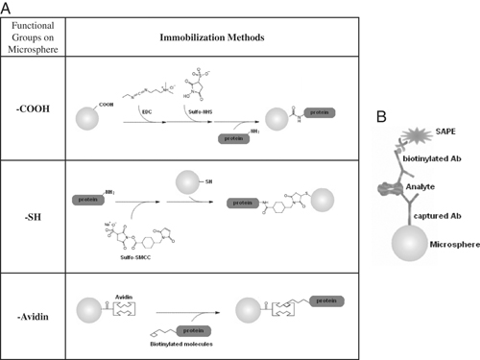
Multiplex microsphere‐based flow cytometric platforms for protein analysis and their application in clinical proteomics – from assays to results
ELECTROPHORESIS
Volume 30, Issue 23, pages 4008-4019, 3 DEC 2009 DOI: 10.1002/elps.200900211
http://onlinelibrary.wiley.com/doi/10.1002/elps.200900211/full#fig1
Notes:
Microspheres can be immobilized with capture molecules and immunoassays can be performed. (A) Coupling reactions for microspheres: Microspheres with functional groups (carboxyl‐, thiol‐) can be used for immobilizing peptides, proteins, or amino group‐functionalized molecules; alternatively, streptavidin‐functionalized microspheres can be applied for biotin‐labeled capture molecules. (B) Standard capture sandwich assay: An individual assay involving an optically encoded microsphere immobilized with a specific capture molecule (antibody) is being carried out on the particle. After sample incubation, another analyte‐specific antibody (a so‐called detection antibody, which is biotinylated and usually recognizes epitopes that are different from that of the capture antibodies) is then applied to the reaction. The presence and quantity of the reporter tag (e.g. strepavidin‐phycoerythrin) allows the precise quantification of the reactions that occur.
© This slide is made available for non-commercial use only. Please note that permission may be required for re-use of images in which the copyright is owned by a third party.

Slide 25
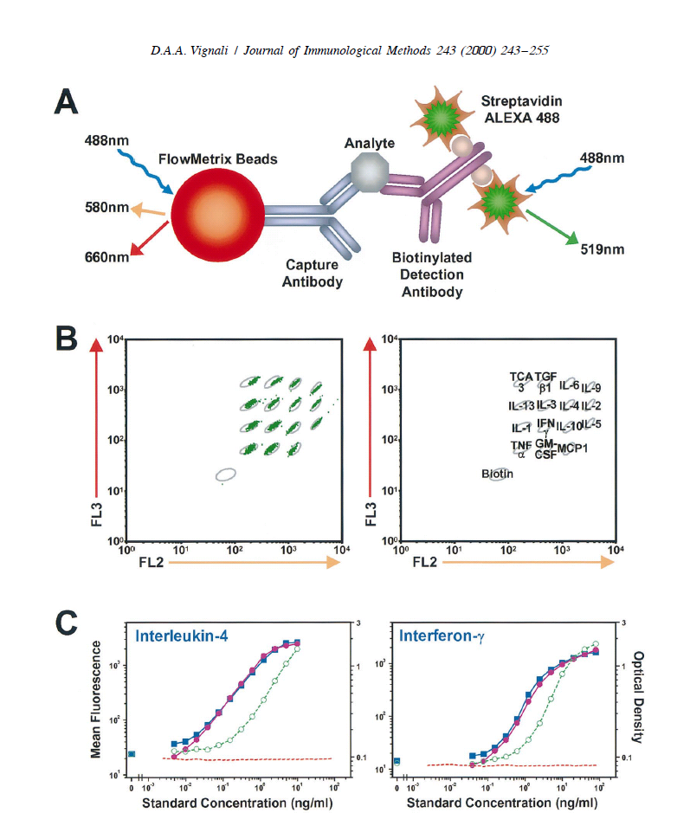
CBA

Slide 26
CBA
multiplexing capabilities
speed
incorporation of multiple assay formats
rapid assay development and reasonable cost
automation

Slide 27
Biologické aplikace průtokové cytometrie
Cytogenetika
  analýza chromozómů
    karyotyp
    sortrování
      chromozómové DNA knihovny
      FISH značení (chromosome painting)
K. Souček Bi9393 Analytická cytometrie

Slide 28
Analýza a sortrování chromozómů

Slide 29
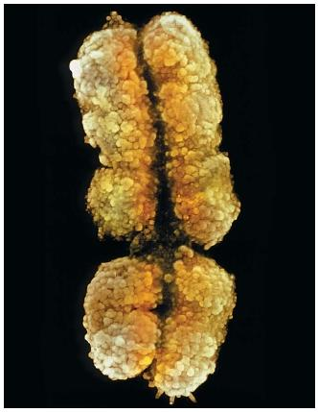
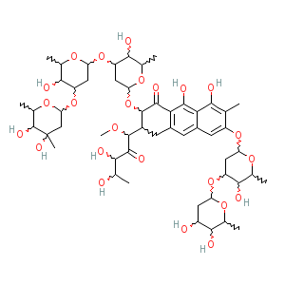
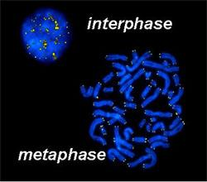

Analýza a sortrování chromozómů
synchronizace buněk – zisk metafázních chromozómů (colcemid, hydroxyurea)
izolace chromozómů
značení DAPI nebo Hoechst vs. chromomycin A3 (CA3) nebo mithramycin
= celková DNA vs. G/C-bohaté oblasti
http://www.scienceclarified.com/Ca-Ch/Chromosome.html
http://www.nccr-oncology.ch/scripts/page9243.html

Slide 30
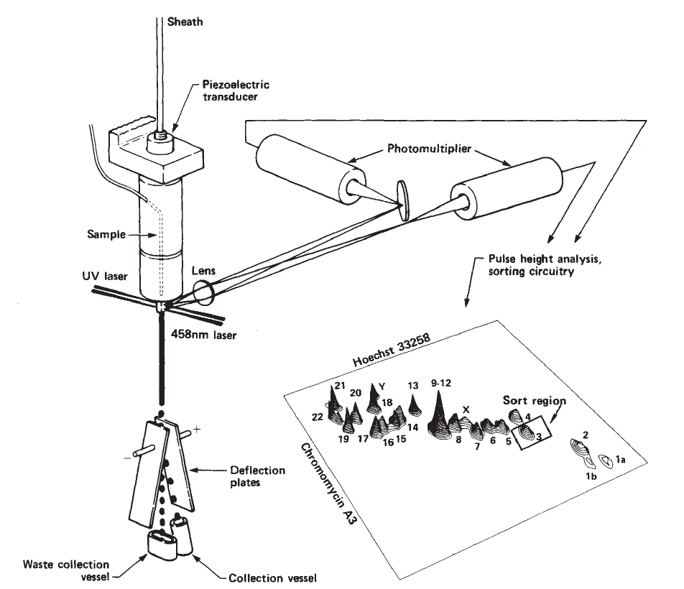
Analýza a sortrování chromozómů

Slide 31
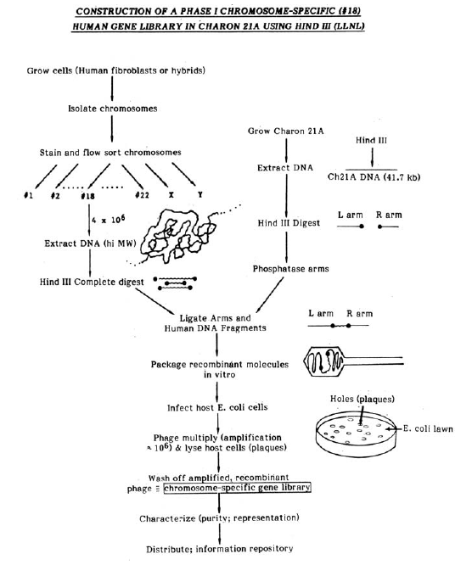


Slide 32
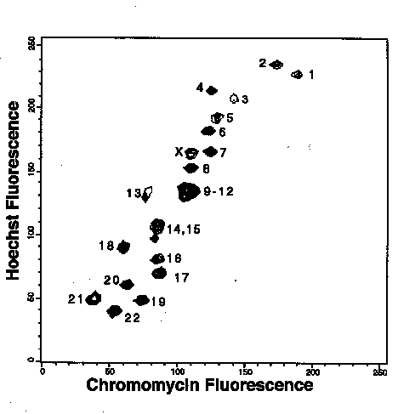
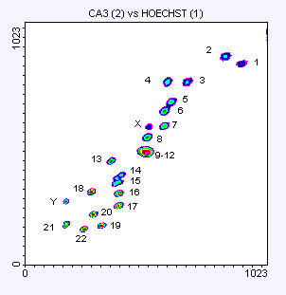
„Flow karyotype“
♀
♂
Karcinom močového měchýře
http://www.sanger.ac.uk/HGP/Cytogenetics/

Slide 33
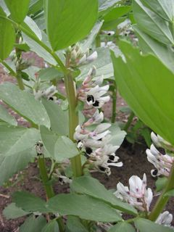
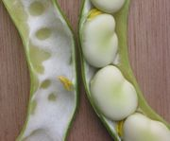
Sortrování chromozómů
Pisum sativum

Slide 34
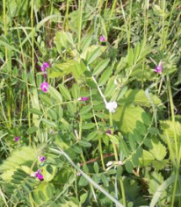
Sortrování chromozómů
Vicia faba

Slide 35
Aplikace průtokové cytometrie v mikrobiologii
ekologie
potravinářství
bioterorismus
http://www.cyto.purdue.edu/flowcyt/research/micrflow/

Slide 36
Aplikace průtokové cytometrie v mikrobiologii

Slide 37
Aplikace průtokové cytometrie v mikrobiologii
viabilita
metabolické funkce
sortrování
analýza aerosolů (Fluorescence Aerodynamic Particle Sizer (Flaps))

Slide 38
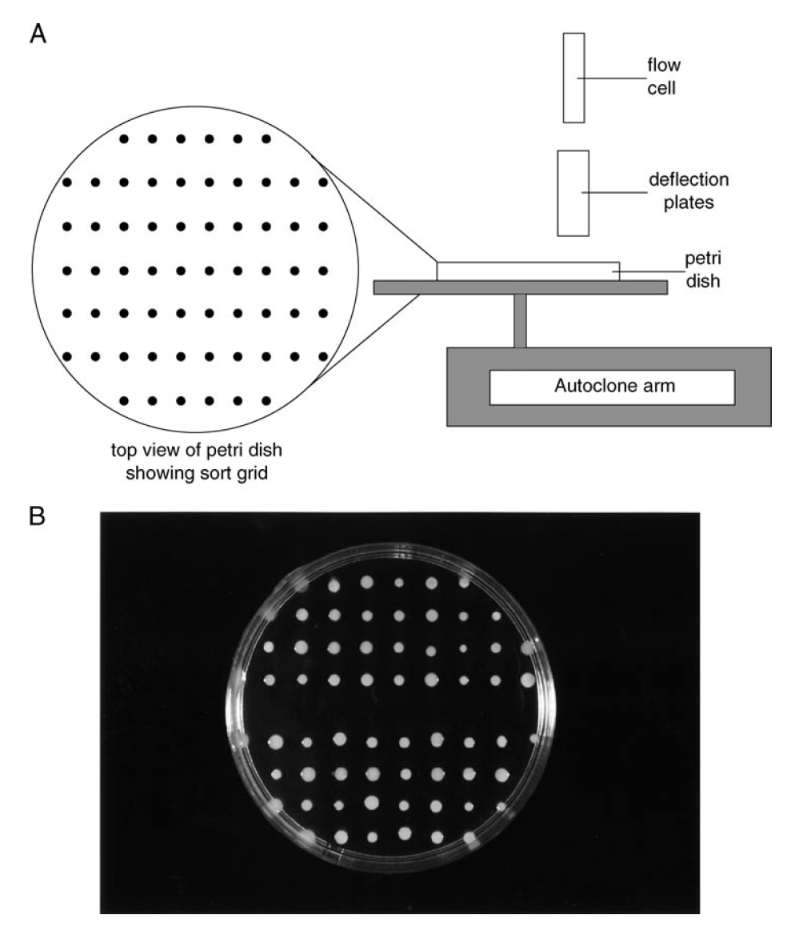

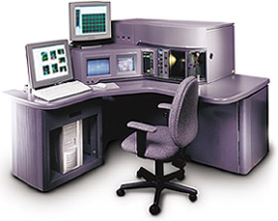
Aplikace průtokové cytometrie v mikrobiologii
Sortrování
  EPICS + Autoclone® modul

Slide 39




Fluorescence Aerodynamic Particle Sizer (Flaps)
http://www.dres.dnd.ca/ResearchTech/Products/CB_PRODUCTS/RD98001/index_e.html

Slide 40


Průtoková cytometrie kvasinek
buněčné dělení
viabilita
membránový potenciál
respirace
produkce H₂O₂
citlivost k antibiotikům
separace
http://www.sbs.utexas.edu/mycology/sza_images_SEM.htm
Saccharomyces cerevisiae
http://en.wikipedia.org/wiki/Image:Budding_yeast_Lifecycle.png

Slide 41


Průtoková cytometrie kvasinek

Slide 42

Průtoková cytometrie v hydrobiologii
studium pico- a nano-fytoplanktonu (< 20 μM)
analýza metabolických funkcí planktonu
studium pigmentace (analýza chlorofylu a fykoeritrinu)

Slide 43
Průtoková cytometrie v hydrobiologii

Slide 44



Průtoková cytometrie v hydrobiologii
analýza DNA
http://www.soes.soton.ac.uk/staff/tt/
http://planktonnet.awi.de/portal.php?pagetitle=assetfactsheet&asset_id=15127

Slide 45





Průtoková cytometrie v hydrobiologii
http://omlc.ogi.edu/spectra/PhotochemCAD/html/chlorophyll-a(MeOH).html
http://www.cyto.purdue.edu/flowcyt/research/micrflow/sieracki/sierack2.htm

Slide 46



Slide 47




Průtoková cytometrie bezobratlých
lze aplikovat běžné metodické přístupy a fluorescenční značky
Příklady aplikací:
  buněčný cyklus
  cytotoxicita
  apoptóza

Slide 48
Invertebrate Survival Journal
http://www.icms.qmul.ac.uk/flowcytometry/uses/insects/index.html

Slide 49


Figure 5. Representative flow-cytometry scatter plot of hemocytes from 25 oysters.
Rebelo MdF, Figueiredo EdS, Mariante RM, Nóbrega A, et al. (2013) New Insights from the Oyster Crassostrea rhizophorae on Bivalve Circulating Hemocytes. PLoS ONE 8(2): e57384. doi:10.1371/journal.pone.0057384
http://www.plosone.org/article/info:doi/10.1371/journal.pone.0057384

Slide 50

Figure 6. Proposed model for hemocyte maturation, as seen by flow cytometry.
Rebelo MdF, Figueiredo EdS, Mariante RM, Nóbrega A, et al. (2013) New Insights from the Oyster Crassostrea rhizophorae on Bivalve Circulating Hemocytes. PLoS ONE 8(2): e57384. doi:10.1371/journal.pone.0057384
http://www.plosone.org/article/info:doi/10.1371/journal.pone.0057384

Slide 51
ex vivo flow cytometrie - limitace
Ovlivnění některých vlastností buněk (morfologie, exprese znaků);
neumožnuje dlouhodobější studie buněčného metabolismu a buněčných interakcí (komunikace, adheze) v přirozeném tkáňovém mikroprostředí;
další:
  nízká citlivost pro detekci vzácných buněčných subpopulací (1-10 buněk/ml ~ 5000 – 50000 buněk v 5 litrech krve dospělého člověka);
  časově náročná příprava vzorku (hodiny, dny);
  diskontinuita odebíraných vzorků.
Cytometry part A 79A: 737-745, 2011

Slide 52
in vivo vizualizace - limitace
Tloušťka tkáně

Slide 53
















Imaging Basics – Reporter Molecules
Luciferase
Fluorescent dyes
+ D-luciferin substrate
+ ATP and O₂ – Live cells
Quantum dots and Nanoparticles
Fluorescent Proteins
+ excitation light source
Transfection Direct cell/protein labeling
Genetic Marker
Label Proteins
Label Cells
Label Bacteria
Biology

Slide 54

IVIS® Lumina XR – Hardware
  Customized for in-vivo imaging
  High sensitivity from 300-900 nm
  Large dynamic range
Hardware

Slide 55

The IVIS® Lumina XR Imaging Chamber
CCD Camera Cooled -90C
f/1 Lens & Aperture
Interchangeable Emission Filter Wheel
Cesium Iodide
(CsI(Tl)) scintillator
Heated
Sample Stage
Light-tight
and shielded imaging chamber
Automated aluminum filter
X-Ray Source (40kVp,100mA)
Tungsten Anode
Hardware

Slide 56


The Value of X-Ray + Optical Imaging
X-Ray Provides a Fixed Anatomical Reference
The Question: Where is the source origin relative to the surface signal?
The Problem: Tissue attenuation/ scattering makes 2D optical signals difficult to locate at a defined location.
The Solution: A co-registered X-ray image provides a fixed anatomical reference, defining skeletal structure and soft tissue organs and enabling better localization of the optical signal.
Mechanics

Slide 57








Camera and Lens Settings are Analogous to Photography
Field of View (FOV) is dependent on the distance from the lens to the sample
Light collected is proportional to how long the shutter is open (exposure time)
Aperture (ƒ/stop) controls the amount of light collected
Digital pixel binning is possible on the CCD – alters sensitivity/resolution
CCD
Shutter
Lens
Emission Filters
Aperture (f/stop)
A
B
C
D
Field of View
Mechanics

Slide 58
Field of View
FOV D = 12.5 x 12.5 cm
FOV C = 10 x 10 cm
FOV B = 7.5 x 7.5 cm
FOV A = 5 x 5 cm
Mechanics

Slide 59





Photons Diffuse Through Tissue – Surface Light Pattern is Recorded
Light traveling through tissue scatters many times creating a “fuzzy” image at the surface of the animal
The IVIS® views the diffuse image on the camera-facing (top) surface of the subject
Not all light from the source will make it to the camera – light absorption will occur as signal exits the animal
CCD
Optics
Bioluminescent Source
Mechanics

Slide 60



Christ with St. Joseph in the Carpenter's Shop
Georges De La Tour, ~ 1640 (Musee du Louvre, Paris).
http://osa.magnet.fsu.edu/teachersparents/articles/sourcesoflight.html

Slide 61


Průchod světla tkání
The absorption spectrum of a human hand.
The spectrum was recorded with a very sensitive spectrophotometer with the hand in close juxtaposition with the photocathode (unpublished data of Karl H. Norris, from The Science of Photobiology (KC Smith, ed., Plenum Press, 1977; p. 400).

Slide 62

Effective penetration depth in breast tissue

Slide 63


Challenge of in vivo Optical Imaging
Photons are absorbed and scattered in tissue
Surface signal depends on source depth
Tissue is both autoluminescent and autofluorescent
Autofluorescence levels are much higher that autoluminescence
Autoluminescence
Luminescent or Fluorescent source
Mechanics

Slide 64


How an X-Ray Image is Acquired
CCD
  X-rays will be attenuated in tissue differently resulting in an image on the scintillator
  The CCD views the scintillator resulting in a planar X-ray image
  X-ray and Optical images have different path lengths. To correct this geometrical difference, the X-ray image is registered to the optical image
Optics
Scintillator
Stage
X-ray Source
Close Up of Scintillator in Position
Mechanics

Slide 65



Field of View (X-ray)
FOV C
10 x 10 cm
FOV B
7.5 x 7.5 cm
FOV A
5 x 5 cm
Mechanics

Slide 66


Optional Z-FOV (2.5)
Magnified Mouse Paw
Magnified Hip Ball and Socket
Mechanics

Slide 67

IVIS® Lumina Fluorescence Components
  Fully computer controlled
  User interchangeable eight position Emission filter wheel
  Twelve position
  Excitation filter wheel
  Low Auto Fluorescence
  optics and fiber optics
  150 Watt Tungsten/Halogen lamp
  with computer controlled intensity
Overview

Slide 68



IVIS® Lumina XR
Camera Cover
10 excitation filters
CCD Array
f/1 Lens & Aperture
Shutter
Optical Filter
Wheel
Light-tight
Enclosure
Heated
Sample Stage
Electronics
Tray
Overview

Slide 69
In Vivo Fluorescent Agent Applications
Oncology
Cardiovascular
IntegriSense
Annexin Vivo
ProSense
ProSense FAST
CatB FAST
MMPSense
MMPSense FAST
AngioSPARK
AngioSense
Neutrophil Elastase FAST
RediJect 2-DG
RediJect COX-2
Cat K FAST
OsteoSense
Inflammation
Bone Biology
Arthritis
Hypertension
ReninSense
GastroSense
Gastric emptying
Infectious Disease Bacterial Detection Probe
Agents support multiple in vivo research areas

Slide 70
tools for in vivo molecular imaging
  Prostate, Breast, Melanoma, and Colon Carcinoma Models
    for syngeneic immunocompetent mice strains C57Bl/6 or BALB/c
    stable transfected with lentiviral luc vector
      CT26 luc, GFP - mouse colon cancer in process
      4T1 luc - mouse breast cancer done, tested in vivo
      B16 F10 luc, GFP – mouse melanoma done, tested in vivo
      TRAMP-C1 GFP, luc – mouse prostate cancer in process
      Future plan: transfect cells with pLKO.1-CMV-fLuc-IRES-mCherry

Slide 71

4T1 luc - s.c. injection

Slide 72

B16 F10 luc - s.c. injection

Slide 73



GFP ex-vivo imaging: example

Slide 74






Color is a “pigment” of our imagination
Light has no color
“Color” resides in the eye of the observer
These two yellows are visually indistinguishable
BUT multispectral imaging can be used to resolve their spectral differences

Slide 75


Fluorescence unmixing in cell biological research
Modern Research and Educational Topics in Microscopy.
A. Méndez-Vilas and J. Díaz (Eds.) ©FORMATEX 2007

Slide 76


Spectral unmixing: basic principle
Modern Research and Educational Topics in Microscopy.
A. Méndez-Vilas and J. Díaz (Eds.) ©FORMATEX 2007

Slide 77


Spectral unmixing: results
Modern Research and Educational Topics in Microscopy.
A. Méndez-Vilas and J. Díaz (Eds.) ©FORMATEX 2007

Slide 78

IntegriSense 680 Fluorescent Imaging Agent
IntegriSense™ 680 fluorescent imaging agent is used for in vivo detection of integrin α_{v}β₃ using a low molecular weight peptidomimetic antagonist coupled to a red fluorochrome. IntegriSense 680, an integrin-targeted molecular imaging agent allows the non-invasive imaging of disease status and progression.

Slide 79



Excitation unmixing: Setup

Slide 80


Excitation unmixing: Setup

Slide 81

Excitation unmixing: Raw data - Autoflurescence, GFP, AF680

Slide 82

Excitation unmixing: Autoflurescence, GFP, AF680

Slide 83

Excitation unmixing: Autoflurescence, GFP, AF680

Slide 84


Excitation unmixing: Autoflurescence, GFP, AF680

Slide 85



In vitro 3D imaging using Lumina XR: autofluorescence & GFP
- B16 F10 GFP cells
- seeded 100 000, 200 000, 300 000 cells per insert (bottom row, 3D) and the same per well (top row, 2D)
- imaging using IVIS Lumina XR
- excitation from the top, plate without the lid
- data analysis using spectral unmixing
Ex. 430/Em. 515-575
Ex. 465/Em. 515-575

Slide 86




In vitro 3D imaging using Lumina XR: autofluorescence & GFP
24 h
48 h
72 h

Slide 87
IVIS Lumina XR souhrn
Výhody:
možnost kombinace detekce luminescence, fluorescence, X-ray
intuitivní ovládání
option Z-FOV 2.5 x 2.5 cm
spektrální unmixing
Limitace:
omezený počet emisních filtrů
aktuální konfigurace FOV max. 12.5 x 12.5 cm (tendr option 24 x 23 cm)
zatím jen syngenní in vivo modely
X-ray pouze pro malé hlodavce a FOV max. 10 x 10 cm
3D object - > 2D image

Slide 88

in vivo flow cytometry – základní principy
Zobrazení buněk přímo v krevním nebo lymfatickém řečišti.
Vizualizace pomocí CCD nebo CMOS kamery po ozáření konvenční mikroskopickou lampou nebo lasery.
Detekce absorbce, fluorescence, Ramanova spektra, fototermálních nebo fotoakustických signálů.
Cytometry part A 79A: 737-745, 2011

Slide 89

in vivo flow cytometry
Cytometry part A 79A: 737-745, 2011

Slide 90

in vivo flow cytometry – bez značení
Nahrávka videa pomocí vysokorychlostní CCD nebo CMOS kamery s vysokým rozlišením v režimu propustnosti nebo odrazu.
Příklad: high-speed transmittance digital microscopy (TDM)
Limity: hloubka tkáně.
TDM může sloužit k navedení zdrojů záření pro další analýzu do určené oblasti.
Cytometry part A 79A: 737-745, 2011

Slide 91

photoacoustic and photothermal imaging
The photoacoustic effect was first discovered by Alexander Graham Bell in his search for a means of wireless communication.1 Bell succeeded in transmitting sound with an invention he called the “photophone,” which carried a vocal signal with a beam of sunlight that was reflected by a vocally modulated mirror. The sound could be recovered with an ordinary telephone receiver connected to a selenium cell illuminated by the light. Bell published the results in a presentation to the American Association for the Advancement of Science in 1880.
The Photoacoustic Effect
Benjamin T. Spike
Physics 325
April 21, 2006

Slide 92

Schematic illustration of photoacoustic imaging
Cytometry part A 79A: 737-745, 2011

Slide 93




ACS Nano 2010 4 (8), 4559-4564

Slide 94

In vivo flow cytometrie – detekce specifických signálů
Detekce fotoakustických a fototermálních jevů
Cytometry part A 79A: 737-745, 2011

Slide 95


in vivo flow cytometry - aplikace

Slide 96
Shrnutí přednášky
„High-throughput“ průtoková cytometrie …
… a uplatnění vícebarevné detekce a beads array
sortrování chromozómů
aplikace v mikrobiologii, hydrobiologii a studiu bezobratlých
in vivo průtoková cytometrie
in vivo zabrazovací metody
Na konci dnešní přednášky byste měli:
vědět co je to „high-throughput„ průtoká cytometrie
  …a jak se v ní může uplatnit princip vícebarevného značení.
znát základní principy měření a sortrování chromozómů pomocí průtokového cytometru;
mít představu o možných aplikacích průtokové cytometrie v mikrobiologii, hydrobiologii a studiu bezobratlých;
rozumět limitům a principům in vivo zobrazovaní a in vivo průtokové cytometrie.
K. Souček Bi9393 Analytická cytometrie

