Slide 1
GEO INFO STRATEGY
IN BIG DATA ERA
Henan University, Kaifeng. December 1st. 2013
Milan Konecny
Masaryk University, Brno,
Henan University, Kaifeng????
Czech Republic

Slide 2
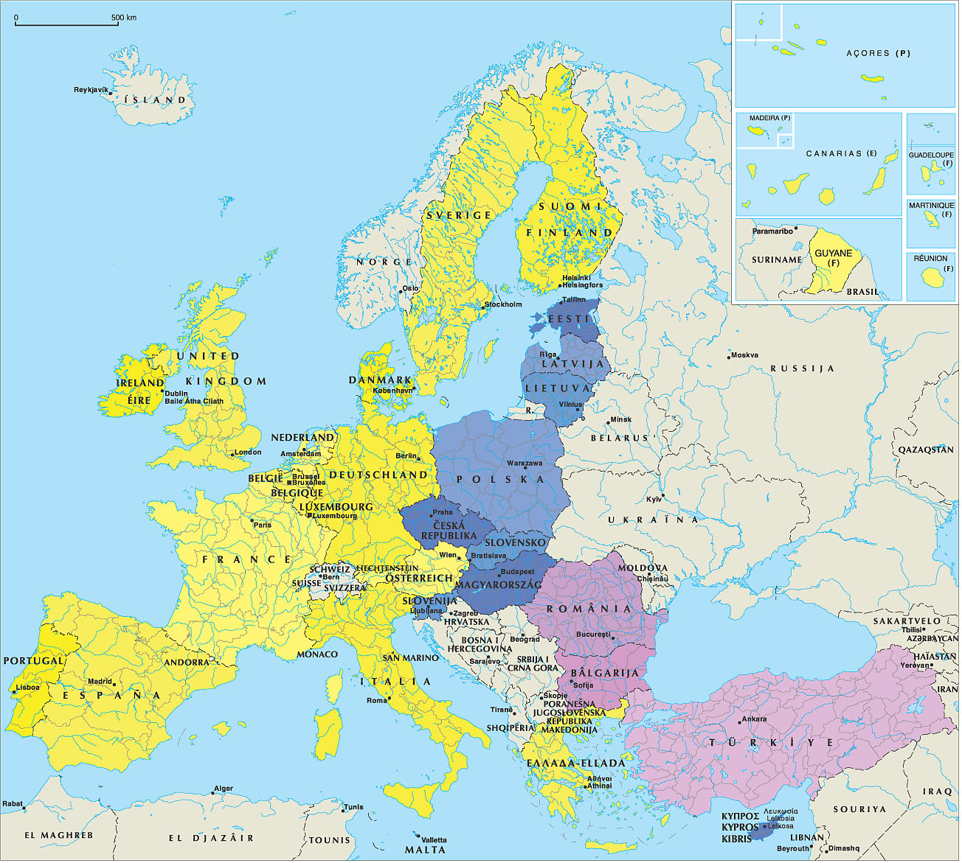

Slide 3
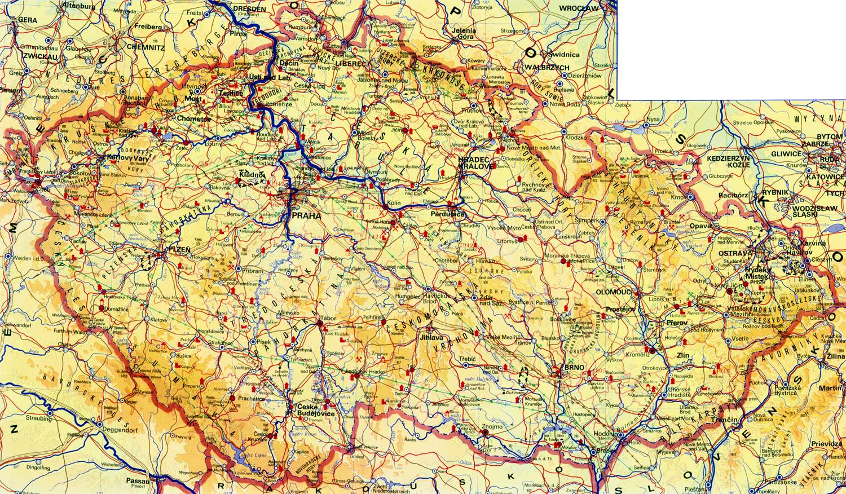
Main catchment areas of the Czech Republic:
Labe (Elbe) - Vltava (Moldau) - Morava - Odra (Oder)
Czech Rep.

Slide 4


Praha – Vltava river
PRAHA – capital of Czech Rep.
57 districts
Area 496 km²
Amount of Inhabitants 1,16 mil .

Slide 5
CONTENT
1. Big Data: USA and EU
2. What is it Geo Info Strategy and
why we need it?
3. Where we are now?
4. Spatial Data Infrastructure Concepts
5. Spatially-Enabled Society
6. GeoInfoStrategy - Integral Component
of Czech eGovernment
7. Conclusions

Slide 6
1. Big Data: USA and EU

Slide 7
Obama Administration Releases Historic Open Data Rules to Enhance Government Efficiency and Fuel Economic Growth
- groundbreaking new steps to make information generated and stored by the Federal Government more open and accessible to innovators and the public, to fuel entrepreneurship and economic growth while increasing government transparency and efficiency.

Slide 8
President Obama said:
“One of the things we’re doing to fuel more private sector innovation and discovery is to make vast amounts of America’s data open and easy to access for the first time in history. And talented entrepreneurs are doing some pretty amazing things with it.”
“Starting today, we’re making even more government data available online, which will help launch even more new startups. And we’re making it easier for people to find the data and use it, so that entrepreneurs can build products and services we haven’t even imagined yet.”

Slide 9
European Union
Big Data is an emerging field where innovative technology offers alternatives to resolve the inherent problems that appear when working with huge amounts of data, providing new ways to reuse and extract value from information.
Three main dimensions characterize Big Data: huge variety of data format, often time-sensitive and large.
Big Data offers tremendous untapped potential value for many sectors but no specific intelligent-large-data-handling/brokering industrial sector exists.

Slide 10
2. What is it Geo Info Strategy and
why we need it?

Slide 11
GeoInfoStrategy:
Complex system ensuring management of spatial (geographic) data and information and,
contemporary defining the position, tasks, methods of realization and specifications of geospatial community in the very wide ICT stream (visualization, standardisation, georeferencicing, object classifications,….)

Slide 12
Geo Info strategy of Czech Rep. should be based on 4 principles (Konečný, 2009)
Management:
Design of management structure necessary for optimization of the benefits of geospatial resources
paid by the government.
Data:
to collect, maintain and protect fundamental (priority) geospatial datasets and create directives for non-fundamental (other) geospatial data.

Slide 13
Access:
ensure that geospatial information and services paid by the state were easily available , accesible, and evaluable;
Interoperabilita:
Ministry of Interior should ensure continuity of Geospatial Strategy for the development of strategic plans in information, knowledge - based society.
Creating a panel led by non-political expert.
Ensure the sustainability of the processes in the GI regardless of political changes.

Slide 14
3. Where we are now?
Global Mapping
GMES and INSPIRE: step ahead than GOOGLE, offering data (not only showing)
GEO, GEOSS
Digital Earth (Annoni and JRC)
Concepts and strategies (Spatial-Enabled Society, e-Government, ….)
But also privacy data problems

Slide 15
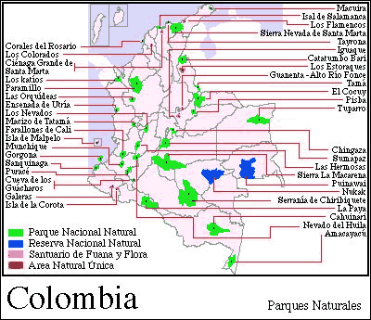
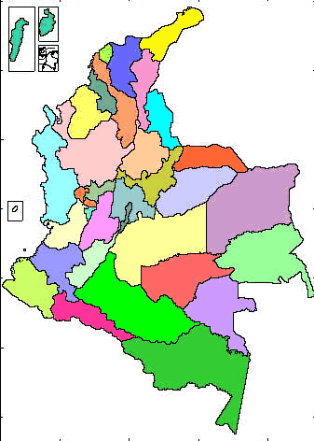
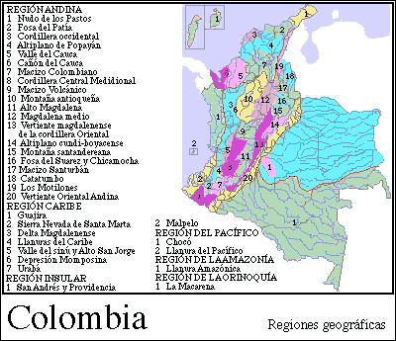
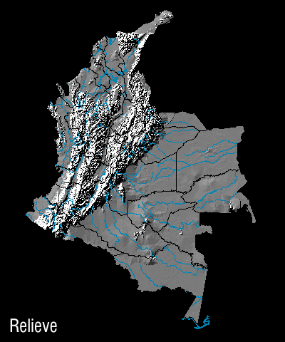
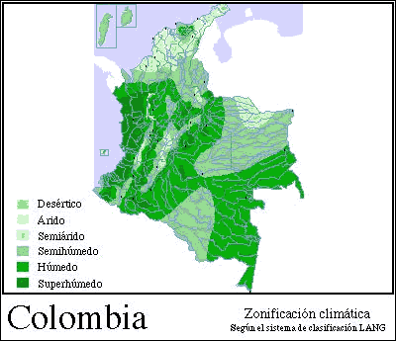

Slide 16








Understanding Digital Earth
  Cloud
  El Nino
Sea water temperature
Vegetation
Earth Surface
  Earthquake
Volcano
Plate Boundary
(http://www.nasm.si.edu/EarthToday)

Slide 17

Understanding Digital Earth
Enabling Citizens
Tools &
Applications
Enabling Citizens
Tools &
and Communities
Technology
and Communities
Technology
Private
Public
Interoperability
Interoperability
EARTH
EARTH
Digital Resources
Digital Resources
Collecting Data
Collecting Data
(White paper by NASA Digital Earth office, 2000)

Slide 18
4. Spatial Data Infrastructure Concepts

Slide 19
I
Spatial Data Infrastructures
sources
requirements
added value
databases
metadata
network
institutional
agreements
policy &
standards
technology
users

Slide 20
The term Spatial Data Infrastructure (SDI) is used to encapsulate the technologies, policies, institutional arrangements, financial and human resources that facilitate the availability, access and effective usage of geographic data.
The SDI provides the means for discovery, access and application of spatial data for policy-makers, planners and managers, citizens and their organizations.

Slide 21
SDI technologies consist of a set of data services that provide geographic data and their attributes.
Services and data are documented with meta-data which that subsequently offer the means
to discover, visualise and evaluate the data through the Web. Additionally, methods are provided to access the data. Applications are built to solve specific needs on the data service layer.

Slide 22
Global Monitoring for Environment and Security
(INSPIRE/ESDI)

Slide 23

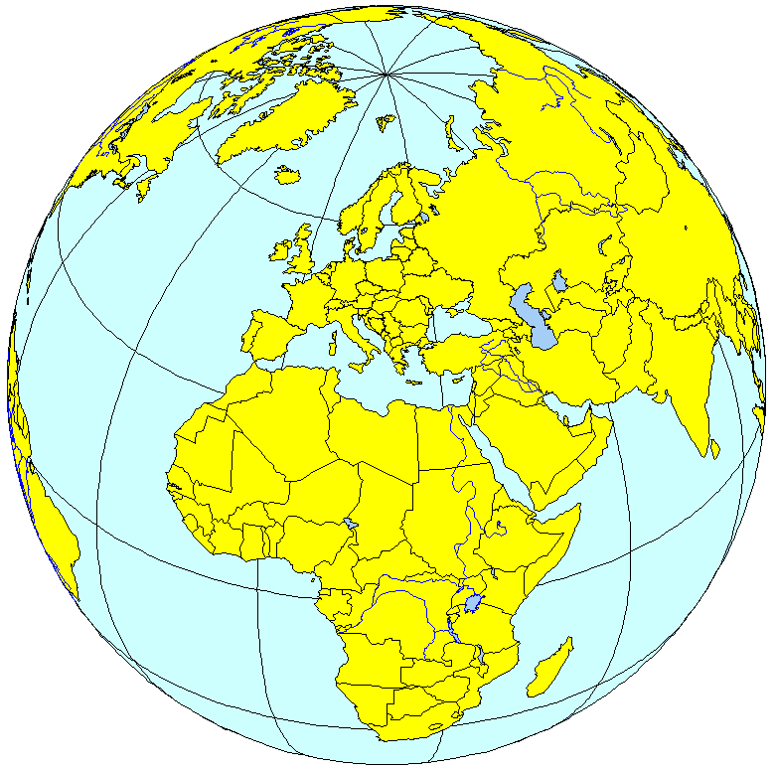
Overall GMES objectives
to provide information services to policy-makers and other users
Information
EARTH OBSERVING
SYSTEMS
(space, airborne, in-situ)
PUBLIC
POLICIES
(Environment & Security)
Needs
(policy driven)
Space Agencies
In-situ Observing systems
Scientific Community
EO Value Adding Industry
National Governments and Agencies
European Union Institutions
Inter-Governmental Organisations (IGOs)
Non Governmental Organisations (NGOs)
Virginia PUZZOLO, EC DG Enterprise-GMES Burreau, Prague Symposium, 2009
Notes:
23

Slide 24
Overall architecture
Space Infrastructure
In Situ
Infrastructure
Security
Emergency
Atmosphere
Users
CORE
SERVICES
Marine
Land
Added Value Chain
Farming
ICZM
Air quality
DOWNSTREAM SERVICES
Notes:
24

Slide 25
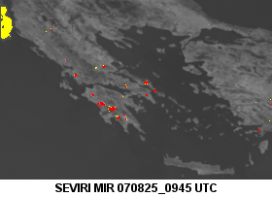

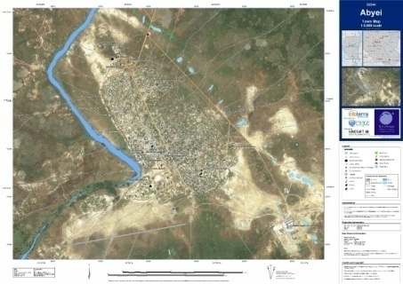
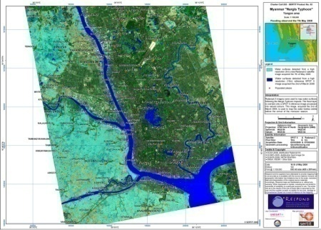

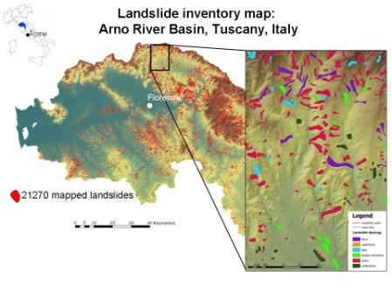
Four main types of products:
Early warning
Reference maps
For headquarters,
decision-makers
and in-field operatives
In Europe and worldwide
Assessment maps
Thematic maps
Notes:
25
25

Slide 26


ERCS 1st priority
Rapid mapping on demand in case of humanitarian crises, natural disasters, and man-made emergency situations within & outside Europe
  Reference maps available within 6 hours over crisis area
  Damage assessment maps available within 24 hours & daily updated
  Situation maps and forecasts of evolution of situations within the few days-weeks after crisis
Notes:
26

Slide 27
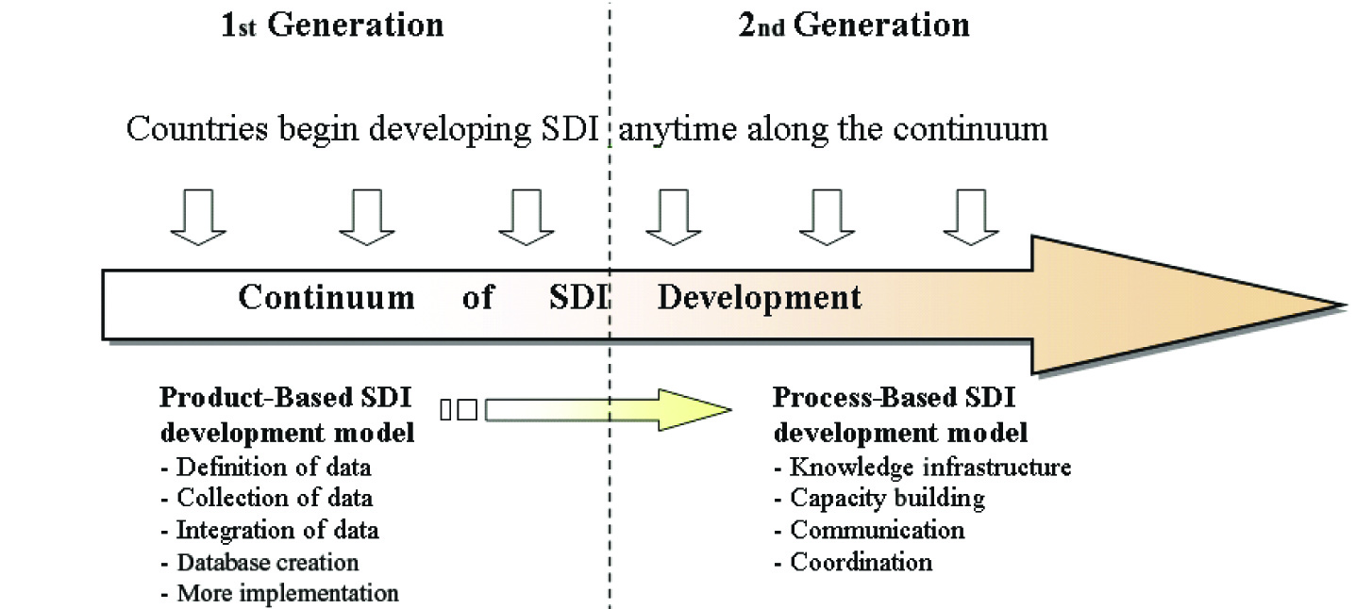
Relationship between the first and second generations of SDIs.
(by Williamson Rajabifard, Binns, 2007, reprinted from Rajabifard at al.2006 with permission of the International Journal of GIS)

Slide 28
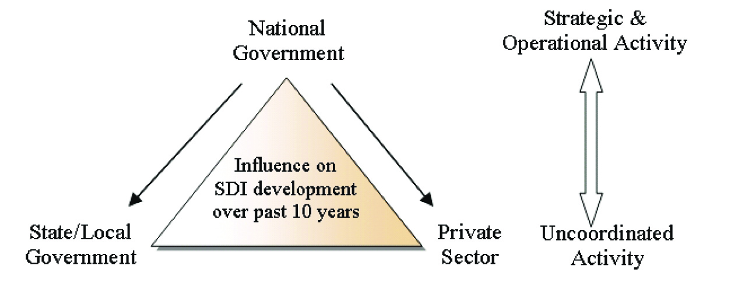
Roles of national governments, subnational governments and the private sector in SDI development over the part decade.(by Williamson Rajabifard, Binns, 2007 reprinted from Rajabifard at al.2006 with permission of the International Journal of GIS)

Slide 29
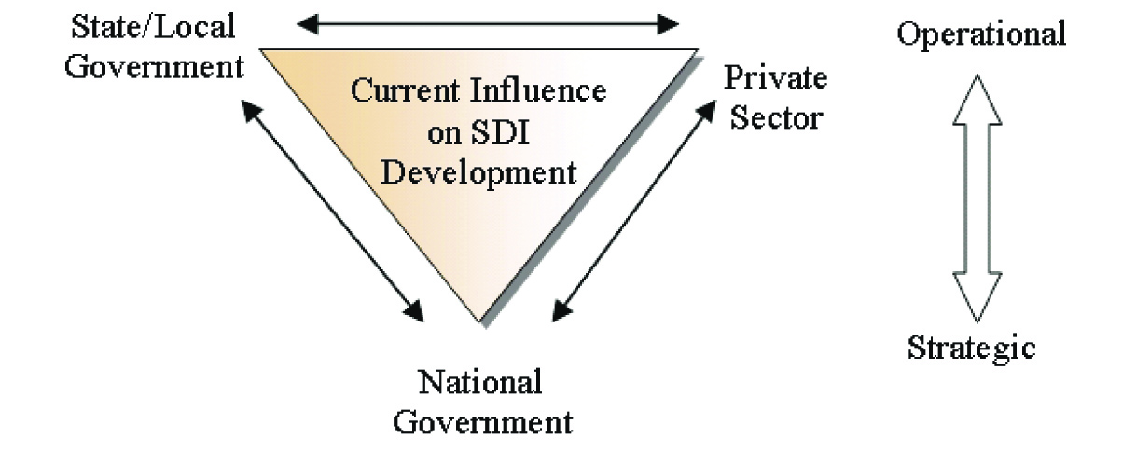
Current roles of national governments, subnational governments,
and the private sector in SDI development (by Williamson Rajabifard, Binns, 2007, reprinted from Rajabifard at al.2006 with permission of the International Journal of GIS).

Slide 30
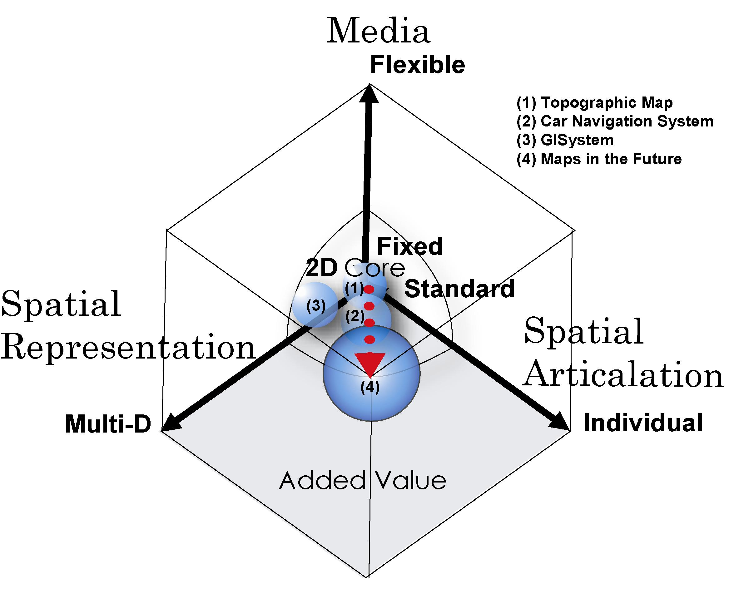

Slide 31
5. Spatially-Enabled Society

Slide 32
Australian Government, Ministerial Online and Communications Council
8 September, 2006
“…spatially-enabled government is an exciting area for government. Spatially-enabled government uses place or location to manage and integrate government services and enhance business opportunities.”
The Hon Gary Nairn MP, Special Minister for State, Australian Government

Slide 33
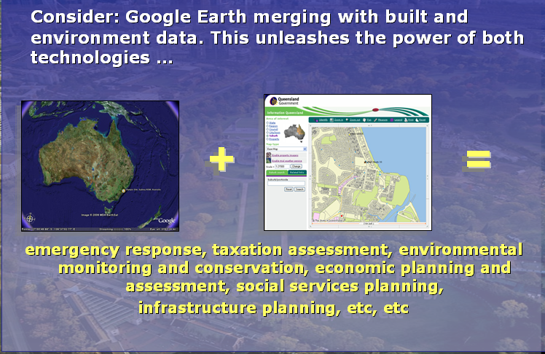
The answer: Provide the systems and people use them!!!

Slide 34
Three visions to support spatially enabled government as part of e-government
A land management vision: incorporating spatially enabled land administration
A spatial data infrastructure (SDI) vision: SDI as an enabling platform
A vision for a spatially enabled society

Slide 35
But first understand three fundamental concepts
Land in society
Spatial information in society
Importance of integration of natural and built environment in delivering sustainable development

Slide 36
Land in Society
Land policy
Land management
Land administration system
Cadastre
Land parcel

Slide 37
Spatial Information in Society
Spatial enablement of society and government
Spatial information policy as part of e-government
SDI
Spatial Data layers
Objects

Slide 38
The challenge is the relationship between Built (cadastral) and Natural (topographic) Environmental Datasets
Sustainable Development
Built
Dataset
Natural
Dataset

Slide 39
Vision of spatially enabled government

Slide 40
Governments are spatially enabled when -
Location is used to organise their information
and
Location and spatial information are common goods available to citizens and businesses to encourage creativity and product development.

Slide 41
Challenges and Issues for spatially enabled society
SDI to facilitate spatially enabled government as part of an e-government strategy
SDI to facilitate integration of natural and built environment datasets
Development of SDI vision, mission and road map – where are we heading?
Role of government, private and academic sectors
Capacity building

Slide 42
Conclusion
SDI is a new and evolving concept
SDI development is multi-disciplinary with policy, legal, institutional and technical dimensions
SDI will be a virtual environment supported by an enabling platform - spatially enabling society and government within an e-government environment
Innovations in use of information will involve private and government sectors.
Research is central to SDI development

Slide 43
5. GeoInfoStrategy-
- Integral Component of Czech eGovernment
Eva Kubatova, M. Rada, M. Konecny
Ministry of the Interior of the Czech Republic

Slide 44
Content
Czech MoI Role in ICT
Czech eGovernment
System of PA Basic Registers - RUIAN
Czech NSDI
Towards Geoinformation Strategy
Key PA Authorities Agreement
GeoInfoStrategy
Project of GeoInfoStrategy
Conclusion

Slide 45
Czech MoI Role in ICT
since 2007
  central state administration body in charge
  of public administration information systems
  coordination body for information and communication technologies
fundamental objectives
  modernization of public administration
  reaching an efficient public administration by use
  of ICT
    eGovernment

Slide 46

Czech eGovernment
PA Basic Registers
smart public administration
  better laws
  functional authorities
  professional public servants
  effective information technologies
„the document has to circulate instead of the citizen“
four measures
  Czech Point
  Public Administration Communication Infrastructure
  eGovernment Act (2008)
  Public Administration Basic Registers (2012)
eGov Act
CzechPoint
PA Communication Infrastructure

Slide 47

Czech eGovernment Strategies
Smart Administration (2007 – 2013)
  definition of the process of Czech PA modernization and improving
    by effective use of ICT
    via provision of high-quality public services
eGov 2014+ (2014 – 2020)
  strategic framework for the development of public administration and eGovernment 2014+
    modern PA is designed as transparent and efficient „service to the citizen“
    the main principle is „sharing“ data and services

Slide 48
PA Basic Registers System
Act No. 111/2009 Coll., on basic registers
4 basic registers of public administration
  Register of Inhabitants (MoI)
  Register of Corporations (Czech Statistical Office)
  Register of Rights and Obligations (MoI)
  Register of Territorial Identification, Addresses
  and Real Estates (Czech Office for Surveying, Mapping
  and Cadastre)
Basic Registers Information System (MoI)
ORG (The Office for Personal Data Protection)
fully operational in July 2012

Slide 49

RUIAN
Basic Register of Territorial Identification, Addresses and Real Estates (RUIAN)
content of RUIAN
  administration units (country, regions, …cadastral units, parcels, buildings)
  entities of land administration (municipality districts, streets, …)
  addresses
  location data (centroids of parcels, buildings, …)
  other data (building features, …)
no personal data
the crucial pillar of the Czech NSDI
administrated by Czech Office for Surveying, Mapping
and Cadaster (COSMC)
edited by Municipal and Building Authorities, Czech Statistical Office (CSO) and Local Cadastral Authorities

Slide 50
The Czech NSDI
(reference) spatial data on territory (COSMC)
  RUIAN
  cadastral maps, state maps, Fundamental Base of Geographic Data, …
thematic spatial data (both public and private)
    national INSPIRE infrastructure (MoE)
    statistical spatial data (CSO)
    spatial data on technical infrastructures
    …
systematic, transparent and formal determination of the Czech NSDI is missing up to now
lack of
  coordination of PA authorities activities
  legislation
  coherent concept of spatial data handling
  spatial data and services standards
National Geoinformation Strategy

Slide 51

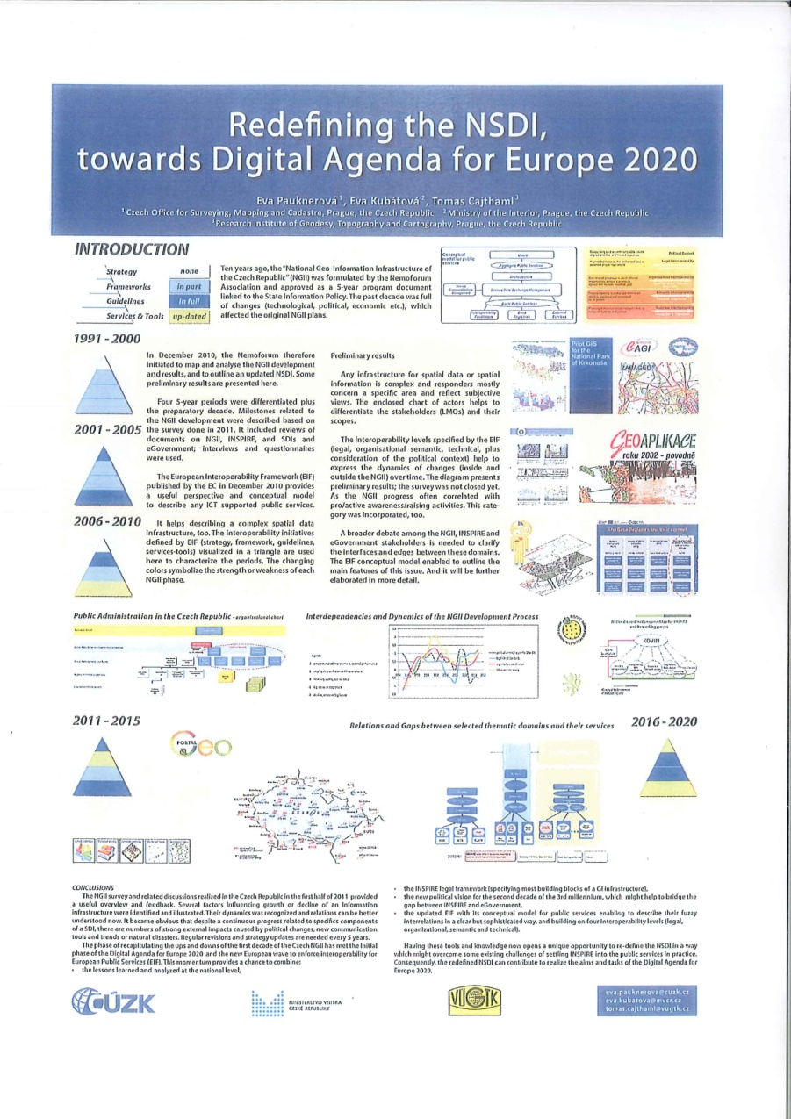
Towards Geoinformation Strategy
Conference INSPIRE 2011, Edinburgh
first analysis of NSDI in 2001 (Nemoforum)
then the Ministry of Informatics tried hard to go on but with no success
first turning point was 2007
  INSPIRE adoption
  MoI assumed the responsibility for ICT
INSPIRE transpozition in the course of 2007 and 2009

Slide 52



INSPIRE
INSPIRE transposition and implementation is in responsibility of Ministry of the Environment (MoE)
  transposition was executed by updating of Act No. 123/1998 Coll., on right of environmental information
  www.geoportal.gov.cz
  INSPIRE coordination body (KOVIN)
INSPIRE becomes real MoI inspiration in the way towards national geoinformation strategy

Slide 53





Key PA Authorities Agreement
after election in 2010 unstable political situation
second key point in mid-2012
agreement on cooperation in the process of national geoinformation strategy drawing up
  under MoI coordination
  without any public money
Minister of the Interior submitted the joint proposal for Czech Government´s approval in October 2012
53
Notes:
53

Slide 54
GeoInfoStrategy
Czech Government
  approved the proposal of working out of the „Strategy of spatial information infrastructure development in the Czech Republic up to 2020“ (GeoInfoStrategy) by Resolution No. 837 on the 14th November 2012
  ordered to submit the GeoInfoStrategy draft for approval to the end of February 2014
  ordered to cooperate to all central state administration bodies
  recommend to cooperate to regions and cities

Slide 55
GeoInfoStrategy Main Goals
to set up effective coordination and integration of public bodies and commercial sector activities in the field of spatial data
to help to set up conditions for
  major improvement of eGovernment services regarding spatial data
  reduction of costs of public administration
  enhancing of the overall competitiveness of the Czech economy

Slide 56
GeoInfoStrategy Inspiration
European
  INSPIRE
  existing geoinformation strategies (Wales, Netherland, Sweden, Nothern Ireland…)
National
  development eGovernment strategy
  INPIRE Implementation Strategy
  existing departmental development strategies
  points of view of
    relevant PA bodies
    professional associations
    …

Slide 57
GeoInfoStrategy Content
Implemetation Plan
description of NSDI current state, list of key problems and analysis of their causes
setting up target state that contains clear priorities and measurable goals (SMART)
proposal of concrete arrangements and tasks to reaching target state
  Legislative and organization arrangements
  Arrangement administrators
  Time schedule of future tasks performance
  Costs and Benefits of the arrangement realization
specification of roles of relevant PA bodies and user groups
institutional designation of suitable coordination structure

Slide 58
Project of GeoInfoStrategy
project GeoInfoStrategy has been set up
  Administrator is MoI
  Managing Committee (COSMD, MoE, MoLD, MoD, MoT)
  Processing Team (experts from PA and academic sphere)
  Consulting Team (PA bodies, professional associations (Nemoforum, CAGI, …, universities)
  Working Groups
http://www.geoinfostrategie.gov.cz
geoinfostrategie@mvcr.cz

Slide 59
Project Rough Time Framework
Period | Phase
01 – 02 / 2013 | Project Setting up
03 – 05 / 2013 | Analytic and Prognostic Phase
06 / 2013 | Vision, Global Goal and Strategic Goals Proposal
07 – 11/2013 | Start of working on GeoInfoStrategy Draft
12 / 2013 | Proposal of Implementation Plan
01 – 02 / 2014 | Consulting of the GeoInfoStrategy Draft
59
Notes:
59

Slide 60
GeoInfoStrategy – Where we are
Working and Organisational Plan is approved by Managing Committee
work in compliance with Cooperation and Communication Plan (workshops, presentations, articles in specialized magazins, …)
collection of
  information for analysis
  impulses for proposal
worked out
    document structure
    vision and global goal
    strategic nd specific goals
60
Notes:
60

Slide 61
6. Conclusion
important is
  intention to work out the national geoinformation strategy (GeoInfoStrategy) has governmental support
      Governmental Resolution No. 837/2012
    future GeoInfoStrategie is seen as the eGov 2014 + subsequent strategy
      GeoInfoStrategy is going to be an integral component of Czech eGovernment
    Czech Republic makes efforts to
      coordinate national geoactivites
      activate huge spatial data economic potencial
61
Notes:
61

Slide 62
Thanks for your attention!
http://www.geoinfostrategie.gov.cz
geoinfostrategie@mvcr.cz
eva.kubatova@mvcr.cz
62
Notes:
62

Slide 63


Slide 64


Slide 65


Slide 66
Xie, Xie!!!!!
Bardzo Dziekuje
Chvala
THANK YOU
Muchas Gracias
Terima KasimO Brigada
Kammsa Hamida
Aligator
SHUKRAN
BLAGODARJA
DĚKUJI ( in Czech)

