Slide 1
BIOMARKERS AND TOXICITY MECHANISMS
08 – Mechanisms
Signalling and regulation
Luděk Bláha, PřF MU, RECETOX
www.recetox.cz

Slide 2
Cell communication & regulation: a target for toxicants
… especially sensitively regulated processes are highly susceptible to toxicants
→ toxicity to REGULATIONS & SIGNALLING
Hierarchy in signalling
- systems: neuronal ←→ endocrine
- cell-to-cell
hormonal & neuronal signal transmission
contact channels
- intracellular signal transduction

Slide 3
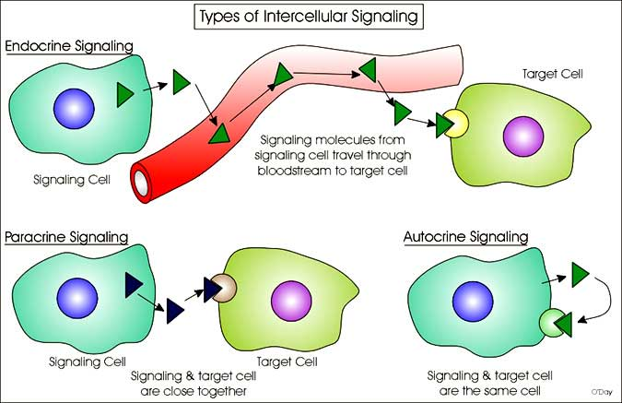
Cell communication & regulation: a target for toxicants

Slide 4
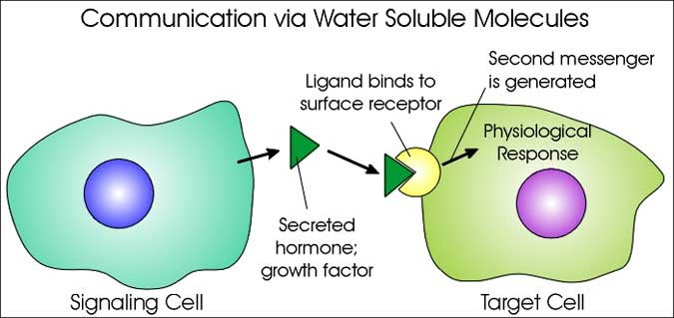
Cell communication (1)

Slide 5
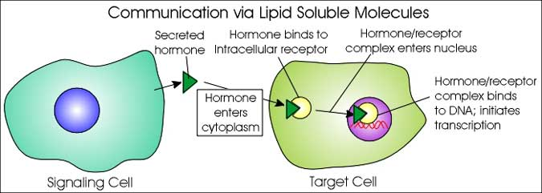
Cell communication (2)

Slide 6
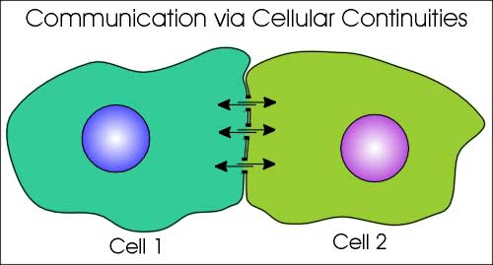
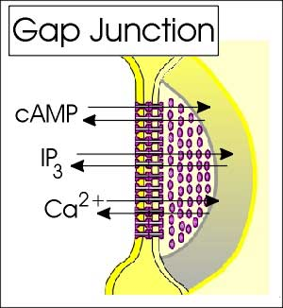
Cell communication (3)

Slide 7
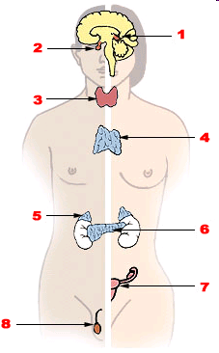
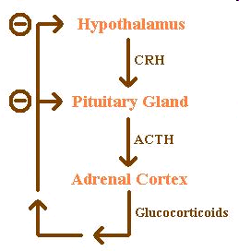
Endocrine system:
1. Pineal gland, 2. Pituitary gland, 3. Thyroid gland, 4. Thymus, 5. Adrenal gland, 6. Pancreas, 7. Ovary, 8.Testis
Example: feedback loop

Slide 8
FUNCTIONS OF HORMONES
* stimulation or inhibition of growth
* mood swings
* induction or suppression of apoptosis
(programmed cell death)
* activation or inhibition of the immune system
* regulation of metabolism
* preparation for fighting, fleeing, mating …
* preparation for a new phase of life
  (puberty, caring for offspring, and menopause)
* control of the reproductive cycle
…. etc.

Slide 9
System regulation = HORMONES & ENDOCRINE SYSTEM
FATE OF HORMONES: target for toxicants
Toxic compounds can affect “hormone signalling” at various levels (highligted):
1. Biosynthesis of a particular hormone in a particular tissue
2. Storage and secretion of the hormone
3. Transport of the hormone to the target cell(s)
4. Recognition of the hormone by an associated cell membrane or intracellular receptor protein.
5. Relay and amplification of the received hormonal signal via a signal transduction process -> cellular response.
6. The reaction of the target cells is recognized by the original hormone-producing cells (negative feedback loop)
7. Degradation and metabolism of the hormone

Slide 10
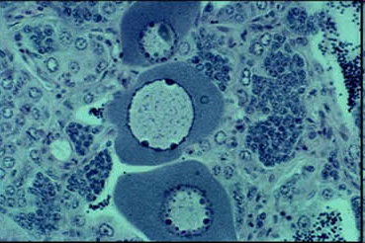
Toxicity to hormone regulation = ENDOCRINE DISRUPTION
ED & EDCs (endocrine disrupting compounds)
= major problem in environmental toxicology
Effects at all levels of hormonal action have been demonstrated
→ synthesis, transport, site of action ….
- Multiple effects due to ED (! Not only „xenoestrogenicity“ & feminization)
→ immunotoxicity, developmental toxicity
(ED - WILL ALSO BE DISCUSSED FURTHER)
Example of ED - Intersex roach testis
containing both oocytes and spermatozoa,
caused by exposure to environmental oestrogens

Slide 11
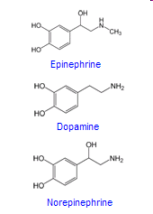
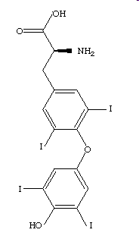
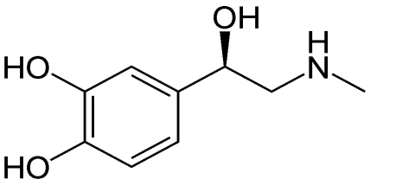
Types of hormones in vertebrates
Amine-derived hormones
structure: derivatives of the amino acids tyrosine and tryptophan.
Examples - catecholamines and thyroxine.
(small molecules - similar to organic toxicants → TOXIC EFFECTS)
Adrenalin
Thyroxin

Slide 12
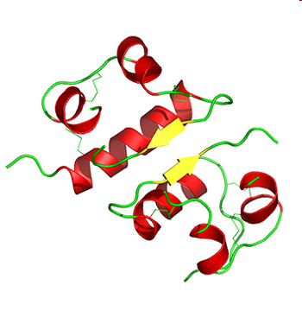
Types of hormones in vertebrates
Peptide hormones
structure: chains of amino acids.
- small peptides: TRH and vasopressin;
- large proteins: insulin, growth hormone, luteinizing hormone, follicle-stimulating hormone and thyroid-stimulating hormone etc.
Large molecules;
receptors on surfaces of the cells
(Interactions with toxic chemicals less likely)
Example - insulin

Slide 13
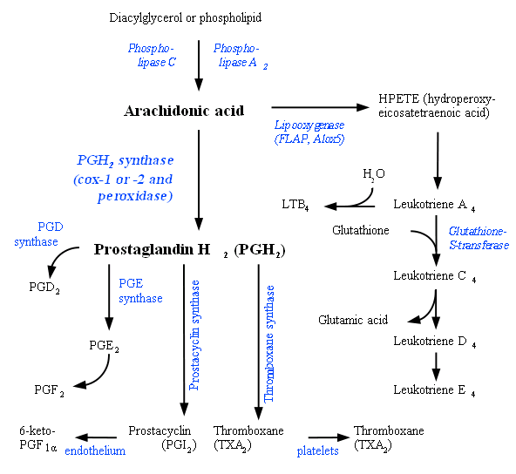
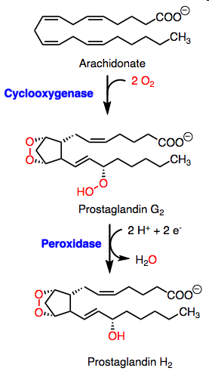
Types of hormones in vertebrates
Lipid derived “hormones” (1) - from linoleic acid, arachidonic acid
- prostaglandins

Slide 14
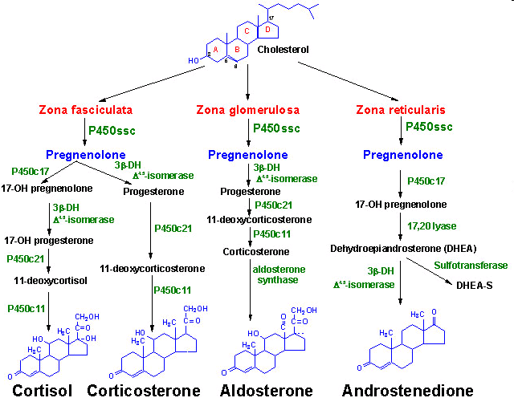
Types of hormones in vertebrates
Lipid derived hormones 2 - steroid hormones
* Small molecules - similar to organic toxicants:
→ several compounds interfere with steroid hormones → toxicity !!!
Derived
from cholesterol
Examples:
testosterone,
cortisol,
estradiol …

Slide 15
Intracellular signal transduction: target of toxicants
- Regulation of cell life = control of major cell functions
- metabolism
- proliferation
- differentiation
- death (apoptosis)
- Regulation controlled by complex signalling
- "network" of general pathways
- similar in all cells / different cell-specific effects

Slide 16
Intracellular signal transduction: target of toxicants
- Consequences of signalling disruption
- unwanted changes in „homeostatic“ rates among
proliferation / differentiation / apoptosis
  → cell transformation (carcinogenicity)
  → embryotoxicity
  → immunotoxicity
  → reproduction toxicity
  .... and other chronic types of toxicity

Slide 17
Signal transduction - principles
Two major signalling processes
– protein-(de)phosphorylation
ProteinKinases - PKs, ProteinPhosphatases - PPases
- secondary messengers
cAMP / IP3, PIP2, DAG, Ca2+, AA
Three major types of signalling
  1: Membrane receptors (G-protein, kinases)
  → activation of protein kinase A (PKA):
  major messenger: cAMP
  2: Membrane receptors
  → activation of membrane lipases → and later proteinkinase C
  IP3, PIP2, DAG, Ca2+, AA
  3: Cytoplasmic (nuclear) receptors (discussed in detail in other sections)

Slide 18
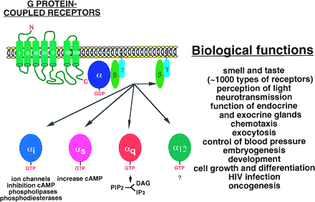
Membrane receptors acting as ProteinKinases
G-proteins & G-protein coupled receptors - GPCRs

Slide 19
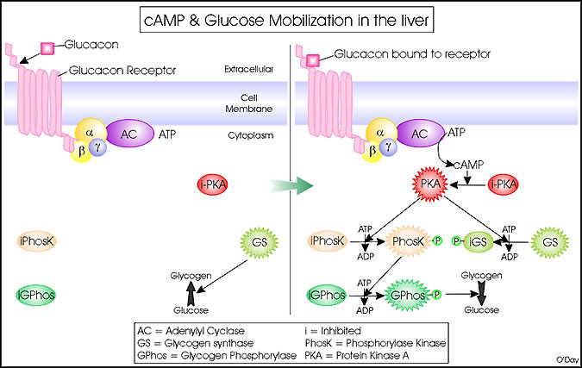
Signalling mechanism 1
→ Activation of adenylate cyclase → cAMP → PKA

Slide 20
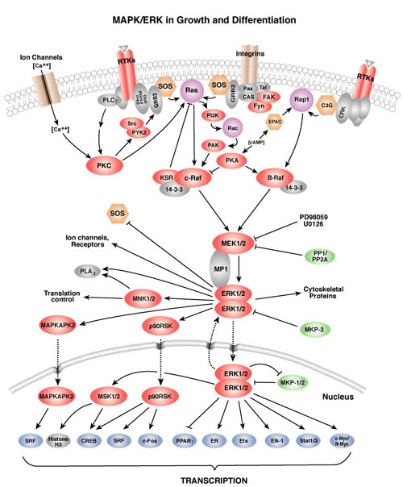
←PKA is central to
a number of signalling
events and following
effects
←Including modulation
of “MAPKs”

Slide 21
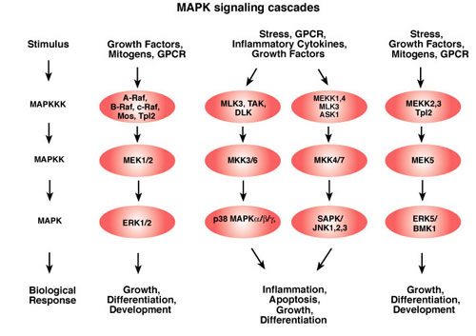
Mitogen Activated Protein Kinases (MAPKs)
& dependent effects

Slide 22
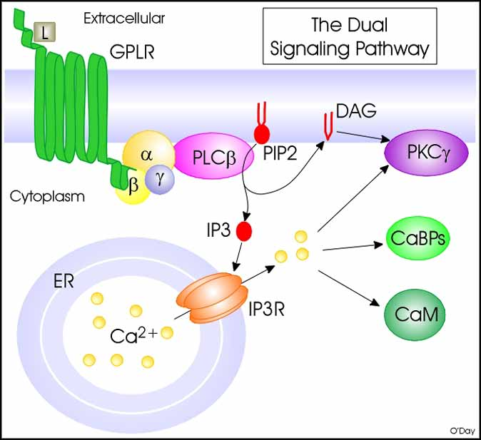
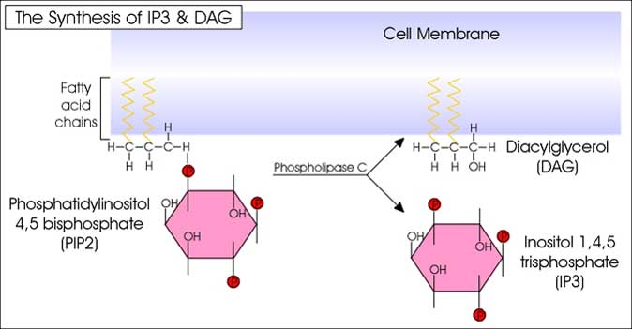
Signalling mechanism 2
Activation of Phospholipase C
→ release of PIPs → DAG → PKC / arachidonic acid
+ IP3 → activation of Ca²⁺ signalling

Slide 23
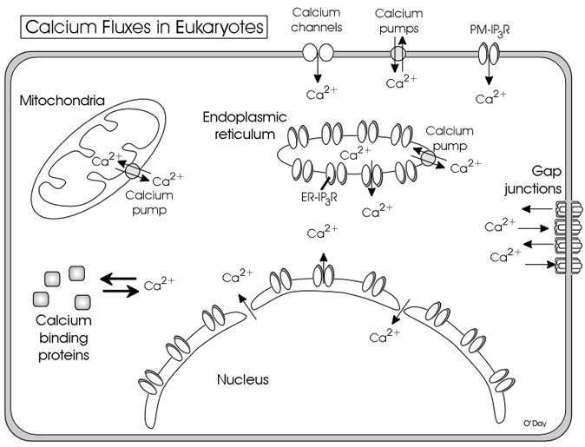

Slide 24
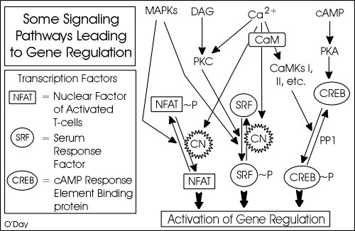
Different “types” of signalling crosstalk and form networks

Slide 25
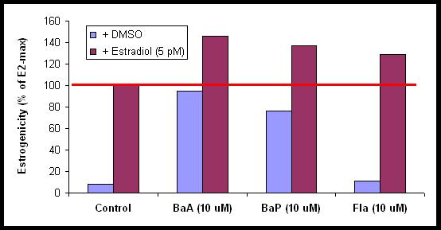
Examples
Estrogenicity of PAHs independent on activation of estrogen receptor
PAHs →modulation of PKs/PPases: phosphorylation events
→ ligand independent activation of ER
PAHs significantly potentiate the effect
of 17β-estradiol (via increased phosporylation of ER)
Vondráček et al. 2002 Toxicol Sci 70(2) 193

Slide 26
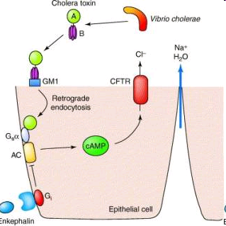
Example - cholera toxin:
CT acts as adenylate cyclase
→ increasing cAMP levels → TOXICITY

Slide 27
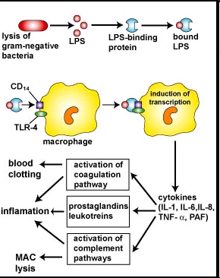
Example: Lipopolysaccharides (LPS) from cell walls
→ hyperactivation of intracellular signals → immunotoxicity

