Slide 1
BIOMARKERS AND TOXICITY MECHANISMS
12 – BIOMARKERS
of EFFECTS
Luděk Bláha, PřF MU, RECETOX
www.recetox.cz

Slide 2
In vivo biomarkers of effects / response
Behavioral and Clinical biomarkers
Pathology
Clinical chemistry and hematology
Enzymatic changes
Protein synthesis biomarkers
Oxidative stress markers

Slide 3
Behavioral and clinical biomarkers

Slide 4
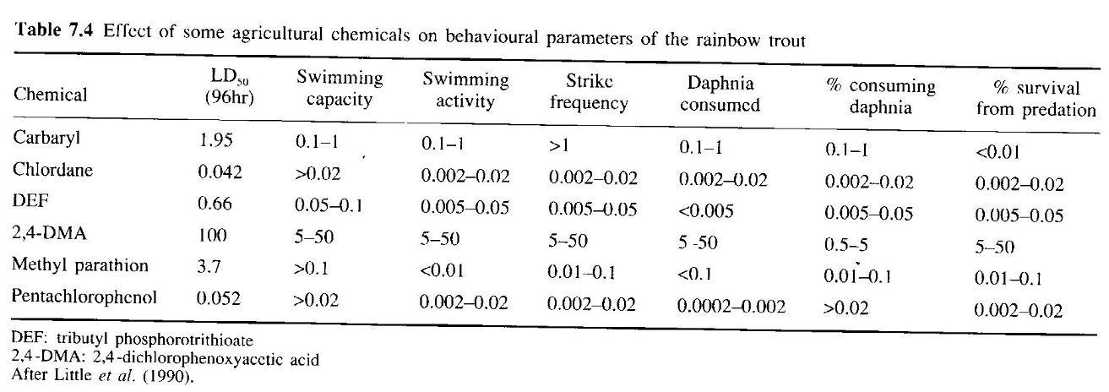
Examples of behavioral biomarkers
Concentrations affecting behaviour: often lower than LD50
→ early markers of lethal toxicity

Slide 5
Behavioral and clinical “biomarkers”
Interpretation
: are these really biomarkers ?
(effects already demonstrated in vivo)
= biomarkers of existing serious stress / intoxication
Parameters evaluated
body weight
food consumption
fitness & welness

Slide 6
(Histo)pathology biomarkers

Slide 7
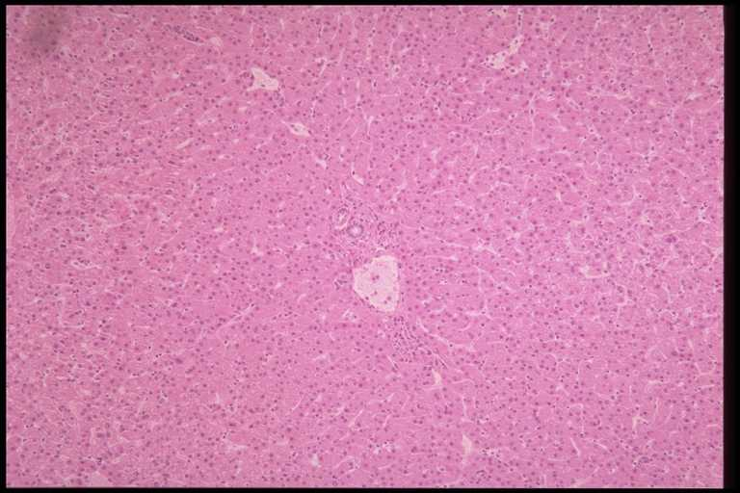
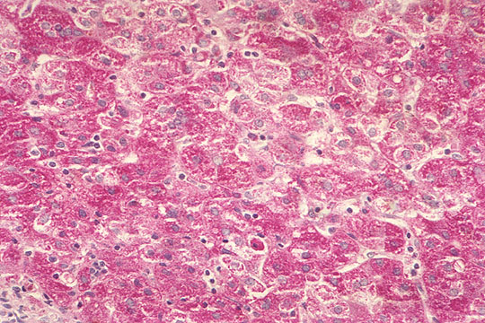
Pathology
(-) Destructive methods, Time consuming, Professional requirements
(+) High relevance – organ/tissue changes
1) microscopy of internal organs
A) observations of non-specific changes in internal organs
B) specific changes, e.g.
in liver (dioxin-like POPs, cyanobacterial toxins ..)
intersex / imposex formation (xenoestrogenicity)
Example: Liver damage by cyanobacterial toxins microcystins

Slide 8
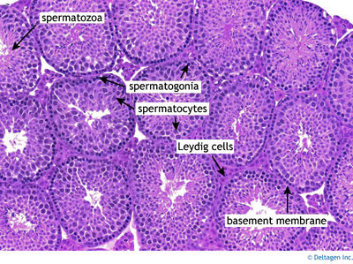
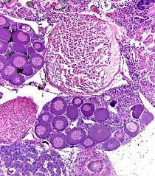
Endocrine disruption: Intersex microscopy
Oocytes within testis
Testicular tissue

Slide 9
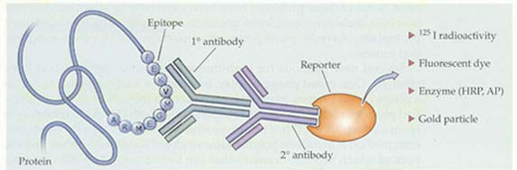
2) immunohistochemistry & microscopy
: determination of “specific” changes in tissues
: Fluorescein (FITC) - labeled antibodies (Ab) applications
Example → toxicant induced autoimmunity:
anti-nuclear Ab (ANA test)

Slide 10
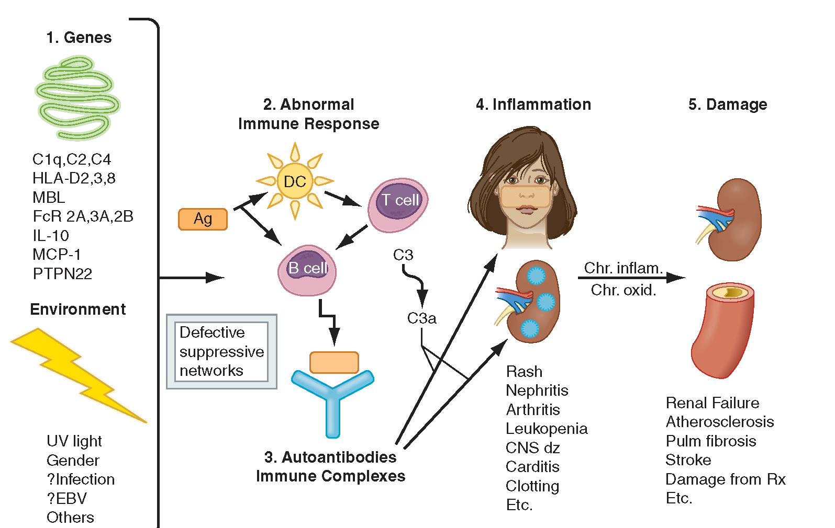
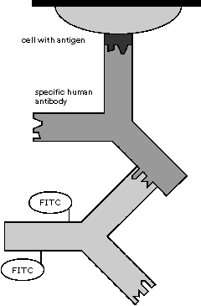
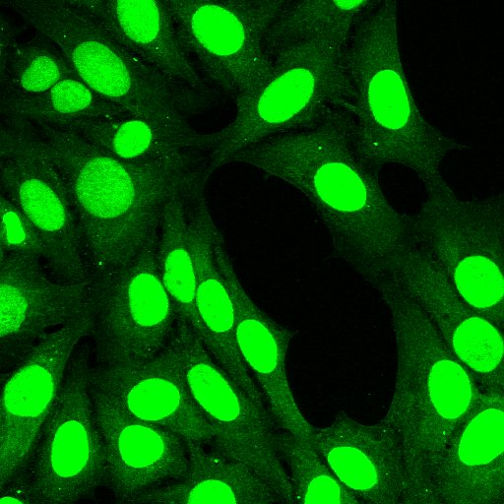
2) immunohistochemistry & microscopy
anti-nuclear Ab (ANA test)
ANA test
* Determination of antibodies in patient blood acting against “nuclei” proteins (ANA)
: target: permeated liver cells on slide
: application of blood (Ab)
: visualization (secondary Ab)
Systemic lupus

Slide 11
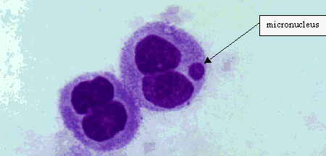
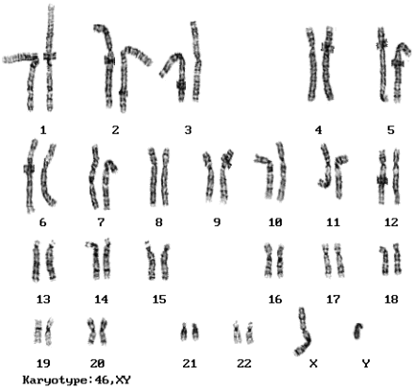
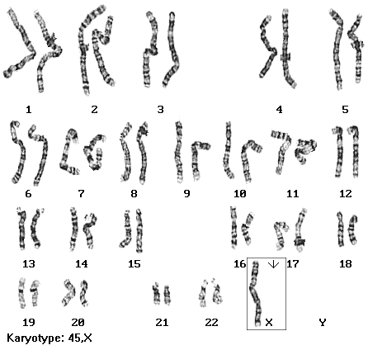
Pathology
3) Nuclear DNA damage characterization
- micronuclei evaluation by microscopy
- chromosomal abnormalities
karyotype biomarkers (human genetic disorders)

Slide 12
Standard clinical chemistry
& hematology biomarkers

Slide 13
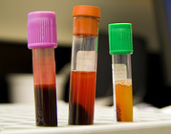
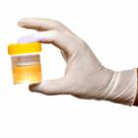
Clinical chemistry & hematology
Non-destructive (BLOOD, URINE sampling)
Multipe parameters can be measured
- responses to various types of stresses (including toxic stress)
- „normal“ value ranges known for humans, rats and few other species
(limited use as biomarkers in other organisms)
Blood analyses
- chemistry and biochemistry
- cells (hemogram)
Urine analyses
- chemistry, cells, bacteria etc.

Slide 14
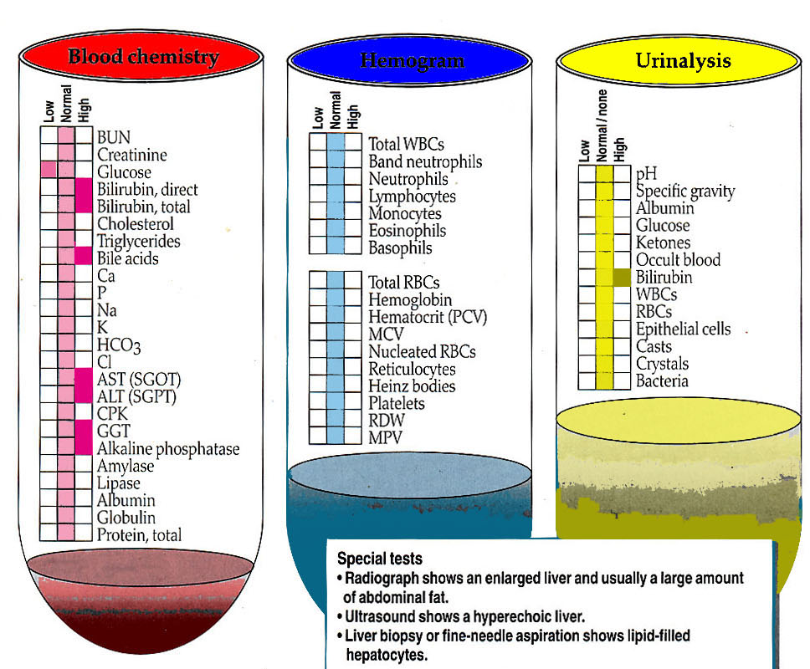
Example: intoxication & liver damage
→ change in biomarker profiles in blood chemistry and urine
→ Further assays possible:

Slide 15
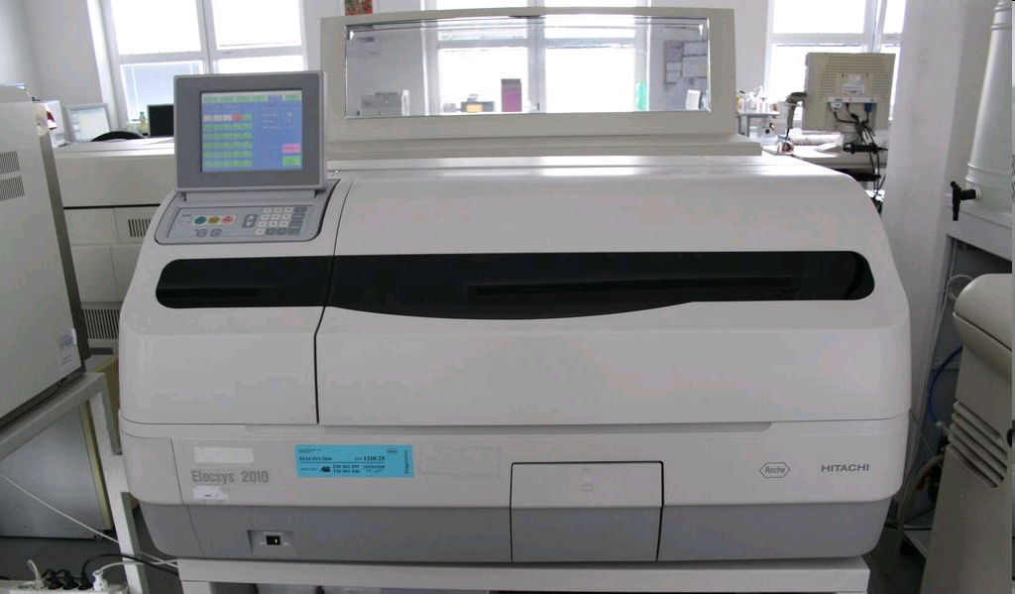
Methods in clinical chemistry
Methods:
- automatic biochemical and hematological analyzers
- different „analytes”: various principles of methods (see example →)

Slide 16
Methods in clinical chemistry
Example
- determination of enzymatic activities in blood
- interpretation: tissue/organ-specific damage damage
Examples (toxicological studies)
  Liver damage (toxicants, POPs, alcohol)
    AST (Aspartate aminotransferase),
    ALT (Alanine aminotransferase) in blood
  General damage in cell (tissue non-specific)
    LDH - lactate dehydrogenase
  Muscle damage:
    creatine kinase in serum (isozymes - tissue specific – muscle vs heart);
Other enzyme biomarkers→ see further

Slide 17
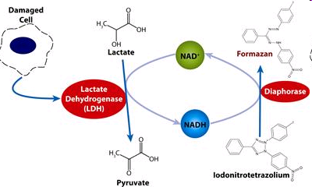
Methods in clinical chemistry: example LDH analysis
Done in automatic analyzer:
Blood sample + addition of (NAD+ tetrazolium salt + diaphorase enzyme)
Incubation and spectrophotometry determination
Automatic evaluation → final value (LDH activity)
  → comparison with “limits” → highlighting for a doctor
Coloured product:
kinetic
spectrophotometry

Slide 18
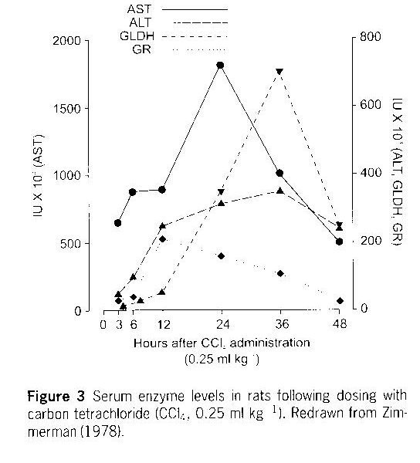
Example – changes in rat serum enzymes after CCl₄ exposure

Slide 19
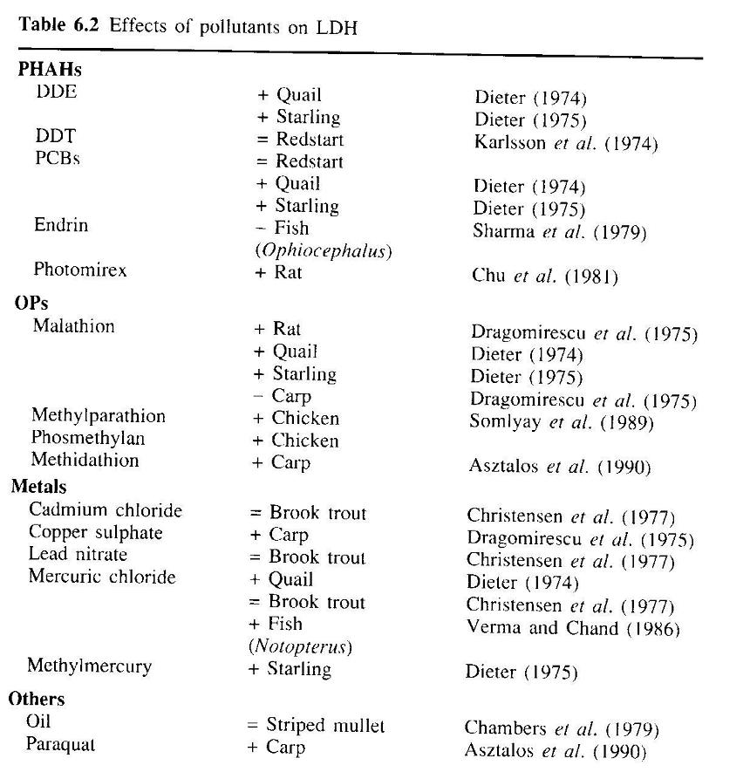

Slide 20
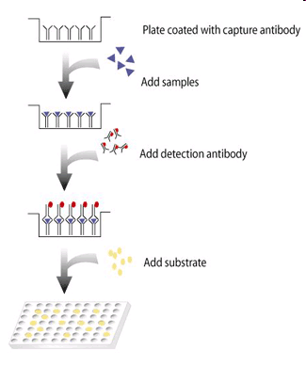
ESTABLISHED PROTEIN MARKERS – determination in blood
Tumor genes and tumor markers
- cancer genes ras, myc,
- α-fetoprotein (AFP)
- suppressor genes p53, Rb
Methods of determination in practice:
ELISA
(enzyme linked immunosorbent assays)

Slide 21
Changes in enzyme activities

Slide 22
Enzymatic changes
Biomarkers reflecting „enzyme changes“:
  Example biomarkers … inhibitions of
    AcChE (organo-phosphates)
    d-Aminolevulinic Acid Dehydratase (ALAD) (lead - Pb)
    Proteinphosphatases (microcystins)
  Inductions of detoxication & oxidative stress enzymes
  (hepatopancreas / liver / blood)
    MFO [CYP classes - EROD / MROD / BROD
    Phase II enzymes (GSTs)
    Glutathion metabolism enzymes (GPx, GRs)
(+) Rapid enzymatic assays, specific responses
(-) Some ~ EXPOSURE biomarkers

Slide 23
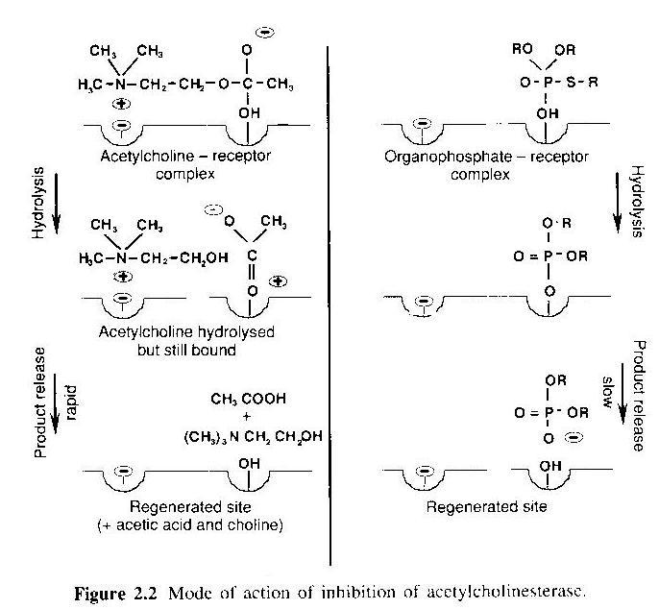
Reminder: AcChE inhibition mechanism

Slide 24
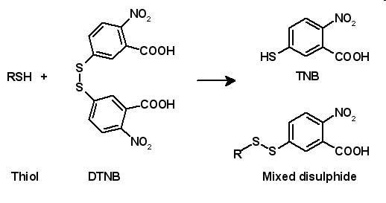
AcChE assessment
Model Substrate (butyryl-thio-choline, acetyl-thio-choline)
- cleaved by AcChE → formation of free –SH groups
- reaction of SH with thiol reactive probe = Ellman´s reagent (DTNB)
→ DTNB-S-choline: yellow colour (spectrophotometry A420)
Spectrophotometry

Slide 25
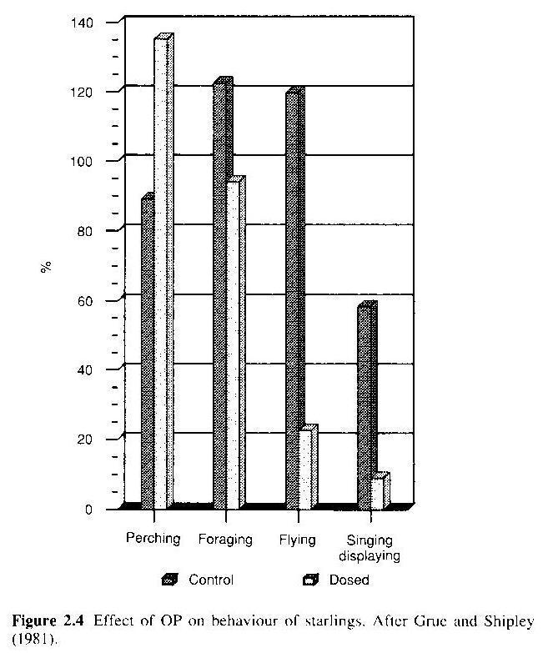
Changes in AcChE in birds after exposure to organophosphates

Slide 26
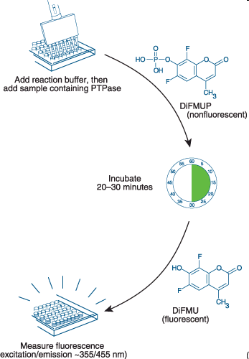
Proteinphosphatase inhibition assay
Model substrates cleaved by PPase
  ³²P-labelled protein → free ³²P radioactivity
  6,8-difluoro-4-methylumbelliferyl phosphate → fluorescence

Slide 27
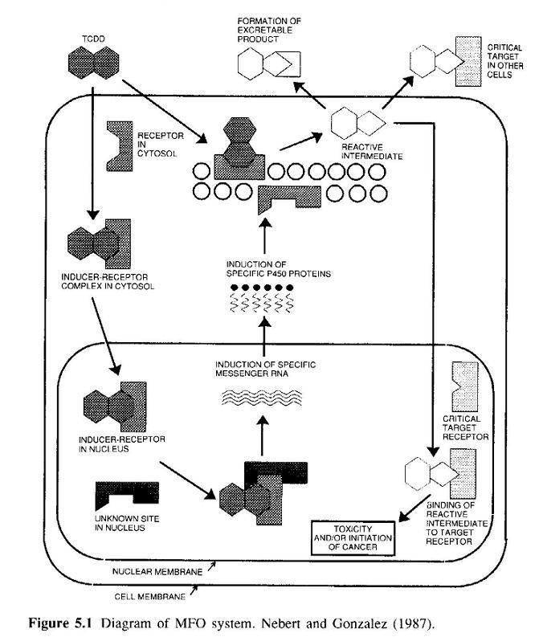
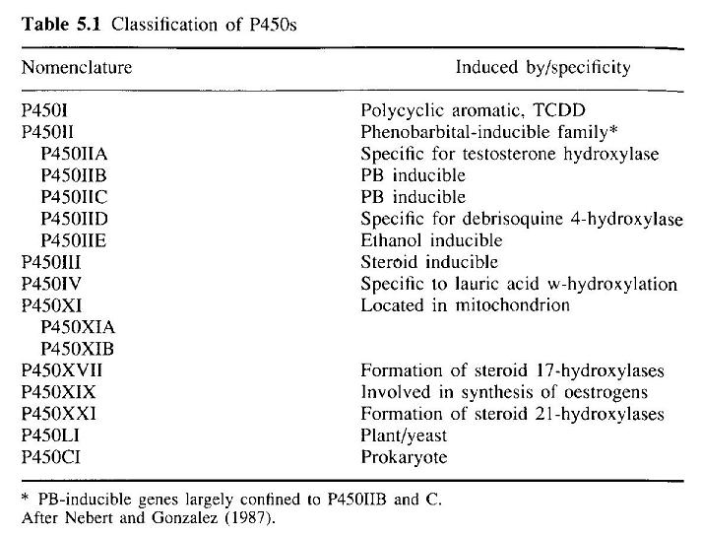
MFO (CYPs) - reminder

Slide 28

Assessment of CYPs – “EROD”
Determination of CYP1A1 activity
“EROD” - EthoxyResorufin-O-Deethylase activity
Substrate: Ethoxyresorufin
: Oxidation by CYP1A1
→ Fluorescence (easy determination)
EROD = sensitive biomarker of organic pollution (exposure & effects)
: AhR-activating compounds (PCDD/Fs, PCBs, PAHs)
: often used in environmental studies
Use of other substrates: assessment of other CYPs
BROD – butoxy-ROD (CYP3A), MROD, PROD …

Slide 29
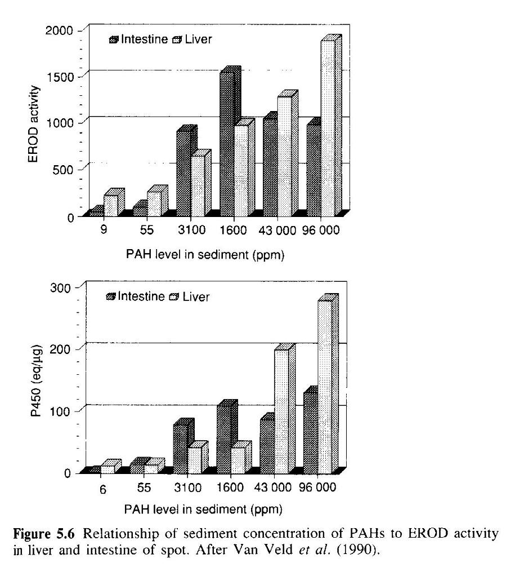

Slide 30
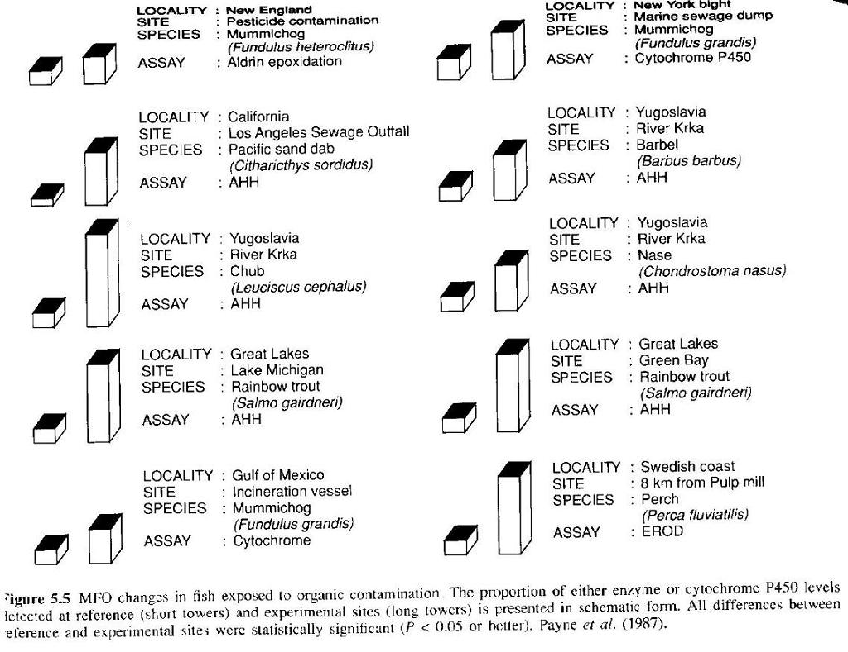
Locality:
Reference Exposed

Slide 31
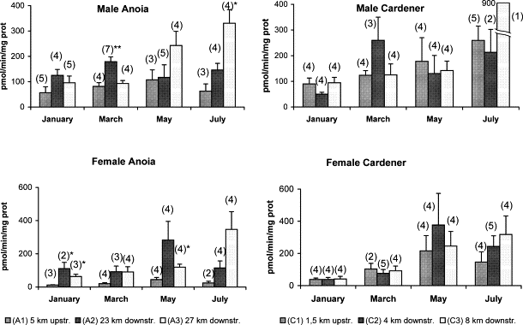
EROD variation on male and female carp from the Anoia and Cardener tributaries
– seasonal variability & response at contaminated localities

Slide 32
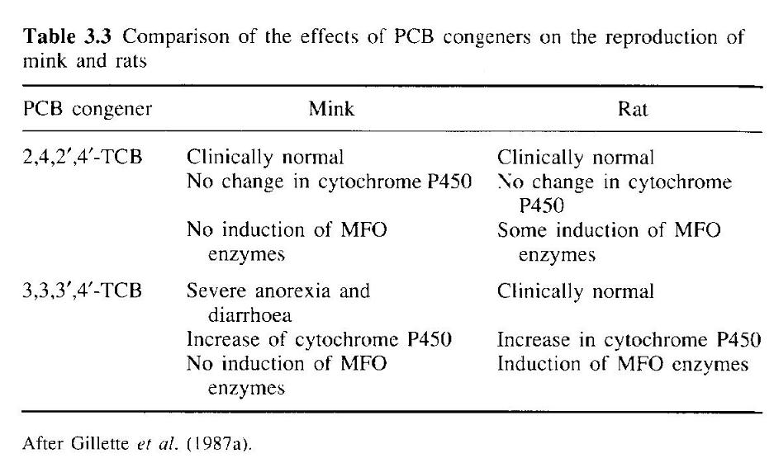
MFO responses are strongly species specific
& not always related to clinical signs

Slide 33
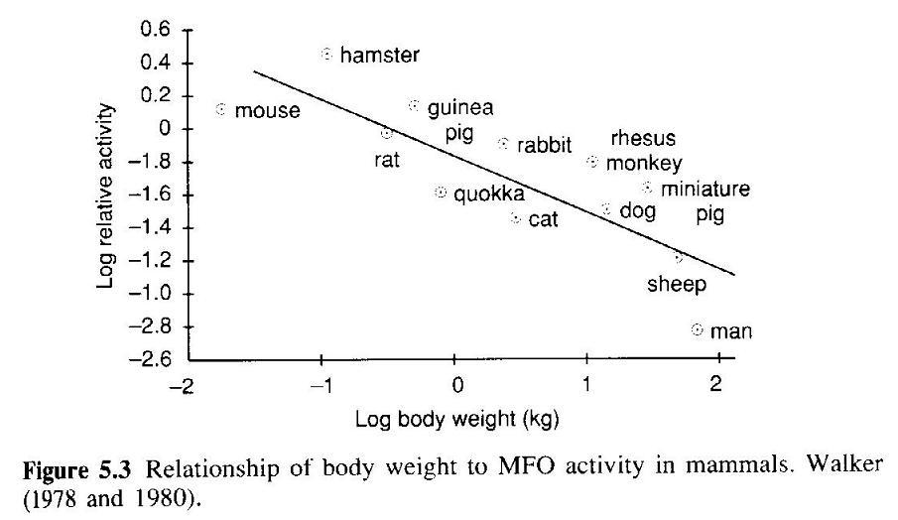
MFO-responses depends on animal size and metabolism rate

Slide 34
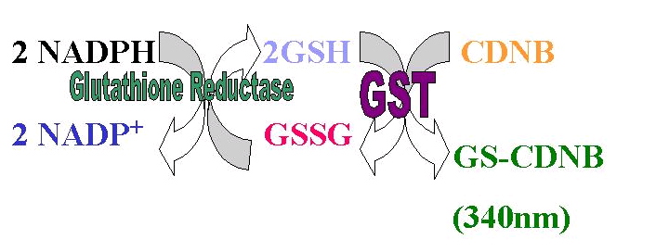
Phase II conjugation enzymes - GSTs
GSTs
soluble and membrane (endoplasmic reticulum) variants:
activities can be measured in cytoplasm or ER microsomes
Methods
Chemical reaction of
reduced GSH
+ thiol selective probe (CDNB)
GST
GSH + CDNB → GS-CDNB (formation of yellow product) kinetic or endpoint determination

Slide 35
GST activity determination: example
Kinetic assessment of GSTs
stress → Induction of GSTs
faster reaction = increasing slope of the kinetics

Slide 36
Biomarkers - protein expression

Slide 37
PROTEIN SYNTHESIS
Protein determination
- amount (concentration)
- activity (see enzymatic assays)
Amount quantification
- mRNA levels
- protein levels
- electrophoresis and Western-(immuno)blotting
- ELISA techniques
Examples of protein biomarkers
heat shock proteins (hsp90, hsp60, hsp 70, ubiquitin)
metalothioneins
Vitellogenin(-like) Vtg proteins in male
Aromatase

Slide 38
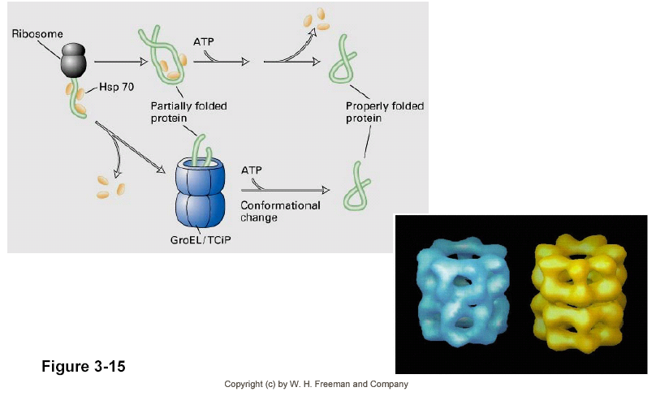
Heat Shock Proteins (hsp)
General stress = synthesis of new proteins
~ equilibrium and homeostasis buffering
- temperature (cold / heat) → proteins assuring cryo-preservation
- salinity & metals → ion buffering
- organic xenobiotics → detoxication
New proteins must be folded to their 3D stucture
by activity of „CHAPERONES“
Chaperons = hsp90, hsp60, hsp 70
~ 60-90 kD molecular weight kD

Slide 39
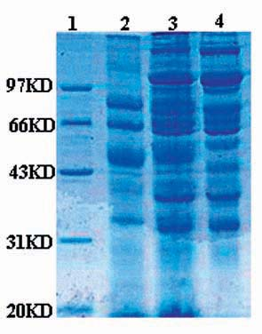
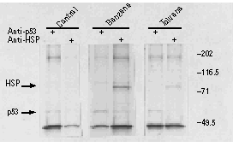
HSP determination - example
HSP = GENERAL STRESS biomarker, non-specific
- phylogenetically conserved (similar genes in most of the organisms)
- structural similarity → easy determination:
electrophoresis + immunoblotting (Western blotting)

Slide 40
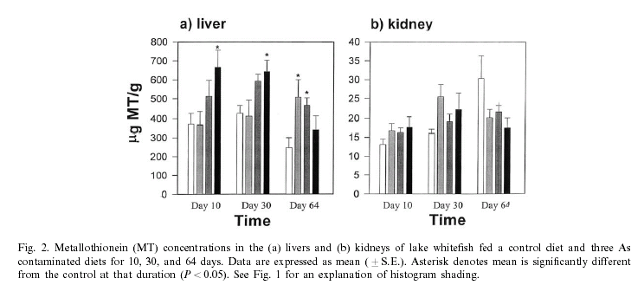
Metalothioneins (MTs, MT-like proteins)
Low MW proteins (6-10 kD) rich of Cystein (-SH)
detected in numerous eukaryotic organisms
induced in the presence of metals or less specific stress (low O2, T)
long halflife (~ 25 days)
binding of divalent metals (Zn, Cd, Hg) → exposure elimination
- natural function (?) – regulation of essencial metals in cells

Slide 41
Protein biomarkers of estrogenicity
ER = transcription factor controling number of target genes
Target genes of ER = biomarkers of estrogenicity
Major examples
  Vitellogenin
  Aromatase - CYP19A

Slide 42
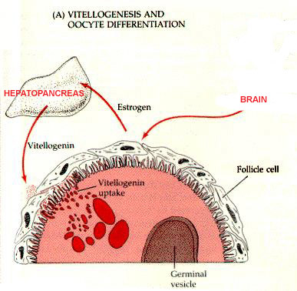
Vitellogenin (Vtg)
Precursor of yolk proteins, phospho-protein („energy“ rich)
→ egg formations (females) at oviparous animals
Synthesized in liver and distributed via blood / haemolymph
Xenoestrogens & other endocrine disruptors
→ increased levels or early production in FEMALES
→ production de novo in MALES

Slide 43
Vitellogenin (Vtg) assessment
ELISA in exposed organisms (F/M) or in vitro
(-) specific antibodies are necessary for each species
(low crossreactivity of Abs)
2) „Vitelin-like proteins“
- total amount of „alkali-labile“ phosphate in haemolymph (mussels)
alkaline extraction of P from sample → spectrophotometric determination

Slide 44
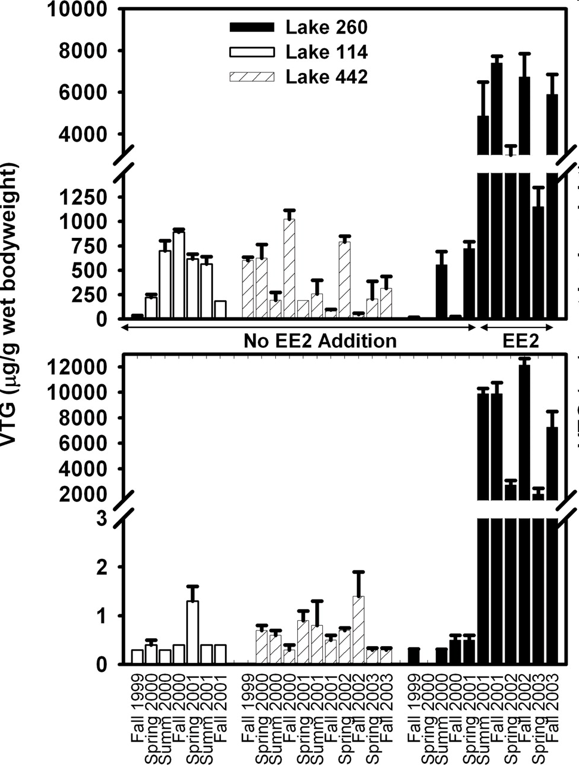
Vitellogenin in fish
FEMALE
Kidd et al. (2007) PNAS
Fig. 1. Mean ± SE (n = 4–7) VTG concentrations in whole-body homogenates of male (Lower) and female (Upper) fathead minnow captured in 1999–2003 from reference Lakes 114 and 442 and from Lake 260 before and during additions of 5–6 ng·L⁻¹ of EE2 (low catches of fish in Lake 260 in 2004 and 2005 did not allow for these analyses in the latter 2 years of the study).
MALE

Slide 45
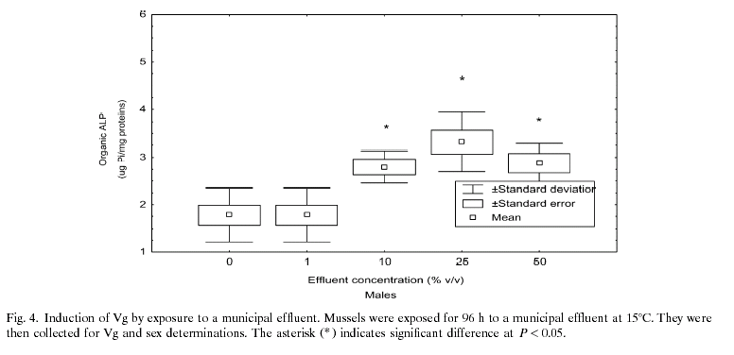
Vitelin-like proteins in mussels

Slide 46
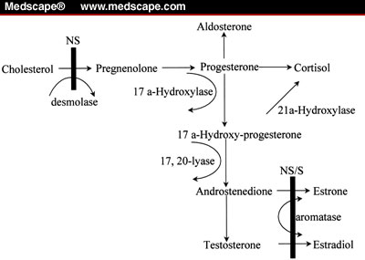
Aromatase (CYP19A)
- Levels inducible by estrogens
Catalyzes single enzymatic step
androgens → estrogens
Experimental assessment
(in reseach and practice)
1. PCR / Quantitative-Real-Time-PCR
2. GM-organisms (zebrafish): reporter gene with GFP
Green Fluorescence Protein under the control of aromatase promoter

Slide 47
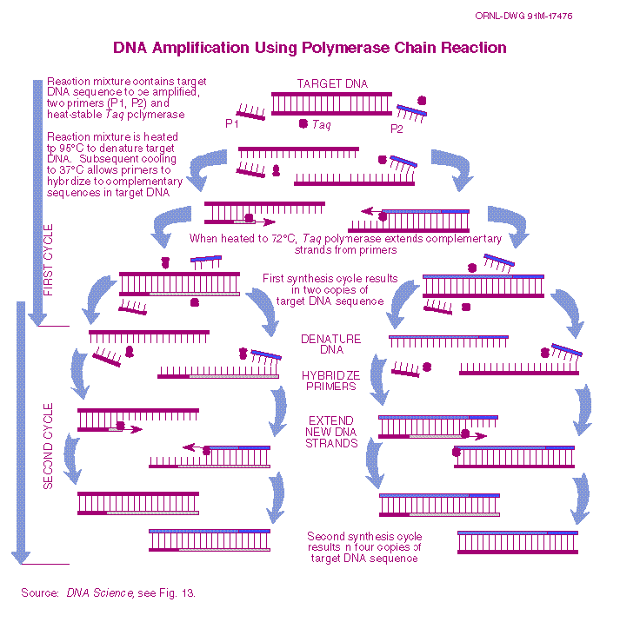
PCR principle

Slide 48
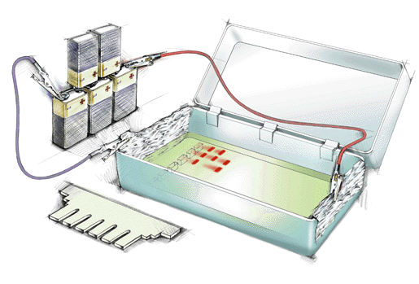
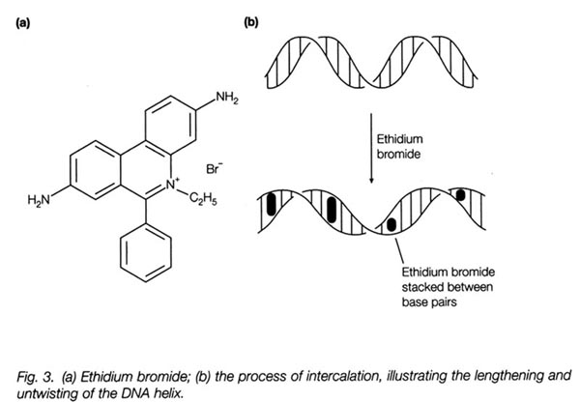
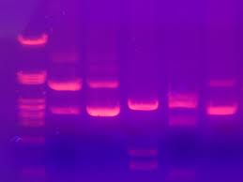
Visualization of PCR product
Electrophoresis (qualitative)
Intercalation dyes
– e.g. ethidium bromide

Slide 49
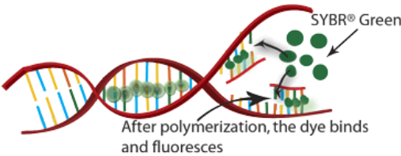
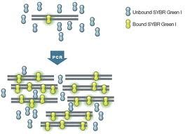
Visualization of PCR product
2a) Real-time (quantitative)
SYBR GREEN dye
more DNA synthesized,
more fluorescent dye incorporated
  Higher fluorescence

Slide 50
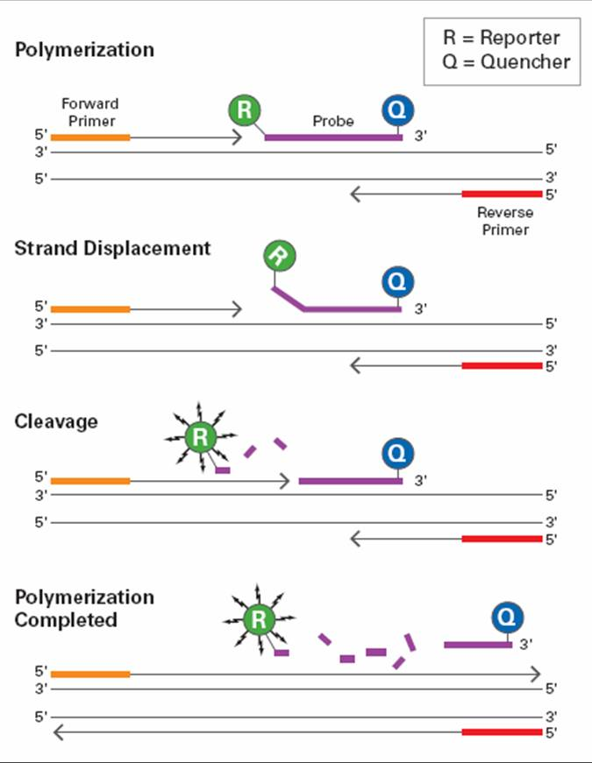
Visualization of PCR product
2b) Real-time (quantitative)
TaqMan probes
(more DNA replications
more fluorescent dye released)

Slide 51
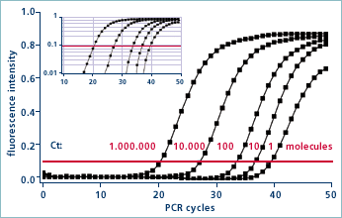
Principle of “quantitative” PCR

Slide 52
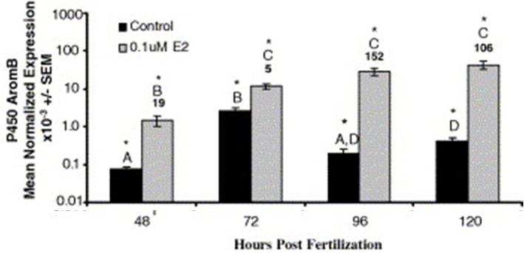
qPCR determination of the aromatase gene in Zebrafish
http://dx.doi.org/10.1016/j.ygcen.2005.12.010,

Slide 53
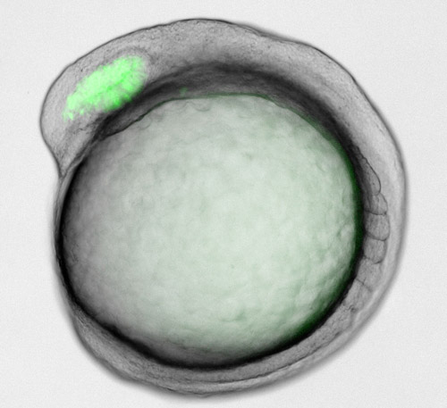


GFP-reporter for estrogens in zebrafish embryo
http://endo.endojournals.org/content/152/7/2542.full

Slide 54
Biomarkers of oxidative stress

Slide 55
Oxidative stress markers
Several parameters respond to oxidative stress
: enzymes – detoxification, antioxidants: GPx, GR, GSTs) ..
- enzymatic activities (see elsewhere)
: antioxidants – e.g. GSH (discussed further), vitamin E
: markers of oxidative damage
- membranes: MDA (discussed further)
- DNA: 8OH-dG (see at DNA damage / adducts)
- proteins: oxidized forms (carbonyls)

Slide 56

Oxidative stress markers
GSH
- antioxidant (scavenger of ROS) & reactive molecules
- conjugation molecules for detoxication
- probable intracellular regulatory molecule (? apoptosis ?)
Total glutathione = reduced GSH + oxidized GSSG
Method of determination
GSH + Ellman´s reagent (DTNB) → Reduced GSH
GSH + GSH-reductase + DTNB → Total GSH
Total – Reduced = Oxidized

Slide 57

Example - GSH modulation by toxic nanoparticles
Bláhová et al. 2014 Anal Bional Chem 406:5867–5876

Slide 58

Markers of oxidative DAMAGE

Slide 59

Lipid peroxidation → Malondialdehyde (MDA)
MDA – malondialdehyde
product of lipid peroxidation

Slide 60

Malondialdehyde (MDA) determination
MDA – formed from oxidized membrane phospholipids
: determination:
- HPLC (instrumental)
- TBARS (spectrophotometric) method
TBARS – ThioBarbituric Acid Reactive Species
: less specific than HPLC
: easy determination (spectrophotometry)
Method:
1) sample extract (with MDA)
2) add TBA
3) boil (cca 30´ / 90°C)
→ formation of red/violet coloured product
4) determination by spectrophotometry (A 540 nm)
TBA

Slide 61


MDA modulation - examples
Effects of nanoFeOxide particles on MDA in fish
Induction of MDA (TBARS) by carbamazepine (and protection by antioxidants)

