Slide 1
lecture 0 - Introduction
Programming in geoinformatics
Autumn 2015

Slide 2



VISION - “Not everyone can be a programmer” ?
http://www.makeuseof.com/tag/6-signs-meant-programmer/ - Final Thoughts
http://programmers.stackexchange.com/questions/163631/has-not-everyone-can-be-a-programmer-been-studied

Slide 3
VISION - objectives
IT - a place for everyone?
outside of IT:
science
journalism
data analyses
services
mechanical engineering
...
programming in geoinformatics - a basic course?

Slide 4
PROGRAMMING LANGUAGES (IN GEOINFORMATICS)
why python?
“Is it true that once you learn one language most of the rest come easy?” (http://programmers.stackexchange.com/questions/108578/is-it-true-that-once-you-learn-one-language-most-of-the-rest-come-easy)
what is next?

Slide 5

PROGRAMMING LANGUAGES IN GEOINFORMATICS
C / C++
extremely fast
low-level
most of software written in C++ (ArcGIS, QGIS)
big desktop applications
not so easy for “everyday-use” problems

Slide 6
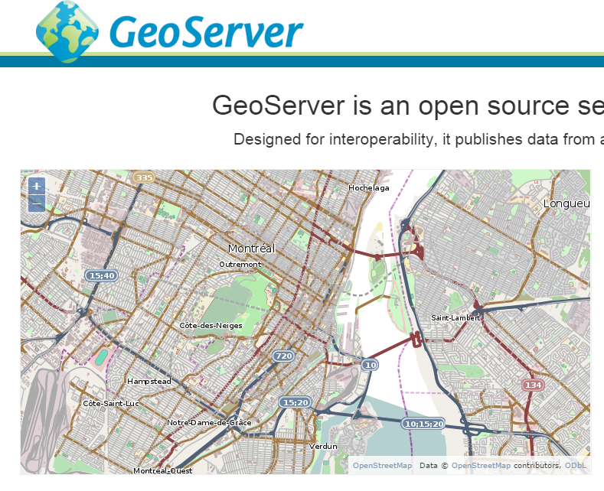
PROGRAMMING LANGUAGES IN GEOINFORMATICS
Java / C#
C# - “Microsoft version of Java”
mostly desktop application, servers, databases
Java - Android
JTS, GeoServer

Slide 7
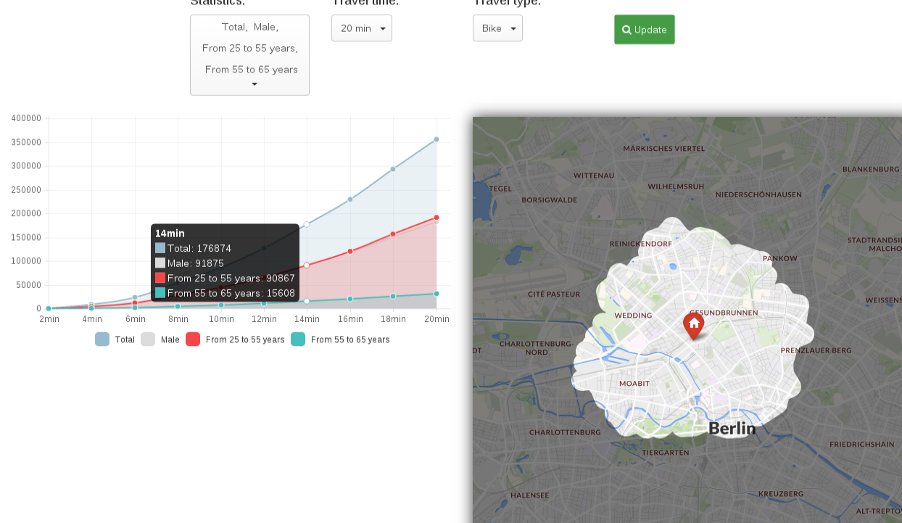
PROGRAMMING LANGUAGES IN GEOINFORMATICS
Javascript
primary client-side web applications
server side (node.js, io.js), desktop, mobile (phonegap, react.native), …
cartography - visualization and sharing
leaflet.js
turf.js
openlayers
google maps
no-sql databases (mongodb, couchdb)
...

Slide 8
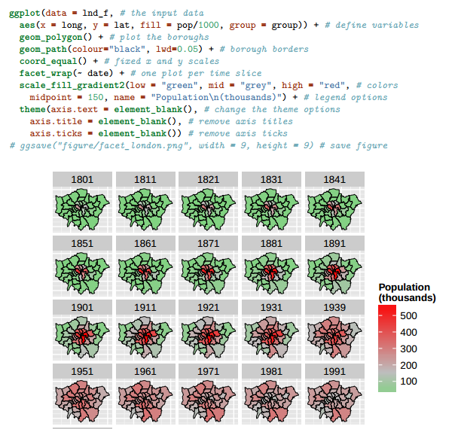
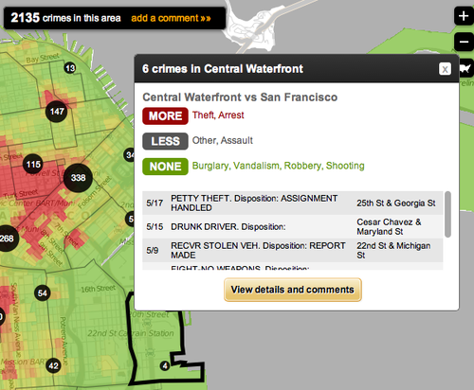
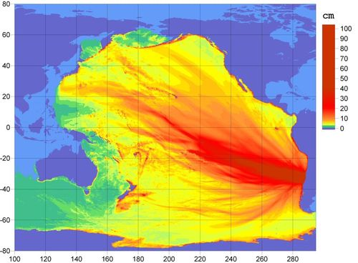
PROGRAMMING LANGUAGES IN GEOINFORMATICS
R
designed by statisticians, for statisticians (?)
created primary for (big) data analysis
  implemented statistical methods
  creating graphs, visualizations, maps…
  shiny - web applications

Slide 9
PROGRAMMING LANGUAGES IN GEOINFORMATICS
Python
universal language - lot of possibilities
  in geoinformatics:
    ArcGIS scripting - automatization of processes
    visualization and mapping
    processing data
    ...
easy to learn
“scientific language”
web applications, servers, desktop
UNIX
python 2 v 3 ! ( http://sebastianraschka.com/Articles/2014_python_2_3_key_diff.html )

Slide 10
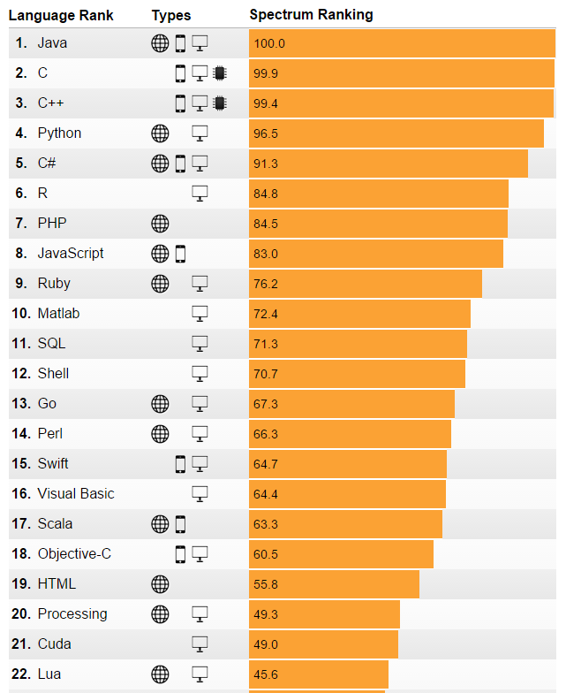
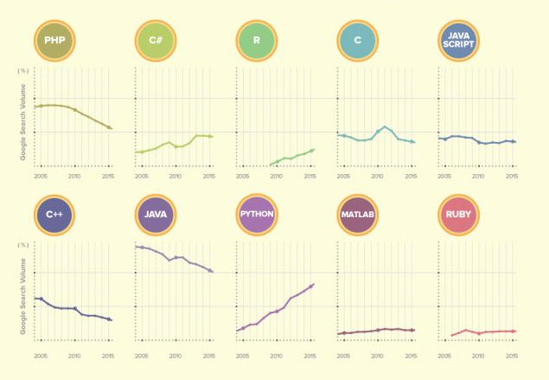
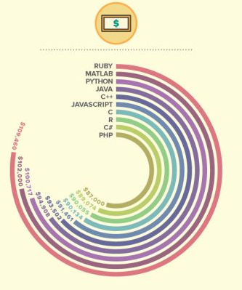
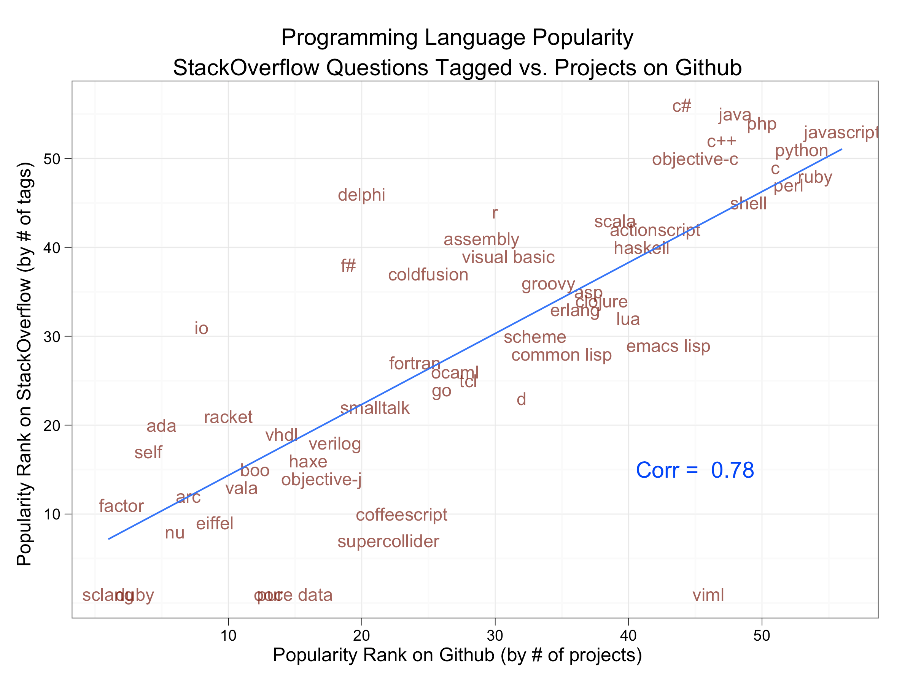
PROGRAMMING LANGUAGES IN GEOINFORMATICS
Summary
http://gis.stackexchange.com/questions/61221/what-programming-languages-are-used-by-different-gis-platforms
http://www.atlefren.net/post/2015/04/gis-programming-languages-breakdown/
http://www.quora.com/Which-programming-language-is-best-for-geographical-information-system-GIS-software
http://cdn-media-2.lifehack.org/wp-content/files/2015/07/e25a76a815e29c38d88f1035629b7eaa-2.jpg

Slide 11
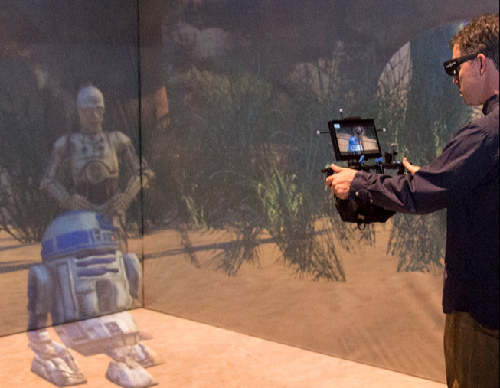
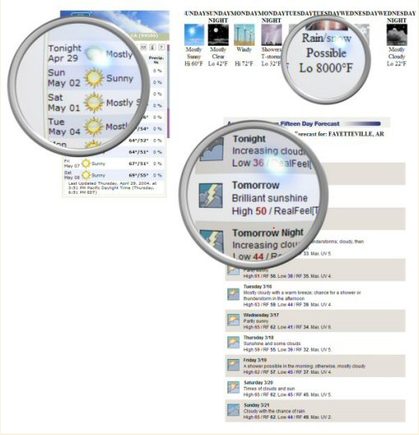
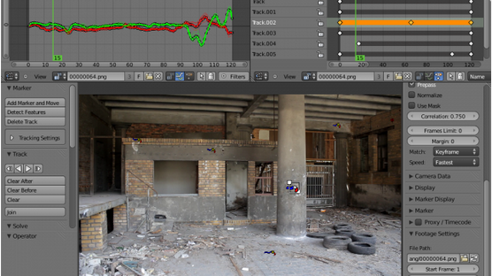

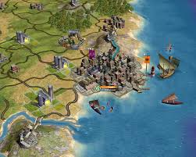
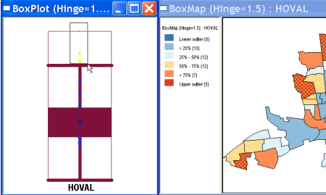

MOTIVATION - Python is everywhere
https://www.python.org/about/success/, https://wiki.python.org/moin/Applications

Slide 12
MOTIVATION - Solving problems
import os,os.path,shutil
import osgeo.ogr
import shapely.wkt
shapefile = osgeo.ogr.Open("TM_WORLD_BORDERS-0.3.shp")
layer = shapefile.GetLayer(0)
thailand = None
myanmar = None
for i in range(layer.GetFeatureCount()):
feature = layer.GetFeature(i)
if feature.GetField("ISO2") == "TH":
geometry = feature.GetGeometryRef()
thailand = shapely.wkt.loads(geometry.ExportToWkt())
elif feature.GetField("ISO2") == "MM":
geometry = feature.GetGeometryRef()
myanmar = shapely.wkt.loads(geometry.ExportToWkt())
commonBorder = thailand.intersection(myanmar)
if os.path.exists("common-border"):
shutil.rmtree("common-border")
os.mkdir("common-border")
spatialReference = osgeo.osr.SpatialReference() spatialReference.SetWellKnownGeogCS('WGS84')
driver = osgeo.ogr.GetDriverByName("ESRI Shapefile")
dstPath = os.path.join("common-border", "border.shp")
dstFile = driver.CreateDataSource(dstPath)
dstLayer = dstFile.CreateLayer("layer", spatialReference)
wkt = shapely.wkt.dumps(commonBorder)
feature = osgeo.ogr.Feature(dstLayer.GetLayerDefn()) feature.SetGeometry(osgeo.ogr.CreateGeometryFromWkt(wkt))
dstLayer.CreateFeature(feature)
feature.Destroy()
dstFile.Destroy()
automatization of work
  tasks that could be repeated
  tasks that are boring,...
  creating interactive tool for solving task
diploma thesis,
getting data,
parsing data,
visualization,
...
Calculate the border between Thailand and Myanmar
(WESTRA - Python Geospatial Development)

Slide 13
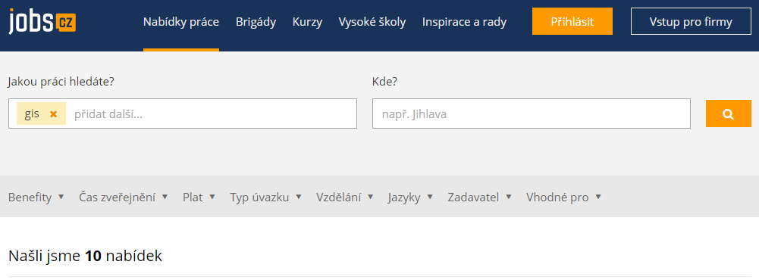
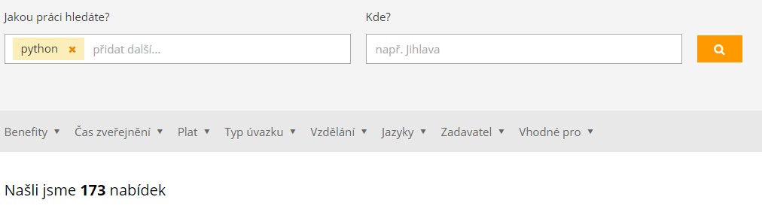
MOTIVATION - Getting jobs

Slide 14
COURSE - conditions and grading system
7 short exams (+- 5 questions) for -2 to +1 points
2 tests (with internet) for 0 to 10 points and 0 to 10 points
1 team project for 0 to 20 points
grading (required min. 5 points from team project):
0 - 17 F
18 - 24 E
25 - 28 D
29 - 32 C
33 - 36 B
37+ A

Slide 15
COURSE - organization
Monday 9:00 - 13:00 Z7
05. 10. 2015 - Variables, basic commands, basic data structures
12. 10. 2015 - Conditions, lists, cycles (+ exam)
19. 10. 2015 - Tuples, dictionaries, sets, functions (+ exam)
26. 10. 2015 - Reading/writing files, exceptions, repeating (+ exam)
02. 11. 2015 - Libraries - numpy, pyqt, request (+ exam)
09. 10. 2015 - Test 1
16. 10. 2015 - Visualization (+ exam)
23. 10. 2015 - Handling data (+ exam)
30. 10. 2015 - QGIS / arcGIS scripting (+ exam)
07. 12. 2015 - Test 2
14. 12. 2015 - Project presentations

Slide 16
COURSE - organization
Homeworks
not graded, optional
solutions in IS later
Team project
team ~ 3 people
presentation
protocol
documented code
Absence
send mail before
Short exams
at the beginning of the lesson

Slide 17
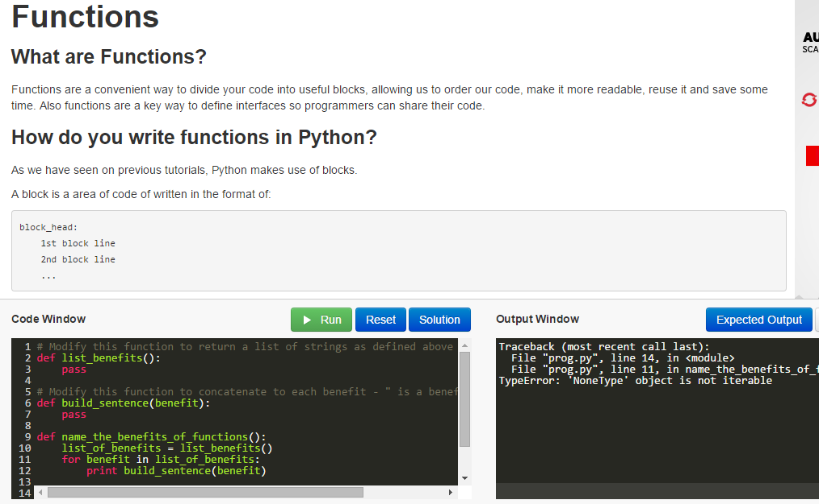
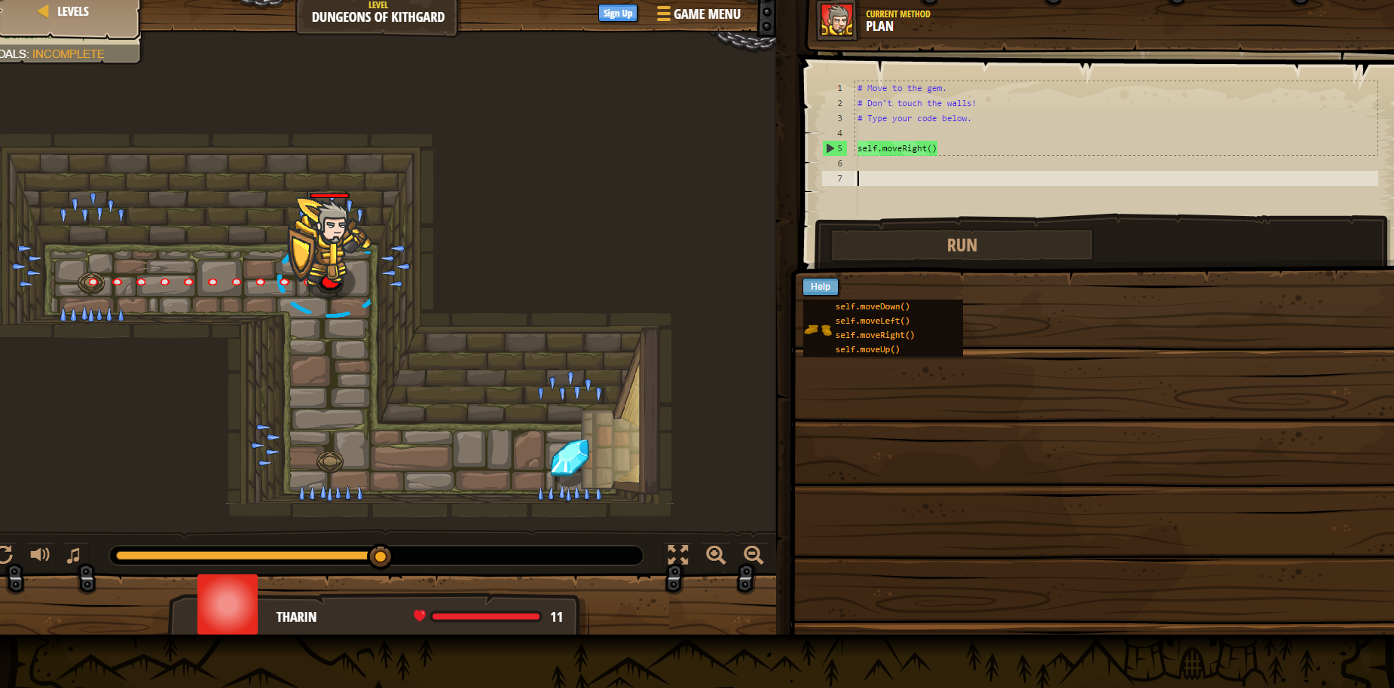
WHERE TO LEARN
Online
codeacademy - https://www.codecademy.com/en/tracks/python
learn python - http://www.learnpython.org/
learn python the hard way - http://learnpythonthehardway.org/book/index.html
python scientific lecture notes - http://scipy-lectures.github.io/index.html
pyQGIS - http://docs.qgis.org/testing/en/docs/pyqgis_developer_cookbook/
tutorialspoint - http://www.tutorialspoint.com/python/
Python course - http://www.python-course.eu/course.php
http://www.learnpython.org/
https://codecombat.com/play

Slide 18
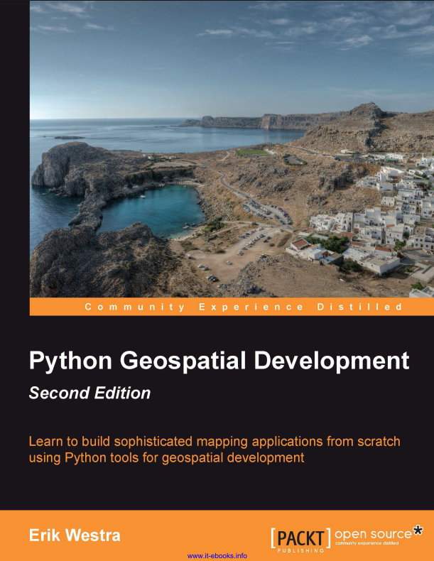
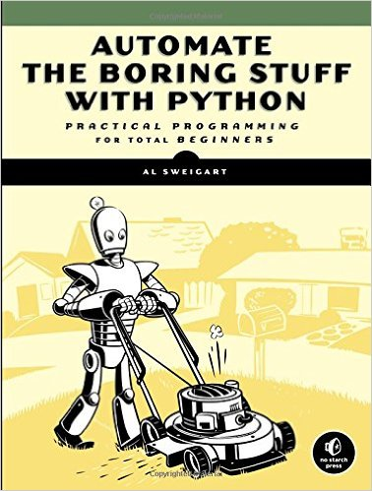
WHERE TO LEARN
Ebooks
SWAROOP - A Byte of python (http://www.mybridge.co/view/5668)
SWEIGART - Automate the boring stuff with Python (https://automatetheboringstuff.com/)
SEVERANCE - Python for Informatics (http://do1.dr-chuck.com/py4inf/EN-us/book.pdf)
LAWHEAD - Learning Geospatial Analysis with Python
WESTRA - Python Geospatial Development (http://www.allitebooks.com/python-geospatial-development)
MCKINNEY - Python for Data Analysis (http://www.cin.ufpe.br/~embat/Python%20for%20Data%20Analysis.pdf)

Slide 19
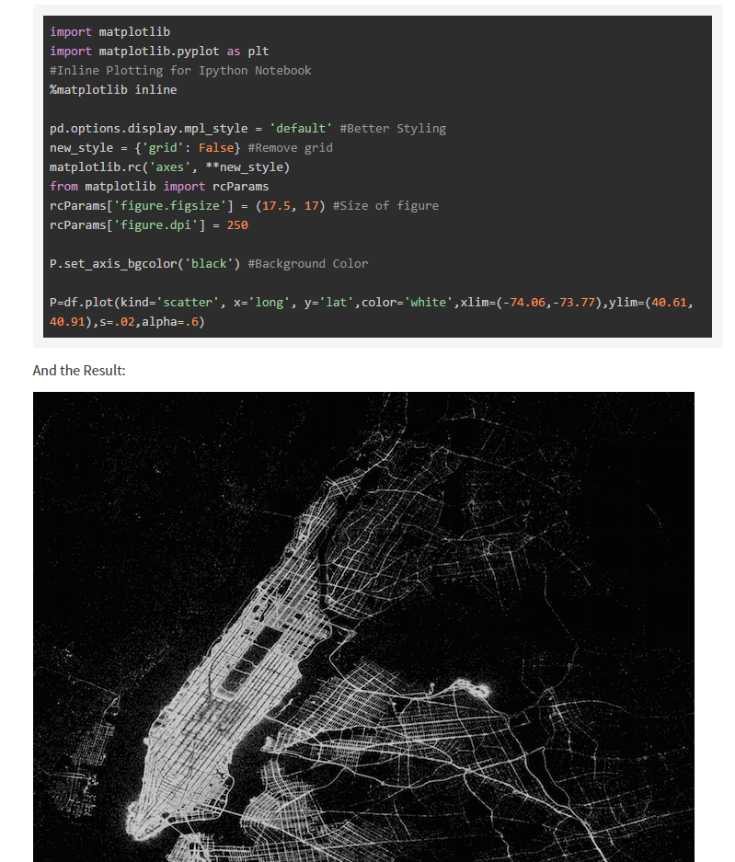
WHERE TO LEARN
Blogs, Social, Communities
http://stackoverflow.com / gis.stackexchange.com
http://www.python.cz
http://geospatialpython.com/ - Points, Polylines, Polygons, Pixels, Python!
http://jakevdp.github.io/ - Musings and ramblings through the world of Python and beyond
http://www.danielforsyth.me/
http://nbviewer.ipython.org/ - A simple way to share Jupyter Notebooks
http://www.analyticsvidhya.com/blog/category/python-2/ - Learn everything About Analytics
...

Slide 20

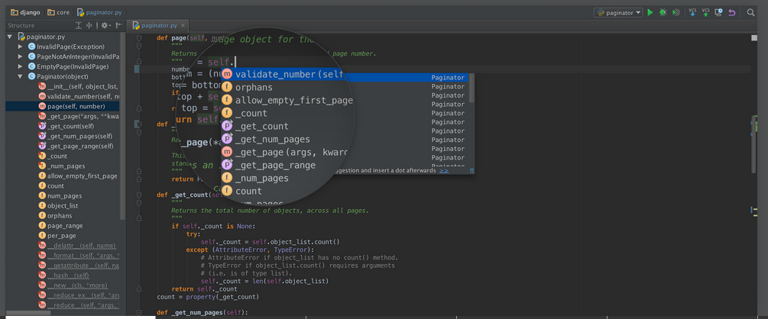
WHERE TO LEARN
Editors
pyzo - http://www.pyzo.org/
komodo IDE - http://komodoide.com/
sublime text - http://www.sublimetext.com/
pywin - http://sourceforge.net/projects/pywin32/files/pywin32/
pycharm - https://www.jetbrains.com/pycharm/
atom - https://atom.io/
learnpython - http://www.learnpython.org/
getdatajoy - www.getdatajoy.com
pyfiddle - http://pythonfiddle.com/

