Slide 1
Assessment of toxic effects
Ludek Blaha et al.

Slide 2
Outline
Why toxicity assessment
Who wants the assessment
When
Where the assessment is needed
What to assess for toxicity
How to assess toxicity
What if not do we need tests? alternatives …
?

Slide 3

1996 - Chemicals in the environment
Do you believe that chemicals in products sold to consumers have been proven safe?
Think again
most chemicals in modern use have simply not been tested for their impacts on
human, even very basic effects.
… what about the effects in nature, then ?
How we stand 20 years later?

Slide 4
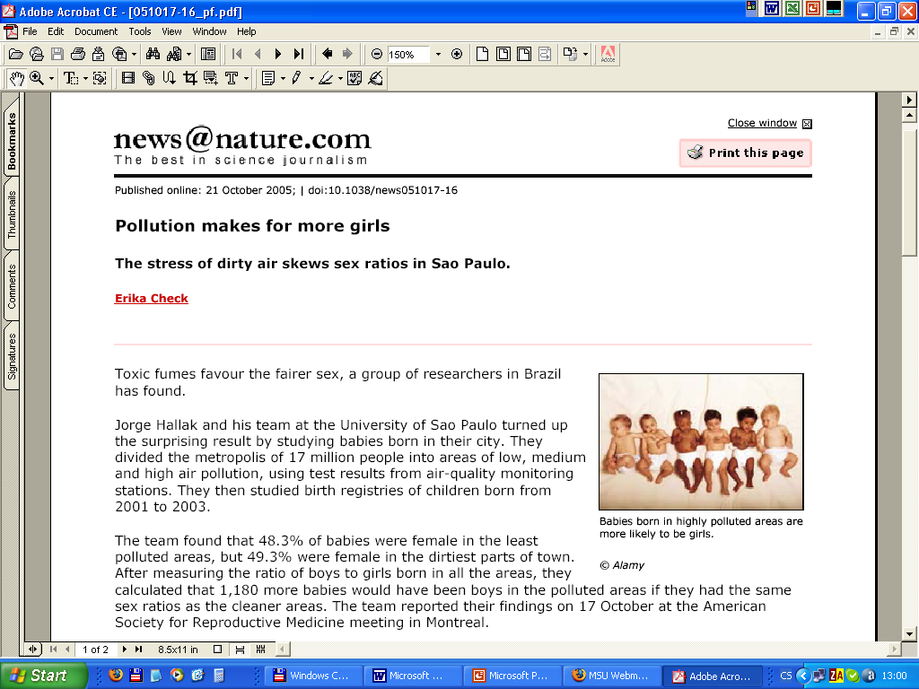

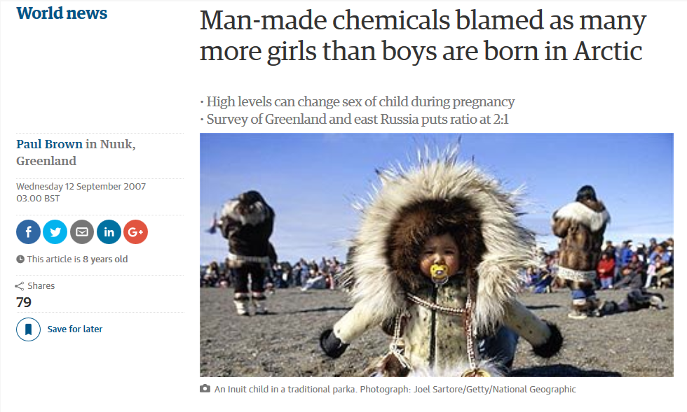

Slide 5
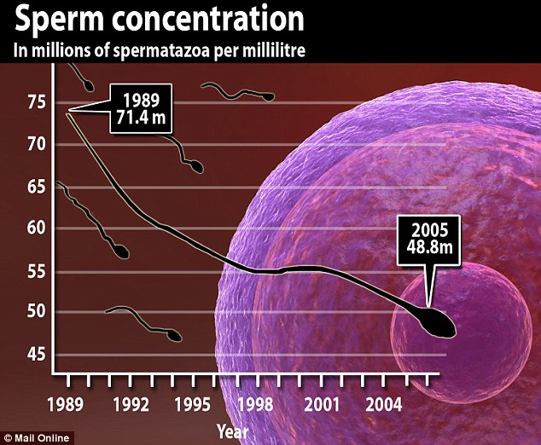
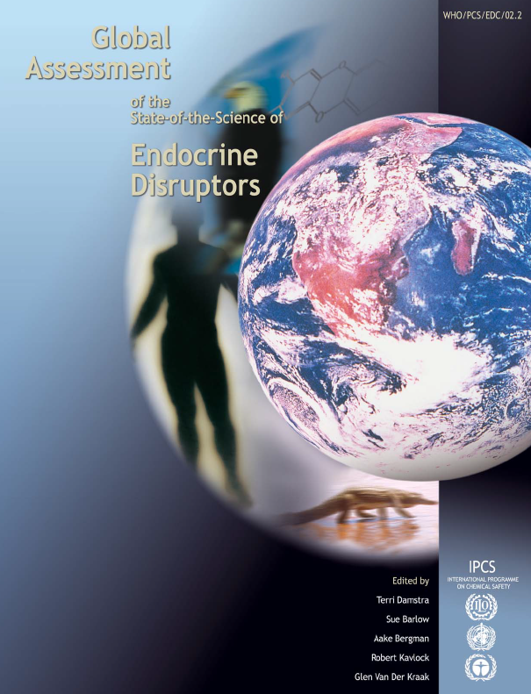

Slide 6



Impacts on biota → global effects
Mixing oceans
→ cooling the atmosphere
[Nature 447, p.522, May 31, 2007]
Marine life supplies up to 50% of the mechanical energy required worldwide to mix waters from the surface to deeper cool layers
[Dewar, Marine Res 64:541 (2006)]
[Katija a Dabiri, Nature 460:624 (2009)]

Slide 7
Who
wants the assessment ?

Slide 8


Who wants the toxicity assessment?

Slide 9
Who wants the toxicity assessment?
 | Researcher | Government
Goal | To understand with joy! | To survive (law or jail? $$ or hunger?)

Slide 10
Who wants the toxicity assessment?
 | Researcher | Government
Goal | To understand with joy! | To survive (law or jail? $$ or hunger?)
Approach | Why rules? | Strict and tough rules

Slide 11
Who wants the toxicity assessment?
 | Researcher | Government
Goal | To understand with joy! | To survive (law or jail? $$ or hunger?)
Approach | Why rules? | Strict and tough rules
Stakeholders | Any? (… other scientists?) | Many! Businesses … providing jobs People … wanting jobs but also health

Slide 12

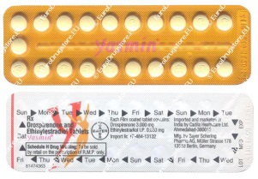
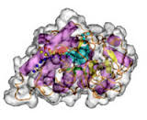
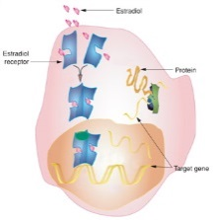
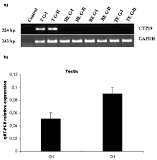


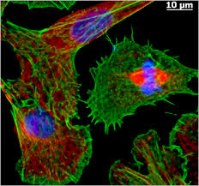

Scientific approach – EE2 (part 1/2)
1. Problem definition
2. Hypotheses!
Ethinylestradiol (EE2)
Estrogen
receptor?
in fish?
snails?
rabbits?
More proteins?
yolk? vitellogenin?
her2neu?
cyp19a?
More cell
proliferation?
cancer? gut?
stem cell?
Adverse effects?
Death?
Infertility?
Hyperactivity?

Slide 13

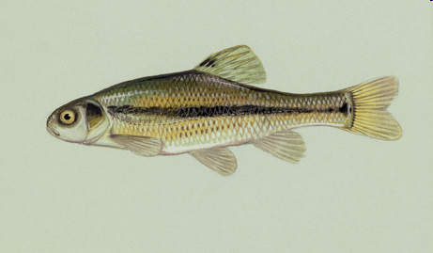
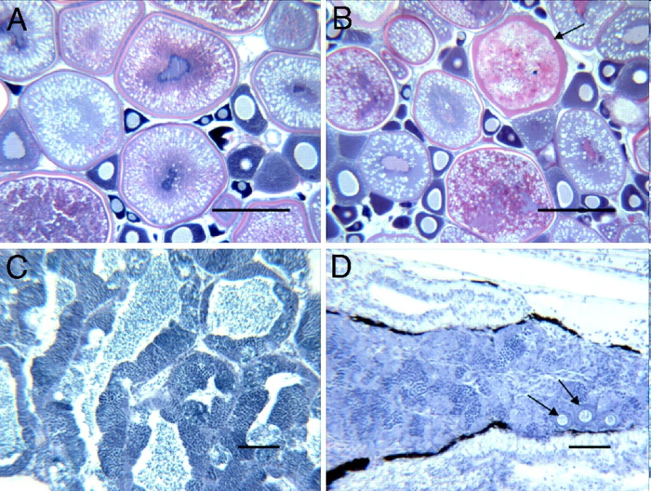
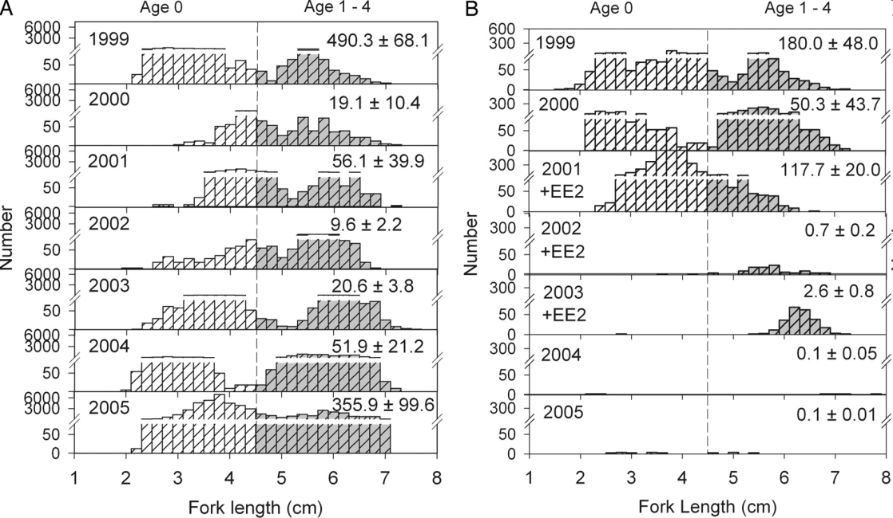
Scientific approach – EE2 (part 2/2)
Kidd, K.A. et al. 2007. Collapse of a fish population following exposure to a synthetic estrogen. Proceedings of the National Academy of Sciences 104(21):8897-8901
5 ng/L (!)
7 years
Controls +Ethinylestradiol

Slide 14
Regulatory approach: risk assessment and management
Hazard
Exposure assessment
Dose (or PEC)
Effect assessment
TDI (or PNEC)
Risk characterisation
RQ = Dose / TDI
(or PEC / PNEC)
RQ < 1
RQ > 1
Risk management

Slide 15

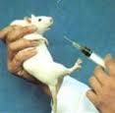

Regulatory approach: risk assessment and management
§ EU Directive 98/83/EC
(in addition to others)
pesticide in drinking water
Hazard
Exposure assessment
Dose (or PEC)
Effect assessment
TDI (or PNEC)
No pesticide
in DW
>0.1 μg/L
Risk characterisation
RQ = Dose / TDI
(or PEC / PNEC)
DW in city of Bruno …
atrazine 0.15 μg/L
RQ < 1
RQ > 1
RQ = 0.15/0.1 = 1.5
DWTP company
$$ for penalty
$$ for DWTP improvement
$$ lobbying to affect
legislation
Risk management

Slide 16


Summary on Who?
Toxicity assessment depends on goal
  approaches, standardization, demands on quality etc
Science vs Regulatory/business reality
are different worlds with specific requirements
(Eco)Toxicological research is exciting and important:
  if relevant (and if accepted by the society / polititans) the results continuously improve quality of life
Risk assessment concept integrates is central to decision making
  Integrates eco/toxicity testing (= „effect“ assessment or dose-response assessment)

Slide 17
When
Where
the assessment of toxicity is needed?
What
to assess for toxicity?

Slide 18
When & where the toxicity assessment is needed?
Anytime!
… depending on researcher’s
budget
As the law says!
… what are the
law(s)? →

Slide 19
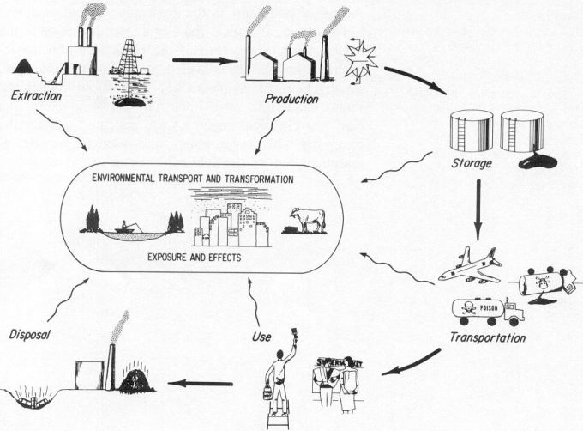

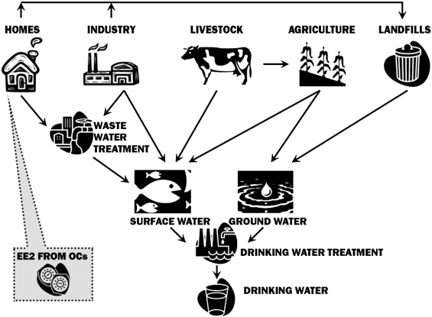
Chemical laws („bulk“)
§§
Industrial chemicals
Cosmetics
PPP (pesticides)
Biocides
Human
pharmaceuticals
Veterinary
pharmaceuticals
REACH
(ECHA)
PPP
(EFSA)
nano nano nano nano
MPs
(EMA)
MIXTURES!
§§
AIR
Two §§ approaches:
Prospective
(chemicals…)
Retrospective
(mixtures …)
WFD – surface w.
GWD – ground w.
Air quality
Food and feed
Soil & Sediments
Wastes
SOIL
WATER

Slide 20
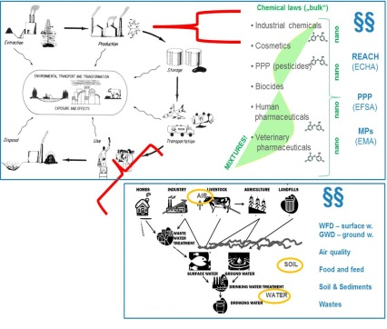



What to assess for toxicity?
 | Current research topics | As required by law
Individual chemicals | Engineered nanomaterials/particles Ecological effects (e.g. of pharmaceuticals) Endocrine disruption & chronic diseases | Industry & biocides (REACH) PPPs = pesticides Pharmaceuticals Cosmetics
Mixtures | Multistressors +T°C, salinity, pathogens, irradiation, food Exposome
Contaminated samples | Can analyzed chemicals explain observed effects ? | Chemical analyses & limits Effect testing rare: Remediation, dredged sediments (CZ), effluents (DE)

Slide 21
What to assess for toxicity?
 | Current research topics | As required by law
Individual chemicals | Engineered nanomaterials/particles Ecological effects (e.g. of pharmaceuticals) Endocrine disruption & chronic diseases | Industry & biocides (REACH) PPPs = pesticides Pharmaceuticals Cosmetics
Mixtures | Multistressors +T°C, salinity, pathogens, irradiation, food Exposome
Contaminated samples | Can analyzed chemicals explain observed effects ? | Chemical analyses & limits Effect testing rare: Remediation, dredged sediments (CZ), effluents (DE)

Slide 22
What to assess for toxicity?
 | Current research topics | As required by law
Individual chemicals | Engineered nanomaterials/particles Ecological effects (e.g. of pharmaceuticals) Endocrine disruption & chronic diseases | Industry & biocides (REACH) PPPs = pesticides Pharmaceuticals Cosmetics
Mixtures | Multistressors +T°C, salinity, pathogens, irradiation, food Exposome
Contaminated samples | Can analyzed chemicals explain observed effects ? | Chemical analyses & limits Effect testing rare: Remediation, dredged sediments (CZ), effluents (DE)

Slide 23
What to assess for toxicity?
 | Current research topics | As required by law
Individual chemicals | Engineered nanomaterials/particles Ecological effects (e.g. of pharmaceuticals) Endocrine disruption & chronic diseases | Industry & biocides (REACH) PPPs = pesticides Pharmaceuticals Cosmetics
Mixtures | Multistressors +T°C, salinity, pathogens, irradiation, food Exposome
Contaminated samples | Can analyzed chemicals explain observed effects ? | Chemical analyses & limits Effect testing rare: Remediation, dredged sediments (CZ), effluents (DE)

Slide 24
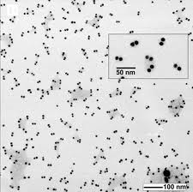
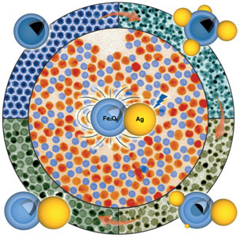
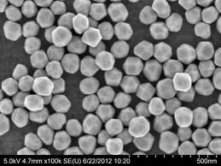
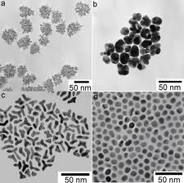
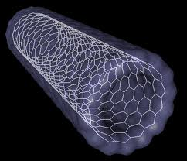
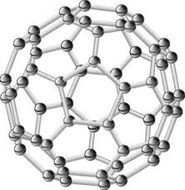
Nanoparticles - examples

Slide 25
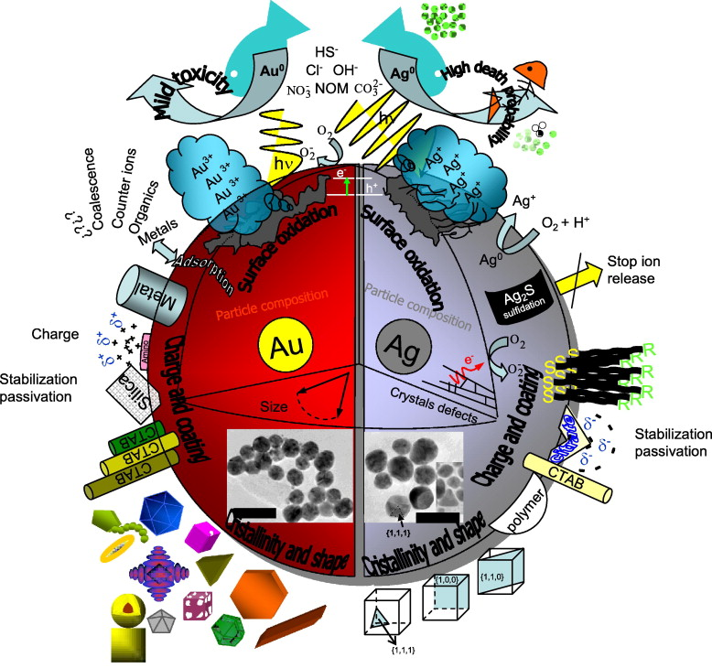
Toxicity of nanoparticles …
(Mostly unknown)
Parameters may
Affect ecotoxicity
Composition (chemical)
Surface (size, area)
Charge
Reactivity
Interactions with ions,
other chemicals…
➔ Effects on
environmental Fate
and toxicity

Slide 26
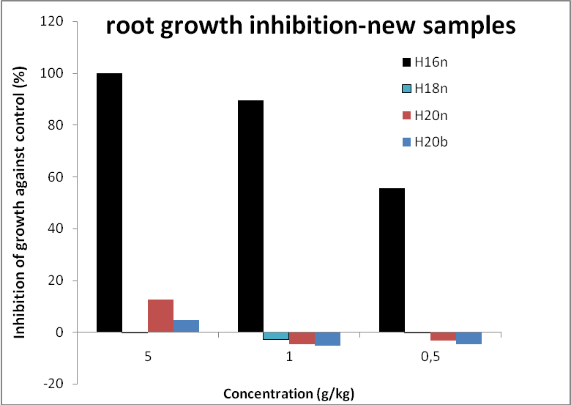
Ecotoxicity of nanoparticles – RECETOX example
Comparison of toxicity - 4 „appeared to be the same“ particles
(one producer – 4 different lots)
(zerovalent iron – ZVI – Fe⁰)
?? Why is H16 so toxic ??
… despite of detailed investigation never revealed

Slide 27
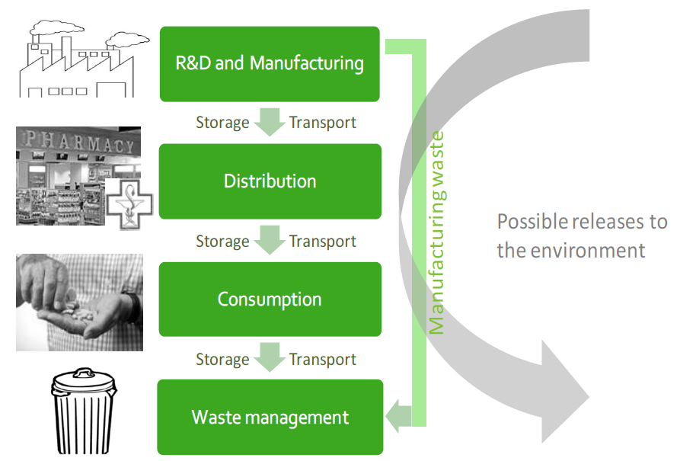
PHARMACEUTICALS

Slide 28
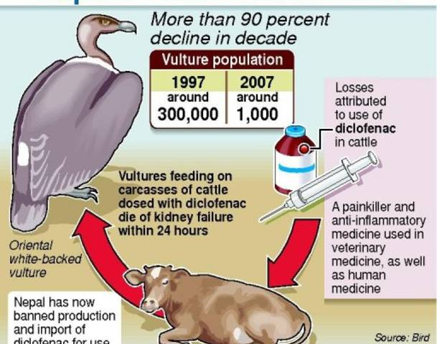
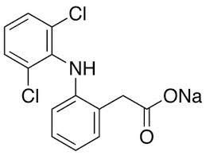
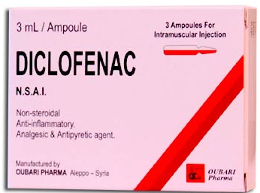
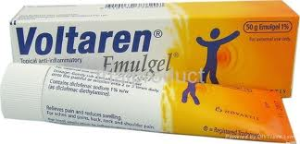
Example 1 - DICLOFENAC
Unexpected effects at NON-TARGET species
- nephrotoxicity at vultures
- Relevant also in EU
(ESP, EL,CY)

Slide 29
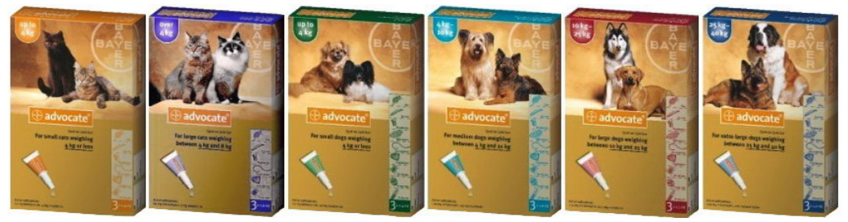
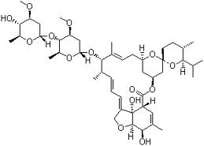
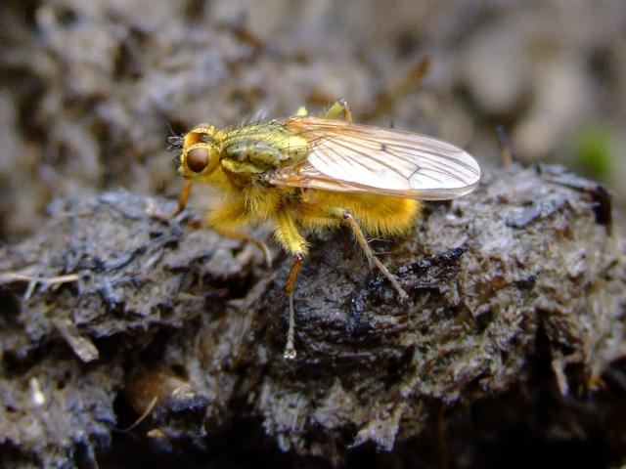
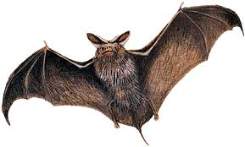
Example 2 – AVERMEKTIN-like antiparasitics
Moxidectin – used e.g. in home
„spot on” products
Ivermectin – antiparasitics in large herds
    Used 2-times per season per sheep/cow
    Kills 100% parasites in sheep
    Released in dung - kills 80-90% larvae of dung flies
    High concentrations in dung (released 2 days post application)
    Persistent in the soil (half-life 30 days)
    Can be washed into adjacent streams (highly toxic to water insects)
?

Slide 30
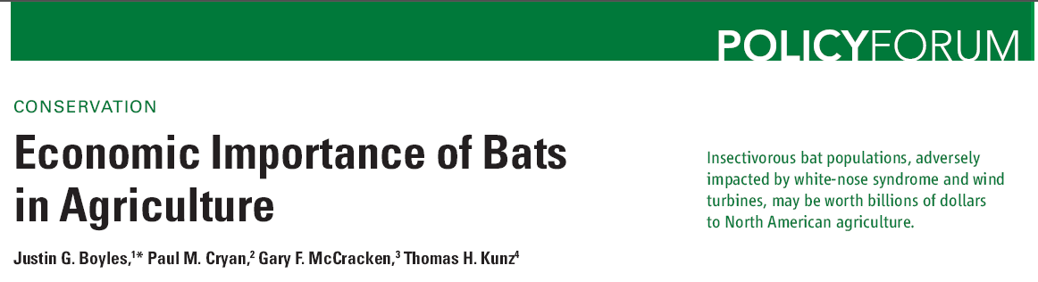

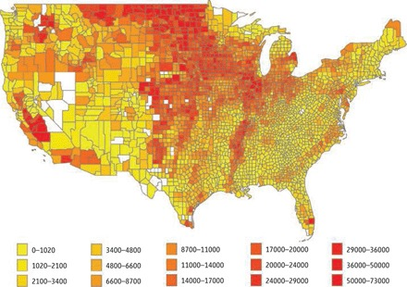
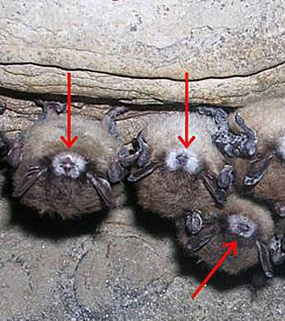
Boyles et al. (2011) Science 332 (60251) 41-42

Slide 31

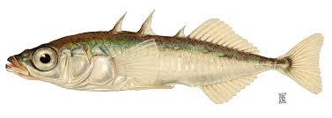
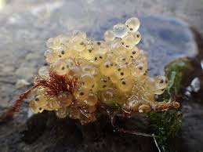
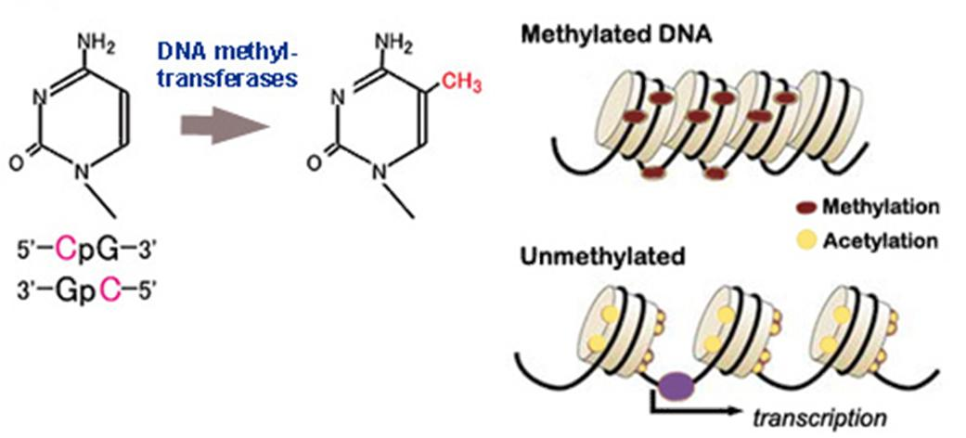
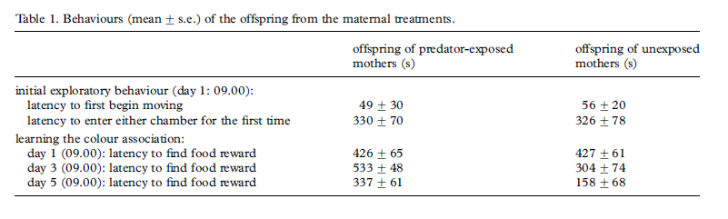
Stress → multigeneration effects
Epigenetics → DNA methylations
2x difference

Slide 32
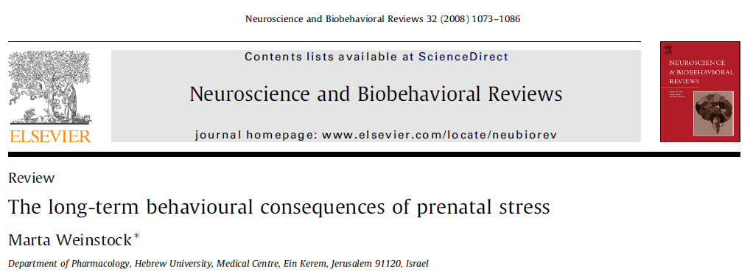
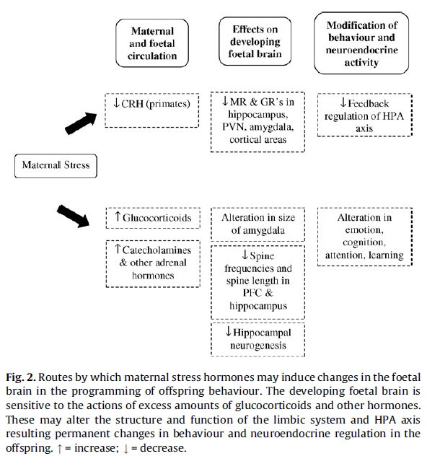

Slide 33
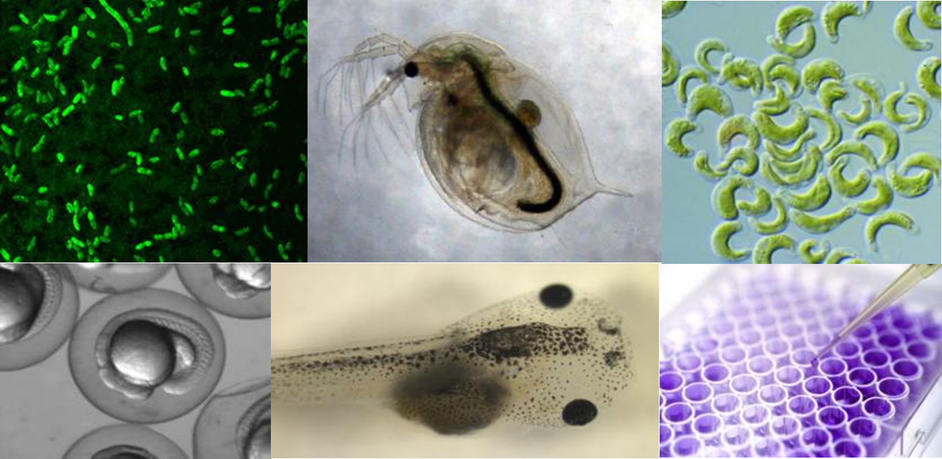
International ring test (2012-13)
Testing comparability of existing and innovative bioassays for water quality assessment
Main questions:
Are current limits (for individual compounds) safe?
Relevance of “Something from Nothing” phenomenon ?
3 samples
→ 12 European laboratories – different bioassays
→ ČR – RECETOX: 11 bioassays
Carvalho, R. et al. (2014) Mixtures of chemical pollutants at European legislation safety concentrations: how safe are they? Toxicol Sci 141(1): 218-233

Slide 34
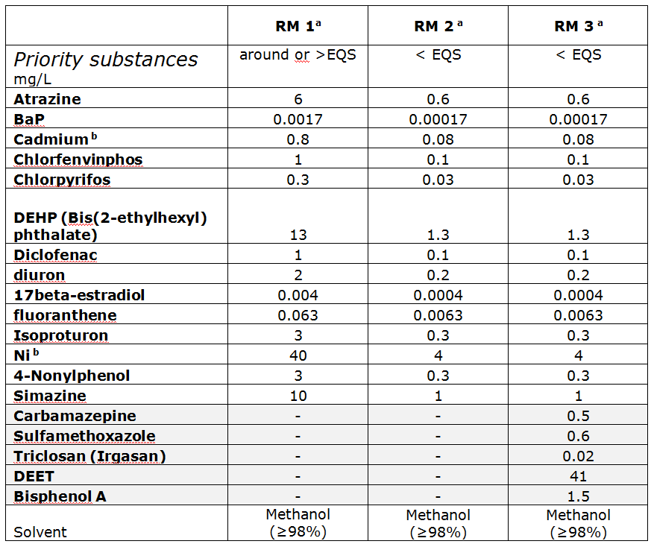
International ring test (2012-13)
Testing comparability of existing and innovative bioassays for water quality assessment
EU WFD
priority
substances
Different
concentrations
EQS
= limit
(Environmental
Quality
Standard)

Slide 35
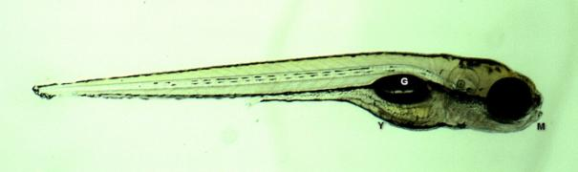
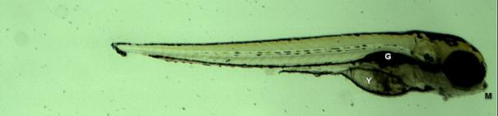
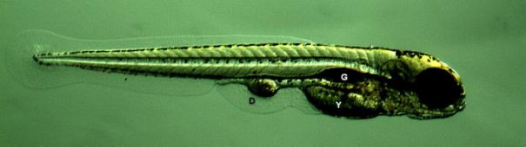
International ring test (2012-13)
Testing comparability of existing and innovative bioassays for water quality assessment
Example: Effects of mixtures on D. rerio fish embryos
Control
Effects of RM 3 (i.e. safe)
mixtures
Carvalho, R. et al. (2014) Mixtures of chemical pollutants at European legislation safety concentrations: how safe are they? Toxicol Sci 141(1): 218-233

Slide 36
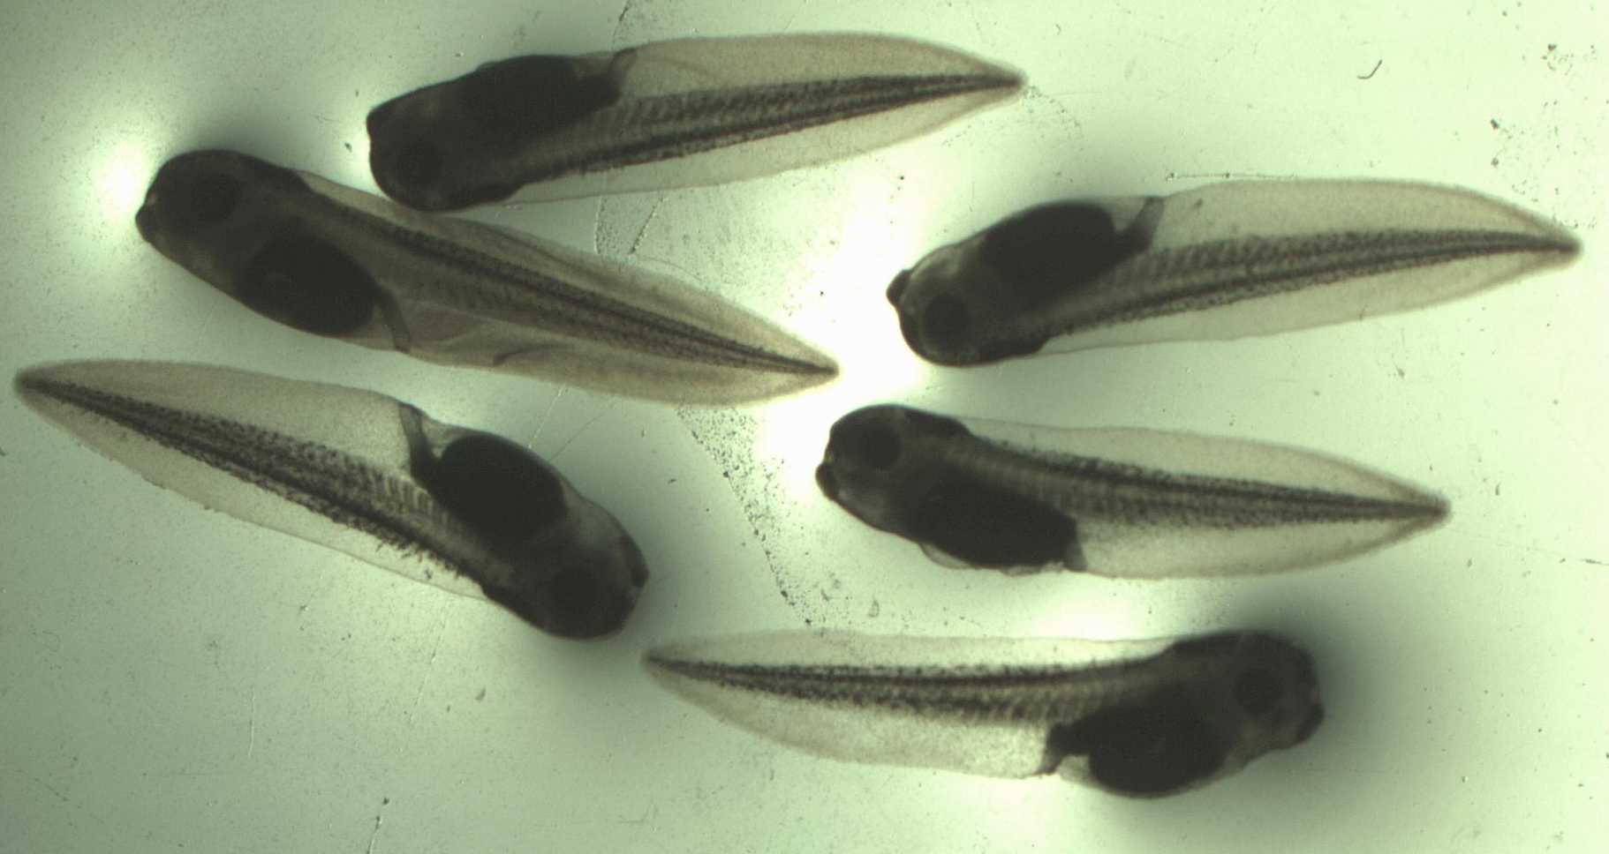
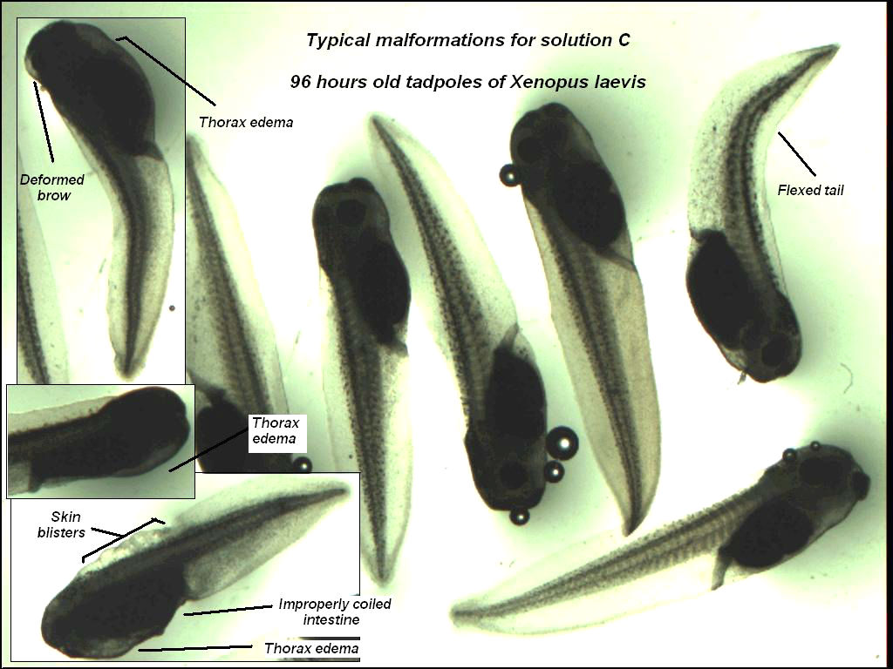
International ring test (2012-13)
Testing comparability of existing and innovative bioassays for water quality assessment
Example: Effects of mixtures on X. laevis frog embryos
Effects of RM 3 (i.e. safe)
mixtures
Controls
Carvalho, R. et al. (2014) Mixtures of chemical pollutants at European legislation safety concentrations: how safe are they? Toxicol Sci 141(1): 218-233

Slide 38
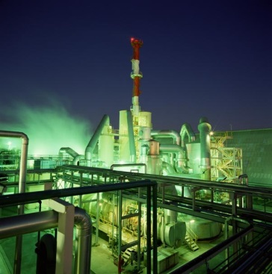



Contaminated samples? Case study “air“
Active sampling
particles vs gaseous phase
Reference locality – agriculture (Košetice observatory)
Region A – industrial
(historically OCPs production)
Region B – combined: industry, agriculture, traffic
Novák et al. (2009) Environment International

Slide 39
Chemical
analyses

Slide 40


Dioxin-like effects
Labs
on Wed + Thu
Difference B>A
Difference B vs A – particles vs gas

Slide 41
Antiandrogenic effects
    Quantitative – comparable
    Clear differences in patterns … no effects on particles in „B“ (?)

Slide 42



Summary on When, Where, What
Regulatory world
  Assessment of „chemicals“!
Contaminated samples
- effects rarely tested
  Great value of bioassays
  in assessment of contaminated samples
      Effects observed (!)
      How to set the „limits“?
Research issues and questions
  Nanomaterials, Pharmaceuticals, EDCs
  Mixtures!
  Exposome

Slide 43
How
to assess the toxicity ?

Slide 44






Assessment of chemical hazards
…to…
Humans Other organisms
(TOXICOLOGY) (ECOtoxicology)

Slide 45

(Eco)Toxicology – science of „doses“
Paracelsus (1493 - 1541)
‘What is there which
is not a poison?
„Cause-effect paradigm“
All things are poison and nothing without poison.
Solely the dose determines that a thing is not a poison.

Slide 46


Toxicology – ultimate goal ?
To identify (or predict)
safe vs hazardous levels

Slide 47


Hazard assessment
Traditionally – Evaluation of adverse effects using the whole organism models
+
Adverse Effects
Death
Altered Reproduction
Inhibition of Growth
Tumorigenicity
Skin irritation
…
Chemical
Organism
REGULATORY FOCUS
(APICAL ENDPOINTS)

Slide 48

What assays and how exactly?
Depends on legislation (… of course !)
… but current EU legislations tend to be harmonized
(use similar approaches)
→ example of REACH

Slide 49

REACH
Registration, Evaluation and Authorisation
of Chemicals
  27-2-2001: White Paper on the Strategy for Future Chemicals Policy
  23-10-2003: Commission’s proposal REACH
  December 2008: Pre-registration mandatory (all chemicals in EU must be registered at ECHA
  European Chemicals
  Agency
  (http://echa.europa.eu)

Slide 50

Existing substances and REACH
  > 95,000,000 known chemicals
  (…and counting http://www.cas.org/)
  100,000 substances in EINECS (i.e. commercial use)
  30,000 relevant for REACH
  cc 3000 HPVCs (High Production Volume Chemicals)

Slide 51

REACH legislation in EU
Registration, Evaluation and Authorisation and Restriction of Chemicals

Slide 52
REACH: what data type must be registered?
Physico-chemical properties, e.g.:
  Vapour pressure, boiling point, Kow,…
Human toxicology, e.g.:
  Acute and chronic toxicity, skin irritation, carcinogenity,…
Environment/ Ecotoxicological information, e.g.:
  Acute and/or chronic toxicity for aquatic organisms, biodegradation, …

Slide 53

REACH: testing
Total costs: 2,8 to 5,6 billion € (industry pays)
Testing costs (50-60% of total): 86% for Human, 14% Ecotox

Slide 54

What assays and how exactly?
Depends on legislation (… of course !)
… but current EU legislations tend to be harmonized
(use similar approaches)
→ example of REACH
Assays must be STANDARDIZED
for REACH should follow OECD Guidelines
Other standardization agencies
(also include toxicity tests) e.g. ISO, ASTM

Slide 55
OECD guidelines for testing of chemicals
Organization for Economic Cooperation Development
5 main sections
  Section 1: Physical Chemical Properties
  Section 2: Effects on Biotic Systems
  (i.e. Ecotoxicity)
  Section 3: Degradation and Accumulation
  Section 4: Health Effects
  (i.e. Toxicity)
  Section 5: Other Test Guidelines

Slide 56
OECD guidelines (examples – selection)
SECTION 2 - Aquatic organisms
Test No. 201: Alga, Growth Inhibition Test | 11 July 2006
Test No. 221: Lemna sp. Growth Inhabition Test | 11 July 2006
Test No. 202: Daphnia sp. Acute Immobilisation Test | 23 Nov 2004
Test No. 211: Daphnia magna Reproduction Test | 16 Oct 2008
Test No. 203: Fish, Acute Toxicity Test | 17 July 1992
Test No. 204: Fish, Prolonged Toxicity Test: 14-Day Study | 04 Apr 1984
Test No. 210: Fish, Early-Life Stage Toxicity Test | 17 July 1992
Test No. 212: Fish, Short-term Toxicity Test on Embryo and Sac-Fry Stages | 21 Sep 1998
Test No. 215: Fish, Juvenile Growth Test | 21 Jan 2000
Test No. 229: Fish Short Term Reproduction Assay | 08 Sep 2009
Test No. 230: 21-day Fish Assay | 08 Sep 2009
Test No. 231: Amphibian Metamorphosis Assay | 08 Sep 2009

Slide 57
OECD guidelines (examples – selection)
SECTION 4 – Human health effects
Test No. 401: Acute Oral Toxicity
Test No. 402: Acute Dermal Toxicity
Test No. 403: Acute Inhalation Toxicity
Test No. 404: Acute Dermal Irritation/Corrosion
Test No. 405: Acute Eye Irritation/Corrosion
Test No. 406: Skin Sensitisation
Test No. 407: Repeated Dose 28-day Oral Toxicity Study in Rodents
Test No. 408: Repeated Dose 90-Day Oral Toxicity Study in Rodents
Test No. 409: Repeated Dose 90-Day Oral Toxicity Study in Non-Rodents
Test No. 410: Repeated Dose Dermal Toxicity: 21/28-day Study
Test No. 411: Subchronic Dermal Toxicity: 90-day Study
Test No. 412: Subacute Inhalation Toxicity: 28-Day Study

Slide 58


Try it! … download and study
your guideline for free!

Slide 59
Hazard assessment
Traditionally – Evaluation of adverse effects using the whole organism models
+
Adverse Effects
Death
Altered Reproduction
Inhibition of Growth
Tumorigenicity
Skin irritation
…
Chemical
Organism
REGULATORY FOCUS
(APICAL ENDPOINTS)

Slide 60



Hazard assessment
Traditionally – Evaluation of adverse effects using the whole organism models
+
Adverse Effects
Death
Inhibition of Growth
Altered Reproduction
Tumor
Skin irritation
…
Chemical
Organism
New – Ex vivo / in vitro / In chemico / In silico Methods
+
10^4 Chemicals
HTS
High-Throughput-Screening
Chemical-biological interactions,
Mechanistic Toxicological Data
Key task/question:
How to link MECHANISTIC INFORMATION with APICAL ENDPOINTS ?

Slide 61




MoA and omics are supported by strategic documents
Toxicity Testing in the 21st Century: A Vision and a Strategy
US National Academies of Sciences
http://www.nap.edu/catalog/11970.html

Slide 62
Adverse Outcome Pathways
Adverse Outcome Pathway
Mode of Action
Toxicity Pathway
Chemical
Macro-Molecular Interaction
Cellular Response
Tissue Effect
Organ Response
Organism
Response
Population Response
Molecular Initiating
Event
Key
Event 1
Key
Event 2
Key
Event 3
Adverse Outcome
Chemical Property
Receptor/Ligand
Interactions
DNA Binding
Protein Oxidation
Gene Activation
Protein Production
Altered Signaling
Altered Physiology
Disrupted Homeostasis
Altered Development / Function
Lethality
Impaired Development
Impaired Reproduction
Altered Sex Ratio
Extinction
In silico, In chemico, In Vitro, Ex vivo
In vivo
The EXISTING KNOWLEDGE is used to link the two anchor points: Molecular Initiating Event (MIE) and Adverse Outcome (AO)
via a series of intermediate steps: Key Events
Ankley, G. T., R. S. Bennett, et al. (2010). "Adverse outcome pathways: a conceptual framework to support ecotoxicology research and risk assessment." Environmental Toxicology and Chemistry 29(3): 730-741.

Slide 63

AOP = Global strategy with support from OECD, EU, USA
http://www.oecd.org/chemicalsafety/testing/projects-adverse-outcome-pathways.htm

Slide 64

http://aopkb.org/
Key documents
OECD Guidance document and a template for developing and assessing adverse outcome pathways (Series No. 184, Series on Testing and Assessment)
Handbook for AOP developers

Slide 65

AOP Wiki
https://aopkb.org/aopwiki/index.php/Main_Page
Wiki-based platform for development of AOPs
Only members of an OECD AOP development project can create / edit AOPs

Slide 66
What AOPs are now
in AOP Wiki (May 2016?)
OECD Endorsed (WNT and TFHA) | 1 | Covalent Protein binding leading to Skin Sensitisation
EAGMST Approved | 6 | 1x ecotoxicology: Aromatase inhibition leading to reproductive dysfunction (in fish)
EAGMST Under Review | 12
EAGMST Under Development | 84
SAAOP AOP Under Development | 15
OECD Extended Advisory Group on Molecular Screening and Toxicogenomics (EAG MST)
The Working Group of the National Coordinators of the Test Guidelines Programme (WNT)
https://aopwiki.org/aops

Slide 67

https://aopwiki.org/aops

Slide 68

AOP Example: MIE aromatase inhibition
Environmental Toxicology and Chemistry, Vol. 30, No. 1, pp. 64–76, 2011

Slide 69


Aromatase inhibition leading to reproductive dysfunction (in fish)
https://aopwiki.org/wiki/index.php/Aop:25

Slide 70





AOP Example from RECETOX:
Modulation of RAR/RXR → developmental toxicity in fish
Activation of RAR/RXR
in P19/A15 cells by atRA and
cyanobacterial metabolites
ZF exposed to ATRA and cyanobacterial (120 hpf) - Control (A), exudates of C. raciborskii 3.3× (B) and 10× (C), M. aeruginosa 10× (D) and D. quadricaudatus 17× (E). ATRA 4 μg/L (13.3 nM) (F), 12 μg/L (40 nM) ((G) and (H)), 36 μg/L (I) and 108 μg/L (J).
atRA
other RAs in cyanos
Jonáš et al. 2014 Aquatic Toxicology
http://dx.doi.org/10.1016/j.aquatox.2014.06.022

Slide 71

Summary on How
Toxicology is about doses
  The goal is LD(LC)50 or NOAEL/NOEC
Legislation defines
… what assays and how to do them
  About 30 assays
  The most widely used standard - OECD Guidelines for Testing of Chemicals
Replacing „black box“ in traditional testing
  Synthesis of mechanistic and omics data
  Adverse Outcome Pathways
  Strategically supported by OECD, EU, USA

Slide 72
What if not
Do we need testing? Are there alternatives?

Slide 73






„Alternatives“ to toxicity testing … 3R rules
3Rs
REPLACEMENT
REFINEMENT
REDUCTION

Slide 74
Why doing replacement, reduction, refinement?
Because activists put pressure to do so?
Because animal welfare is a concern for EU citizen?
Because animal testing is “bad” and “alternatives” are good?
Because I will get “better” results?
Because it is cutting edge technologies?
Because I have to? E.g. EU law directive 2010/63/eu, ban on animal testing for cosmetics
3Rs are driven by EU laws, little by Member States.
Scientific agenda is not driven enough by scientists itself…
Academia is in general more reactive than proactive e.g. stop vivisection’s ECI

Slide 75



European Policies on 3Rs

Slide 76

Use of animals in EU (2011)

Slide 77





VALIDATION
    MoA
    Reliable
    Relevant
Substance Tested
e.g. endocrine disrupters receptor binding

Slide 78

Alternative Methods – R&D to Implementation
Research
Implementation
Development
Regulatory Acceptance
Prevalidation
Independent Review
ESTAF
ESAC
Industry
Academia
Validation
Regulators
7-8 YEARS
PARERE

Slide 79

>60 3Rs Tests submitted to ECVAM since 2008 (update 01/2015)
10 validated or ongoing validation => Prioritisation!

Slide 80
COMPUTATIONAL
(ECO)TOXICOLOGY
?

Slide 81


PBPK models
PBPK (PBTK)
Physiologically based pharmacokinetic (toxicokinetic) models
Fragmentation of
a complex systém
to „boxes“
→ All Processes
described by arrows
(mathematical
equations)

Slide 82

Example – computational toxicology for EDCs

Slide 83


Li (2011) BMC Systems Biology
EE2 – ethinylestradiol
ER, AR atd. – receptors
VTG – vitellogenin
(marker of toxicity)
Arrows – differential
equations
Conceptual
model

Slide 84

Li (2011) BMC Systems Biology
Results:
MODELLED (white)
Vs
MEASURED (grey)
…good comparable

Slide 85

Wrap-up
Eco/Toxicology matters
  Relevant especially for „chemicals“
  … but also for „mixtures“
  and contaminated samples
    Effect based tools in monitoring
  Important results improving lives
  Exciting with many open questions
Regulatory and Science worlds are different
… but are getting closer and closer
  Mechanistic knowledge and utilization of „omics“ data
  Development of AOPs
  In vitro (alternative) models
  Quantitative computational toxicology

Slide 86




Slide 87


Slide 88

Thank you for your attention
blaha@recetox.muni.cz

