Slide 1


COSMETIC
SAFAXAN RANGE
INCI Name: XANTHAN GUM

Slide 2
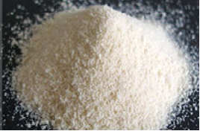
OUTLINE
BACKGROUND
MARKET STUDY
PRODUCTION
STRUCTURE
MAIN PROPERTIES
PH AND TEMPERATURE STABILITY
SOLUBILISATION AND HYDRATION
USAGE INSTRUCTIONS
APPENDICES

Slide 3
SAFAXAN RANGE: BACKGROUND
Definition
  Polysaccharide prepared by bio-fermentation of sugars by bacterium Xanthomonas campestris
  INCI name: Xanthan Gum
  3 grades:
    Safaxan 80 : high particle size (177 µm), low hydration rate, fast dispersion
    Safaxan 200 : low particle size (80 µm), fast hydration rate, low dispersion

Slide 4
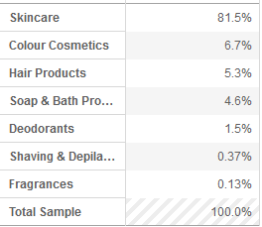
SAFAXAN RANGE: MARKET STUDY
Number of products launched with “xanthan” in Europe* in the past 12 months : 3834 (source Mintel)
France, Germany, UK, Italy, Spain, Belgium,
Poland, Czech Republic, Portugal, Netherlands, Turkey

Slide 5
SAFAXAN RANGE: MARKET STUDY

Slide 6
SAFAXAN RANGE: PRODUCTION
Fermentation by Xanthomonas Campestris
30°C / 72h aerob
Selection
Cultivation
Precipitation
Packing
Dehydration
Sieving
Grinding
Drying
Squeezing

Slide 7
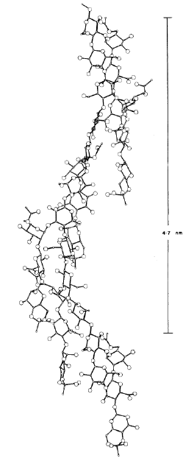
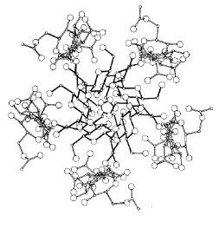
SAFAXAN RANGE: STRUCTURE
  Xanthan is made of β-1,4-glycosidic glucose units with side chains containing an acetylated mannose, a glucuronic acid and a terminal mannose
  Half of the terminal mannose carry a pyruvic acid residue
  Molecular weight is around 4*10⁶
  Synergy with other polysaccharides (see Safimix GX)
Glucose
CH2OH
CH2OH
CH2OH
CH2OH
O
O
O
O
GLU
O
GLU
O
GLU
O
GLU
OH
OH
OH
OH
OH
OH
AcOH2C
O
O
AcOH2C
O
Acetylated mannose
MAN
O
OH
MAN
Acetylated mannose
HO
HO
OH
COO-M+
O
COO-M+
O
Glucuronic acid
O
O
OH
OH
Glucuronic acid
M⁺⁻OOC
OH2C
O
OH
CH2OH
O
OH
Pyruvic acid
C
O
Mannose
O
O
MAN
MAN
Mannose
CH₃
OH
OH
HO
OH
OH
Xanthan “helix type” of structure seen from the top and from the side

Slide 8
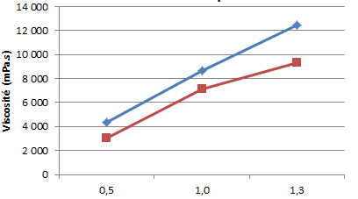
SAFAXAN RANGE: MAIN PROPERTIES
  Thickening and suspending agent with as yield values
  High stability in extreme conditions (pH & temperature) but sensitive to cationic surfactants
  High degree of pseudoplasticity
  Synergy with other polysaccharides (see Safimix GX)
Safaxan 200
Competitive xanthan
(200 mesh)

Slide 9
SAFAXAN RANGE: MAIN PROPERTIES
  At rest xanthan molecules adopt an equilibrium : hydrogen bounding creates a network able to suspend particles, droplets, air bubbles
  In presence of stress (movement), molecules are reoriented and the gel is broken
  When the flow occurs , the molecules turn toward the current and the viscosity decreases
  When the stress is removed, the molecules go back to equilibrium
stress increases
stress increases
stress decreases
stress decreases
Xanthan molecules are
at rest and form a gel
Xanthan molecules
are reoriented

Slide 10
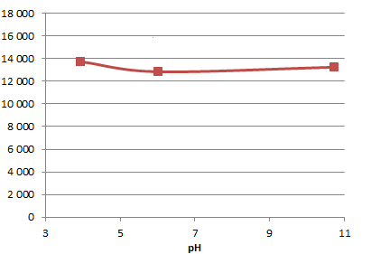
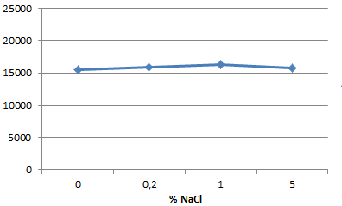
SAFAXAN RANGE: PH AND TEMPERATURE STABILITY
Xanthan is stable over a broad range of pH
Xanthan is also stable over a broad range of temperature (up to 90ºC, data not shown here) and in presence of ions
  Viscosity (mPa.s)
Safaxan 80 Clear (1%)
  Viscosity (mPa.s)
Safaxan 80 (1%)

Slide 11
SAFAXAN RANGE: SOLUBILISATION AND HYDRATION
Safaxan
80
Dispersibility
Safaxan 200
Hydration rate

Slide 12
SAFAXAN RANGE: USAGE INSTRUCTIONS
Usage instructions
  Pre-disperse Safaxan in glycerin
  Once the mixture is homogeneous, add it to the water phase
  Xanthan can be added at room temperature
  It is recommended to use Xanthan in presence of electrolytes (salt stabilizes the helix structure)
Application formulae
  Face, neck, body, eye care formulae
  Hair care formulae
  Sun care, after sun and self-tanning formulae
Recommended usage
  0.2 – 1%
Gloss & Glow
Golden Blond Hair Leave-on Elixir
Formulated in
Wait & Glow
Antioxidant Radiance Mask
Go to “Detailed application formulae”

Slide 13
APPENDICES
Notes:
Carte à utiliser uniquement en affichage Plein Ecran

Slide 14


GLOSS & GLOW: GOLDEN BLOND HAIR LEAVE-ON ELIXIR
Repairing and moisturizing actives
Blond hair elixir
Soft and dry touch
Giving strength and vitality to your hair

Slide 15
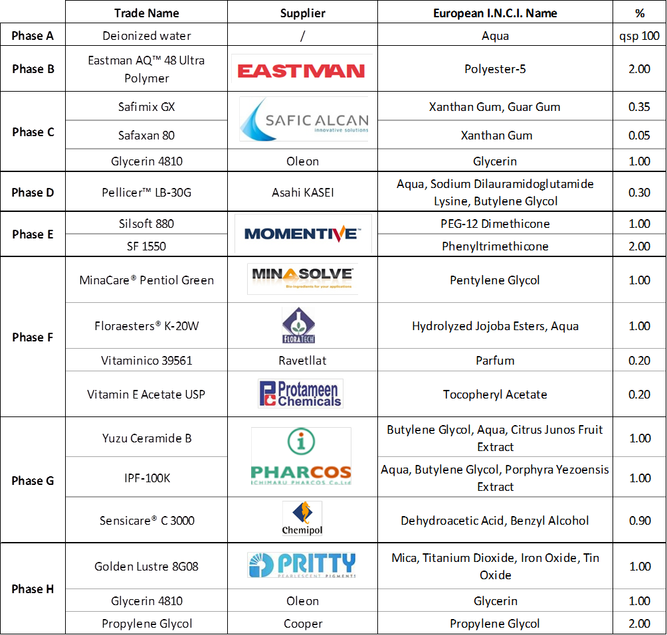
GLOSS & GLOW: GOLDEN BLOND HAIR LEAVE-ON ELIXIR
Silicone gel
Soft and dry touch
4 repairing and moisturizing actives
Pearlescent pigments
Go back to “Usage instructions”

Slide 16

WAIT & GLOW: ANTIOXIDANT RADIANCE MASK
Creamy gel texture
Protective, moisturizing, softening and illuminating actives
Thanks to CaCl2 solution, emulsion instantaneously becomes a mask that can be easily removed like a « second » skin

Slide 17
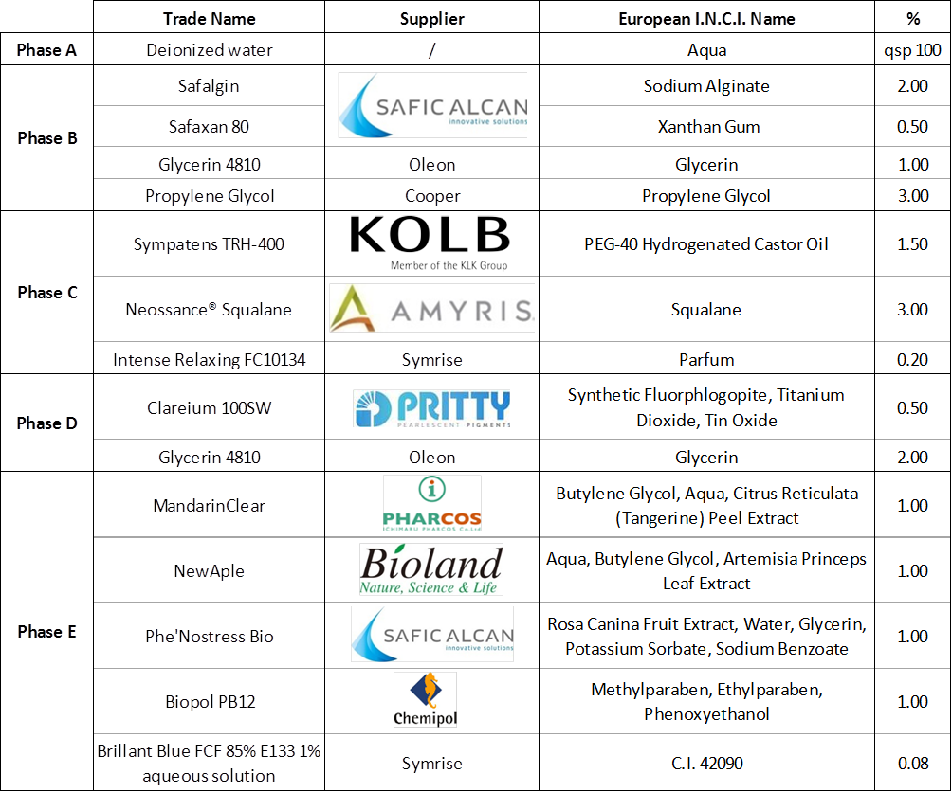
WAIT & GLOW: ANTIOXIDANT RADIANCE MASK
Oil / Water emulsion
Low oil phase
Association of 3 actives:
  Brightning and glowing active
  Soothing active
  Antioxidant active
Go back to “Usage instructions”

