Slide 1
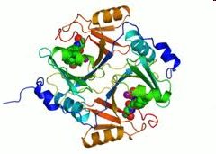
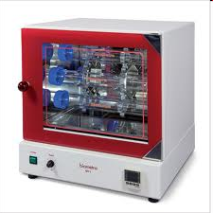
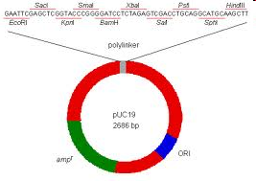
ENZYMES USED IM MOLECULAR BIOLOGY

Slide 2
Nucleic acid processing enzymes
nucleases
polymerases
phosphatases
methylases
kinases
ligases
polynucleotidyl phosphorylase

Slide 3
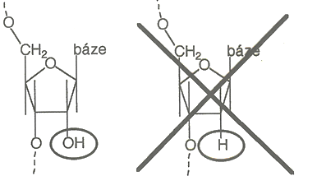
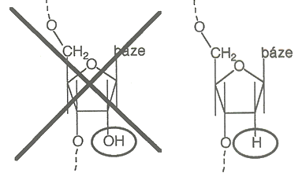
Nucleases
hydrolases cleaving phosphodiester bonds
DNases, RNases, „non-specific“

Slide 4
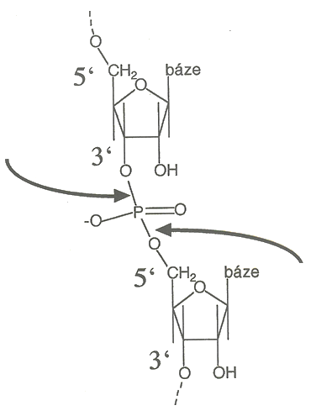
Nucleases
which phosphoester bond is hydrolyzed
3‘-OH, 5‘-phospho
DNase II
phosphodiesterase II
RNase A
MNase
DNase I
repair nucleases
phosphodiesterase I
S1, P1 nucleases
5‘-OH, 3‘-phospho

Slide 5
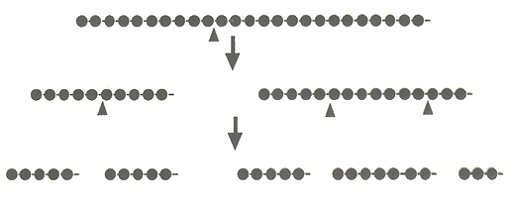
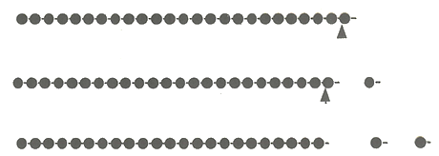

Nucleases
endonuclease or exonucleases
exonucleases:
  processive or distributive
  direction of cleavage (5‘→3‘, 3‘→5‘)
association-(cleavage-translocation-cleavage)_{n}
(association-cleavage-dissociation)_{n}

Slide 6
Nucleases
other criteria (levels of selectivity/specificity):
  secondary structure of substrates (ss, ds, untwisted)
  preference for certain nucleotide (Pu vs Py or particular base) – RNases (A, U1, U2, T1, T2, PhyI, PhyII)
  sequence specificity (restriction endonucleases)
  modification specificity (methylation-sensitice restrictases)

Slide 7
RESTRICTION ENZYMES
Sequence-specific DNA binding + cleavage
Type I RE: 3 different subunits (specificity, methylation, nuclease)
cleave outside binding sequence
Type II RE: 2 identical subunits, both share spocific binding + nuclease
cleave within the binding sequence (4-6 bp, palindromes)
complementary methylases
Type III RE: 2 different subunits, „something between“

Slide 8
RESTRICTION ENZYMES
Nomenclature:
EcoRI
E | Escherichia | Genus
co | coli | Species
R | RY13 | Strain
I | první | Order of discovery

Slide 9
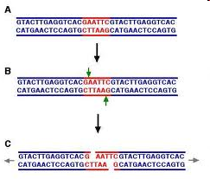
RESTRICTION ENZYMES
sticky end formation
EcoRI (GAATTC) – 5´-overhangs
PstI (CTGCAG) – 3‘-overhangs
3´
5´
NNNNNCTGCAGNNNNNNN
NNNNNGACGTCNNNNNNN
3´
5´
3´
5´
3´
5´
5´
3´
5´
NNNNNCTGCAGNNNNNNN
NNNNNGACGTCNNNNNNN
3´
3´
5´
3´
5´
3´
5´
5´
3´
5´
3´
5´
3´
NNNNNCTGCA pGNNNNNNN
NNNNNGp ACGTCNNNNNNN
3´
5´
5´
3´
5´
3´
5´
3´

Slide 10
RESTRICTION ENZYMES
Isoschisomers:
-recognize+cleave the same sequence X not necessarily in the same way
-may differ in sensitivity to methylation (Msp I x Hpa II, Bstn I x EcoR II)
Linear difussion mechanism:
-efficient searching for binding sites by sliding along DNA; balanced non-specifc binding
Star activity:
-less specific cleavage under improper conditions (reduced water activity)
blunt end formation
HaeIII (GGCC):
NNNNNGGCCNNNNNNN
NNNNNCCGGNNNNNNN
NNNNNGGCCNNNNNNN
NNNNNCCGGNNNNNNN
NNNNNGG CCNNNNNNN
NNNNNCC GGNNNNNNN

Slide 11
METHYLATION-RESTRICTION SYSTEMS
Bacterial defence against viral (phage) infection: methylated DNA is not cleaved by the restrictases, unmodified phage DNA is
Methylation systems in v E. coli:
dam - ⁶N methylation of adenine GATC
roles in mismatch repair, DNA replication, gene expression
BamHI – GGATCC + (Bacillus amyloli)
BclI – TGATCA - (Bacillus caldolyticus)
MboI – GATC -
Sau3AI – GATC +
dcm – inner cytosine methylation (⁵C) in CCAGG, CCTGG
EcoRII -
BstNI +
EcoKI – ⁶N methylation of adenine AAC(N)₆GTGC, GCAC(N)₆GTT
For example, plasmid DNA cloned in E. coli dam⁺ is resistant to MboI

Slide 12
Post-replication maintenance DNA methylation in symmetrical sequences
……. ^{m}CG…. ^{m}CNG….. ^{m}CG…. ……. ^{m}CG…. ^{m}CNG….. ^{m}CG………
..........G^{m}C… GN^{m}C….G^{m}C… ….......GC…...GNC……GC……..
-bacterial DNA: hemimethylated after replication, methylation follows
-phage DNA: non-methylated, cleaved
-ca 0.2 % frequency of de-novo methylation: phage „learns“ how to survive and replicate
REPLICATION

Slide 13
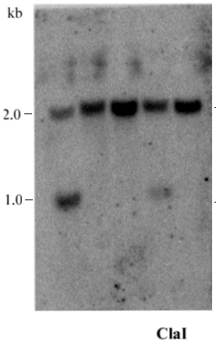
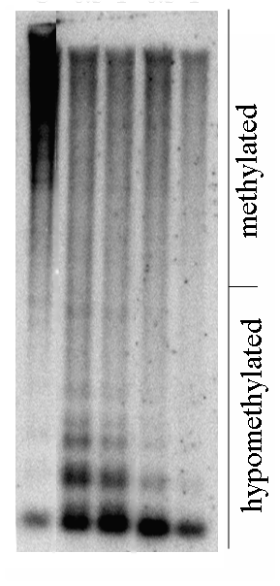
  METHYLATION-SENSITIVE RE
CG: HpaII ^{m}C^{m}CGG (either of the ^{m}Cs)
CfoI G^{m}CGC
SmaI CC^{m}CGGG
TaiI A^{m}CGT
ClaI AT^{m}CGAT
CNG: MspI ^{m}CCGG
CHH: Sau96I GG(A/T)^{m}C^{m}C

Slide 14
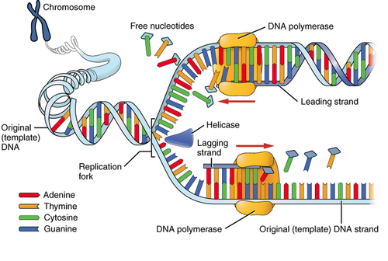
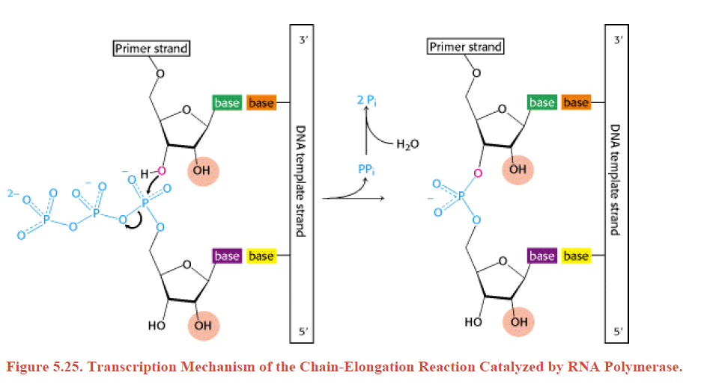
DNA POLYMERASES
E. coli DNA polymerase I:
5‘→3´ polymerase
5´→3´ exonuclease (degradation ahead)
3´→5´ exonuclease (proofreading)
Polymerization ALWAYS 5‘→3‘!

Slide 15
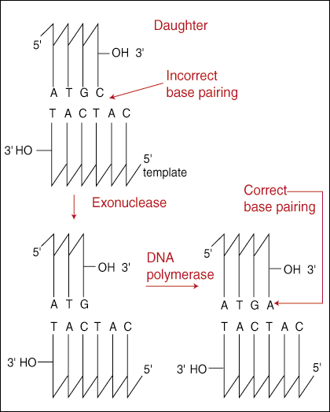
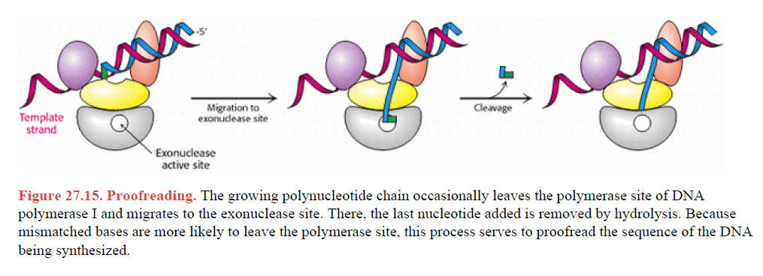
DNA POLYMERASES
Proofreading exonuclease activity
(removal of misincorporated bases)
-labeling of 3‘-ends

Slide 16
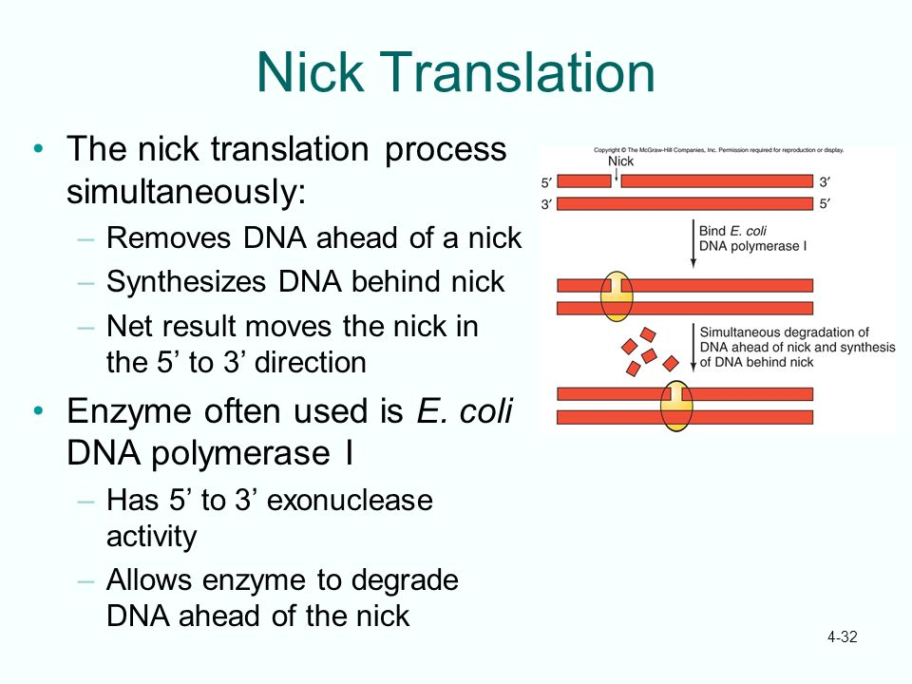
DNA POLYMERASES
5‘ → 3 ‘exonuclease activity

Slide 17
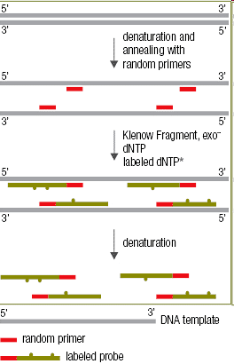
DNA POLYMERASES
Klenow fragment:
5 ´ 3´ polymerase
3´ 5´ exonuklease
NO 5‘→ 3‘ exonuclease!!
(small fragment)
„random priming“ DNA labeling
http://www.thermoscientificbio.com/molecular-labeling
-and-detection/biotin-decalabel-dna-labeling-kit/

Slide 18
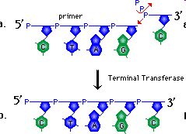
Terminal (deoxy)nucleotidyl transferase
- statistical RNA/DNA polymarization without template
- transfers nucleotides from dNTP to free 3´-OH end
- selectivity control by metal ions: purine – Mg²⁺
pyrimidine – Co²⁺
- 3‘-OH overhangs (or ss NA) are prefered
- labeling of 3´-ends
http://bioweb.wku.edu/courses/biol350/RestrictionEnz3/Review.html

Slide 19
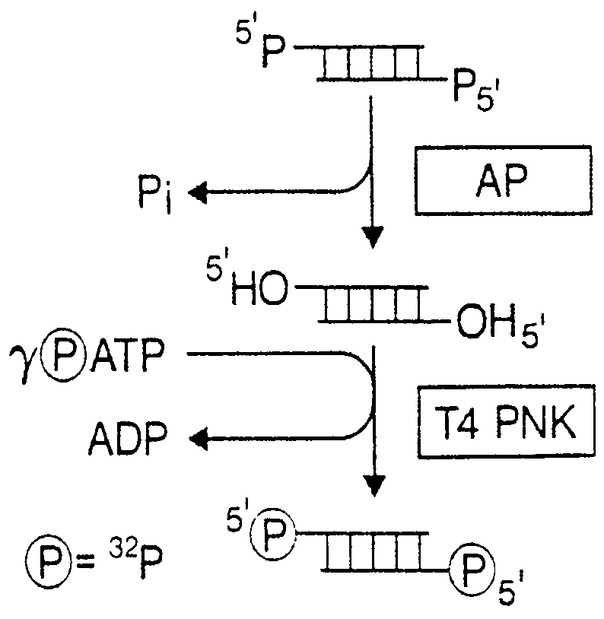
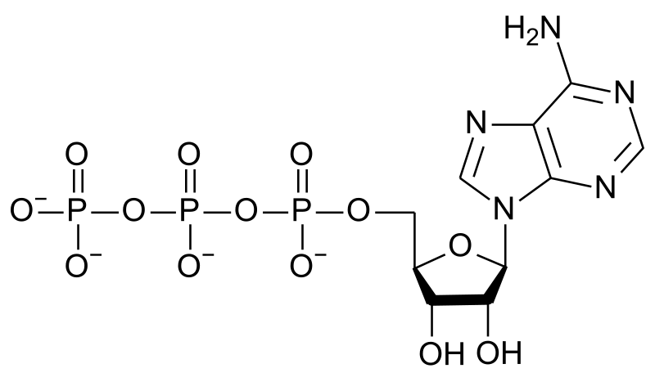
T4 polynucleotidyl kinase:
- transfer of γ-phosphate from ATP to 5‘-OH end of DNA/RNA
- 5‘-end labelling
Alkaline phosphatase (AP):
5‘-phosphate removal
(restrictases and other DNases produce 5‘-phosphate)
- prevention of vector/insert self-ligation
- bacterial alkaline phosphatase (BAP)
- calf intestinal phosphatase (CIF)
γ
β
α

Slide 20
SUMMARY REMARKS TO DNA LABELING
5‘-labeling: polynucleotidyl kinase + ATP (γ-phosphate is used)
³²P, ³³P, ³⁵S (as thiophosphate); thiol-reactive labels
3‘-end labeling: DNA-polymerases or terminal transferase(TnT, TdT) (nucleotide including α-phosphate is used)
any labels attached to sugar or base
nick translation, random priming, PCR
γ
β
α

Slide 21
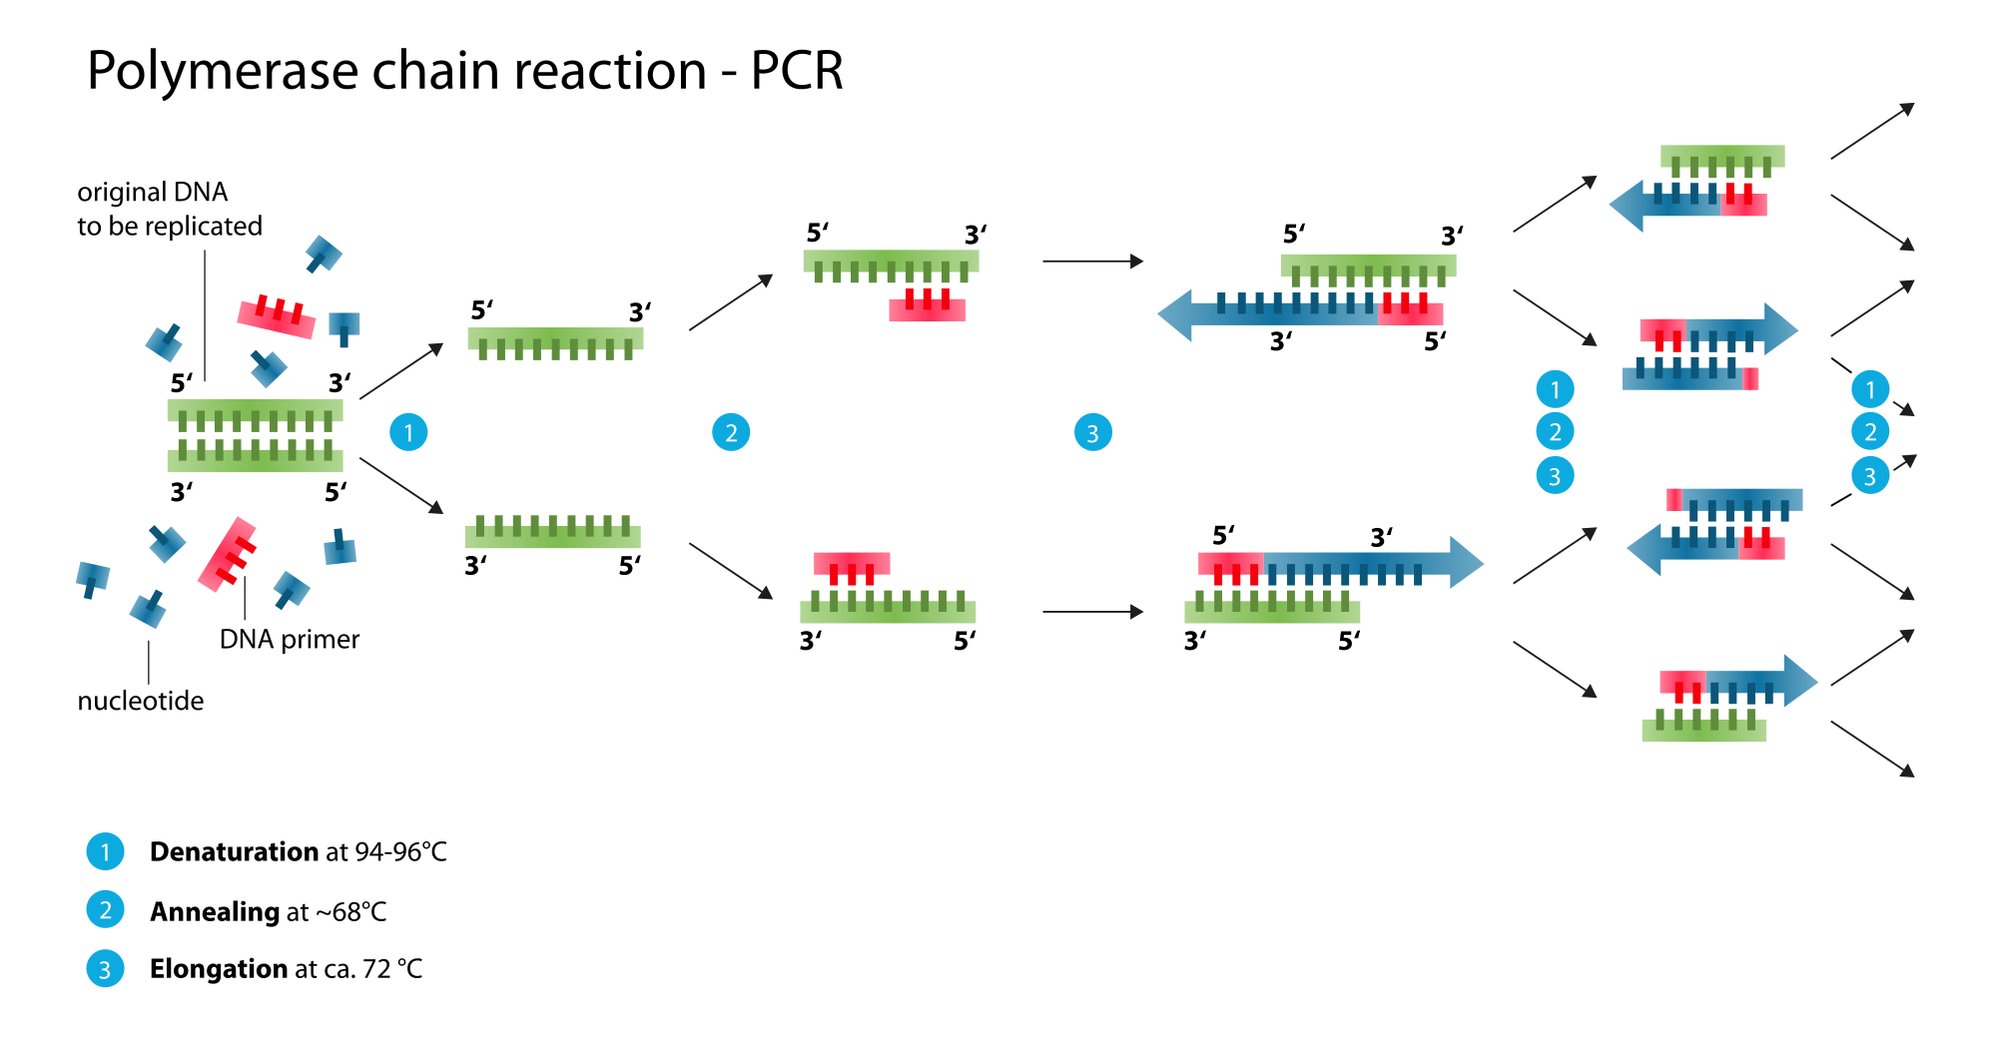
DNA POLYMERASES
Thermostable DNA polymerases:
Taq DNA polymerase (Thermus aquaticus)
temperature optimum 72 – 80 °C
DyNAzyme, Vent, KOD... exo+/-....
fidelity versus speed versus tolerance to modifications

Slide 22
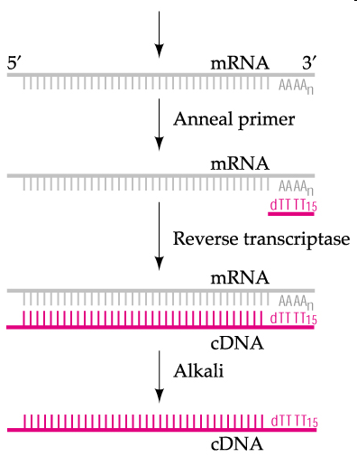
Reverse transcriptase
RNA-dependent DNA polymerase
MuLV (Moloney murine leukemia virus)
AMV (avian myeloblastosis virus)
„SuperScript“: higher temperatures
no RNaseH activity
(RNaseH: exonucleolytic degradation of RNA strand in DNA/RNA hybrid)
RT-(q)PCR analysis of gene expression
37 – 42 °C

Slide 23
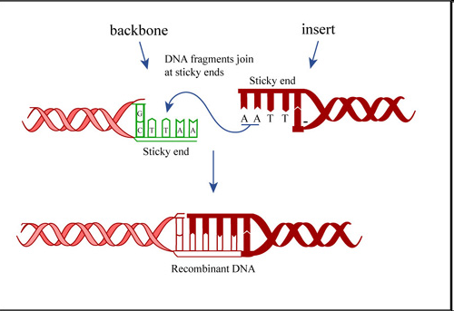
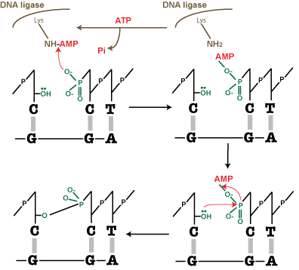
DNA ligases
Bacteriophage T4 DNA ligase:
joining of sticky as well as blunt end
cofactor = ATP
E. coli DNA ligase:
joins sticky ends
bacterial ligases usually use NAD as the cofactor
1. step: transfer of APM to 5‘-phospho DNA end (the intermediate involves a diphosphate macroergic bond)
http://ocw.mit.edu/courses/biological-engineering/20-109-laboratory
-fundamentals-in-biological-engineering-fall-2007/labs/mod1_3/

Slide 24
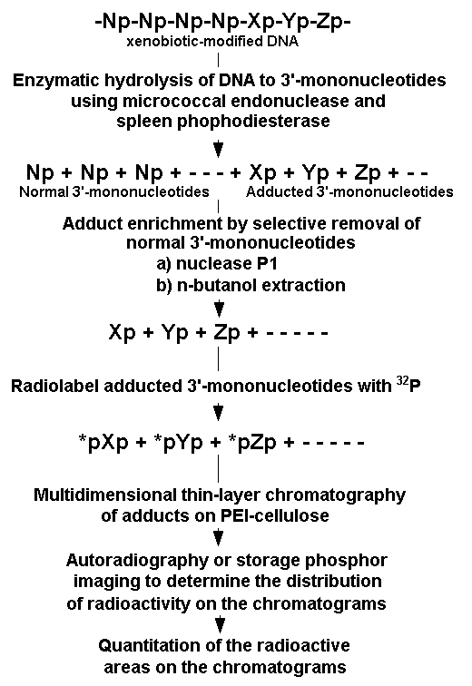
SINGLE STRAND SELECTIVE NUCLEASES
In general: cleavage of both DNA and RNA
Nuclease S1: endo- and exonuclease
acidic pH optimum (4.5), Zn²⁺ ions
-removal of ss overhangs, opening of hairpin loops
-open local structures
Mung Bean Nuclease:
-similar to S1, milder conditions (less acidic)
Nuclease P1:
-neutral pH optimum, Zn²⁺ ions
-ss-selective endonuclease + 3‘phosphatase
-³²P postlabeling analysis of DNA adducts
Micrococal nuclease (MNase)
-selective cleavage of untwisted DNA; AT-rich
-chromatin digestion to (oligo)nucleosomes

Slide 25
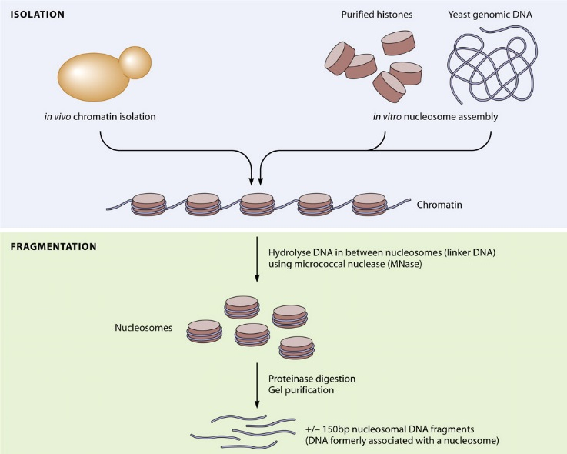
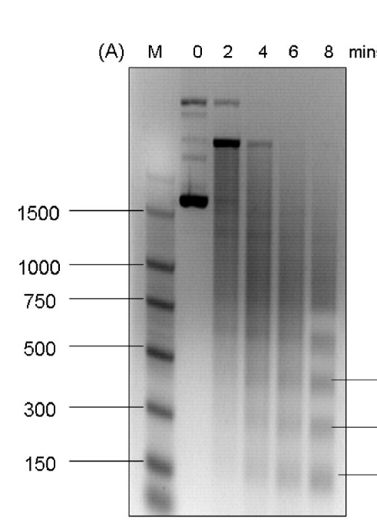
SINGLE STRAND SELECTIVE NUCLEASES
In general: cleavage of both DNA and RNA
Nuclease S1: endo- and exonuclease
acidic pH optimum (4.5), Zn²⁺ ions
-removal of ss overhangs, opening of hairpin loops
-open local structures
Mung Bean Nuclease:
-similar to S1, milder conditions (less acidic)
Nuclease P1:
-neutral pH optimum, Zn²⁺ ions
-ss-selective endonuclease + 3‘phosphatase
-³²P postlabeling analysis of DNA adducts
Micrococal nuclease (MNase)
-selective cleavage of untwisted DNA; AT-rich
-chromatin digestion to (oligo)nucleosomes

Slide 26
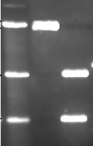
Single-strand selective enzymes
only detection of a open structure, not identification at the sequence level
often sufficient: evidence of formation of a expected structure
nucleases S1, P1, mung bean... cleave ss DNA (or RNA)
scDNA cleaved by S1, then restriction cleavage to map S1 celavage site
restrictase
S1
restrictase
agarose elfo
restriction site
S1
distinct bands indicate site-specific cleavage by S1

Slide 27
Combination of chemical probes with S1 nuclease
chemical probes work within wider range of conditions than enzymes
modification of scDNA
then restrictase cleavage
chemical modification of bases in structure that existed in scDNA prevent formation of B-DNA
then S1 cleavage in the modified site
S1
restrictase
S1
agarose elfo
restriction site
chemical modification
distinct bands indicate site-specific modification

Slide 28
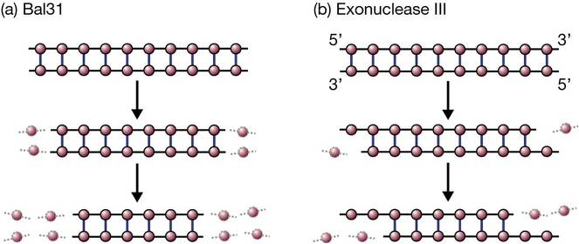
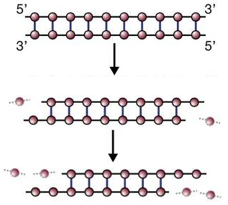
NUCLEASES PROCESSING DNA ENDS
Bal31 nuclease: cleaves both 3´ and 5´ ends in dsDNA
-removal of ss ovehangs, cleavage in nicks and gaps
-shortens blunt-ended dsDNA
-identification of terminal DNA sequences
Exonuclease III: degrades one strand in dsDNA (RNA strand in RN/DNA hybrid) from its 3‘-terminus
-creates 5‘-overhangs
Lambda exonuclease: degrades one strand in dsDNA from its 5‘-terminus
-creates 3‘-overhangs
(c) Lambda-exonuclease

Slide 29
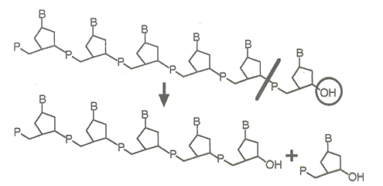
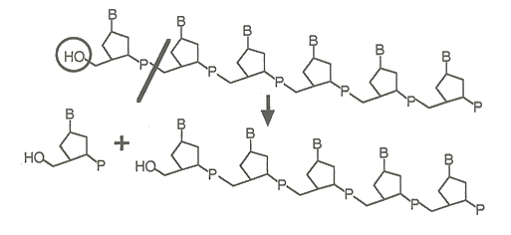
PHOSPHODIESTERASES
DNA/RNA exonucleases
Phosphodiesterase I
from snake venom
cleaves 3‘→5‘
requires 3‘-OH
produces 5‘-dNMP
Phosphodiesterase II
from spleen
cleaves 5‘→3‘
requires 5‘-OH
produces 3‘-dNMP

Slide 30
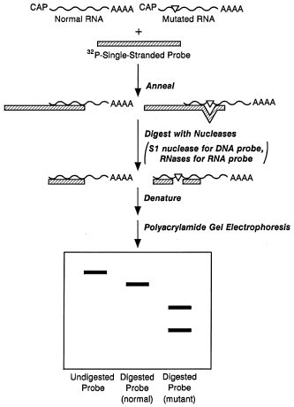
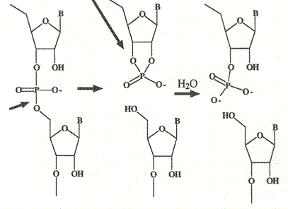
RNase A: endoribonuclease
cleaves preferentially ssRNA „after“ Py, produce 3‘-phospho ends
extremely stable, no cofactors, difficult to inactivate
DNA purification (RNA removal)
SNP mapping in DNA (RNase protection assay)
http://www.gene-quantification.de/mrna.html

Slide 31
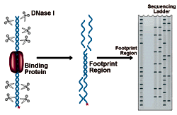
DNase I: DNA endonuclease
cleavage of dsDNA or ssDNA to ~tetranucleotides
requires Mg²⁺ (inhibition by EDTA), neutral pH optimum
reductive inactivation (-S-S- bond stabilize structure), Ca2+ protection
in dsDNA creates single-strand breaks, 5‘-phospho ends
RNA purification (RNase-free!!), protein-DNA footprinting
DNase II: double strand breaks, 3‘-phospho ends, no cofactors, acidic pH optimum

Slide 32
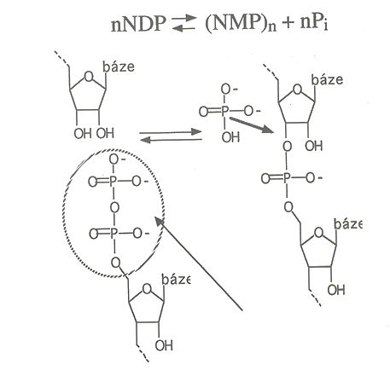
Polynucleotide phosphorylase
-random polymerization of ribonucleotides from NDPs
-RNA degradation by inorganic phosphate (not hydrolysis) into NDP
-reversible
-polyribonucleotide biosynthesis
-used during genetic code solution
Phosphorylase does not phosphorylate!
chemical energy preserved

Slide 33
Engineered nucleases for genome editing

Slide 34
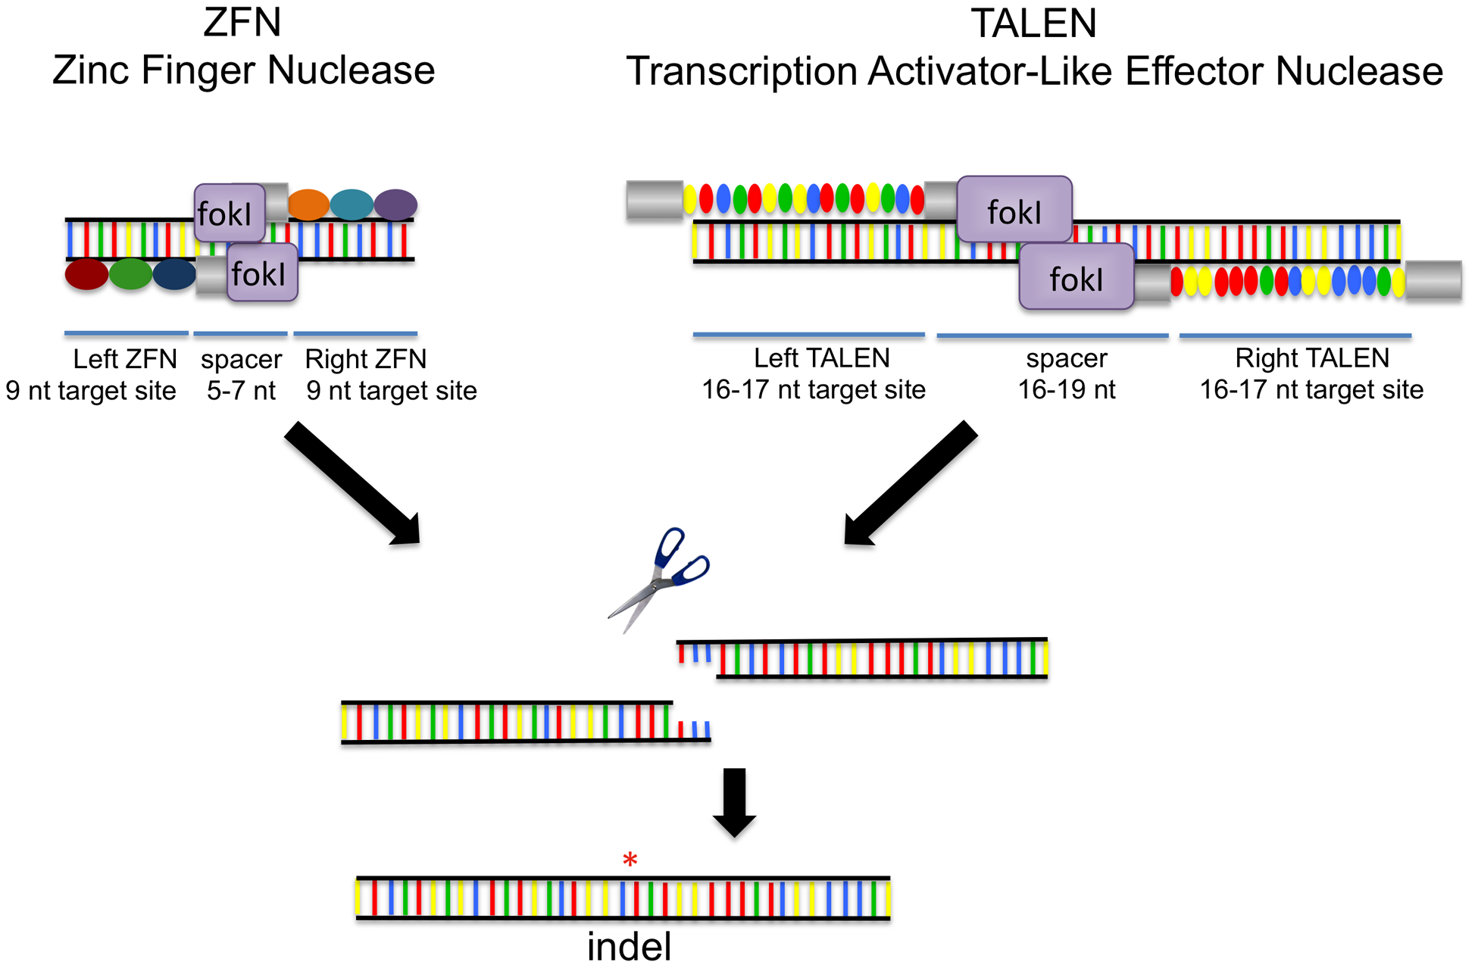
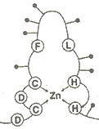
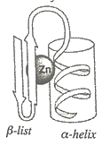
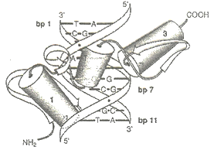
ZNF, TALEN
-constructs of a nuclease (fok I) with DNA binding domains (addressing cleavage to a specific sequence)
-analogous construct with DNA methylases, histone (de)acetylase: epigenetic modifications
http://www.labome.com/method/Genomic-Engineering.html

Slide 35
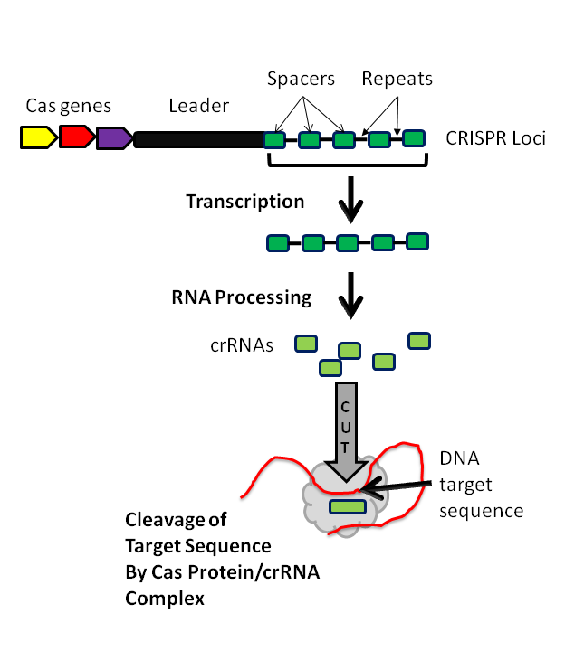
CRISPP
clustered regularly
interspaced short
palindromic repeats
RNA-directed DNA celavage
http://www.labome.com/method/Genomic-Engineering.html

Slide 36
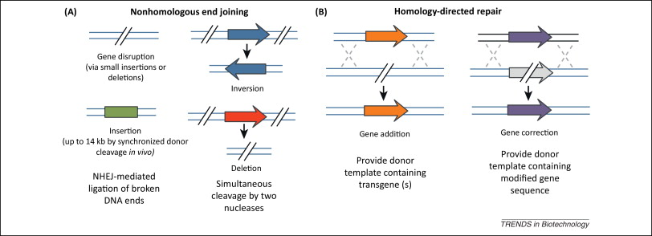
Modifications of genomes
Repair of the (ZNF, TALEN, CRISPP-induced) double strand breaks via NHJ of HR:
-insertions, deletions – gene inactivation
-inversions
-transgene insertions, modifications of genes (precise by HR)
Gaj et al. Trends Biotechnol 2013

Slide 37
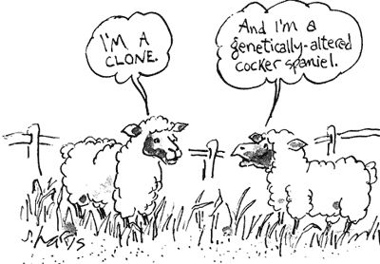
http://worldofbiochemistry.blogspot.cz/2011/08/cartoon-about-cloning-2.html

