Slide 1
Genes and Proteins
Katerina Dadakova, Department of Biochemistry
1
Figures adopted from Buchanan et al., Biochemistry & molecular biology of plants

Slide 2
Genes and proteins
Amino acids

Slide 3
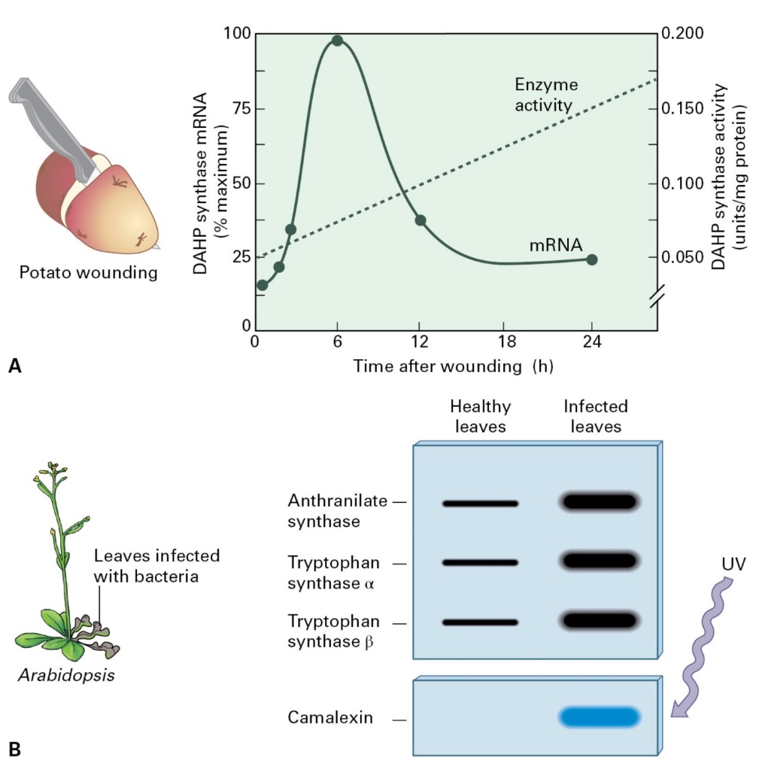
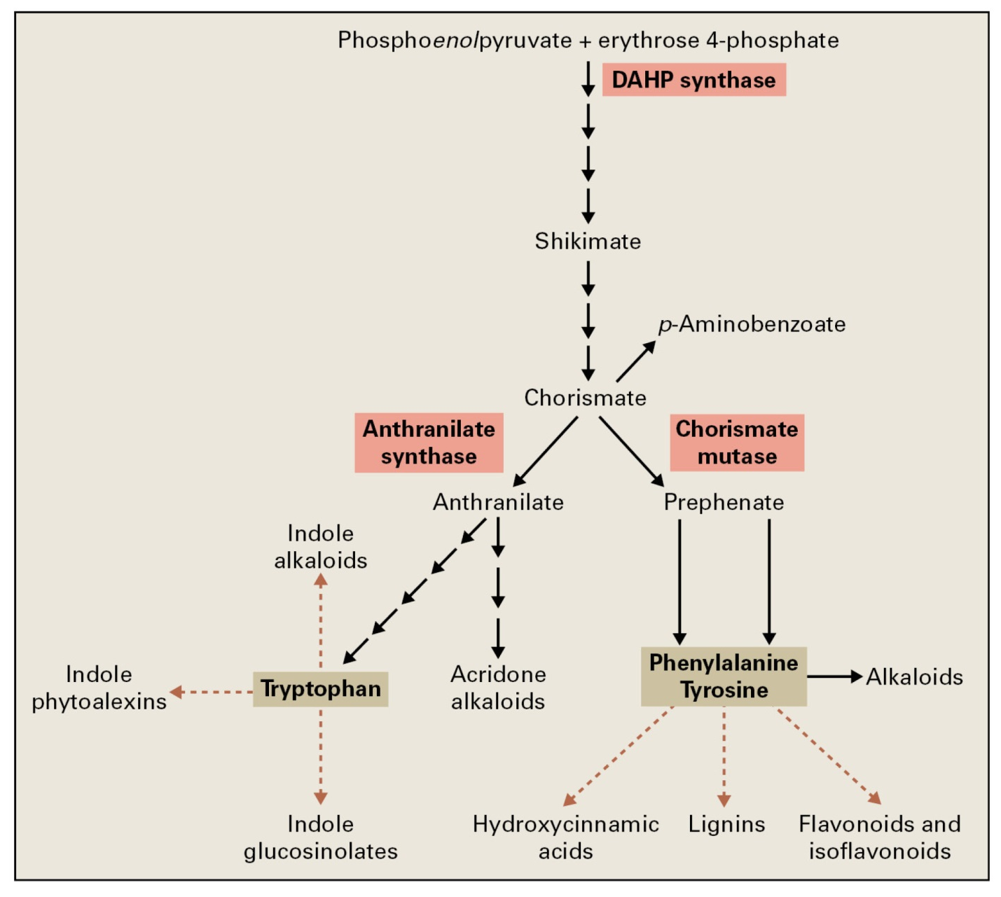
Genes and proteins
Aromatic amino acids
Synthesis of aromatic amino acids

Slide 4
Genes and proteins
Aspartate-derived amino acids
Regulation of threonine, lysine, and methionine synthesis

Slide 5
Genes and proteins
Branched-chain amino acids
Examples of herbicides that inhibit acetohydroxyacid synthase

Slide 6
Genes and proteins
Glutamate-derived amino acids
Osmotic adjustment
No osmotic adjustment

Slide 7
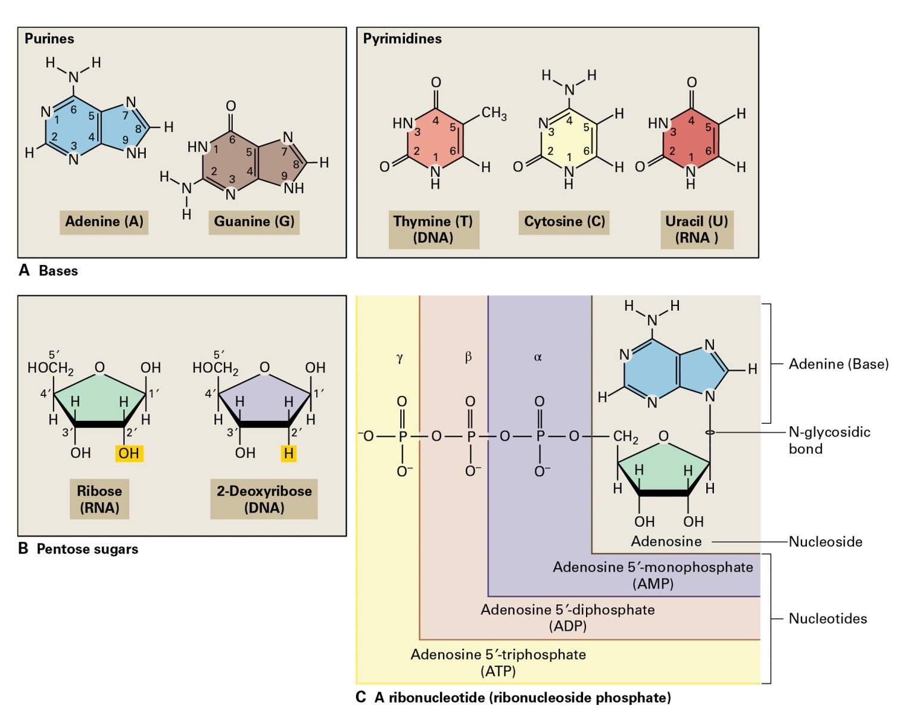
Genes and proteins
Nucleic acids
The chemical composition of nucleic acids

Slide 8
Genes and proteins
Replication of nuclear DNA
Telomere sequences are conserved

Slide 9
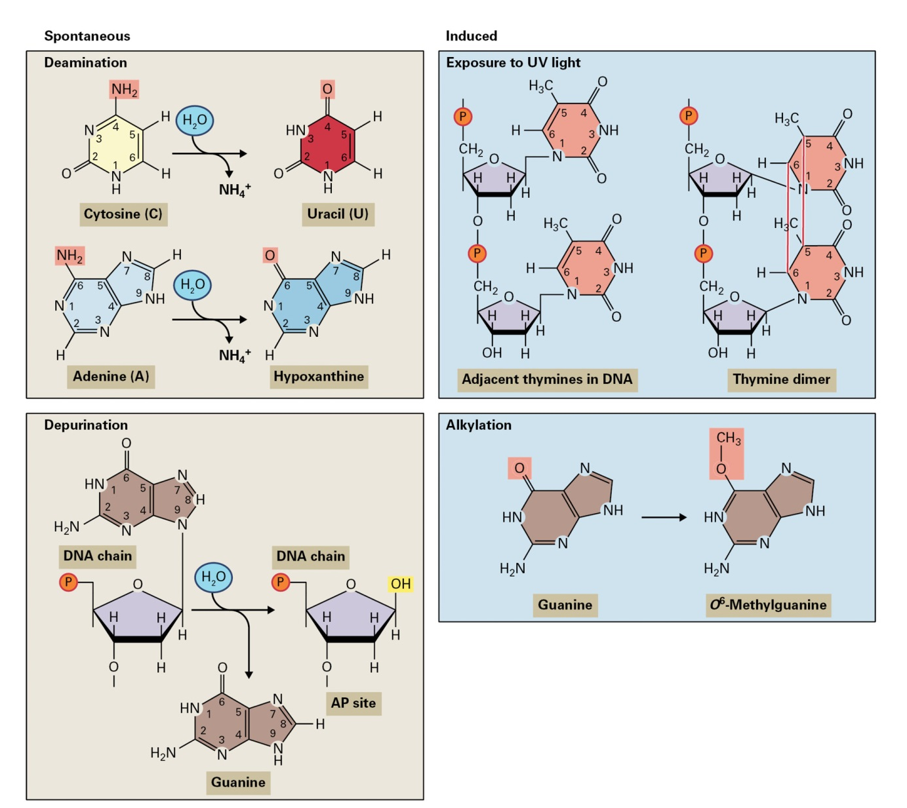
Genes and proteins
DNA repair

Slide 10
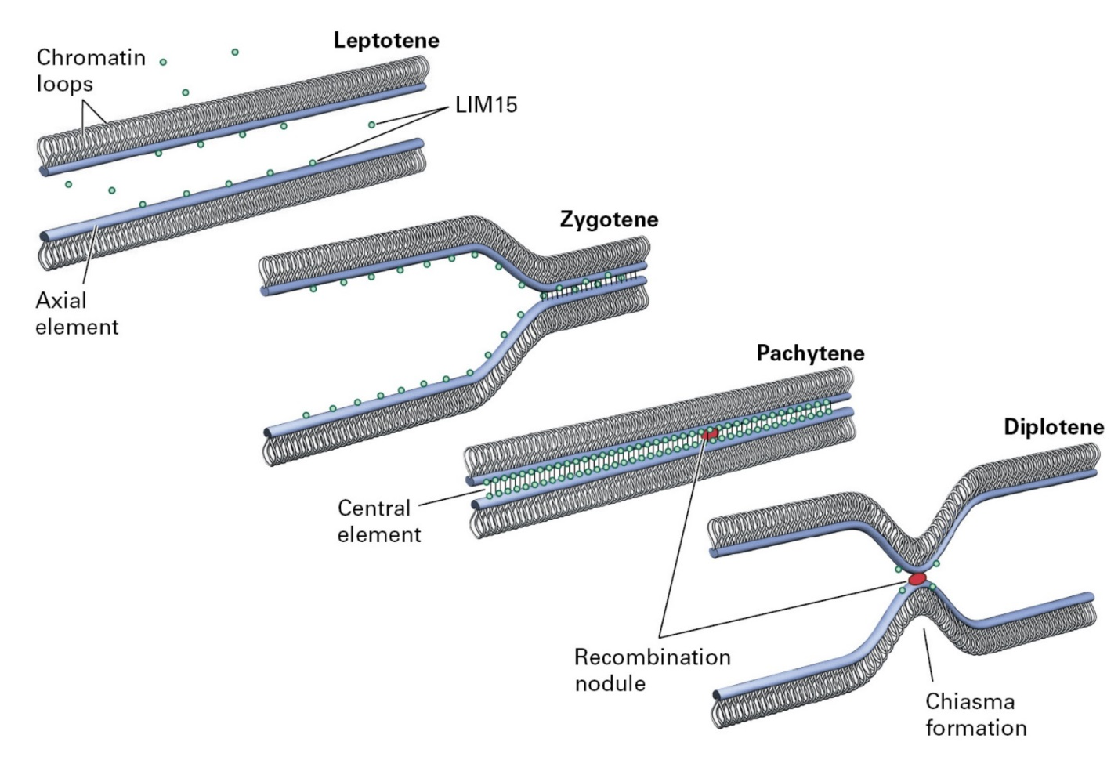
Genes and proteins
DNA recombination

Slide 11
Genes and proteins
Structure and organization of nuclear genome

Slide 12
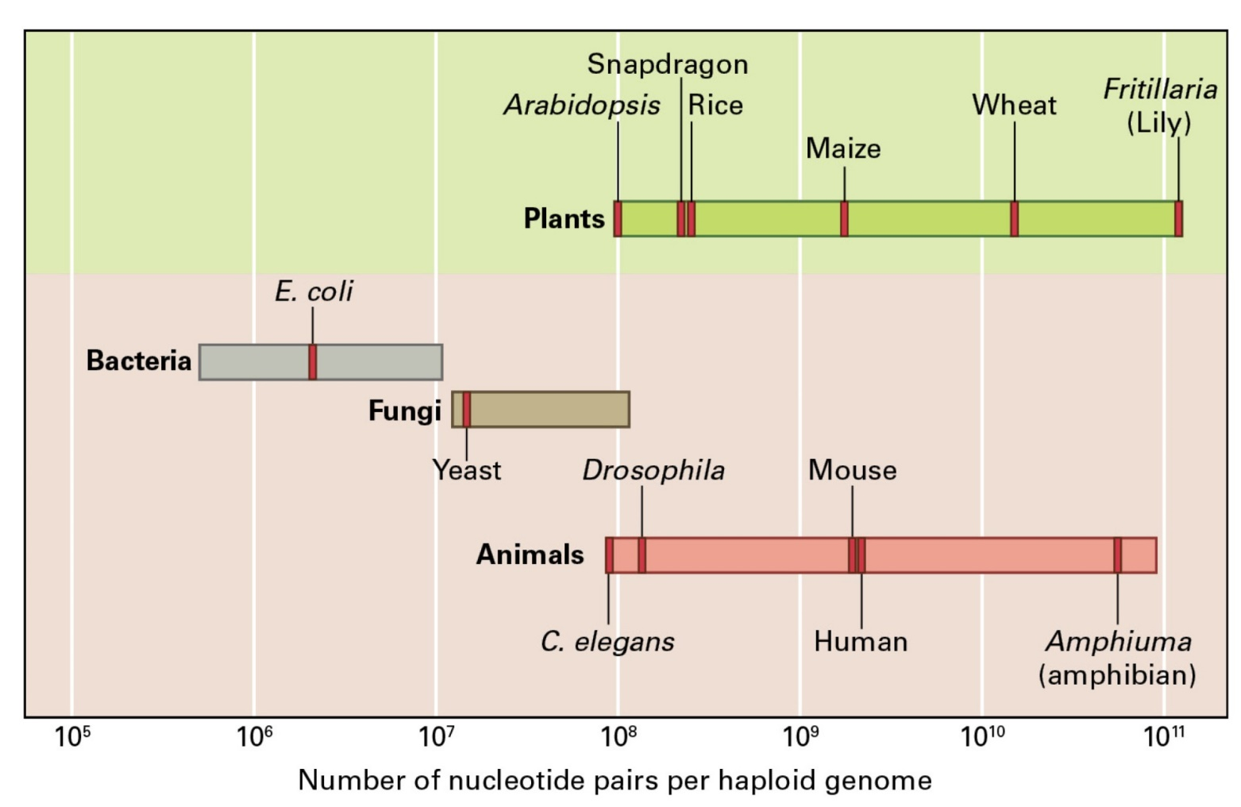
Genes and proteins
Structure and organization of nuclear genome
Genes are found on either DNA strand, but rarely in the same region on both strands.

Slide 13
Genes and proteins
Transposable elements
Mechanism of retrotransposon transposition
Structure and transposition of a class II transposable element

Slide 14
Genes and proteins
Organellar DNA
Comparison of mitochondrial and chloroplast DNA sequences from rice.
The colored boxes represent DNA sequences that have been transferred from chloroplast genome to the mitochondria.

Slide 15
Genes and proteins
RNA
Ribosomal RNAs can fold into complex secondary structures by pairing of complementary sequences.
A notable feature of all tRNA molecules is the presence of unusual bases.
Structures of typical mature nuclear-encoded and chloroplast mRNAs differ.

Slide 16
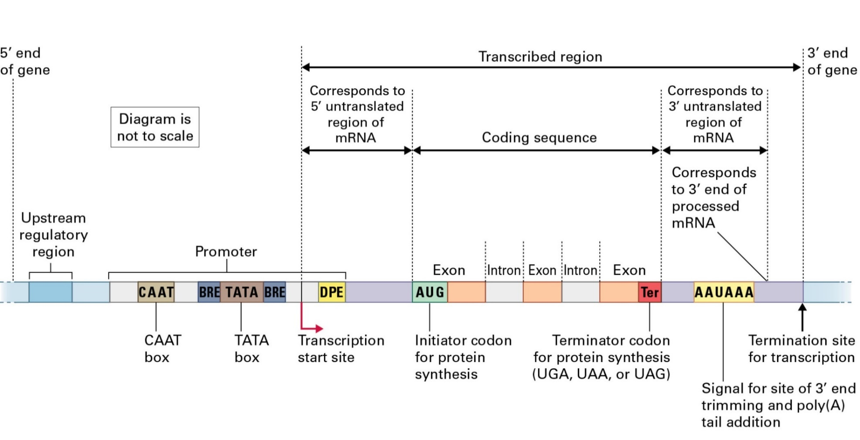
Genes and proteins
Gene expression
Example of a transcription preinitiation complex

Slide 17
Genes and proteins
Chromatin and regulation of gene expression

Slide 18
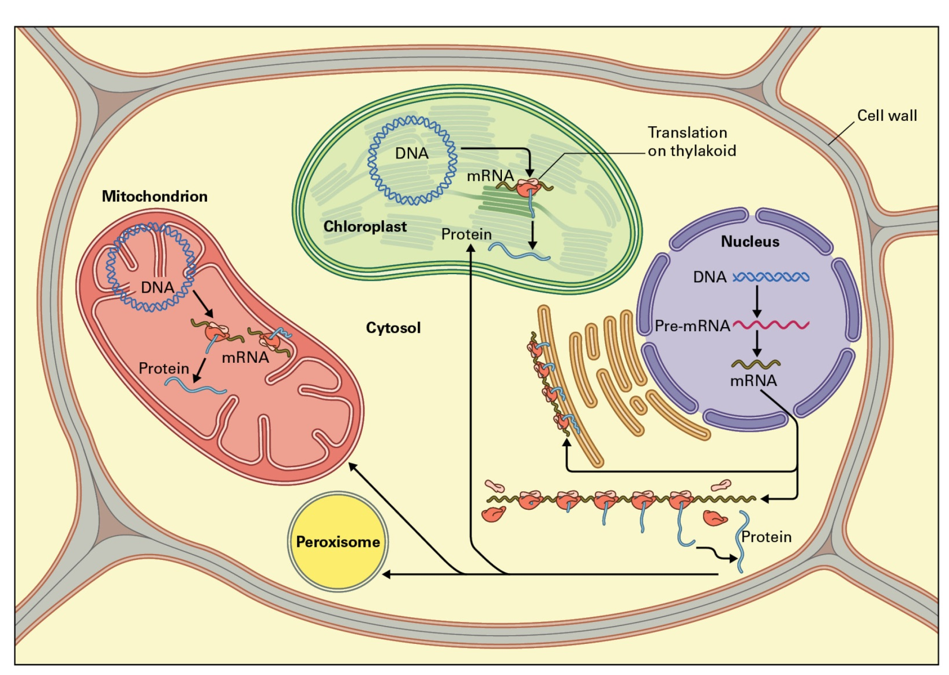
Genes and proteins
Protein synthesis

Slide 19
Genes and proteins
Post-translational modification of proteins
Structures of chaperonins illustrating the central cavity in which folding takes place

Slide 20
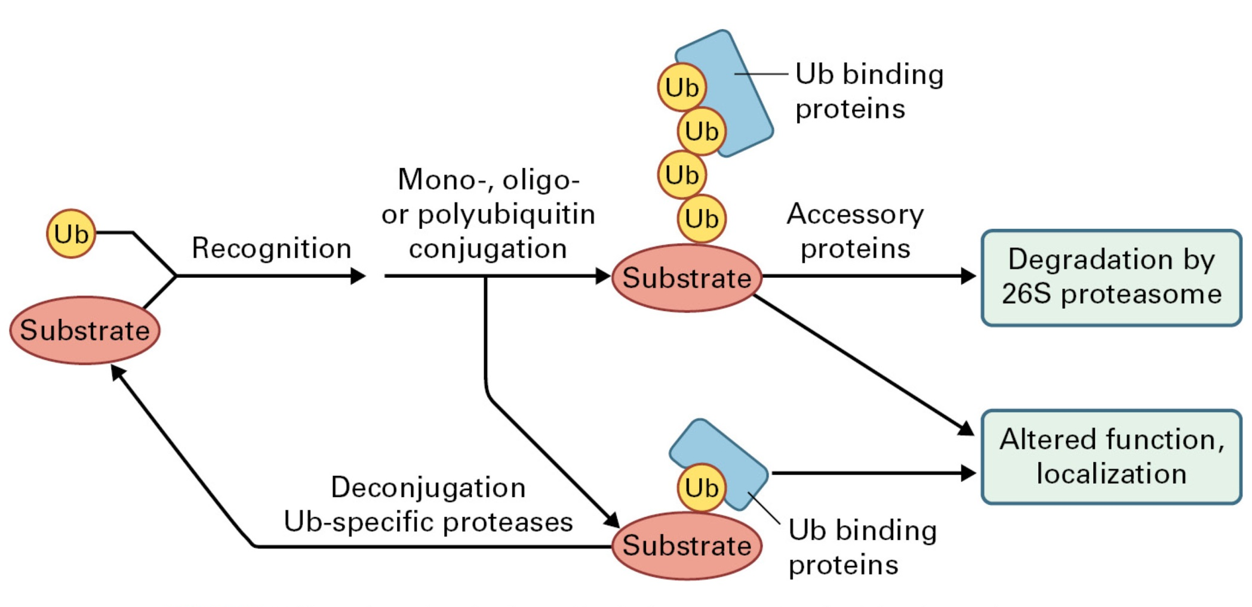
Genes and proteins
Protein degradation
Ubiquitin pathway

