Slide 1
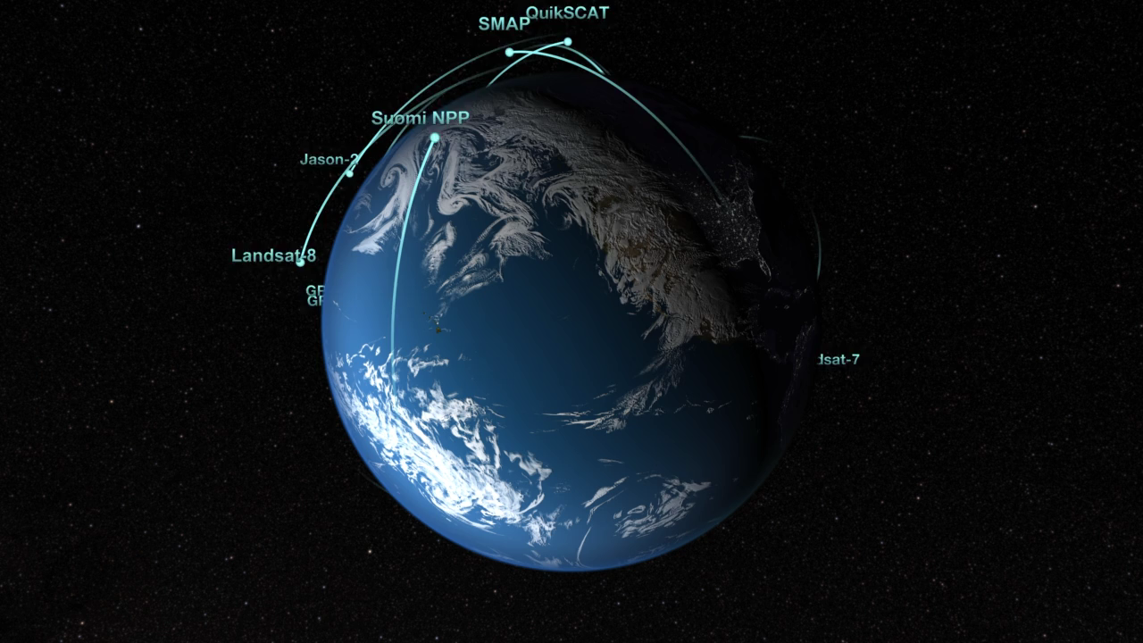
Notes:
Like orbiting sentinels, NASA’s Earth-observing satellites vigilantly monitor our planet’s ever-changing pulse from their unique vantage points in orbit. This animation shows the orbits of all of the current satellite missions. The flight paths are based on actual orbital elements. These missions—many joint with other nations and/or agencies—are able to collect global measurements of rainfall, solar irradiance, clouds, sea surface height, ocean salinity, and other aspects of the environment. Together, these measurements help scientists better diagnose the “health” of the Earth system.

