Slide 1
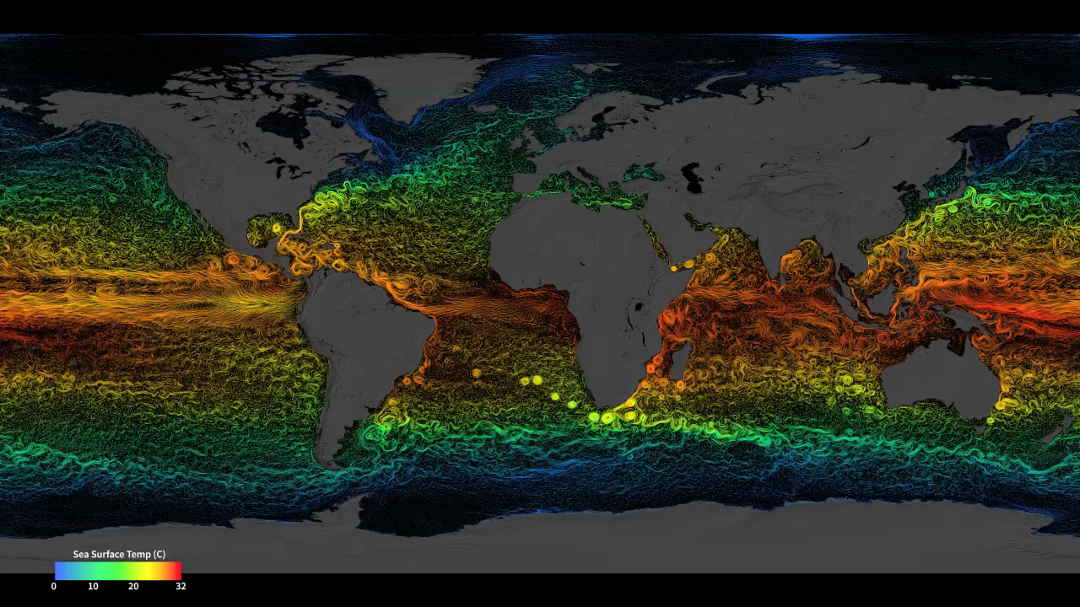
Notes:
The sun continually heats our planet, but the heating is unevenly distributed over Earth’s surface. The tropics receive more energy than they emit and the polar regions emit more energy than they receive. Things are out of balance. Ocean water near the equator gets hotter and hotter while ocean water near the poles gets colder and colder. Nature won’t stand for that kind of imbalance for very long. Its solution: the wind. Surface winds blow from areas of low pressure to high pressure, and help to steer ocean currents that transport heat in our oceans from the tropics to the poles. Scientists use model simulations like this one—produced by the Estimating the Circulation and Climate of the Ocean, Phase II (ECCO2)—to help resolve ocean eddies and other narrow-current systems that transport heat (and carbon) in our oceans. In this animation, from March 25, 2007 to March 3, 2008, colors represent sea surface temperatures while the flow lines represent sea surface currents.
Model: EECO 2The sun continually heats our planet, but the heating is unevenly distributed over Earth’s surface. The tropics receive more energy than they emit and the polar regions emit more energy than they receive. Things are out of balance. Ocean water near the equator gets hotter and hotter while ocean water near the poles gets colder and colder. Nature won’t stand for that kind of imbalance for very long. Its solution: the wind. Surface winds blow from areas of low pressure to high pressure, and help to steer ocean currents that transport heat in our oceans from the tropics to the poles. Scientists use model simulations like this one—produced by the Estimating the Circulation and Climate of the Ocean, Phase II (ECCO2)—to help resolve ocean eddies and other narrow-current systems that transport heat (and carbon) in our oceans. In this animation, from March 25, 2007 to March 3, 2008, colors represent sea surface temperatures while the flow lines represent sea surface currents.
Model: EECO 2

