Slide 1
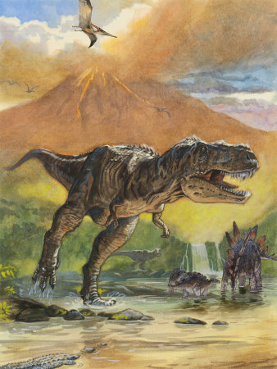
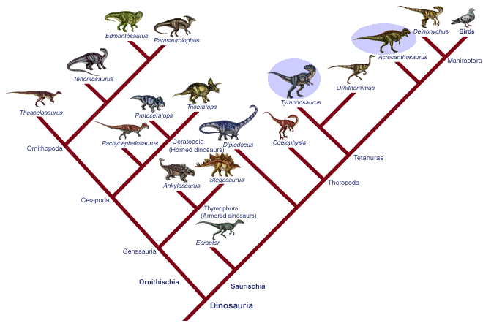
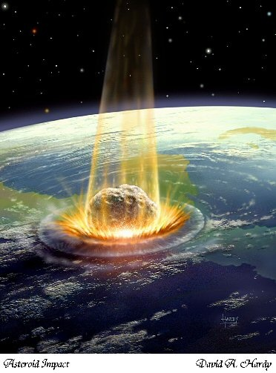
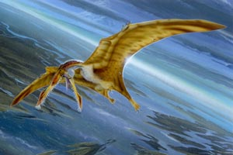
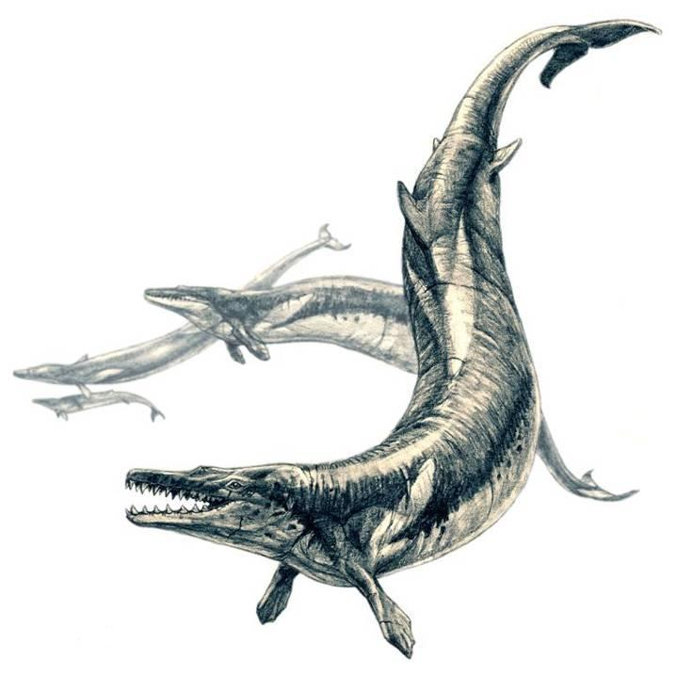
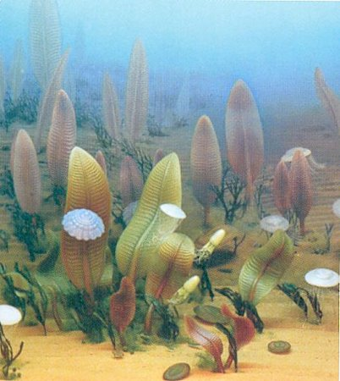
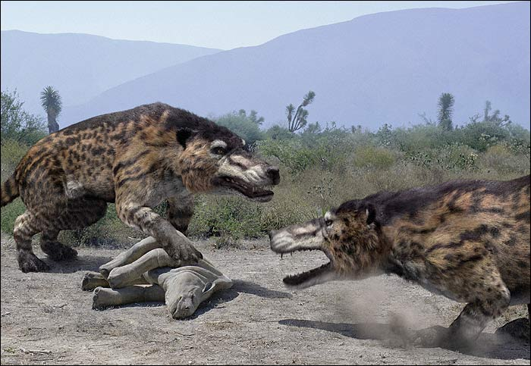
HISTORY OF LIFE ON EARTH

Slide 2
Systematics and taxonomy
systematics, paleontology → history of evolutionary changes
systematics = study of relationships between organisms
taxonomy = theory and practice of classification
category: class, order, family, species, …
taxon: Mammalia, Primates, Hominidae, Homo sapiens, …

Slide 3
1. Before Linnaeus
honeybee = Apis pubescens, thorace subgriseo, abdomine fusco, pedibus posticis glabris utrinque margine ciliatis
[Bee with soft short hairs, gray chest, dark brown abdomen, legs with no hair, and small sacs with hair-like outgrowths along the edge]
Acaciae quodammodo accedens, Myrobalano chebulo Veslingii similis arbor Americana spinosa, foliis ceratoniae in pediculo geminatis, siliqua bivalvi compressa corniculata seu cochlearum vel arietinorum cornuum in modum incurvata, sive Unguis cati
[A spiny American tree, in some way resembling Acacia, similar to Vesling´s Myrobalanus chebulae, with Ceratonia leaves in pairs on the pedicle, a silique with two valves, which is compressed, and horn-shaped or curved like the horns of snailshells or ram´s horns, or like a cat´s claws]

Slide 4
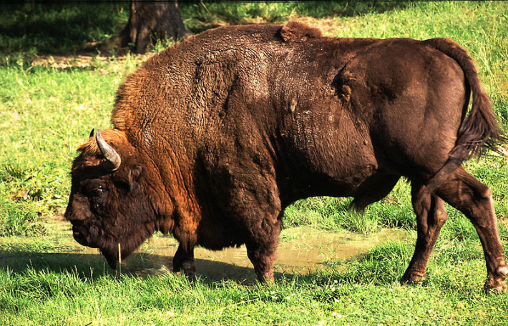
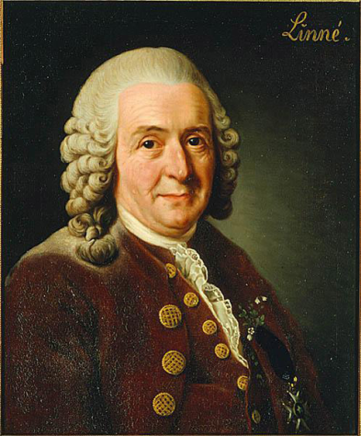
European bison = buffle, urus, bubalus, catoblepas, theur, the bubalus of Belon, Scottish bison
… Aristotle: bonasus → the same?
2. Carolus Linnaeus:
1735 Systema Naturae
binomial nomenclature: genus + species
hierarchical classification: kingdom, class, order, genus, species, (variety/subspecies)
Carolus Linnaeus

Slide 5
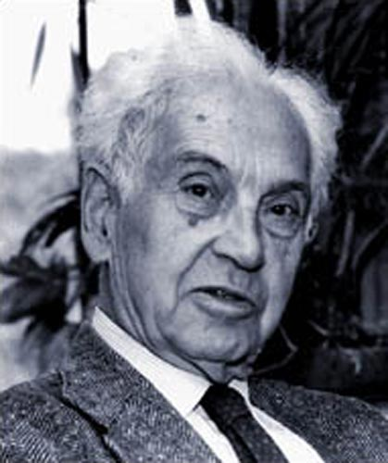
3. Darwin:
cladogenesis (branching) and anagenesis (change without branching)
a system should reflect a real phylogeny → but HOW?
Evolutionary systematics
before 1950: common ancestor + adaptive divergence
discussions if adaptive or neutral traits better
subjective and unclear criteria of choosing and weighing of traits ⇒ taxonomy in crisis (⇒ the word „taxonomy“ itself replaced by „systematics“)
controversy between splitters and lumpers
E. Mayr

Slide 6
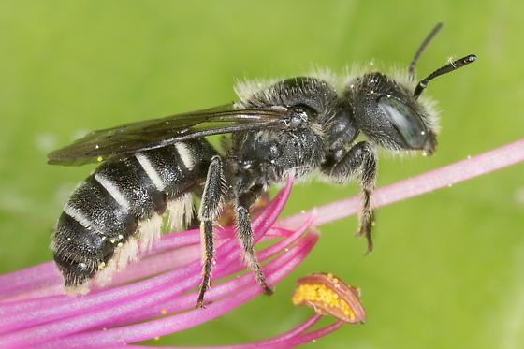
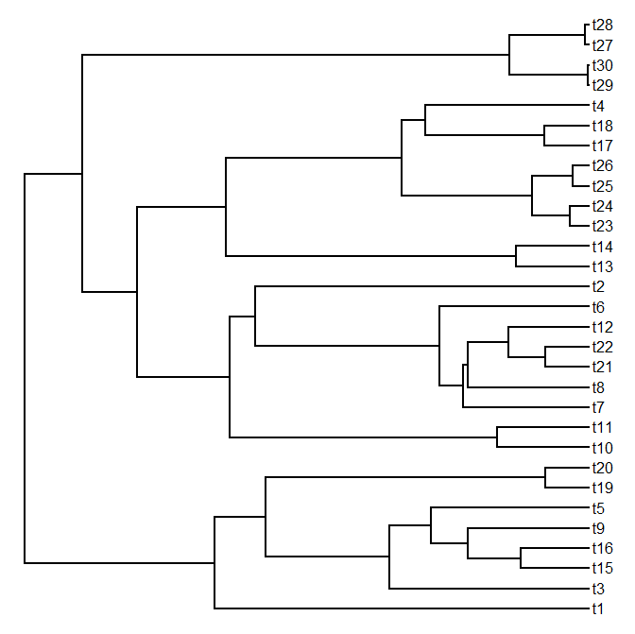
Numerical taxonomy (phenetics)
1957: Charles Michener, Robert Sokal, P.H.A. Sneath
taxonomy should be based on a total similarity rather than on a small number of „important“ traits
as many traits as possible
numerical methods: morphological and genetic distances, ordination (PCA, DFA, CVA, MDS, ...), cluster analysis (UPGMA)
phenograms
problems: homoplasy (= convergence, parallelism, reversion) shared primitive (ancestral) traits unequal rate of evolution
Hoplitis
phenogram
distance/
similarity

Slide 7
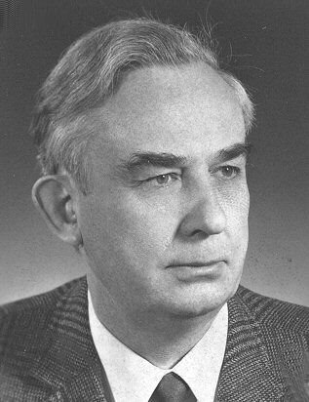
Phylogenetic systematics (cladistics)
1950, 1966: Willi Hennig: Phylogenetic Systematics
only genealogies, not adaptive divergence
strict monophyly
monophyletic group = clade
W. Hennig
monophyly
polyphyly
paraphyly

Slide 8
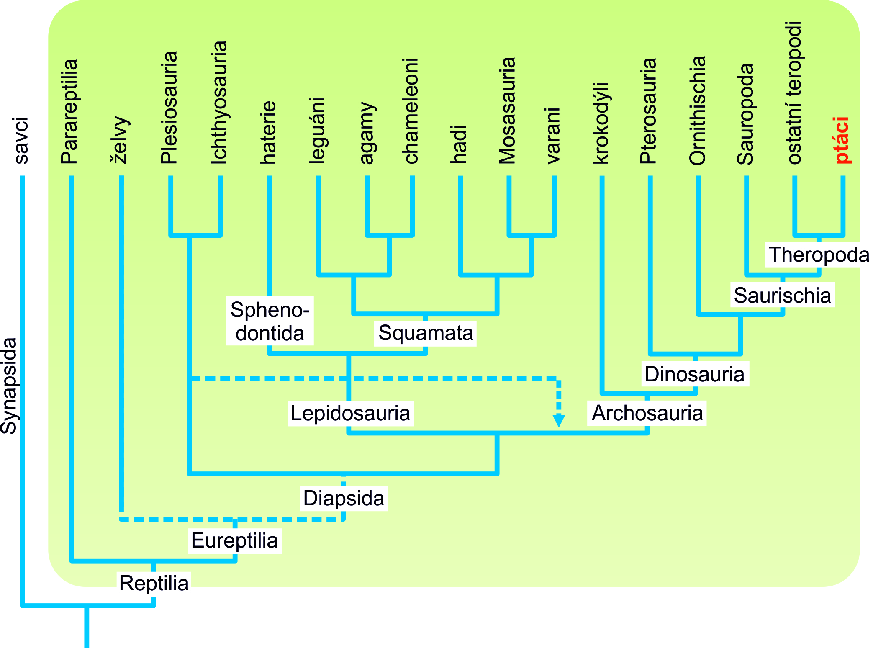
“Reptilia”

Slide 9
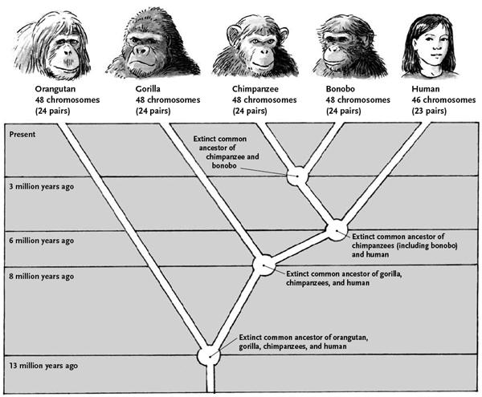
“Pongidae”

Slide 10
characters:
plesiomorphic (= ancestral, „primitive“) symplesiomorphic (= shared ancestral)
apomorphic (= derived) synapomorphic (= shared derived) autapomorphic (= unique derived)
clades defined only by synapomorphies
synapomorphy
symplesiomorphy
autapomorphy
mutation
mutation

Slide 11
Definition of clades and classification of extinct taxa:
crown group
origin of an apomorphy
stem group

Slide 12
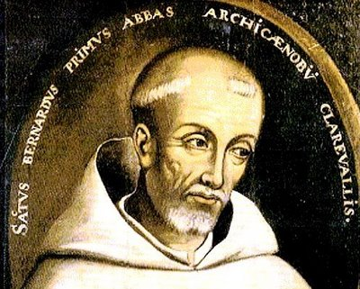
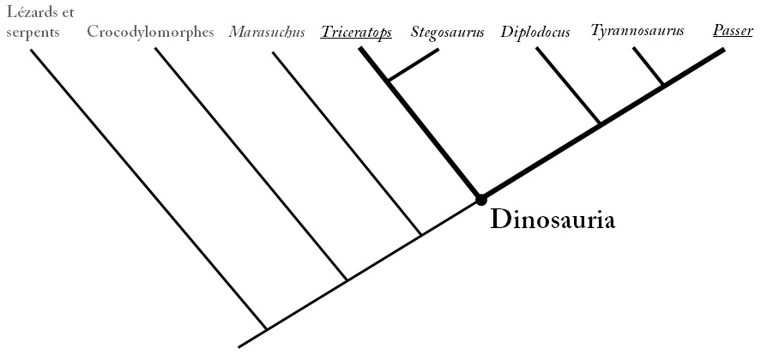
principle of parsimony: Occam´s razor (William of Ockham, 14th century)
cladograms
arbitrary dimension
PhyloCode (International Code of Phylogenetic Nomenclature) till now somewhat controversial and impractical
problems: homoplasy, rapid evolution

Slide 13
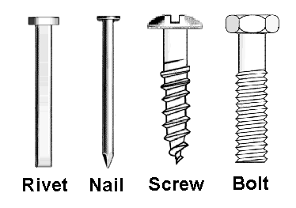
Cladistics and phenetics exemplified by the „evolution“ of fasteners
Rivet: the simplest structure ⇒ we suppose that it is the most similar to the common ancestor of all modern types of fasteners
We can define 7 derived character states (ie. those nonexistent in rivets):
1) notched heads, 2) rounded heads, 3) hex heads, 4) threaded shafts, 5) tapered shafts, 6) pointed tips, and 7) thick diameter.

Slide 14
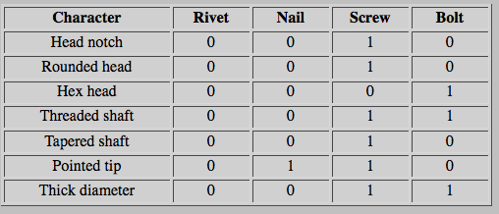
Cladistics and phenetics exemplified by the „evolution“ of fasteners
Character states of all 4 types are listen in the following table where
„0“ = plesiomorphic („rivet-like“) state
„1“ = apomorphic (derived) state

Slide 15
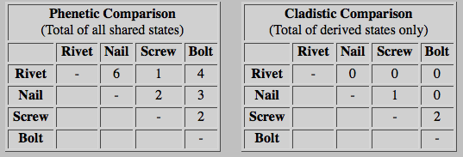
Cladistics and phenetics exemplified by the „evolution“ of fasteners
If we use the phenetic approach we count the total number of shared states (both ancestral and derived).
For example rivet vs. nail: 6 similarities, 1 difference

Slide 16
Cladistics and phenetics exemplified by the „evolution“ of fasteners
If we use the cladistic approach we take into account only shared derived states.
For example. screw vs. bolt: 2 synapomorphies

Slide 17
Cladistics and phenetics exemplified by the „evolution“ of fasteners

Slide 18
Evolutionary systematics – a response
phylogenetic relationships + degree of divergence ⇒ combination of phenetic and cladistic approach
reflection of both clades and grades
An evolutionary grade is a group of similar species that has given rise to another group that differs markedly from the ancestral condition, and is thus not considered part of the ancestral group. ⇒ the ancestral group is then paraphyletic
eg. reptiles (without birds), fishes in a traditional sense
E. Mayr

Slide 19
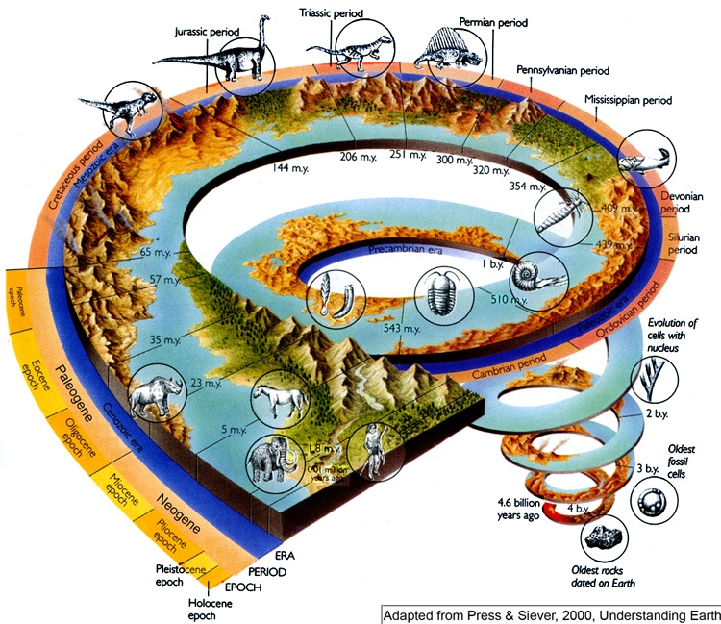
HistorY of life on earth

Slide 20
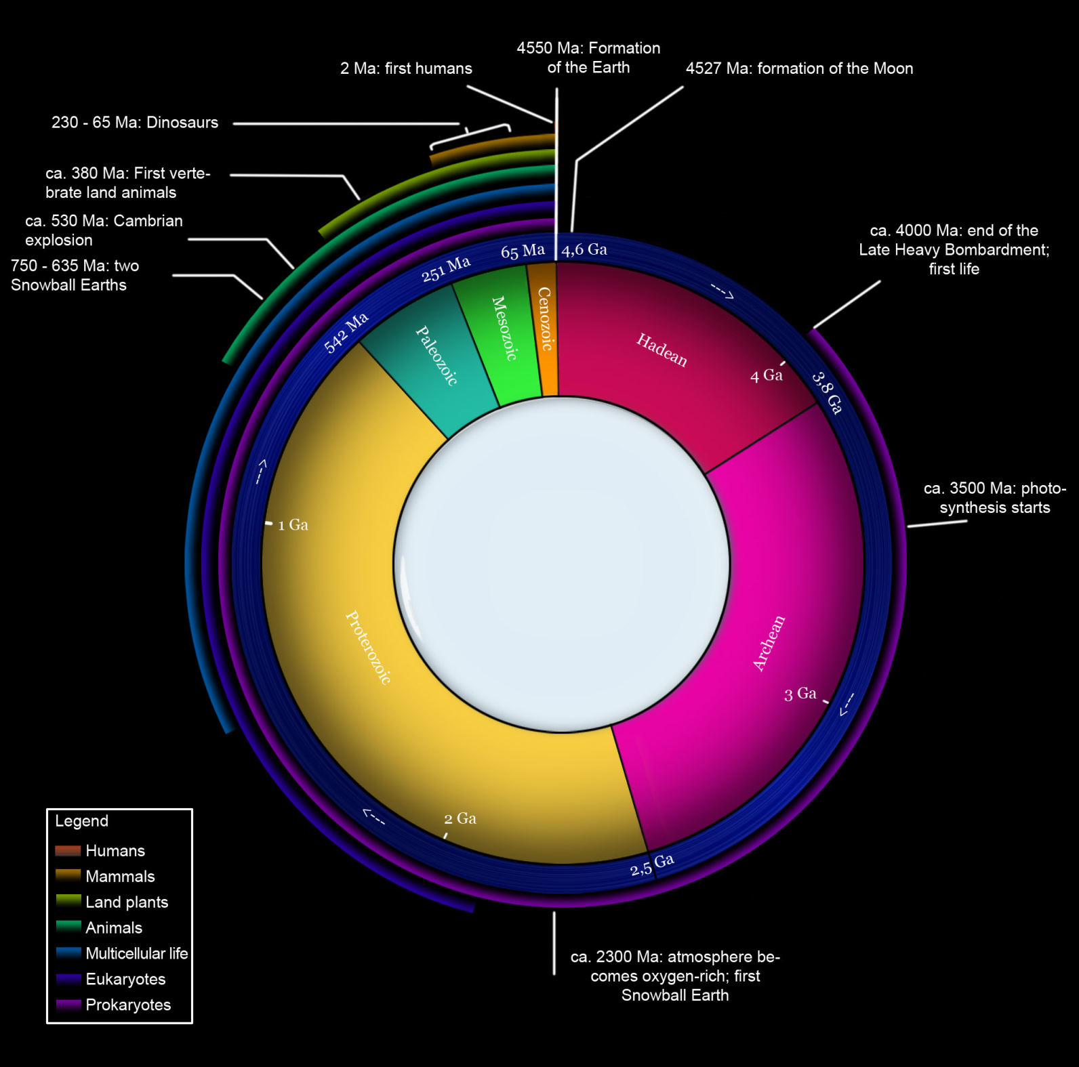

Slide 21
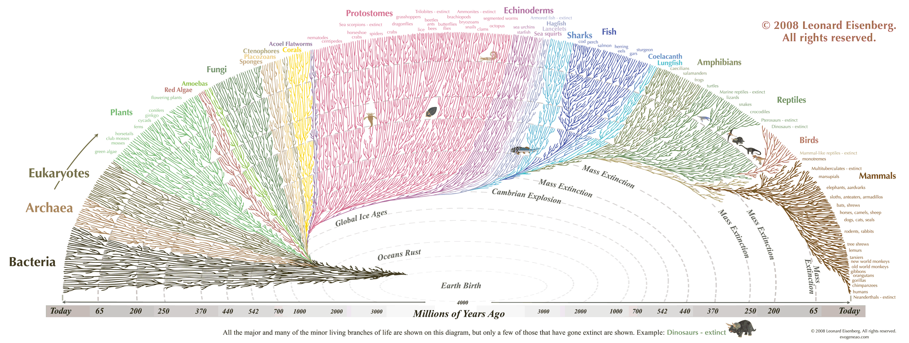

Slide 22
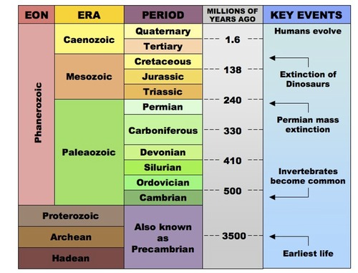
Precambrian
eon
Hadean
Archean
Proterozoic
Phanerozoic

Slide 23
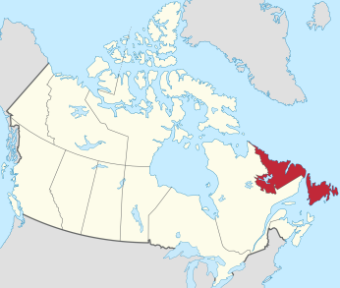
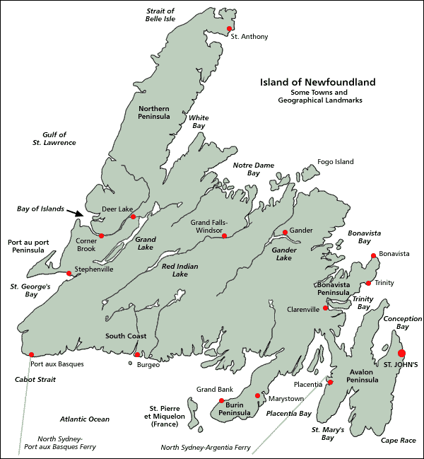
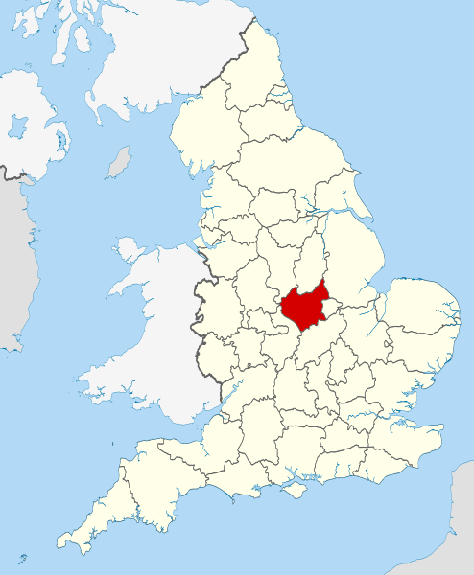
Precambrian
eon
Hadean
Archean
Proterozoic
Phanerozoic
Ediacaran (Vendian) fauna
∼635-542 M
Charnwood,
Leicestershire
∼ 560 M
Mistaken Point,
Newfounland
∼ 565 M

Slide 24
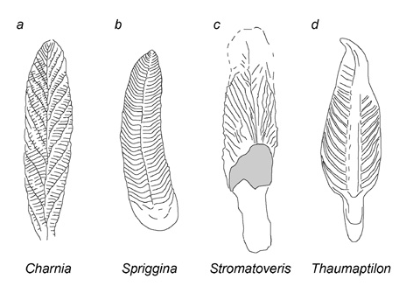
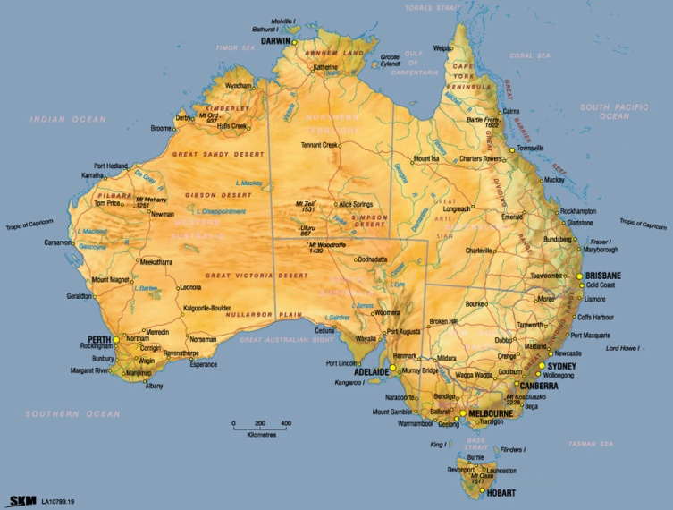
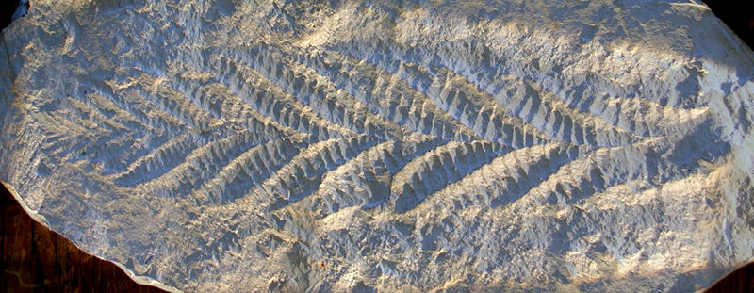
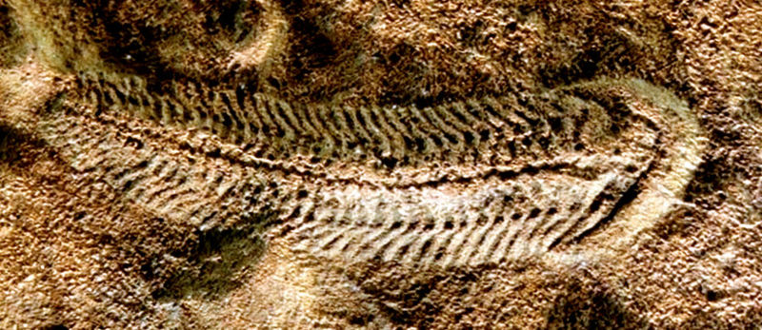
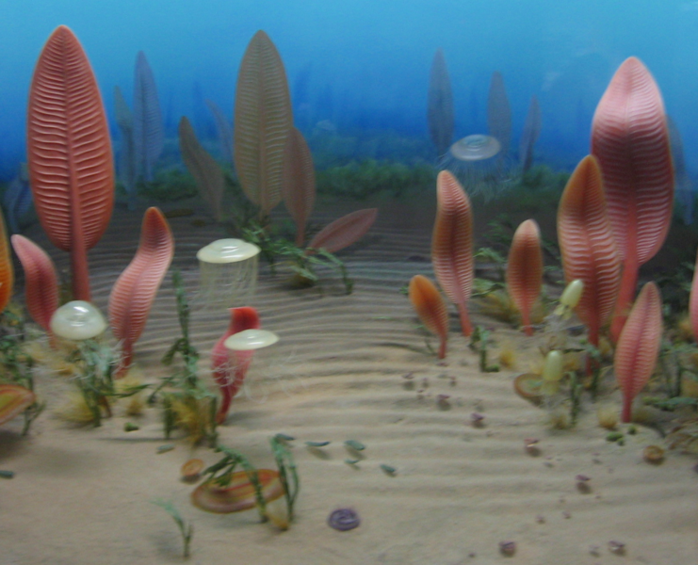
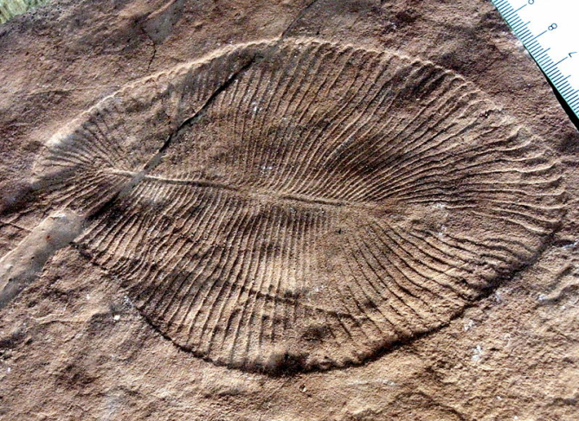
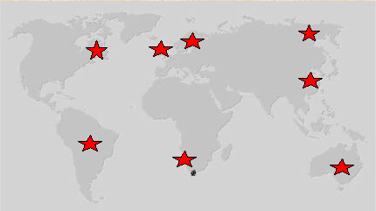
Ediacara Hills,
Australia
Charnia
Spriggina
Dickinsonia
∼ 580 M

Slide 25
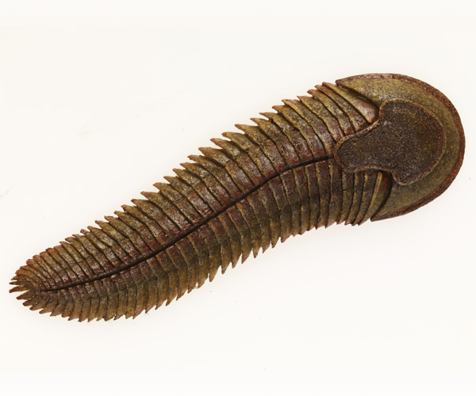
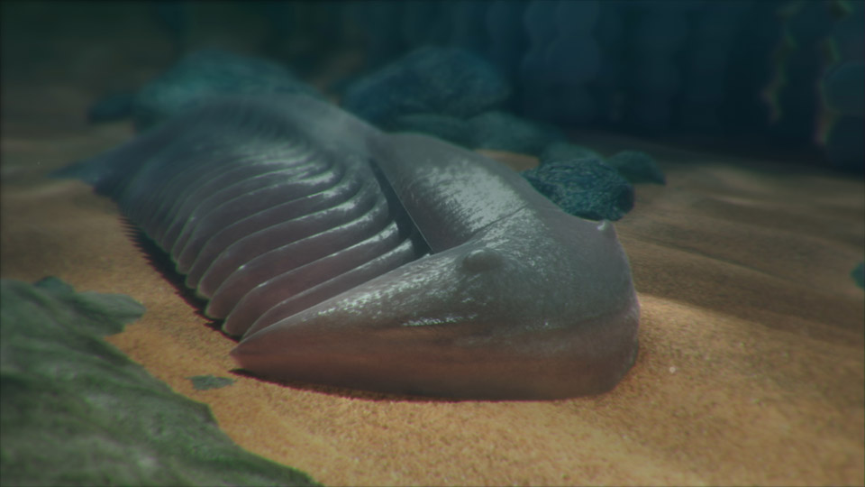
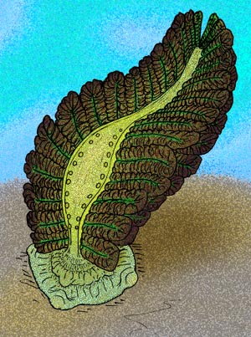
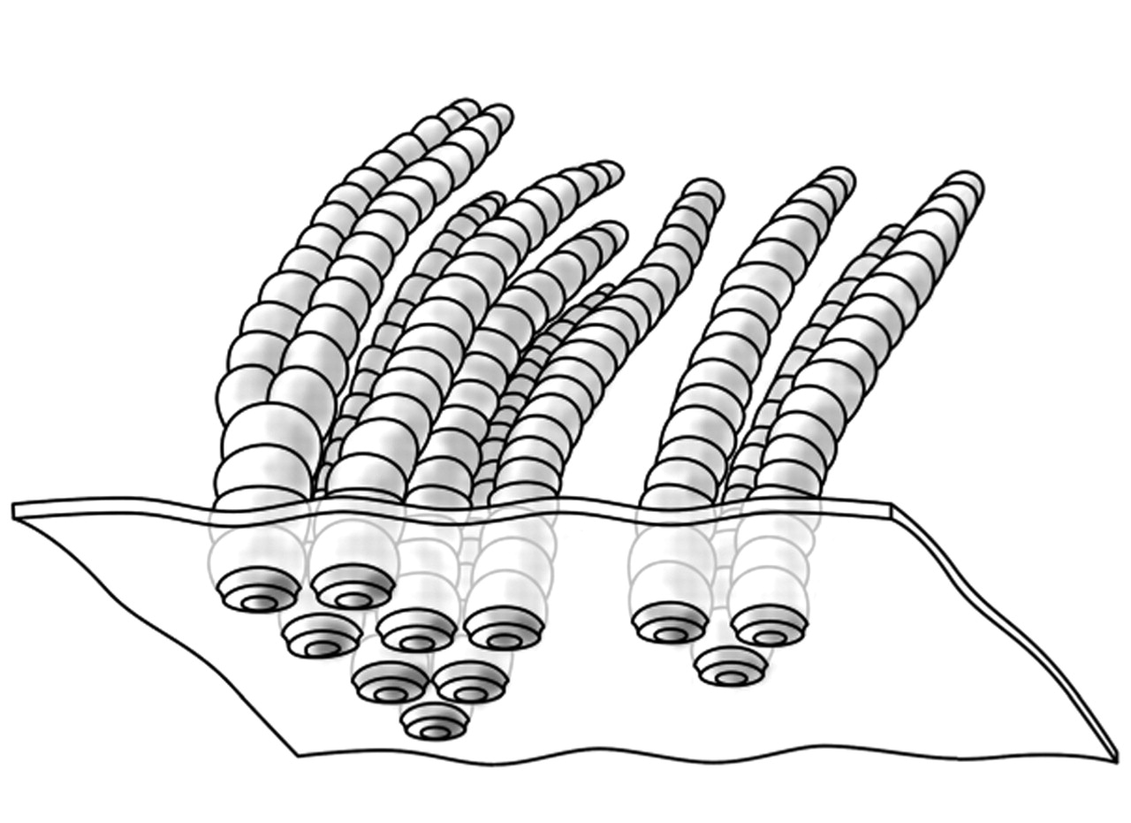
Spriggina
Funisia: sex?

Slide 26
Phanerozoic
era
Paleozoic
Mesozoic
Cenozoic
Cambrian explosion
∼ 542-520 M

Slide 27
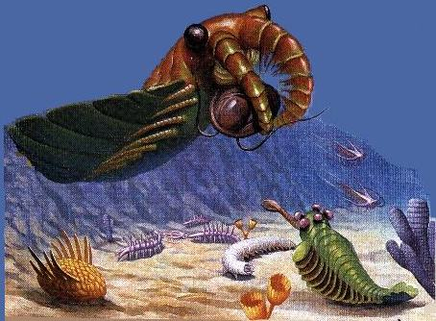
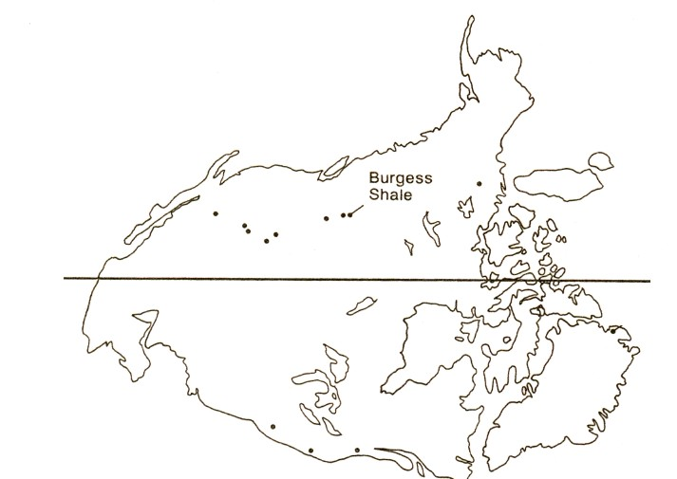
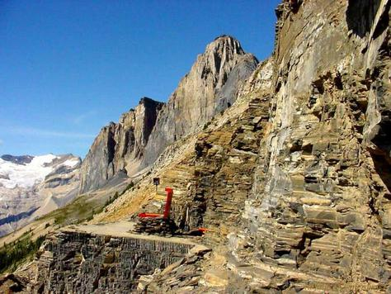
Cambrian explosion
Burgess Shale
~ 542-520 M
Canadian Rockies, Yoho National Park
continent

Slide 28
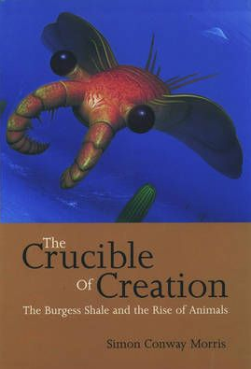
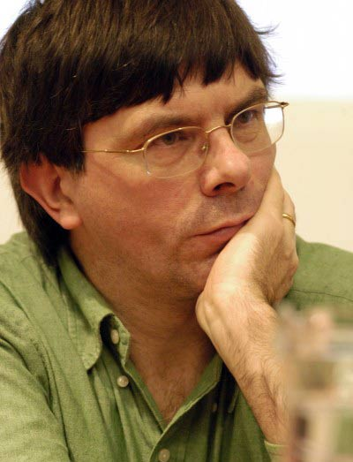
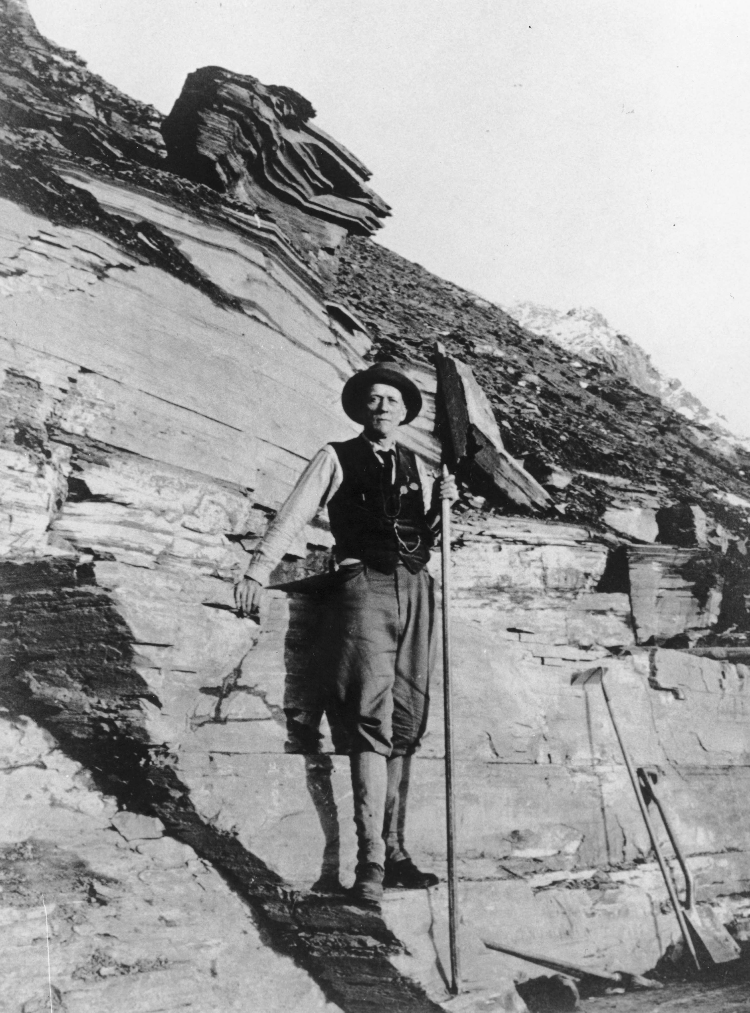
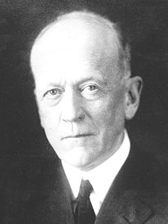
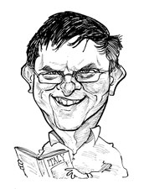
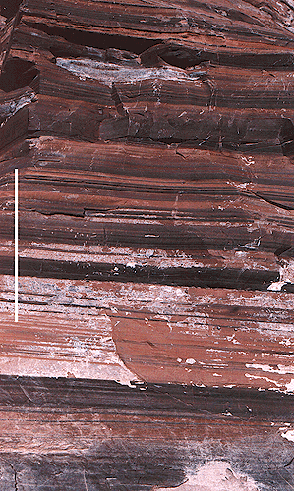
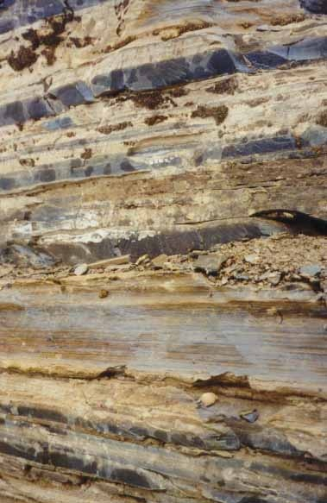
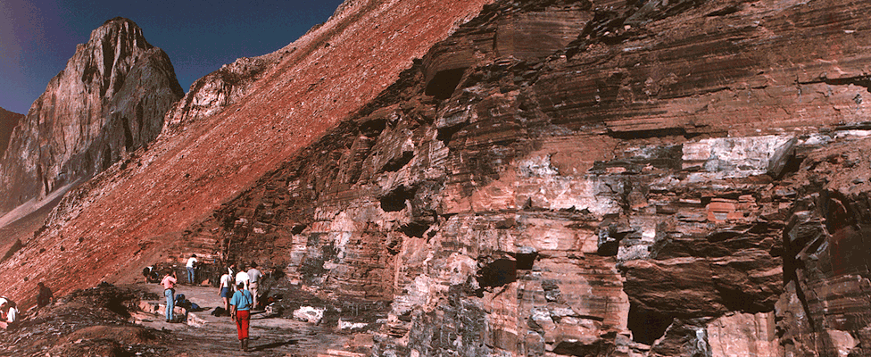
Charles Doolittle Walcott (1909)
Simon Conway Morris

Slide 29
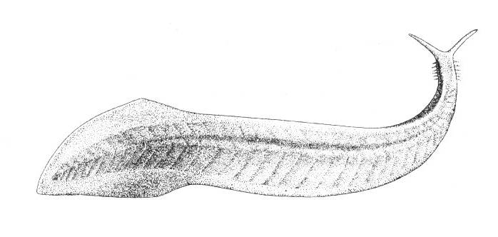
Pikaia gracilens
Yohoia
Anomalocaris
nathorsti
Marella
Hallucigenia
A. canadensis

Slide 30
Odaraia
Aysheaia
Wiwaxia
Leachoilia
Opabinia
Nectocaris

Slide 31
Hallucigenia
Pikaia gracilens (Chordata)

Slide 33
Aysheaia
Transition from sea to land?

Slide 34
Onychophora

Slide 35
diversity and disparity:
interpretation of Burgess fossils
Stephen Jay Gould vs. Simon Conway Morris
diversity = number of species
disparity = number of „Bauplans“
traditional
Gould
Conway Morris

Slide 36
Phanerozoic
modern fauna
increasing
diversity
Cambrian fauna
Paleozoic fauna
Jack J. Sepkoski (1981): logistic model
Michael J. Benton (1997):
curve for terrestrial organisms differs
exponential model

Slide 37
If we take into account incompleteness
of the fossil record → no trend?

Slide 38
Ordovician
Devonian
Permian
K/T
Triassic
Extinction:
background extinctions
mass extinctions → „Big Five“
greatest: end of the Permian

Slide 39
Paleozoic
Cambrian:
single supercontinent Rodinia (Proterozoic) → Gondwana, Laurentia, Baltica, Angara (Siberia), Avalonia …
Ordovician:
increase of diversity (marine organisms)
the end: 1st mass extinction
Silurian:
gnathostomes
first terrestrial o.
(plants, scorpions)
Laurentia+Baltica = Laurasia

Slide 40
Devon:
radiace ryb, první žraloci, lalokoploutví, obojživelníci
na konci 2. masová extinkce
Ichthyostega
365 Ma

Slide 41
Devon:
radiace ryb, první žraloci, lalokoploutví, obojživelníci
na konci 2. masová extinkce
Ichthyostega
Acanthostega
Karbon:
přesličky, hmyz, první plazi
Archaeothyris
(Synapsida)
Edaphosaurus (Pelycosauria)
Perm:
Pangea
Therapsida (→ savci)
na konci 3. masová extinkce

Slide 42
Mesozoic
Triassic:
butterflies, dipterans
radiation of reptiles (tortoises, ichthyosars, plesiosaurs,
pterosaurs)
the end: dinosars, mammals, 4th extinction
synapsid
Pelycosauria
(Palaeohatteria)
ichthyosaurs
plesiosaurs
Therapsida
cynodont
(Cynognathus)
pterosaurs
primitive mammal (Castorocauda)

Slide 43
Evolution of mammals
Sphenacodon: Lower Permian (270 M ) – mandible from several bones, reptile-like articulation, no eardrum
Biarmosuchia: Upper Permian – one of the first therapsids, articulation already more mammal-like, knit upper jaw, hind legs more upright
Biarmosuchus

Slide 44
Procynosuchus: end of Permian – primitive cynodont
Thrinaxodon: Lower Triassic – more derived cynodont, eardrum in the lower jaw

Slide 45
Probainognathus: Middle Triassic (~ 235 M) – 2 joints: mammalian+reptilian
Diarbrognathus: Lower Jurassic (~ 209 M) – advanced cynodont, although still 2 joints, but the reptilian one used almost entirely for hearing
Morganucodon: Lower Jurassic (~ 220 M) – still a residue of the reptilian joint

Slide 46
Hadrocodium: Lower Jurassic – transition of the middle ear ossicles from the jaw to the cranium

Slide 47
Mesozoic
Jurassic:
bone fishes
bird evolution
Stegosaurus
dinosaurs
Ornithischia
Saurischia
Brachiosaurus
Allosaurus

Slide 48
Mesozoic
Gigantosaurus
T. rex
Jurassic:
bone fishes
bird evolution
theropod dinosaurs
tyrannosaurs
(Cretaceous)
Maniraptora
birds
Microraptor gui
Archaeopteryx lithographica

Slide 49
Mesozoic
Cretaceous:
angiosperms
modern sharks and rays, mosasaurs, first snakes, birds
mammals: divergenc of marsupials and placentals
Hesperornis
Ichthyornis
the end: 5th extinction, 66 M
→ the cause??
mosasaurs

Slide 50
Extinkce na K/T* (K/Pg**) boundary:
1980 Louis Alvarez et al.:
catastrophic hypothesis – asteroid 10 km in diameter 10⁹ × more than Hiroshima
^{*)} Cretaceous/Tertiary
^{**)} Cretaceous /Paleogene
L. Alvarez
Notes:
Ukázalo se, že extinkce savců alespoň v Severní Americe byla mnohem vážnější (93 % druhů, 86 % rodů) a zotavení rychlejší než se původně myslelo. Během 300 ky lokální diverzita na K úrovni, morfologická disparita dokonce vyšší; díky vysoké míře endemismu regionální diverzita dokonce 2X vyšší. Důvodem to, že extinkce se týkala především druhů s menším rozšířením, proto bias – ten se může týkat i dalších extinkcí.

Slide 51
Extinction on the K/T (K/Pg) boundary:
iridium on the boundary
K/T boundary
cca. 100-fold increase of the amount of iridium

Slide 52
Chicxulub crater (Mexico)
map of gravitational field
cenotes
syncline
tektites from the K/T
shock crystal

Slide 53
Problems of the impact theory:
extinctions not that sudden for most animals, occurring before the impact
species have been disappearing in several phases from more thermophilic to less thermophilic
the impact by ca. 300 ky older than the extinction (but it may have trigger tsunamies and earthquakes ⇒ mixing of layers)
locality El Penon (Mexico): same species above and below the „impact“ layer) Alternative hypothesis:
gradual cooling caused by giant volcano erruptions on the Deccan Plateau in India
basalt layer 1200-1800 m thick, 100 000 km² ⇒ during 1 MY → min. 1,5 mil. km³ of basalts
the origin of the plateau at the turn of the Cretaceous and Tertiary

Slide 54
Recent findings:
According to new dating the Deccan event appeared before the impact – problém: inaccurate dating of the Indian event
More precise dating: the Chicxulub crater corresponds with the extinction
100 ky before the impact cooling by 6–8 °C, probably as a consequence of the Deccan catastrophe – the impact then as the „coup of grace“
Cyanobacteria as a result of the greenhouse effect?
Some theories: two consecutive impacts
Animations:
eg. https://www.youtube.com/watch?v=bU1QPtOZQZU

Slide 55
eon:
Phanerozoic
era
Paleozoic
Mesozoic
Cenozoic
period
Paleogene
Neogene
epoch
Paleocene
Eocene
Oligocen
Miocene
Plio-
Pleisto-

Slide 56
Paleontological vs. molecular data
When have animal phyla and mammalian/bird orders emerged?
Cambrian explosion?
molecular data (Wray et al. 1996):
Protostomia-Deuterostomia ∼ 1200 M Chordata-Echinodermata ∼ 1000 M
„phylogenetic fuse“?

Slide 57
Paleontological vs. molecular data
When have animal phyla and mammalian/bird orders emerged?
Cambrian explosion?
recent molecular estimates closer to the Cambrian explosion:
Metazoa ∼ 650 M (Peterson et al. 2004) Protostomia-Deuterostomia ∼ 582 M (Aris-Brosou and Yang 2003)

Slide 58
Cambrian explosion?
fauna of Chengjiang (Chína) ∼ 525 M
Myllokunmingia
Yunnanozoon lividum
Haikouella lanceolata

Slide 59
Cambrian explosion?
fauna of Chengjiang (China) ∼ 525 M
Doushantuo formation (S China), 590–560 M: many species
early embryonic stages?
Haikouichthys
ercaicunensis 525 M

Slide 60
Paleontological vs. molecular data
When have animal phyla and mammalian/bird orders emerged?
recent groups of mammals and birds and the K/T boundary
cetacean evolution: mesonychids → moving to water → cetaceans
Andrewsarchus
mongolicus
Spinosaurus
Tyrannosaurus
Mesonyx
Allosaurus
Gigantosaurus
polar bear
Andrewsarchus

Slide 61
cetacean evolution
Pakicetus 56-34 M
Ambulocetus 50-49 M
mesonychids ∼ 56 M
Dorudon 41-33 M
Rodhocetus 47 M
Basilosaurus 40-34 M
Cetotherium 15 M

Slide 62
General principles
diversity: stock market analogy
extinction: foot soldier model
lifetime of lineages: gambler´s bankruptcy model
random walk
David Raup, Jack Sepkoski: periodicity? (26 M)
D. Raup
J. J. Sepkoski

