Slide 1
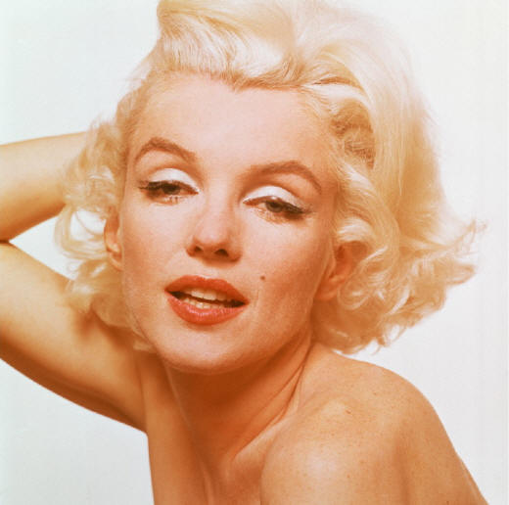
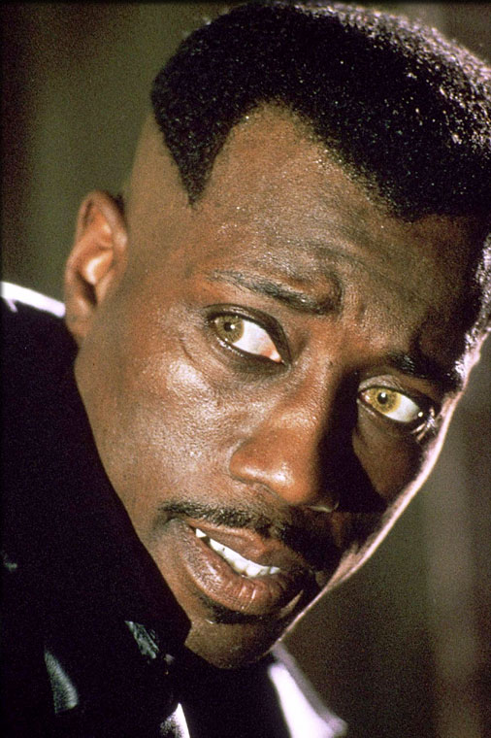
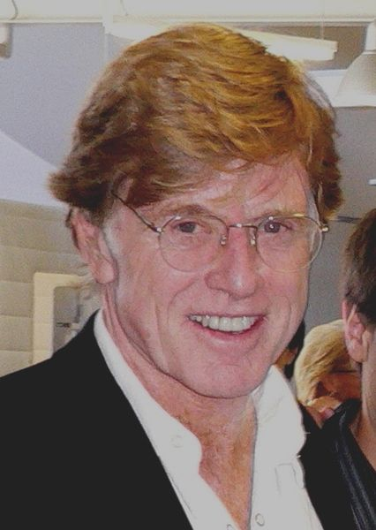
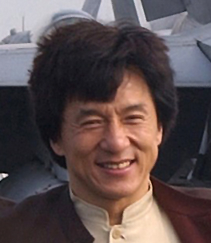
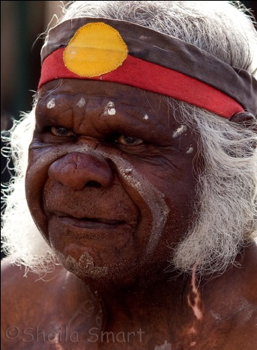
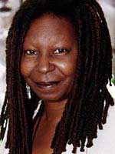
GENETIC AND PHENOTYPIC
VARIATION

Slide 2
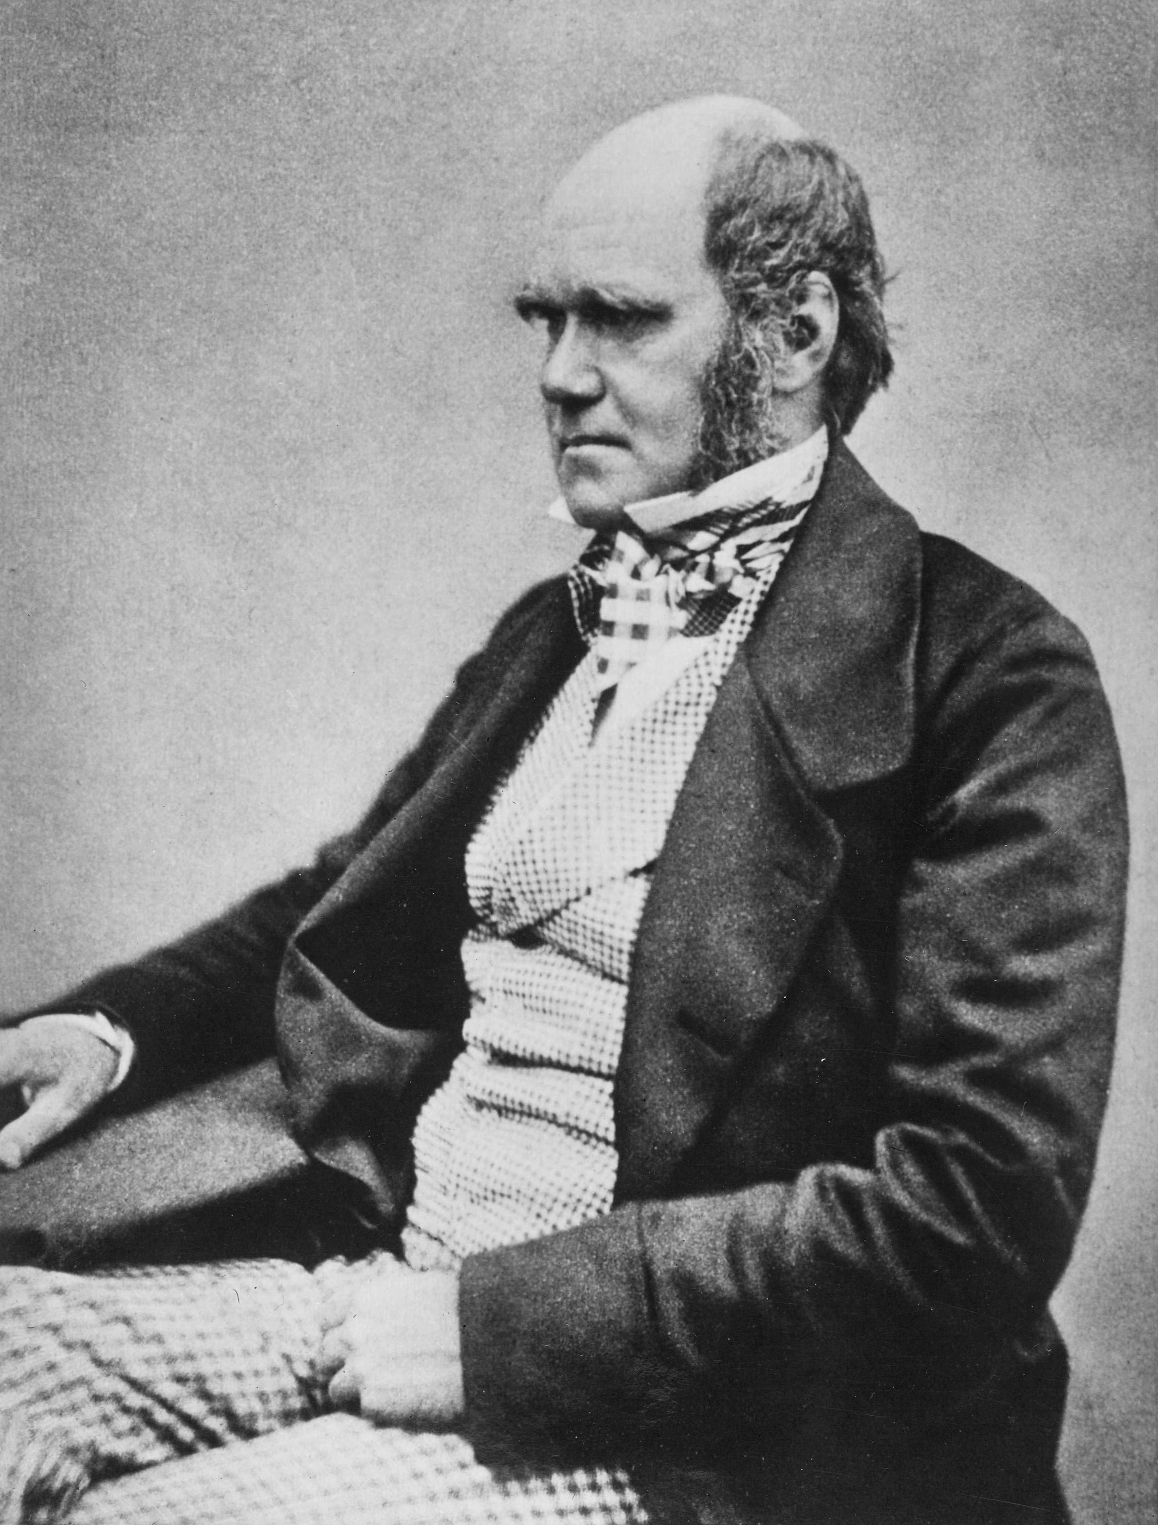
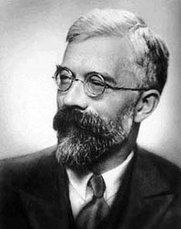
Evolution as a two-stage process:
1. variation among individuals in a population
2. changes in the proportion of variants from generation to generation
The increase in mean fitness due to natural selection is proportional to the additive genetic variance in fitness.
R.A. Fisher

Slide 3
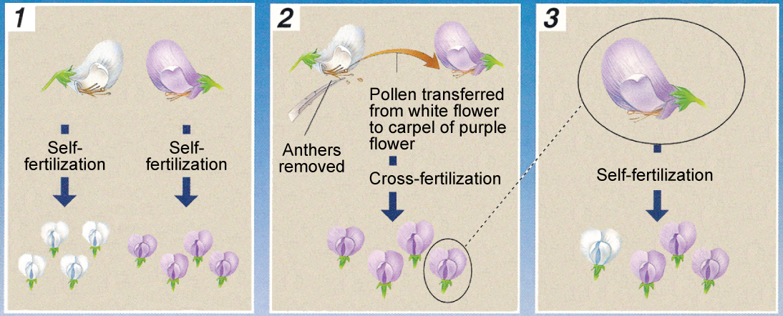
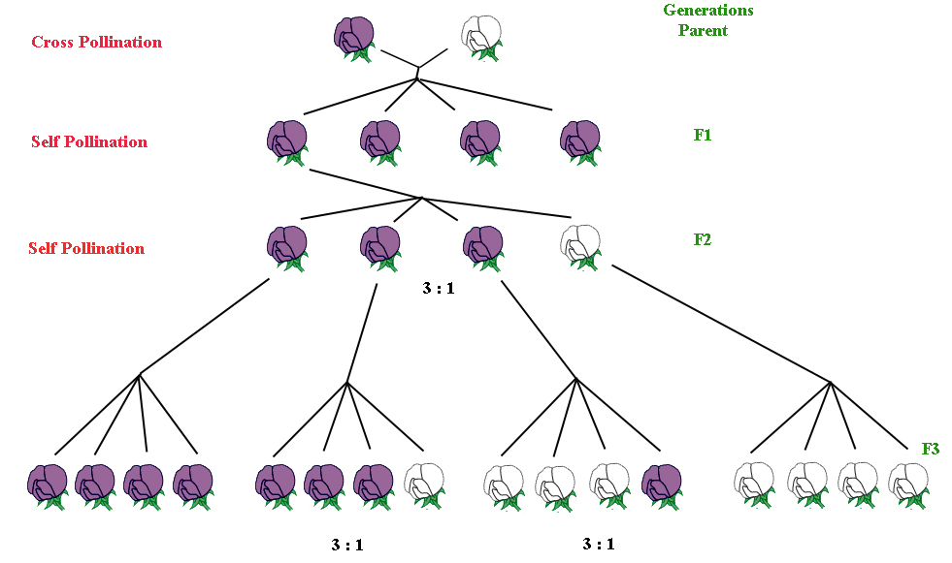

Slide 4
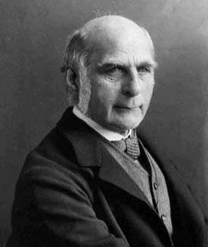
F. Galton
Biometricians: continual variation
many genes
often strong influence of environment

Slide 5
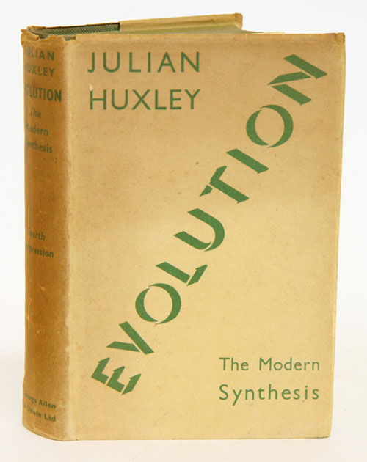
Sources of phenotypic variation:
differences in genotype
differences in environmental conditions
maternal influences (paternal influences)
Paradox:
for evolutionary biologists important to study phenotypes
× for geneticists easier to directly study molecules

Slide 6
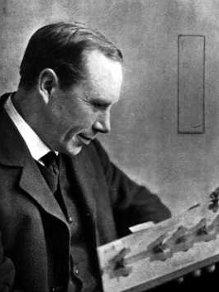
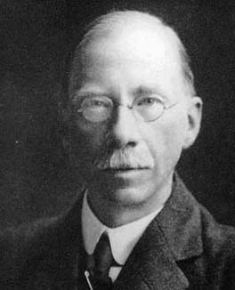
Reginald C. Punnett: brachydactyly
B
b
B
BB
Bb
b
Bb
bb
Why don´t we observe the 3:1 ratio in populations?
George Udny Yule

Slide 7
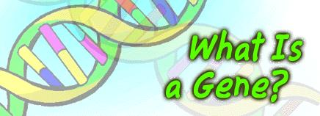
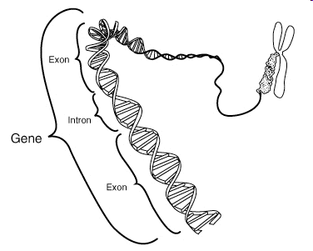
gene … till now difficult to define/delimit
locus … here = gene or any other molecular trait
alleles = alternative forms of genes (now broader meaning – segment of DNA)
genome = set of all genes of an individual (nuclear, mitochondrial...)
genotype = set of alelles of one or more genes of an individual
haplotype (haploid genotype) = combination of alelles inherited together

Slide 8
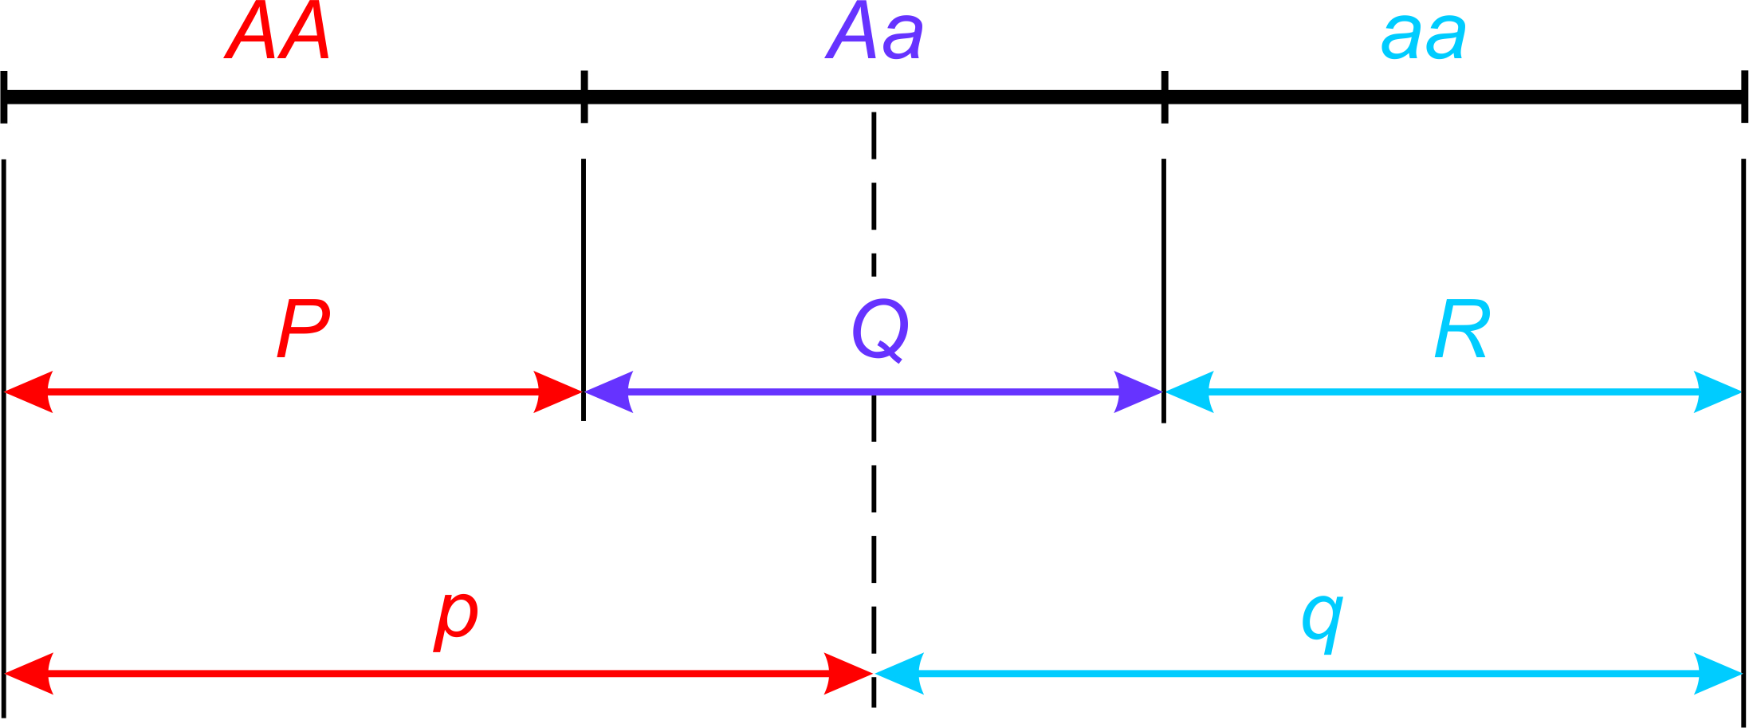
Genotype and allele frequencies
Frequencies: genotype: P (f_{AA}), Q (f_{Aa}), R (f_{aa})
allele (gene): p (A), q (a)
P + Q + R = 1
p + q = 1

Slide 9
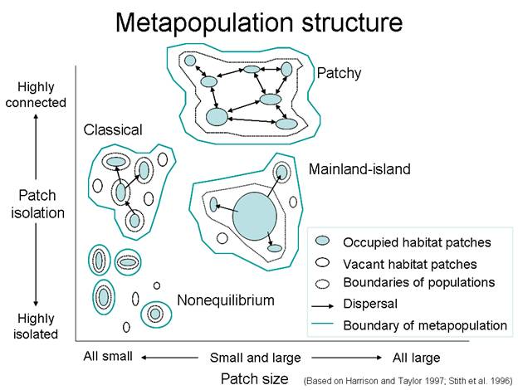
Evolution takes place in populations…
T. Dobzhansky, E. Mayr:
population as a shared gene pool
≈ set of shared alelles or gametes
local populations (subpopulations, demes)
global population, metapopulation

Slide 10
Evolution takes place in populations…
T. Dobzhansky, E. Mayr:
population as a shared gene pool
≈ set of shared alelles or gametes
local populations (subpopulations, demes)
global population, metapopulation
Local populations also share a system of mating
populations natural, experimental, agricultural, model

Slide 11
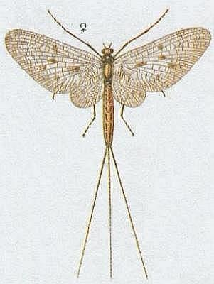
Model populations – Hardy-Weinberg population
Characteristics:
diploid
sexual reproduction
discrete generations
2 alleles, „fair“ segregation 1:1
same frequencies of alleles in both sexes

Slide 12
Model populations – Hardy-Weinberg population
Characteristics:
random mating (panmixis) non-random: assortative mating, inbreeding
very large (effectively infinite) size
no gene flow
no mutation
no selection

Slide 13
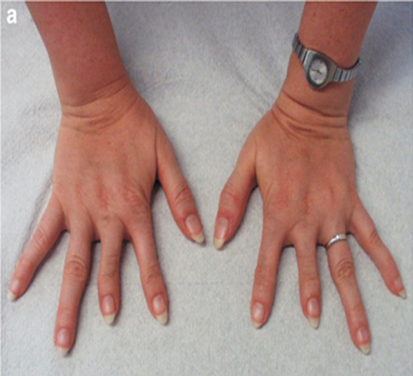
Why don´t we observe the Mendelian ratios in nature?
R. C. Punnett
1908
Godfrey Harold Hardy

Slide 14
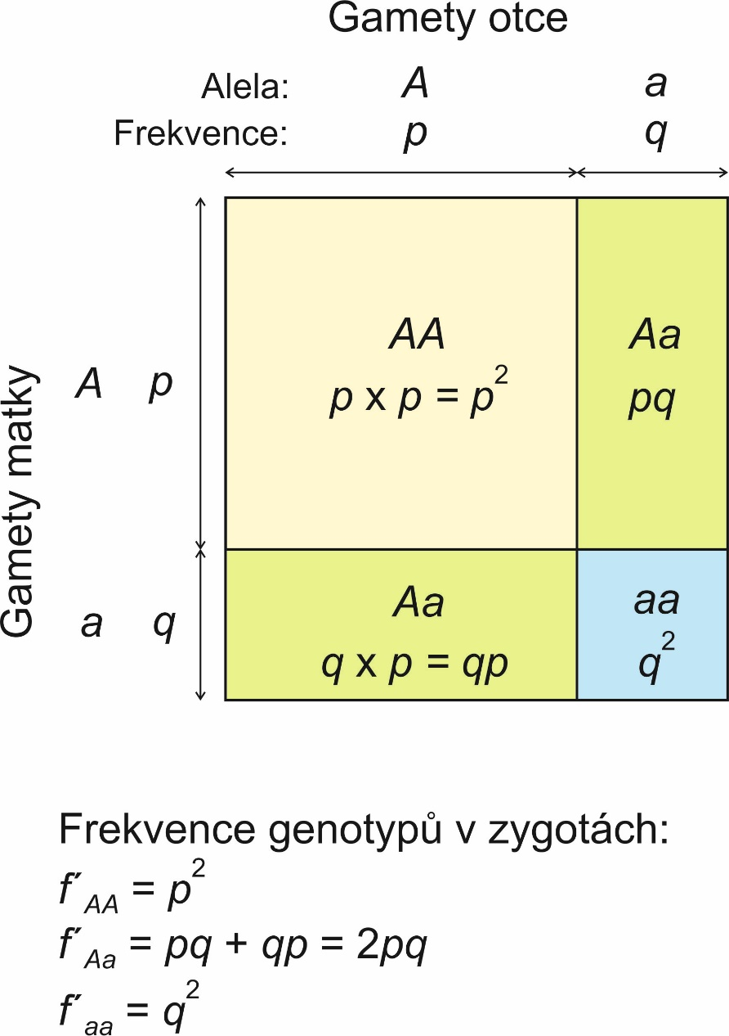
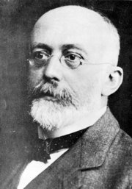
HARDY-WEINBERG PRINCIPLE
Father´s gametes
Godfrey Harold Hardy
(1877-1947)
Mother´s gametes
Genotype frequencies in zygotes:
Wilhelm Weinberg
(1862-1937)
p² + 2pq + q² = 1

Slide 15
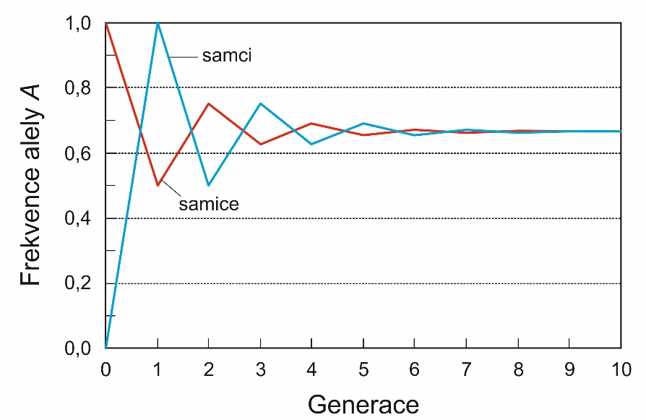
HARDY-WEINBERG PRINCIPLE
1. Alelle frequencies stable across generations
= Hardy-Weinberg equilibrium (HWE)
2. HWE achieved within a single generation of random mating
Generalization:
X-linked genes: females: p² + 2pq + q² males: p + q
more than 2 alleles: 3 alleles: p² + q² + r² + 2pq + 2pr + 2qr in general p_{i}² + 2p_{ij}

Slide 16
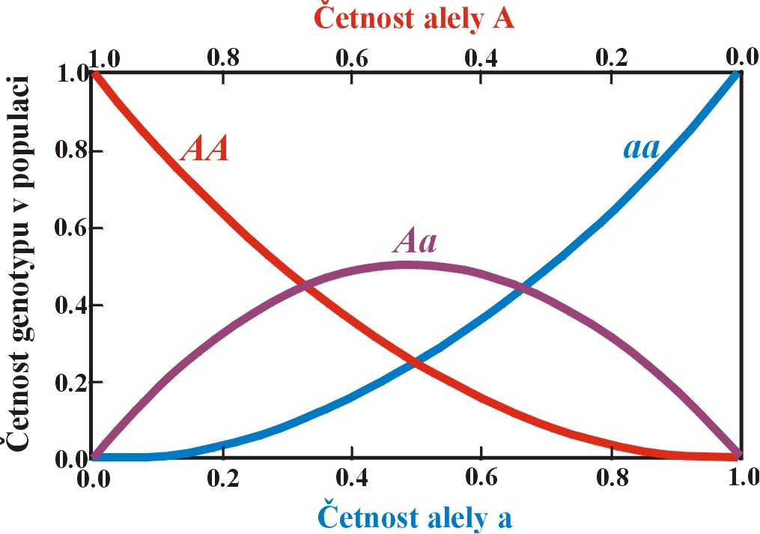
Frekvencies of rare alleles
heterozygotes most frequent when p = q = 0,5
f_{Aa} decreases with 2pq
f_{aa} decreases with q² ⇒ f_{Aa} / f_{aa} increases → rare allele „hidden“ for selection in heterozygous state

Slide 17
Possible causes of HWE violation:
Methodic causes:
null alleles, allelic dropout
Violation of some of the assumptions of the H-W population:
Heterozygote deficiency:
selection against heterozygotes
nonrandom mating (inbreeding, assortative mating)
structured populations (different allele frequencies, cf. Wahlund effect)
Heterozygote excess:
selection in favour of heterozygotes
nonrandom mating (outbreeding, negative assortative mating)
migration
mutation

Slide 18
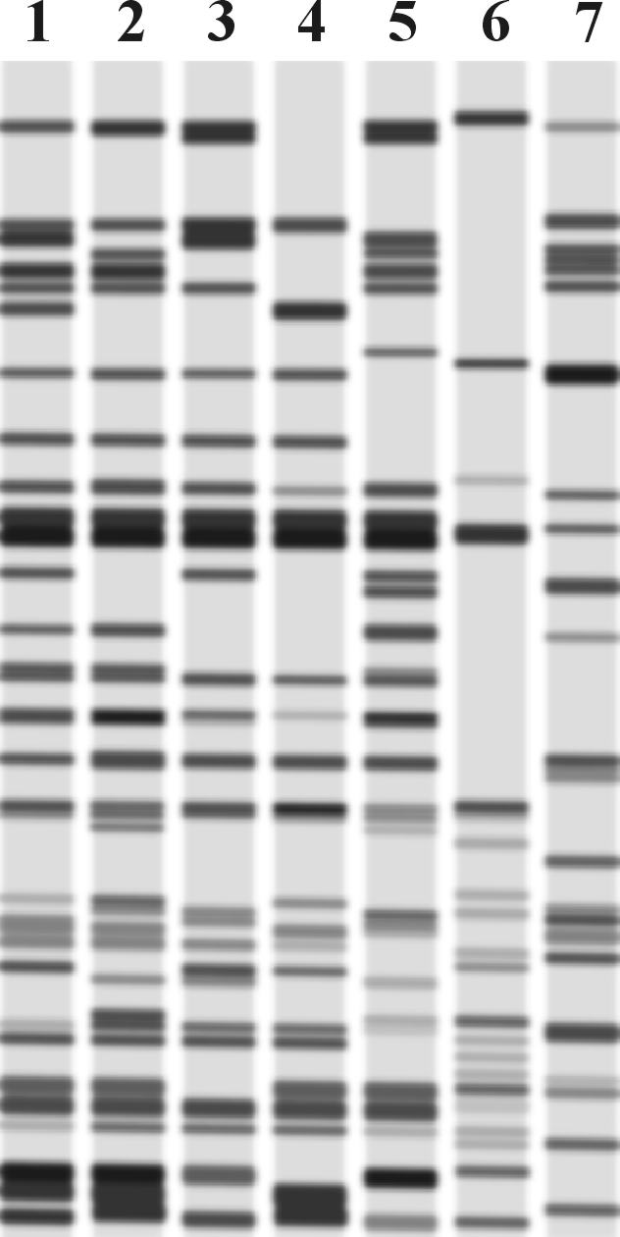
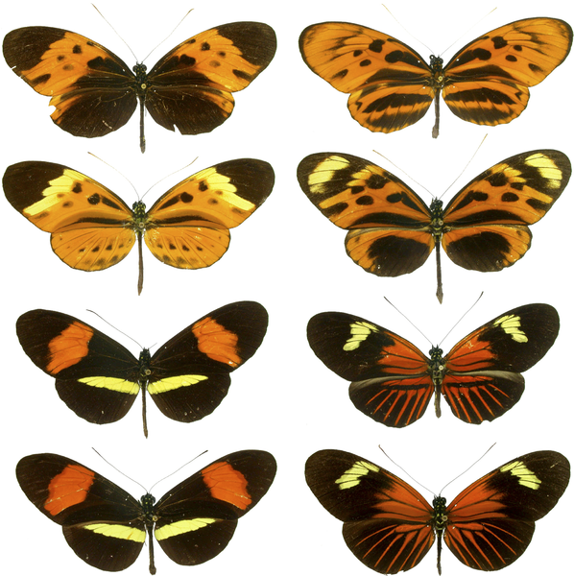
GENETIC VARIATION
IN POPULATIONS
Methods of the study of genetic variation:
+
protein electrophoresis
analysis of restriction fragments (Southern blotting, RFLP, DNA fingerprinting)
-
PCR, sequencing, NGS, microsatellites ...
Polymorfism and polytypy

Slide 19
Polymorfism:
proportion of polymorphic loci (P)
sample size usually finite ⇒
limit 5% (P_{0.05}) or 1% (P_{0.01})
number of alleles per locus (A; allele diversity, allele richness)
mean observed heterozygosity (H_{o})
mean expected heterozygosity (H_{e}) = gene diversity
nucleotide polymorphism (θ)
nucleotide diversity (π)

Slide 20
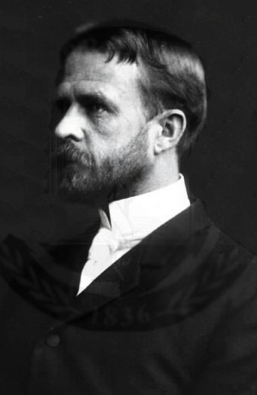
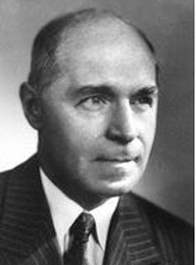
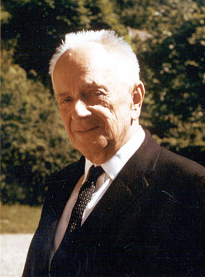
GENETIC VARIATION
IN NATURAL POPULATIONS
Issue of the extent of variation in natural populations:
T.H. Morgan, H. Muller: „classical“ model
limited variability
A. Sturtevant, T. Dobzhansky: „equilibrium“ model
variation widespread

Slide 21
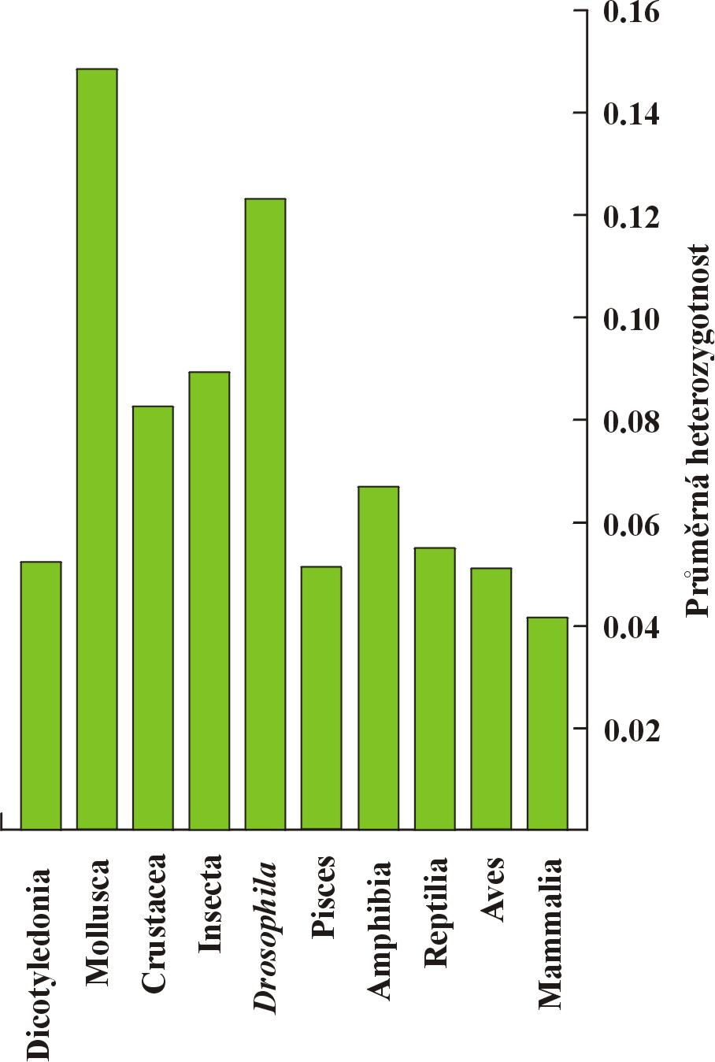
GENETIC VARIATION
IN NATURAL POPULATIONS
1966: Harry Harris – humans; Richard Lewontin, John Hubby – D. pseudoobscura
microsatellites, minisatellites → high mutation rate, high variability
question to what extent protein electrophoresis representative?

Slide 22
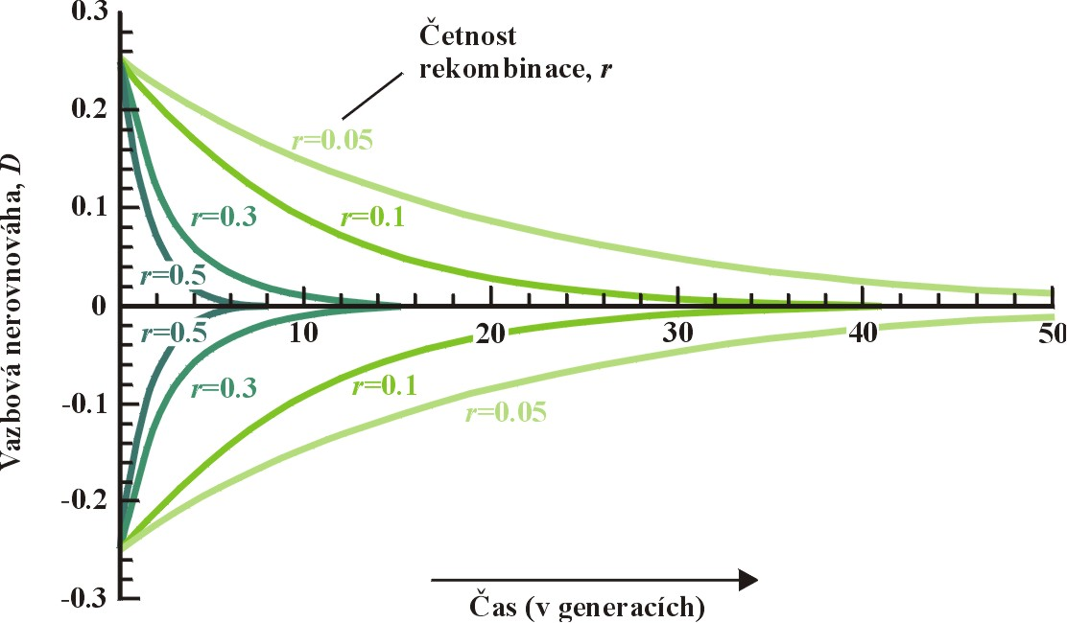
VARIATION AT MORE LOCI
proximity of loci = linkage
valid H-W assumptions ⇒ formation of linkage equilibrium
this proces can be slow ⇒ linkage disequilibrium (LD)
coefficient of LD: D
relation of D to recombination r :

Slide 23
Causes of linkage disequilibrium:
absence of recombination (eg. inversion)
nonrandom mating
selection
recent mutation
sample is a mixture of 2 species with different allele frequencies
recent merging of 2 populations
random genetic drift
LD needn´t exist only between loci on the same chromosome!

Slide 24
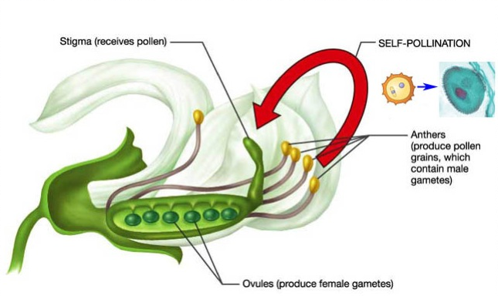
INBREEDING
= mating between relatives
eg. repeated autogamy (self-fertilization, self-pollination):
initial generation (HWE): 1/4 AA, 2/4 Aa, 1/4 aa
1. gen. of selfing: 3/8 AA, 2/8 Aa, 3/8 aa
2. gen. of selfing: 7/16 AA, 2/16 Aa, 7/16 aa
3. gen. of selfing: 15/16 AA, 2/32 Aa, 15/16 aa

Slide 25
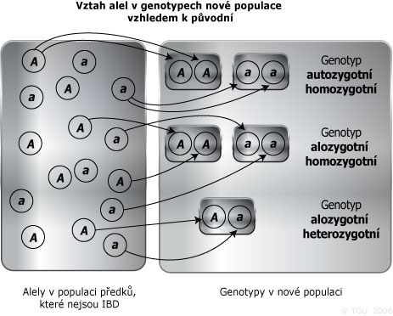
inbreeding CoefFicientS
1. Pedigree inbreeding, F:
= probability of autozygosity
autozygosity:
alleles identical by descent (IBD), always homozygous allozygosity:
either heterozygote or homozygote (alleles identical by state, IBS)

Slide 26
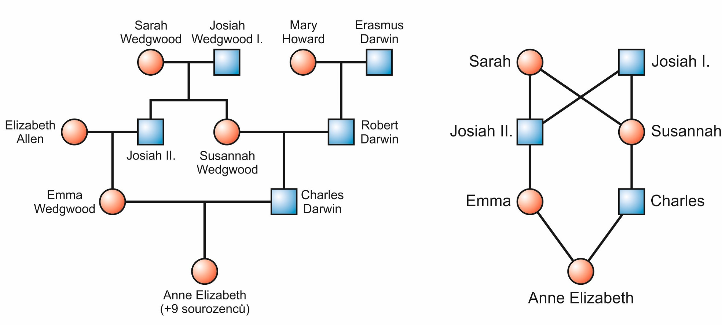
Inbred population = pop. in which the probability of autozygosity due to inbreeding > in panmictic population
F = probability that an individual inherited both alleles at a locus from the same ancestor (both alleles are IBD)

Slide 27
Inbred population = pop. in which the probability of autozygosity due to inbreeding > in panmictic population
F = probability that an individual inherited both alleles at a locus from the same ancestor (both alleles are IBD)
0 ≤ F ≤ 1

Slide 28
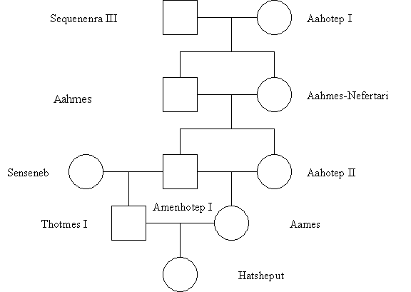
a) Amenhotep I. and Aahotep II. 25%
b) Aames 37.5%
c) Hatsheput 25%
d) Remaining in the pedigree are not inbred, ie F = 0

Slide 29
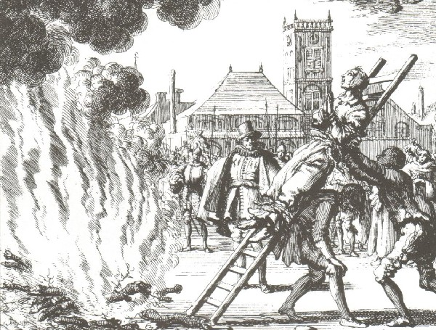
2. System-of-mating inbreeding, F_{IS}:
= deviation from HWE
F_{IS} = (H_{e} – H_{o})/H_{e} -1 ≤ F_{IS} ≤ +1
H_{o}= observed
H_{e}= expected heterozygosity
F and F_{IS} don´t measure the same thing!
F is the individual measure, F_{IS} is the group measure
Př.: hutterites (anabaptists) of the Great Plains in USA and Canada:
in spite of respecting the incest taboo this is one of the most inbred human groups known (F = 0,0255)
caused by a small number of founders (Protestants from Tyrol and Carinthia, 16th century)

Slide 30
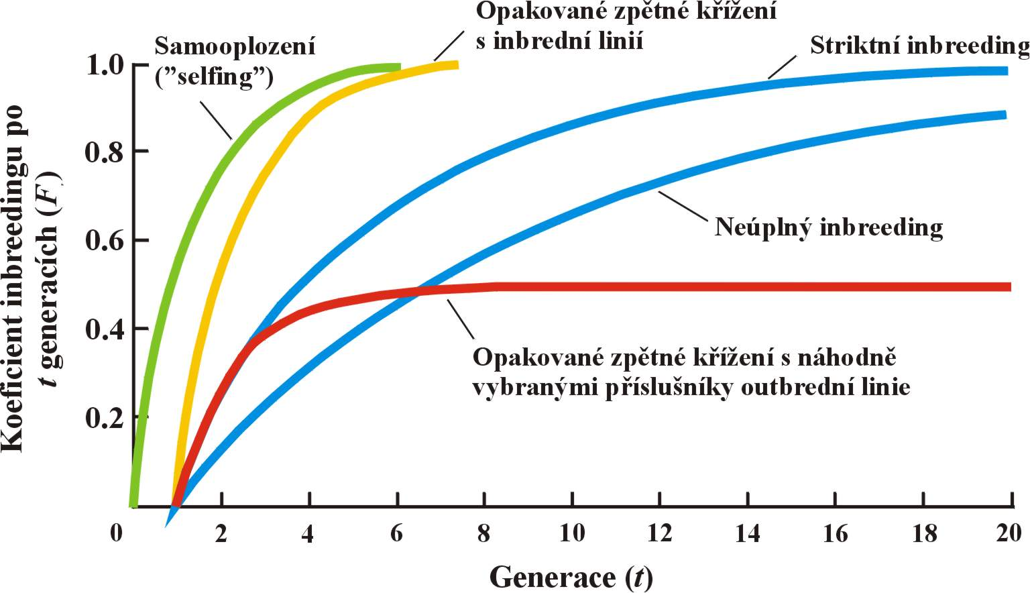
Genetic effects of inbreeding:
inbreeding changes genotype frequencies (increase of homozygote freq.)
× allele freqs. don´t change
affects all loci

Slide 31
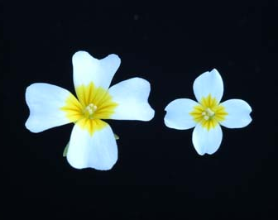
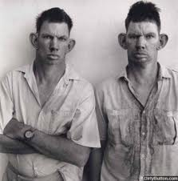
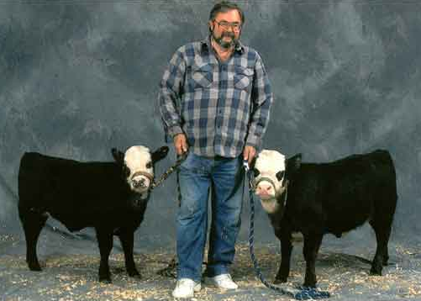
Phenotypic effects of inbreeding:
inbreeding depresion diseases, reduced fertility and/or viability
Leavenworthia alabamica
BUT! Not always must inbreeding be deleterious (eg. many species of embryophyte (land) plants are self-fertilising). Moreover, the inbreeding effects can differ within a single species depending on environment.

Slide 32
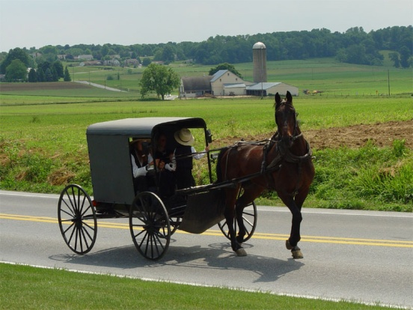
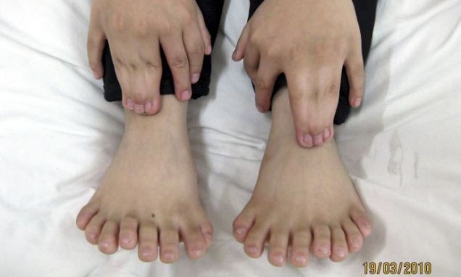
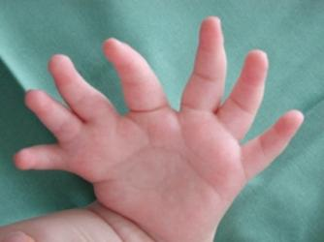
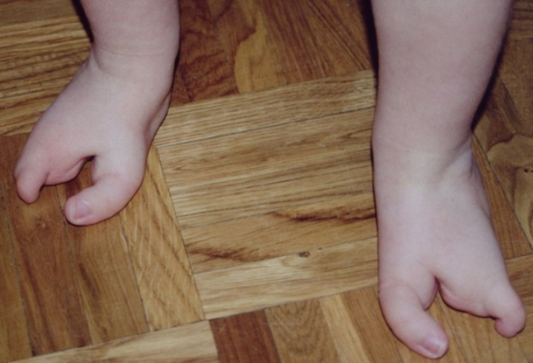
Inbreeding depression in humans:
the Amish: haemophilia B, anemia, myotonic dystrophy, Ellis-van Creveld syndrome (dwarfness, polydactyly), defects in nail development, dental defects
Vadoma tribe, Zimbabwe (tzv. „Ostrich people“): ectrodactyly
Mormons of Hilldale (Utah) and Colorado City (Arizona)
Amazonia Indians
aristocratic dynasties

Slide 33
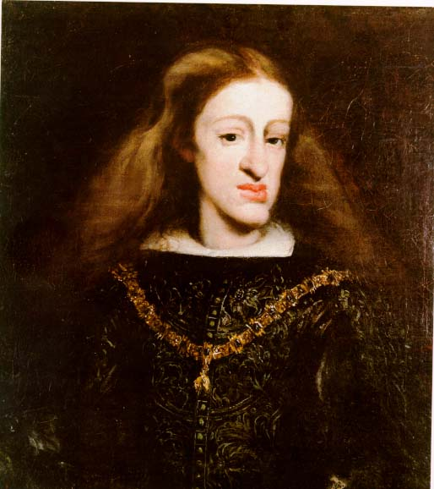
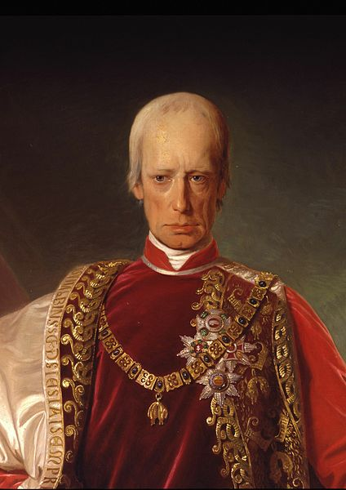
Human inbreeding depression:
Charles II of Spain:
unnaturally big head, deformed mandible, weak body, difficulties with walking and other defects, mental and psychical defects, impotence, sterility
Francis II:
in some children mental retardation, hydrocephaly, seizures, some unable of living without assistence

Slide 34
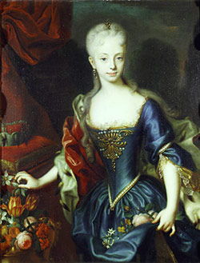
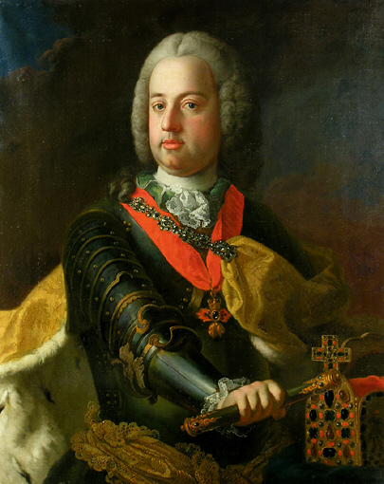
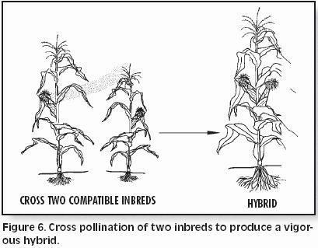
Francis I of Lorraine
Maria Theresa
hybrid vigour (heterosis)

Slide 35
ASSORTATIVE MATING
= higher probability of mating between individuals with the same phenotype
can be caused by active mating preference but another causes can exist as well
eg.: phytophagous insects – individuals living at different host species can mature in different times ⇒ more frequent mating between individuals of the same phenotype (confinement to the host) without active mating preference
⇒ this is only a positive phenotypic correlation
assortative mating causes deficit of heterozygotes
assortative mating causes linkage disequilibrium (LD)

Slide 36
Differences between inbreeding and assortative mating:
affects only locus (loci) connected with preferred phnotype × inbreeding affects all loci
ass. mating is a powerful evolutionary force (strong LD at more loci) × inbreeding only strenghtens existing LD, and only in the case of selfing, in other cases recombination „more succesful“ → reduction of LD

Slide 37
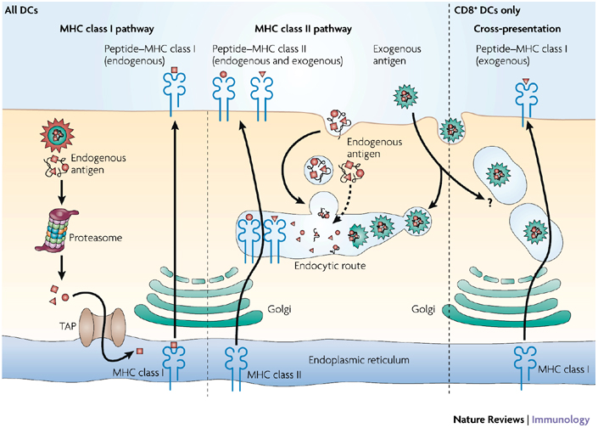
NEGATIVE ASSORTATIVE
(DISASSORTATIVE) MATING
= preference of mates with different phenotypes
results in intermediary allele frequencies, reduces LD
eg. preference of males with different MHC (mouse, man)
MHC
∼ ∼ ∼

