Slide 1
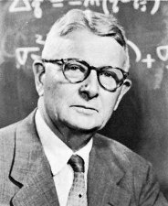
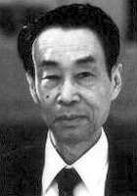
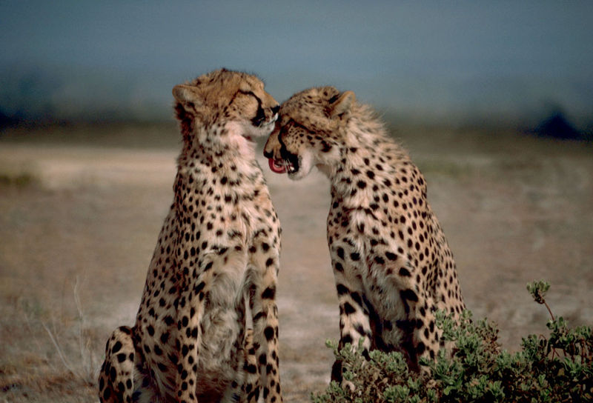
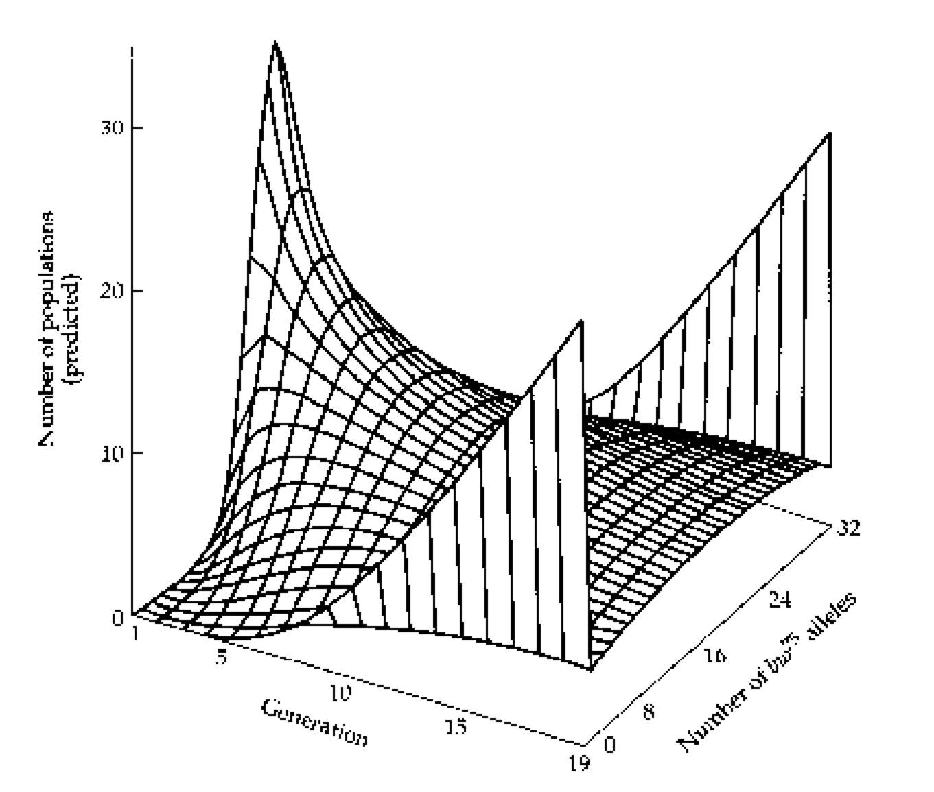
RANDOM GENETIC DRIFT

Slide 2
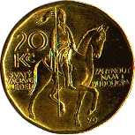
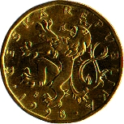
HW: infinite population but in real world population sizes finite
⇒ random processes, nonadaptive evolution
Why randomness?
when number of repetitions finite probability of an event ≠ its frequency
(cf. H-W principle)
10 coins → in more than 75 % cases the ratio differs from 1 : 1

Slide 3
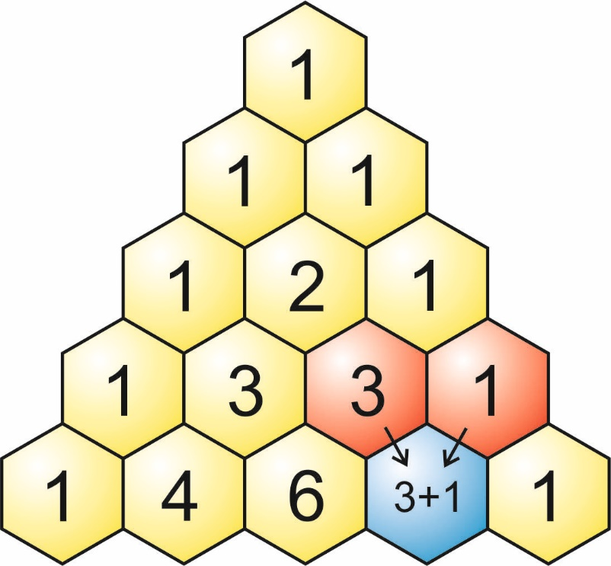
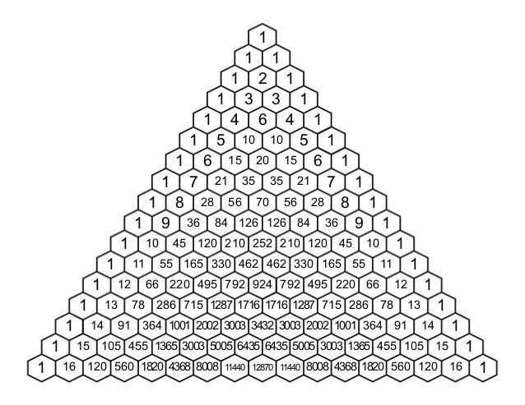
Pascal´s triangle:
11 possible results: 0×, 1×, 2×, ..., 10× „head“

Slide 4
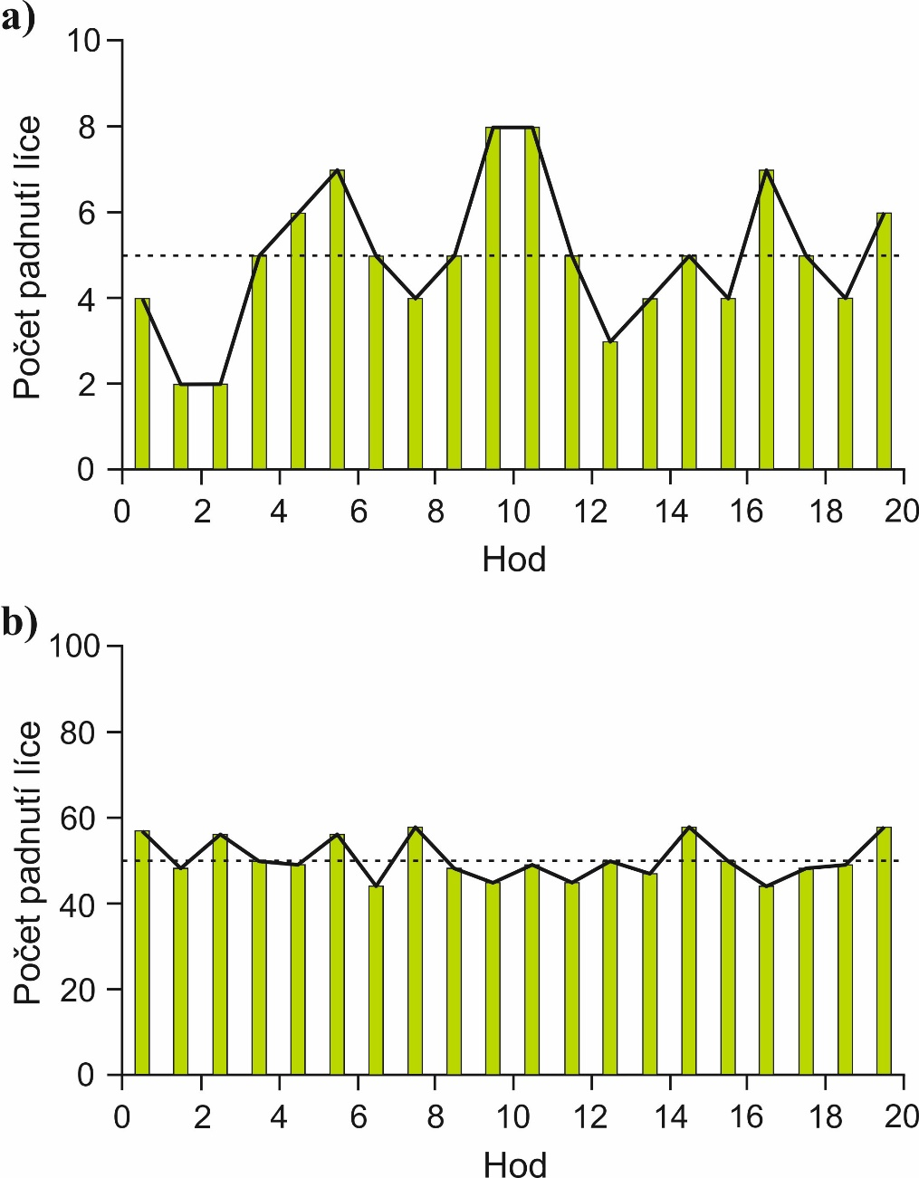
20 hodů, 10 mincí
20 hodů, 100 mincí
S větším počtem mincí menší rozptyl kolem očekávané hodnoty

Slide 5
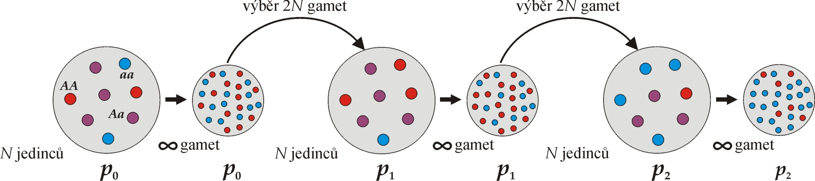
Náhodný výběr gamet z genofondu (sampling error):
Výsledkem náhodného výběru je kolísání frekvencí
mezi generacemi = „random walk“
Wrightův-Fisherův model
≈ Hardyho-Weinbergův model pro malé populace

Slide 6
Random sampling from gene pool (sampling error):
Random sampling results in fluctuations of allele frequencies
across generations = „random walk“
Wright-Fisher model
≈ Hardy-Weinberg model for finite populations

Slide 7
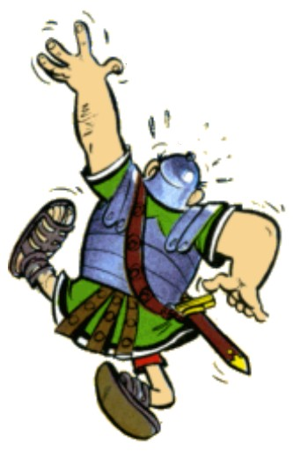
Drunk sailor
Hiccup!
sea
?
?
footbridge
„random walk“

Slide 8
N
Plop!
footbridge width

Slide 9
we can surmise he will fall on the left!
Plop!
N
we don´t know where he will fall
narrower footbridge

Slide 10
Modelling drift:
higher fluctuation of frequency across generations
1 populace
2N = 2000
1 populace
2N = 20
allele fixation/ extinction earlier
Fluctuation of frequencies across generations stronger in small populations
(∼ drunker sailor).

Slide 11
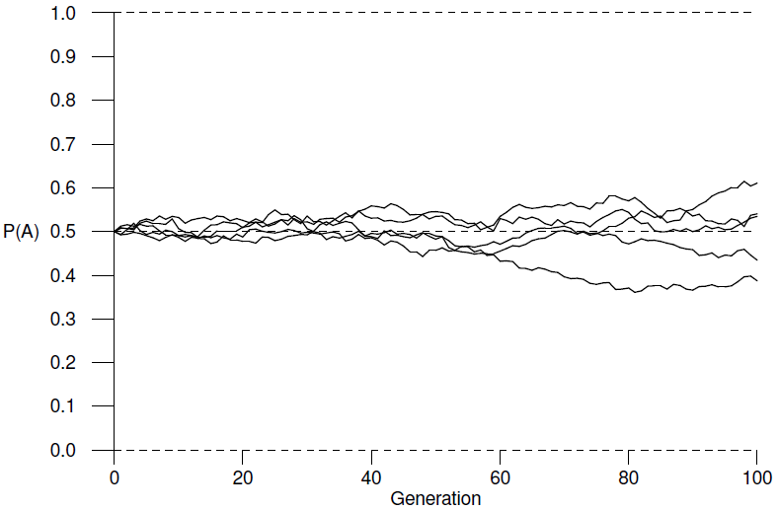
Modelling drift:
some alleles are fixed...
5 populací
2N = 2000
5 populací
2N = 20
... others disappear
Conclusion 1: Drift results either in allele fixation or allele extinction.
Conclusion 2: Drift results in loss of variation in demes.
Conclusion 3: Probability of allele fixation equals its frequency.
Probability of fixation of a new allele in diploids = 1/(2N)
Conclusion 4: Mean time to fixation of a new allele ≈ 4N.

Slide 12
in each generation new sampling from the gene pool with changed frequency...
... these samplings are independent in individual demes
Conclusion 5: Drift results in divergence among demes.

Slide 13
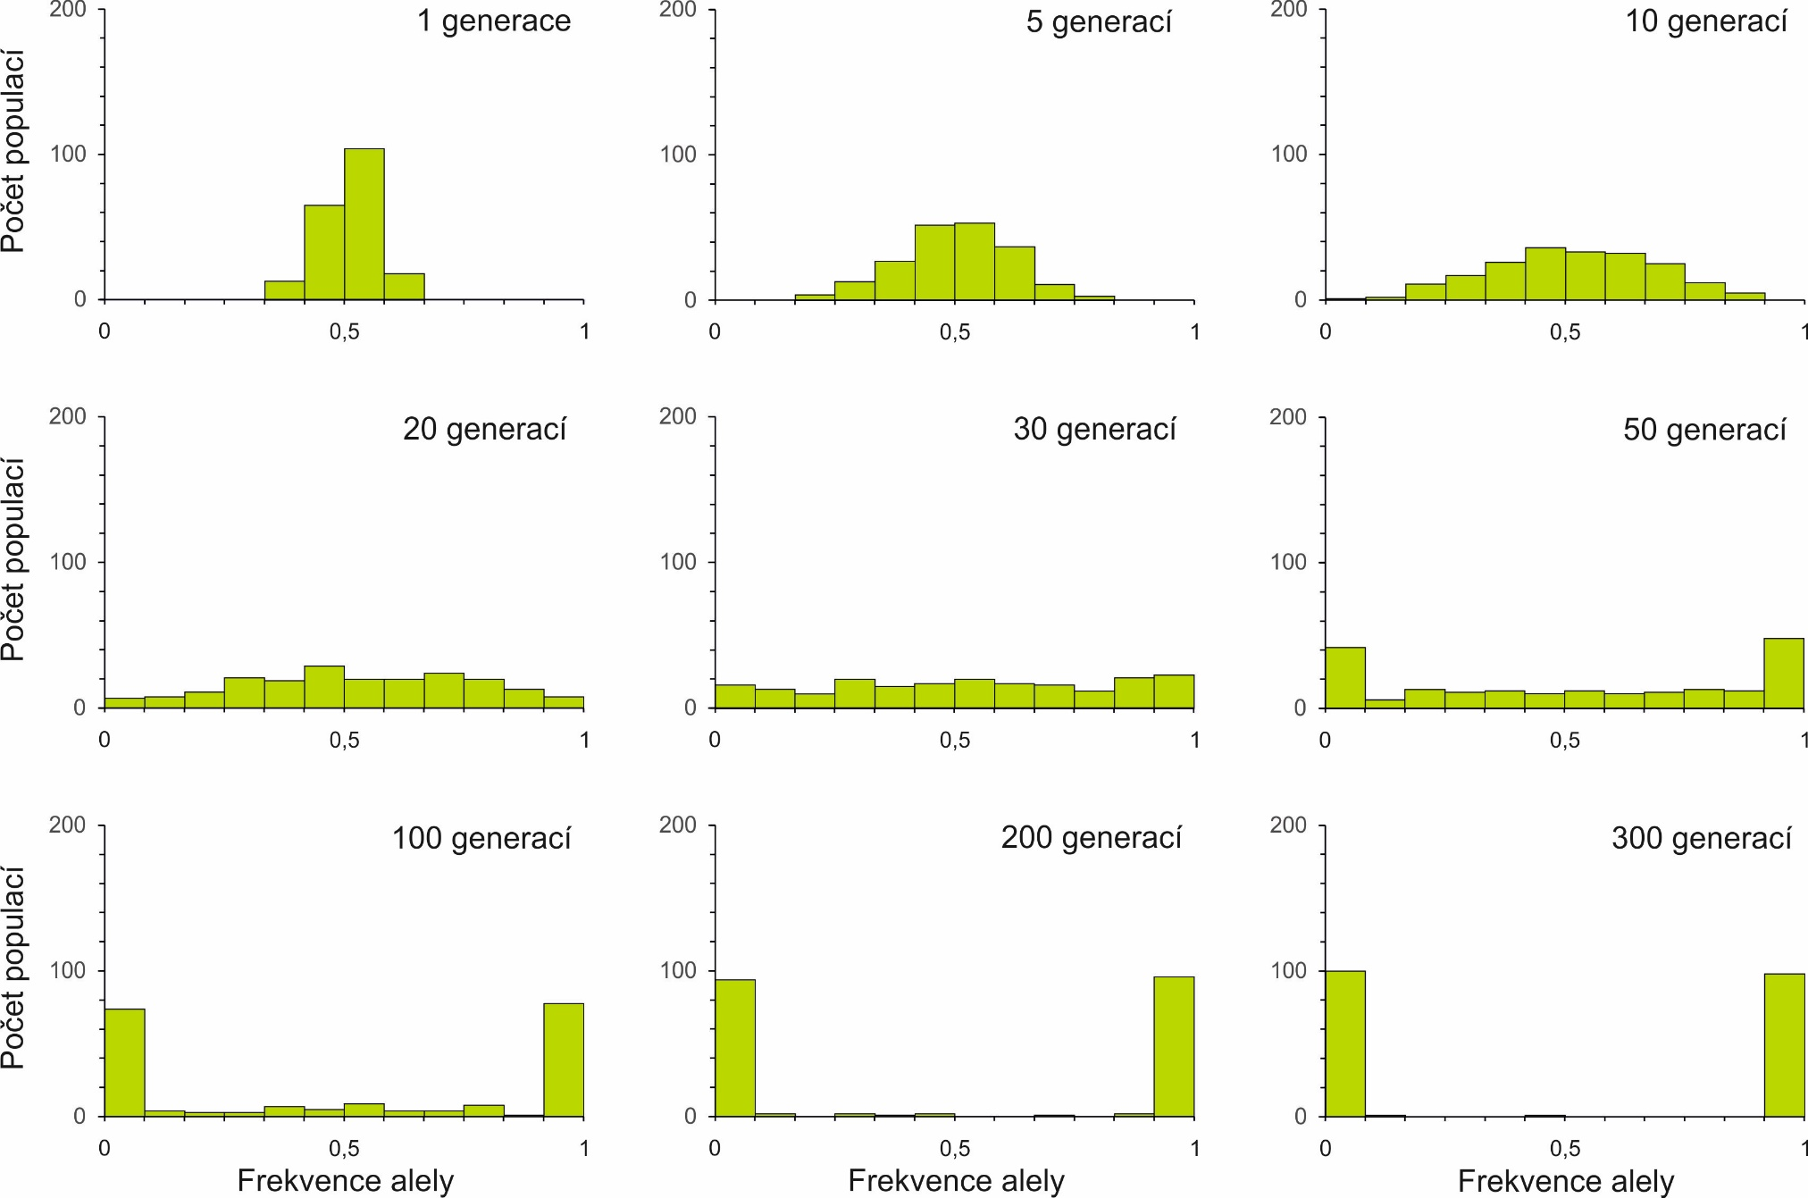

Slide 16
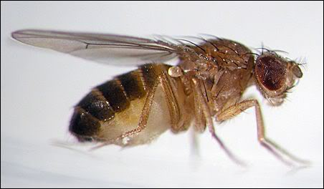
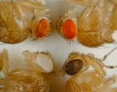
Peter Buri (1956):
107 populations of D. melanogaster
zeroth generation: 16 heterozygous bw⁷⁵/bw individuals in each population
in each generation random sampling of 8 males and 8 females
19 generations

Slide 17
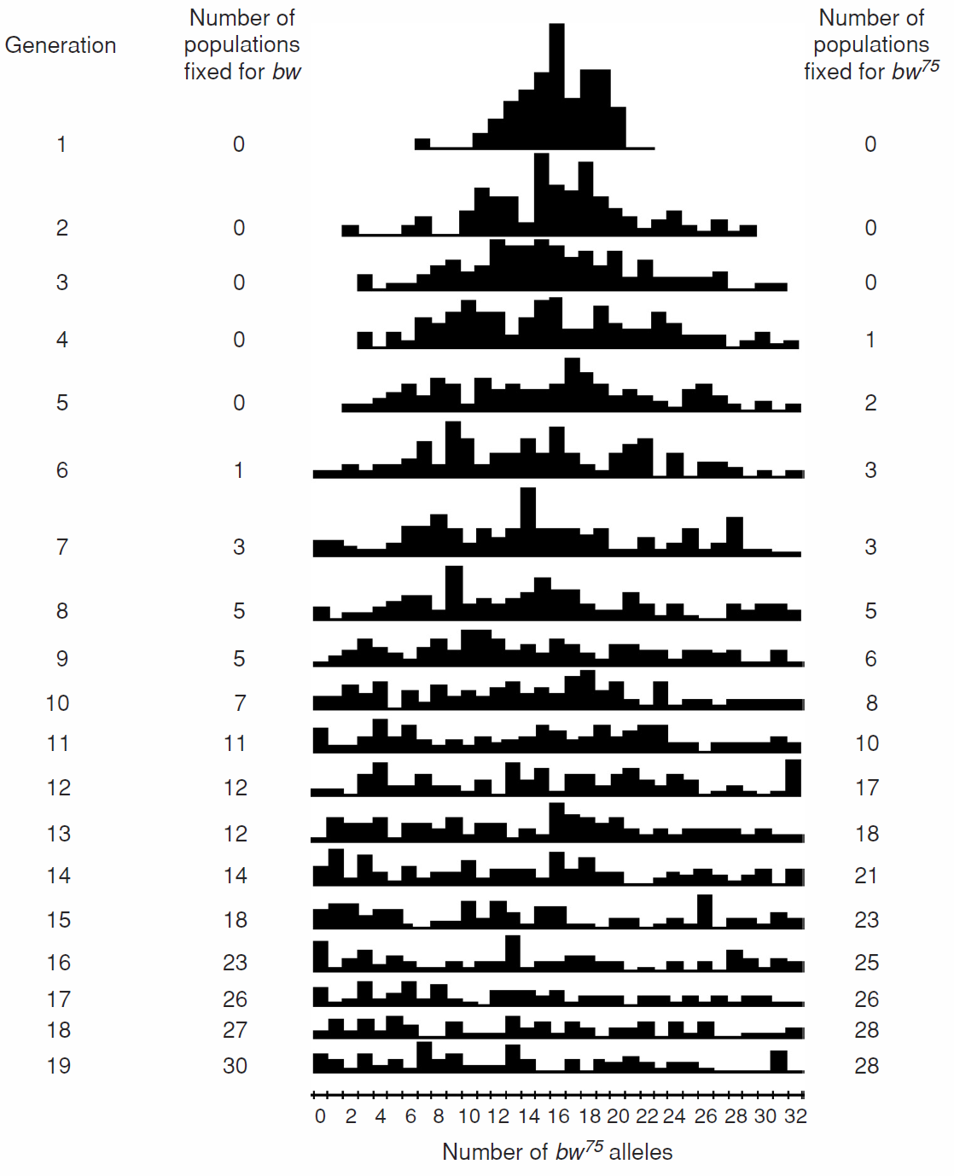
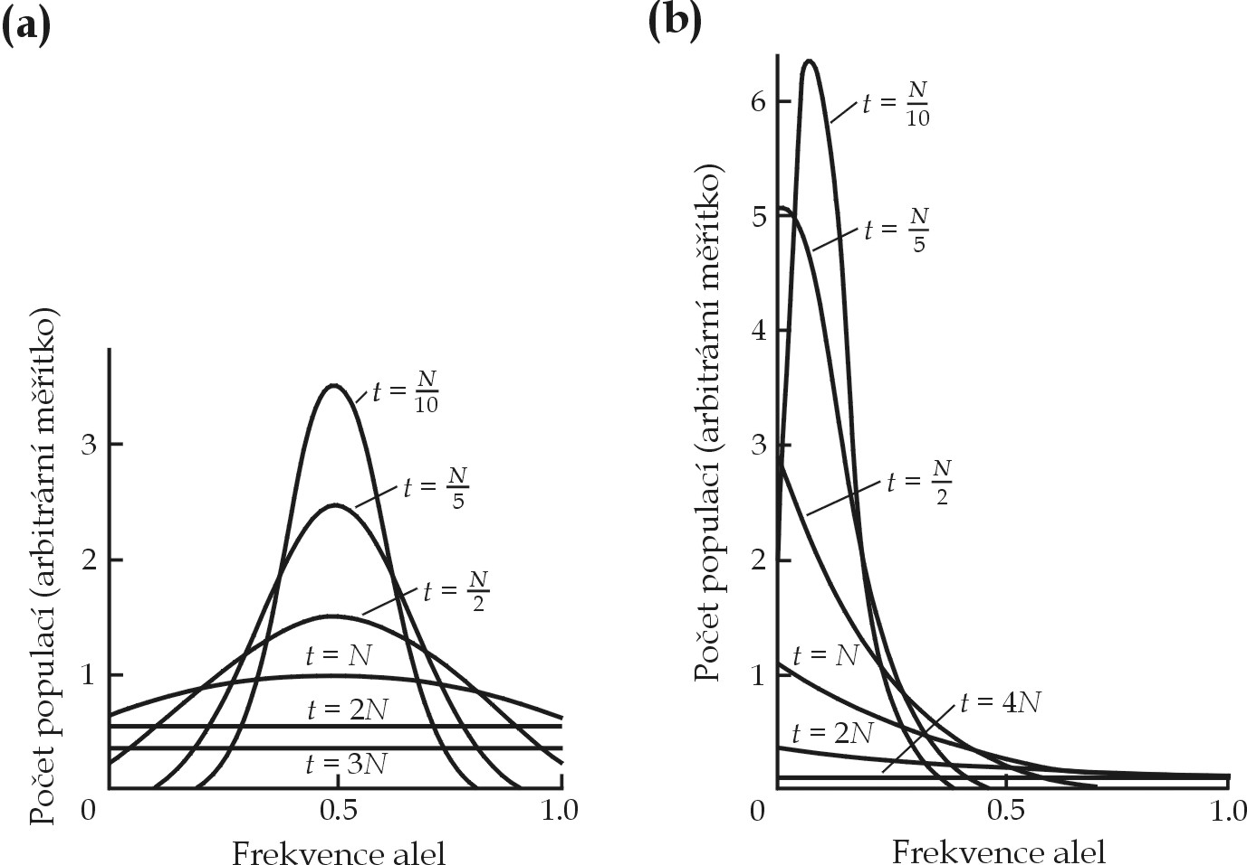
Buri (1956):
in the first generation most populations around p = 0,5
population divergence
ultimately most populations either p = 0 or p = 1

Slide 18
mathematical simulation (difussion aproximation)
simulation with initial frequency p = 0,1

Slide 19
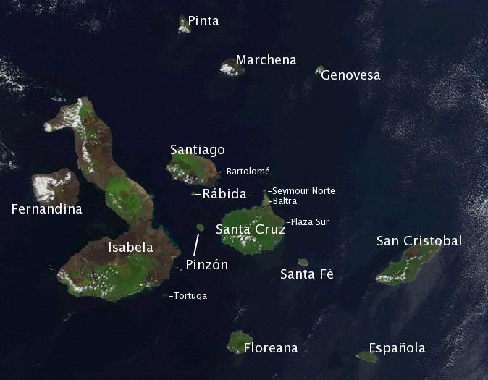
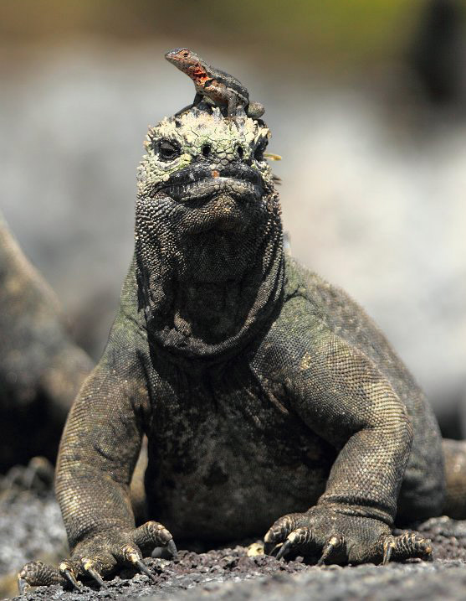
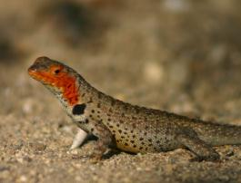
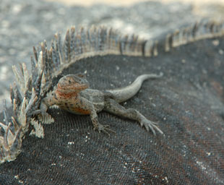
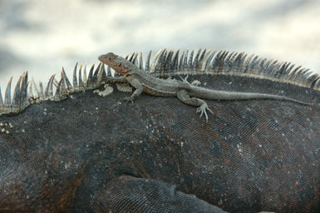
Eg.: Galapágos lava lizard (Microlophus albemarlensis)

Slide 20
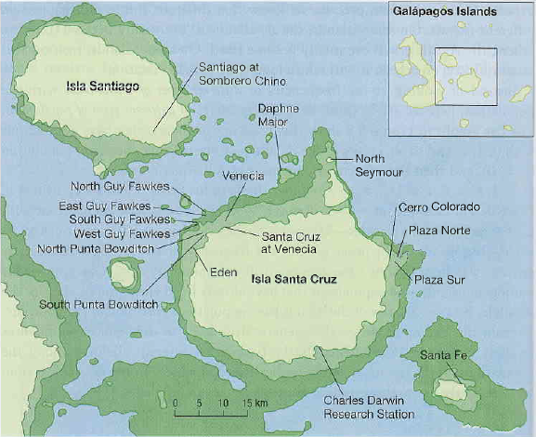
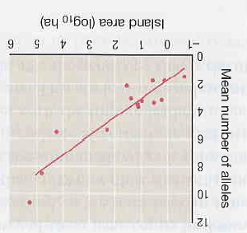
M. Jordan, H. Snell (2002):
17 populations
11 microsatellite loci
lizards on larger islands have higher variation
sea level 17 and 12 thousand years ago and nowadays

Slide 21
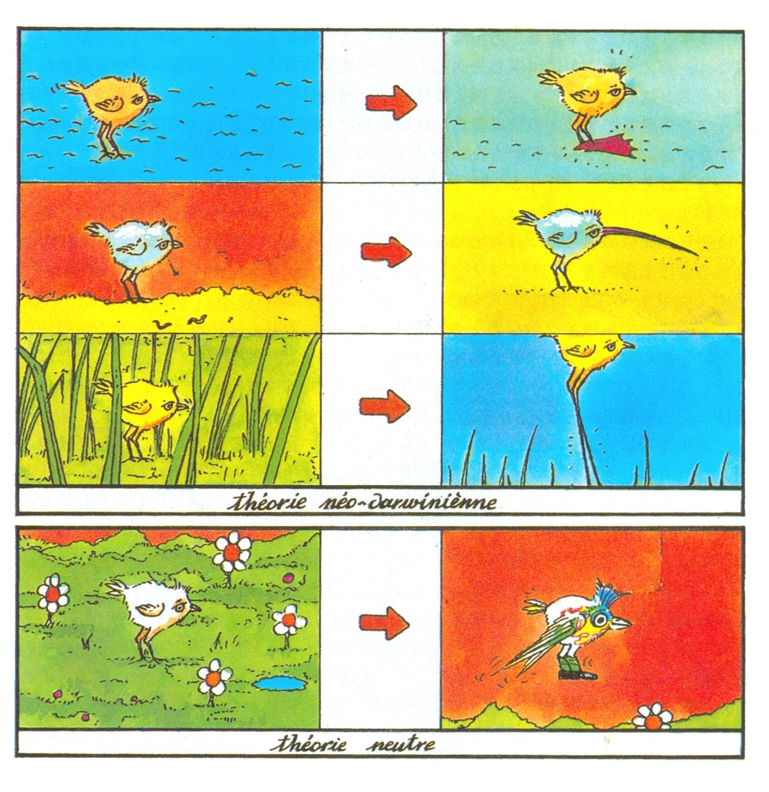
Evolution of selectively neutral traits is random
Darwinian evolution: „survival of fittest“
neutral evolution: „survival of luckiest“

Slide 22
Efective population size
Real populations differ from the WF model (fluctuations of N, different
reproductive success and mortality, unequal sex ratio, ....)
→ effective population size N_{e} allows us to measure drift in non-ideal
populations
Effective population size = the number of individuals of ideal Wright-Fisher population displaying the same rate of drift as the studied non-ideal population
Like in the inbreeding coefficient there is no single effective population size!!

Slide 23
Some factors decrease N_{e} relative to N:
overlapping generations
fluctuating population size across generations
different number of breeding males and females
high variation of the number of offspring within populations
Caution! Under some circumstances
the effective population size can be higher than N!!

Slide 24
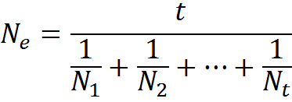

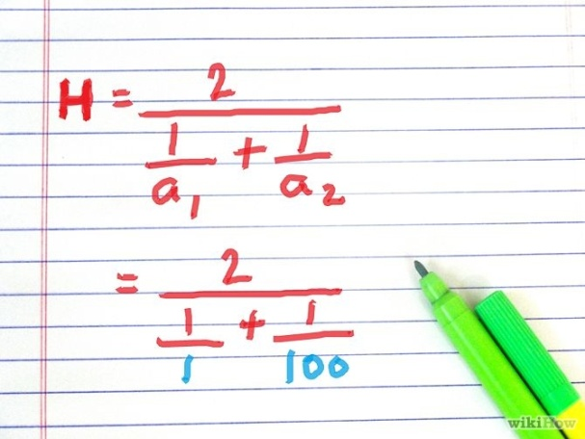
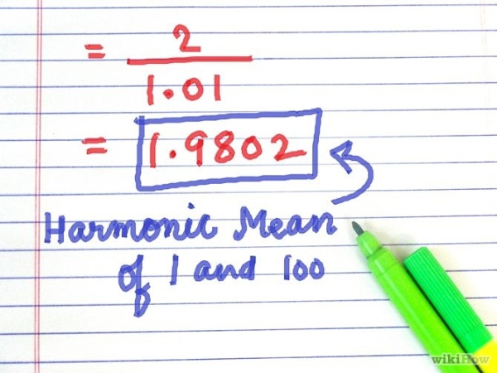
Effect of fluctuating population size:
effective size can be approximated as harmonic mean ⇒ strong influence
of small N!!
harmonic mean
mean much closer to the lower value

Slide 25
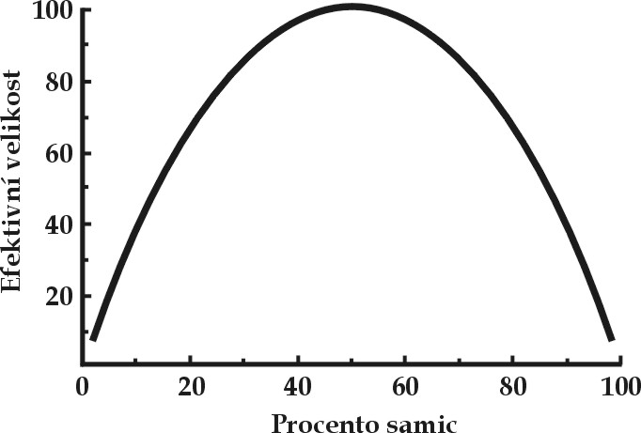
Effect of biased sex ratio:
Till now we assumed the same number of breeding males and females
N_{m} = number of breeding males, N_{f} = number of breeding females
the higher deviation from equal sex ratio, the lower N_{e}

Slide 26
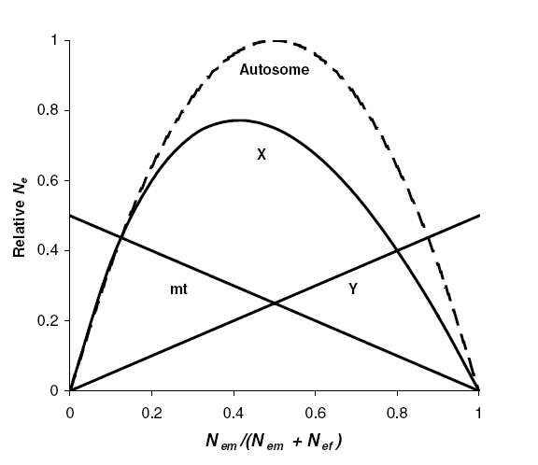
Effect of biased sex ratio:
N_{m} = 1:
it follows from this formula that if there is only a single breeding male in the population N_{e} ≈ 4 regardless of the total number of individuals
effect of sex ratio on N_{e} different for various genetic traits!

Slide 27
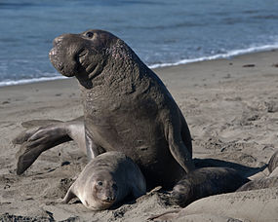
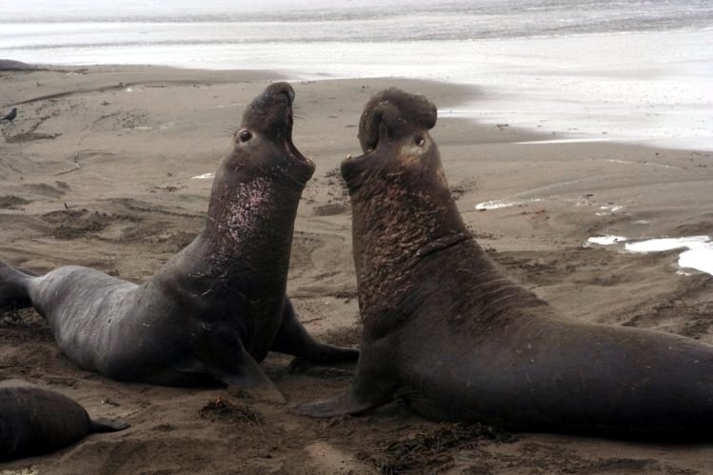
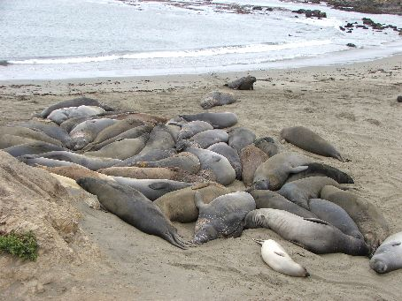
Effect of unequal reproductive success:
southern elephant seal:
sex ratio within a harem 1:40^{*)}
*) effective ratio 1:4-5 due to cuckoldry and short
period of male´s dominance (1-2 years)

Slide 28
Reproductive success on the gene level:
If a gene is affected by selection variance of the number of offspring
among members of a population is high (individuals with a positive
allele have more offspring)
⇒ N_{e} for this gene is lower than for a neutral gene
Each genetic trait requires its own N_{e}:
For genes on autosomes, sex chromosomes, and mtDNA
there are different effective population sizes:
autosomes: N_{e} 4 N_{e}
X, Z: ¾ N_{e} 3 N_{e}
Y, W, mtDNA: ¼ N_{e} 1 N_{e}

Slide 29
COALESCENT
under drift some alleles disappear from a population ⇒ when there are
no mutations ultimately all gene copies have a common ancestor
„forward“ approach
we can proceed also back in time – „backward“ approach →
moving back in time till two or more gene copies „fuse“
= coalescent event
the most recent common ancestor (MRCA)

Slide 30
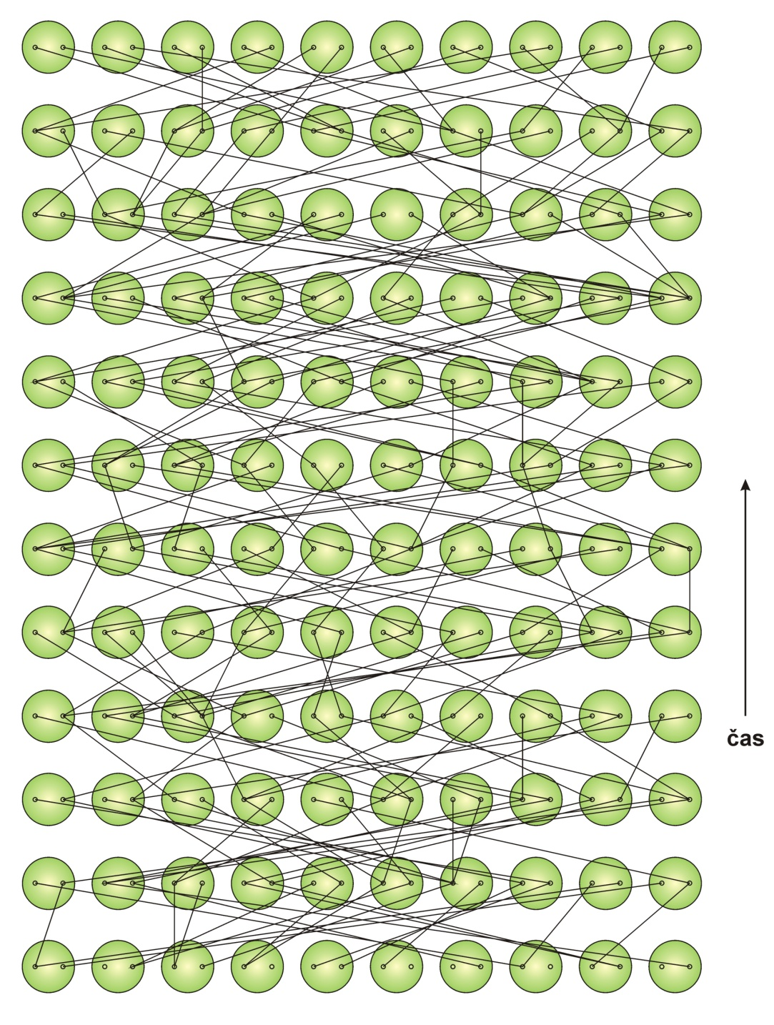
Wright-Fisher model:

Slide 31
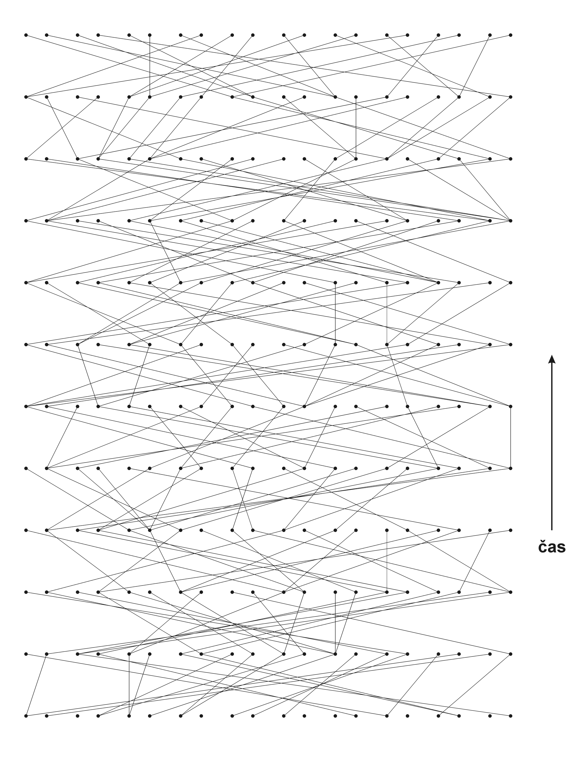

Slide 32
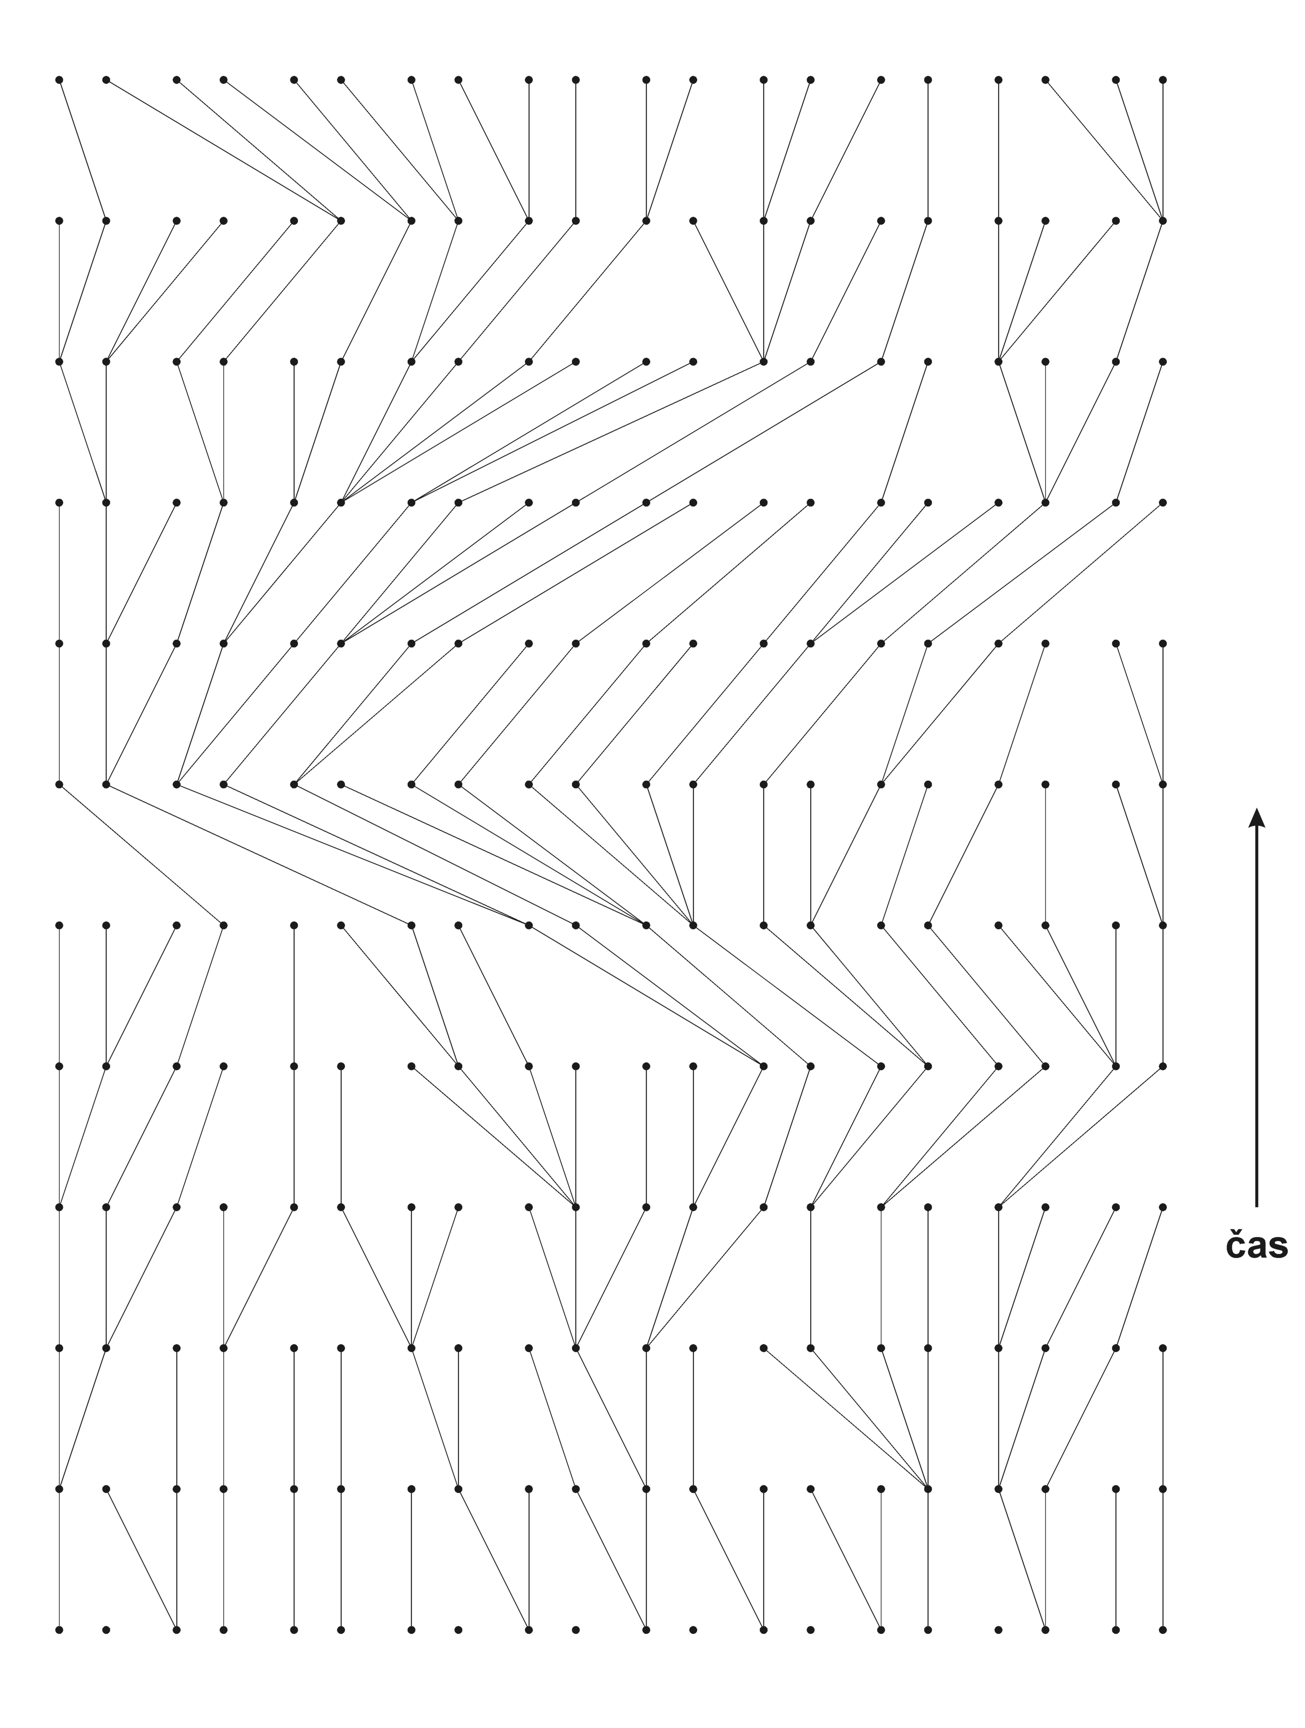
coalescent
sample MRCA

Slide 33
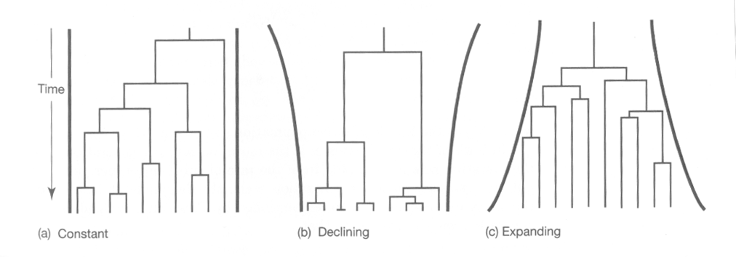
Coalescence and effective population size
from the coalescent theory several interesting consequences follow:
in small populations coalescent rate higher than in large populations
⇒ we can estimate N_{e}
but we can estimate also changes of N_{e} in time
declining population
expanding population

Slide 34
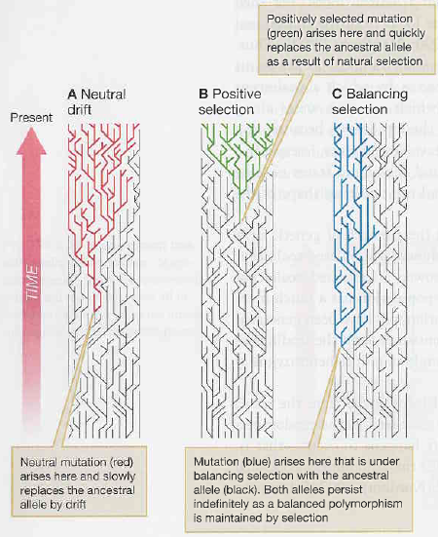
The same effect of selection on the coalescent tree shape:

Slide 35
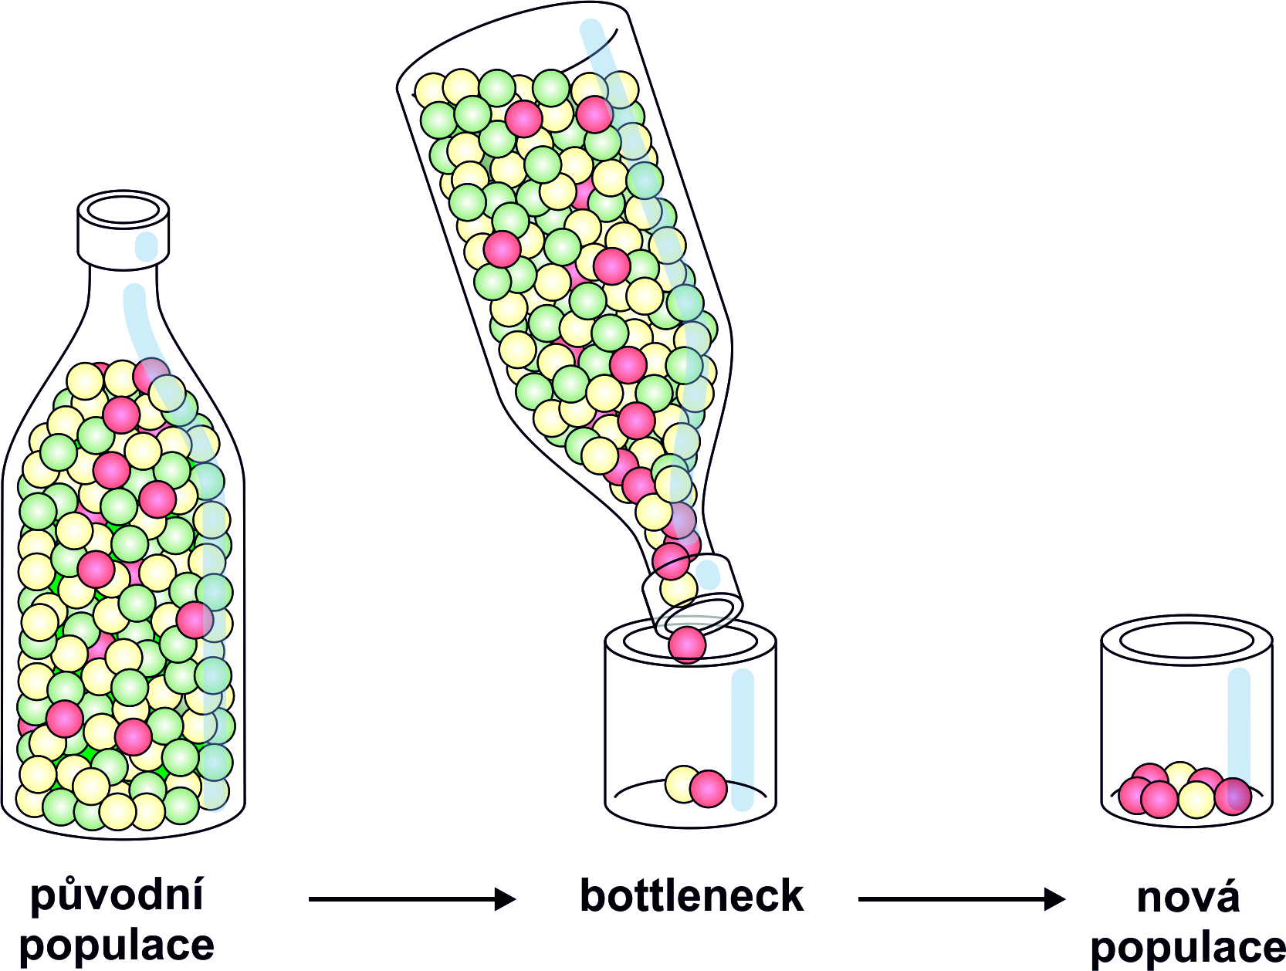
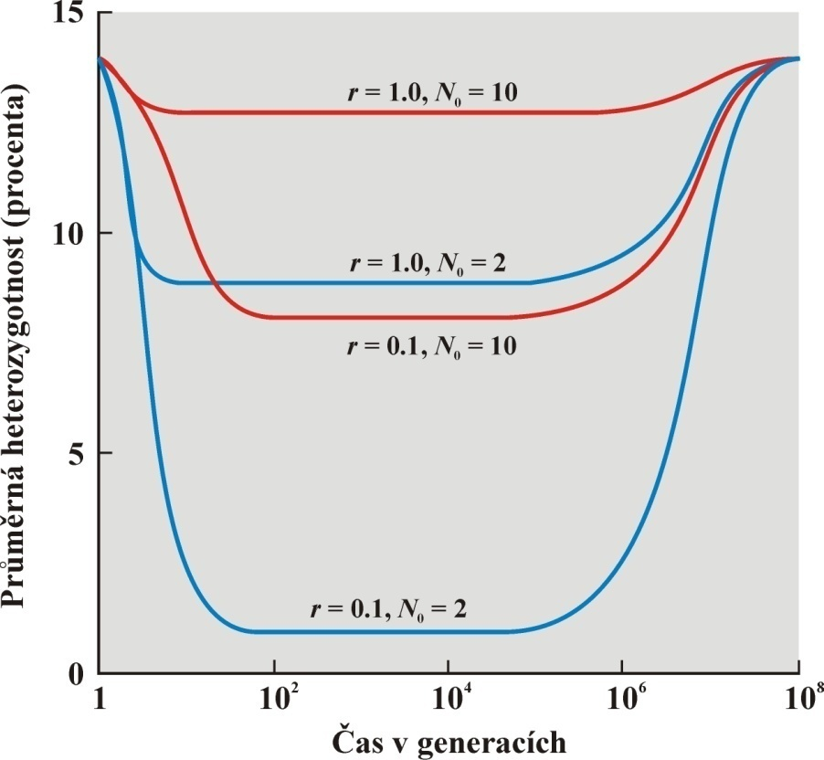
BOTTLENECK and FOUNDER EFFECT
population decline
decrease of variation depends on population growth rate
bottleneck reduces variation
magnitude of this reduction
depends on reduction of N_{e} and duration of bottleneck
rate of decrease of variation different for various genetic traits (autosomes, mtDNA, Y...) – different N_{e}!
variation more reduced under stronger bottleneck

Slide 36
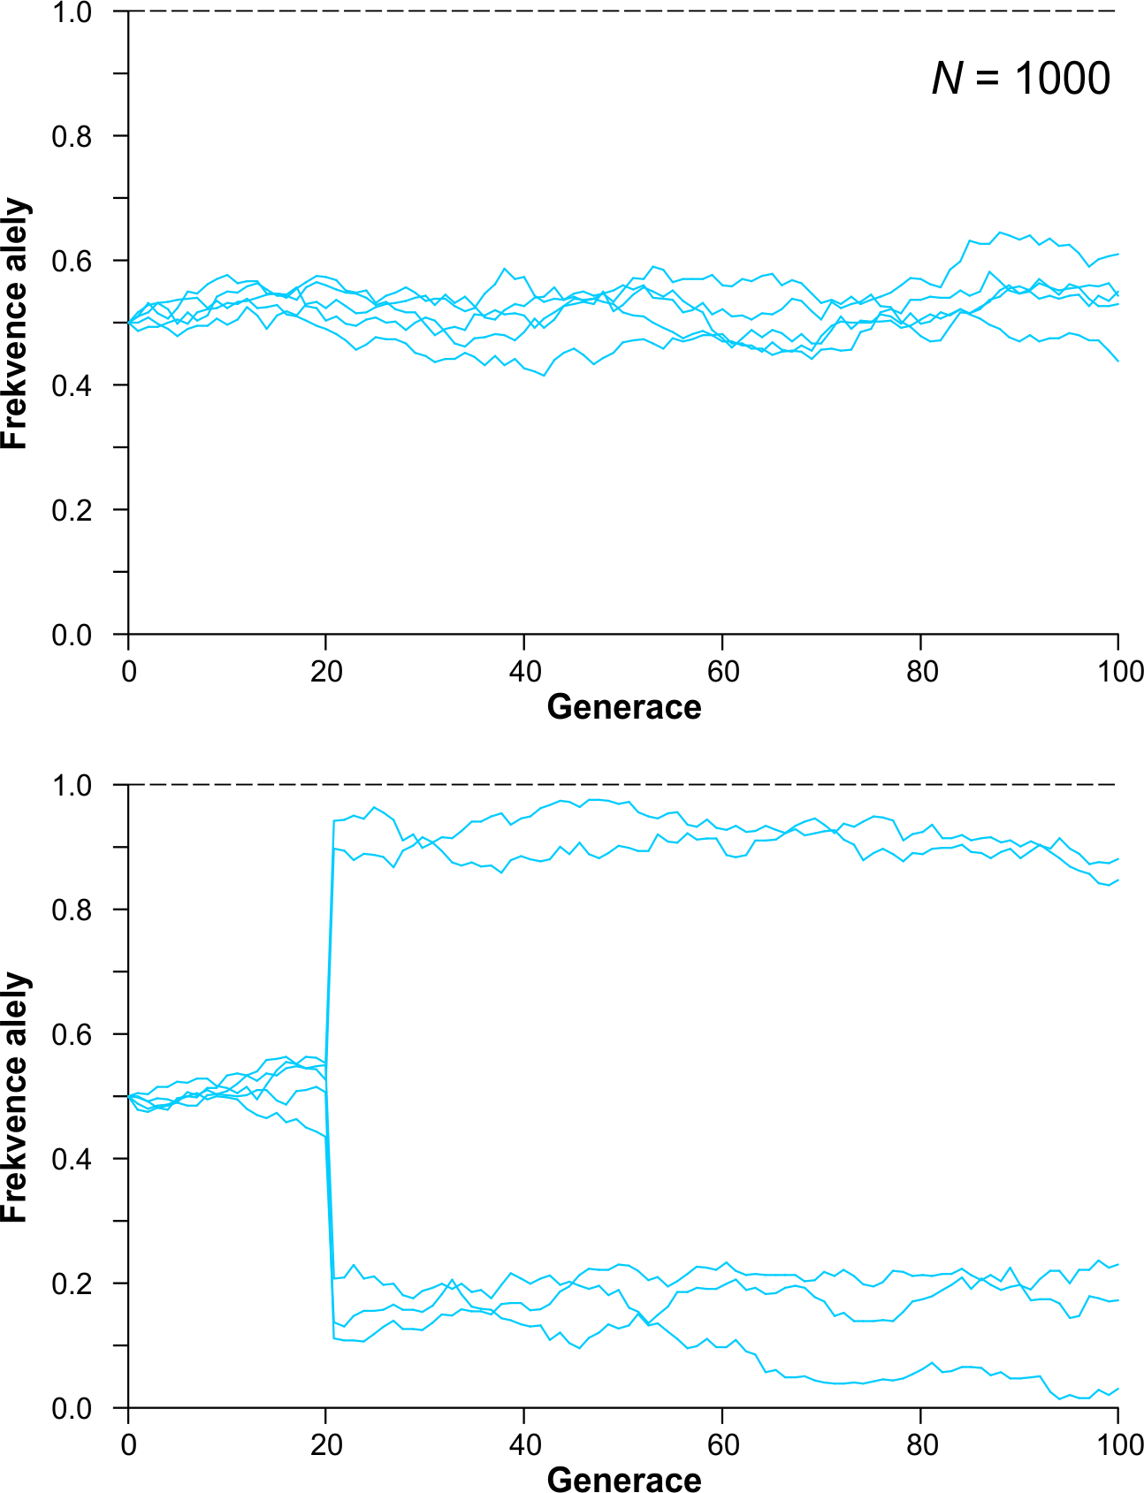
Bottleneck:
bottleneck
N = 1000
N =4
N = 1000

Slide 37
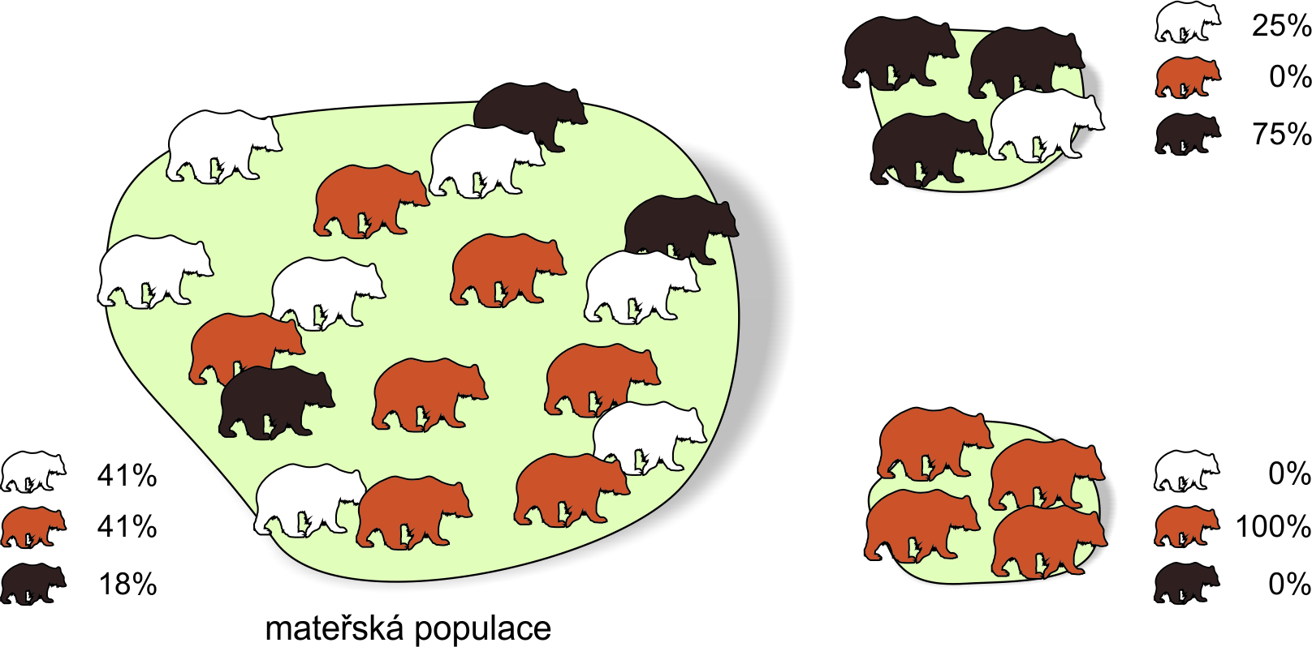
Founder effect:
colonization of a novel territory (eg. island)
because of a small numer of founders (even a single pregnant female)
→ random change of allele frequencies
→ reduction of variation
different environmental conditions → speciation

Slide 38
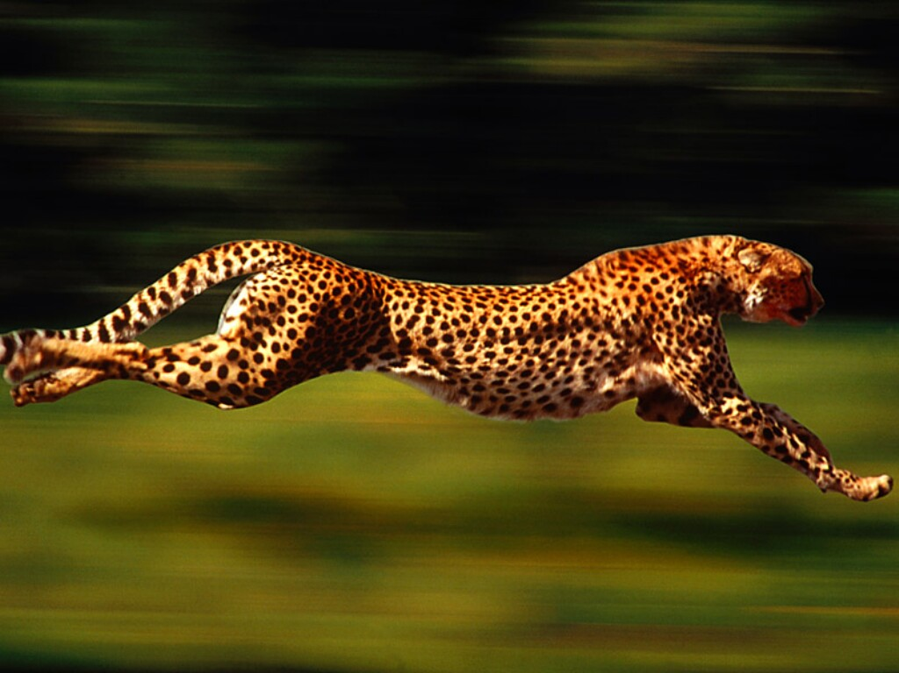
Examples of founder effect and bottleneck
cheetah
30 individuals of Acinonyx jubatus reineyi from E Africa, 49 protein loci:
only 2 loci polymorphic (P = 0,04), mean heterozygosity H_{o} = 0,01
98 individuals of A. j. jubatus from S Africa: P = 0,02, H_{o} = 0,0004!
south-African individuals accept skin grafts of the east-African subspecies
without problems ⇒ monomorphism of MHC genes
assumed strong bottleneck
in the past

Slide 39
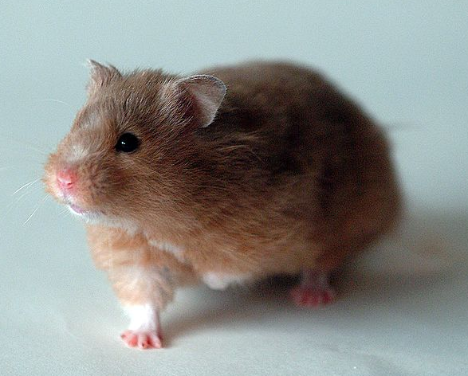
golden hamster
1930: Israel Aharoni (Hebrew Univ., Jerusalem) – female with offspring
escape of several individuals from captivity
1931: transport of several individuals to Britain 1937: private breeders
Recent genetic analyses including mtDNA → all golden hamsters currently
kept in breeding colonies are descendants of a single female, probably
that of 1930
mostly presented as an example
of bottleneck but it is rather an example
of founder effect

Slide 40
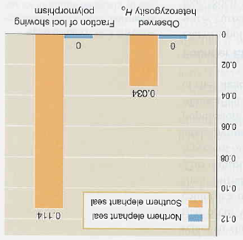
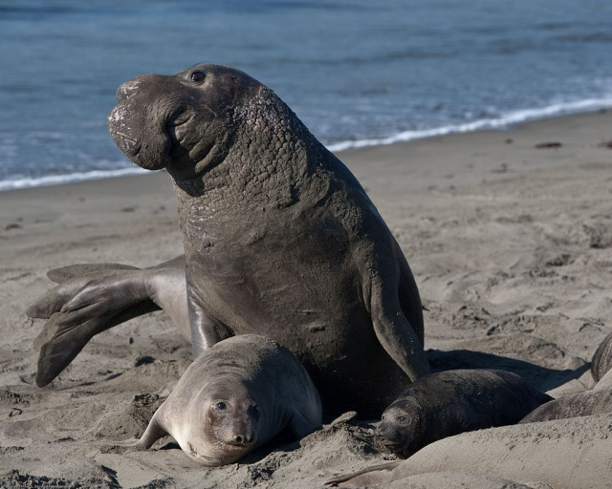
northern elephant seal
Mirounga angustirostris: in 19th century almost eradicated
→ 1892 last 8 individuals on the island of Guadelupe killed for
museum collections
fortunately 10-20 individuals passed unnoticed → today > 100 000 inds.
M. Bonnell a R.K. Selander (1974): blood samples of 159 individuals
electrophoresis at 21 loci → no variation
likewise Hoelzel et al. (1993), 62 loci

Slide 41
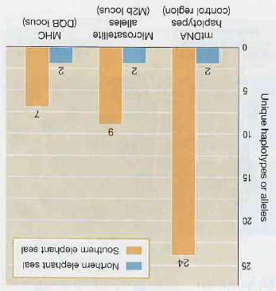
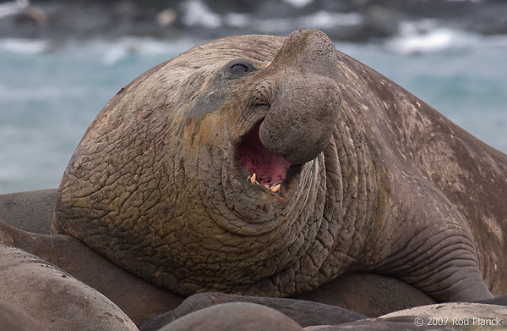
Hoelzel et al. (1999): DNA markers
northern elephant seal
(Mirounga angustirostris)
southern elephant seal
(Mirounga leonina)

Slide 42
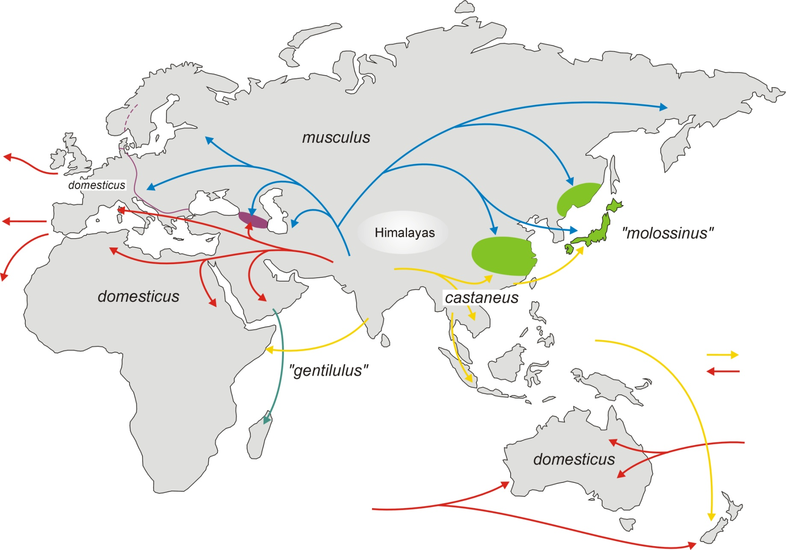
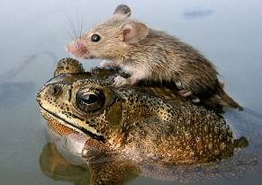

FE in house mouse
∼ 500 tis.

Slide 43



Mus musculus musculus
Neolit
nuclear DNA
mtDNA
M. m. domesticus

Slide 44
mouse colonization of Europe

Slide 45


humans
a) Las Salinas (Dominican Republic):
Altagracia Carrasco:
several children with at least 4 men
Carrasco heterozygous for substitution T → C in 5th exon of
the 5-α-reductase 2 gene ⇒ TGG (Trp) → CGG (Arg) at the 246th position of the protein
the enzyme catalyzes transformation of testosterone to DHT (dihydrotestosterone)
low activity of the mutant enzyme in homozygotes
⇒ boys have testes but other traits are female
in puberty testosterone production increases
⇒ transformation to men
in Salinas high frequency of the mutation ⇒ the word guevedoces (= „penis in 12“)
DHT

Slide 46


Slide 47


Slide 48


Tristan da Cunha:
1816 military garrison
1817 garrison withdrawn;
Skottish corporal William Glass and his family founds
a small colony (20 individuals in total) → founder effect
during 80 years 2 strong bottlenecks

Slide 49

1851: a missionary arrival
1853: death of W. Glass
1856: departure of 25 Glass´s descendants to America, departure of
other 45 people with the missionary
⇒ 103 inds. (1855) → 33 (1857) ... 1st bottleneck
1th bottleneck
strong change

Slide 50
1857–1884: population growth ⇒ conservation of changes caused by previous bottleneck → less changes during 27 years than during
2 years 1855– 1857
minimal change
population growth

Slide 51
1884–1891: drowning of 15 men, only 4 adult remains, of whic 2 very old („Island of Widows“) → departure of many widows with their children
⇒ 106 inds. (1884) → 59 (1891) ... 2nd bottleneck
2nd bottleneck
population growth
again, the following growth has „frozen“ the changes

Slide 52

1st bottleneck
1st bottleneck
2nd bottleneck
2nd bottleneck
Genetic changes during population growth lower than during bottlenecks

Slide 53

Inbreeding on Tristan da Cunha:
Despite the outbreeding strategy
(choice of the least related
partner), ie. F_{IS} < 0, the level of
autozygosity increased
growth of F
?

Slide 54

Inbreeding on Tristan da Cunha:
Despite the outbreeding strategy
(choice of the least related
partner), ie. F_{IS} < 0, the level of
autozygosity increased
growth of F
no unrelated woman available!

Slide 55

RELATION BETWEEN drift And gene flow
higher gene flow
lower gene flow
Gene flow and drift have opposite effects:
drift increases divergence among demes × migration „homogenizes“ demes

Slide 56

RELATION BETWEEN drift aND selecTION
relation between fitness and allele frequency:
adaptive landscape

Slide 57


Adaptive landscape:
selection „pulls“ the population up
Sewall Wright
The notion of adaptive landscape has 2 mutually incompatible meanings:
Allele combinations: fitness values assigned to genotypes
N genotypes → N + 1 dimensions
discontinuous surface, population = cluster of points
Average allele frequencies
number of dimensions = number of sets of allele frequencies
continuous surface

Slide 58

Shifting balance theory (SBT)
Assumptions:
environment changes ⇒ populations in constant change
mutations ⇒ new dimensions, new ways upwards
small populations (drift) ⇒ possibility to move down to adaptive valleys
3 phases of SBT:
1. contemporary fitness reduction of a local population due to drift →
chance to approach the area of attraction of a higher peak

Slide 59
3 phases of SBT:
2. intrademic selection → „pulling“ of the population towards a new peak
3. interdemic selection → spread of the deme´s members at the higher
peak to surrounding demes
The whole proces seen as shifting of the balance between
drift, intrademic, and interdemic selection

Slide 60

2 views on evolution in populations:
S. Wright
R.A. Fisher
small local populations large panmictic populations
combination of selection, drift and mutation and selection
migration
epistasis, pleiotropy, additive effects of genes,
dependence of allele effects on context allele effects independent of context
speciation as a byproduct of local disruptive or locally divergent selection
adaptations in epistatic systems

