Slide 1
Cause and effect
4

Slide 2
In this lesson you are going to:
revise the content of the previous lessons
analyse and discuss the interaction of individual spheres
discuss the cause and effect relationship and learn basic phrases
discuss desertification
learn new vocabulary
practise question forming

Slide 3
REFER, Emitted, Surface, release, OCCUR, TERRESTRiAL, PrecipitatioN, DEFINE, COVER
The location of climates on Earth‘s _________ are not random. Jungles, tundras, and deserts have scientific explanations for their locations. Approximately 30 percent of Earth‘s ________ surface is desert. Deserts are defined as locations of low ___________. While temperature extremes are often associated with deserts, they do not ___________ them. The lack of moisture, including the lack of humidity and cloud _________, allow temperature extremes to ___________. The sun‘s energy is more absorbed by the Earth‘s surface without cloud cover, and nighttime cooling is more drastic without cloud cover and humidity to absorb the __________ heat, so temperature extremes are common in deserts.

Slide 4
REFER, Emitted, Surface, release, OCCUR, TERRESTRiAL, PrecipitatioN, DEFINE, COVER
The location of climates on Earth‘s surface are not random. Jungles, tundras, and deserts have scientific explanations for their locations. Approximately 30 percent of Earth‘s terrestrial surface is desert. Deserts are defined as locations of low precipitation. While temperature extremes are often associated with deserts, they do not define them. The lack of moisture, including the lack of humidity and cloud cover, allow temperature extremes to occur. The sun‘s energy is more absorbed by the Earth‘s surface without cloud cover, and nighttime cooling is more drastic without cloud cover and humidity to absorb the emitted heat, so temperature extremes are common in deserts.

Slide 5
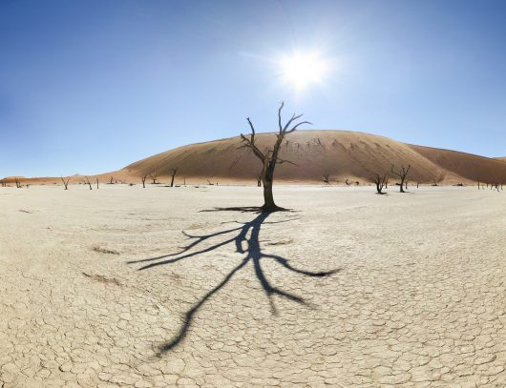
Vocabulary (desertification)
to turn into
widespread
vulnerable
margin
roughly
to affect
to alter
aquifer
drought
soil
fertility
crumbly
to retain
moisture
to exceed
to deteriorate
irrigate
salinization
impermeable
infertile
erratic

Slide 6
Listen to a famous biologist Alan Savory and answer the following questions:
What is holistic management based on? Could you explain its mechanism?
What does this phrase mean in this context: „reinvent the wheel“.
What does it mean „to mimic nature“.
What are the results of his approach?
How did he manage to improve the situation? Describe the method.

Slide 7
Cause and effect
Lack of water results in desertification.
x
Lack of water results from desertification.

Slide 8
Cause and effect
lead to | one reason for
modify | a source of
affect | one cause of
result in | one effect of
result from | one consequence of
as a result of | … is/are caused by
as a result, | due to

Slide 9
sources
https://www.youtube.com/watch?v=vpTHi7O66pI&t=30s
http://opengeology.org/textbook/13-deserts/#13_Deserts
https://www.youtube.com/watch?v=BJgE7O0i0vk
https://borgenproject.org/stop-desertification/ (picture)
Chazal, de Edward and McCarter, Sam. Oxford EAP.

