Slide 1
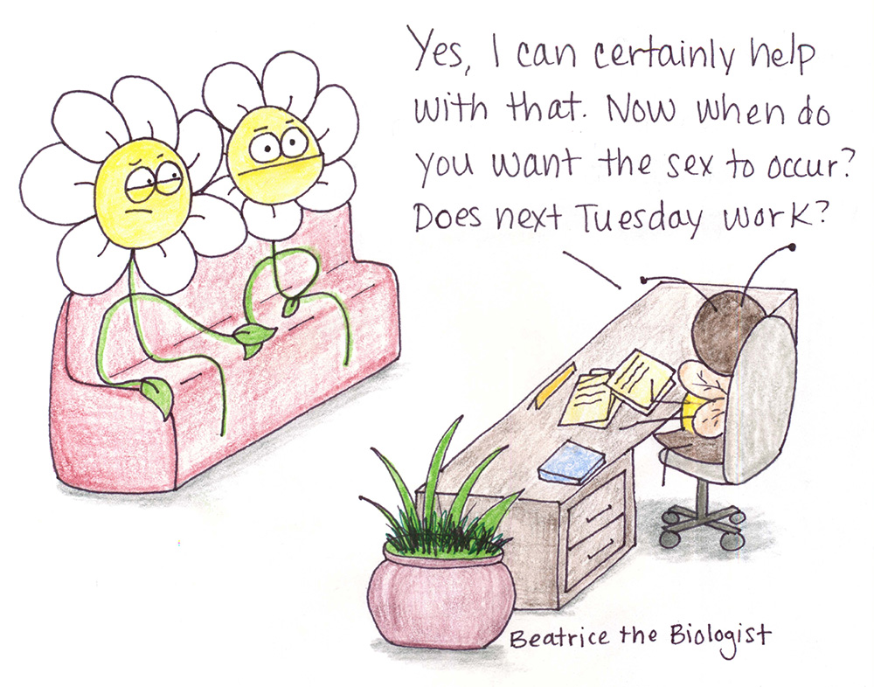
Plant breeding systems
and their evolutionary consequences

Slide 2

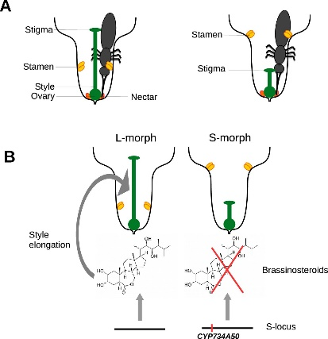
Sexual and asexual reproduction/propagation
Barrett (2002) The evolution of plant sexual diversity. Nature Reviews Genetics 3: 274-284.
Igic et al. (2008) Loss of self-incopatibility and its evolutionary consequences. Int J Plant Sci 169: 93–104.
Raduski et al. (2011) The expression of self-inkompatibility in angiosperms is bimodal. Evolution 66: 1275-1283.
Huu et al. (2016) Presence versus absence of CYP734A50 underlies the style-length dimorphism in primroses. eLife 5:e 17956.

Slide 3
Cons and pros of plant breeding systems
Barringer (2007) Polyploidy and self-fertilization in flowering plants. Am J Bot 94: 1527-1533.
Grossenbacher et al. (2015) Geographic range size is predicted by plant mating systém. Ecology Letters 18: 706-713.
Wright et al. (2013) Evolutionary consequences of self-fertilization in plants. Proc Roy Soc B 280: 20130133.
Igic et al. (2006) Ancient polymorphism reveals unidirectional breeding system shifts. PNAS 31: 1359–1363.

