Slide 1
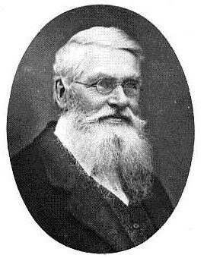
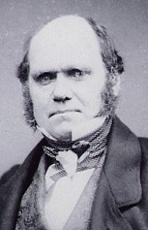
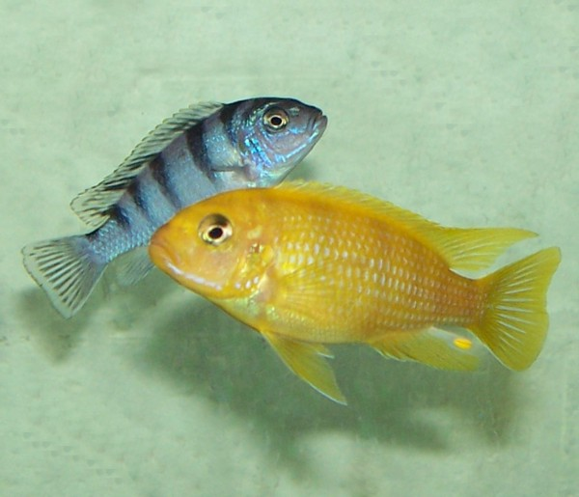
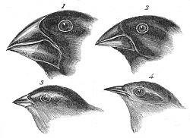
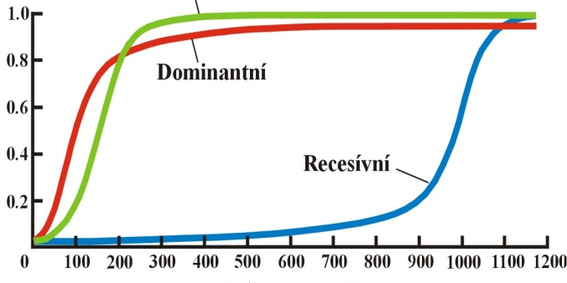
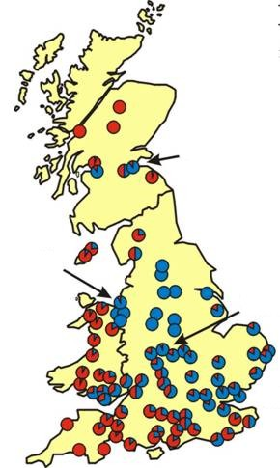
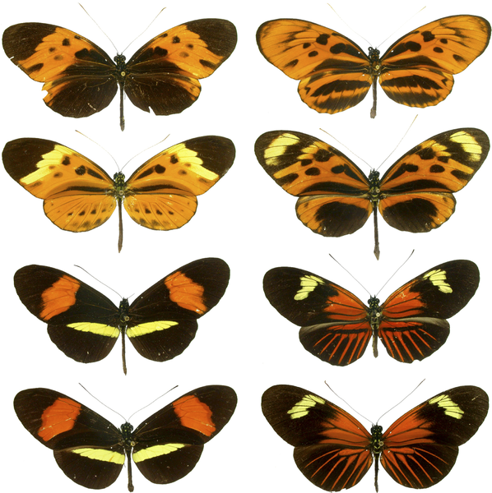
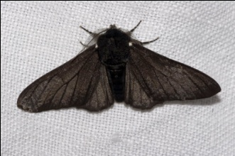
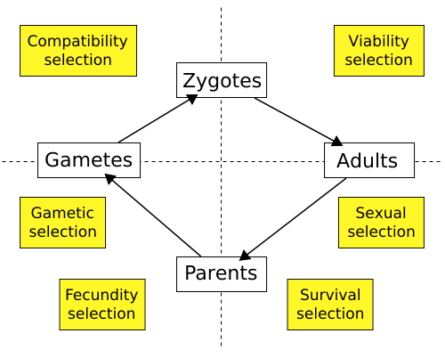
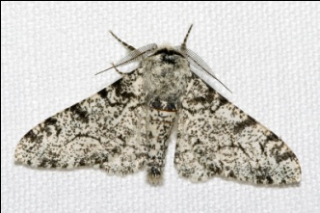
NATURAL SELECTION

Slide 2
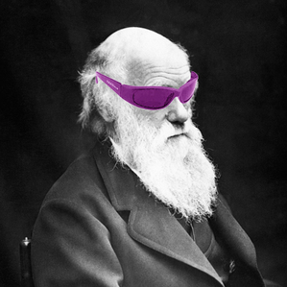
Evolution by natural selection:
All organisms
produce more offspring than can survive and reproduce.
Individuals (genotypes) differ in heritable traits related to survival and reproduction.
The genotypes differ in their contribution to the next generation, ie. the most fit genotypes contribute more than the less fit ones.

Slide 3
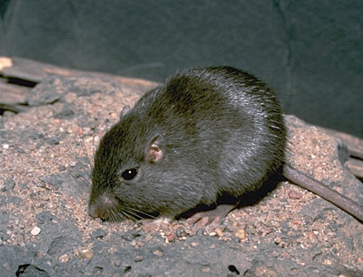
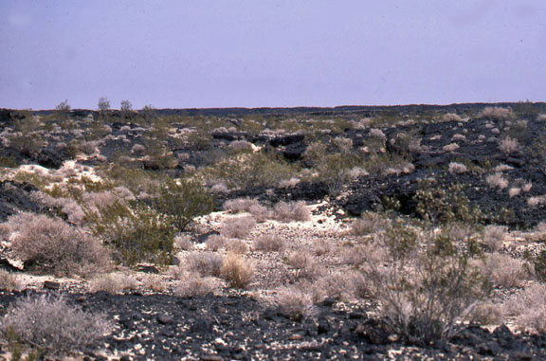
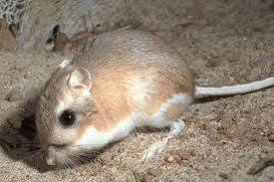
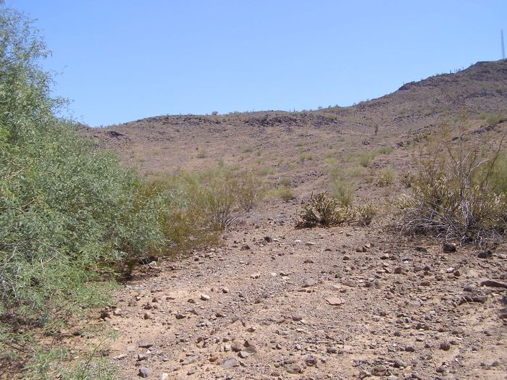
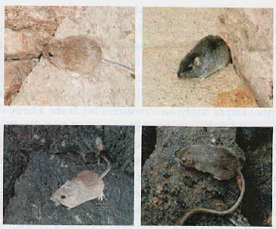
Rock pocket mouse (Chaetodipus intermedius): Sonoran and Chihuahuan Des.
dd
DD, Dd
60-98% survival relative to dark individuals

Slide 4
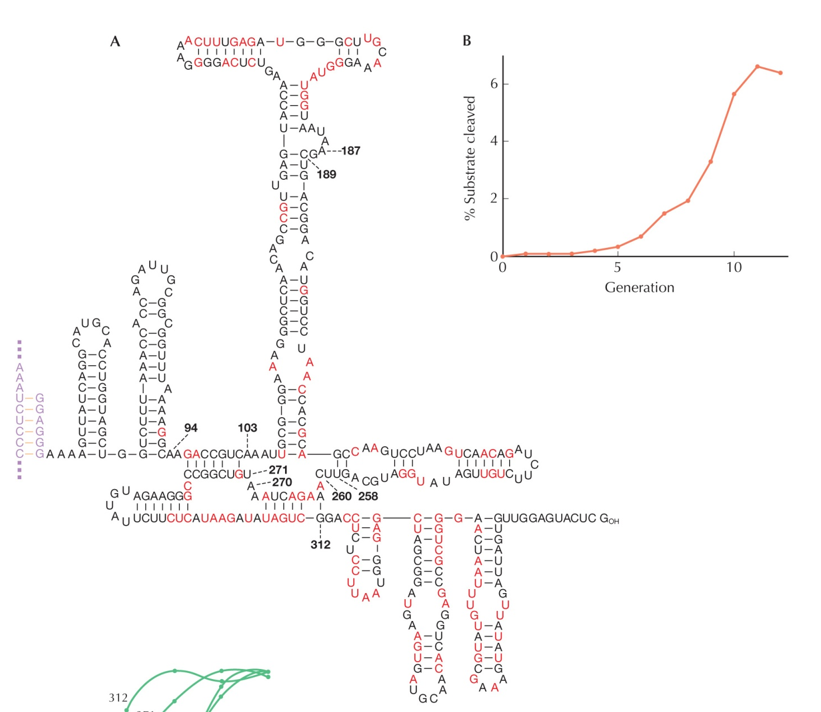
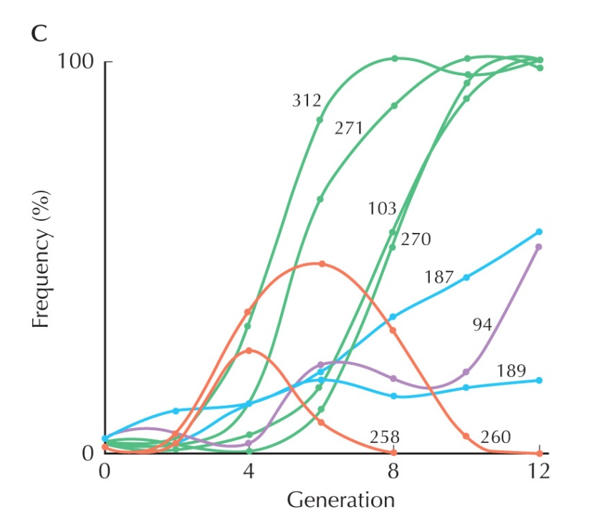
Selection on the RNA level:
intron Tetrahymena: Ca⁺ instead of Mg⁺ (normal state)
increase in activity after 12 generations
frequency of 9 variants
mutant position
invariant position

Slide 5
ReproduCTIVE fitness, w
= average per capita lifetime contribution of individuals of a given genotype to the population after one or more generation
absolute number of the offspring = absolute fitness
discrete generations, stable population → fitness ≈ 1 in asexual
organisms, ≈ 2 in sexual organisms; even with a slight deviation
the population goes either to extinction or to overpopulation
continuous time scale → growth rate ≈ 0
in evolution relationships between genotypes in a population more
important → relative fitness
discrete time → = ratio of absolute fitness; continuous time →
= difference between growth rates
usually relative fitness of the most fit genotype = 1
alternatively we may relate to the mean population fitness

Slide 6
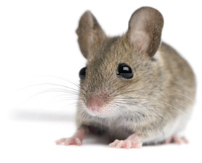
Components of fitness:
Total number
of offspring
Quality of the weaned
offspring
Viability
Reproductive success
Litter size
Litter frequency
Number of litters
Maternal behaviour
Milk production
Resistance to pathogens
Escape from predators
Frequency of ovulations
Survival of embryos
Size of mammary
glands

Slide 7
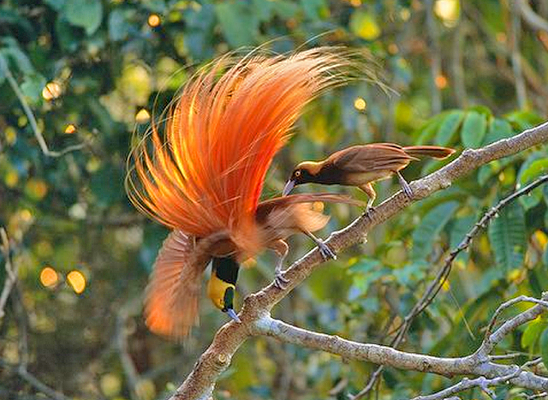
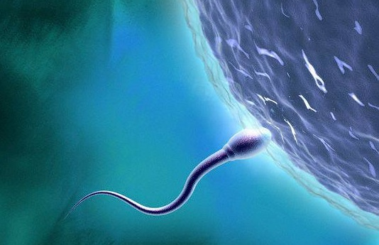
zygotic selection:
viability
reproductive success
fertility/fecundity
gametic selection:
gamete viability
fertilisation success
segregation distortion

Slide 8
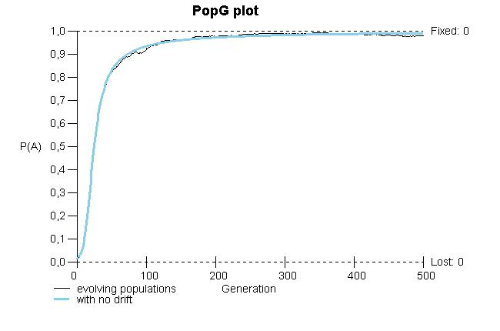
Change of allele frequencies and selection coefficient, s
Fitness in the pocket mouse:
AA 1
Aa 1
aa 1 ‒ s
mean s(aa) ≈ 0,20
w = 0,60‒0,98
⇒ s = 0,02‒0,40
biggest change when p=q=0,5
Increase of beneficial dominant allele A:
negatively proportional to the mean fitness of the population ⇒ with increasing frequency of the beneficial allele the evolution is slowing down;
if q or p = 0 Δp = 0
frequency of A
When s = 0,20 and initial frequency A = 0,01
the freq. increases to 0,95 in ca. 120 generations

Slide 9
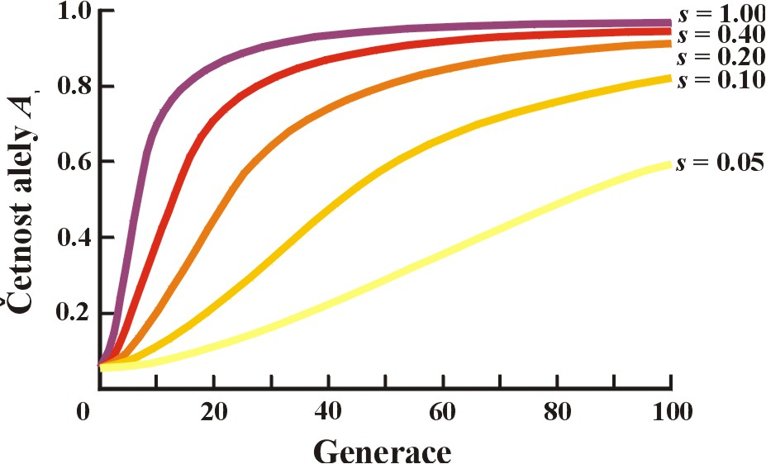
Increase of a advantageous dominant allele A:
the higher s (ie. stronger selection), the more rapid change

Slide 10
Selection and dominance
the most rapid fixation with codominance
frequency of a dominant allele increases very rapidly, then very slowly
p₀ = 0,005
frequency of a recessive allele increases very slowly, then very rapidly

Slide 11
Effect of the initial allele frequency:
p₀ = 0,05

Slide 12
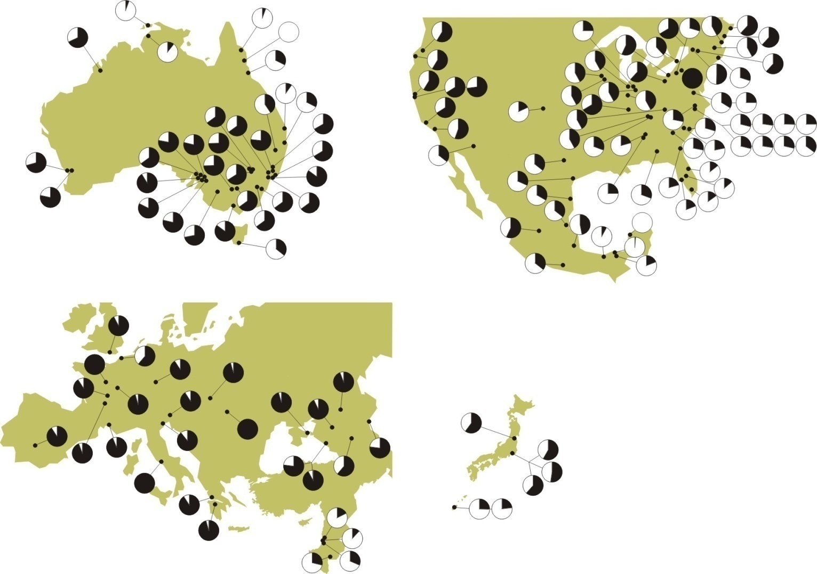
StudY OF NATURAL SELECTION:
1. Correlation of allele frequencies across populations
Adh^{F} in D. melanogaster

Slide 13
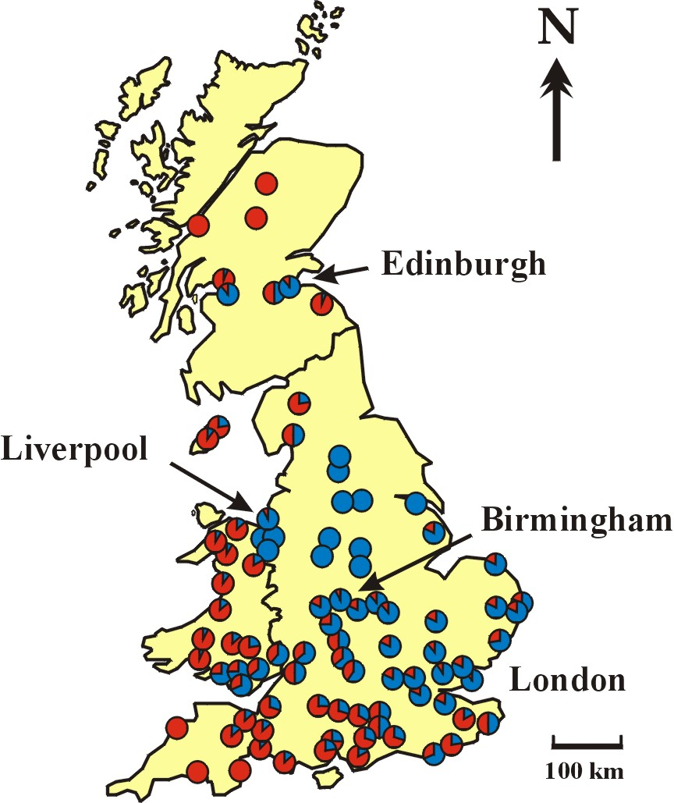
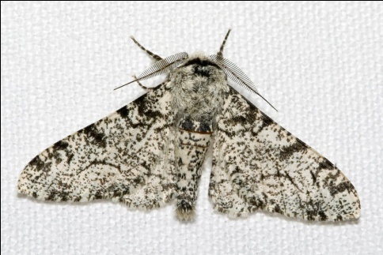
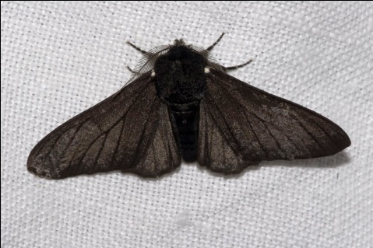
2. Deviations from expected genotype frequencies (HW)
3. Temporal changes of a trait:
industrial melanism in the peppered
moth (Biston betularia) in Britain
„typica“
„carbonaria“

Slide 14
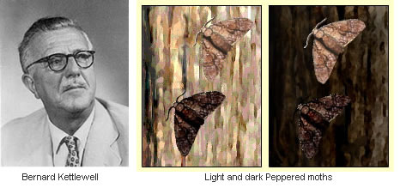

4. Experimental evidence:
H.B.D. Kettlewell
polluted
area
light
dark
Birmingham (znečištěná oblast)
Světlá forma (typica)
Tmavá forma (carbonaria)
Počet zpětně odchycených:
pozorovaný
18
140
očekávaný
36
122
Relativní míra přežívání
0,5
1,15
Relativní fitness
0,5/1,15 = 0,43
1,15/1,15 = 1
Deanend Wood (neznečištěná oblast)
Světlá forma (typica)
Tmavá forma (carbonaria)
Počet zpětně odchycených:
pozorovaný
67
32
očekávaný
53
46
Relativní míra přežívání
1,26
0,69
Relativní fitness
1,26/1,26 = 1
0,69/1,26 = 0,55
relative
fitness
non-polluted
area

Slide 15
Problems:
3 alleles, not 1, affect the colouration
increase of melanism also in species not endangered by predation by
insectivorous birds (pigeons, cats, some beetles)
in some areas correlation between melanism and pollution weak
errors in the experiment:
during the day, peppered moths stay on horizontal branches, not on
trunks (different lichen species); in butterflies and birds different
perception of UV
under laboratory conditions the typica viability by 30% lower than that
of carbonaria
better absorption of solar radiation in melanic forms?
(eg. two-spot ladybird)
industrial melanism of
B. betularia in Britain

Slide 16
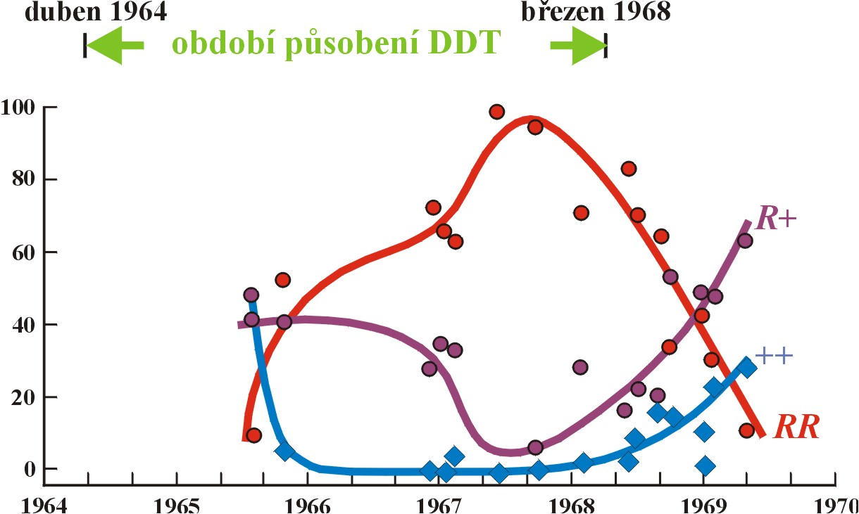
5. Resistance
eg.: DDT resistance in mosquitos (Aedes, Anopheles):

Slide 17
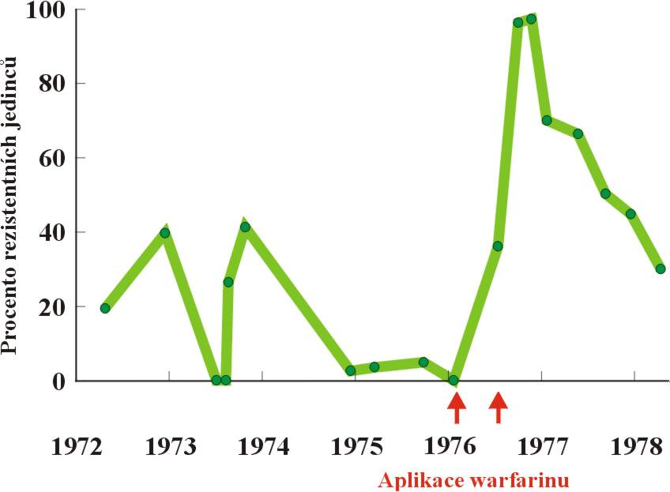
eg.: Warfarin resistance in rats:
Warfarin = blood anticoagulant, inhibiting the enzyme responsible for the
recovery of vitamin K (coagulation cofactor)
dramatic increase of the resistance allele R after Warfarin application
relative to the resistance
R allele dominant but relative to the increased demand of vitamin K recessive

Slide 18
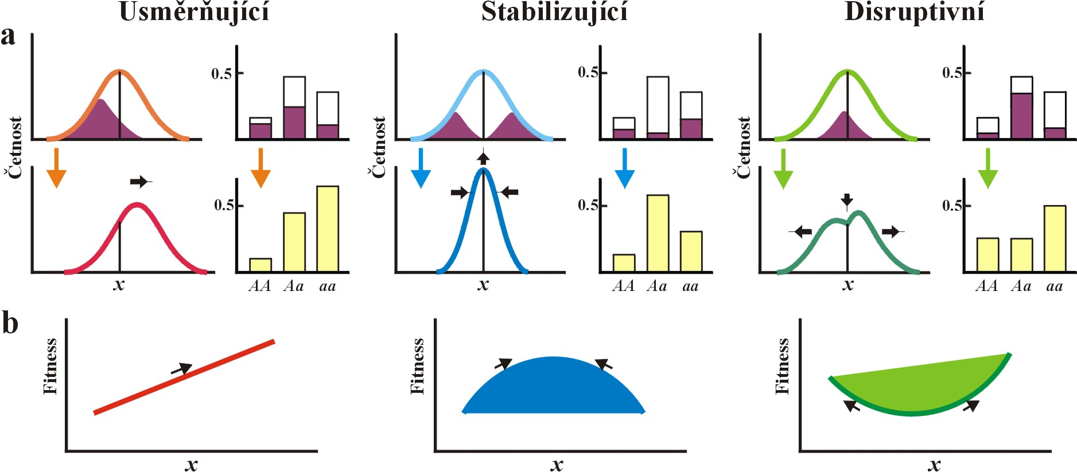
Relationship between phenotype and fitness:
basic selection regimes
directional
these phenotypes are disadvantageous
original mean
consistent change of
environment
shift of the mean
variance unchanged

Slide 19
Relationship between phenotype and fitness:
basic selection regimes
directional
stabilizing
highest fitness in individuals with intermediate (mean) phenotypes
consistent change of
environment
shift of the mean
variance unchanged
stable environment
mean unchanged
lower variance

Slide 20
Relationship between phenotype and fitness:
basic selection regimes
directional
stabilizing
disruptive
consistent change of
environment
shift of the mean
variance unchanged
stable environment
mean unchanged
lower variance
heterogenous environment
intermediate phenotypes
disadvantageous
higher variance

Slide 21
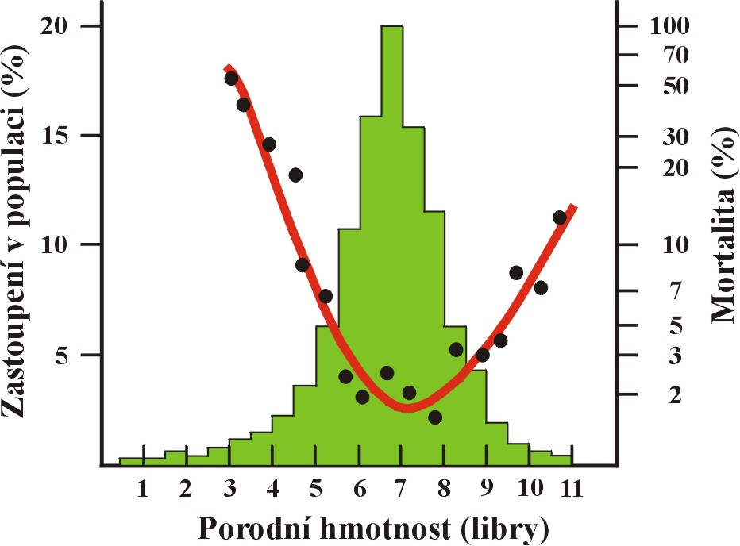
stabilizing selection – birth weight in humans
mortality
(logarithmic scale)

Slide 22
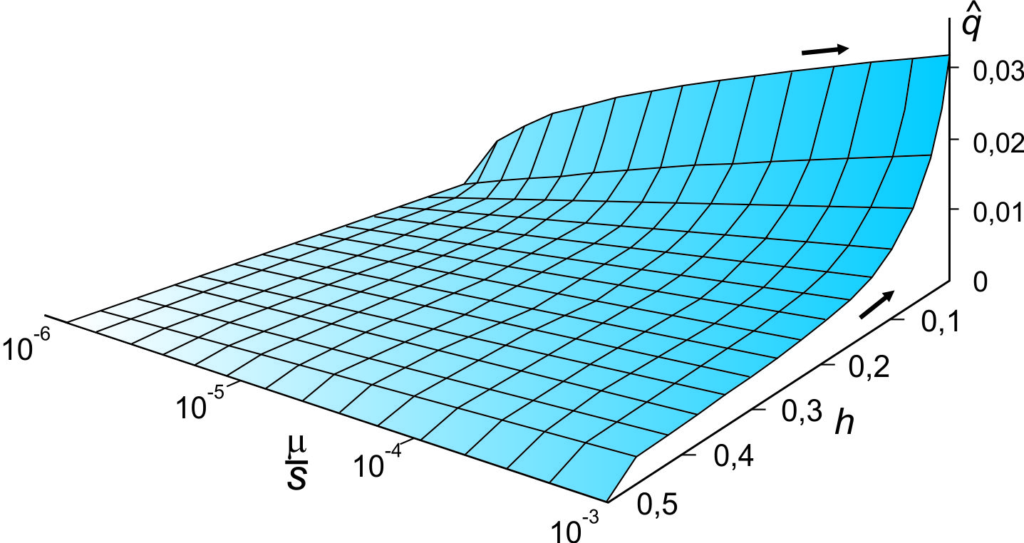
Equilibrium between selection and mutation
recurrent emergence of a deleterious mutation × elimination by selection
weaker selection ⇒ higher frequency
dominance:
equilibrium
recessivity:
μ
μ
q
=
q
=
s
s
complete recessivity (h = 0) ⇒ higher frequency
Muller-Haldane principle:
Regardless of dominance/recessivity of a deleterious mutation, its impact on decreasing fitness is independent of the level of its harmfulness.

Slide 23
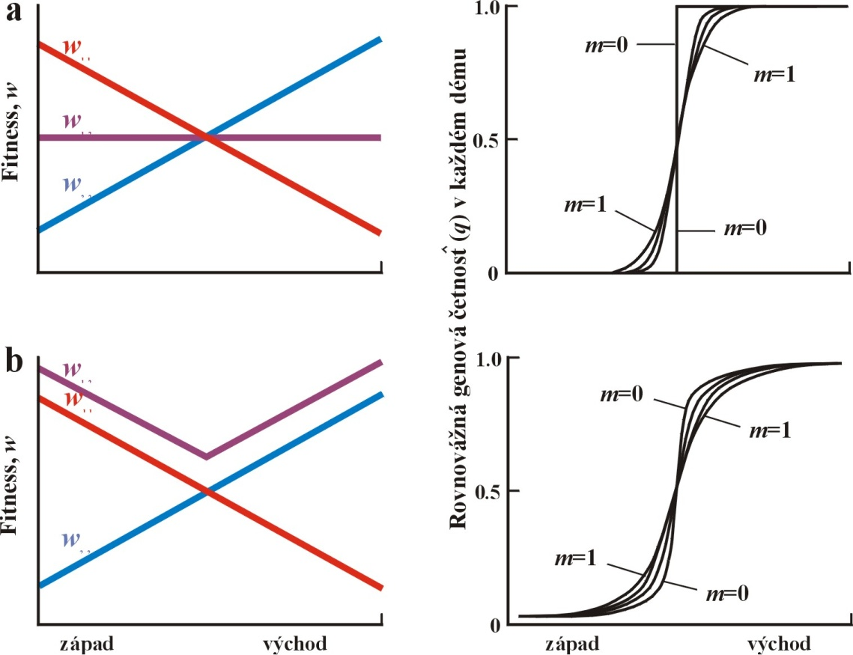
Equilibrium between selection and gene flow
repeated „influx“ od a deleterious allele × elimination by selection
1. m>s ⇒ allele fixation
2. m<s ⇒ allele elimination
3. m=s ⇒ polymorphism
w₁₂ intermediary
equilibrium
w₁₂ higher

Slide 24
Balancing selection
1. Selective advantage of heterozygotes = overdominance
heterozygote fitness is higher than w of homozygotes
w_{AA} < w_{Aa} > w_{aa}

Slide 25
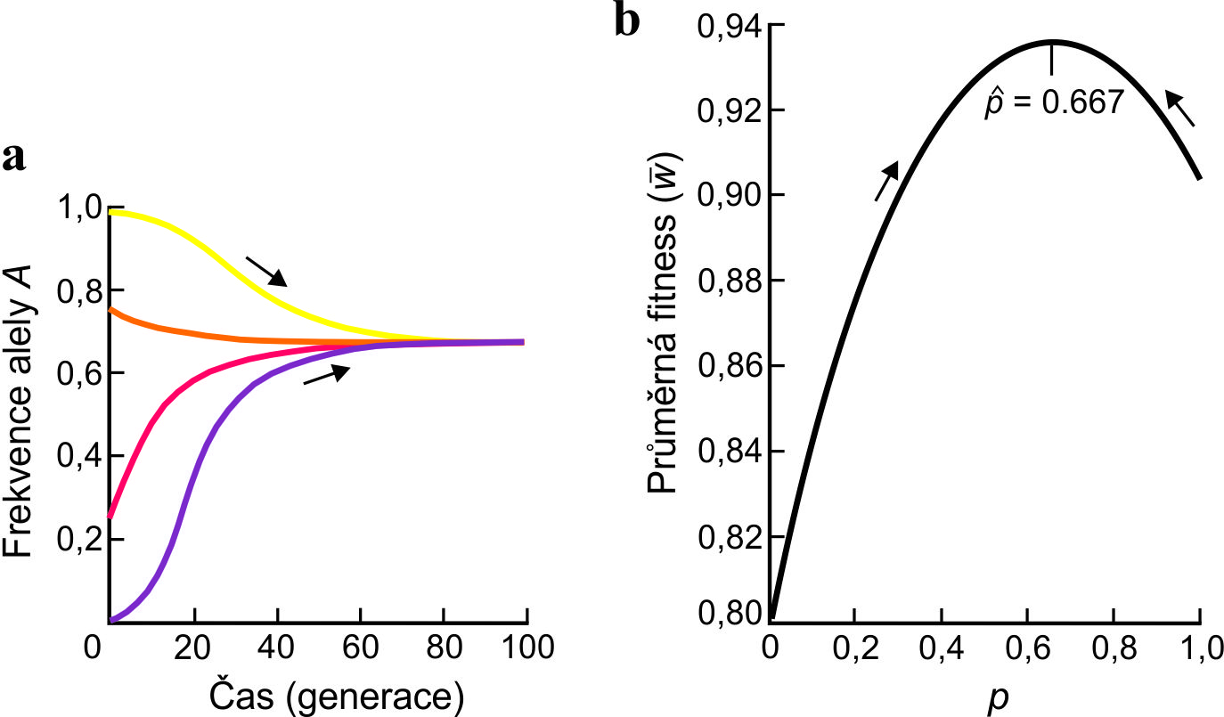
w_{AA} < w_{Aa} > w_{aa}
balanced polymorphism
frequency of the more common allele decreases
frequency of the rarer allele increases
Selection maintains balanced polymorphism

Slide 26
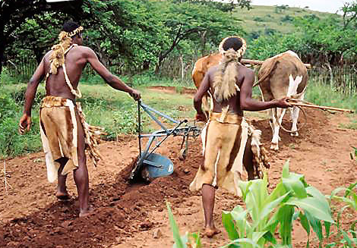
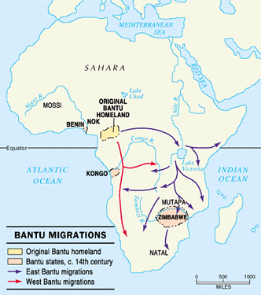
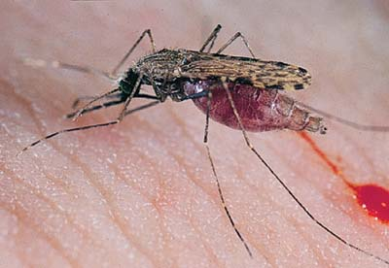
Eg.: sickle cell anemia and malaria
sickle cell
anemia
malaria
∼ 2000 years ago expansion of Bantu peoples
burning off savannas and forests, increase of population density → suitable
environment for Anopheles mosquitos (A. gambiae), the host of Plasmodium
falciparum
⇒ malaria

Slide 27
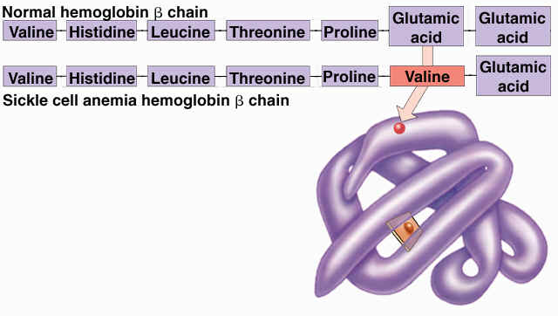
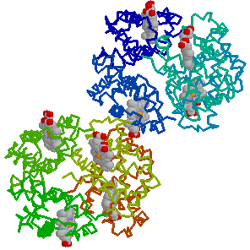
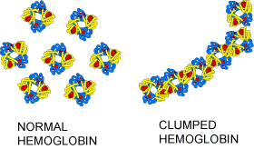
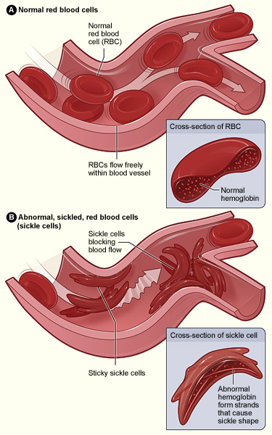
Sickle cell anemia and malaria:
sickle cell anemia: S allele: substitution of 1 AA at 6th position in 6th codon of the β-Hb gene:
at low O₂ concentrations → production of elongated crystals
⇒ anemia
AS – only transmission of anemia, SS – strong anemia

Slide 28
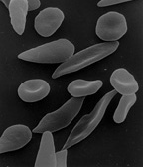
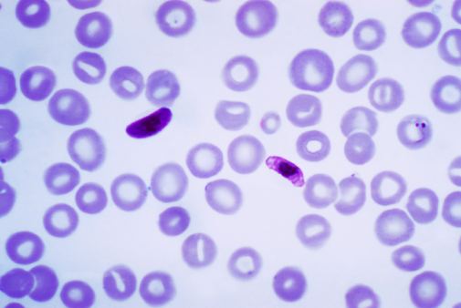
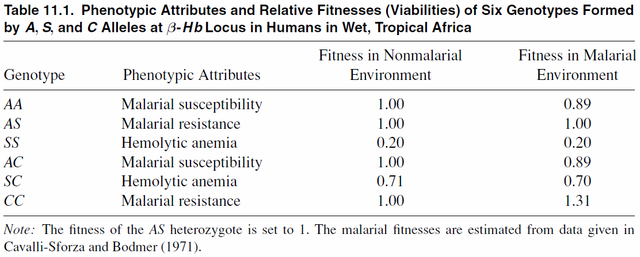
sickle-cell red blood cell invaded by Plasmodium is rapidly breaking ⇒ the parasite cannot reproduce and multiply ⇒ resistance
→ heterozygote advantage
Relative fitness of genotypes related to sickle cell anemia:

Slide 29
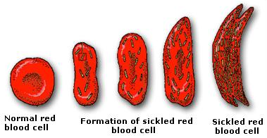
Phenotypes related to the S allele:
both alleles are codominant
1. Electrophoretic mobility
+
start
AA
AS
SS
normal erythrocyte
sickled erythrocyte
sickled erythrocyte
AA AS SS
2. Sickling
sickling in SS and AS individuals ⇒ with respect to deformation S dominant

Slide 30
Phenotypes related to the S allele:
healthy individual
healthy individual
anemic individual
AA AS SS
3. Anemia
in SS individuals longer chains ⇒ stronger deformation of red blood cells
⇒ more fatal impacts on the organism: erythrocyte rupture (anemia),
clogging of capillaries etc.
clinical syndromes only in SS ⇒ S allele recessive

Slide 31
Phenotypes related to the S allele:
4. Resistance to malaria
with respect to resistance the S allele dominant
absence of resistance
resistance
resistance
AA AS SS

Slide 32
Phenotypes related to the S allele:
5. Phenotype of health (viability)
nonmalarial environment: S recessive
viable individual
viable individual
lethality
AA AS SS
malarial environment: SS – strong anemia; AA – malaria; AS – no anemia,
weak malaria ⇒ S is overdominant
weak malaria
without anemia
malaria
lethality
AA AS SS

Slide 33
Emergence of C allele in the AS polymorphism region:
possible genotypes: w_{AC} = 0,89; w_{SC} = 0,70
w_{AS} = 1,00 ⇒ selection acts against beneficial allele!
Although C higly beneficial, selection will decrease its frequency
until it is completely removed!!

Slide 34
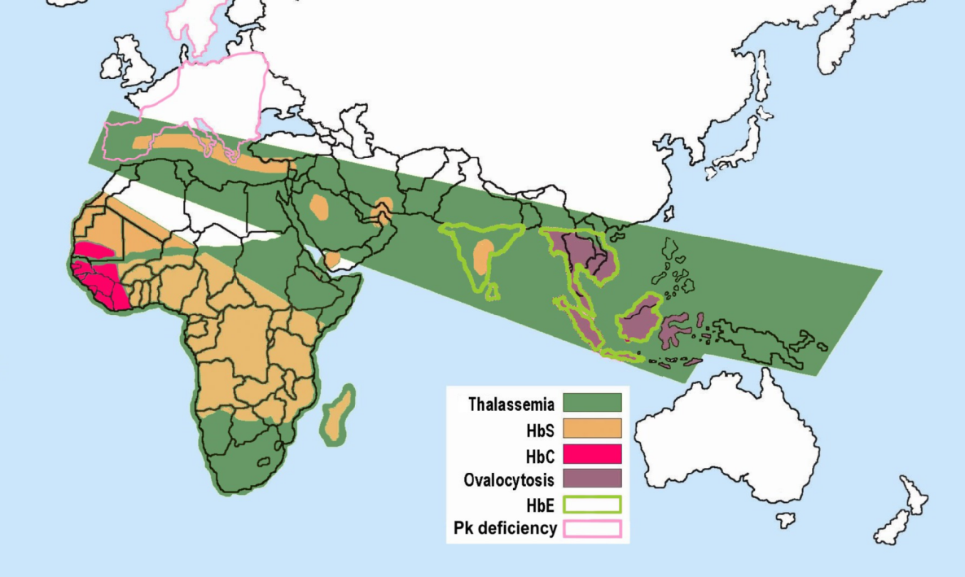
Resistance against malaria can be mediated through other mechanisms:
hemoglobin E (JV Asie)
α- a β-thalassemia
G6PD^{*)} deficiency
Pk^{**)} deficiency
etc. etc.
*) glucose-6-phosphate dehydrogenase
**) pyruvate kinase
However, selection in favour of heterozygotes
is not widespread in nature

Slide 35
Alternative equilibrium: selection against heterozygotes
(underdominance)
w_{AA} > w_{Aa} < w_{aa}
heterozygote fitness is lower than w of homozygotes

Slide 36
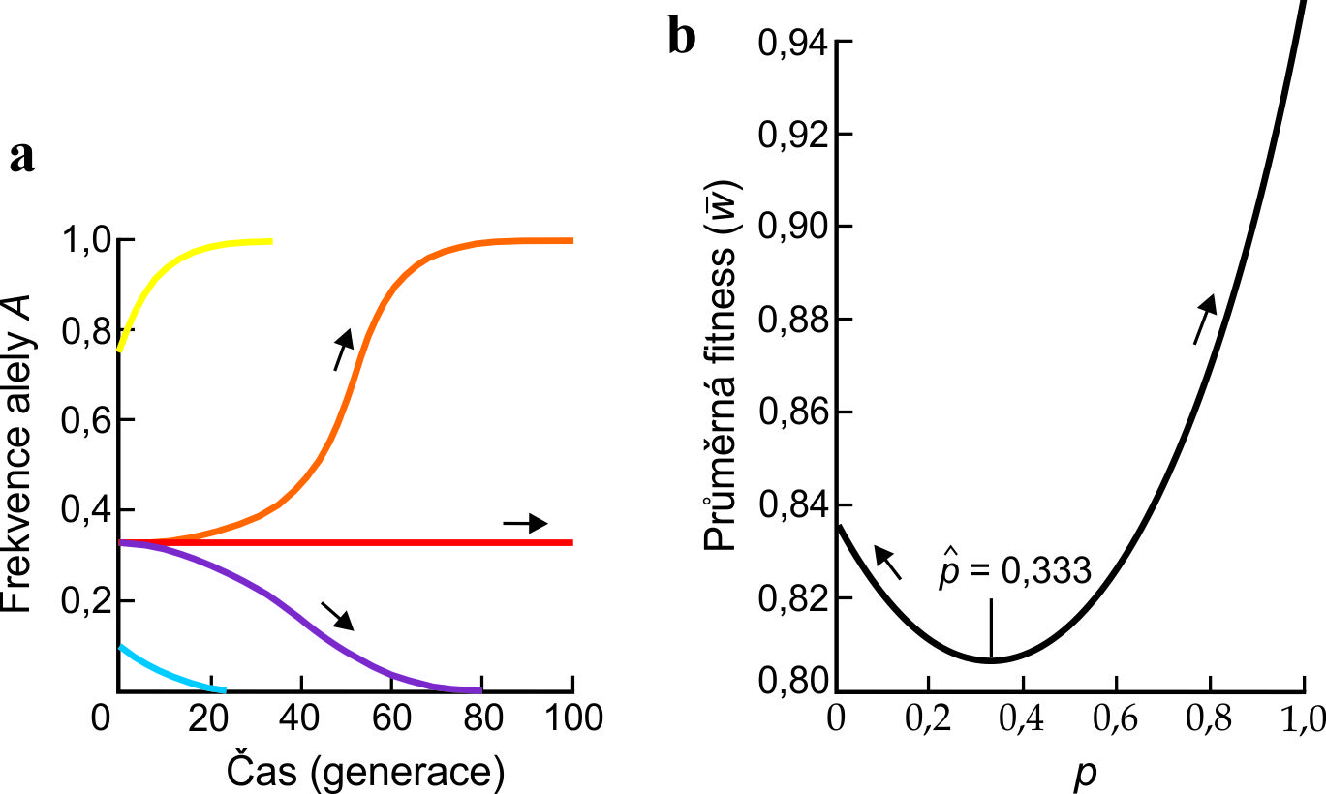
w_{AA} > w_{Aa} < w_{aa}
above the critical level → fixation
non-stable equilibrium
below the critical level → extinction
Selection results in fixation of one of the alleles
(and extinction of the other)

Slide 37
2. Selection in heterogeneous environment
environmental variation:
spatial
temporal
coarse-grained: single environment throughout lifetime
fine-grained: environmental heterogeneity throughout
lifetime
selection: soft
hard

Slide 38
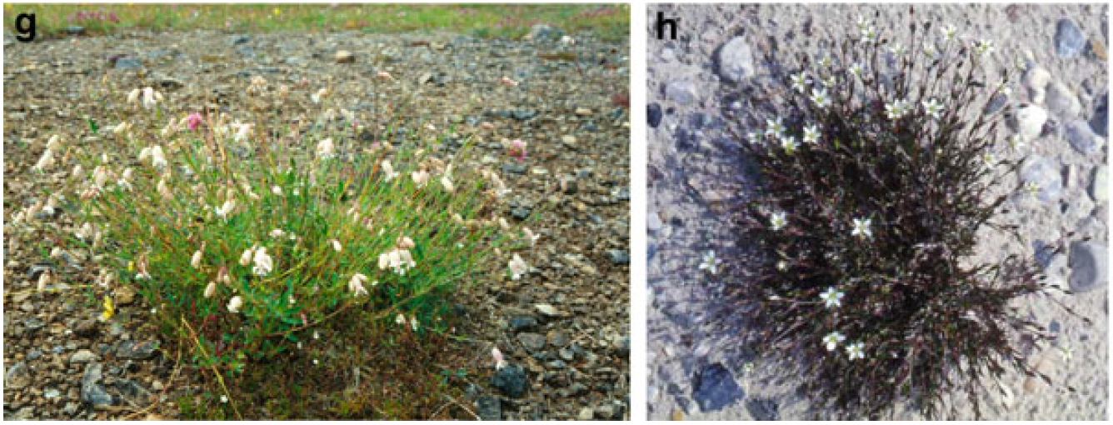
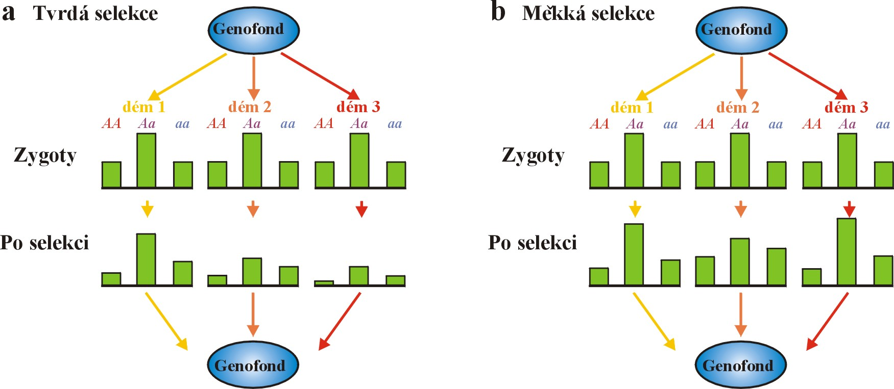
selection
Silene vulgaris
ssp. humilis
hard
Minuartia verna

Slide 39
selekce
hard
soft
Coarse-grained environment and soft selection will maintain polymophism
in the population with higher probability than fine-grained environment
and hard selection.

Slide 40
3. Antagonistic selection
different sexes
different ontogenetic stages
gametic × zygotic phase

Slide 41

4. Frequency-dependent selection
I. Negative
with increasing frequency, fitness of A allele decreases

Slide 42




Eg.: Batesian mimicry
[in this case it is rather density-dependent selection]

Slide 43



Eg.: cichlid Perissodus microlepis (Tanganyika)
Notes:


Slide 44


„right-mouthed“
„left-mouthed“
Notes:


Slide 45
4. Frequency-dependent selection
II. Positive
with increasing frequency, fitness of A allele increases

Slide 46


Müllerian mimicry:
Amereega hahneli
(poisonous)
Lithodytes lineatus
(harmless; Batesian mimicry)
R. variabilis
(poisonous)
Heliconius melpomene
H. erato
R. ventrimaculata
(poisonous)
Ranitomeya imitator
(d,f; poisonous)

Slide 47





Heliconius erato
H. melpomene

Slide 48


Balancing selection at the molecular level:
comparison of observed and expected
polymorphism in the ADH gene
chimpanzee alleles (C) more similar to human alleles (H) than other C alleles
MHC genes

